Slide 1
Layers: Basics
An Introduction to Photoshop Layers

Slide 2
Layers
Layers act as if they were sheets of glass stacked on top of each other.
Each layer can have different content.

Slide 3
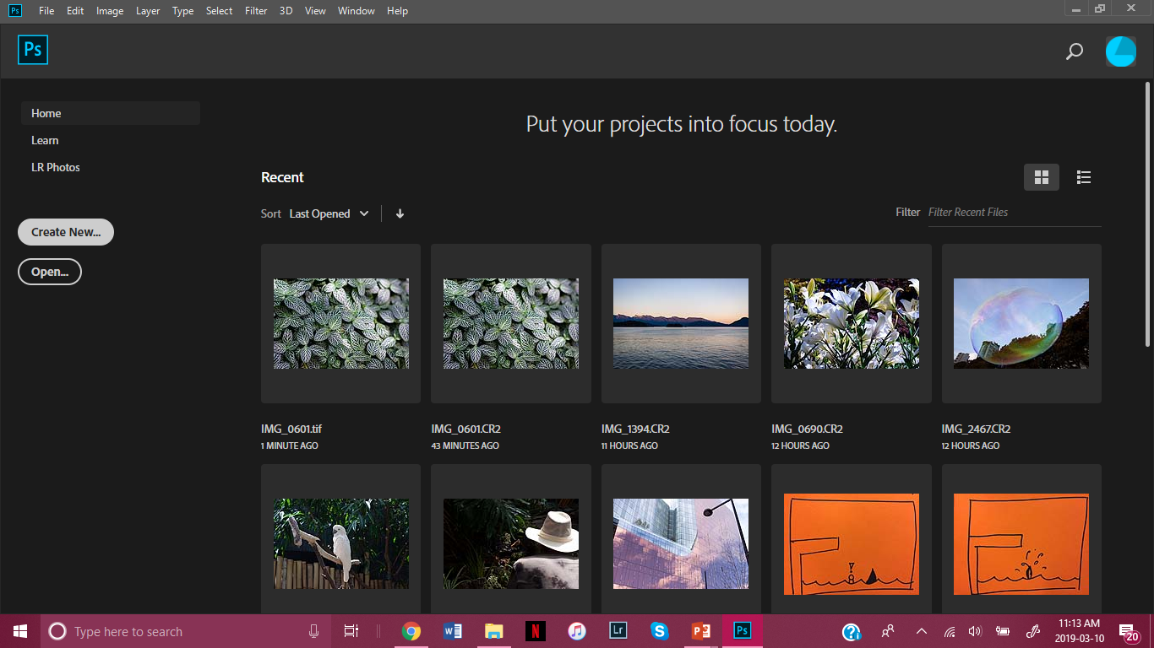
Open a new document window in Photoshop.

Slide 4
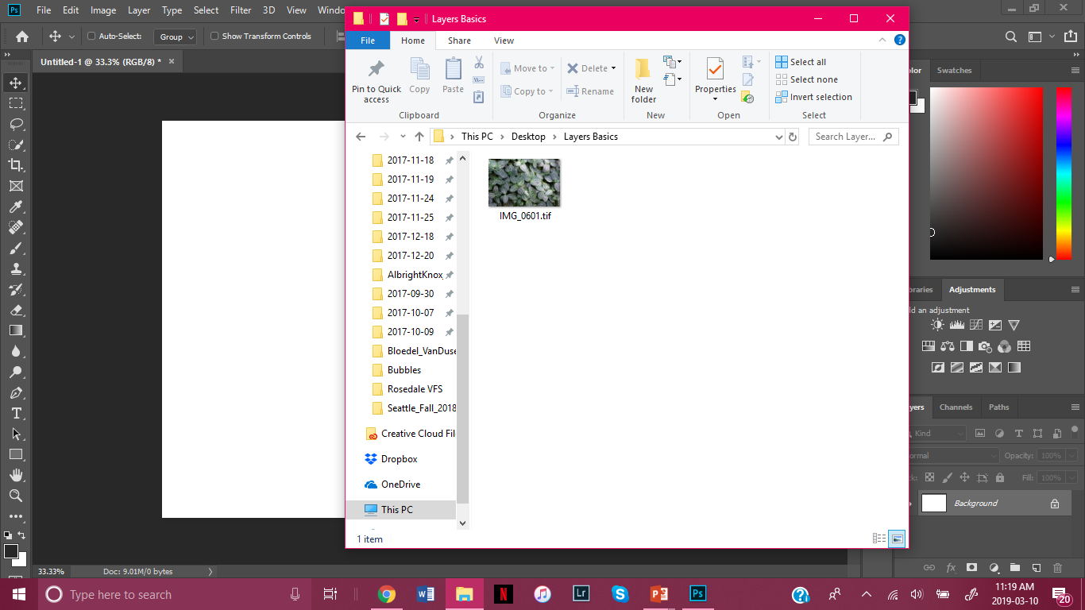
Find an image you want to use as a background and find it then drag it onto the document window.

Slide 5
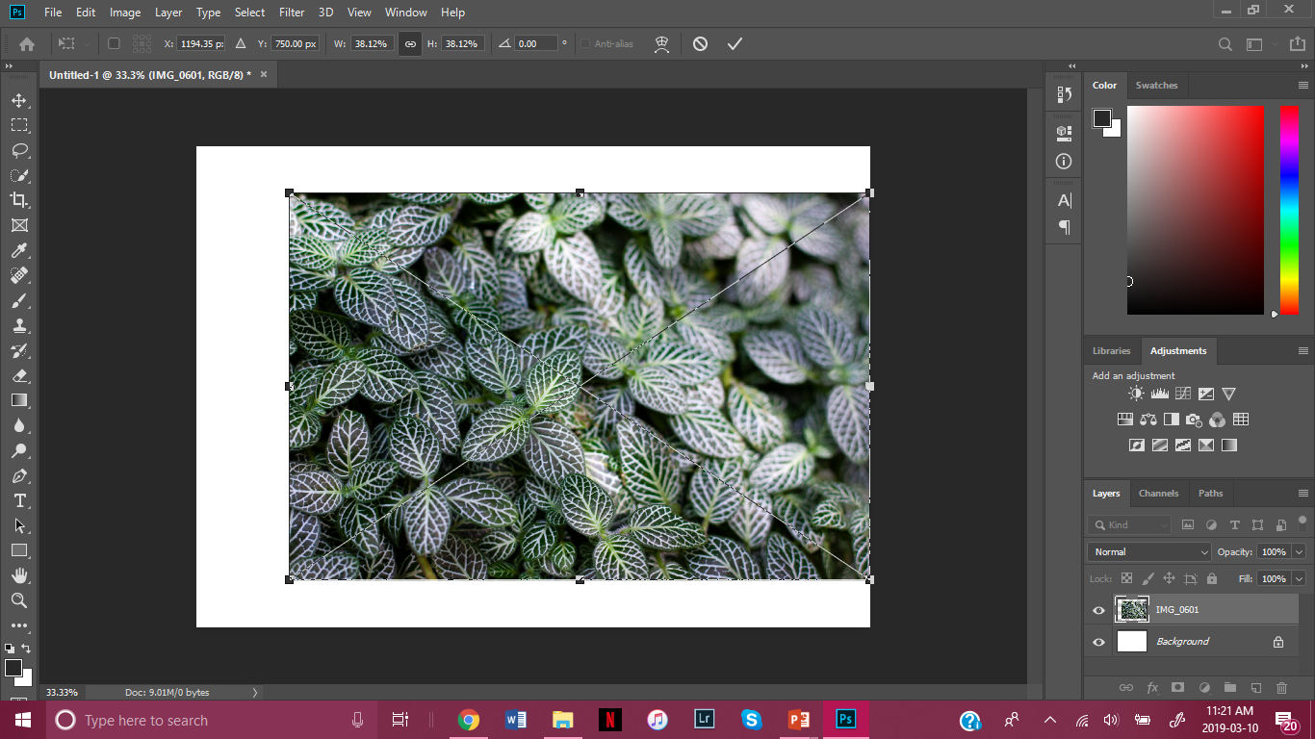
Resize the image accordingly and click the check mark when you’re happy. The corner sliders will always preserve the original aspect ratio of the image.

Slide 6
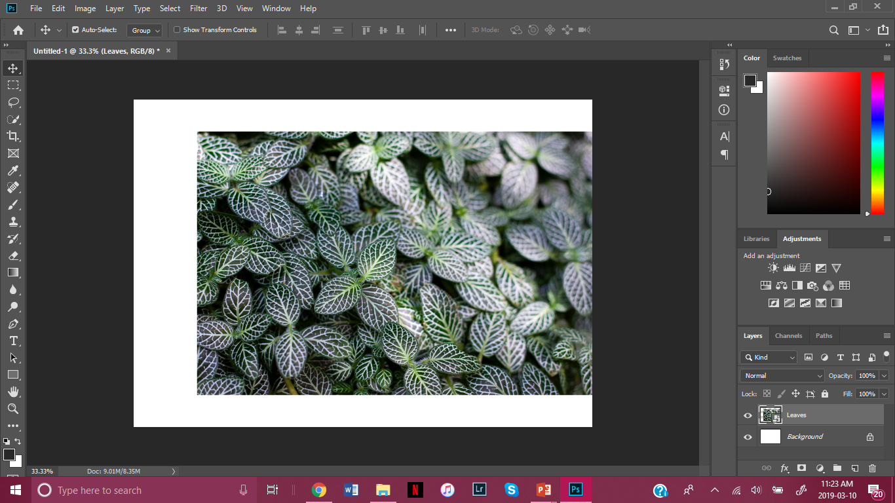
Make sure you name your layers before moving on.

Slide 7
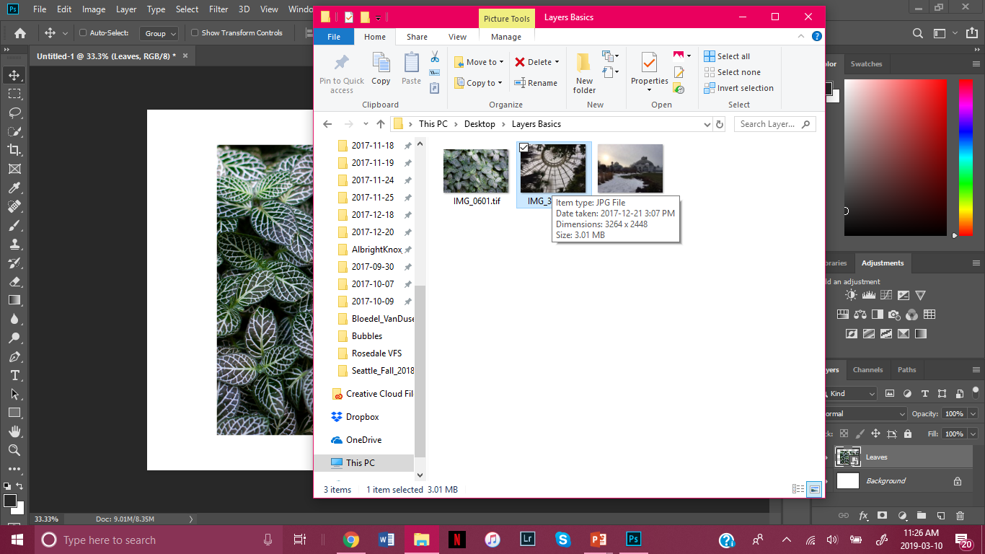
Now, we need multiple images to work with. Bring in the images you like by opening your photo files and dragging one in.

Slide 8
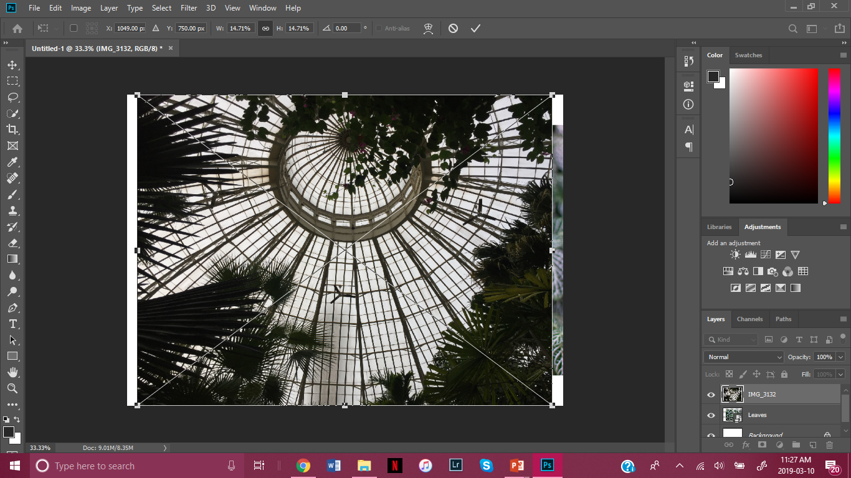
Take the sliders to reduce the image to your preferred size. You can also do this in the Options Bar.

Slide 9
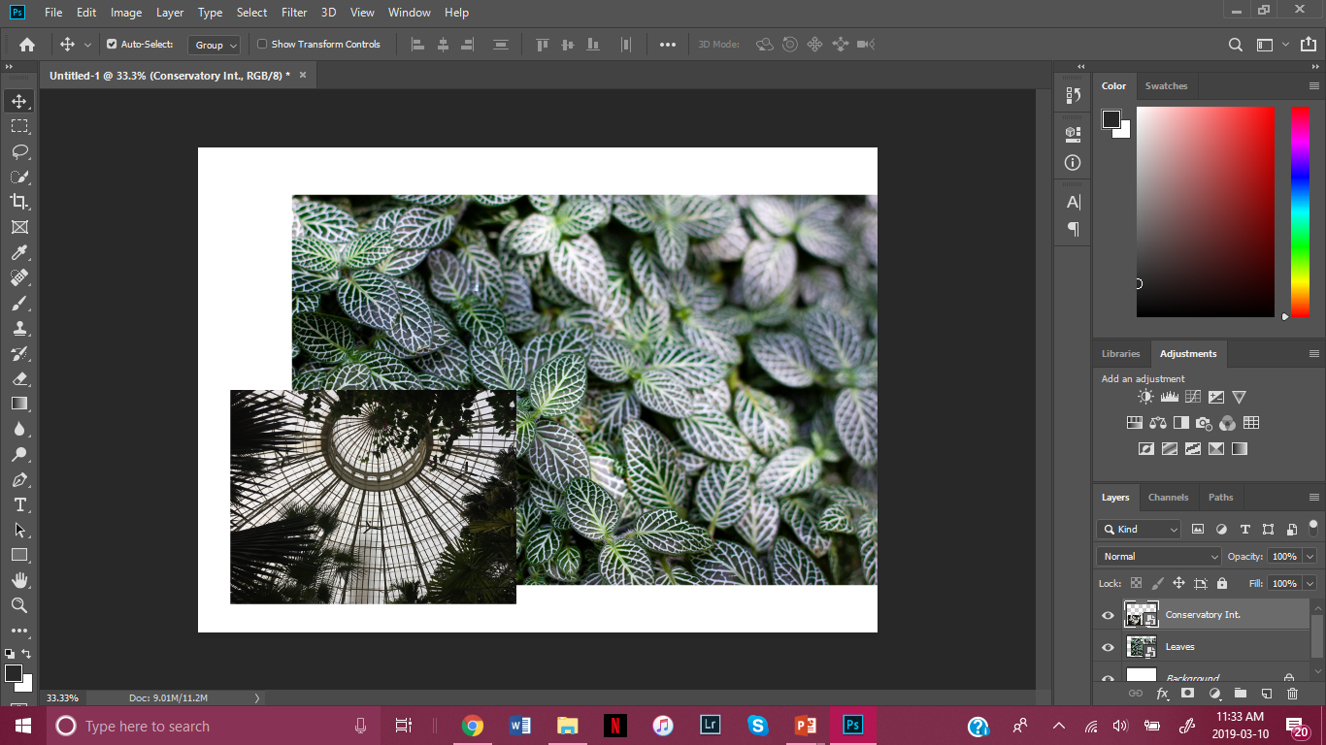
Use the Move tool to move the photo into position.

Slide 10
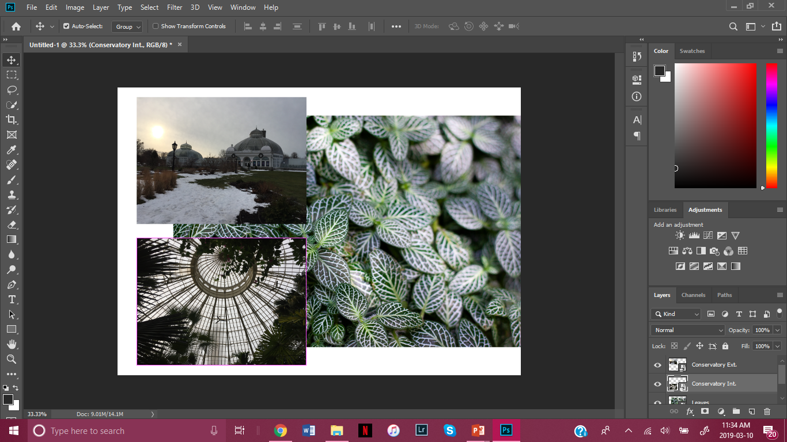
Repeat this process for a third image.

Slide 11
This method of bringing images into Photoshop creates editable Smart Layers which we want so we don’t permanently change an image.

Slide 12
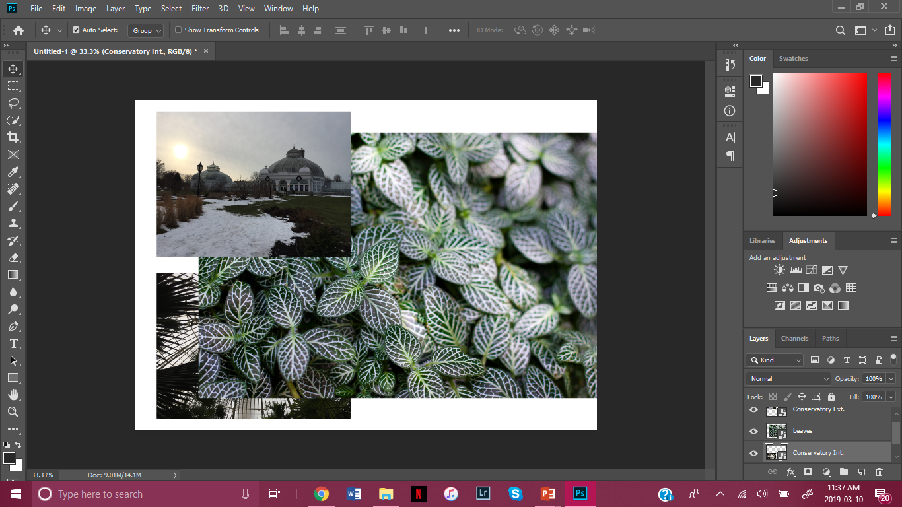
Layers act as if they were sheets of glass stacked on top of each other. Slide one under the other in the layers panel and see what happens.

Slide 13
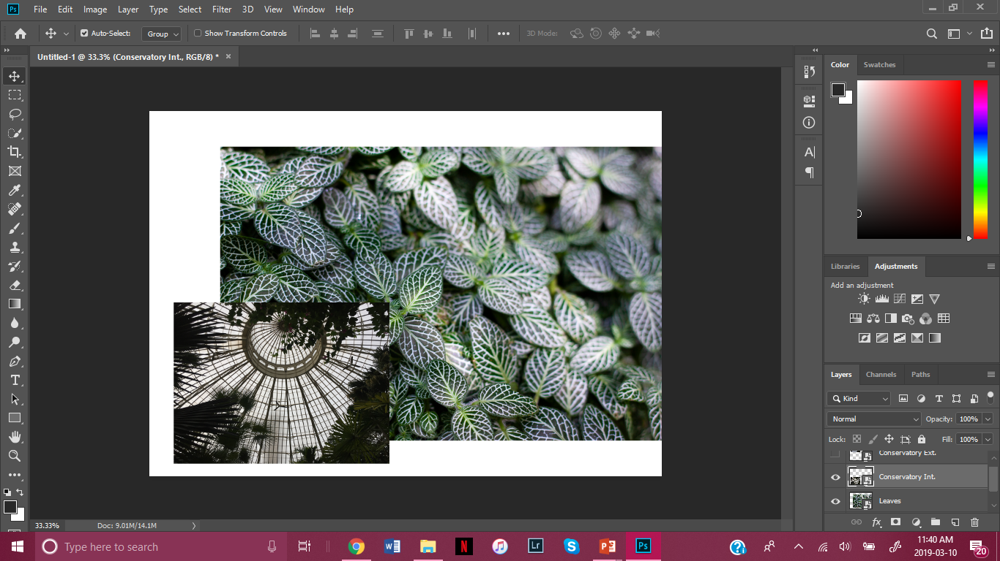
You can choose whether to see all your layers by toggling the eye icon on and off.

Slide 14
You can make a layer invisible by clicking the eye shape to the left of a layer.

Slide 15
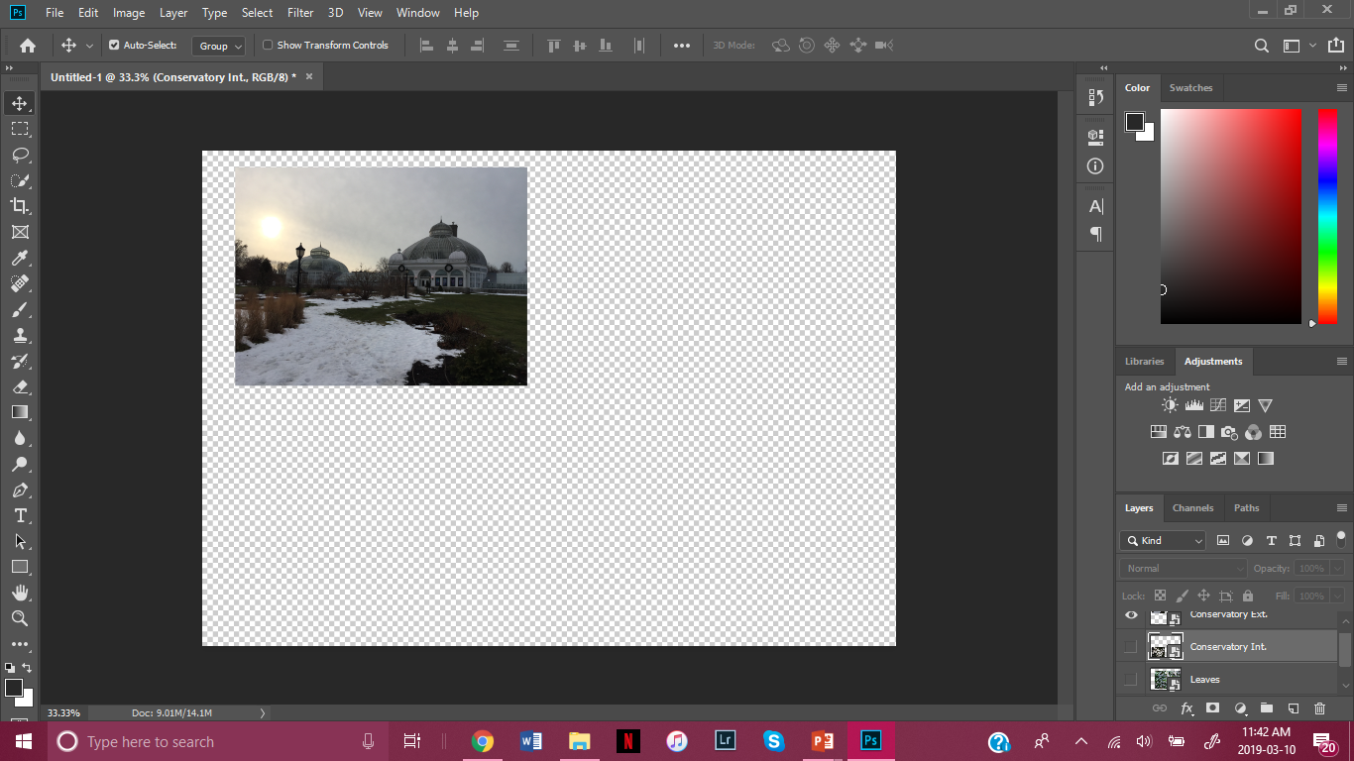
To single out a layer, hold alt and click the layer you want.

Slide 16
To undo press alt again and click the eye icon.

Slide 17
So, why bother?
Layers are necessary because you can edit pieces of an image independently without changing any of the other layers or changes you made.
So:
If the background layer is your original image, you can add as many changes as you like in layers, without damaging the original photograph.
If you want to delete changes, or experiment with how an image looks without them, you can make layers invisible or delete them, without having to undo so many edits.

Slide 18
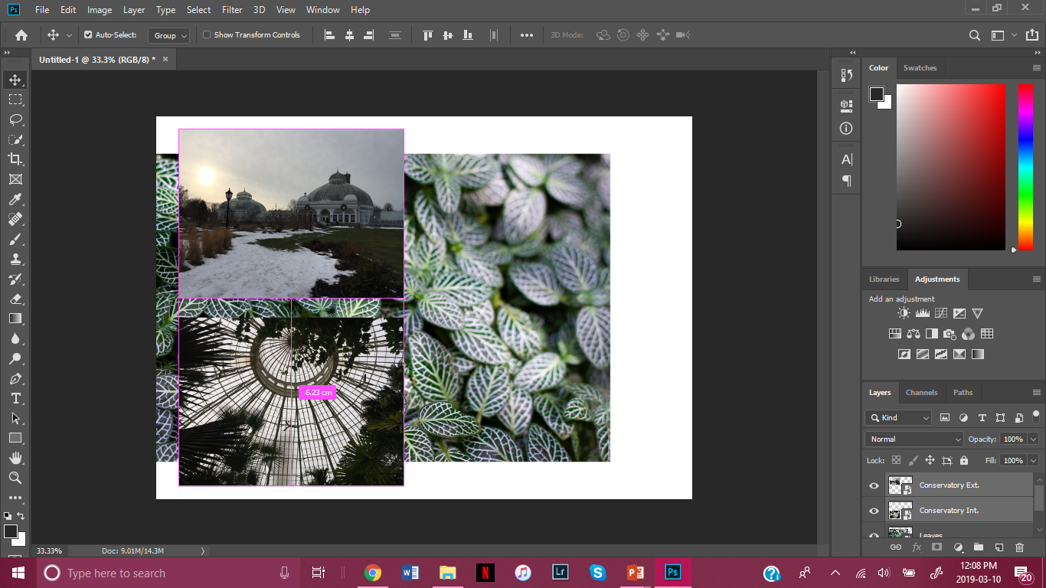
Select two layers to move together by clicking CTRL and selecting both chosen layers.

Slide 19
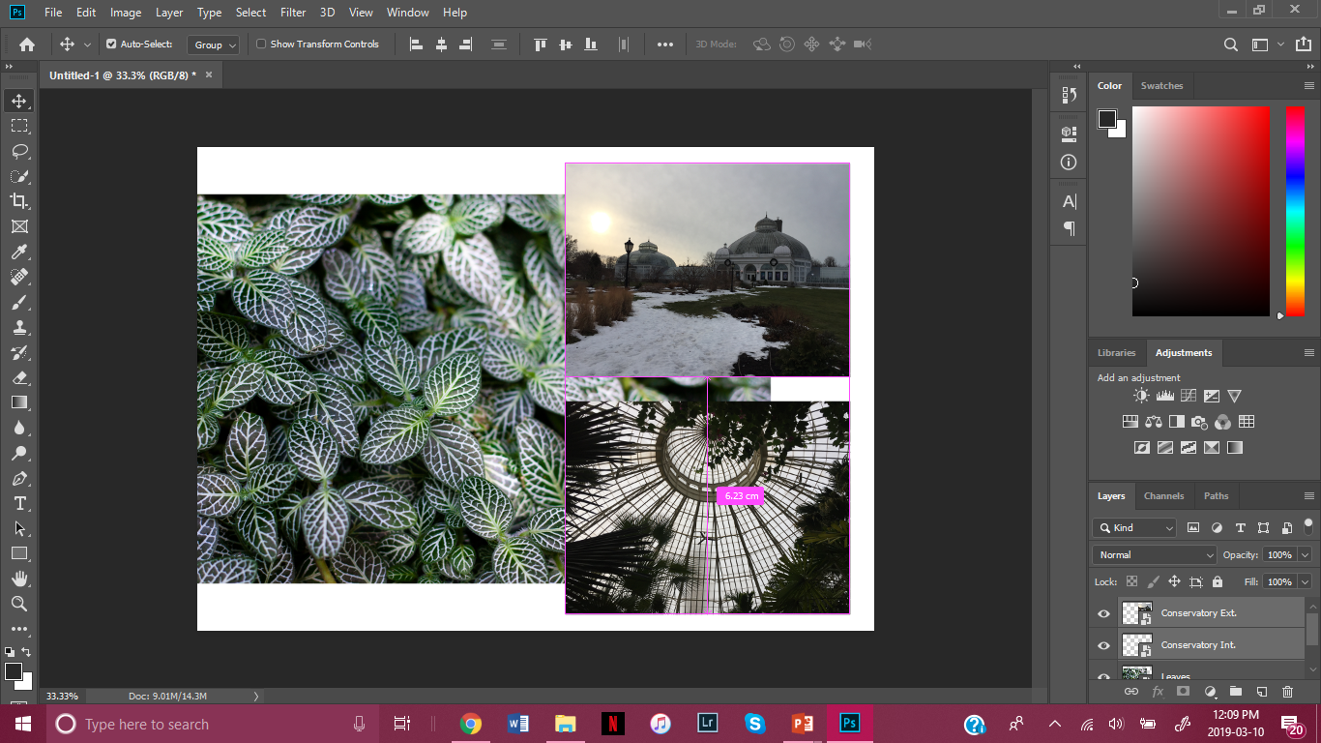
Use the Move tool to drag both selected layers to the left.

