Slide 1
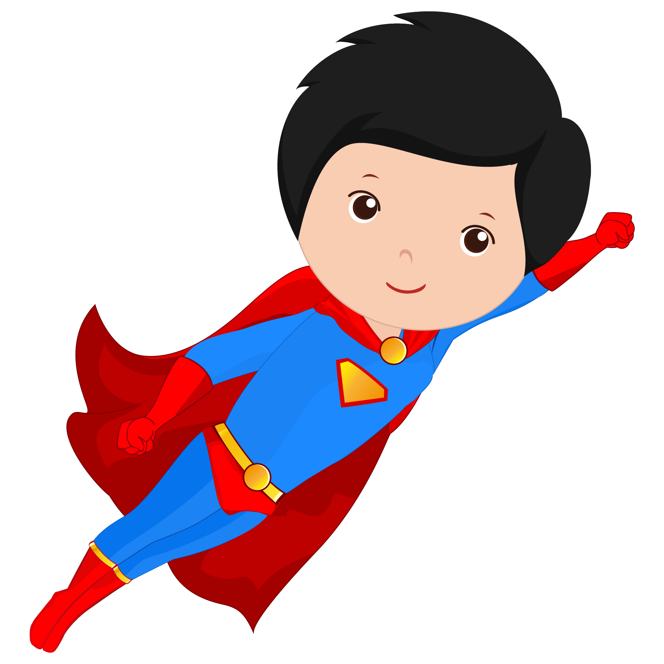
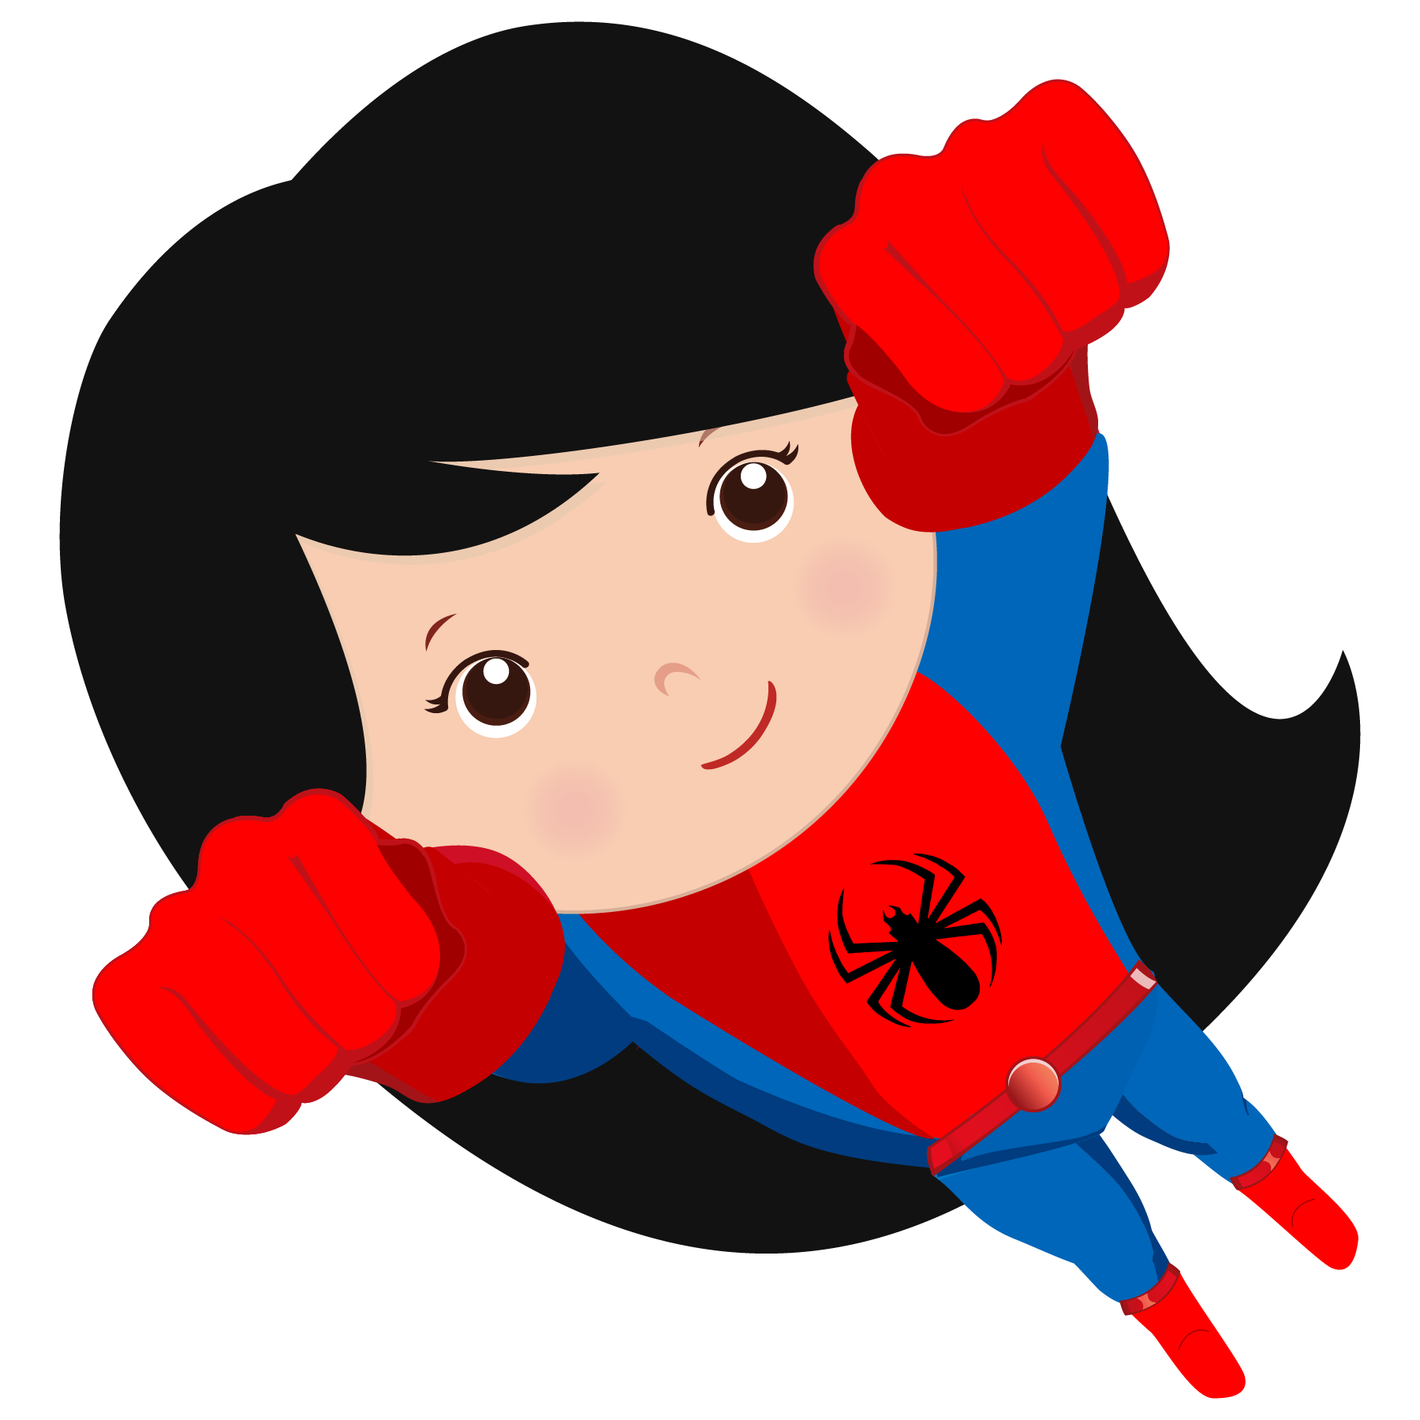
Introductory Lesson 1

Slide 2
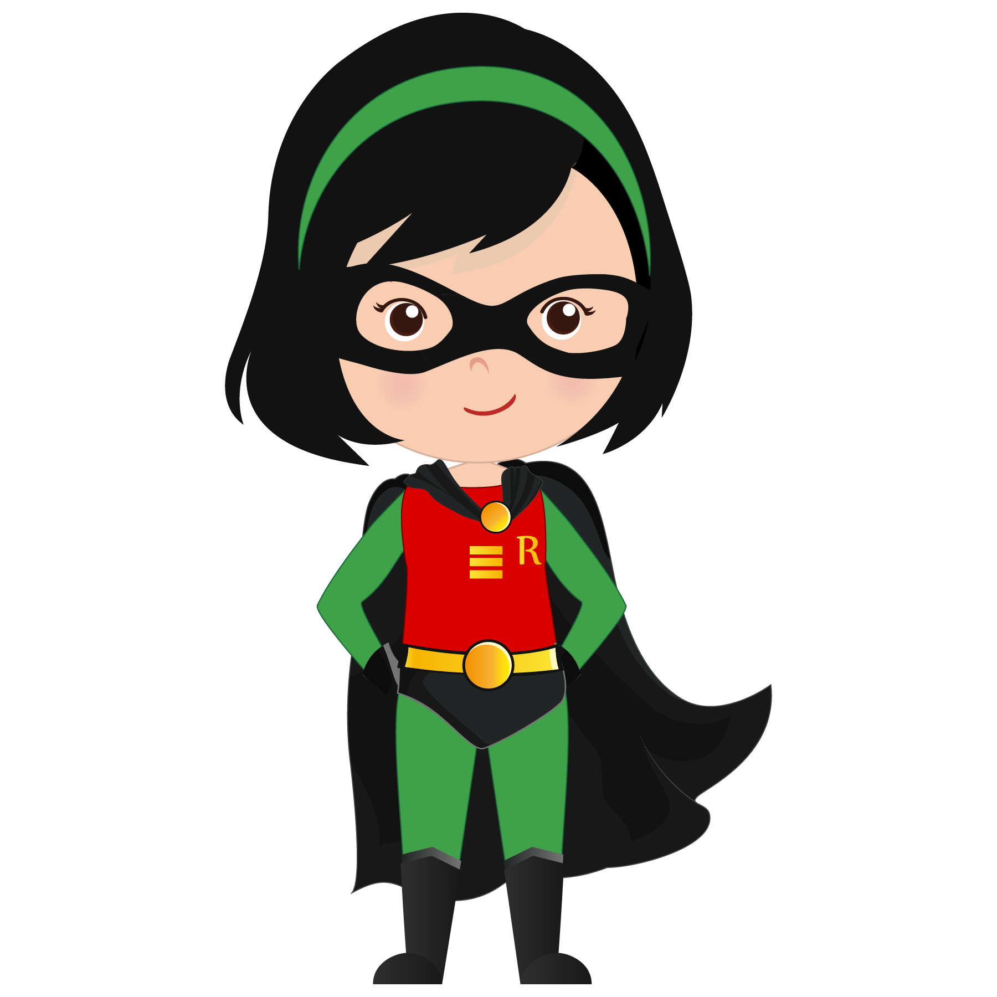
What will I be learning today?
Greetings / Goodbyes
Introducing yourself
How are you?
The alphabet

Slide 3
1. Let’s learn greetings and goodbyes!

Slide 4
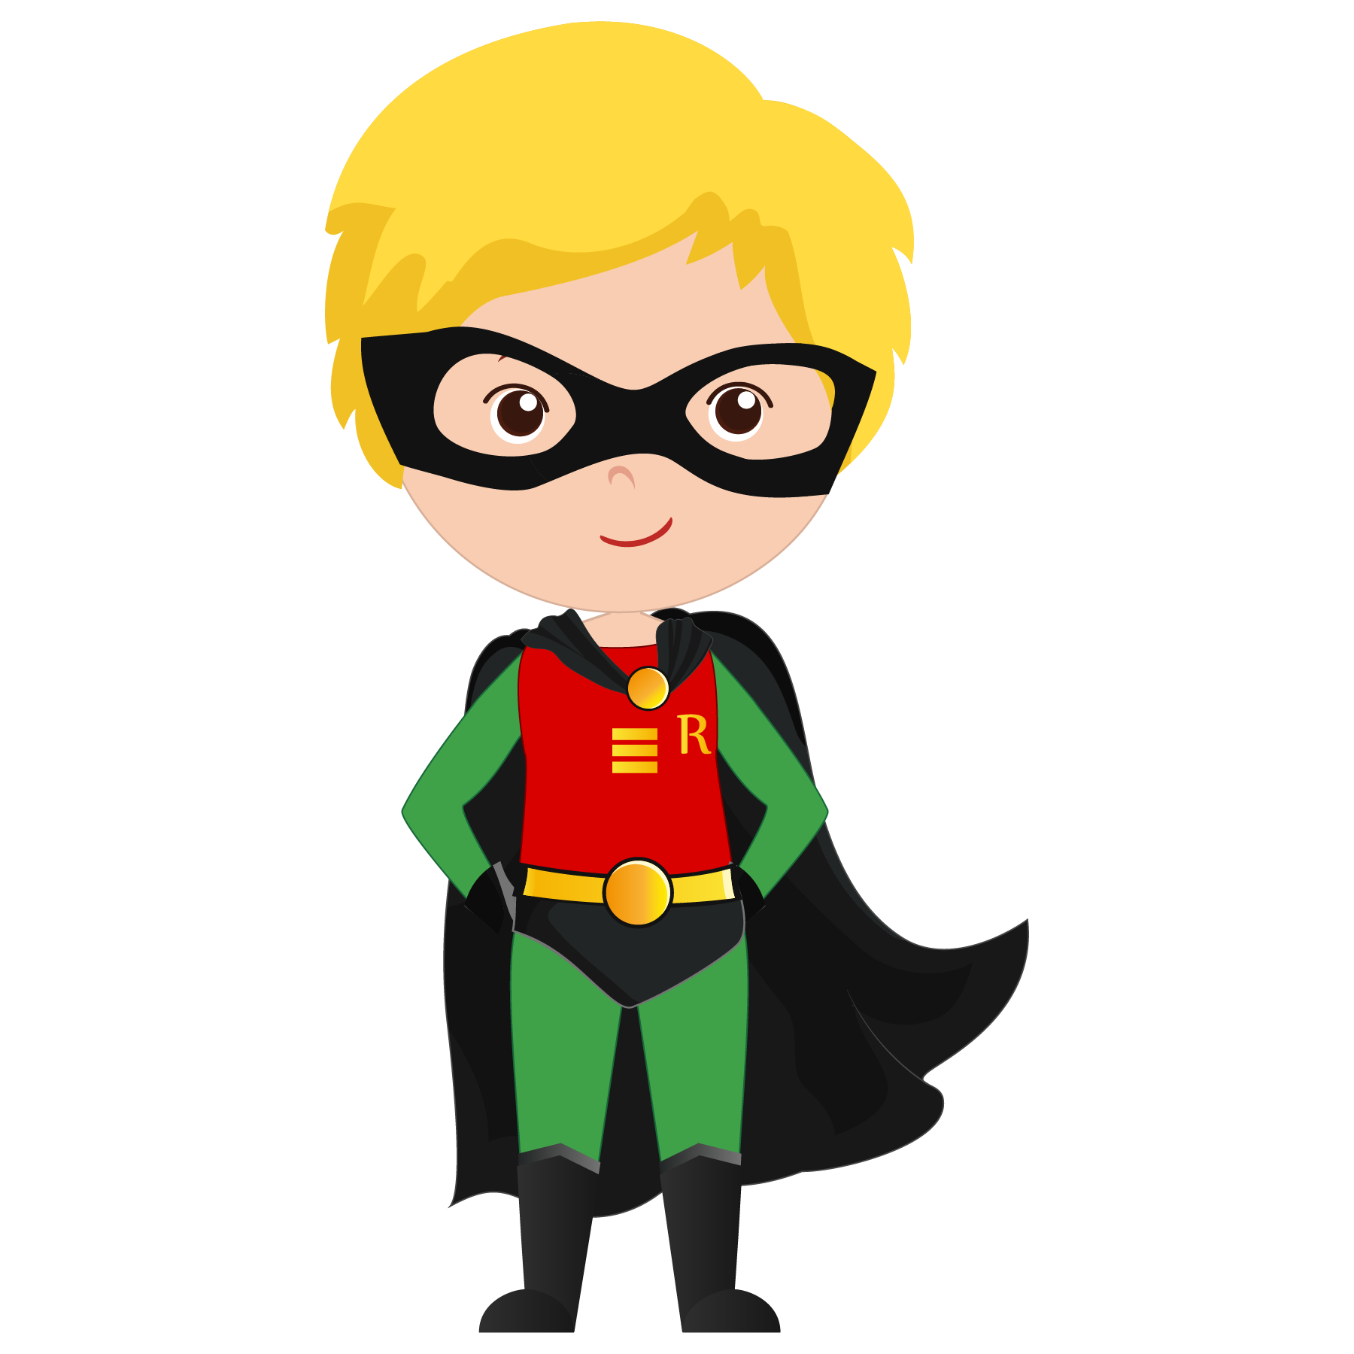
Greetings
Hello!
Hi!
Good morning!
Good afternoon!

Slide 5
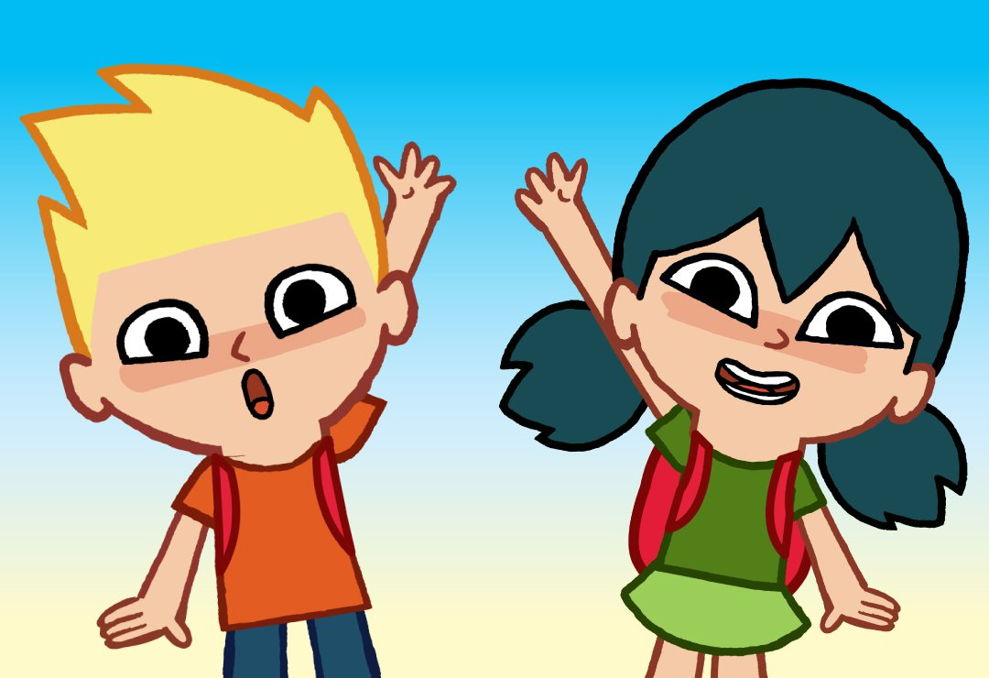
Goodbyes
Goodbye!
Bye!
See you later!
Good night!

Slide 6
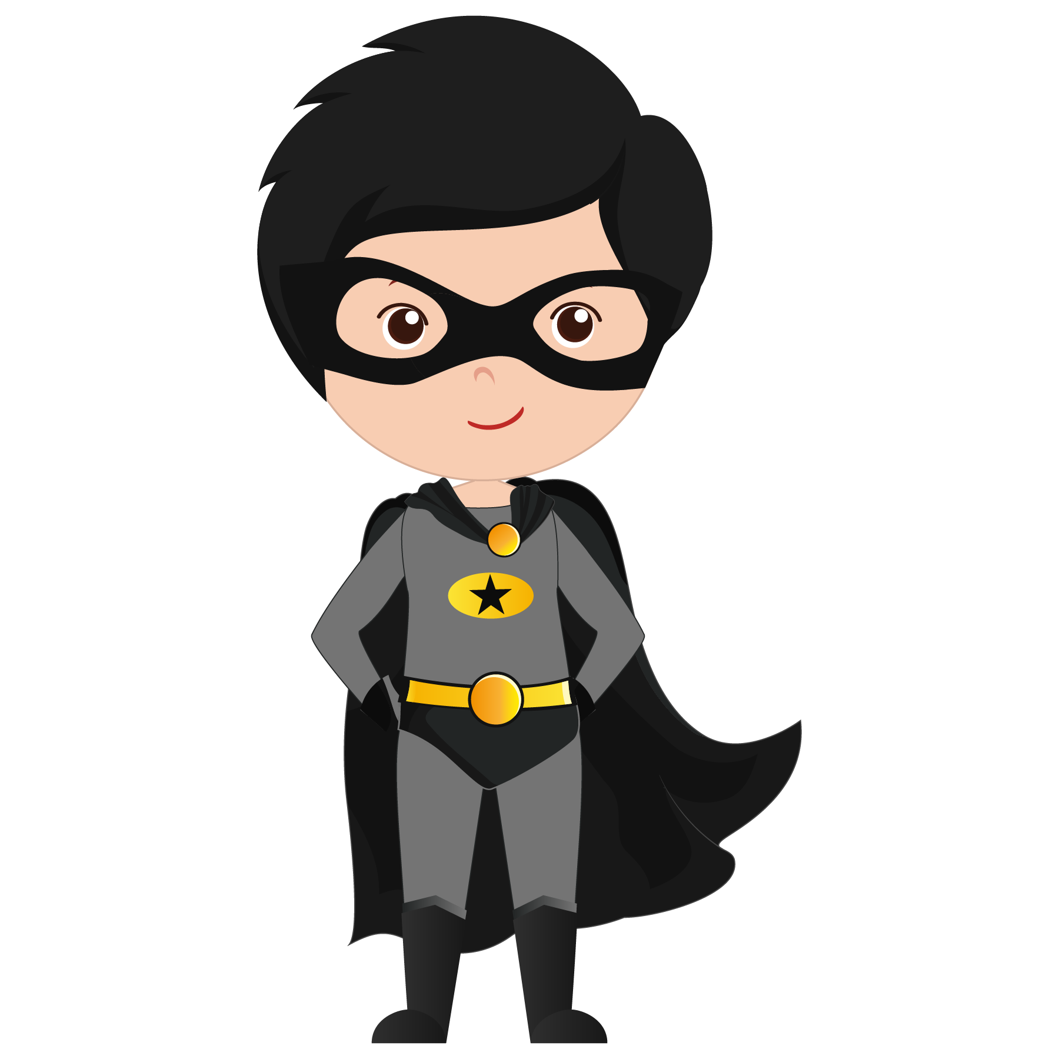
2. Let’s learn how to introduce ourselves!

Slide 7
Try to sing along!
Hello
What’s your name?
My name is _______

Slide 8
Hello, my name is Stargirl. What’s your name?
Hi! My name is Speedy. Nice to meet you.

Slide 9
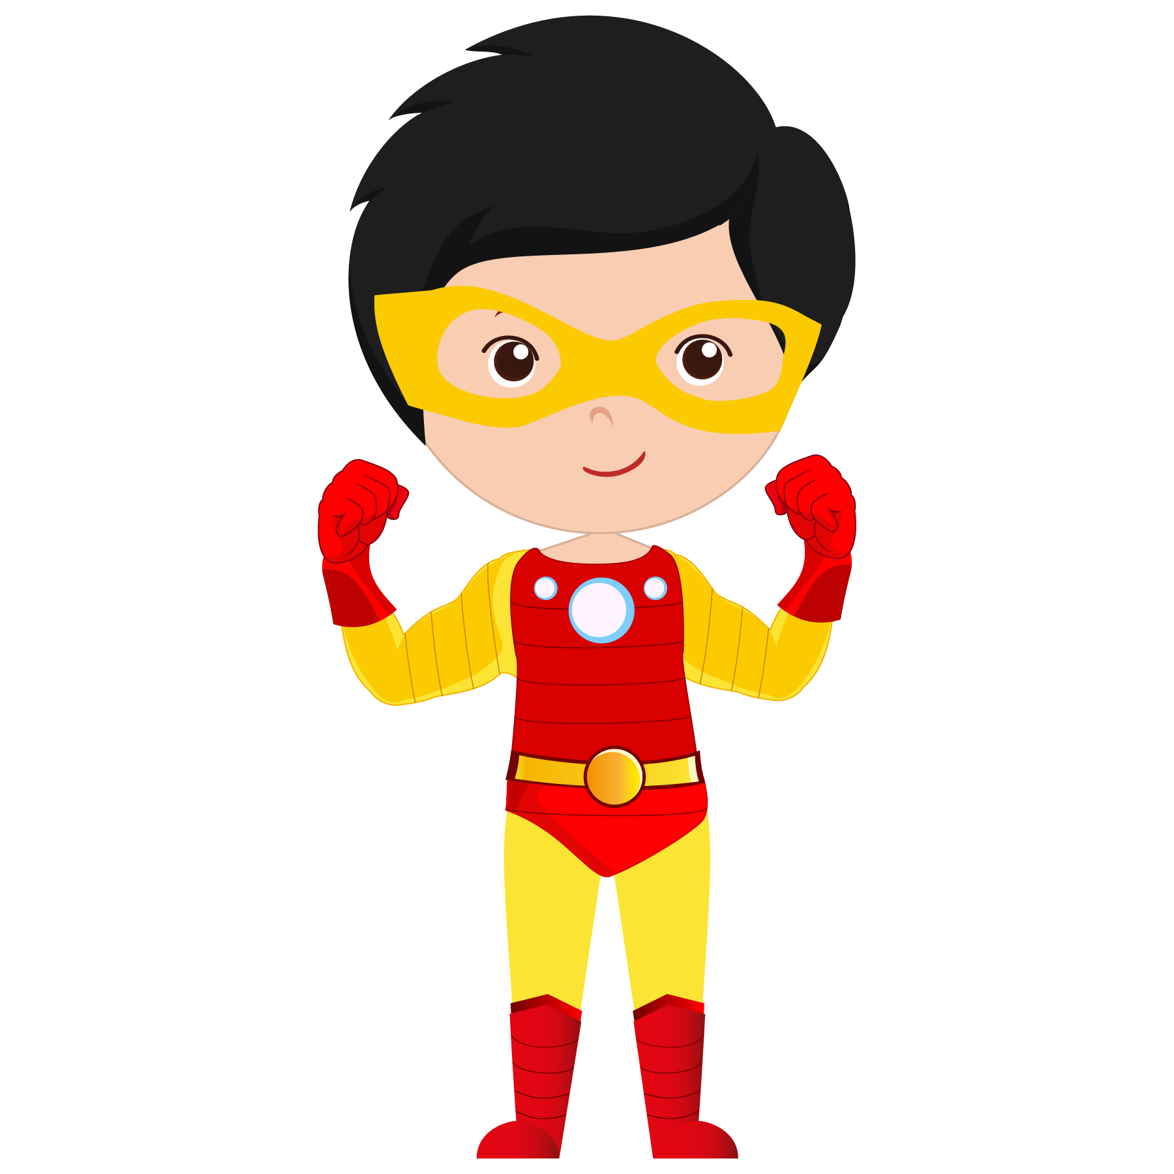
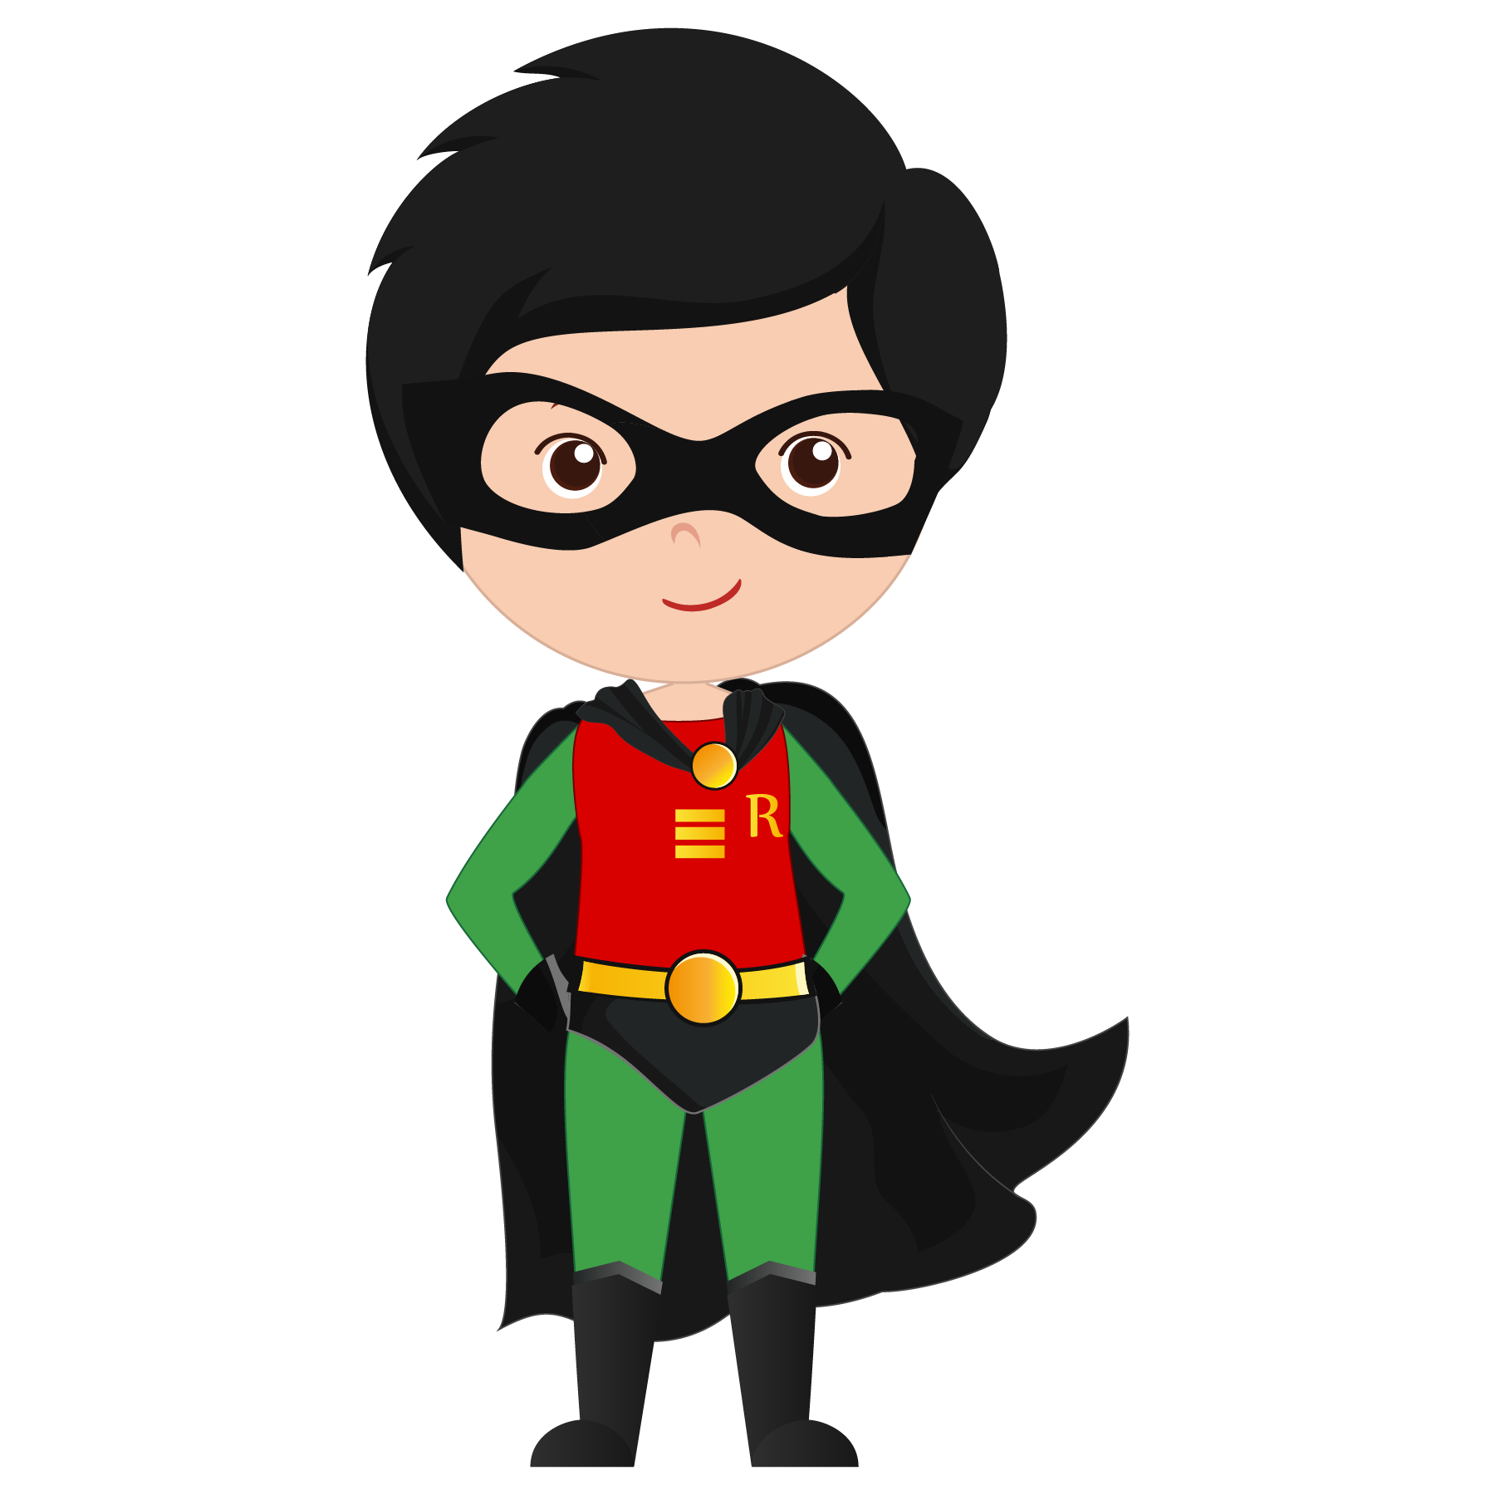
Hi, my name is Flameboy. What’s your name?
Nice to meet you, Flameboy. My name is Rocket.

Slide 10
Let’s Practice!
With a partner, take turns being Person A and Person B and practice introducing yourselves.
PERSON A | PERSON B
Hello, my name is __________. What’s your name?
 | Hi! My name is ________. Nice to meet you.
Nice to meet you, too.

Slide 11
3. Let’s learn the question “How are you?”

Slide 12
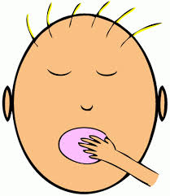
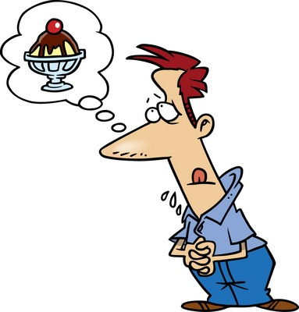
How are you?
I’m _______. How are you?
okay
fine
good
hungry
great
tired
Notes:
Let’s play hangman!

Slide 13
Try to sing along!
Hello
How are you?
I’m great
I’m fine
I’m okay
I’m tired

Slide 14
Let’s Practice!
With a partner, take turns being Person A and Person B and practice asking and answering “How are you?”
PERSON A | PERSON B
Hello, how are you?
 | I’m ______. How are you?
I’m _______.
okay
fine
good
hungry
great
tired

Slide 15
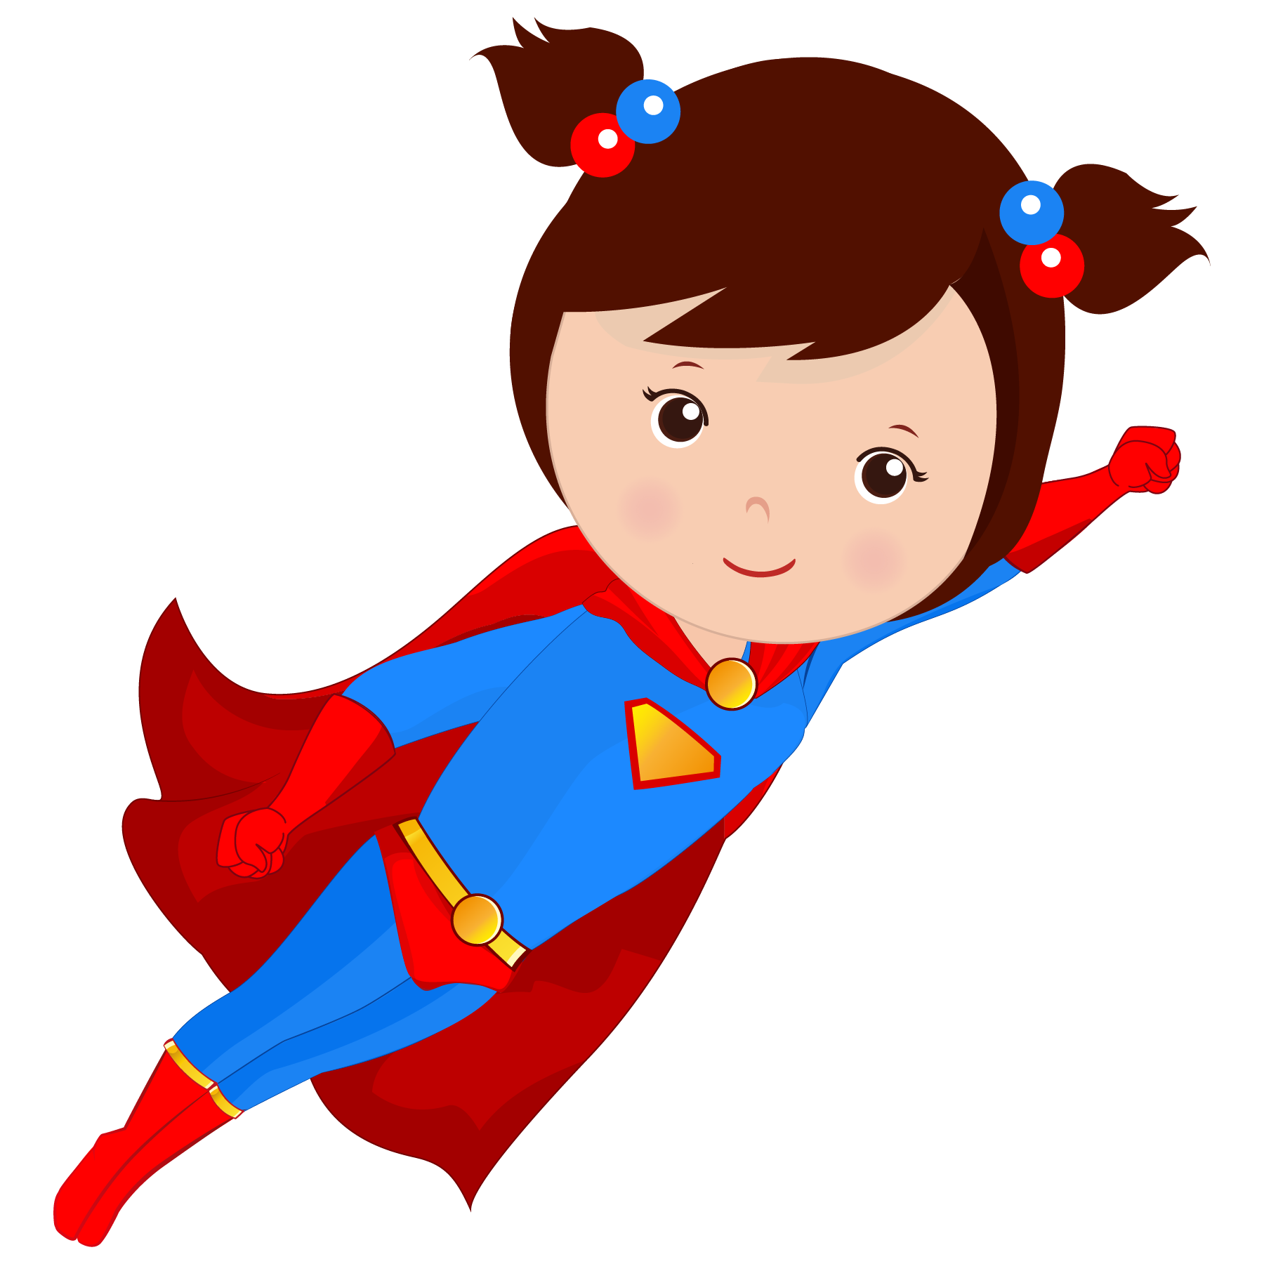
4. Let’s review the alphabet!

Slide 16
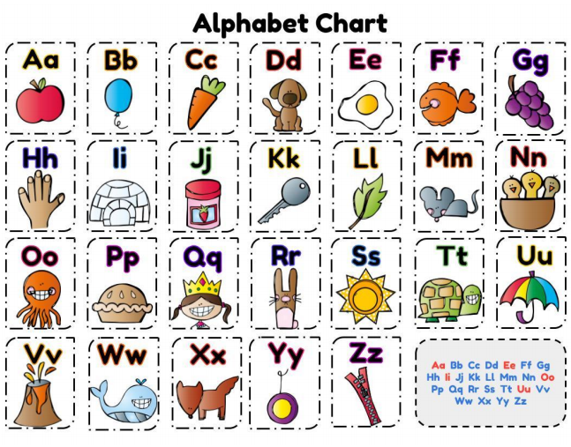
Notes:
Let’s play hangman!

Slide 17
Try to sing along!

Slide 18
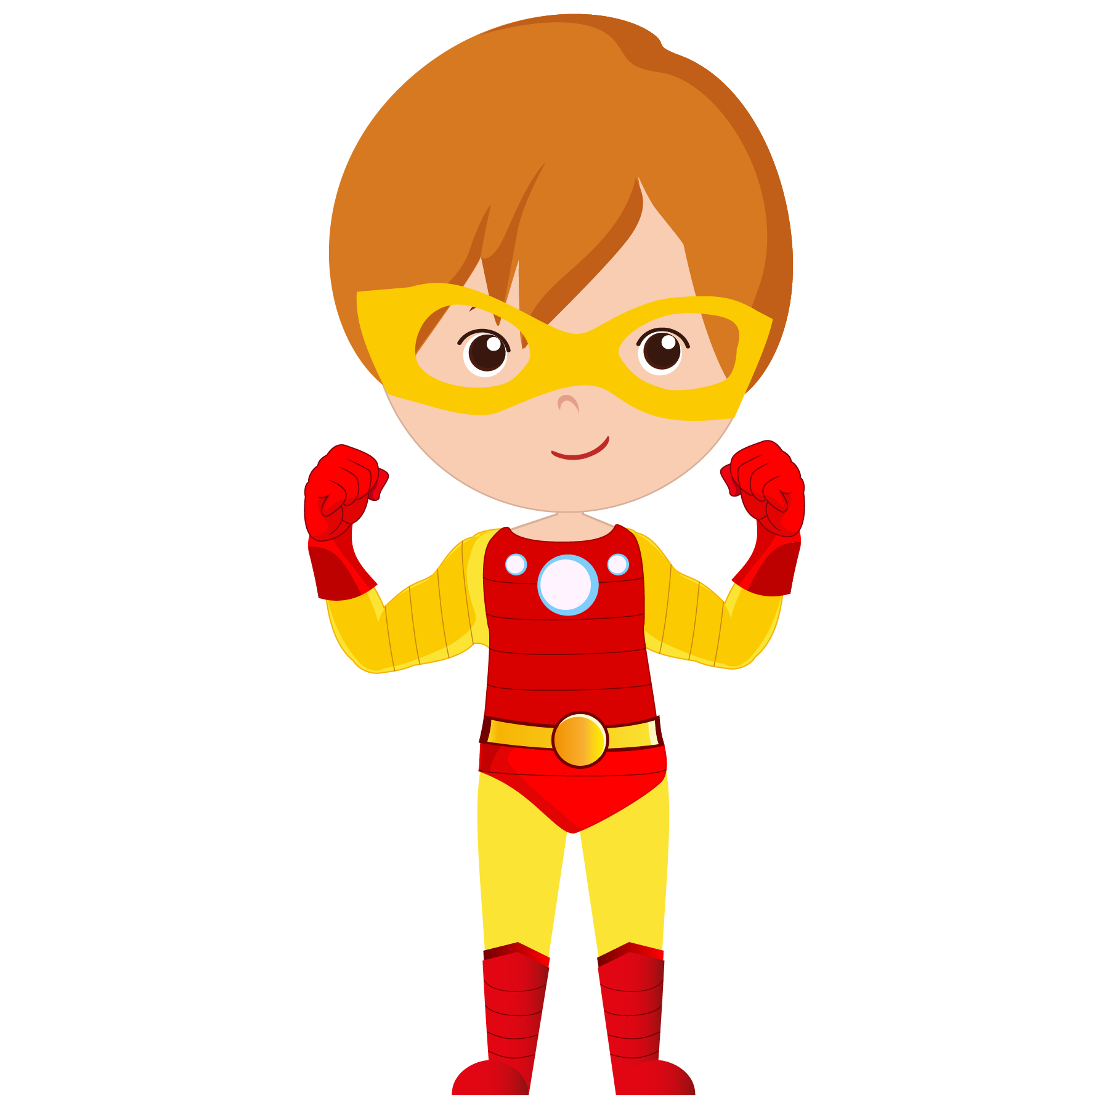
What did I learn today?
Greetings / Goodbyes
Introducing myself
How are you?
The alphabet

Slide 19
Let’s review
Greetings / Goodbyes

Slide 20
2. Introducing yourself
Let’s review

Slide 21
Let’s review
3. How are you?

Slide 22
Let’s review
4. The alphabet

Slide 23
Homework.
What’s the first letter of your name? Find 5 English words that also begin with that letter.
My name is Stargirl. That begins with the letter S
Sit
Soup
Stop
Sand
Sun

Slide 24
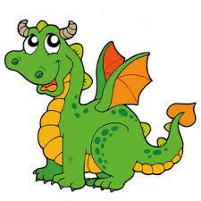
Extra Time – Alphabet Chant
A says /a/ like Apple
A says /a/ /a/ /a/
B says /b/ like Baseball
B says /b/ /b/ /b/
C says /c/ like Cookie
C says /c/ /c/ /c/
D say /d/ like Dragon
D says /d/ /d/ /d/

Slide 25
Extra Time – Alphabet Chant
E says /e/ like Elephant
E says /e/ /e/ /e/
F says /f/ like Feather
F says /f/ /f/ /f/
G says /g/ like Goldfish
G says /g/ /g/ /g/
H say /h/ like Hammer
H says /h/ /h/ /h/

Slide 26
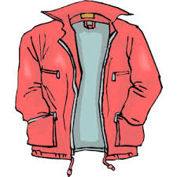
Extra Time – Alphabet Chant
I says /i/ like Insect
I says /i/ /i/ /i/
J says /j/ like Jacket
J says /j/ /j/ /j/
K says /k/ like Kettle
K says /k/ /k/ /k/
L says /l/ like Lemon
L says /l/ /l/ /l/

Slide 27
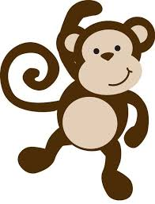
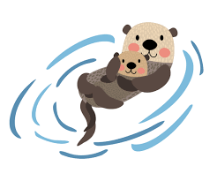
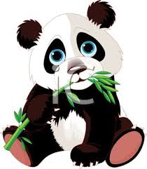
Extra Time – Alphabet Chant
M says /m/ like Monkey
M says /m/ /m/ /m/
N says /n/ like Notebook
N says /n/ /n/ /n/
O says /o/ like Otter
O says /o/ /o/ /o/
P says /p/ like Panda
P says /p/ /p/ /p/

Slide 28
Extra Time – Alphabet Chant
Q says /q/ like Question
Q says /q/ /q/ /q/
R says /r/ like Rainbow
R says /r/ /r/ /r/
S says /s/ like Sailboat
S says /s/ /s/ /s/
T says /t/ like Teacher
T says /t/ /t/ /t/

Slide 29
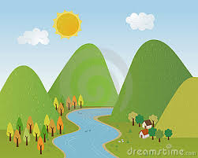
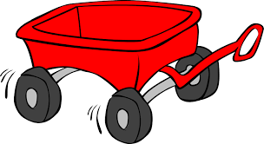
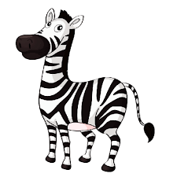
Extra Time – Alphabet Chant
U says /u/ like Umbrella
U says /u/ /u/ /u/
V says /v/ like Valley
V says /v/ /v/ /v/
W says /w/ like Wagon
W says /w/ /w/ /w/
X says /x/ like X-ray
X says /x/ /x/ /x/
Y says /y/ like Yellow
Y says /y/ /y/ /y/
Z says /z/ like Zebra
Z says /z/ /z/ /z/

Slide 30
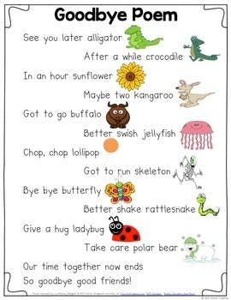
Extra Time

