Slide 1
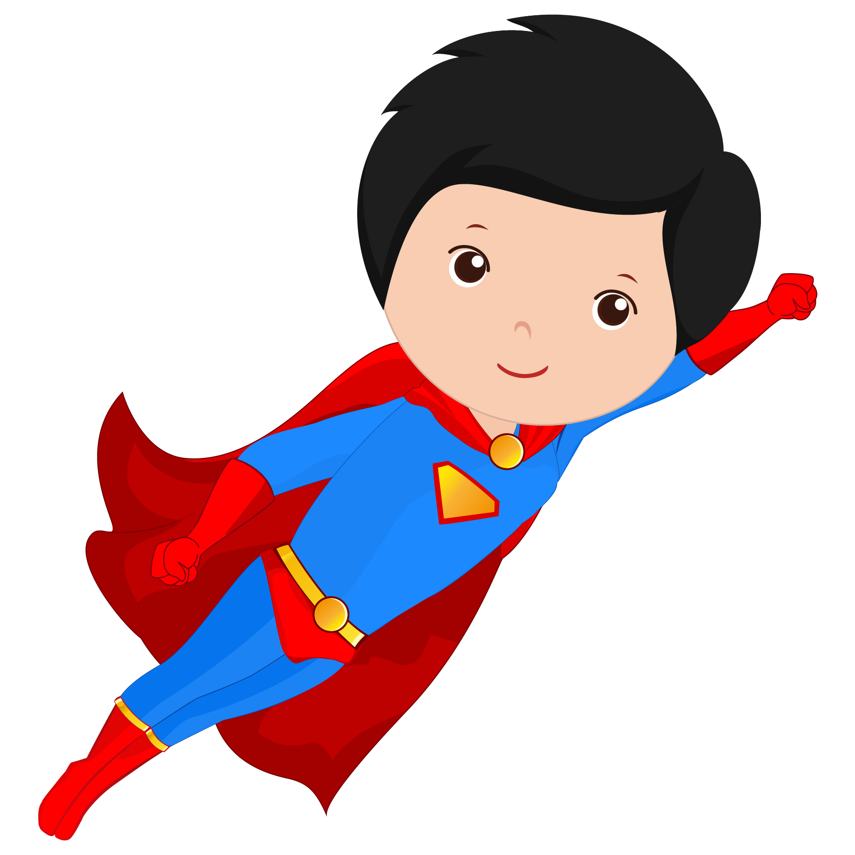
Introductory Lesson 2

Slide 2
Last Week’s Homework:
Write down 5 English words that begin with the same letter as your name.

Slide 3
What will I be learning today?
Numbers
“How old are you?”
Manners

Slide 4
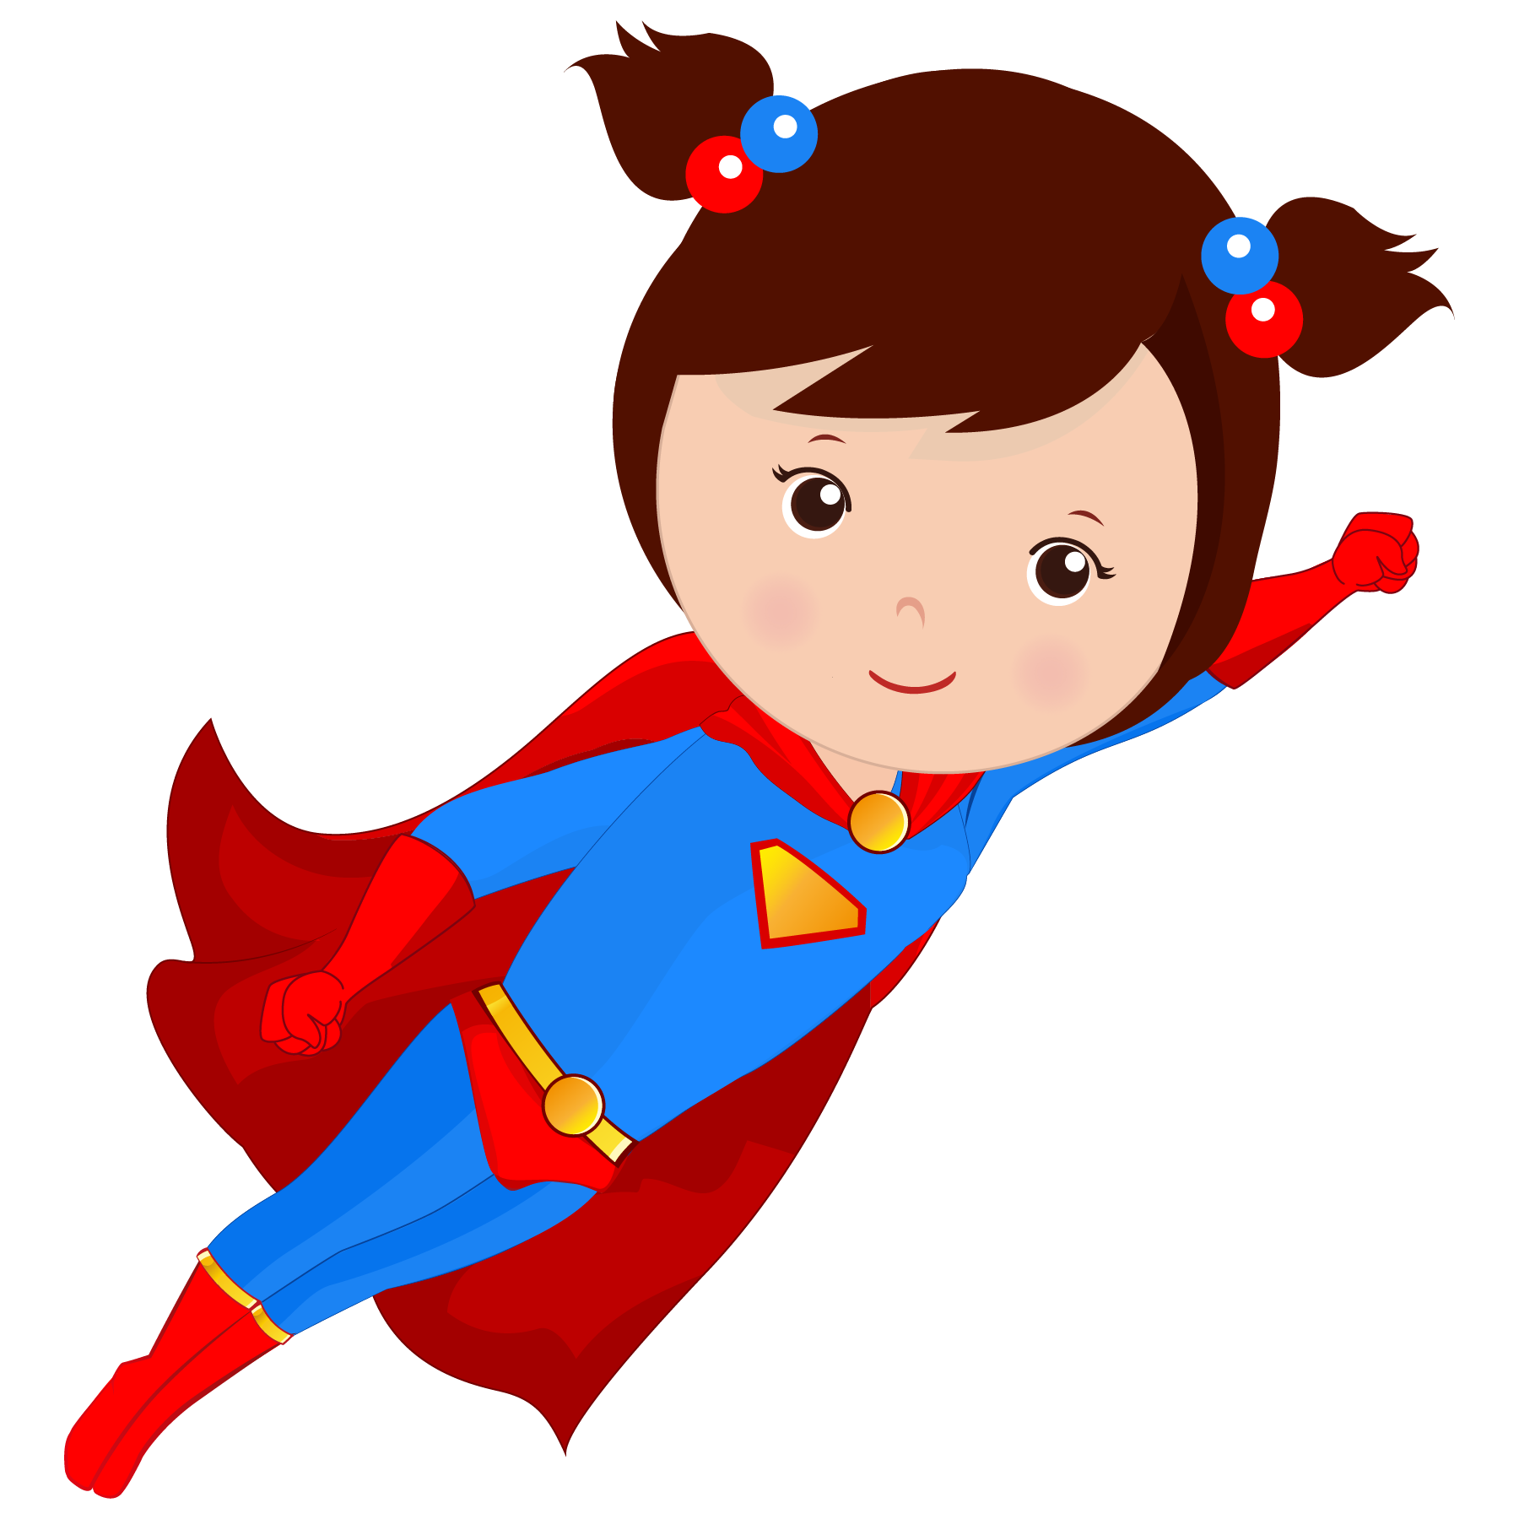
1. Let’s review numbers
1-10

Slide 5
1 one | 2 two | 3 three | 4 four | 5 five
6 six | 7 seven | 8 eight | 9 nine | 10 ten

Slide 6
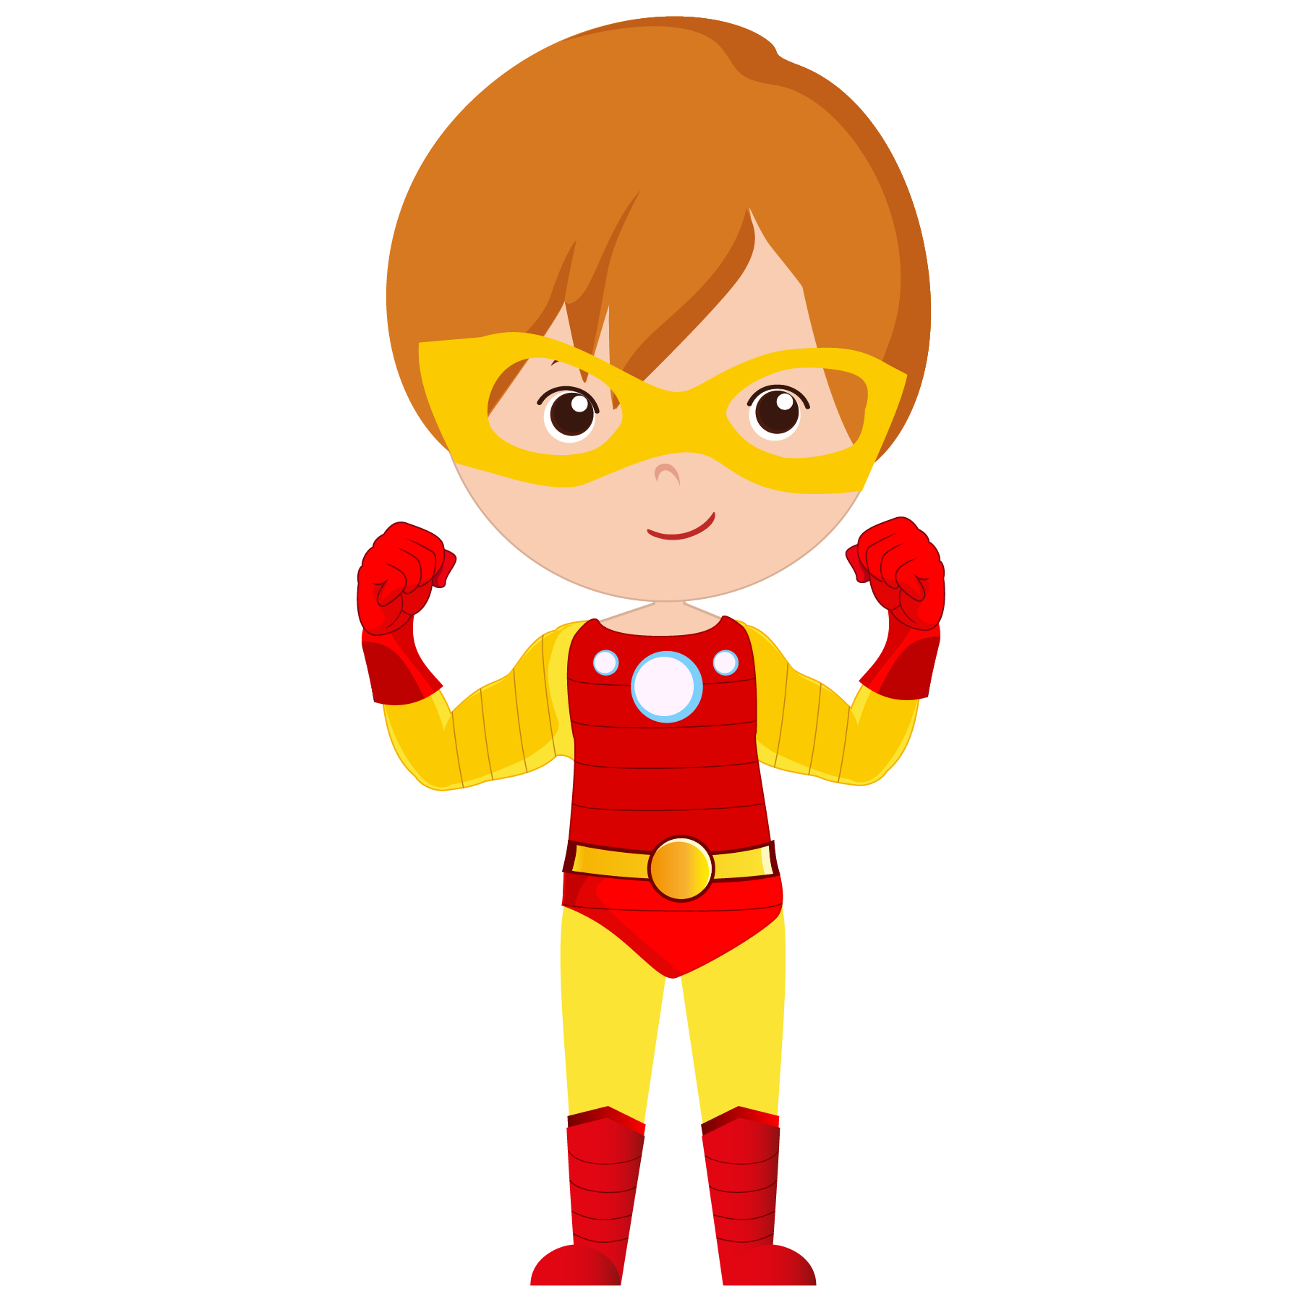
3
5
10
6
7
1
8
2
4
9
Put the numbers in order

Slide 7
That’s right!
1 | 2 | 3 | 4 | 5 | 6 | 7 | 8 | 9 | 10

Slide 8
2. Let’s learn the question “How old are you?”

Slide 9
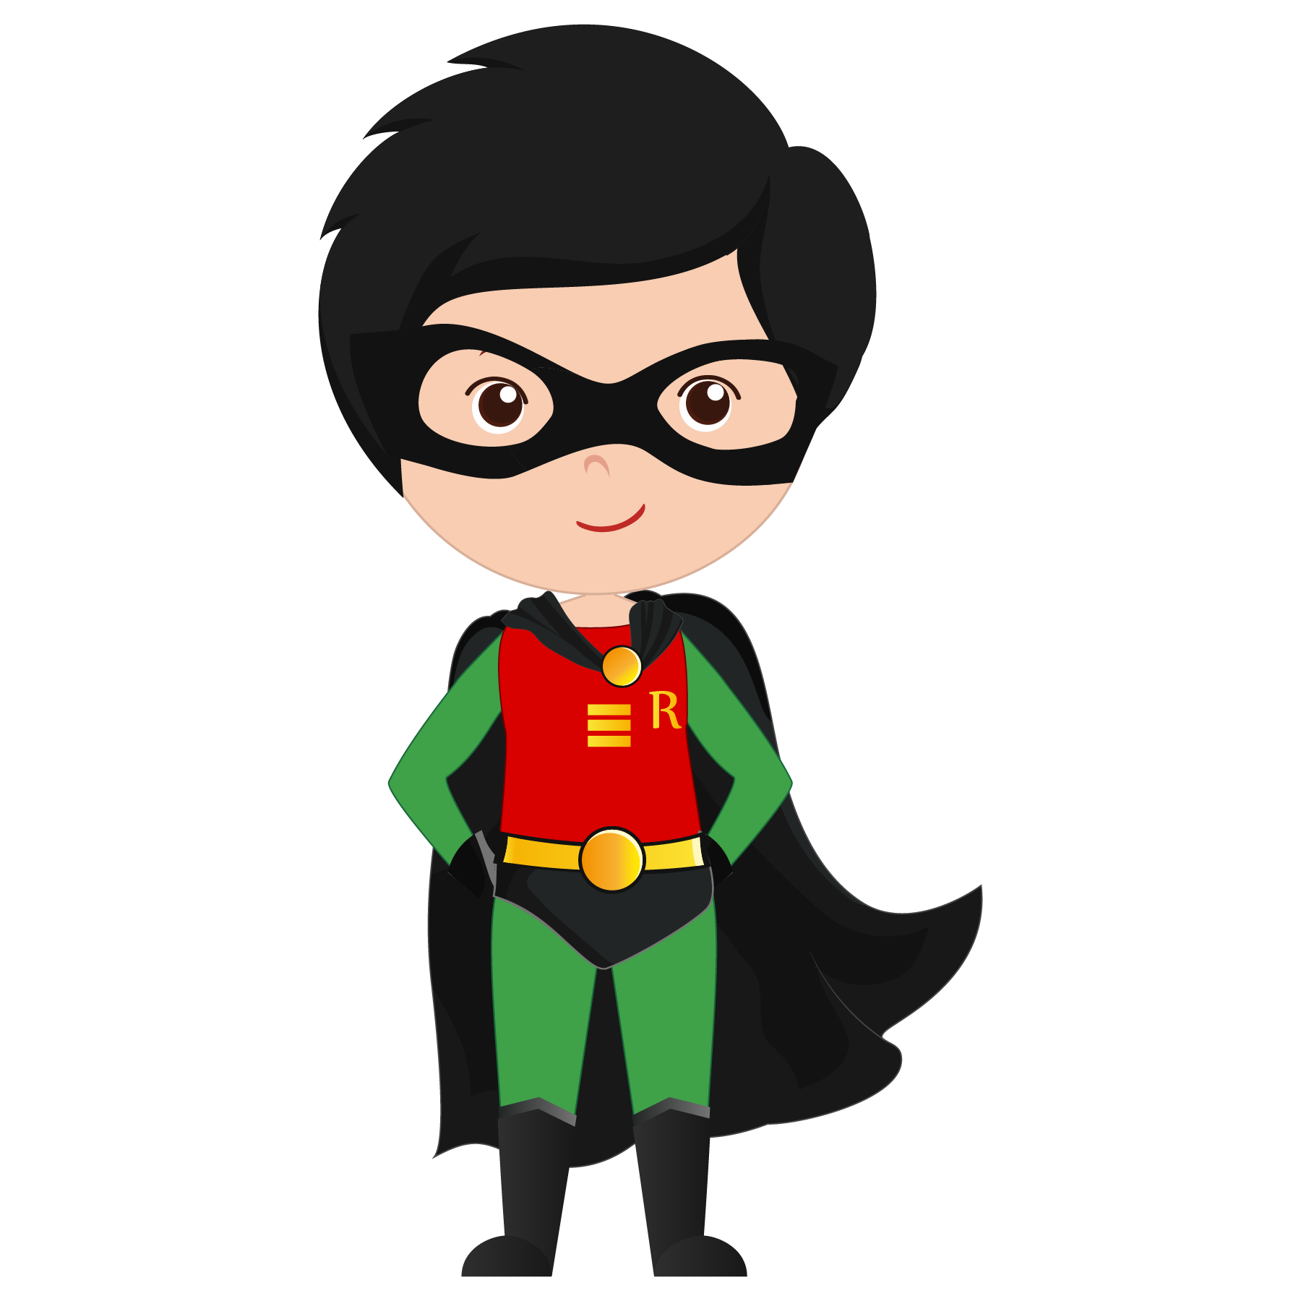
How old are you?
I am 7 years old.

Slide 10
How old are you?
I’m 9!

Slide 11
Let’s Practice!
With a partner, take turns being Person A and Person B and practice asking and answering “How old are you?”
PERSON A | PERSON B
How old are you?
 | I am __ years old. How old are you?
I’m __.

Slide 12
3. Let’s learn basic manners

Slide 13
Please, Thank You, You’re Welcome
We say “please” to ask for things politely
We say “thank you” when someone does or says something nice
We say “you’re welcome” when someone thanks us

Slide 14
Fill in the blanks
“__________ for the birthday present.”
“May I have a piece of cake, ______?”
“Thank you for dinner.” “___________.”
“Will you help me carry this box, _______?”
“I will share my lunch with you.” “_________, that’s very nice of you.”
Please
Thank you
You’re welcome

Slide 15
Fill in the blanks
“Thank you for the birthday present.”
“May I have a piece of cake, please?”
“Thank you for dinner.” “You’re welcome.”
“Will you help me carry this box, please?”
“I will share my lunch with you.” “Thank you, that’s very nice of you.”
Please
Thank you
You’re welcome

Slide 16
Let’s Practice!
With a partner, take turns being Person A and Person B. Find an object and practice asking for it politely. Role play using “please”, “thank you”, and “you’re welcome”.
PERSON A | PERSON B
Can I have that (object), please?
 | Yes, you can.
Thank you.
 | You’re welcome.

Slide 17
What did I learn today?
Numbers
“How old are you?”
Manners

Slide 18
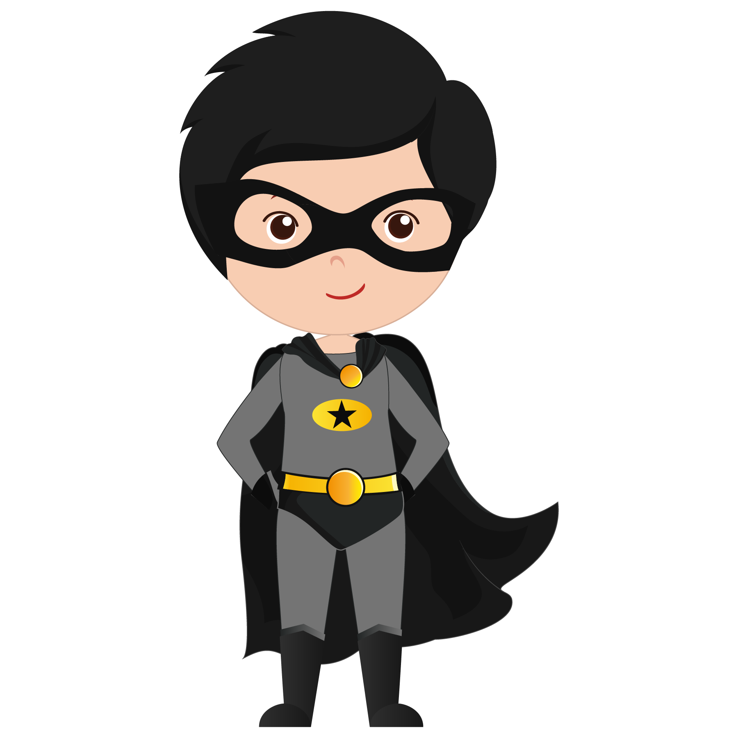
Let’s review
Numbers

Slide 19
Let’s play a review game!
1 | 2 | 3 | 4 | 5 | 6 | 7 | 8 | 9 | 10

Slide 20
“How old are you?”
Let’s review

Slide 21
Let’s watch a video!

Slide 22
Let’s review
3. Manners

Slide 23
Homework:
Write 2 sentences; 1 using “please” and 1 using “thank you”.

Slide 24
Extra Time

Slide 25
Extra Time – More Manners!
We say “Excuse me”
to get a person's attention
to politely interrupt
to ask someone to move from our way
to apologize for minor things (bumping into someone, coughing, burping etc.)

Slide 26
Extra Time – More Manners!
We say “I'm sorry”
when we have done something wrong
to apologize
And "That's okay"
when someone says "I'm sorry" to us

Slide 27
Extra Time – More Manners!

