Slide 1
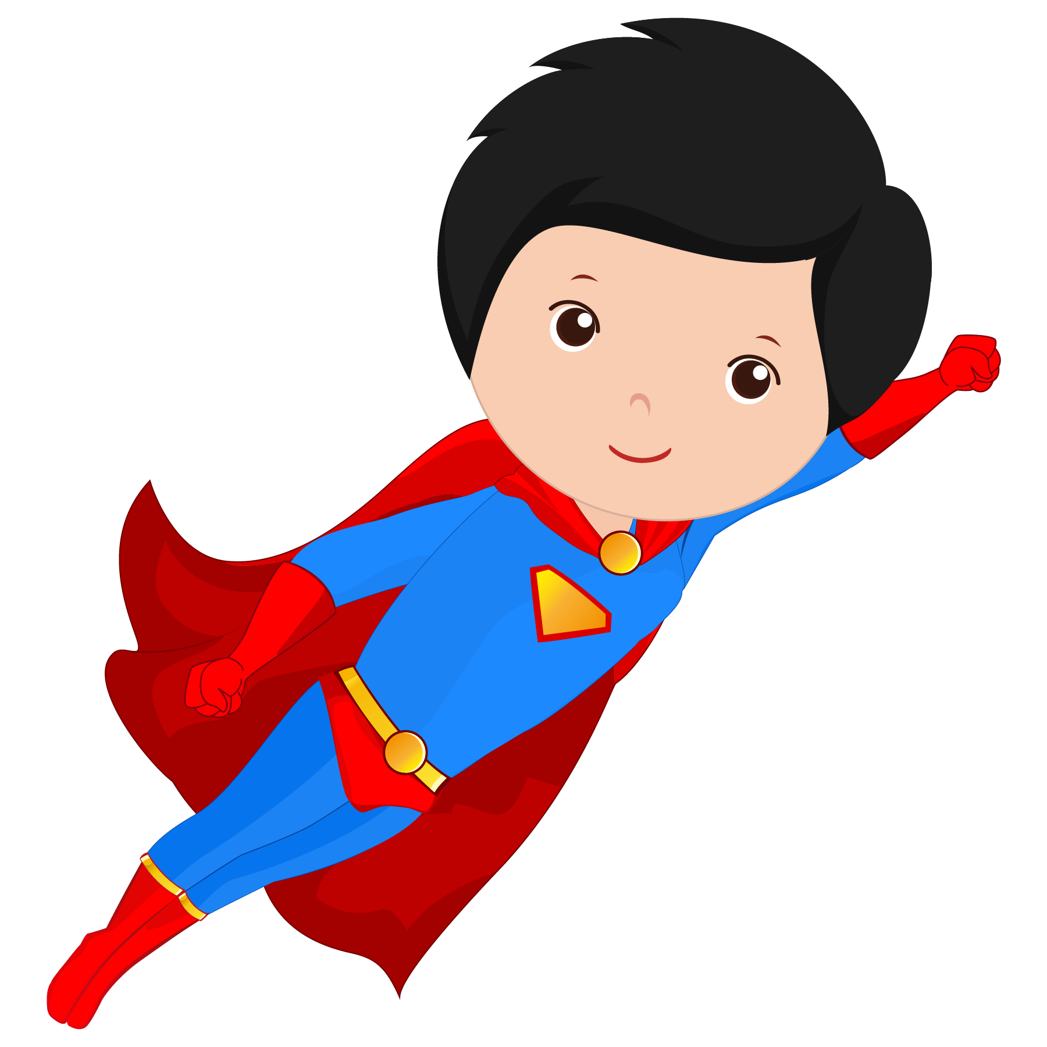
Introductory Lesson 4

Slide 2
Last Week’s Homework:
Write down 5 nouns and whether each is a person, a place, or a thing.

Slide 3
What will I be learning today?
VERBS

Slide 4
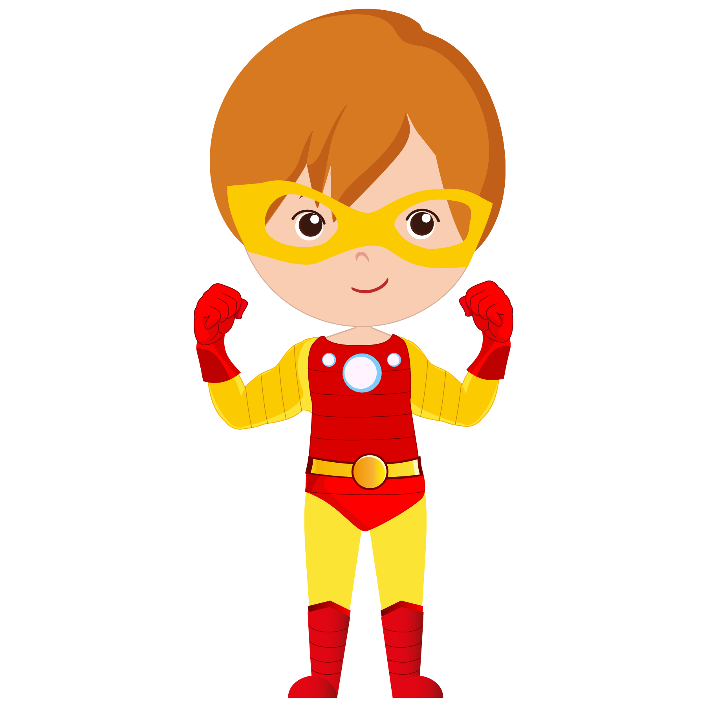
Let’s learn about verbs

Slide 5
What are verbs?
Verbs are “action” or “doing” words
read
talk
sleep
swim
eat
write
learn
walk
jump
go
dance
sing
run
play

Slide 6
Find the verbs in each sentence
She dances beautifully.
Henry cooks dinner for everyone.
My mother reads a lot of books.
We like English.
They walk to school every day.

Slide 7
Find the verbs in each sentence
She dances beautifully.
Henry cooks dinner for everyone.
My mother reads a lot of books.
We like English.
They walk to school every day.

Slide 8
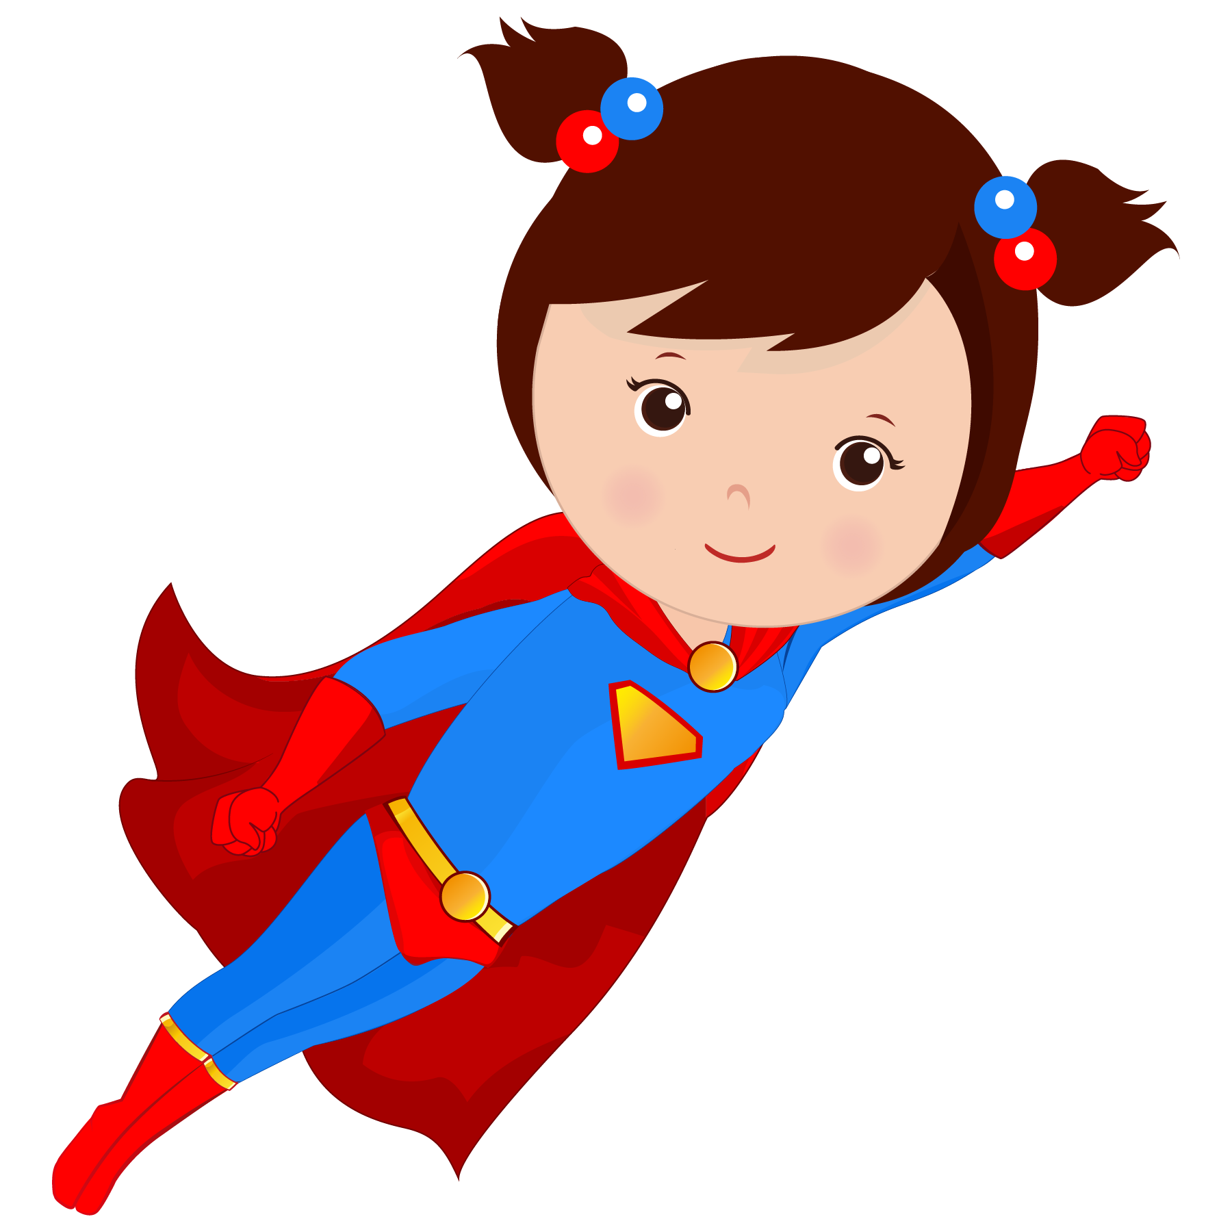
Let’s review nouns

Slide 9
Nouns are PEOPLE, PLACES, or THINGS
Nouns
People | Places | Things
girl | Canada | pencil
teacher | school | computer
Justin Trudeau | Hong Kong | apple
friend | home | dog
man | store | chair

Slide 10
Verbs
VERBS tell what NOUNS do
The dog barks.
The dog is a thing — that makes dog a noun
barks tells us what the dog does — barks is a verb

Slide 11
Verbs
VERBS tell what NOUNS do
A superhero is a person — that makes a superhero a noun.
What are some things a superhero does?

Slide 12
chase
save
change
fly
These are VERBS!
fight
jump
run
swim
crawl

Slide 13
Verb Conjugation – Simple Present Tense
Verbs change depending on the type of noun/pronoun they are paired with.
Let's look at the verb "to play"
To Play
I | play
You | play
He/She/It | plays
We | play
They | play
Examples:
I play soccer.
You play with your friend.
She plays in the park.
They play together.

Slide 14
Verb Conjugation – Simple Present Tense
Verbs change depending on the type of noun/pronoun they are paired with.
Let's look at the verb "to walk"
To Walk
I | walk
You | walk
He/She/It | walks
We | walk
They | walk
Examples:
I walk home.
Sam walks to school.
The dog walks down the road.
Kelly and Robert walk on the beach.

Slide 15
Verb Conjugation – Simple Present Tense
Let's try "to eat"
To Eat
I
You
He
She
It
We
They

Slide 16
Verb Conjugation – Simple Present Tense
Let's try "to eat"
To Eat
I | eat
You | eat
He | eats
She | eats
It | eats
We | eat
They | eat

Slide 17
Verb Conjugation – Simple Present Tense
To Eat
I | eat
You | eat
He | eats
She | eats
It | eats
We | eat
They | eat
Let's try "to eat"
Fill in the blanks
I _______ a cookie.
Sarah _______ a sandwich.
The horse _______ an apple.
My family and I _______ dinner together.

Slide 18
Verb Conjugation – Simple Present Tense
Let's try "to eat"
I eat a cookie.
Sarah eats a sandwich.
The horse eats an apple.
My family and I eat dinner together.

Slide 19
Fill in the blanks with VERBS
The boy ______ his lunch.
The pig ______ in the mud.
We _____ at school.
I ______ books.

Slide 20
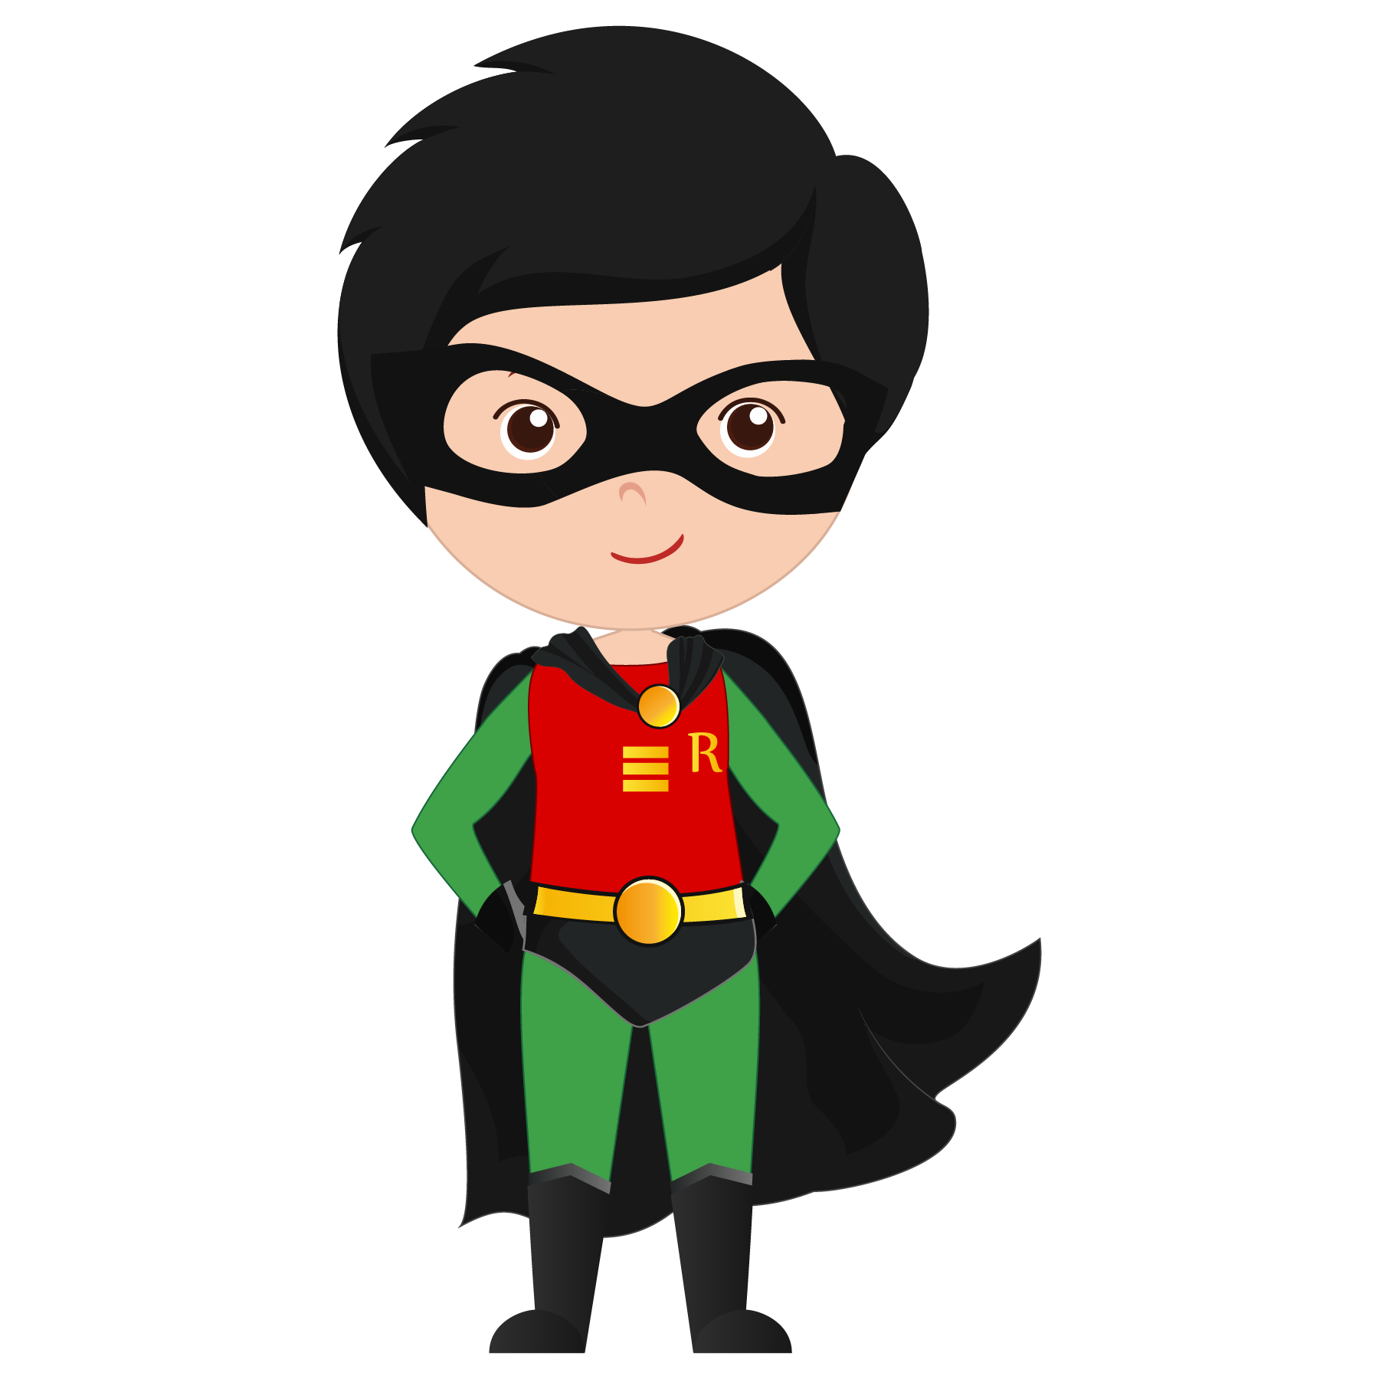
Find the verbs in the following
Rocket is a superhero. He flies really fast, and he is very strong. He lives in a big city. He saves the day by fighting bad guys and carrying people to safety.

Slide 21
Find the verbs in the following
Rocket is a superhero. He flies really fast, and he is very strong. He lives in a big city. He saves the day by fighting bad guys and carrying people to safety.

Slide 22
Let’s play CHARADES

Slide 23
What did I learn today?
VERBS

Slide 24
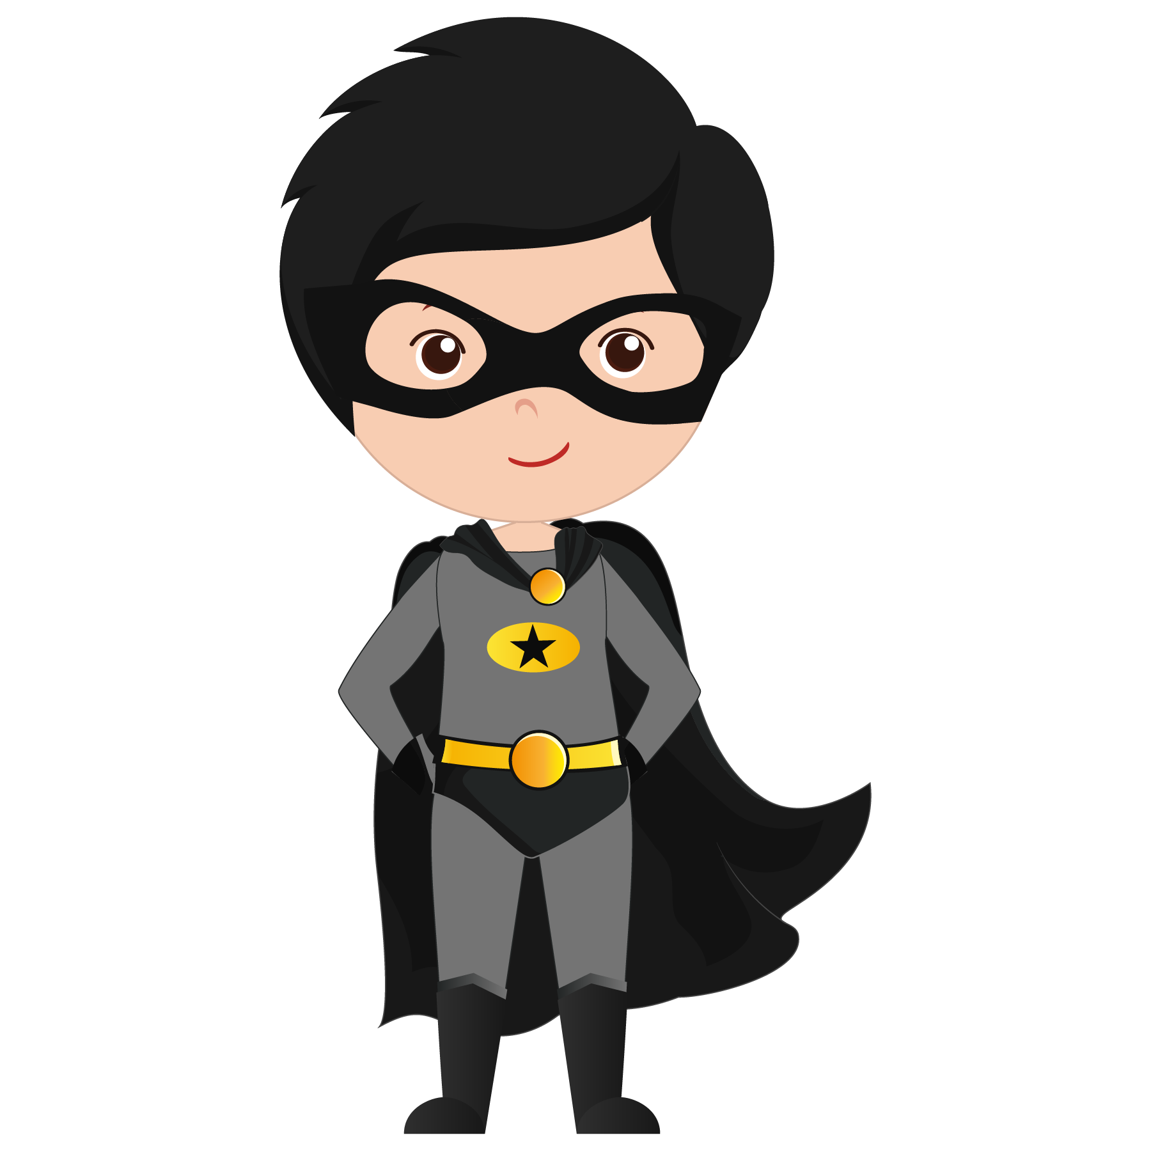
Let’s review
What is a verb?

Slide 25
Verb Conjugation
Let’s review

Slide 26
Let’s review
3. Acting out verbs

Slide 27
Homework:
What are things you like to do? Write down 3 sentences about things you do using verbs.
For example:
I read books.
I walk my dog.
I eat ice cream.

Slide 28
The Verb “To Be”
To Be
I | am
You | are
He | is
She | is
It | is
We | are
They | are

Slide 29
The Verb “To Be”
Fill in the blanks with the correct form of “To Be”
We ___ happy.
They ___ playing.
Tom ___ a student.
Sam and Lucy ___ going to the beach.
I ___ at school.
The tree ___ green.
You ____ young.
To Be
I | am
You | are
He | is
She | is
It | is
We | are
They | are

Slide 30
The Verb “To Be”
Fill in the blanks with the correct form of “To Be”
We are happy.
They are playing.
Tom is a student.
Sam and Lucy are going to the beach.
I am at school.
The tree is green.
You are young.
To Be
I | am
You | are
He | is
She | is
It | is
We | are
They | are

