Slide 1





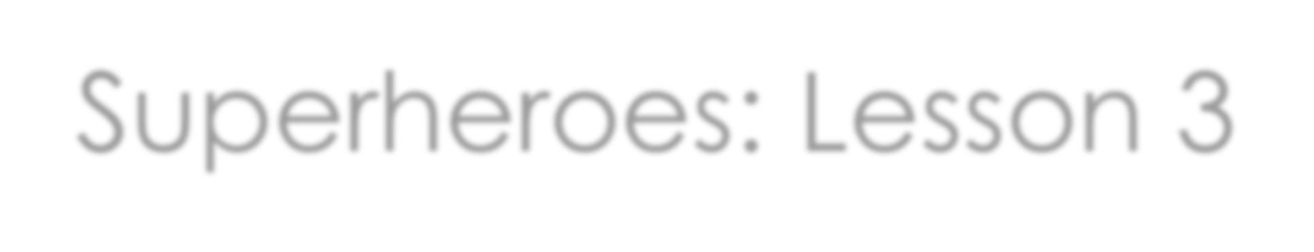
Superheroes: Lesson 3

Slide 2

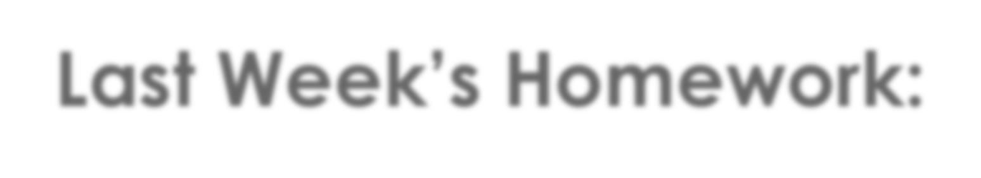
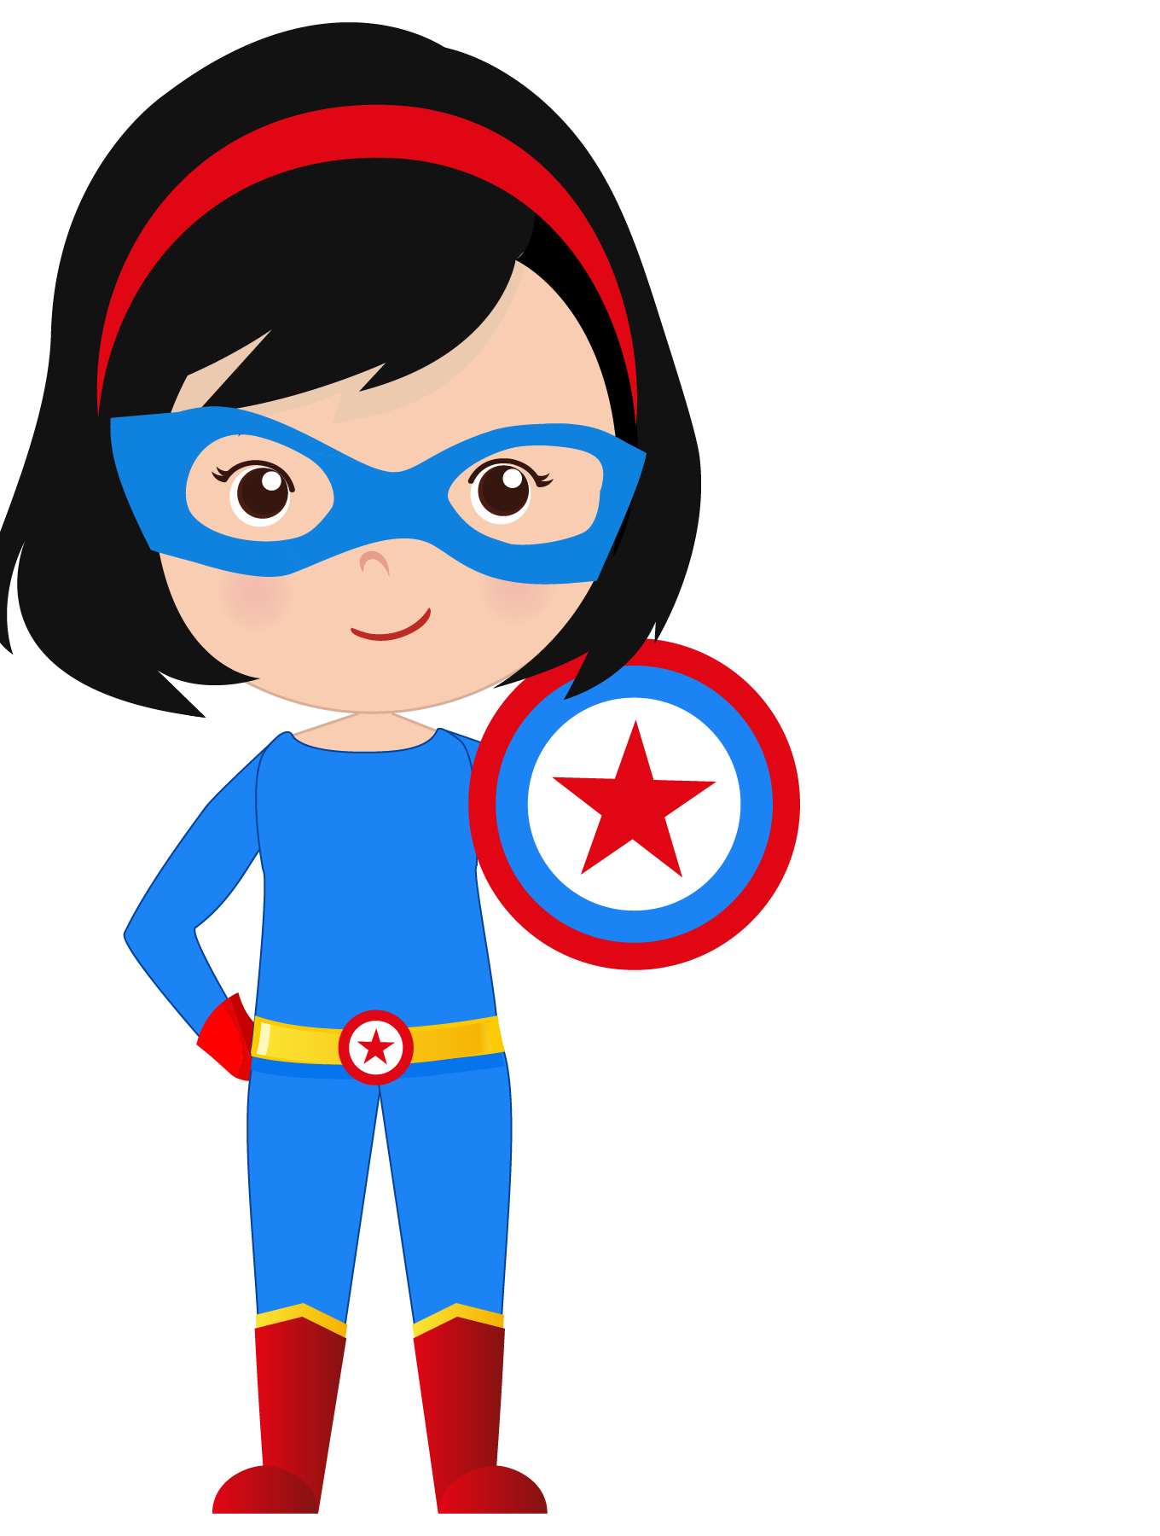
Last Week’s Homework:
Interview the members of your family and ask them what they like and don’t like. Write 5 sentences.
My mom likes pizza.
My sister doesn’t like waking up early. My cousins don’t like dancing.

Slide 3








What new words will I learn today?

Slide 4
What new words will I learn today?

Slide 5










Slide 6
surprised | sleepy | sad | scared
embarrassed | happy | angry | silly

Slide 7




What will I be learning today?

Slide 8

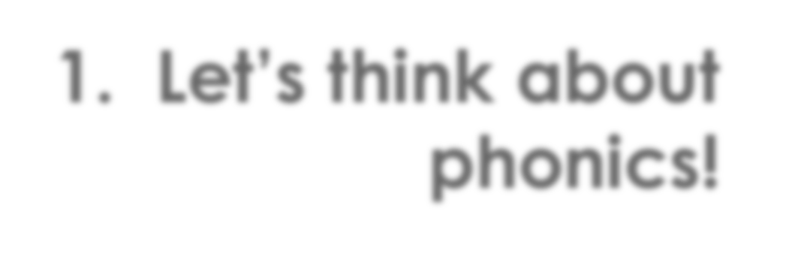


1. Let’s think about
phonics!
C&G

Slide 9


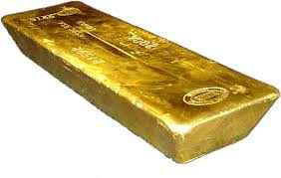
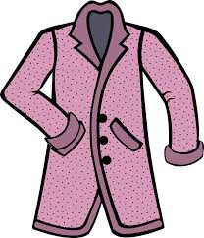







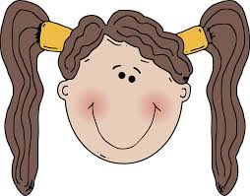
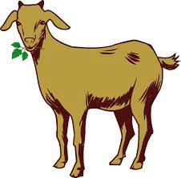
cap gap curl card girl coat goat cold gold

Slide 10






Let’s play tic tac toe!

Slide 11





Let’s play tic tac toe!

Slide 12
Let’s play tic tac toe!
This is something you wear on your head | The opposite of straight | This is an animal
This is the temperature in the north pole | What is some jewelry made from? | Something you put in the mail
When you lose a tooth, you have a | The word for a young woman | Something to wear when it gets cold

Slide 13

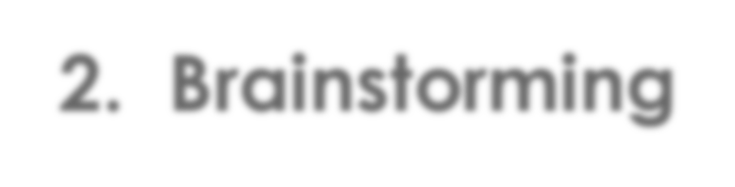
2. Brainstorming

Slide 14
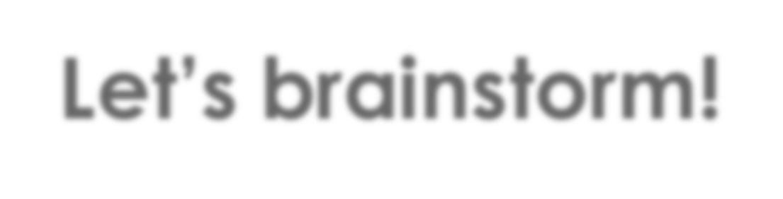
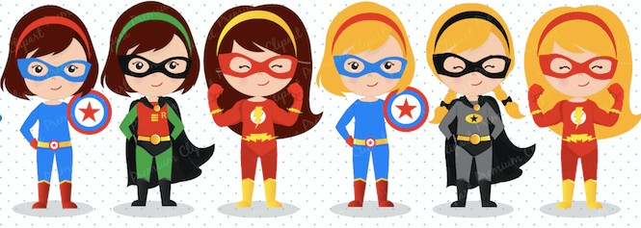
Let’s brainstorm!
Can you list 5 different superheros?

Slide 15
Let’s brainstorm!
Can you list 5 different super powers?

Slide 16

Let’s brainstorm!
Can you remember 5 feelings from earlier today?

Slide 17
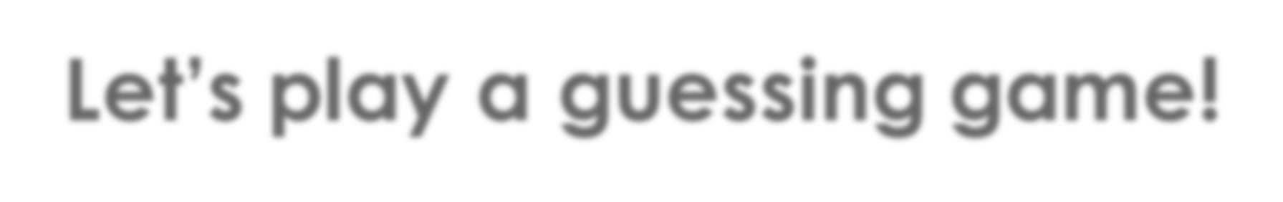
Let’s play a guessing game!
Write down 5 items in one category!
Read your list and see if your classmates can guess the category.

Slide 18
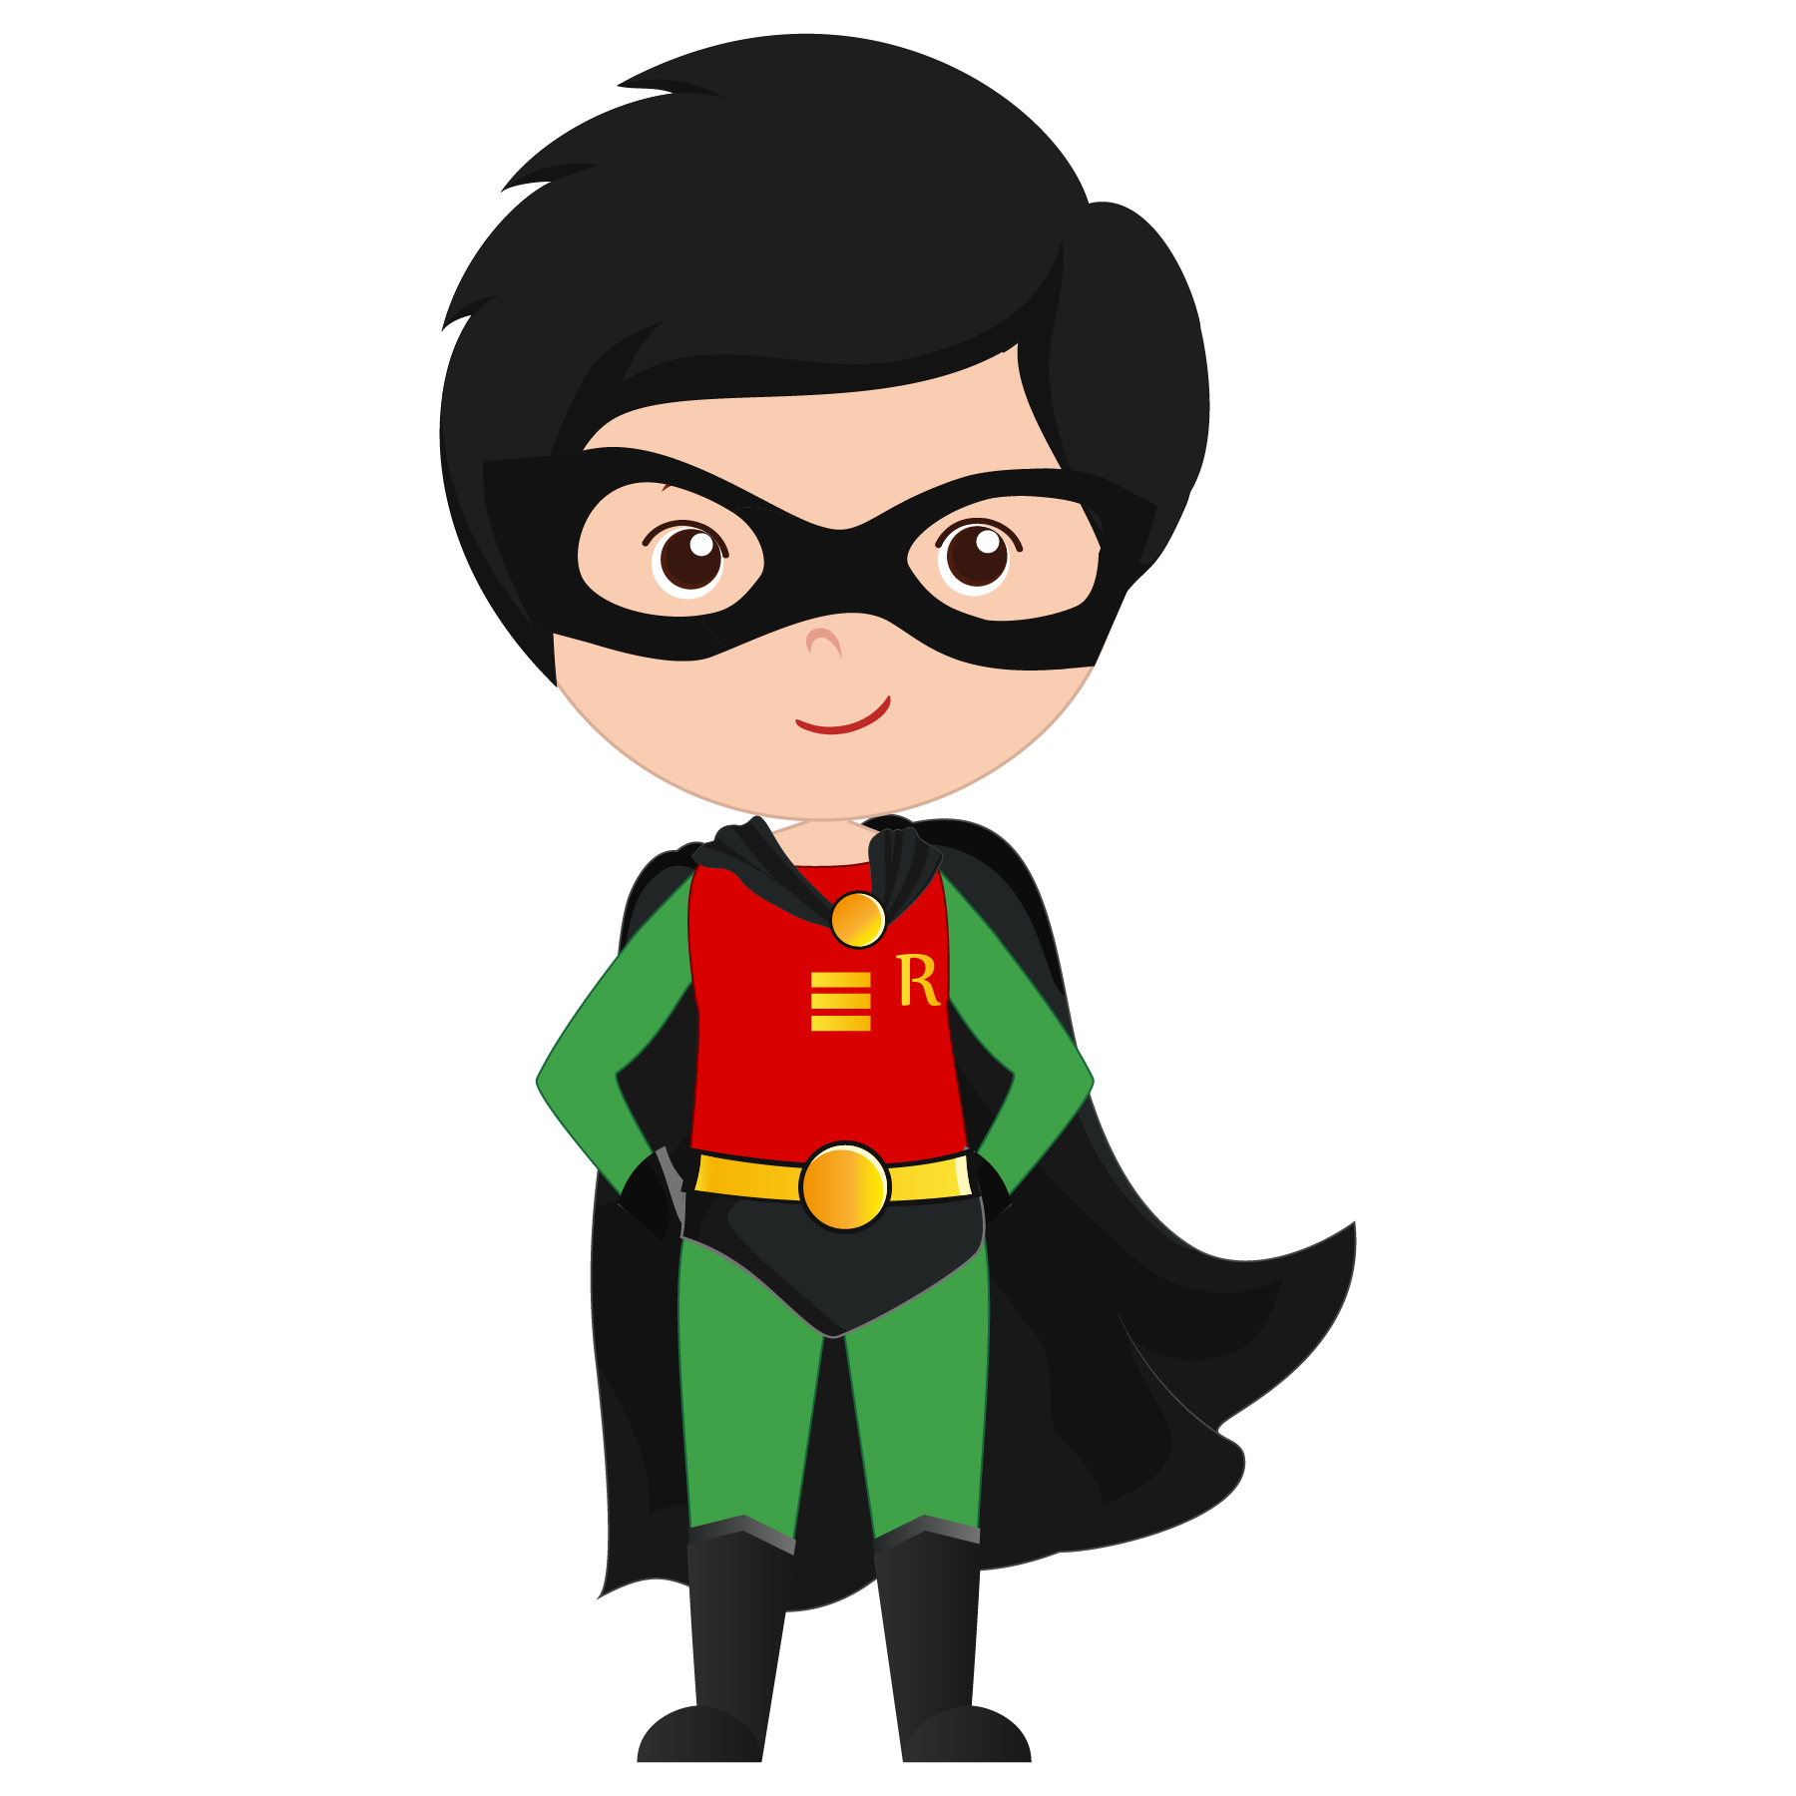
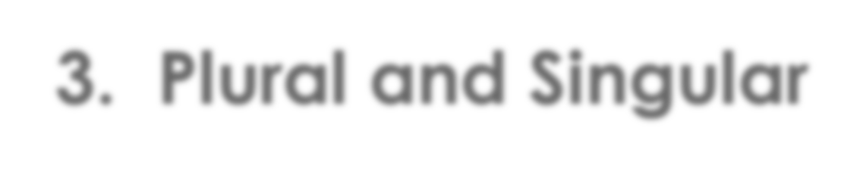
3. Plural and Singular

Slide 19
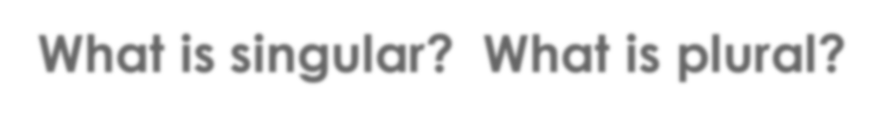

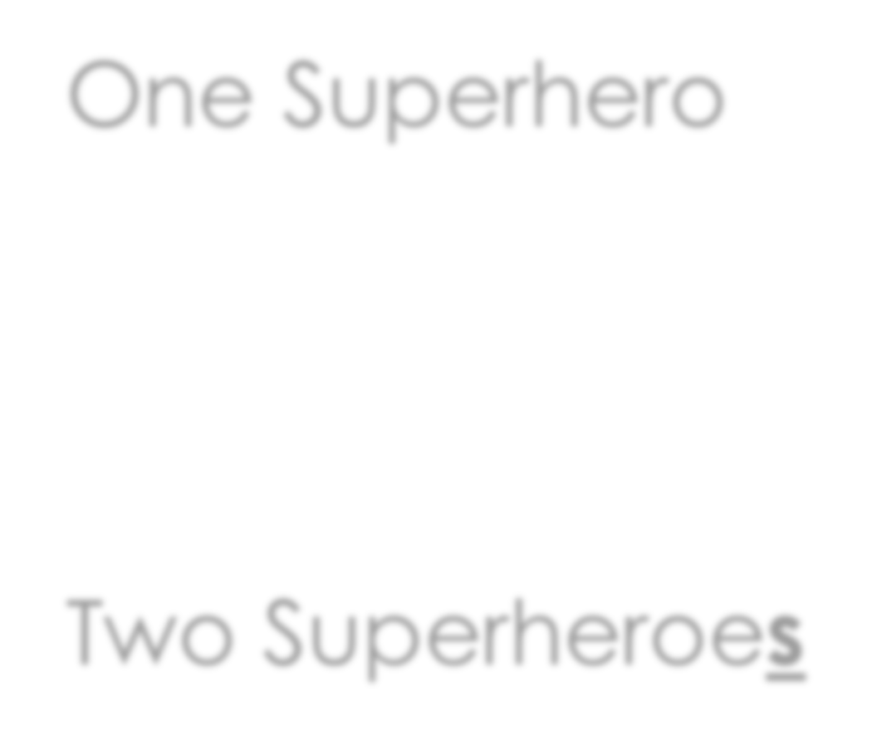
What is singular? What is plural?
One Superhero
Two Superheroes

Slide 20
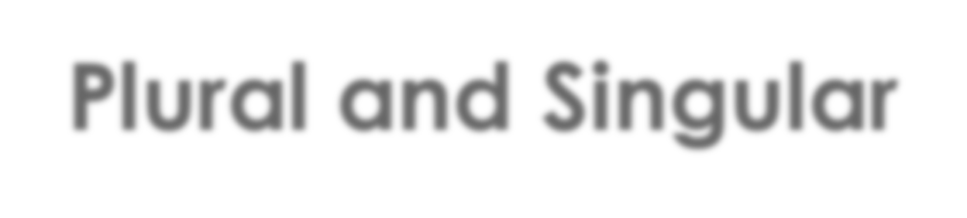
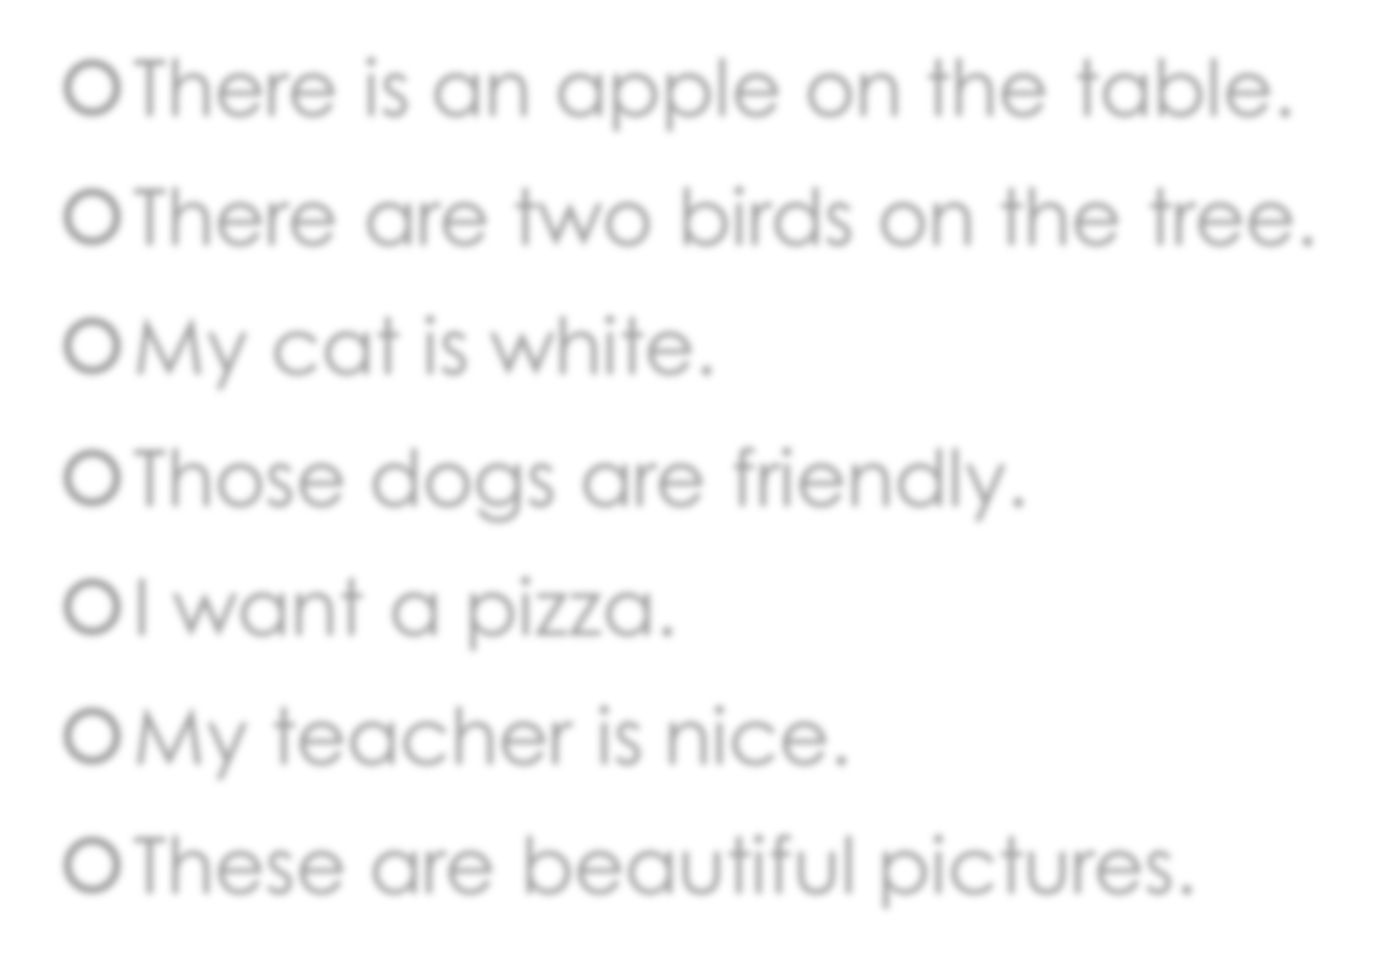
Plural and Singular
There is an apple on the table.
There are two birds on the tree.
My cat is white.
Those dogs are friendly.
I want a pizza.
My teacher is nice.
These are beautiful pictures.
Can you underline the plural words?
Can you draw a circle around the singular words?

Slide 21
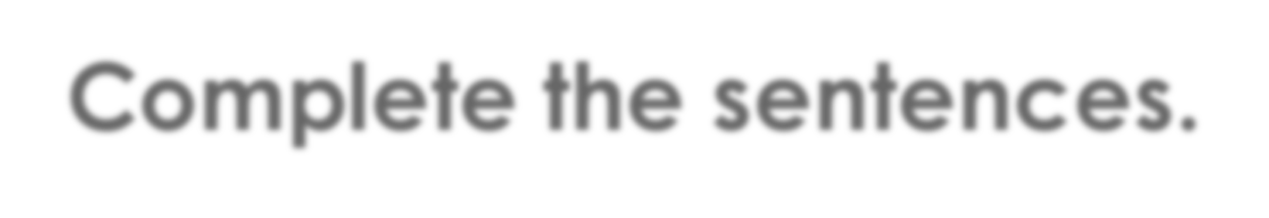
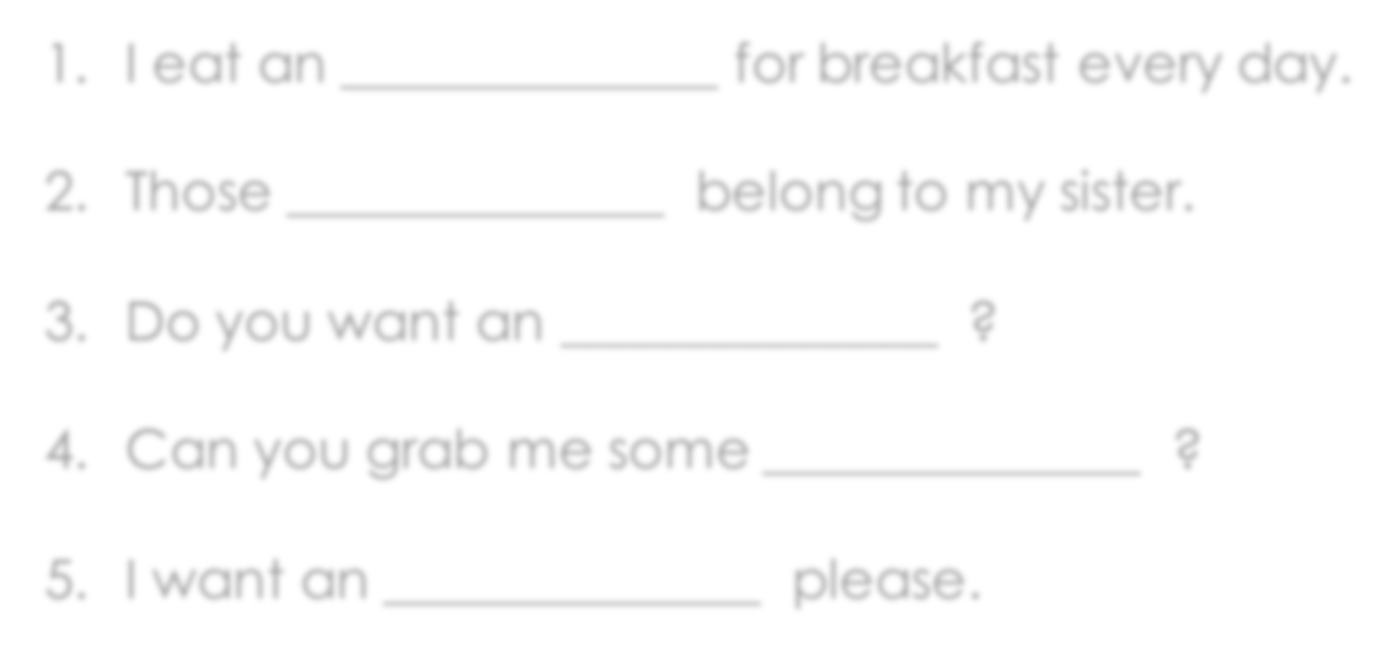

Complete the sentences.
apple or apples
1. I eat an for breakfast every day.
Those belong to my sister.
Do you want an ?
Can you grab me some ?
I want an please.

Slide 22





What did I learn today?

Slide 23




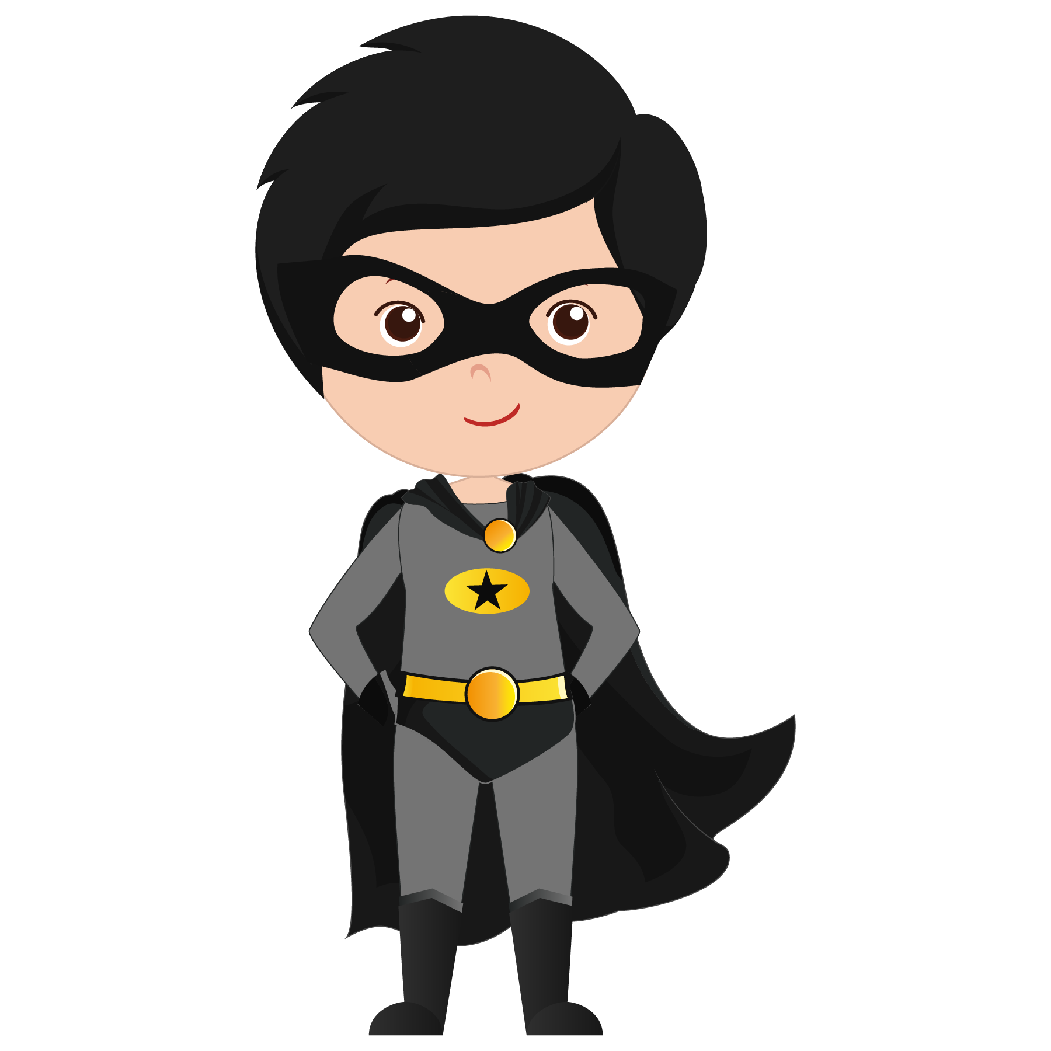
Let’s review

Slide 24
Let’s review

Slide 25

Let’s review

Slide 26


Let’s review

Slide 27
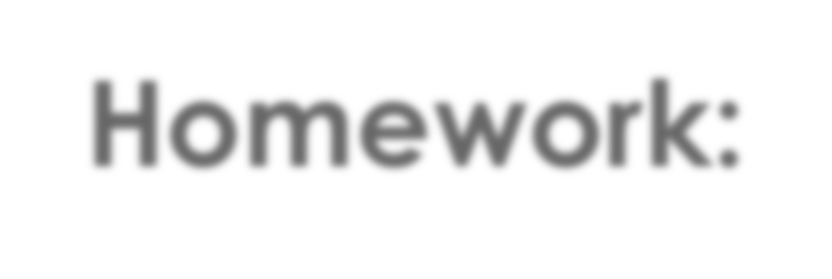
Homework:
Use the list of superpowers we brainstormed earlier. What superpower is the best? Why? Write 5 sentences.

