Slide 1






Superheroes: Lesson 7

Slide 2


Homework:
Write about your favourite memory with a relative. What did you do together?
Write 5 sentences.

Slide 3





What do superheroes like to do?

Slide 4


Can you show these actions?

Slide 5




Slide 6



What will I be learning today?

Slide 7



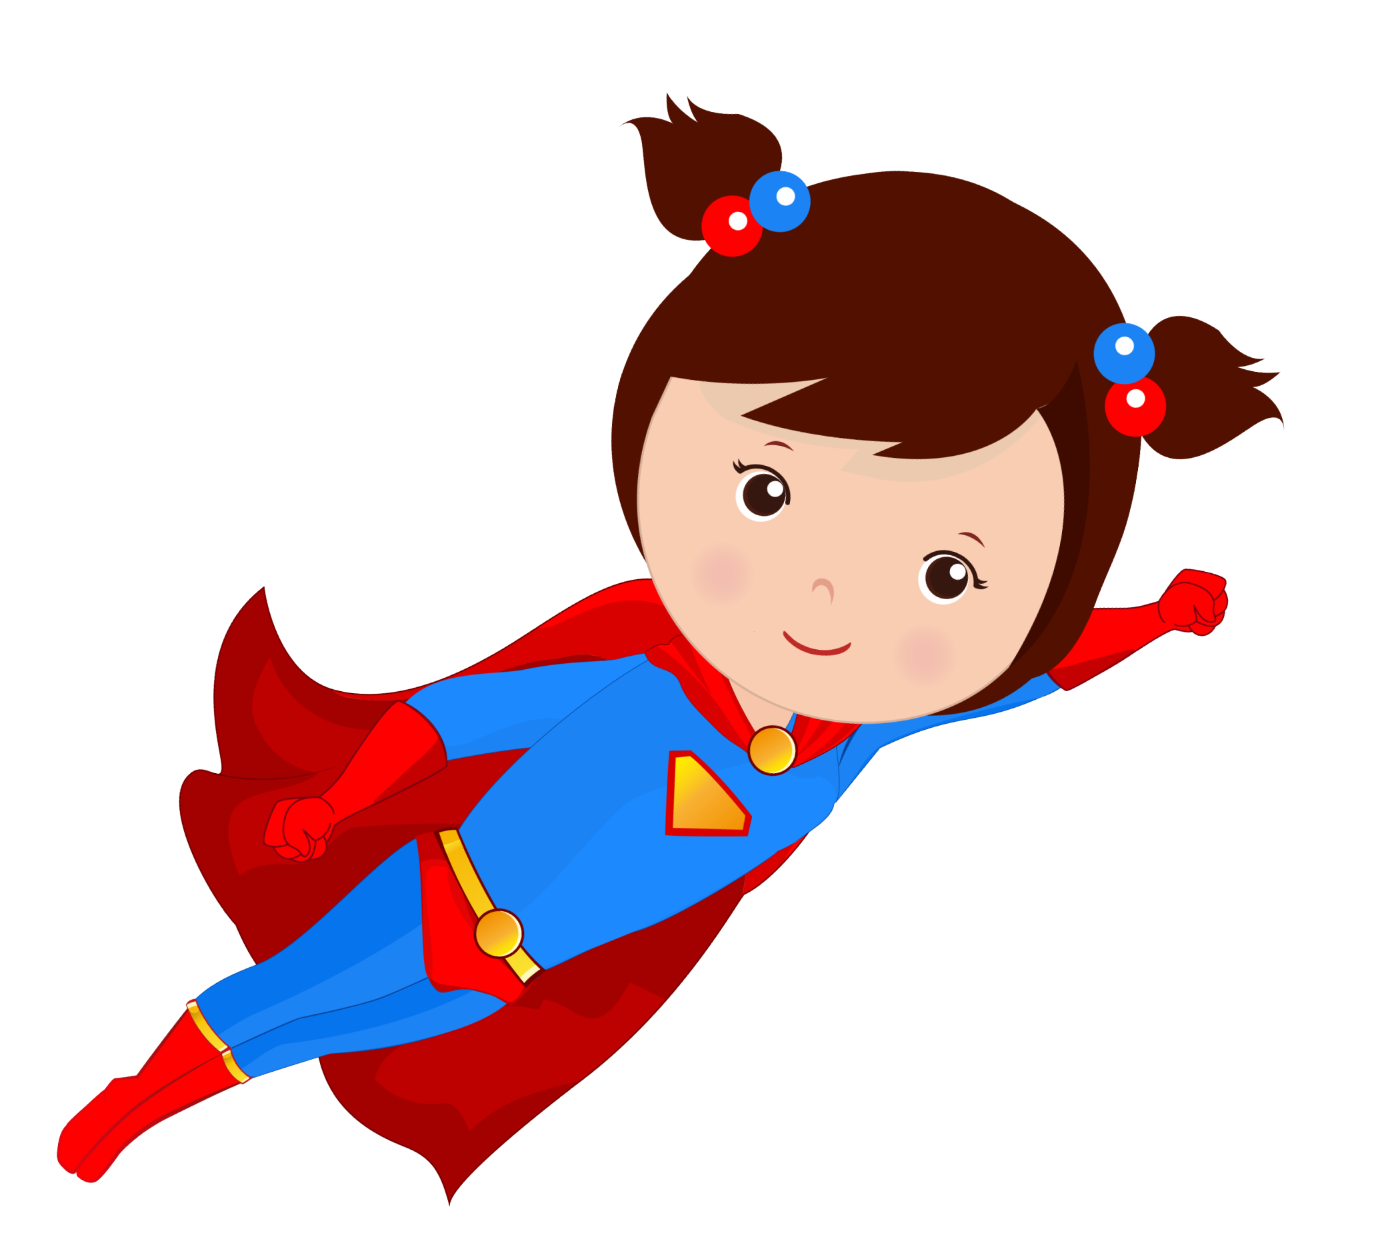

2. Let’s think about
phonics!
A

Slide 8





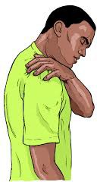


can
cane pan pain back bake man mane

Slide 9

Look at this picture for one minute…

Slide 10

How many words do you still remember?

Slide 11

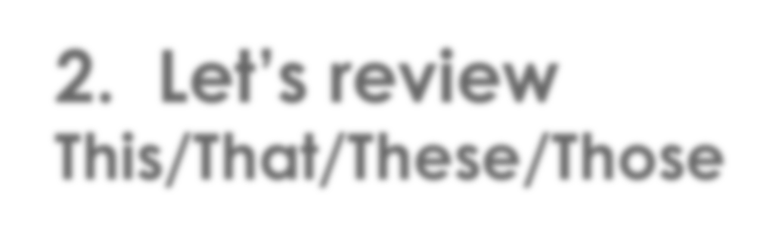
2. Let’s review
This/That/These/Those

Slide 12


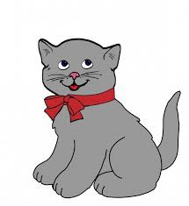
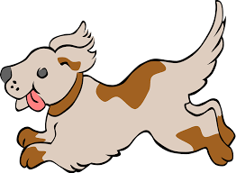
This / That / These / Those
This This is my dog.
These These are my dogs.
That That is my cat.
Those Those are my cats.

Slide 13
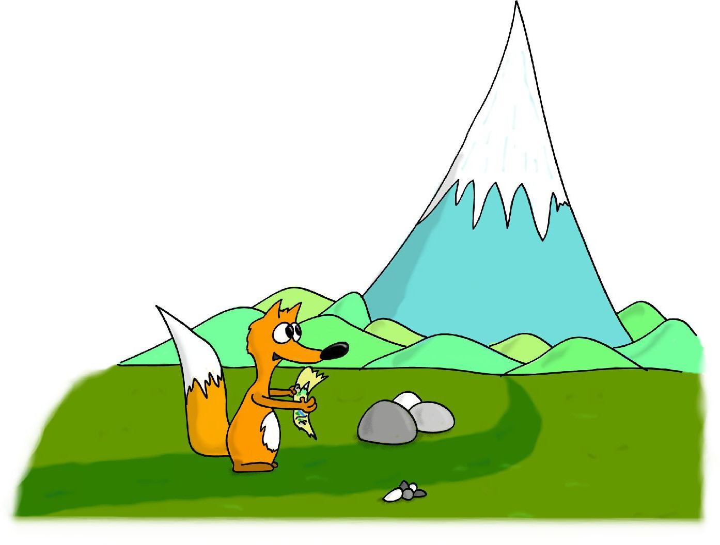
Hero of the Mountain
www.BubuTales.com

Slide 14
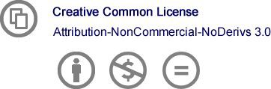
This ebook is distributed under Creative Common License 3.0
http://creativecommons.org/licenses/by-nc-nd/3.0/
You are free to copy, distribute and transmit this work under the following conditions:
You must attribute the work in the manner specified by the author or licensor (but not in any way that suggests that they endorse you or your use of the work)
You may not use this work for commercial purposes
You may not alter, transform, or build upon this work
Ivan Parvov, Hero of the Mountain Copyright © 2010 by Ivan Parvov Text and illustrations by Ivan Parvov www.BubuTales.com

Slide 15
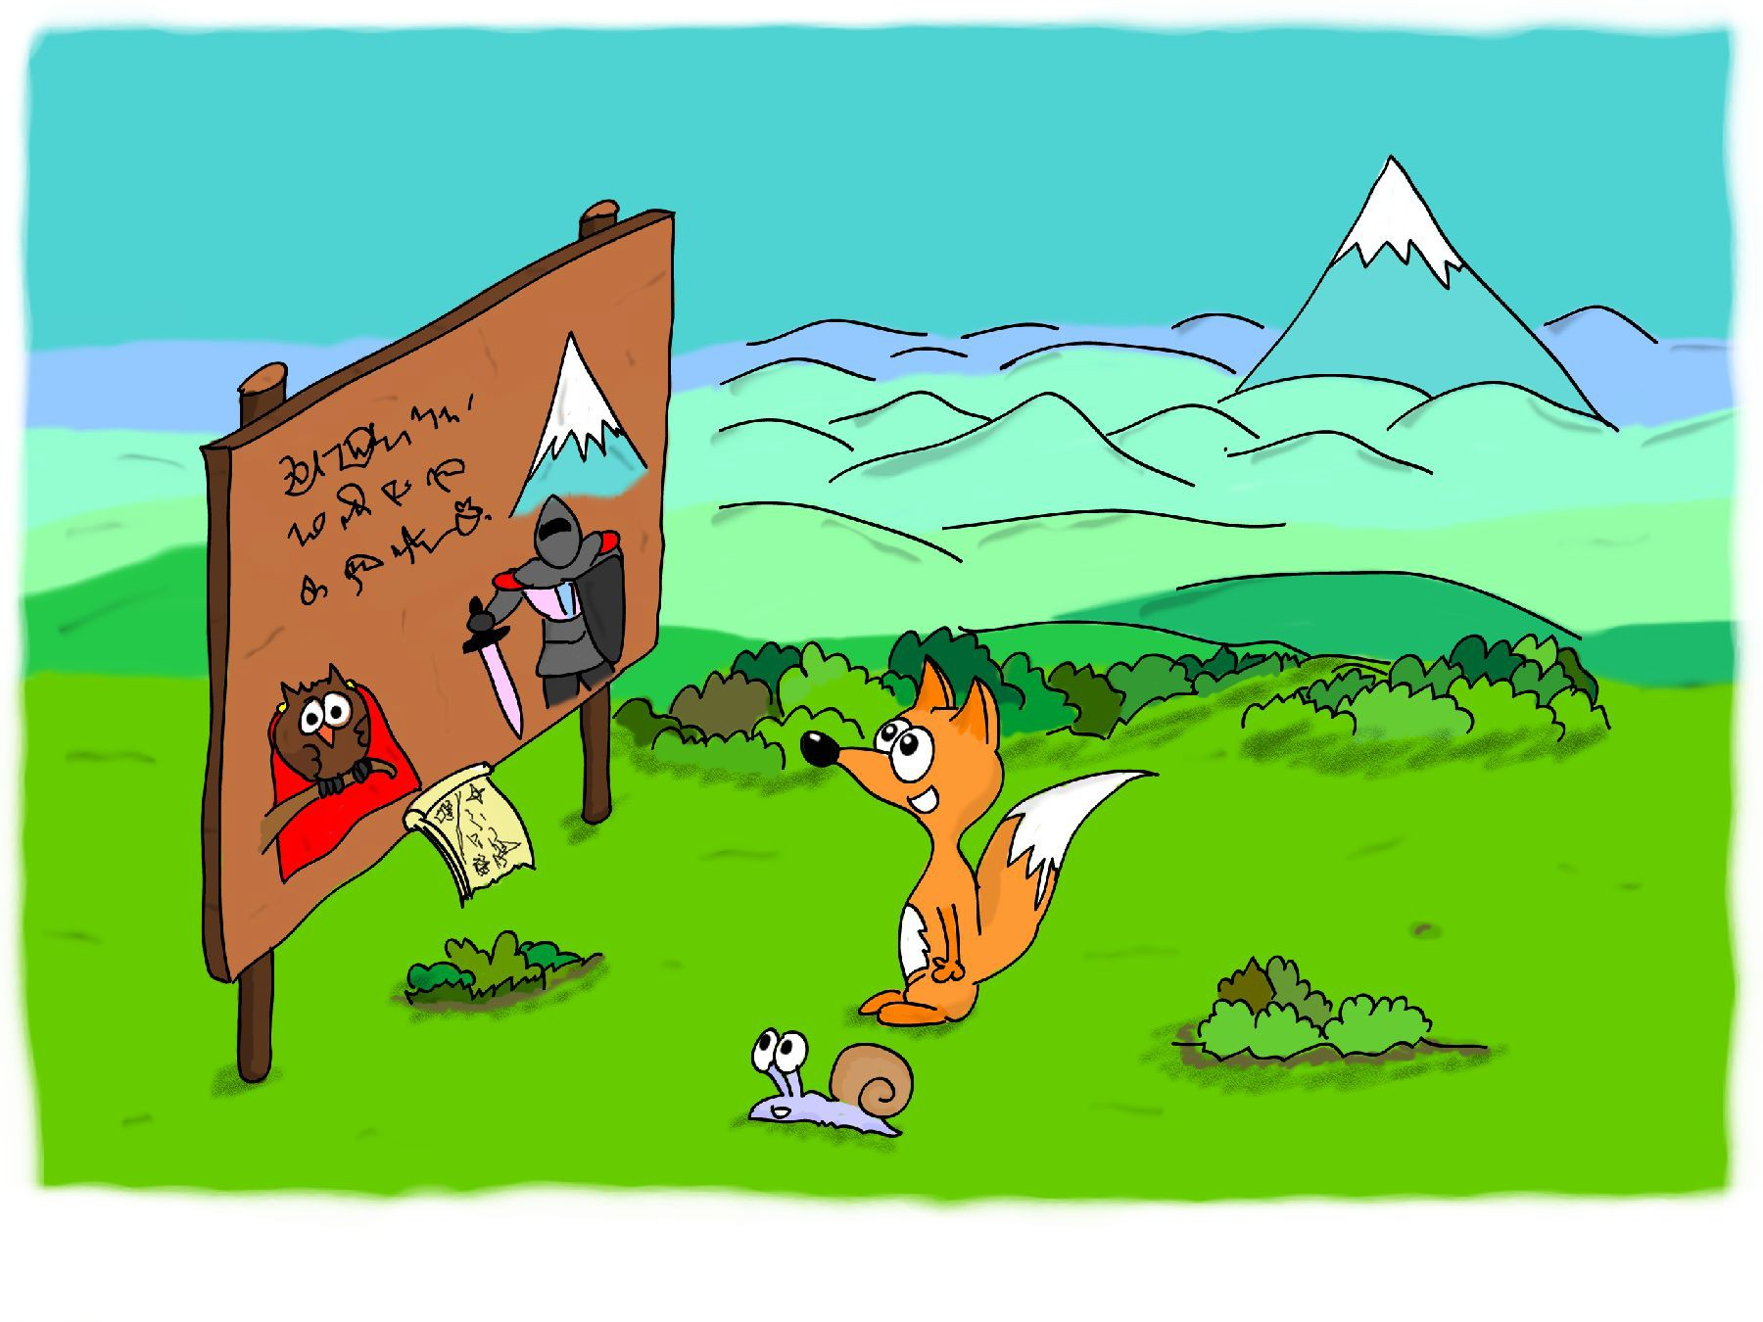
The little fox Bubu was very excited. The big contest “Hero of the Mountain” was going to take place the next day. The bravest and most powerful animals and people were going to take part in it.

Slide 16
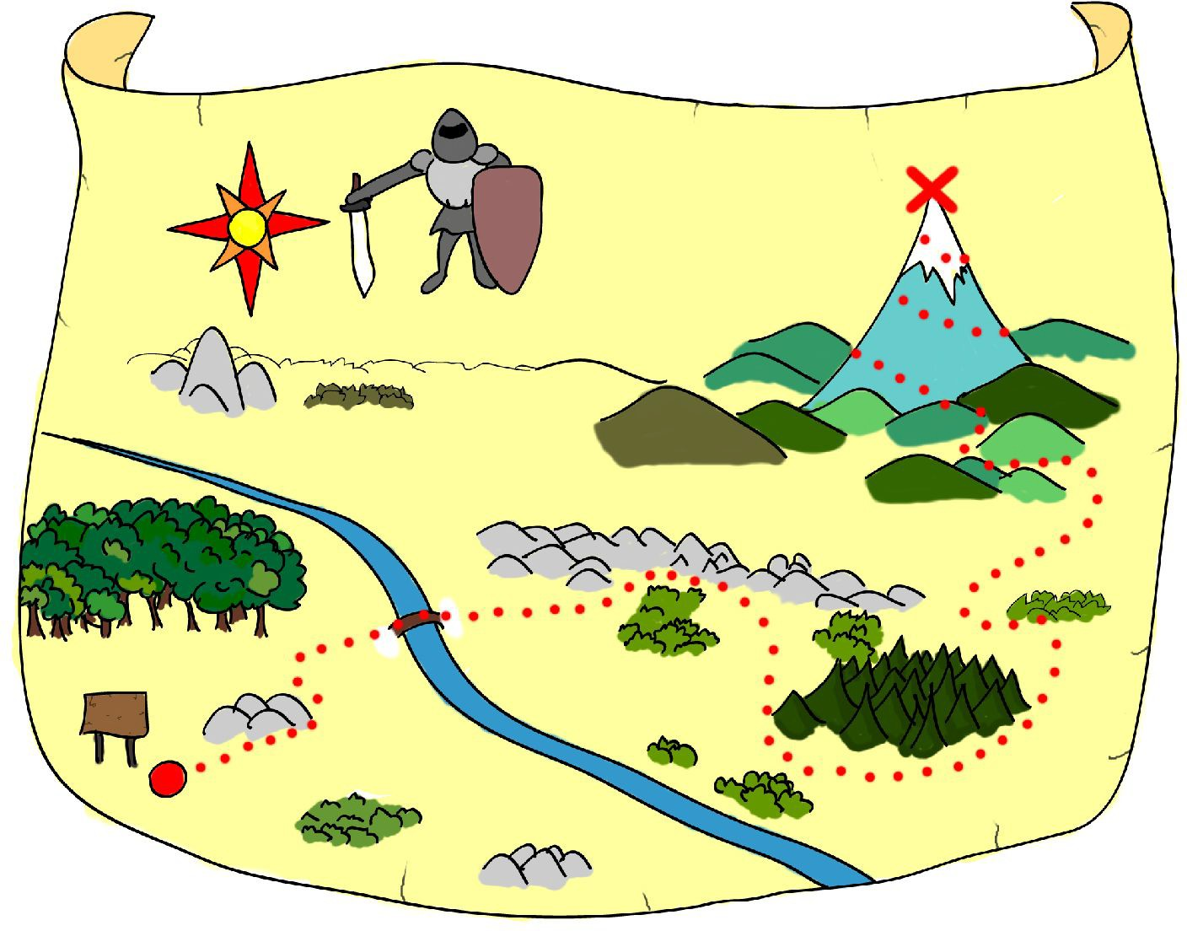
Bubu wanted to see the contest and meet the most famous heroes in the world. He carefully studied the map. The contest would take place high on the mountain, on the grounds of the owl- magician, Boran. Bubu was going to have a long trip the next day . . .

Slide 17
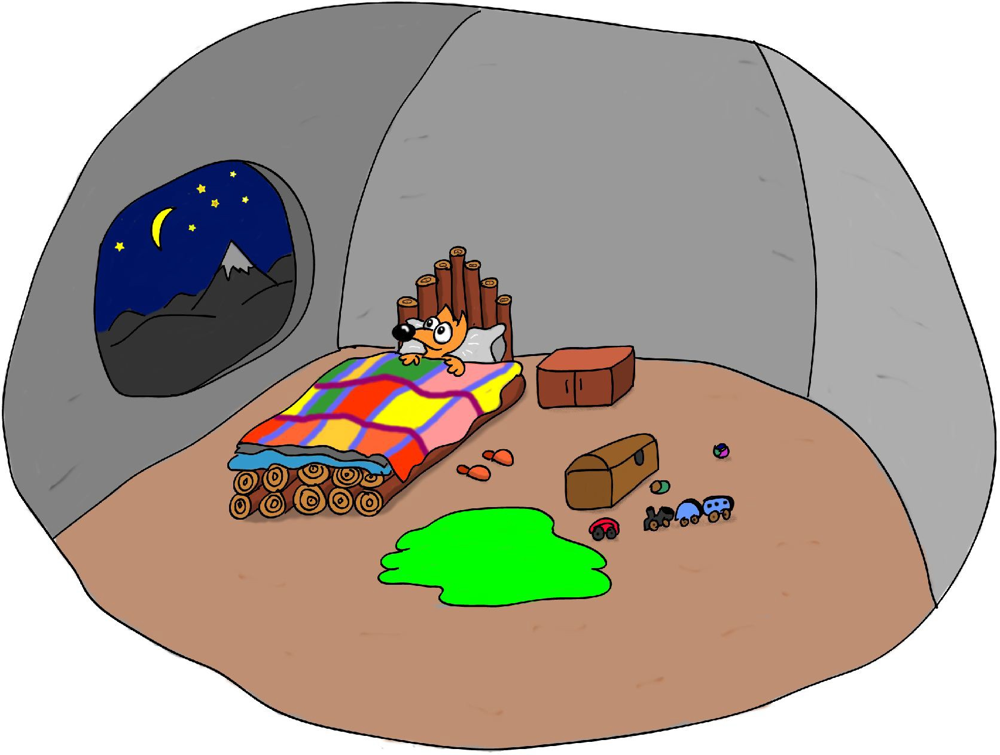
That evening, Bubu could not fall asleep till late at night. He was looking at the distant peak, dreaming about the contest. He was eager for the morning to come.

Slide 18
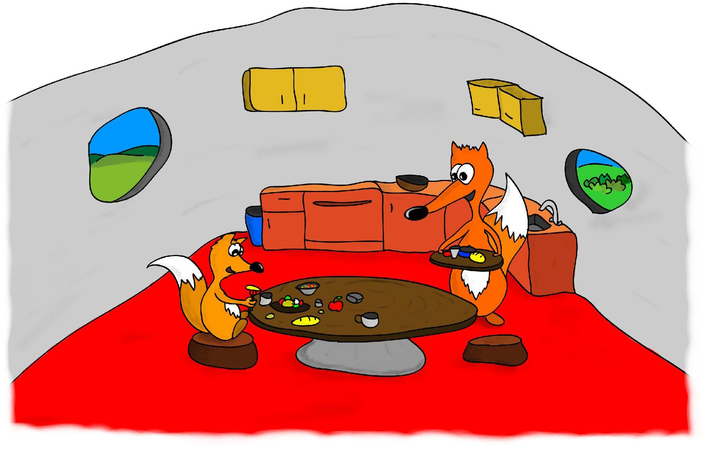
In the morning he woke up early, brushed his teeth and ate his breakfast quickly. He had a long way to go, so he had a good meal. The breakfast, prepared by his mom, was very delicious.

Slide 19
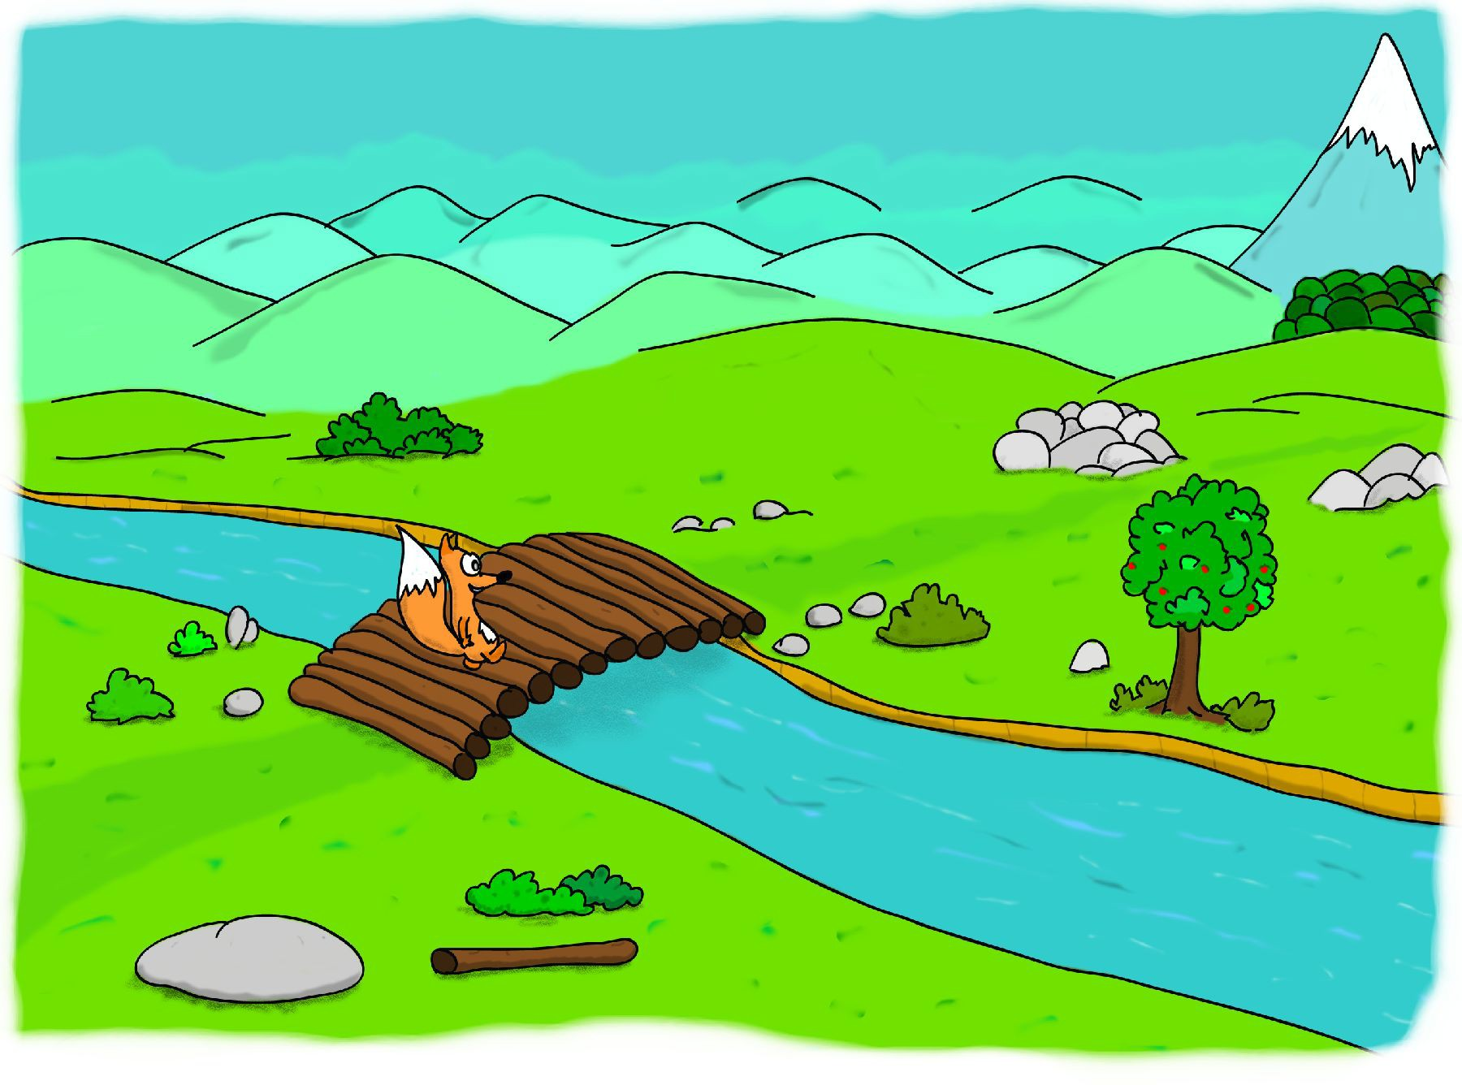
Bubu promised his mom he would be careful and come back before dark, and then he hurried to the mountain. He passed the meadows, walked around the rocky hills, and suddenly, while crossing the river, he heard someone screaming for help . . .

Slide 20
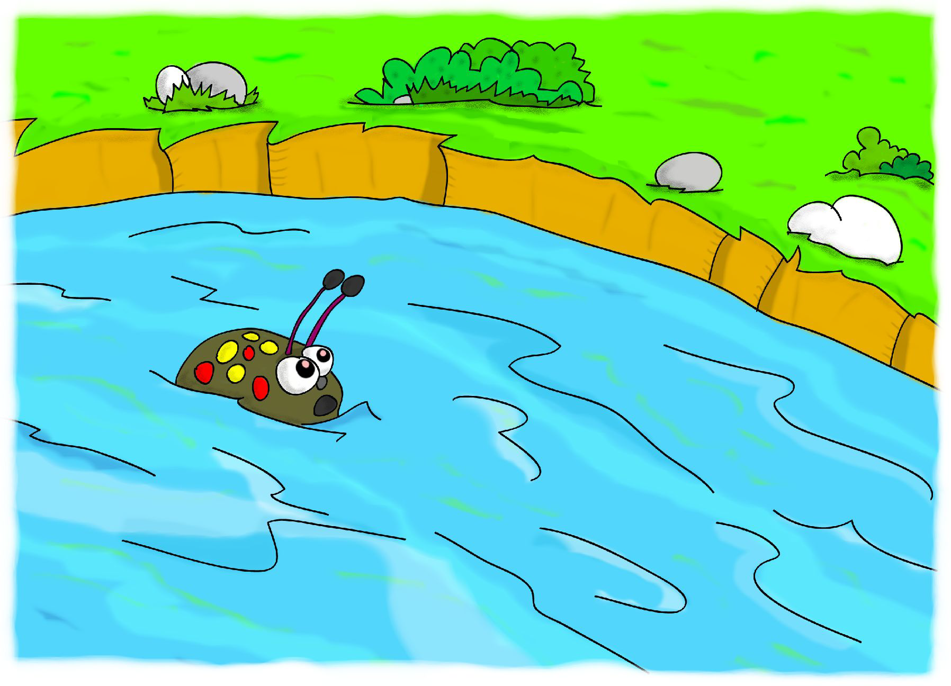
Bubu looked around and saw a beetle, who had fallen into the river. The slope of the bank was too steep for the little beetle—he couldn’t get out of the river!—and he was waving its legs and antennae in panic.

Slide 21
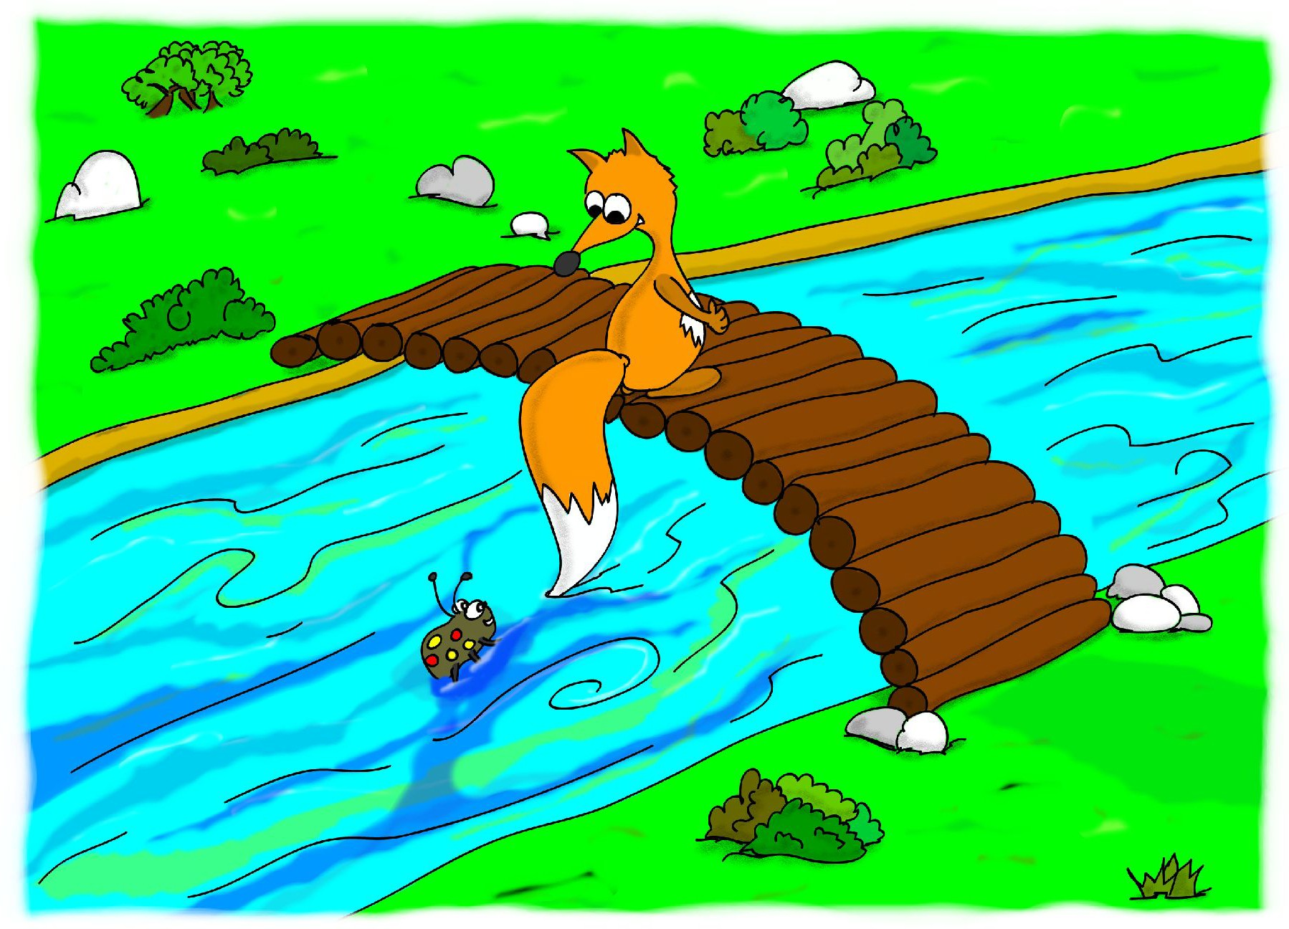
Bubu looked around for a float or a stick, but he could not find anything useful. As time was pressing, Bubu sank his tail into the icy water and cried out to the beetle to grab it.

Slide 22
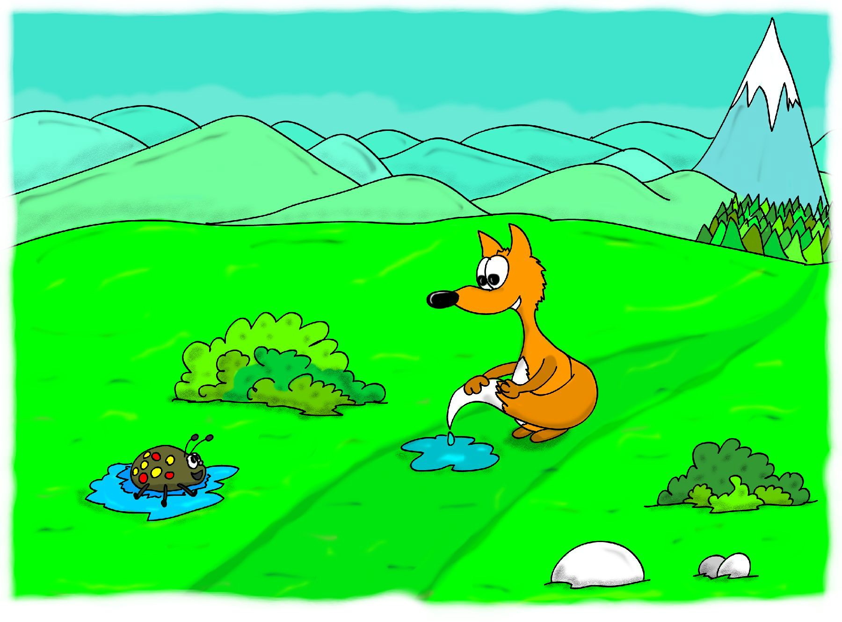
In a little while the beetle was lying on the grass, drying off in the sun—exhausted but very happy for being rescued. Bubu was tired as well, but he had no time for rest. He squeezed his tail, which had become heavy with water, and hurried on to the contest.

Slide 23
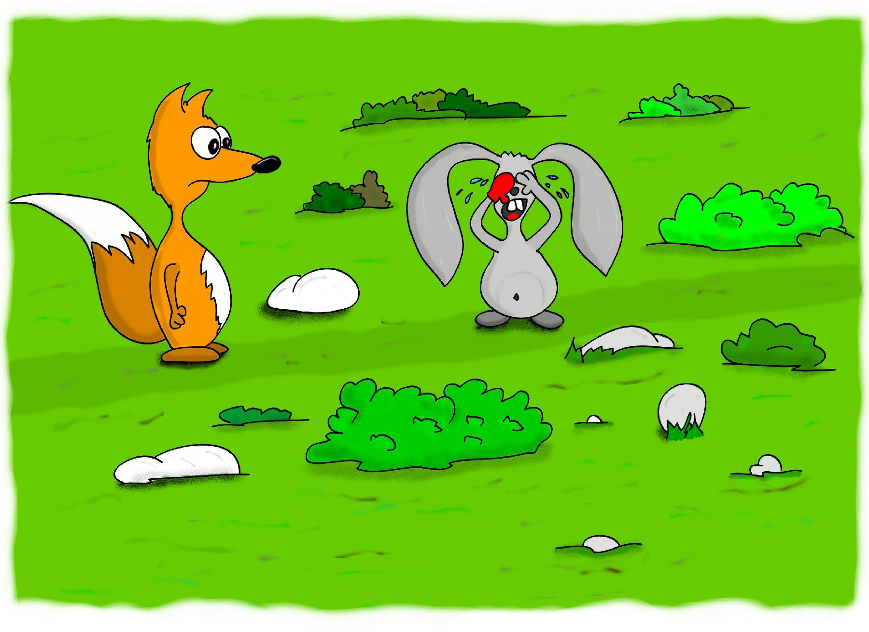
Soon he saw ahead a little bunny, crying sadly. It had lost one of its gloves and did not know how to find it.

Slide 24
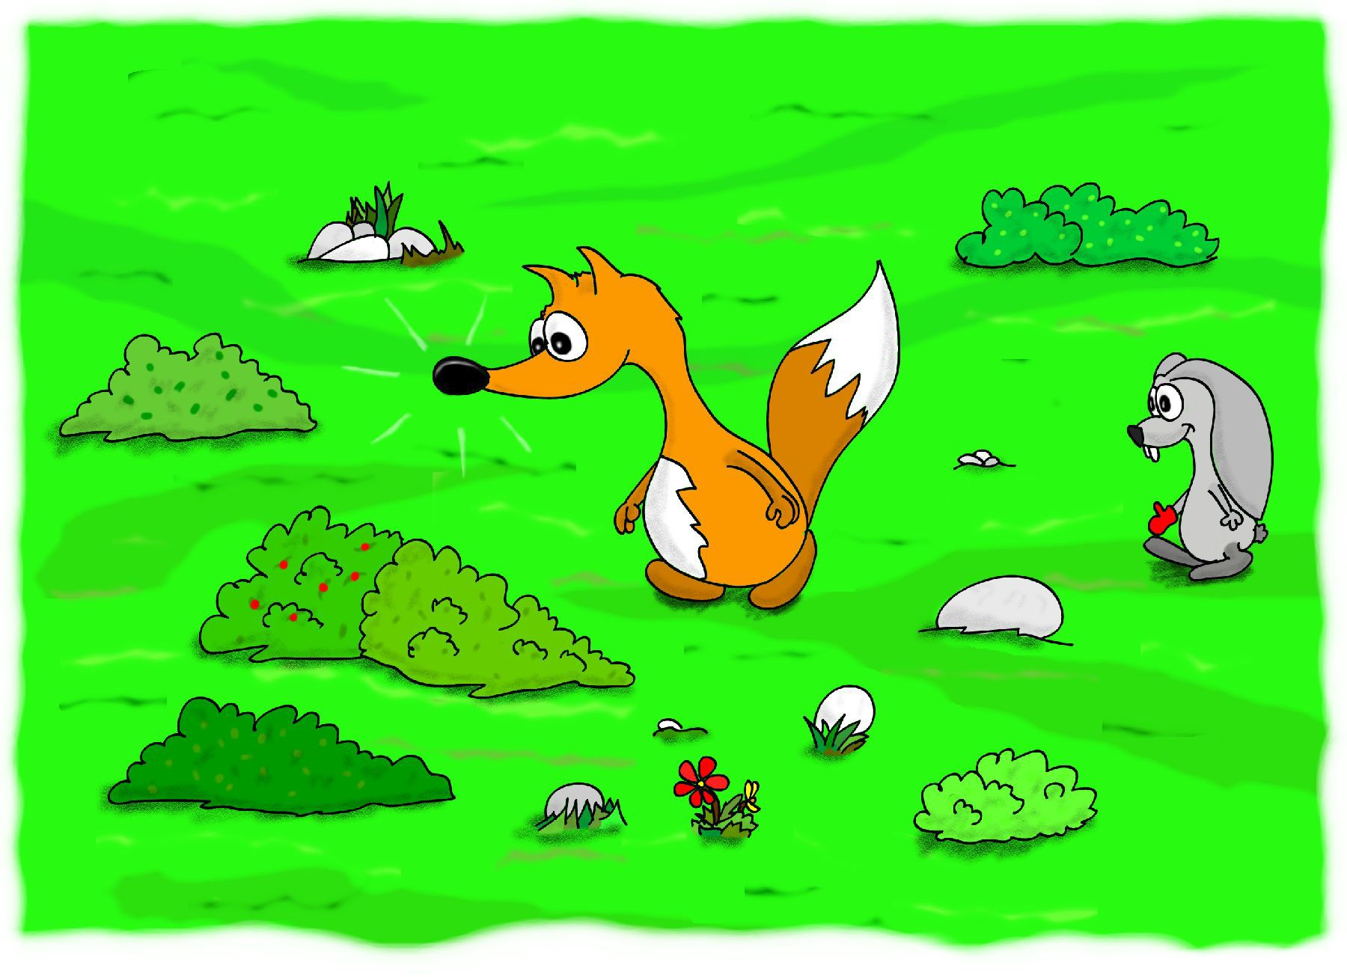
Bubu was in a hurry to get to the contest, but he decided to help the bunny. He lowered his big sensitive nose to the ground and began sniffing, searching for the bunny’s glove. The bunny followed him with hope.

Slide 25
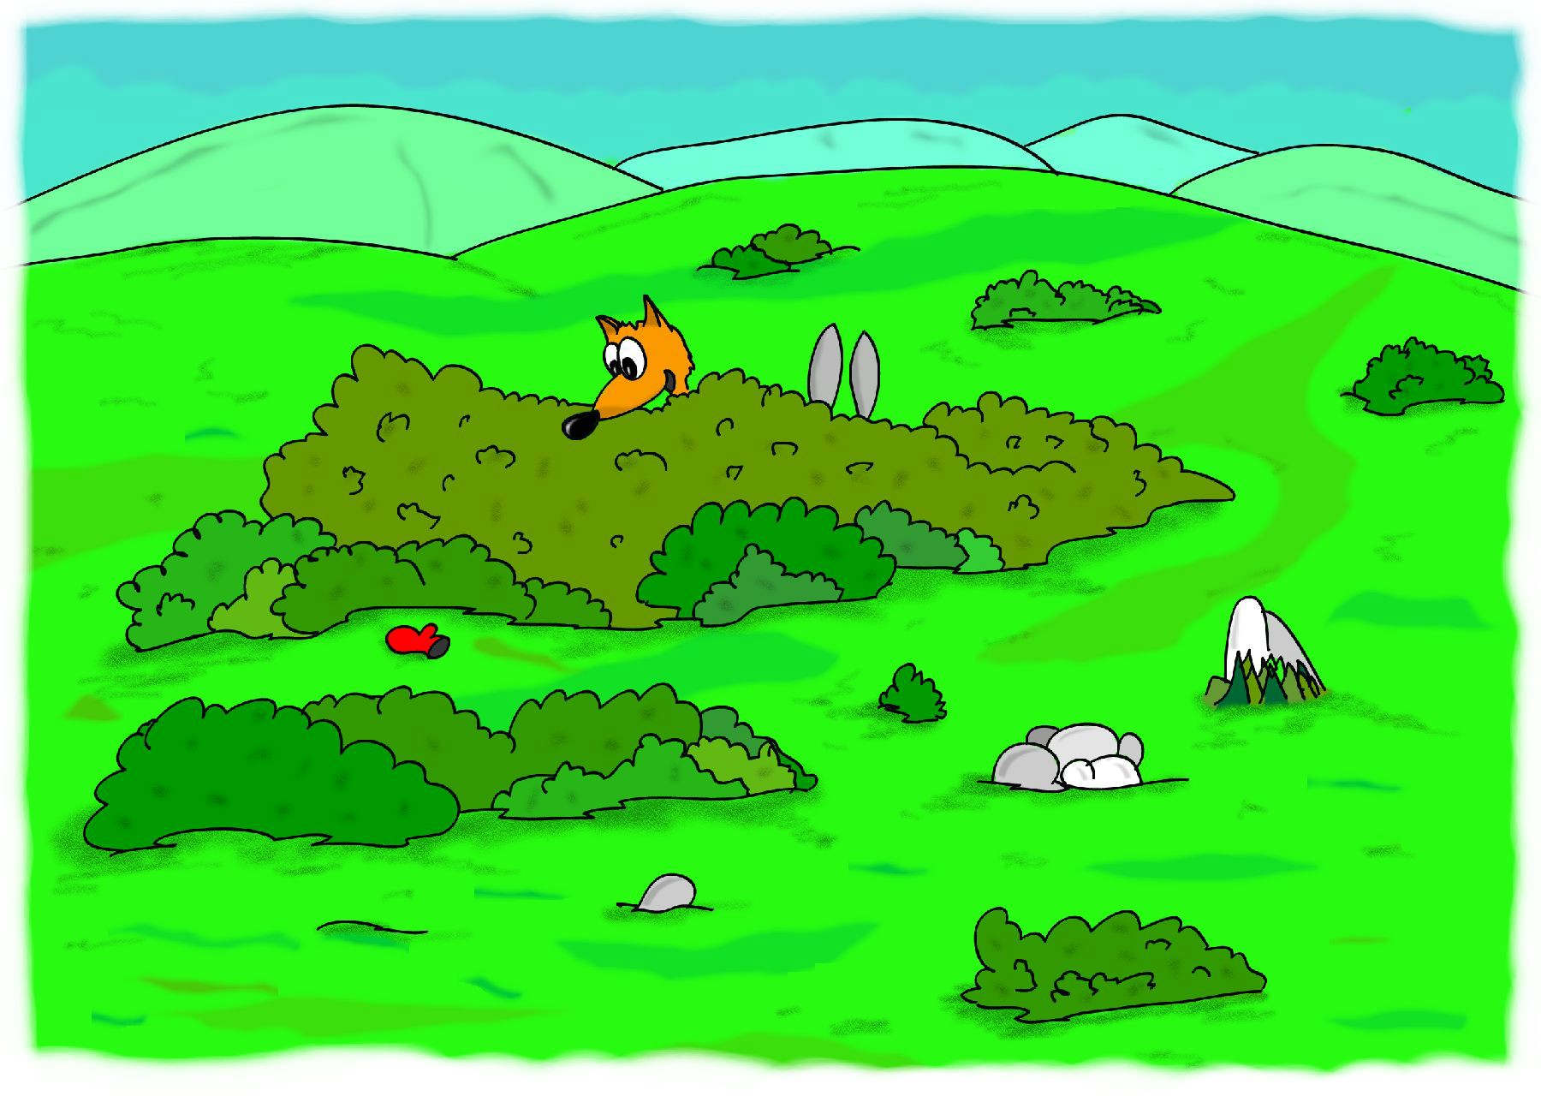
In a little while Bubu found the glove, fallen aside the path. Nothing can hide from a fox’s nose. The bunny was very happy and, grinning widely, hopped home with its gloves on. Bubu hurried to the mountain.

Slide 26
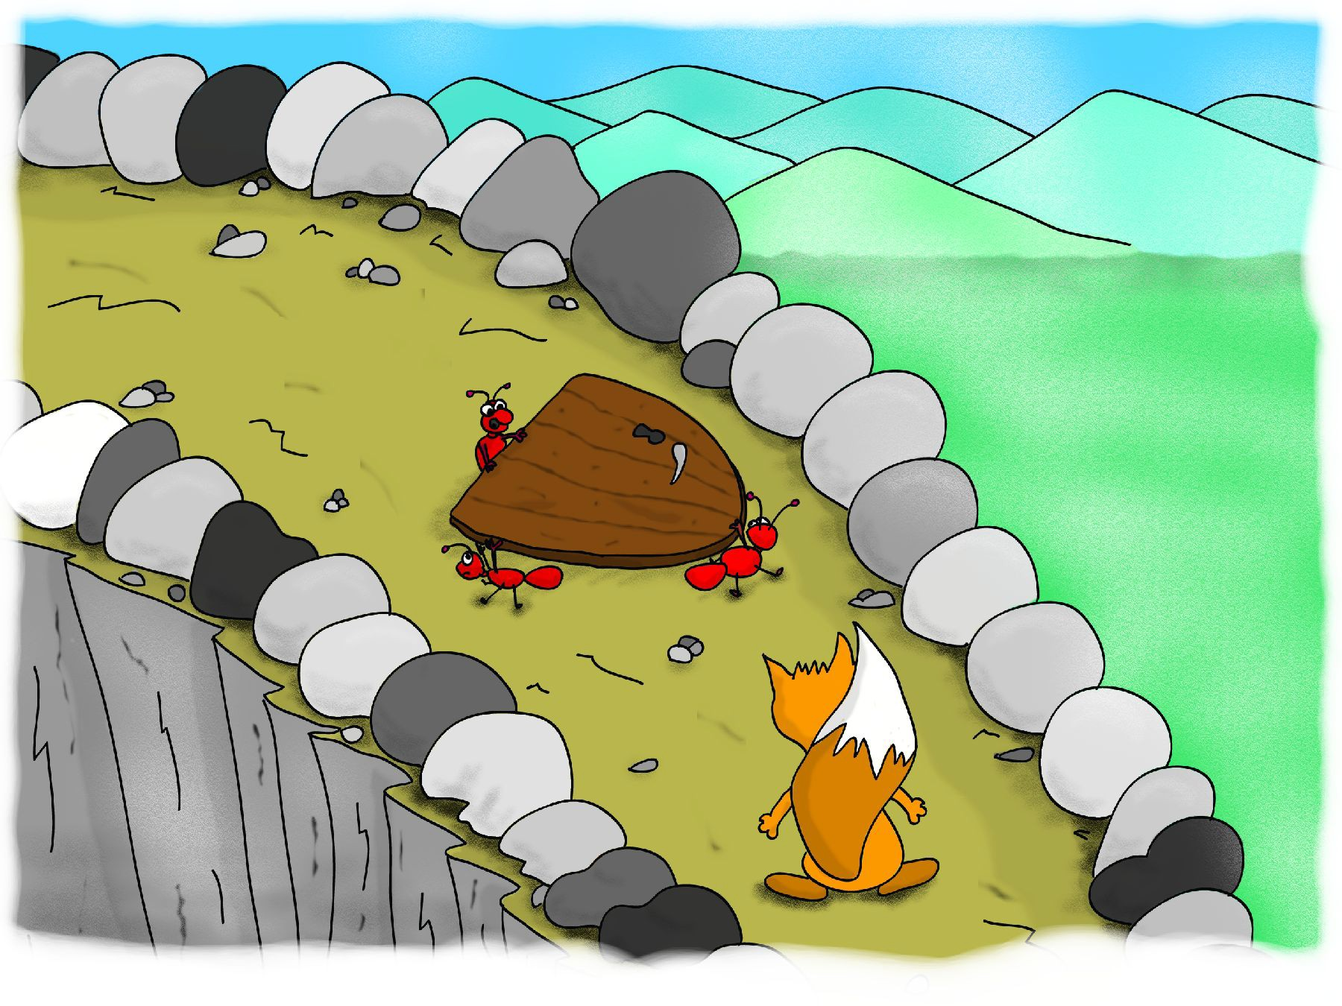
While climbing the steep mountain path, Bubu met three firemen-ants carrying a new door for the ants’ observation post located high on the mountain—the ants looked for forest fires from there.
The door was too heavy and the three ants gasped for breath.

Slide 27
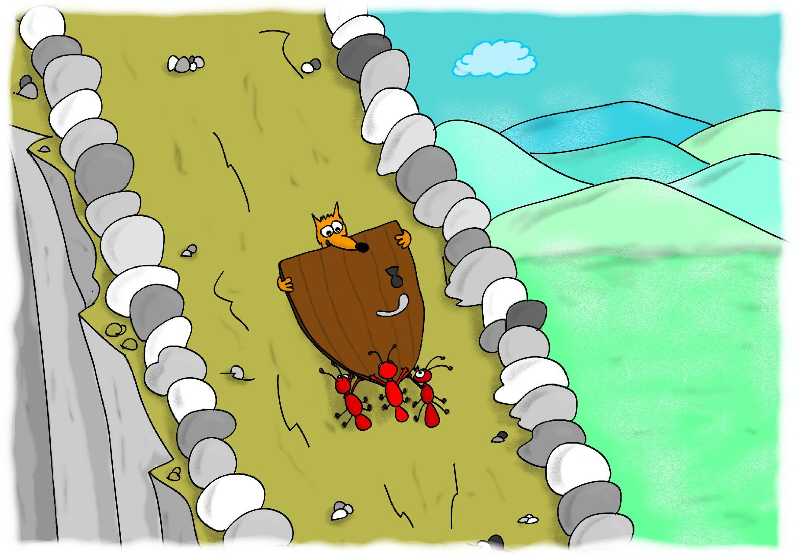
Bubu decided to help them, though he was already late for the contest. He took the heavy door and, together with the ants, carried it up the mountain.

Slide 28
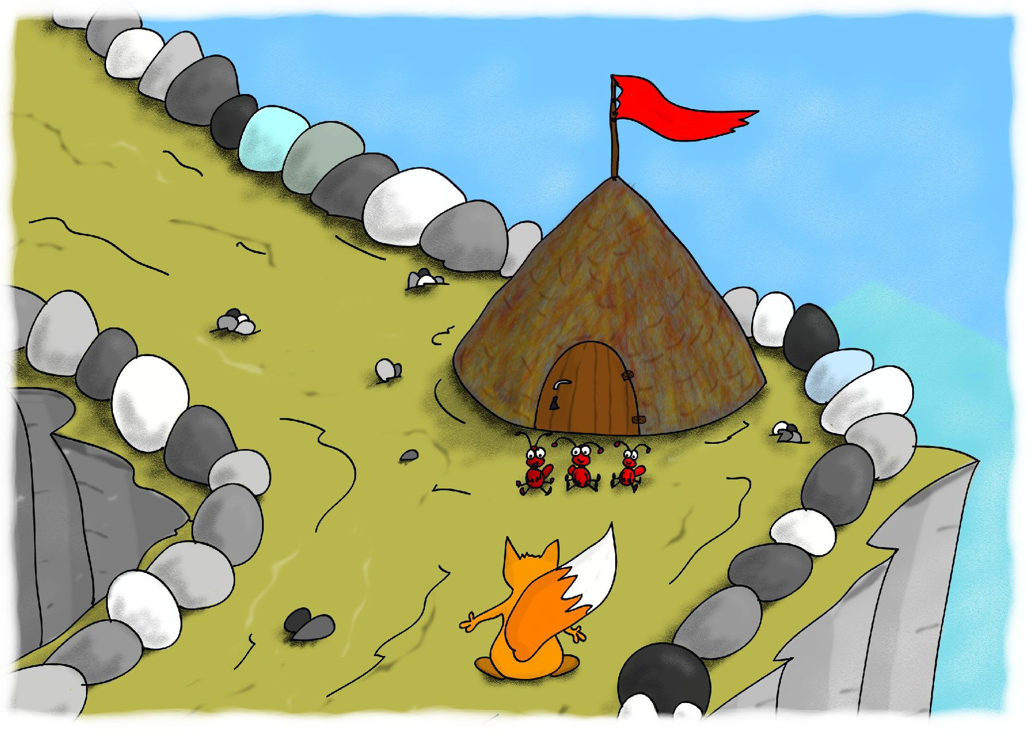
Finally they reached the observation post of the firemen-ants and managed, together, to fix the door in its right place. The ants sat on the ground, tired and satisfied. Bubu was also tired, but there was no time for rest; he continued up the path, climbing the peak.

Slide 29
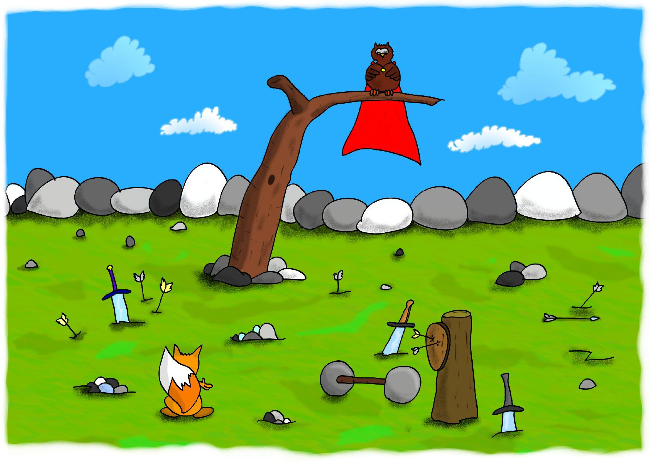
When he climbed the peak at last, the contest was over. Broken arrows, targets, and swords were spread all over the peak meadow . . . but all the heroes had gone.

Slide 30
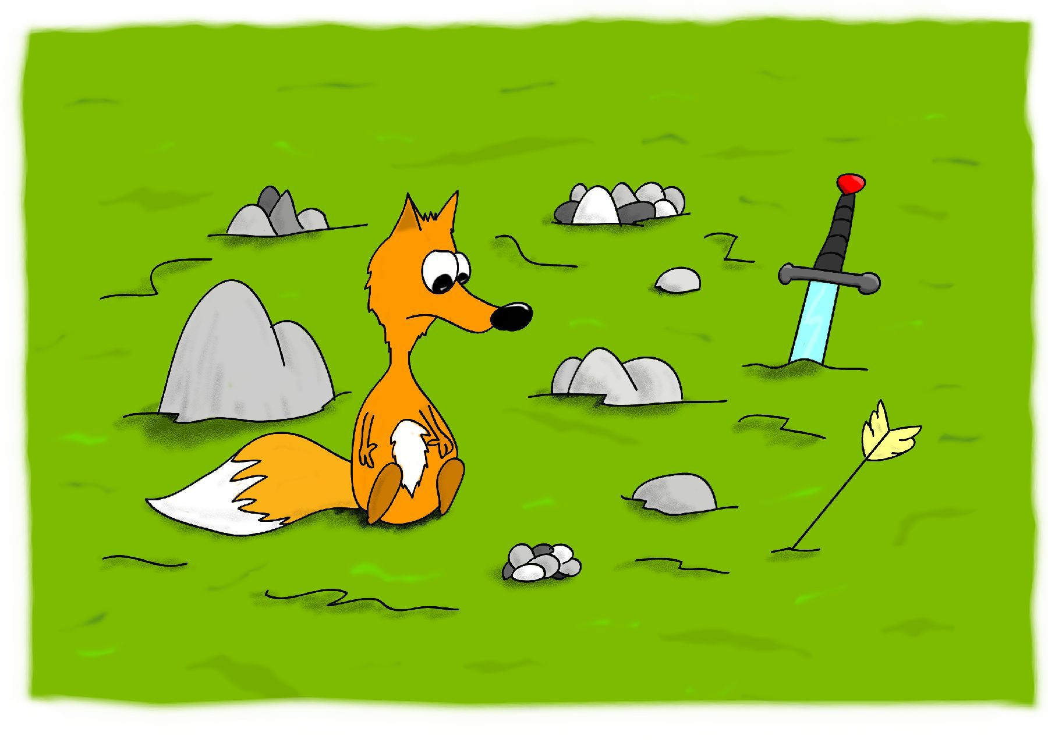
Bubu sat sadly on the ground. He so much wanted to see the contest and meet the greatest heroes in the world, but he had missed everything.

Slide 31
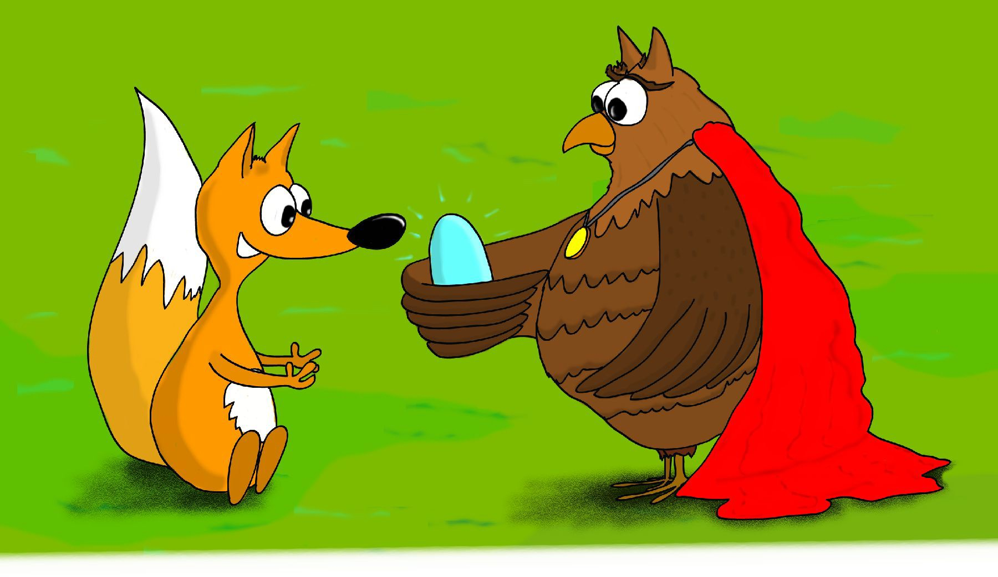
Suddenly he heard a flap of wings. He looked up and saw the owl-magician, Boran, alight before him.
“Don’t be sad, Bubu. You did not miss anything so interesting actually. Look, I have something special for you” and the owl gave Bubu a crystal. On it was inscribed: HERO OF THE MOUNTAIN”—it was the highest-honor award one could receive for the contest!
“But . . . why?” asked a very surprised Bubu. “I have not done any great heroic deed.”
“Is there a greater heroic deed than all the small deeds you have done today?” smiled Boran. “You missed the contest you so much wanted to see, to help the beetle, the bunny, and the ants. You are the real hero of the mountain.”

Slide 32
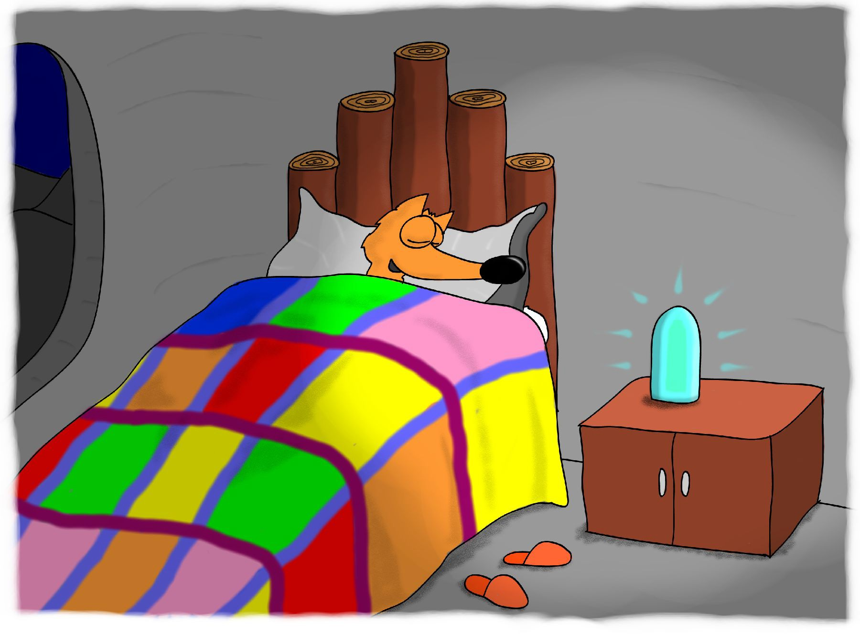
Bubu managed to make it back home before dinner and told his parents what had happened. Everybody at home was pleased and very proud of him. After dinner, Bubu went to bed tired and satisfied. He needed a good night’s sleep—may be tomorrow new great deeds and adventures were waiting for him.

Slide 33
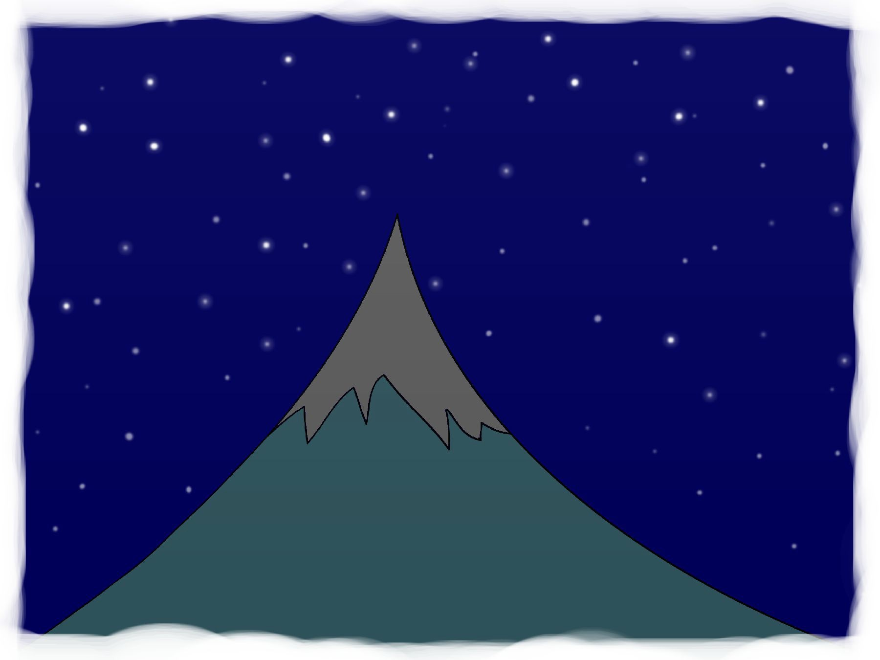
THE END
Check for more illustrated stories at www.BubuTales.com
Don't miss Bubu and his nighttime adventures in “The Best Christmas Gift”

Slide 34
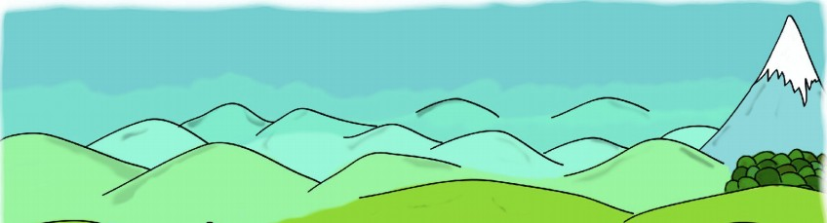
This / That / These / Those
are mountains.

Slide 35
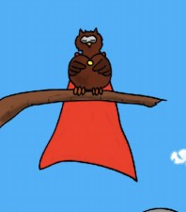
This / That / These / Those
is an owl.

Slide 36
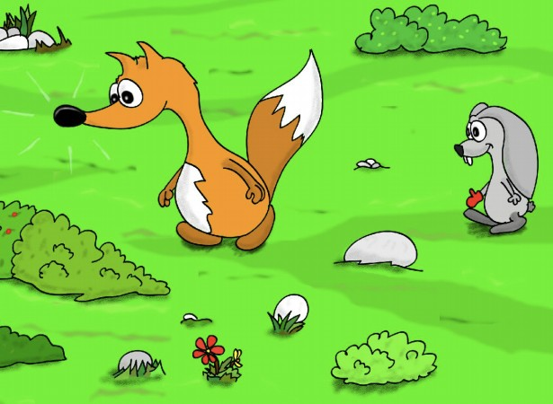
This / That / These / Those
are animals.

Slide 37
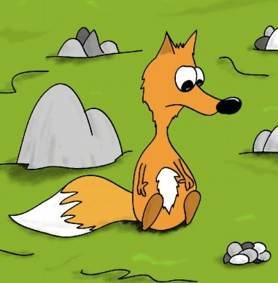
This / That / These / Those
is a fox.

Slide 38
This / That / These / Those
Let’s do some writing!

Slide 39
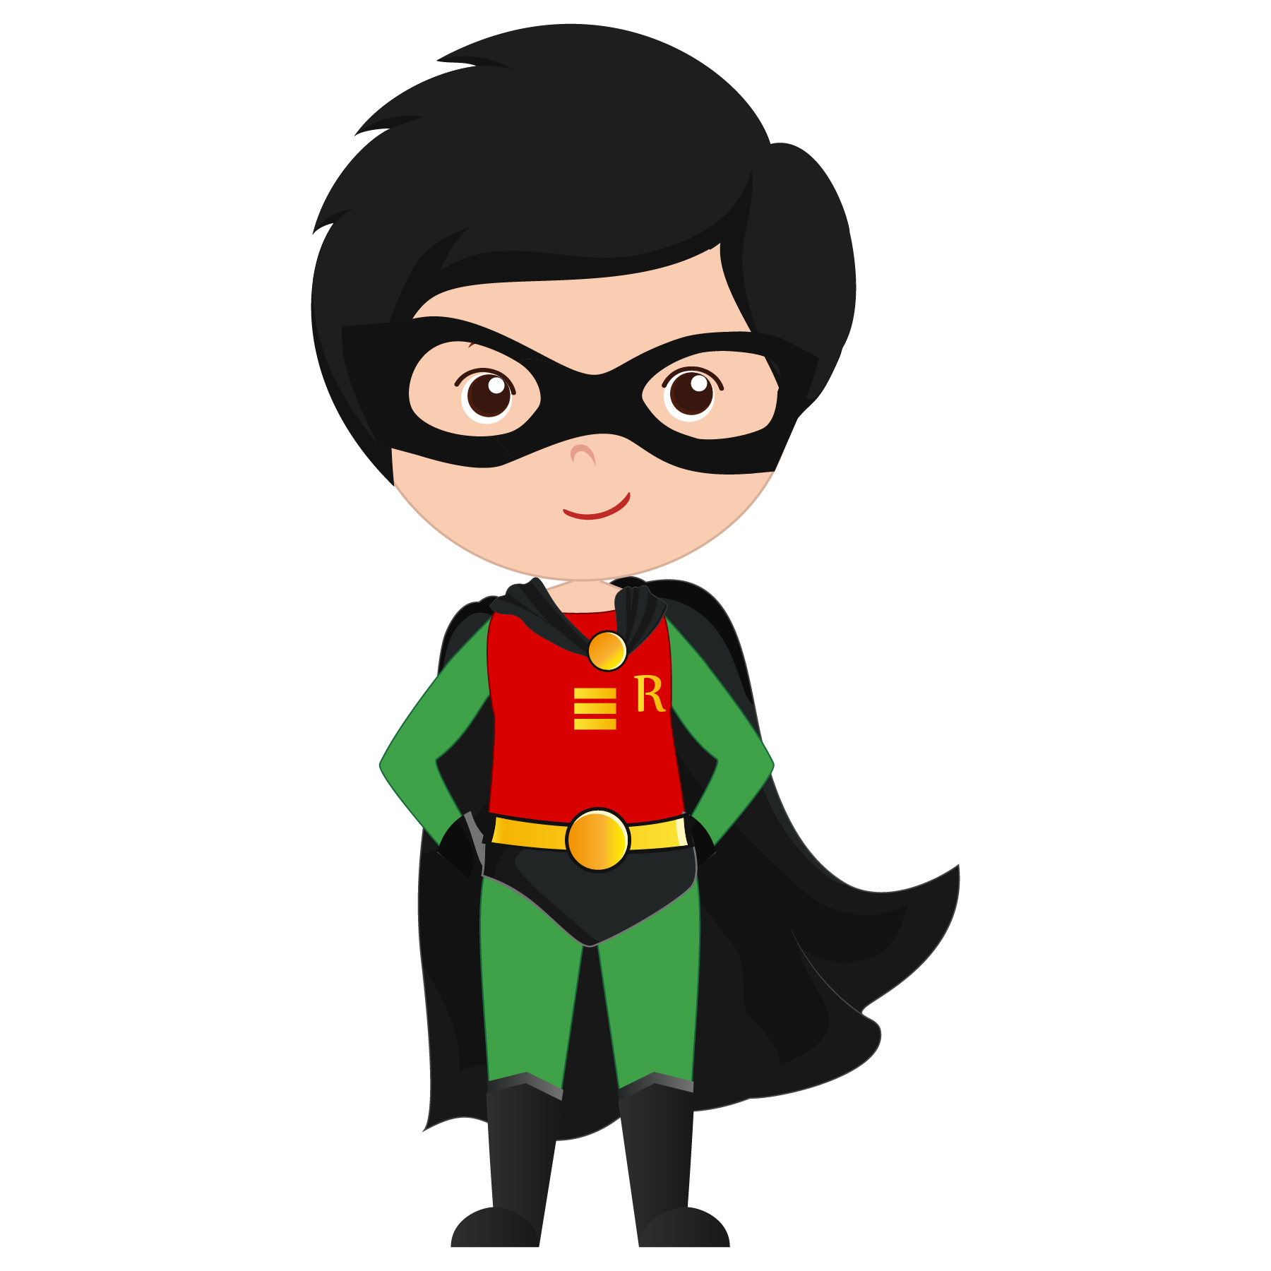
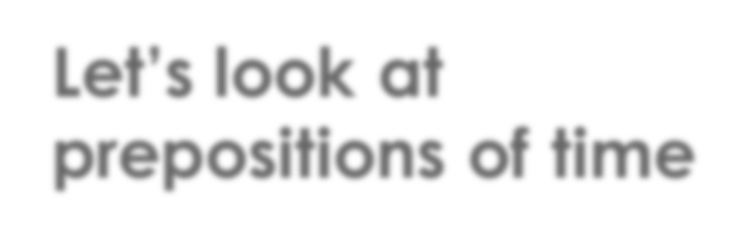
Let’s look at prepositions of time

Slide 40
Prepositions of Time
in
months seasons year
morning/afternoon/evening
Let’s visit New York in July.
I like seeing the snow in winter.
I was born in 2012.
The birthday party is in the afternoon.
I have to study at night.
Lunch is at 1:00pm.
Do you want to visit me on the weekend?
I have to go to the dentist on Thursday.
at
night time
on
the weekend days of the week

Slide 41

Prepositions of Time
at | on | in
2017
Tuesday
2:00pm
night
January
weekend
1999
morning

Slide 42
Prepositions of Time
I wake up 7:00am
I have to go to school Monday. My sister was born 2012.
I like to watch TV night.
We walk the dog the morning.

Slide 43
Prepositions of Time
in July.
in winter.
in 2012.
in the afternoon.
at night.
at 1:00pm.
on the weekend?
on Thursday.

Slide 44





What did I learn today?

Slide 45





Let’s review

Slide 46

Let’s review

Slide 47

Let’s review

Slide 48

Let’s review

Slide 49

Homework.
What would happen if you woke up one morning and you were 8 feet tall? What would you do?
Write 5 sentences.

