Slide 1






Superheroes: Lesson 8

Slide 2

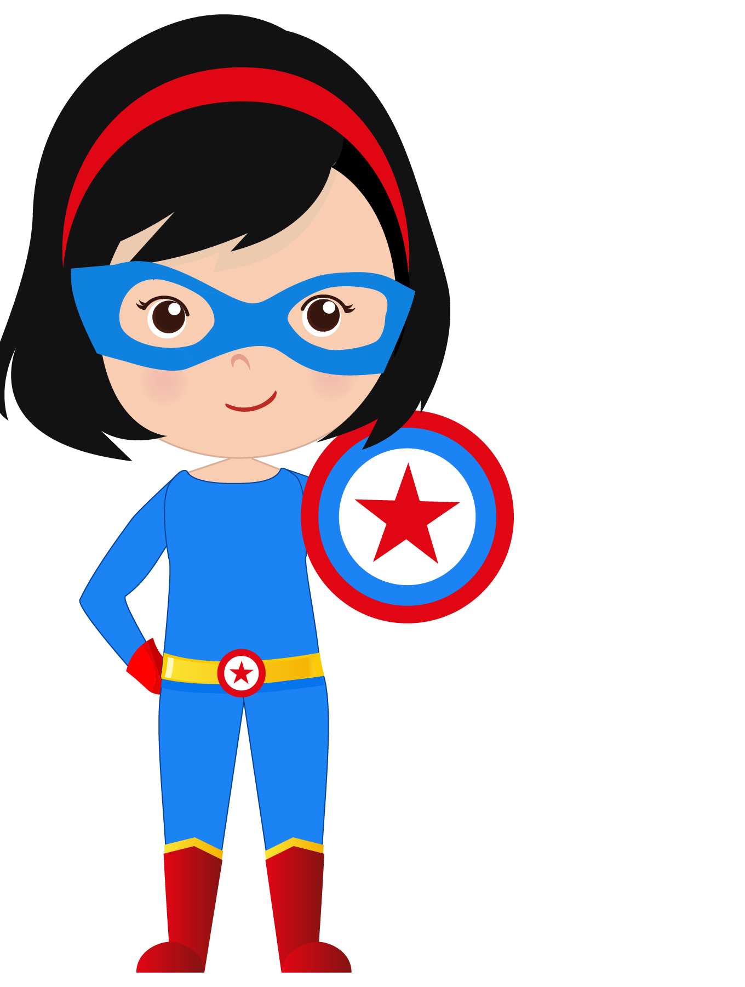
Homework.
What would happen if you woke up one morning and you were 8 feet tall? What would you do?
Write 5 sentences.

Slide 3




What will we do today?

Slide 4
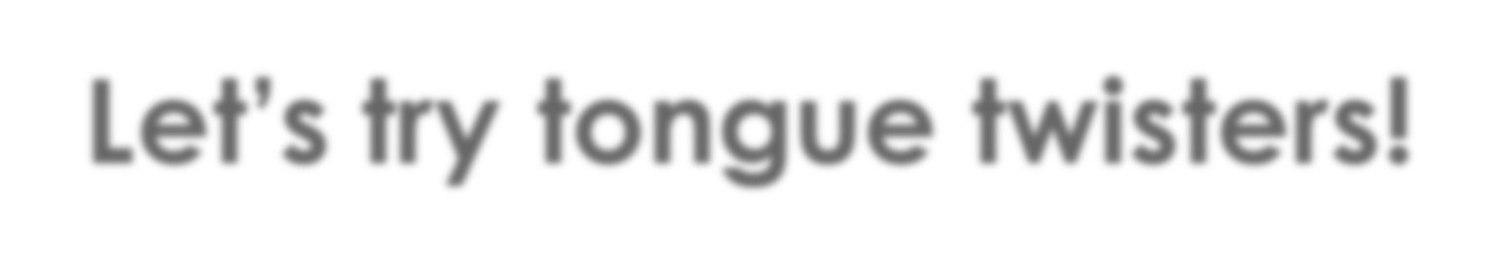



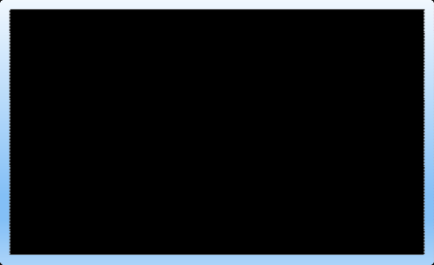
Let’s try tongue twisters!
My mommy makes me muffins on Mondays.

Slide 5
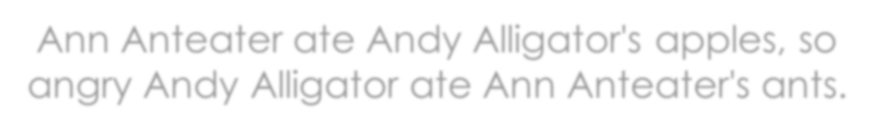


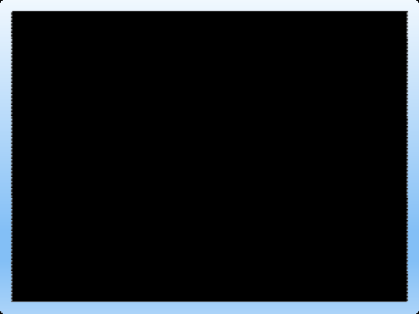
Let’s try tongue twisters!
Ann Anteater ate Andy Alligator's apples, so angry Andy Alligator ate Ann Anteater's ants.

Slide 6



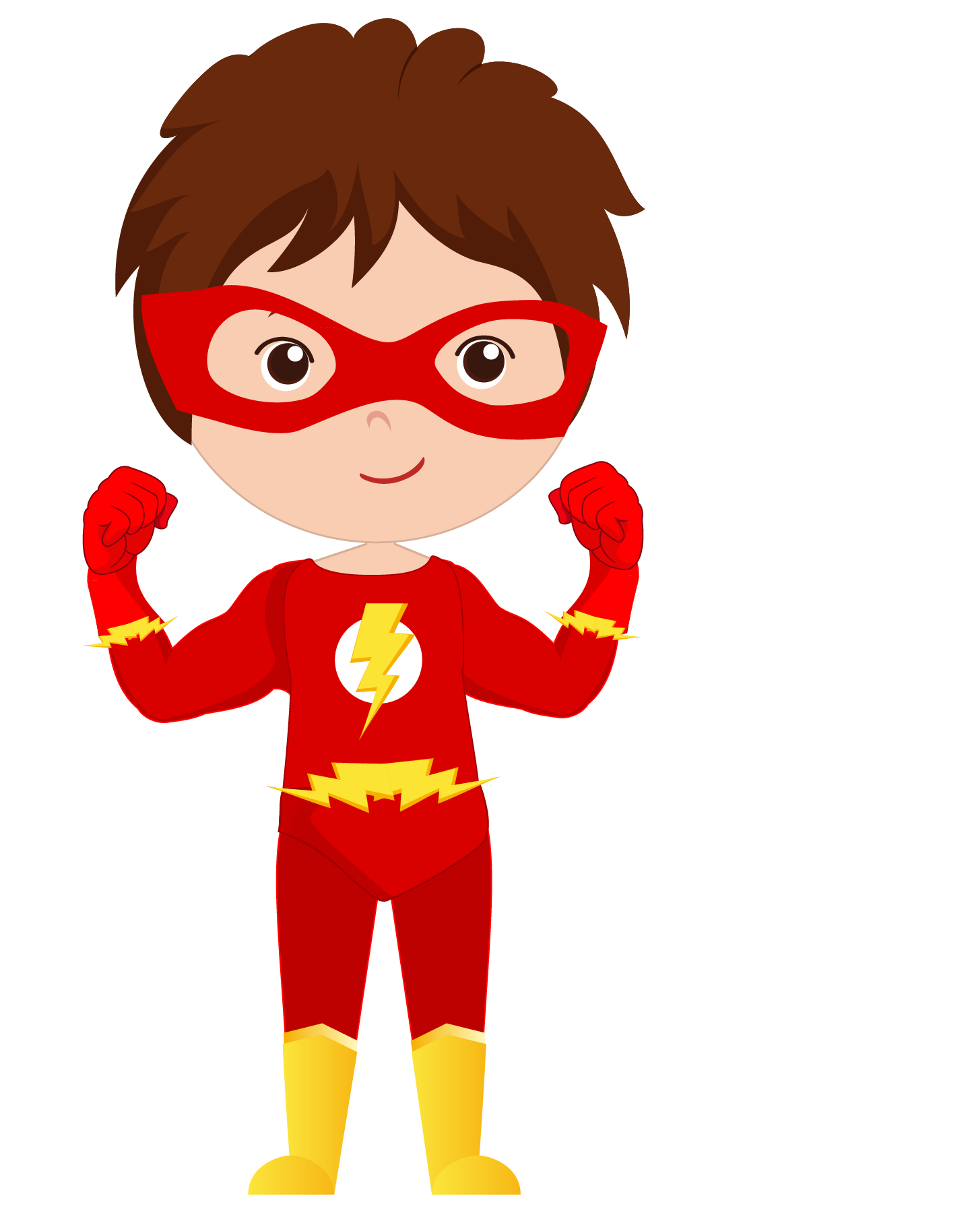
Let’s review retelling a story

Slide 7


Listen to your teacher tell a story.

Slide 8
MIXED UP
PET SHOP
THE
By Michelle Dennise
Copyright 2017 Michelle Dennise FKB Edition
Thank you for downloading this eBook. This book remains the copyrighted property of this author, and may not be redistributed to others for commercial or non-commercial purposes. If you enjoyed this book, please encourage your friends to download their own copy from their favourite authorised retailer. Thank you for respecting the hard work of this author.

Slide 9
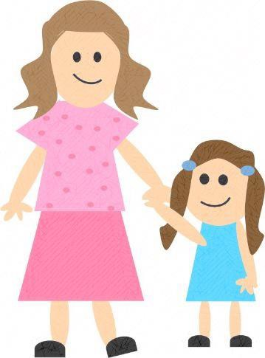
Today my Mum and I went to the pet shop to buy a new puppy.

Slide 10
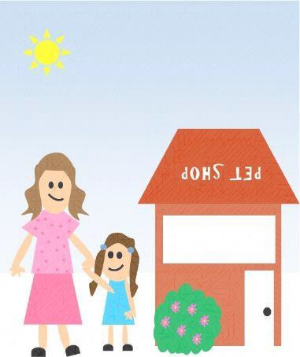
When we got there everything was mixed up.

Slide 11
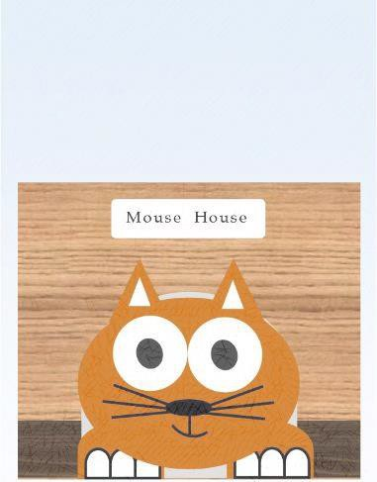
The kitten was in the mouse house.

Slide 12
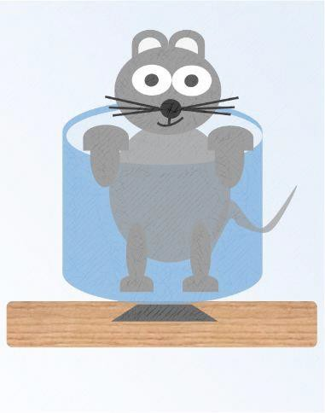
The mouse was in the fish bowl.

Slide 13
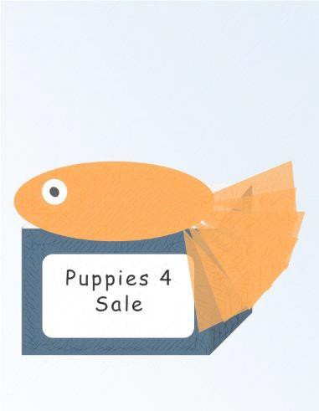
The fish was in the puppy box.

Slide 14
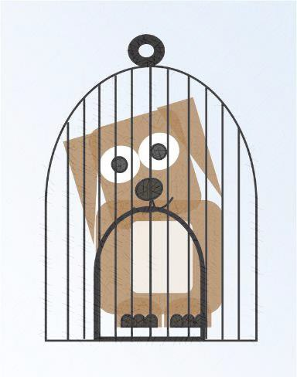
The puppy was in the bird cage.

Slide 15
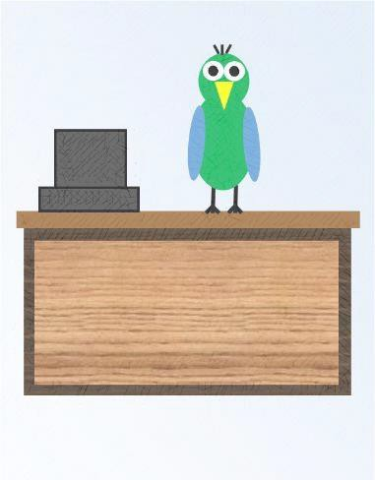
The bird was behind the counter.

Slide 16
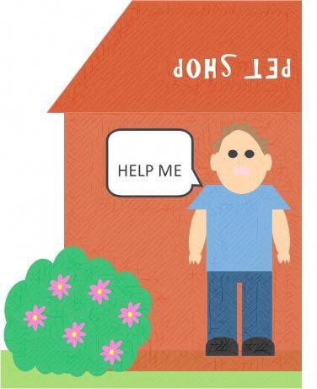
The shop keeper ran to the door, crying, “Help me”!

Slide 17
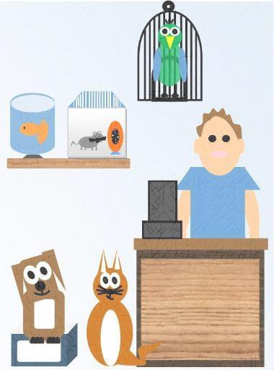
So we did. We put all the animals back where they belonged and then we bought our new puppy.

Slide 18
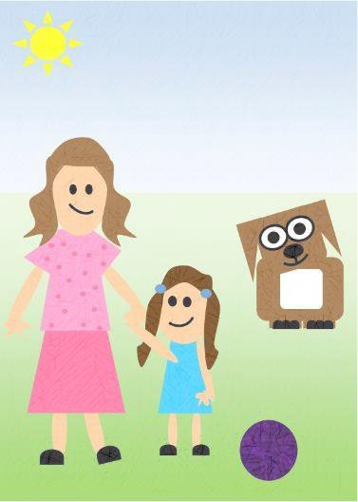
At home we played outside with our new puppy and guess what he said...

Slide 19
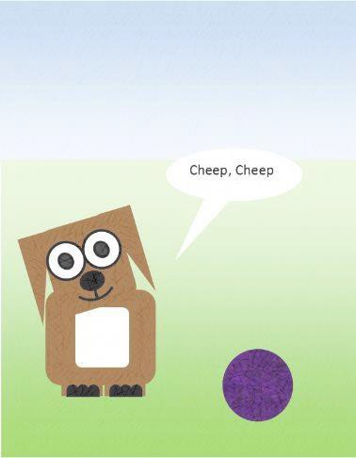
“Cheep! Cheep!”

Slide 20
Thank you for reading my book. If you enjoyed it, won’t you please take a moment to leave me a review at your favourite retailer?
Thanks!
Michelle Dennise

Slide 21
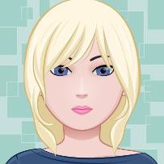
About the Author
Michelle lives in Australia with her husband and two children. She enjoys writing children’s books and reading, spending time with family and friends, and raising budgies.
The Mixed Up Pet Shop is her first book and she hopes she brought some reading enjoyment and giggles to your little one.
Connect with Michelle at: https://www.smashwords.com/profile/view/MichelleDennise https://www.facebook.com/michelledennise.author/

Slide 22
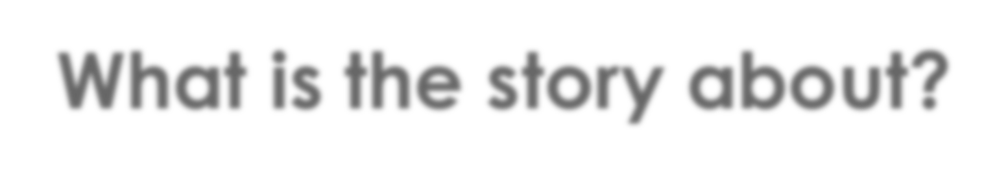
What is the story about?

Slide 23
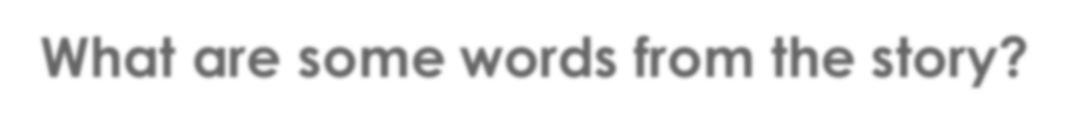
What are some words from the story?
Write them on your
paper.

Slide 24

Draw a picture from the story.
Write a sentence describing it.

Slide 25
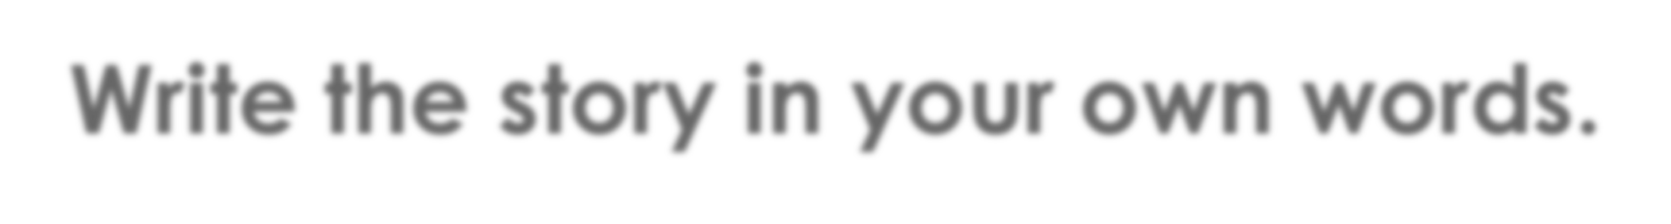
Write the story in your own words.

Slide 26

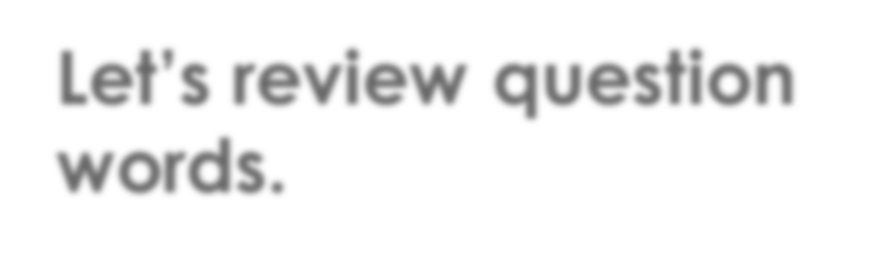


Let’s review question words.

Slide 27

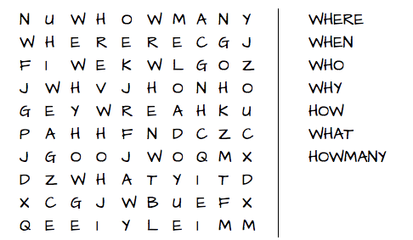

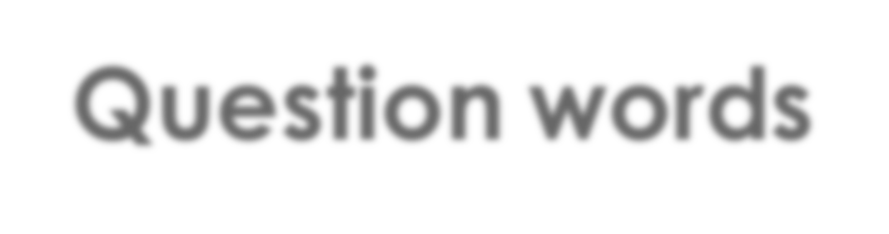
Question words

Slide 28
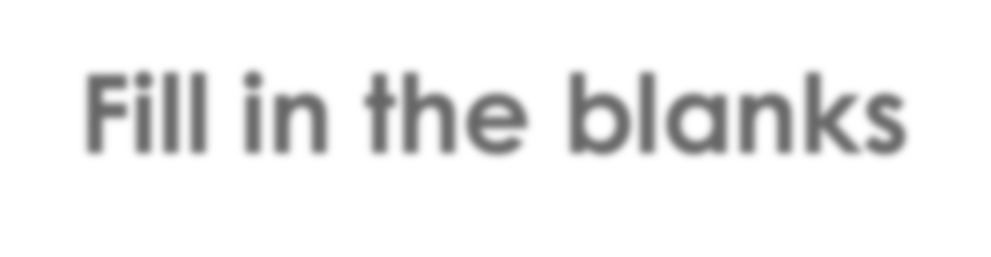
Fill in the blanks
are you going?
I am going to school.
will you be home? I should be home at 4pm.
When | Where | Why
How | What | Who

Slide 29
Fill in the blanks
is your pencil case?
It’s sitting on the desk?
are you doing after school? I’m going to the swimming pool.
When | Where | Why
How | What | Who

Slide 30
Fill in the blanks
is talking to the teacher?
That’s my older sister!
are you wearing that coat? I feel cold.
When | Where | Why
How | What | Who

Slide 31

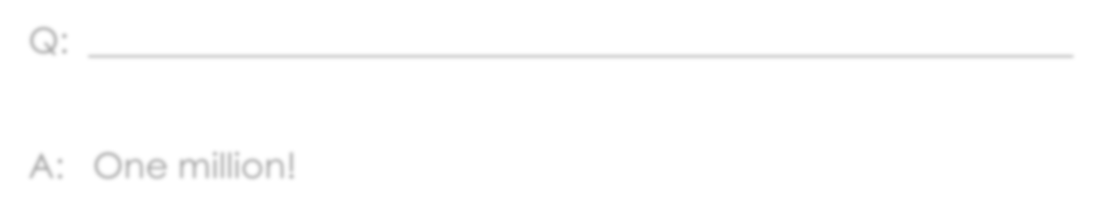
What’s the question?
Q:
A: One million!

Slide 32
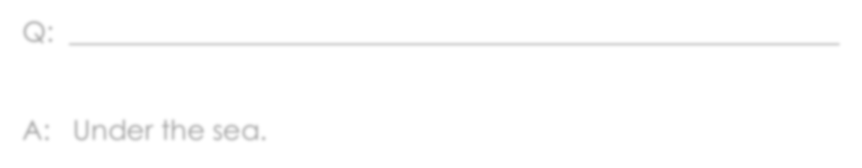
What’s the question?
Q:
A: Under the sea.

Slide 33
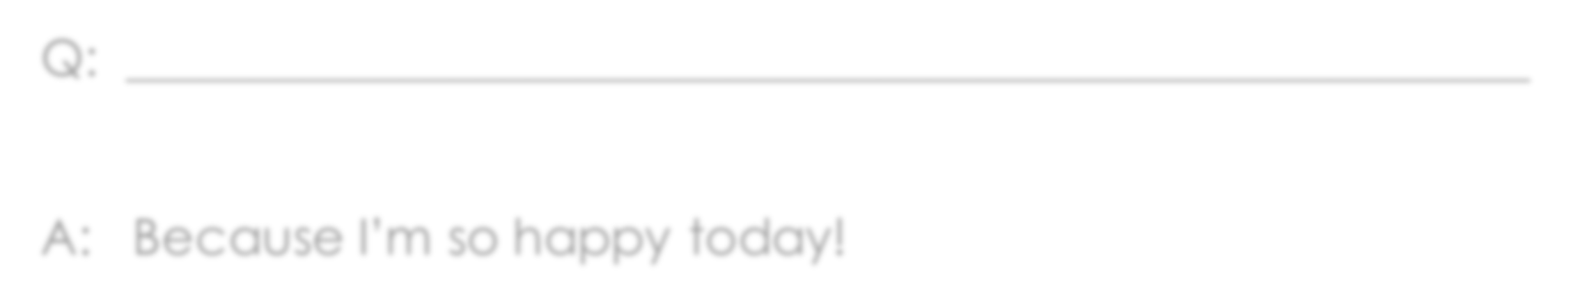
What’s the question?
Q:
A: Because I’m so happy today!

Slide 34
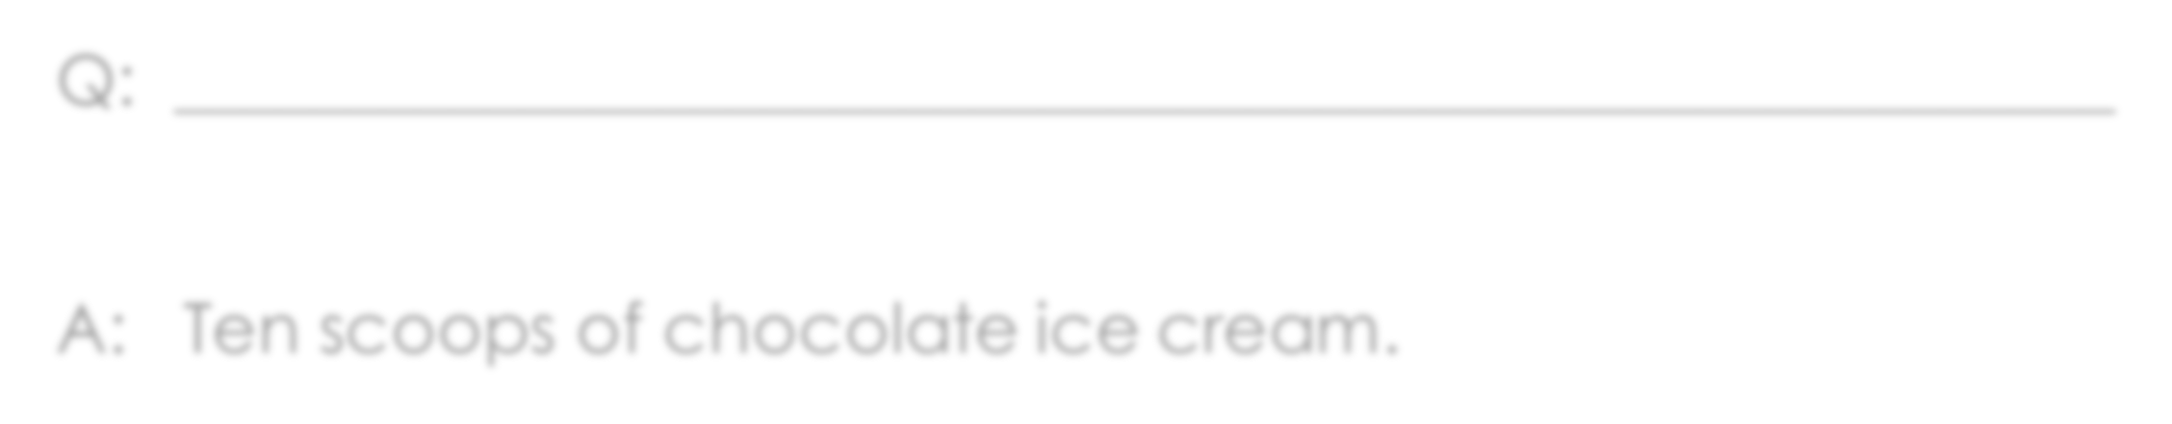
What’s the question?
Q:
A: Ten scoops of chocolate ice cream.

Slide 35
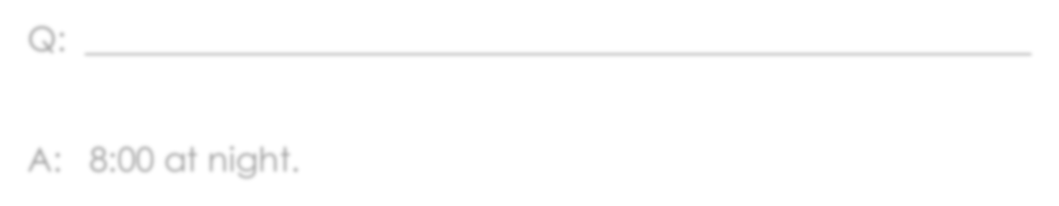
What’s the question?
Q:
A: 8:00 at night.

Slide 36
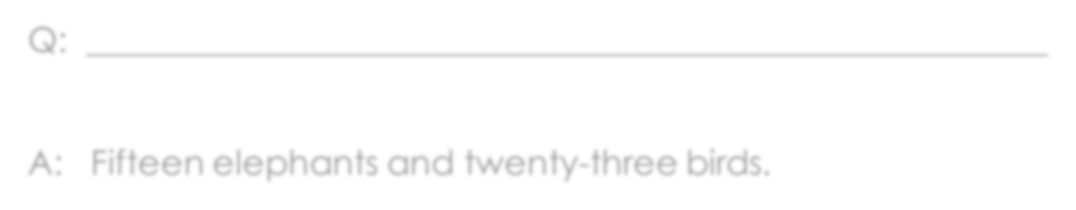
What’s the question?
Q:
A: Fifteen elephants and twenty-three birds.

Slide 37

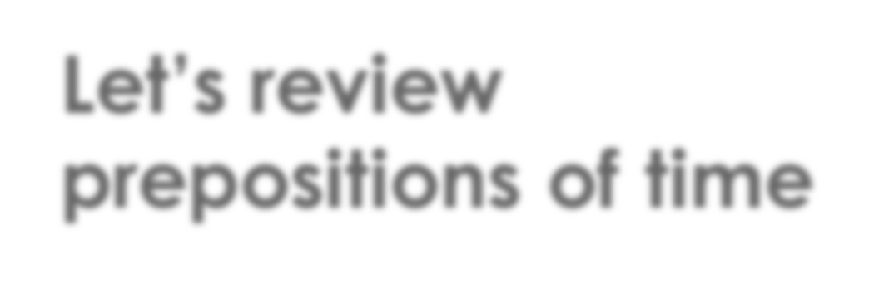
Let’s review prepositions of time

Slide 38
Prepositions of Time
in
months seasons year
morning/afternoon/evening
Let’s visit New York in July.
I like seeing the snow in winter.
I was born in 2012.
The birthday party is in the afternoon.
I have to study at night.
Lunch is at 1:00pm.
Do you want to visit me on the weekend?
I have to go to the dentist on Thursday.
at
night time
on
the weekend days of the week

Slide 39
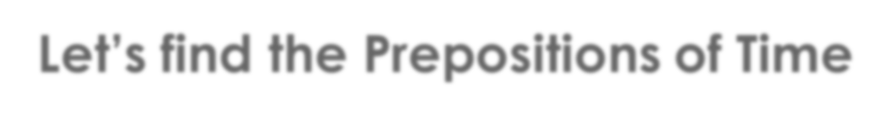
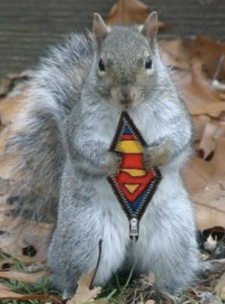
Let’s find the Prepositions of Time
This is SuperSquirrel! He fights crime in the evening and at night. He was chasing bad guys on Tuesday and saving good guys on Wednesday. He became super strong in 2012 when he ate a magic acorn. No matter how busy he is, he goes home at 5:00pm every evening to have dinner with his parents.

Slide 40
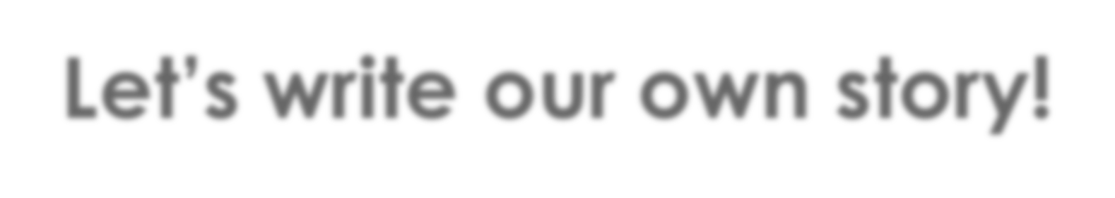
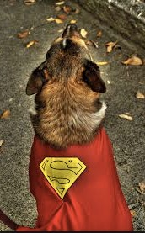
Let’s write our own story!
Use these words:
Superdog
On
In
At
Write 5 sentences.

Slide 41



What did I learn today?

Slide 42
Homework.
What superpower do you think is best: making fire or making snow? Why?
Write 5 sentences.

