Slide 1
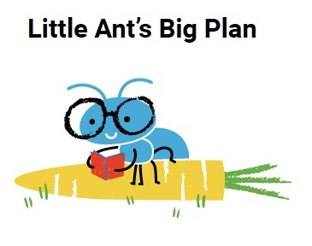
Little Ant’s Big Plan

Slide 2
Let’s Review – Rhymes
What’s a rhyme?
What are some words that rhyme in the story? Can you think of more rhymes?

Slide 3
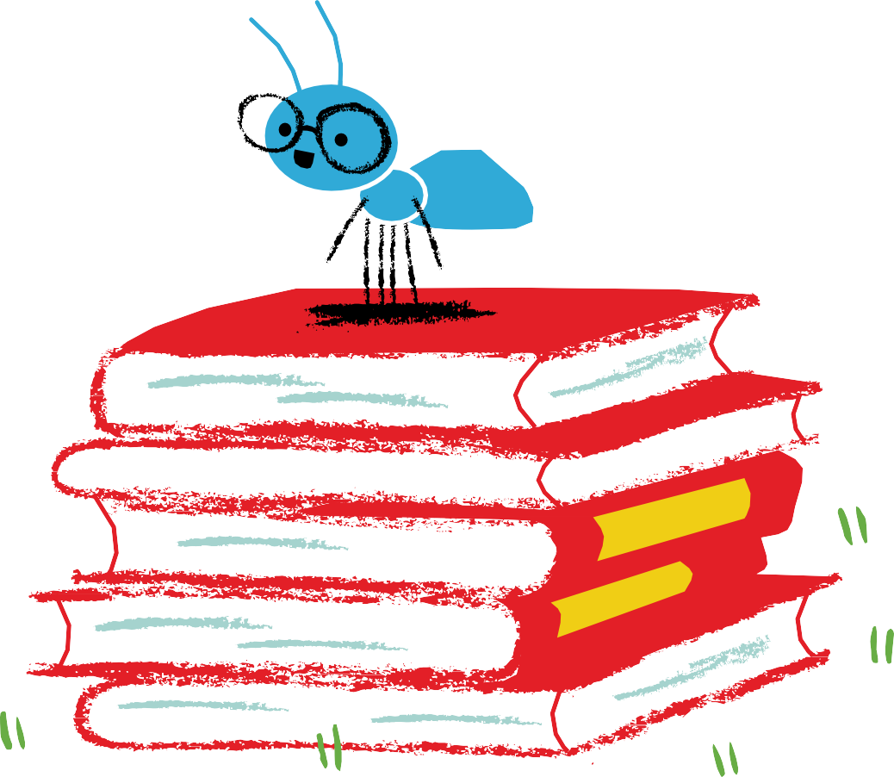
Little Ant’s Big Plan
Candice Dingwall Steven McKimmie Telri Stoop

Slide 4
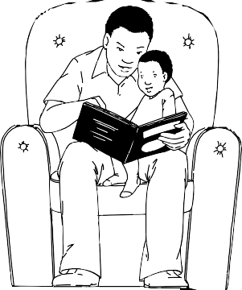
Little Ant’s Big Plan
This book belongs to

Slide 5



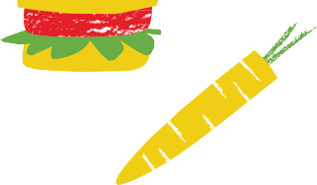



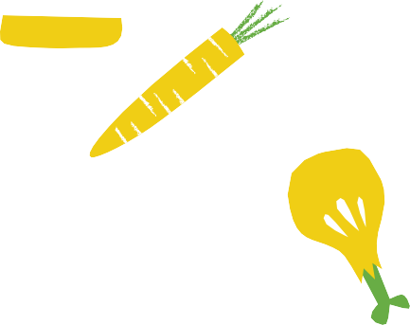









































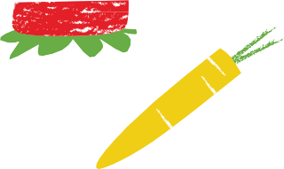




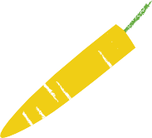









Slide 6

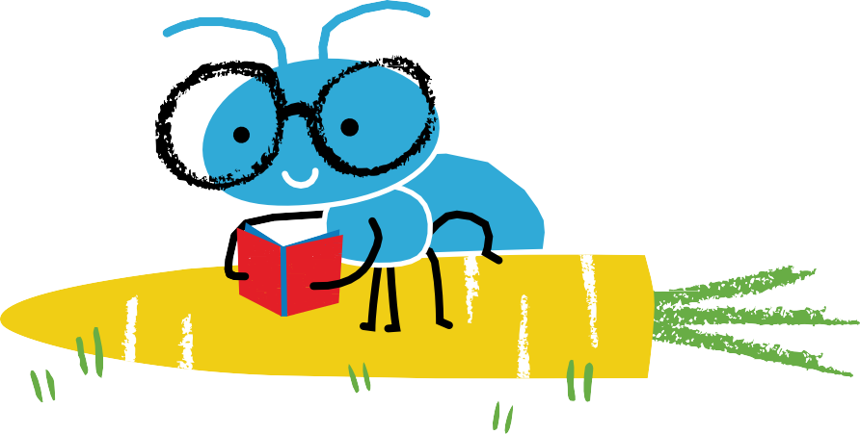
Little Ant’s Big Plan
Little Ant’s Big Plan
Illustrated by Steven McKimmie Written by Candice Dingwall Designed by Telri Stoop
with the help of the Book Dash participants in Johannesburg on 27 June 2015.
ISBN: 978-1-928318-22-4
This work is licensed under a Creative Commons Attribution 4.0 Licence (http://creativecommons.org/licenses/by/4.0/). You are free to share (copy and redistribute the material in any medium or format) and adapt (remix, transform, and build upon the material) this work for any purpose, even commercially. The licensor cannot revoke these freedoms as long as you follow the following license terms:
Attribution: You must give appropriate credit, provide a link to the license, and indicate if changes were made. You may do so in any reasonable manner, but not in any way that suggests the licensor endorses you or your use.
No additional restrictions: You may not apply legal terms or technological measures that legally restrict others from doing anything the license permits.
Notices: You do not have to comply with the license for elements of the material in the public domain or where your use is permitted by an applicable exception or limitation.
No warranties are given. The license may not give you all of the permissions necessary for your intended use. For example, other rights such as publicity, privacy, or moral rights may limit how you use the material.
Candice Dingwall
Steven McKimmie
Telri Stoop

Slide 7


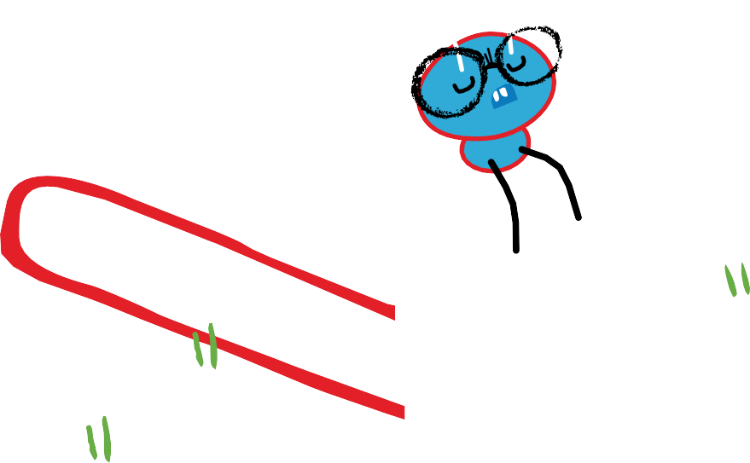
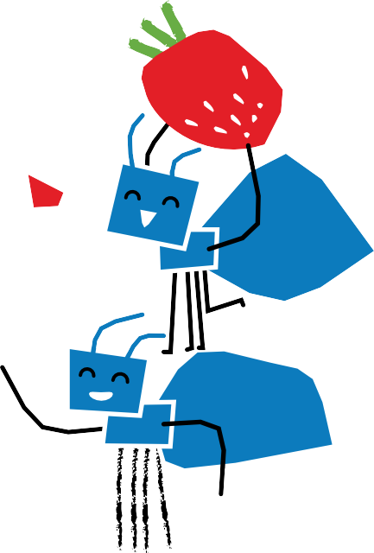



Little Ant loved to read.
Little Ant was often teased.
“Ants don’t read. Ants must feed. Ants collect the food they need.”

Slide 8






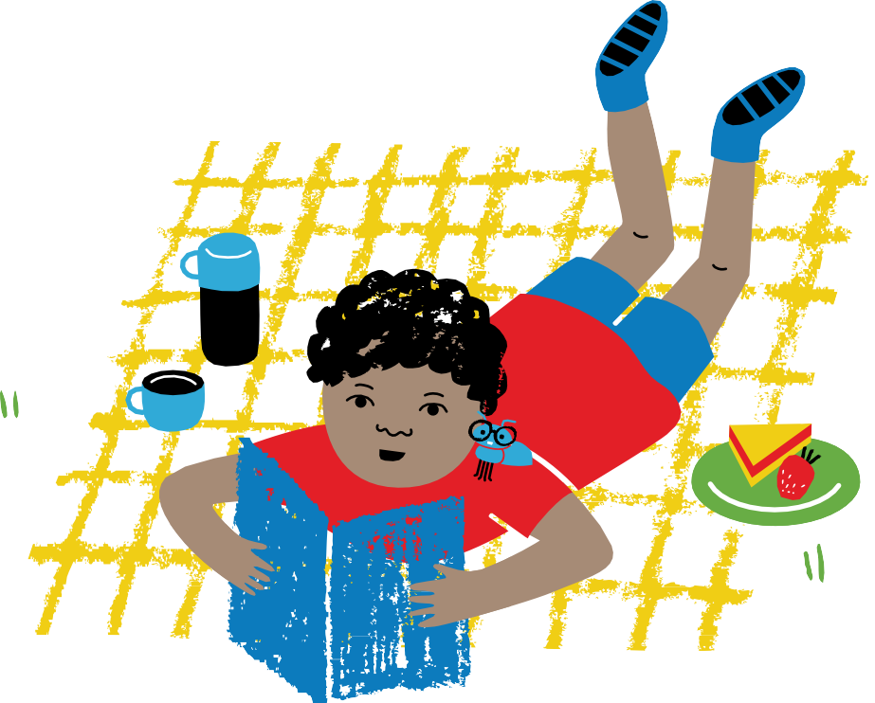
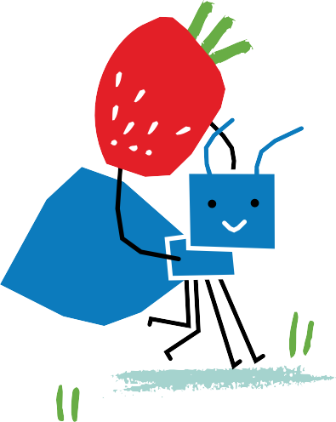
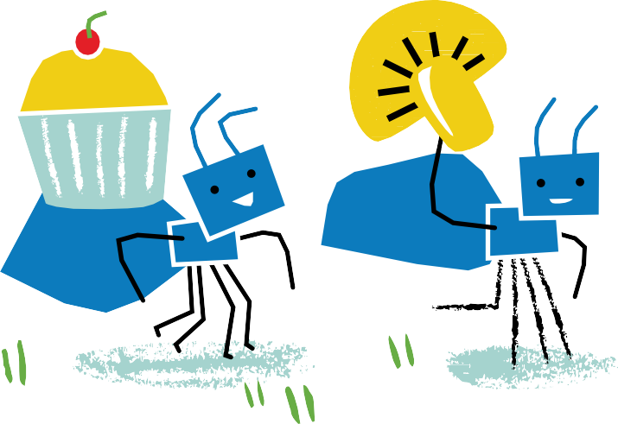
Little Ant would read all day, he’d read and read the day away.
The other ants took what they found to store for winter underground.

Slide 9
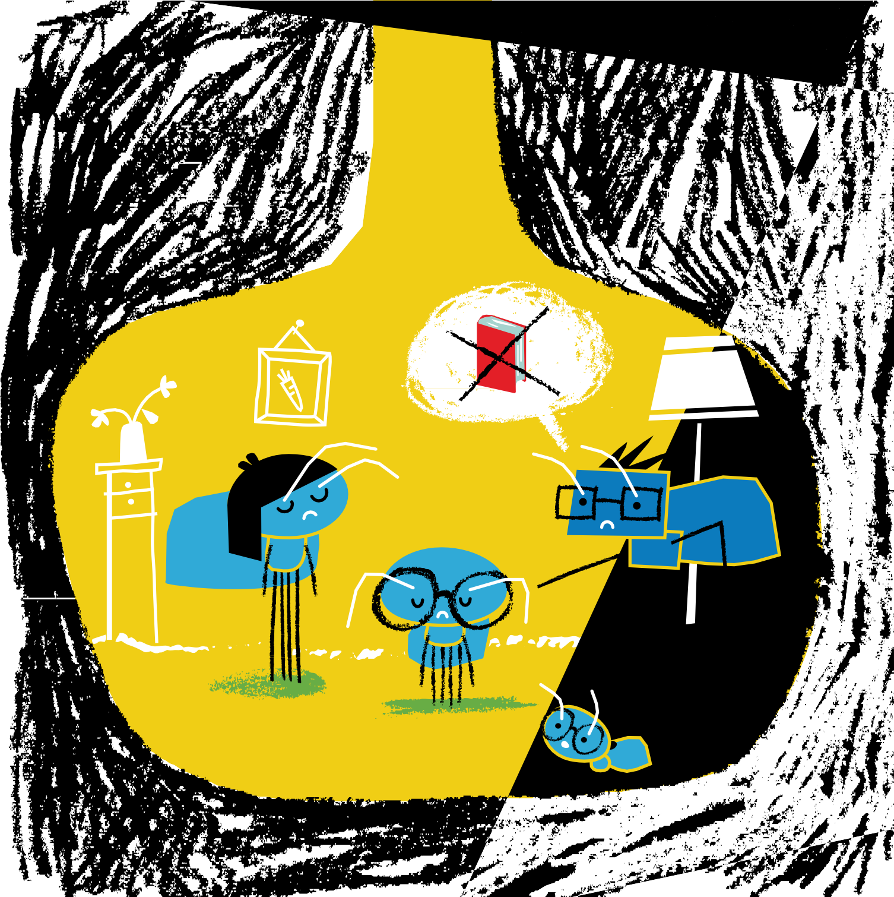
His mum and dad got really mad, and Little Ant felt really bad.

Slide 10
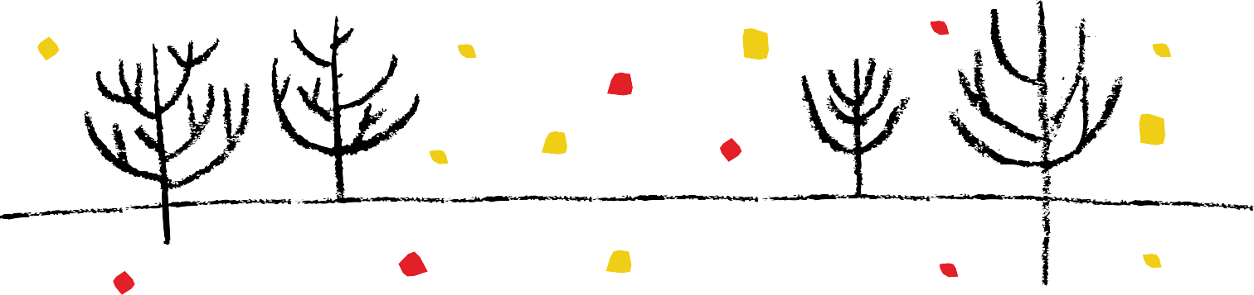


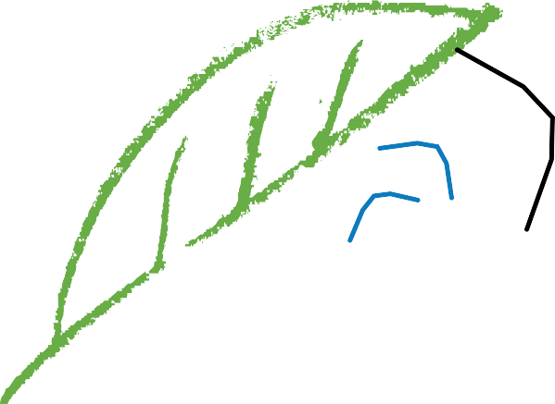
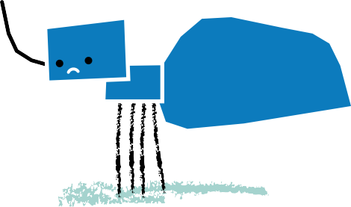
In autumn when the leaves fall down, the ants must keep food underground.

Slide 11

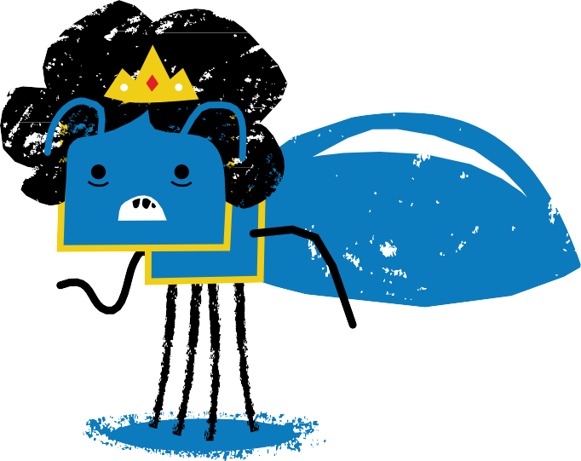
The Queen wants food to fill the store,
so all the ants must work some more.

Slide 12
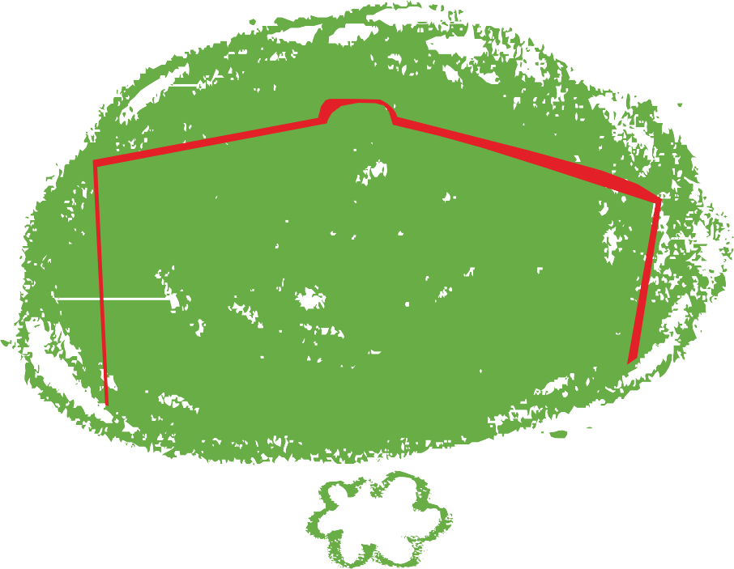
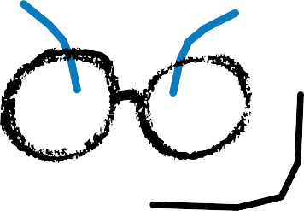
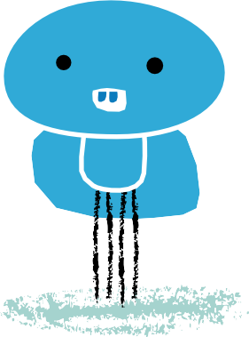
Little Ant begins to shout about a place he read about.
“A restaurant is what we need, a place where people go to feed.
It says so in the books I read.”

Slide 13
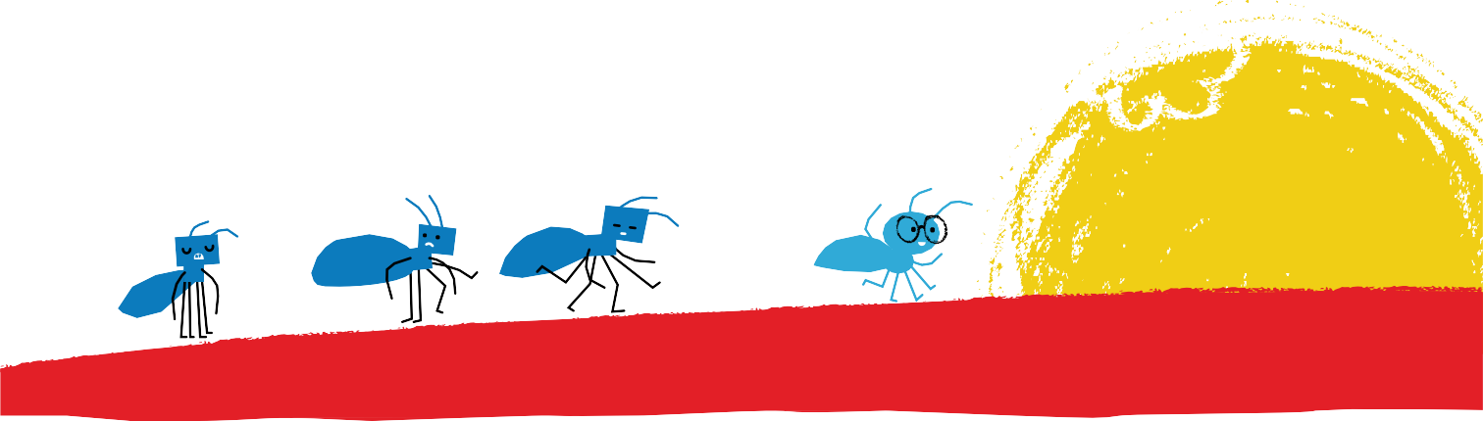
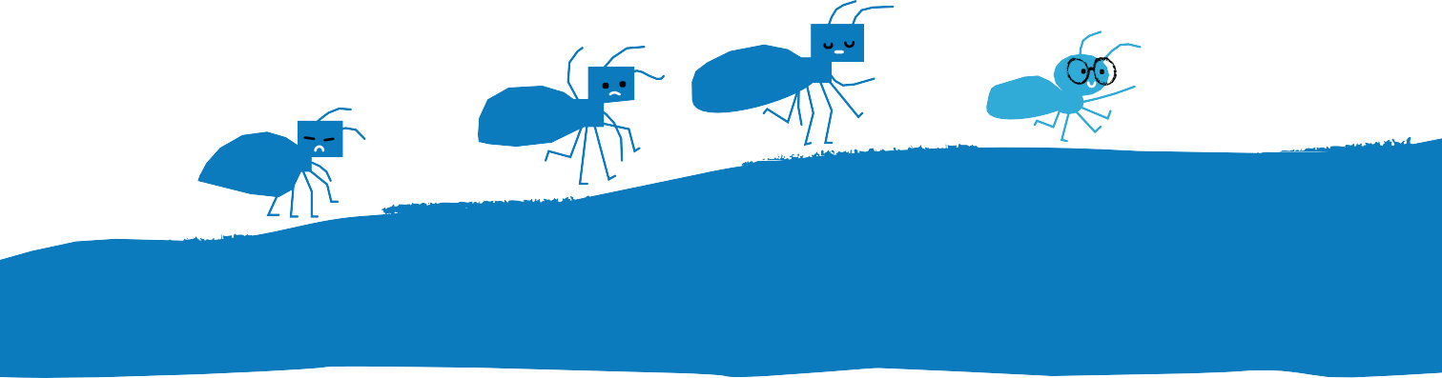
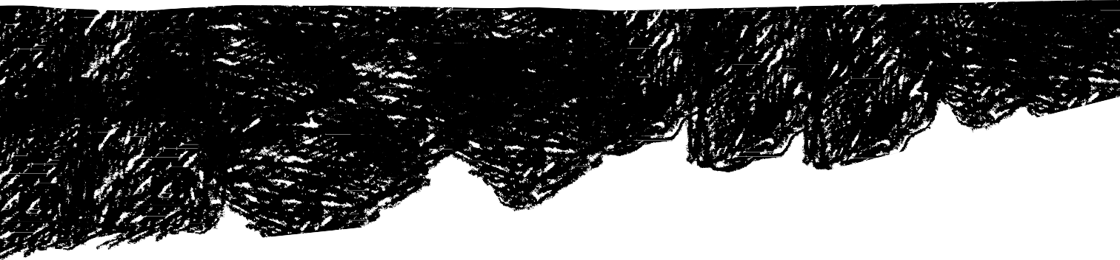
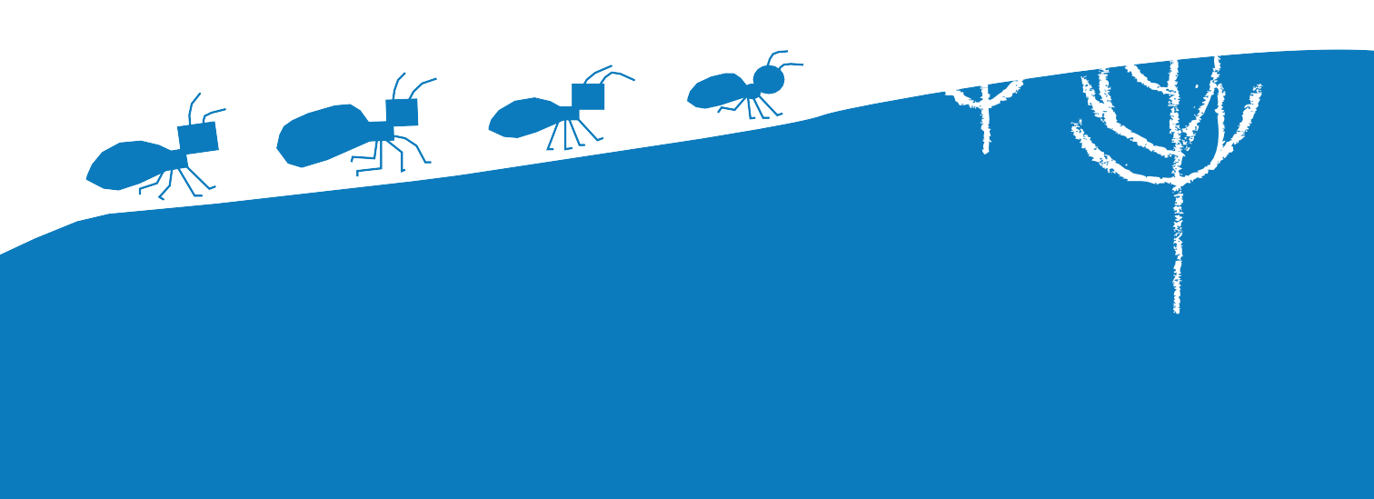
The ants go marching one by one. They march into the setting sun.

Slide 14

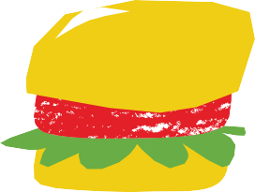






Slide 15
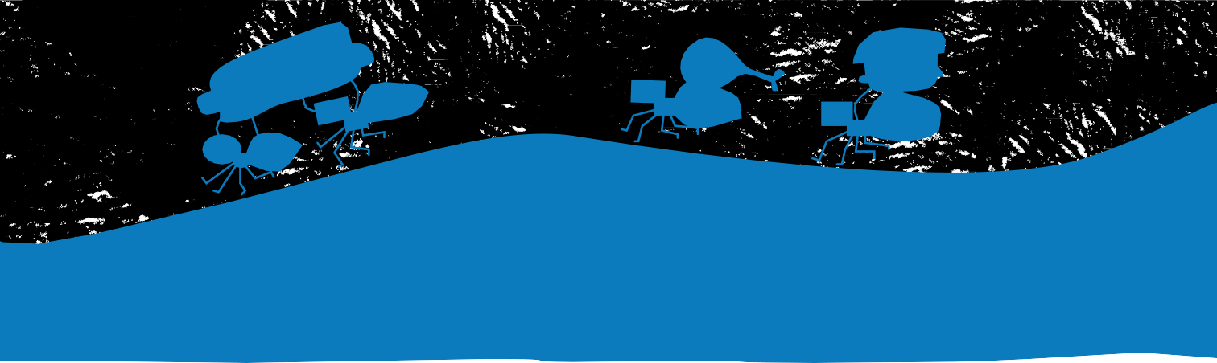
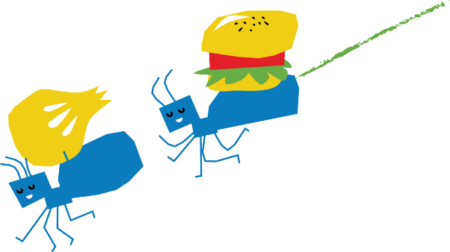
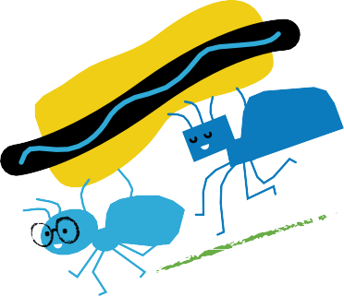
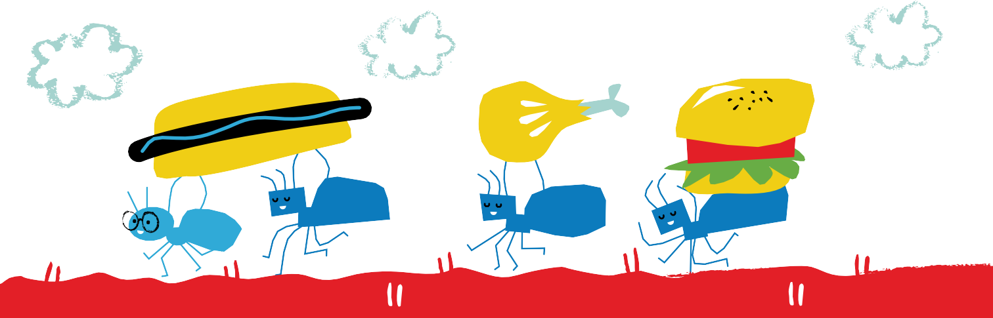
The ants go marching one by one, carrying a burger, carrying a bun.

Slide 16
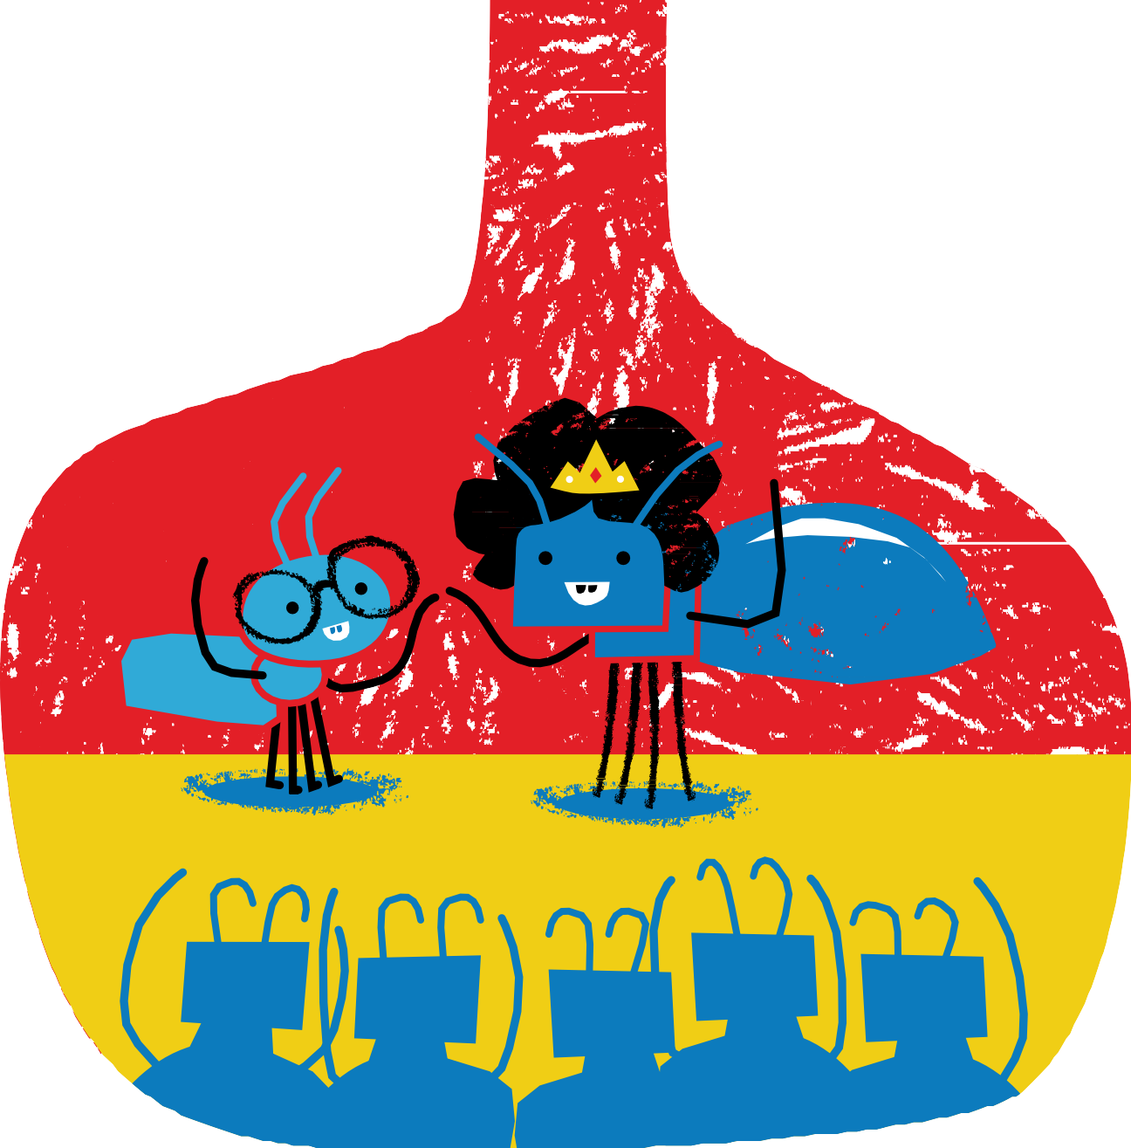
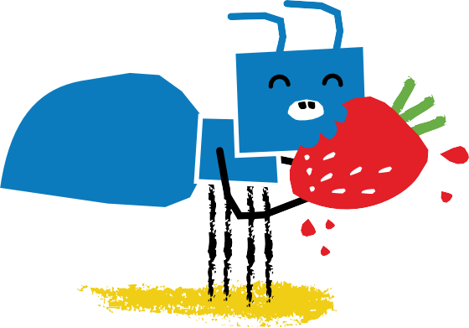
When they return the Queen is glad.
The stores are full. They cheer like mad.

Slide 17


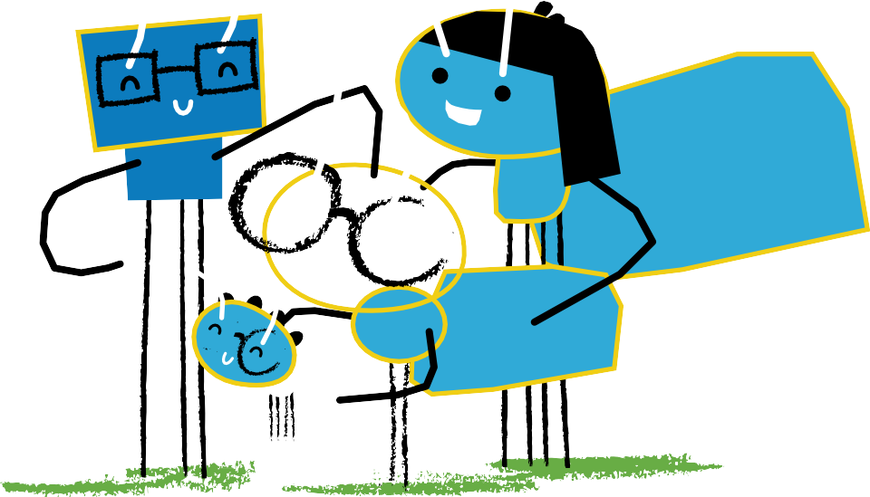

Slide 18
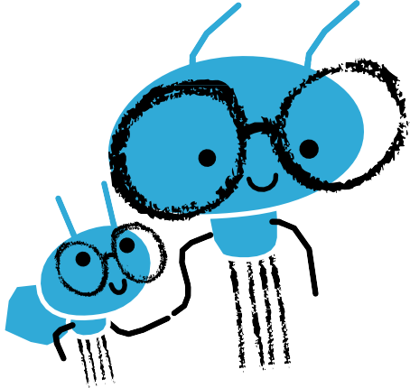





His baby sister takes his hand “Now I think I understand.”
“The way you love to read a book … Makes me want to take a look.”

Slide 20





Slide 21
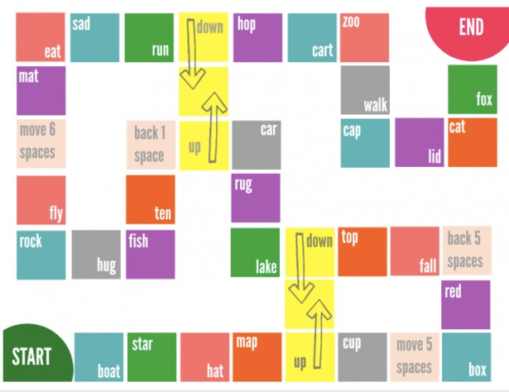
Let’s play a game!
Find a coin
Move your marker
Work with your partner to find a rhyme

Slide 22
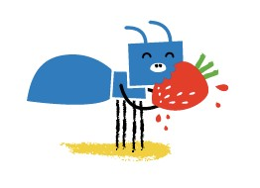
Let’s brainstorm!
How many different types of food can you name? Let’s list them:

Slide 23
What’s your favourite?
This ant likes to eat strawberries! What about other animals?
Let’s brainstorm 10 different animals and try to guess their favourite food.

Slide 24
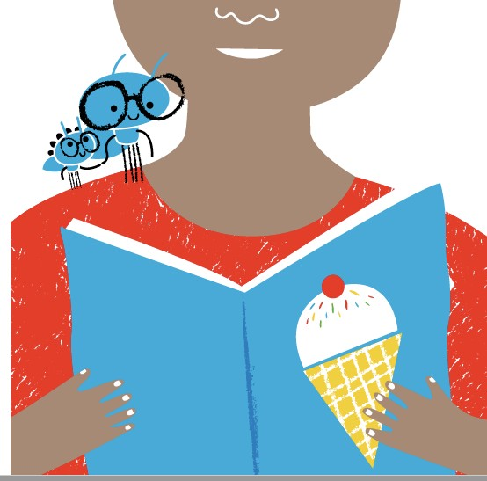
What’s the ending?
Sister Ant loves reading about ice cream. One day she decides to go find some ice cream for herself. After walking through the forest and into the city, she sees an ice cream parlour. She’s so excited to finally try her very first ice cream cone! She crawls into the freezer and finds herself some chocolate ice cream. It’s the most delicious thing she has ever tasted!
Once she’s full, she decides it’s time to go back home. But, wait! The ice
cream store has closed and the doors are locked. How will she get back home?
Write 5 sentences and draw a picture. What will Sister Ant do?

Slide 25
Homework
Little Ant loved to read. He read lots of different books.
What kind of books do you like to read? Why? Write 5 sentences.

Slide 26
References
Dingwall, C., McKimmie, S., & Stoop, T. (2015). Little Ant's Big Plan. Johannesburg: Book Dash.
http://www.notimeforflashcards.com/2015/02/rhyming-board-game-free-printable.html

