Slide 1








Adventures!

Slide 2

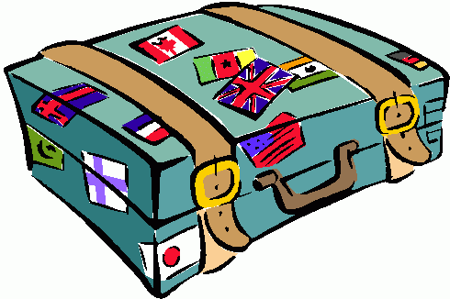
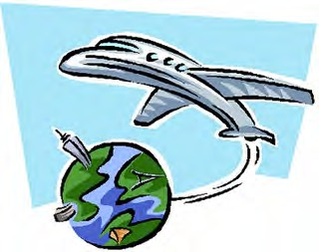

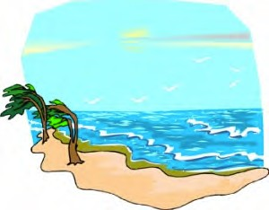
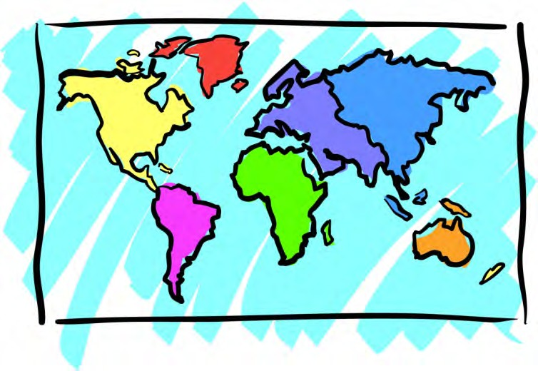


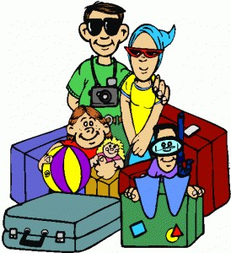
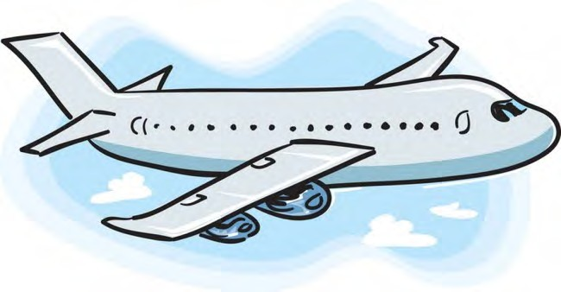
Adventures

Slide 3


What will I learn today?
The sound of the letters ‘tt’
Talk to each other using words like ‘thank you’ and ‘please’
Talk about where we would like to travel Learn about different ways to travel

Slide 4
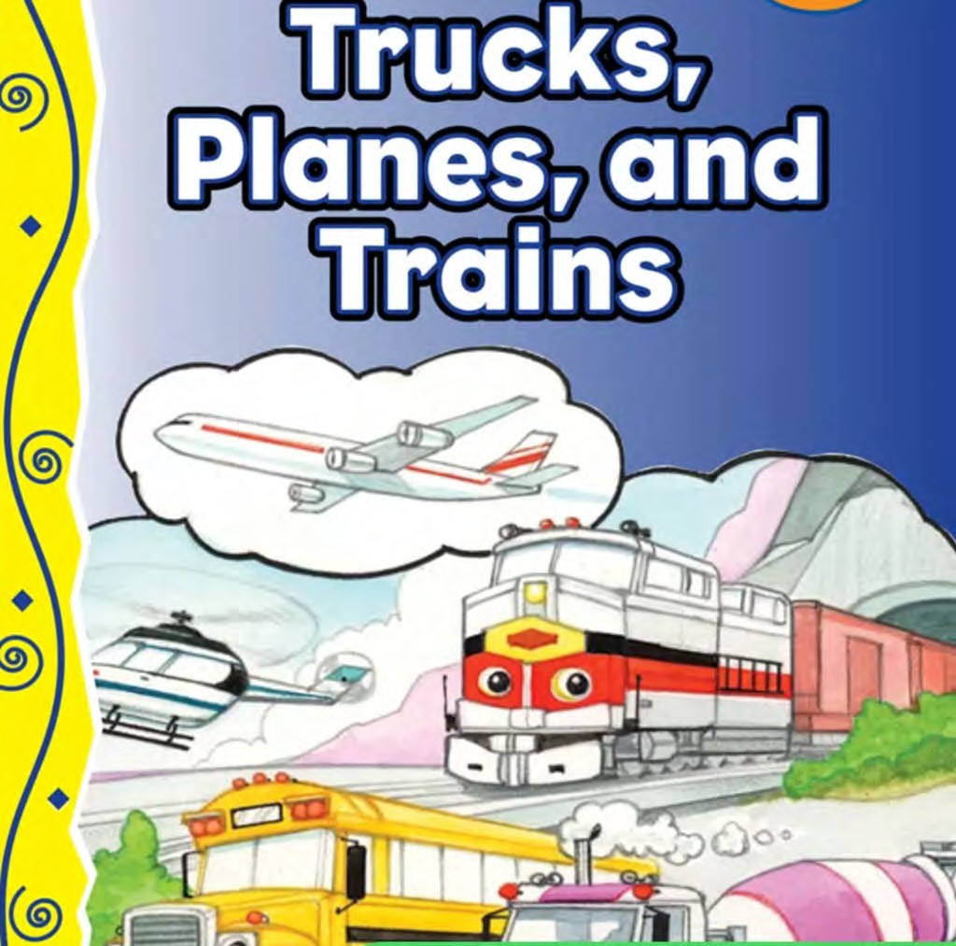

Slide 5
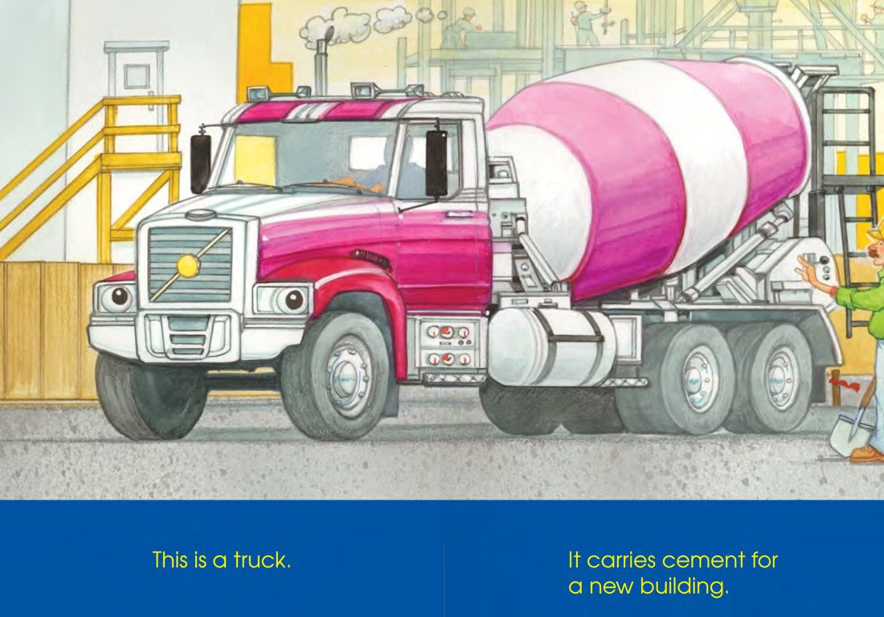

Slide 6
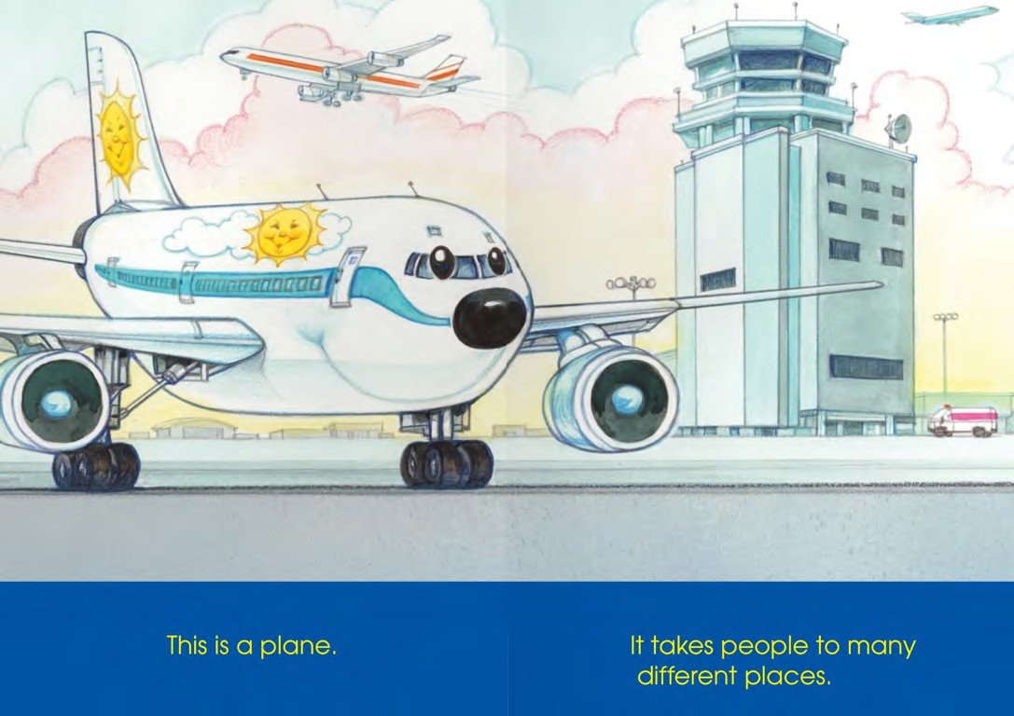

Slide 7
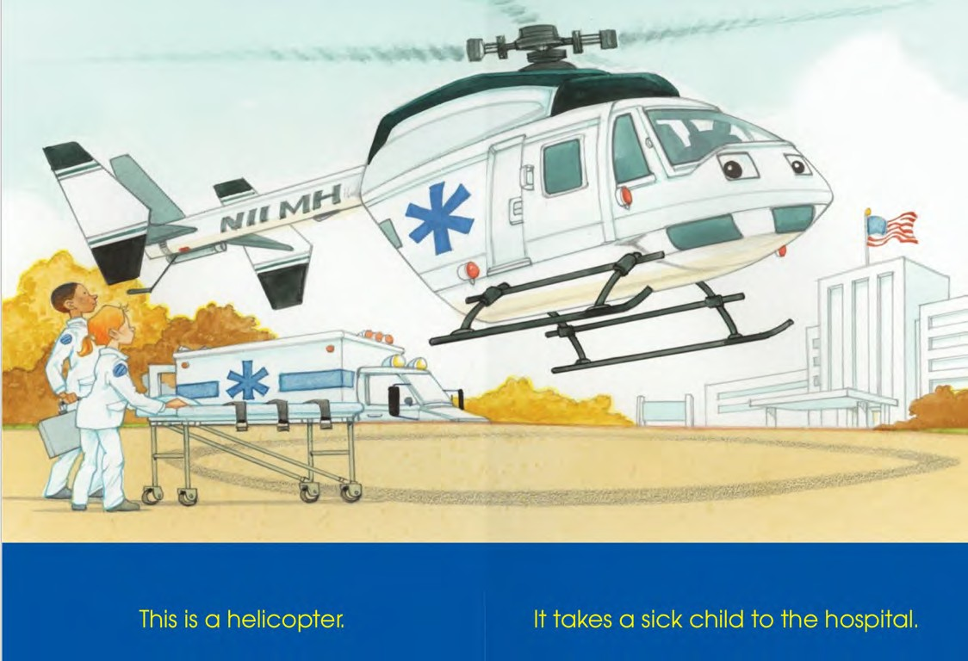

Slide 8
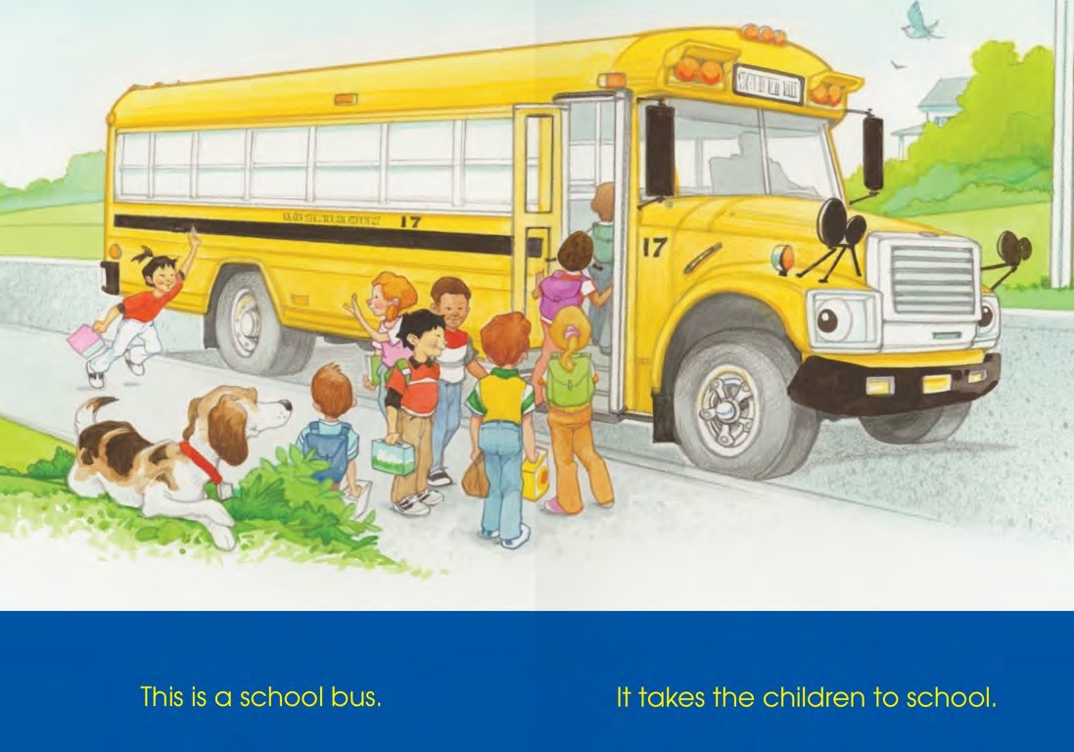

Slide 9
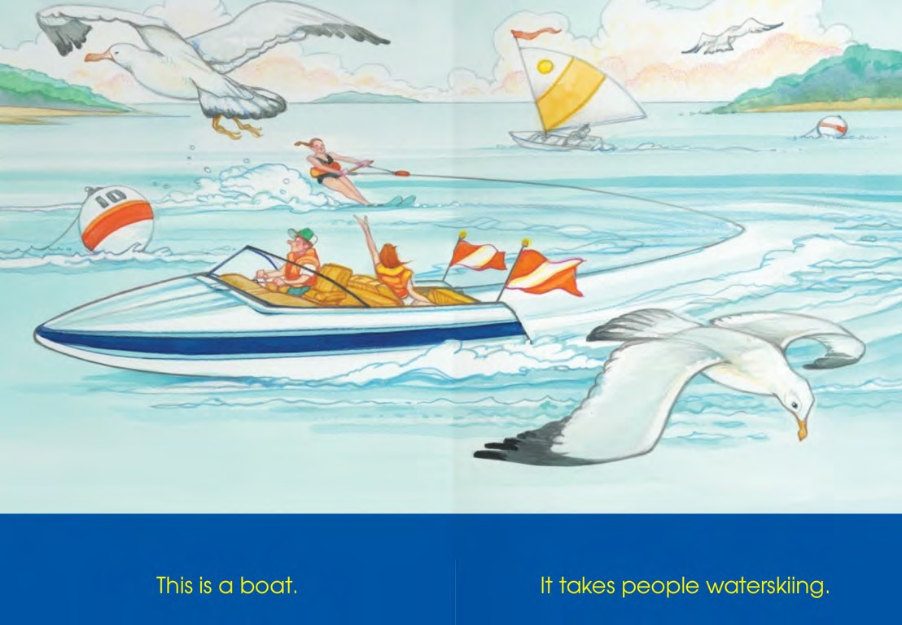

Slide 10
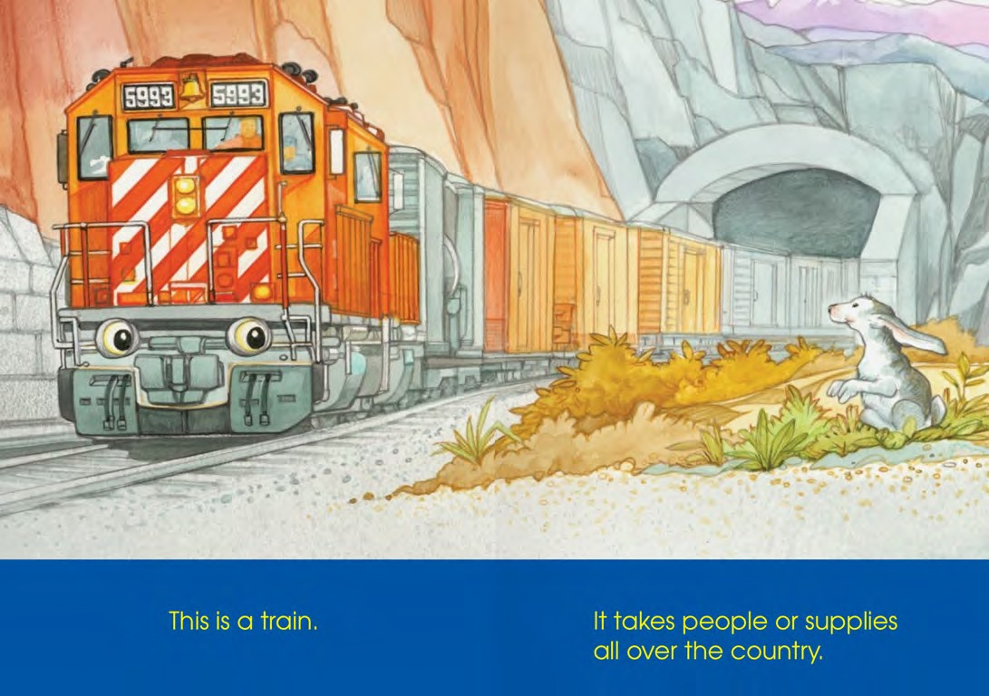

Slide 11
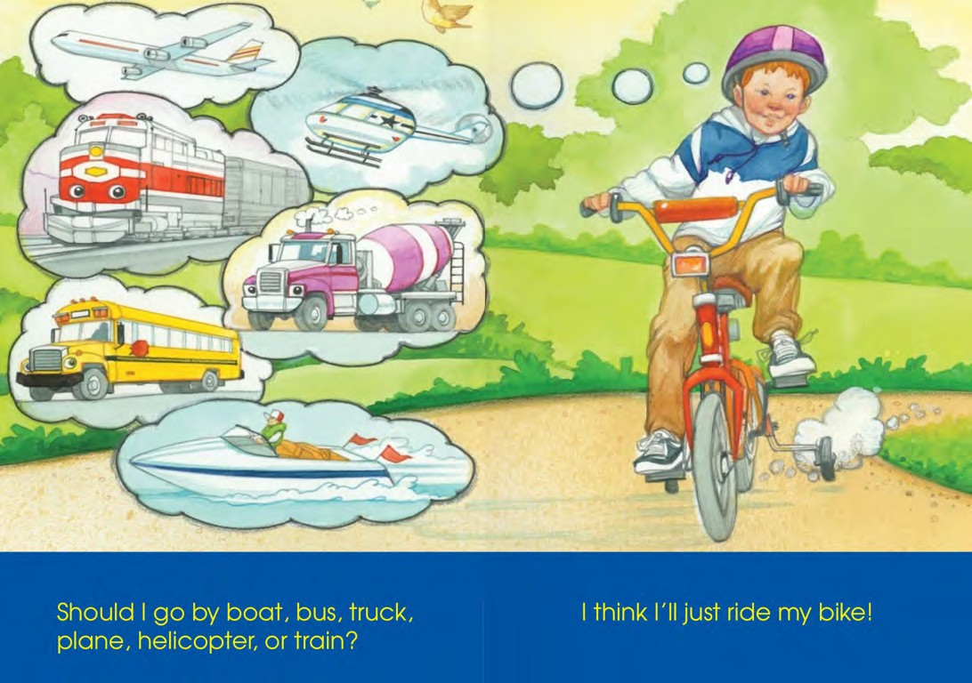

Slide 12
Let’s take a trip together!
Where are we going today?

Slide 13
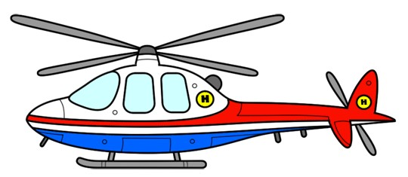
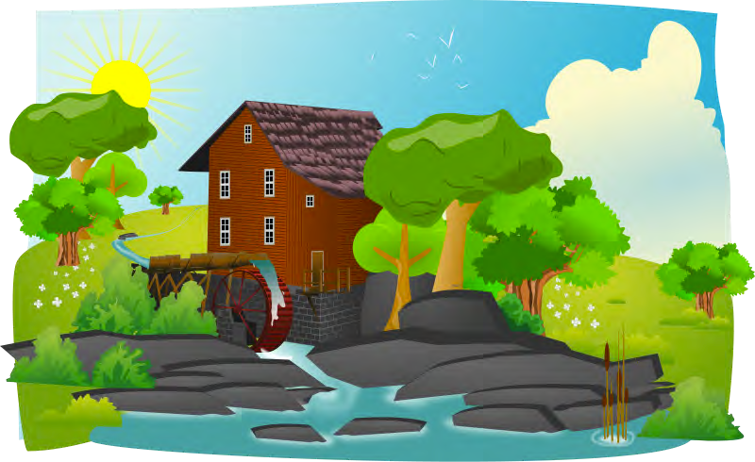
We are taking our helicopter to the cottage.

Slide 14
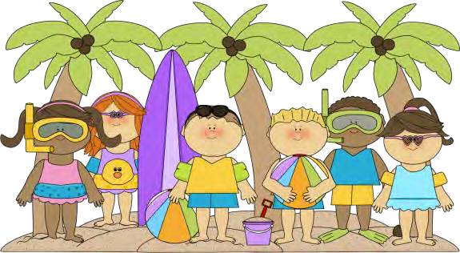
At the cottage, we fly to a little beach and meet some new friends.

Slide 15


We spent the
with our new friends.
“Hi, my name is Jessica”
‘Hello, my name is
Holly”

Slide 16

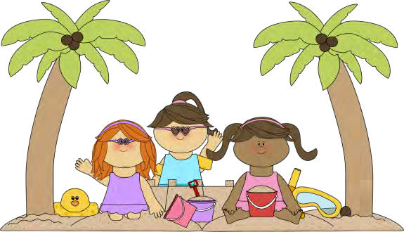
“Yes, you can borrow it! Nice to meet you too.”
‘Nice to meet you. May I borrow your bucket please?’

Slide 17


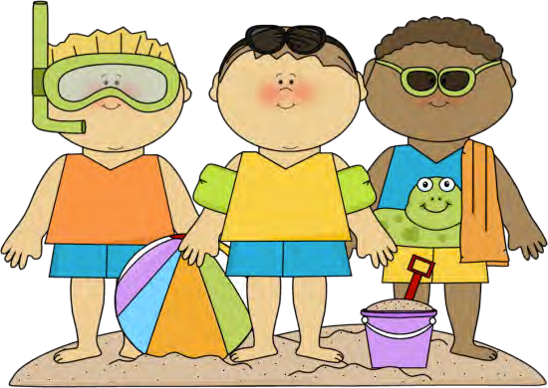
‘Thank you for playing with us.
We are having so
much fun!’
‘You are welcome! Let’s go swimming!’
‘That’s a great idea!
I like
swimming!”

Slide 18

“It is time to go home!
Let’s go back to
the helicopter.”
‘Yes, it is late! I am getting hungry!’

Slide 19

‘I had a great day.
See you later.’
‘Me too! I had a lot of fun!
Good bye!”

Slide 20

Today’s letters! -> ‘TT’

Slide 21
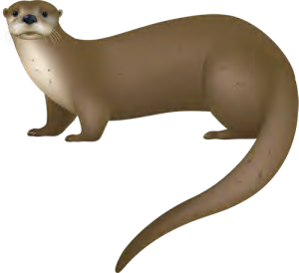

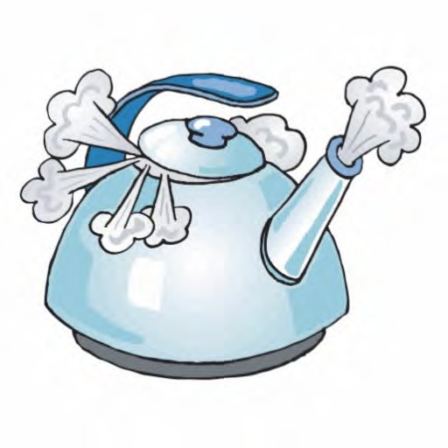
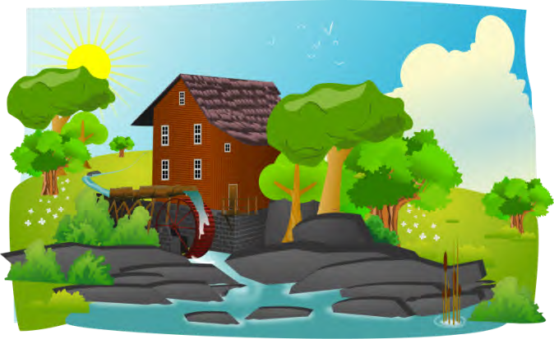
New words I learned today
Helicopter | Otter
Kettle | Cottage

Slide 22
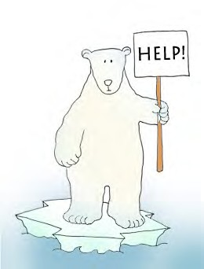

Final Thoughts
Do you have any questions?
Do you understand the handout?

Slide 23

Before the next class
Listen and read along with the ‘Truck, Planes and Trains’ book
Read book to yourself and to your family/friends Complete the worksheet
Practice writing new vocabulary words

