Slide 1


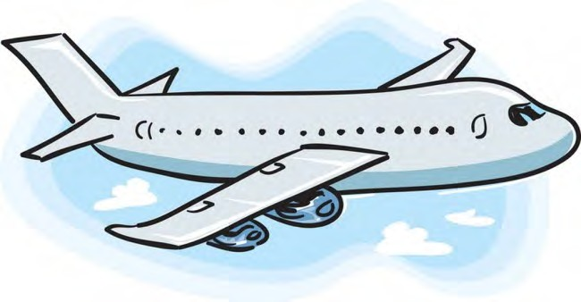






Adventures!
Adventures

Slide 2

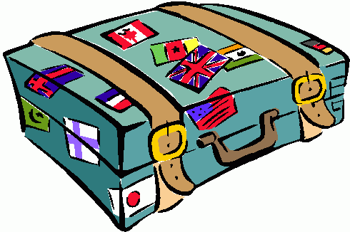
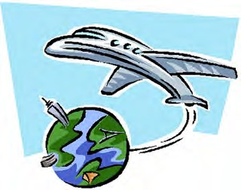
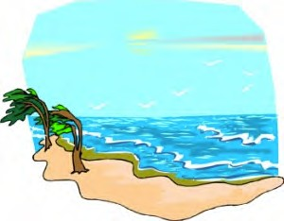
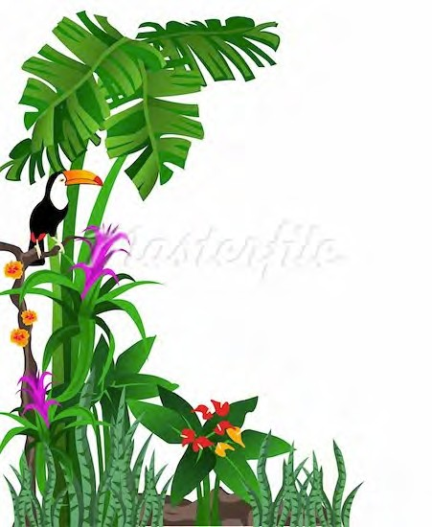
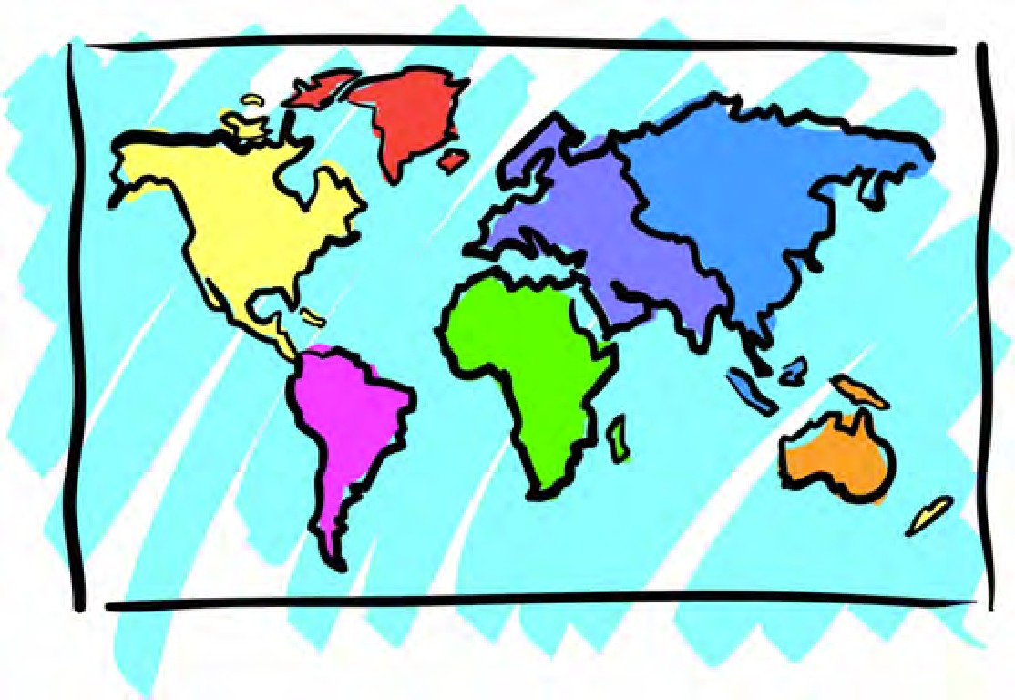


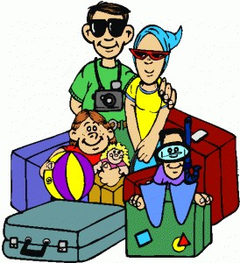
Adventures

Slide 3





What will I learn today?
Sounds of the letters ‘ss’ Negation (Using ‘do not’) New Australia Words

Slide 4


Today’s letters! -> ‘SS’

Slide 5


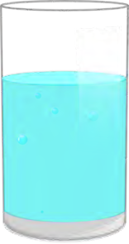
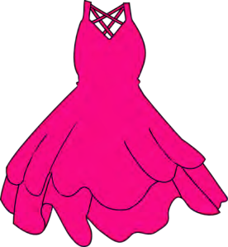
What did I learn today?
The sounds of the letters ‘ss’

Slide 6


Let’s take a trip together!
Where are we going today?

Slide 7





What is that sound?
Listen closely and see if you know what the sound is!

Slide 8
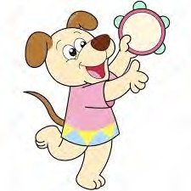
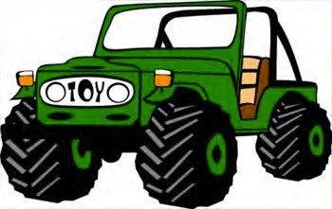
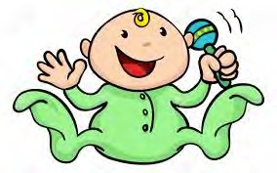
What is that sound?
Listen closely and see if you know what the sound is!
Circle the correct answer below

Slide 9

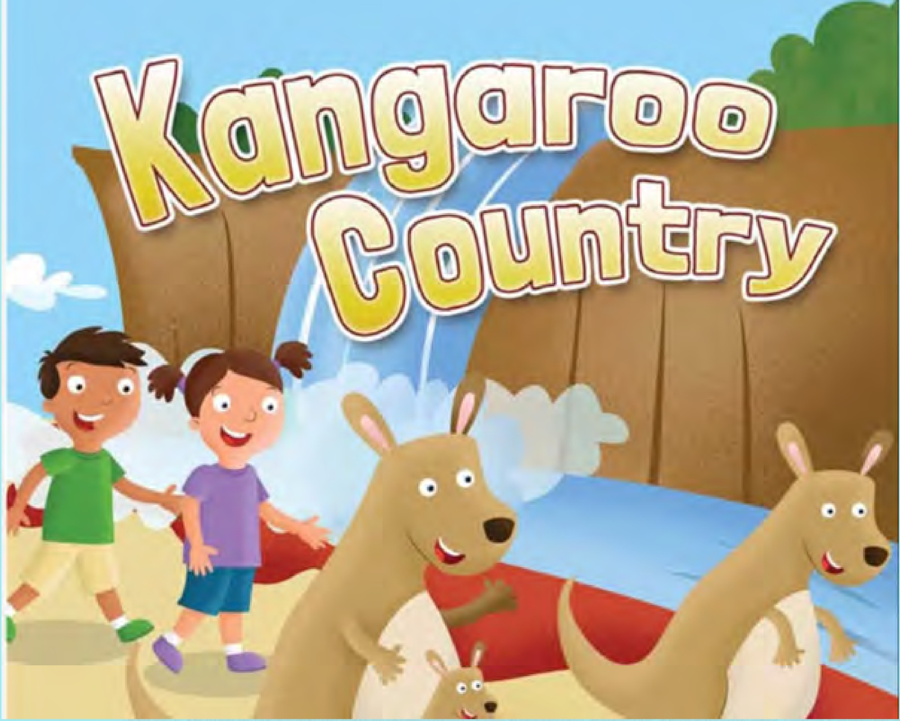
ROSEDALE
ACADEMY

Slide 10
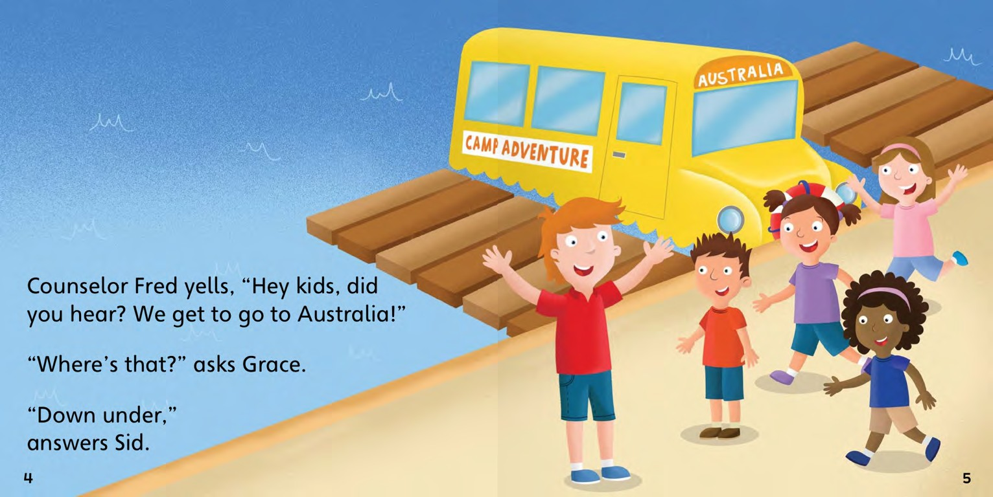
Teacher Mr. Fred says, “Hey Kids!
We are going to Australia!
We are going to see the animals!”

Slide 11
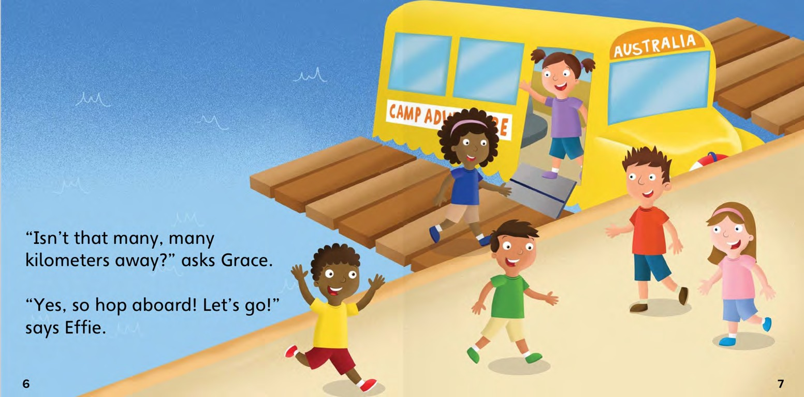
“Horray! We love going on trips!” said the students. “Let’s go!”

Slide 12
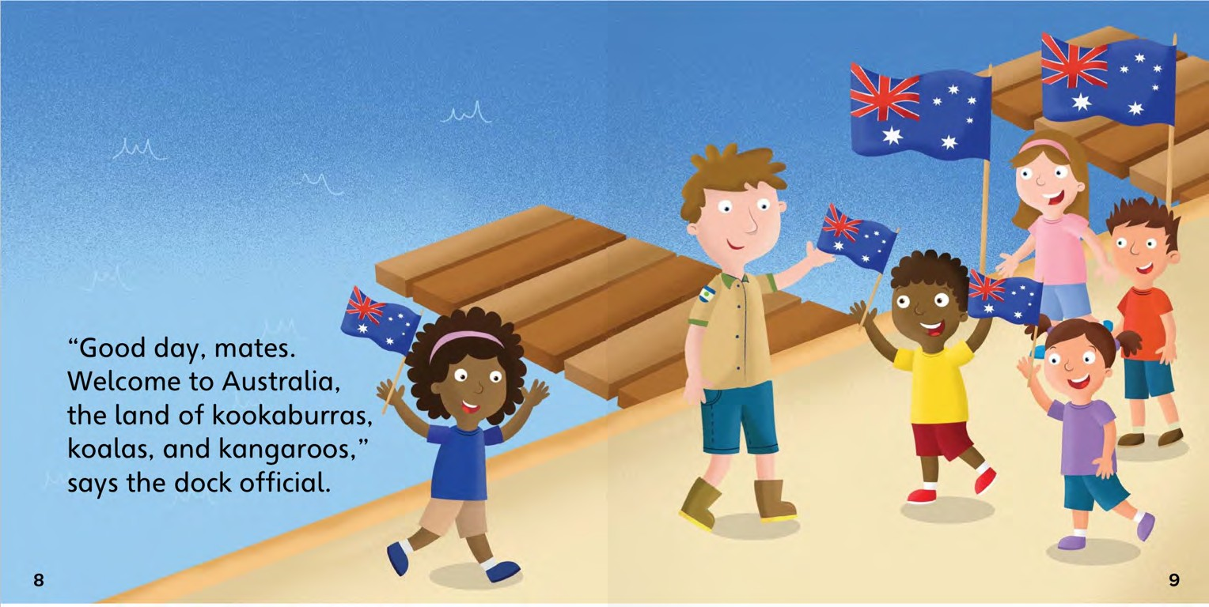
“Hello friends! “Welcome to Australia!
Let’s go explore”

Slide 13
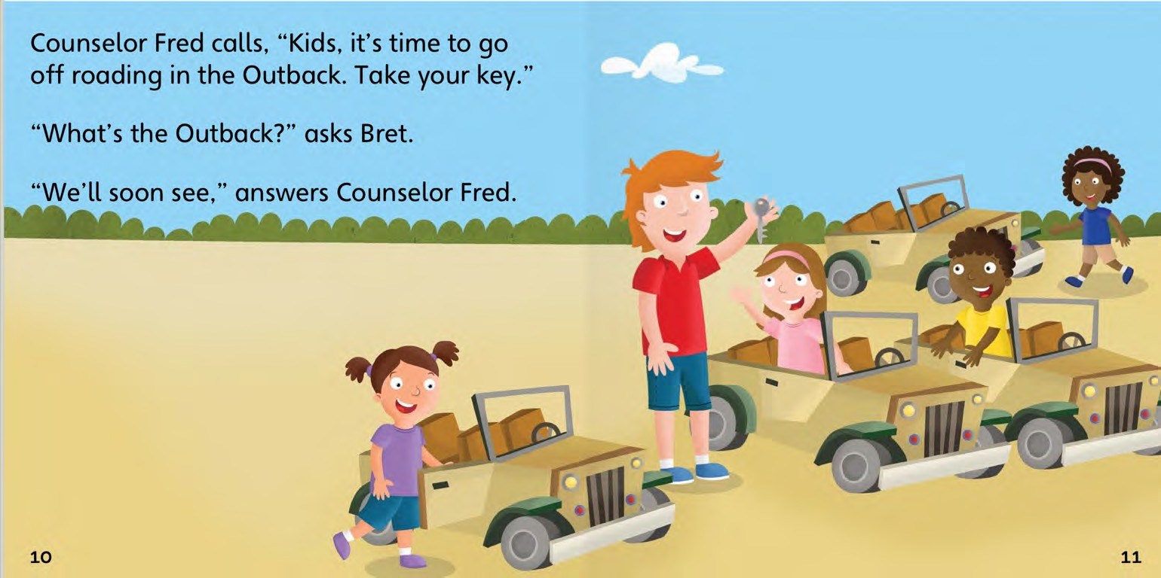
“Get in your car. We are going to see the animals!”

Slide 14
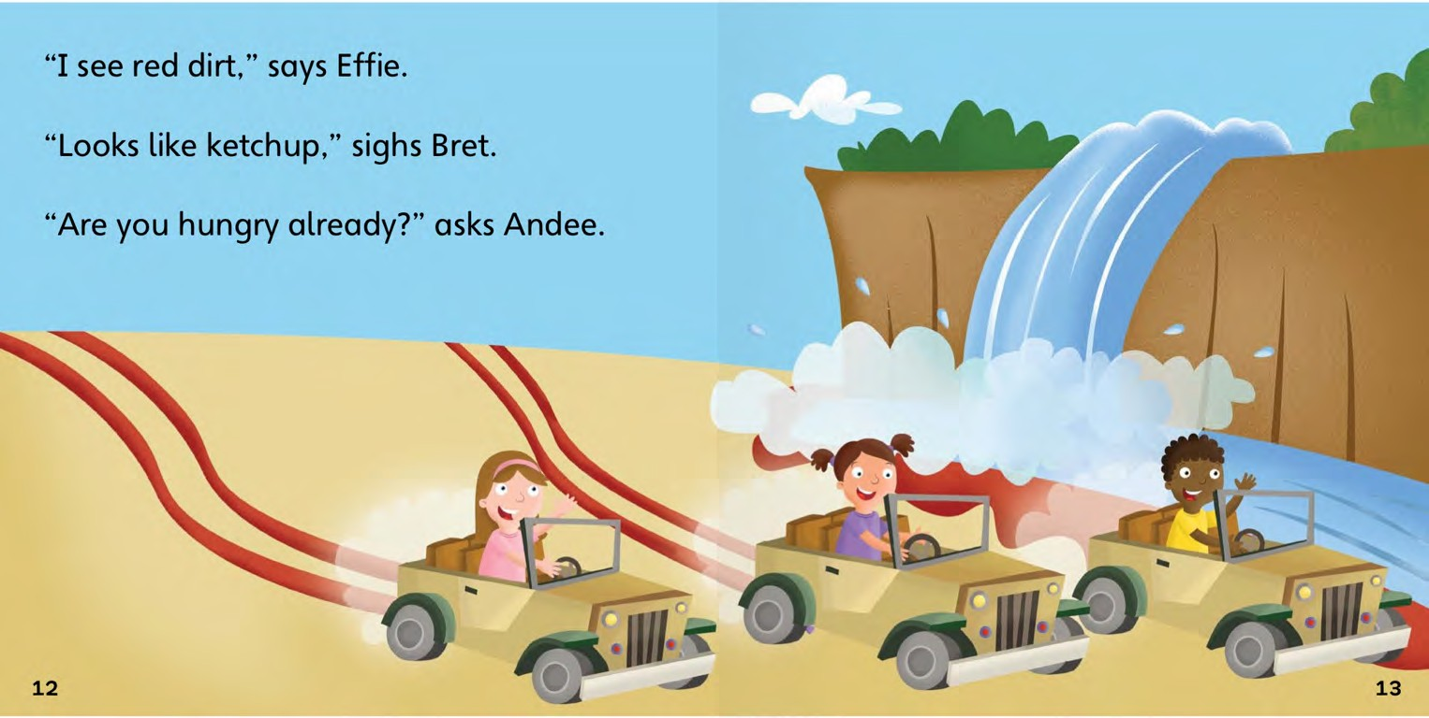
“Wow! Look at that waterfall! It is so big!
Where are the animals?”

Slide 15
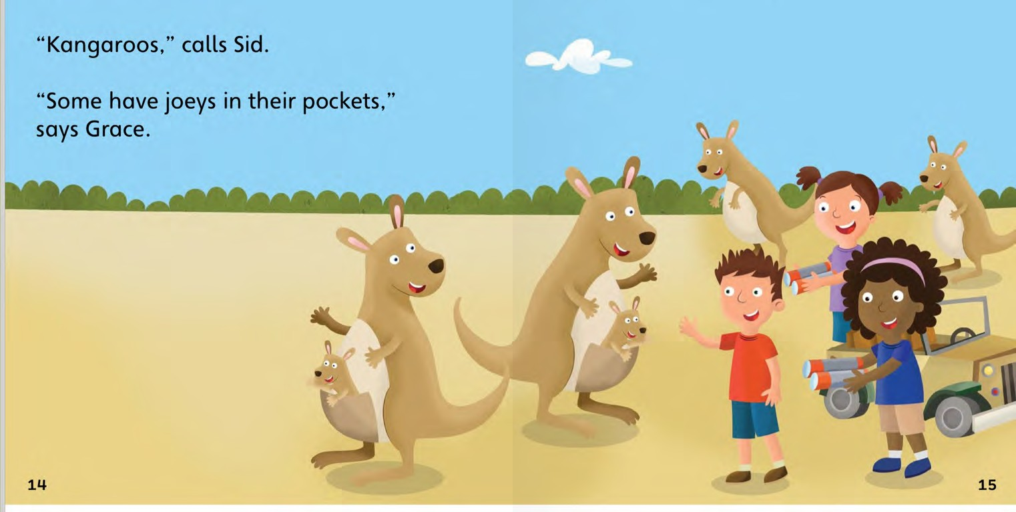
The class stopped when they saw the kangaroos.
They were with their
babies.

Slide 16
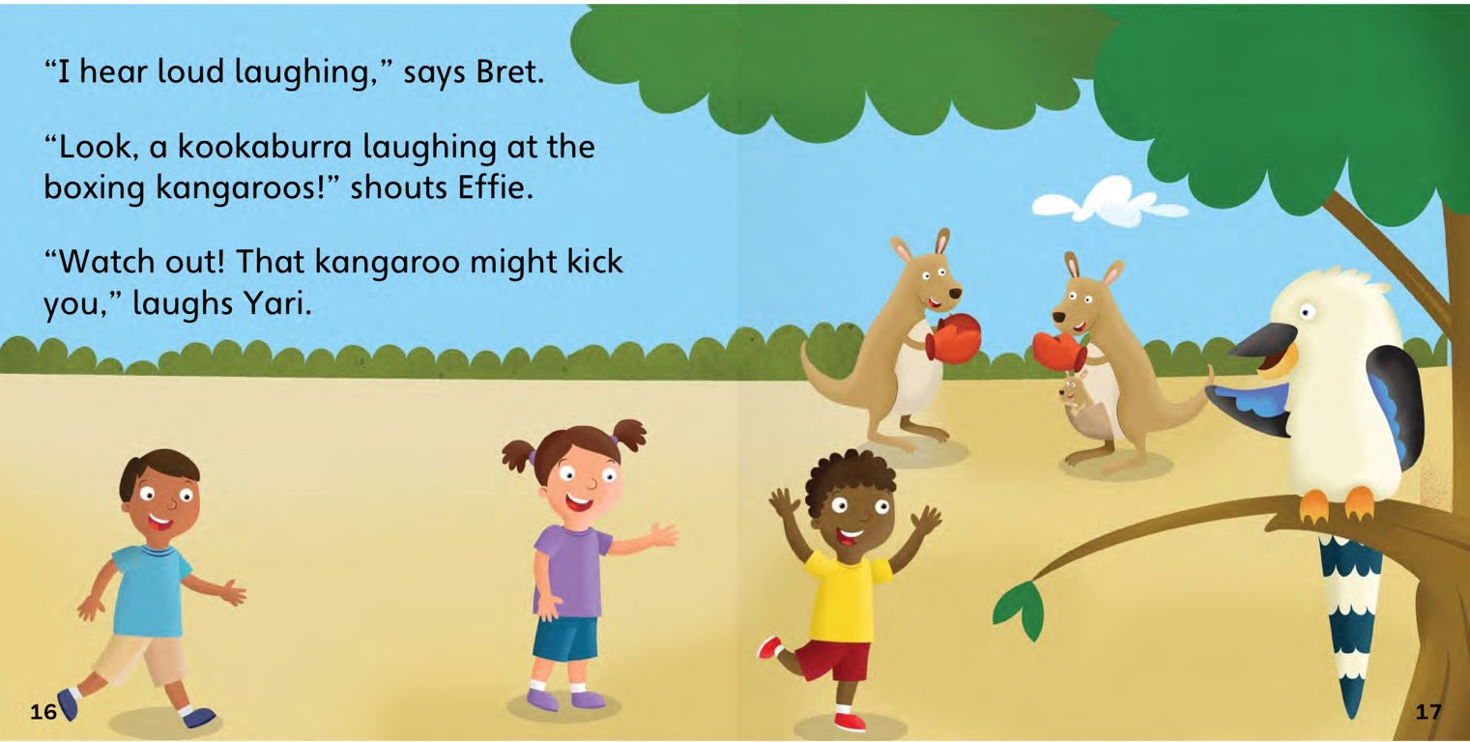
The second animal the class saw was a beautiful bird. The bird was in a tree.

Slide 17
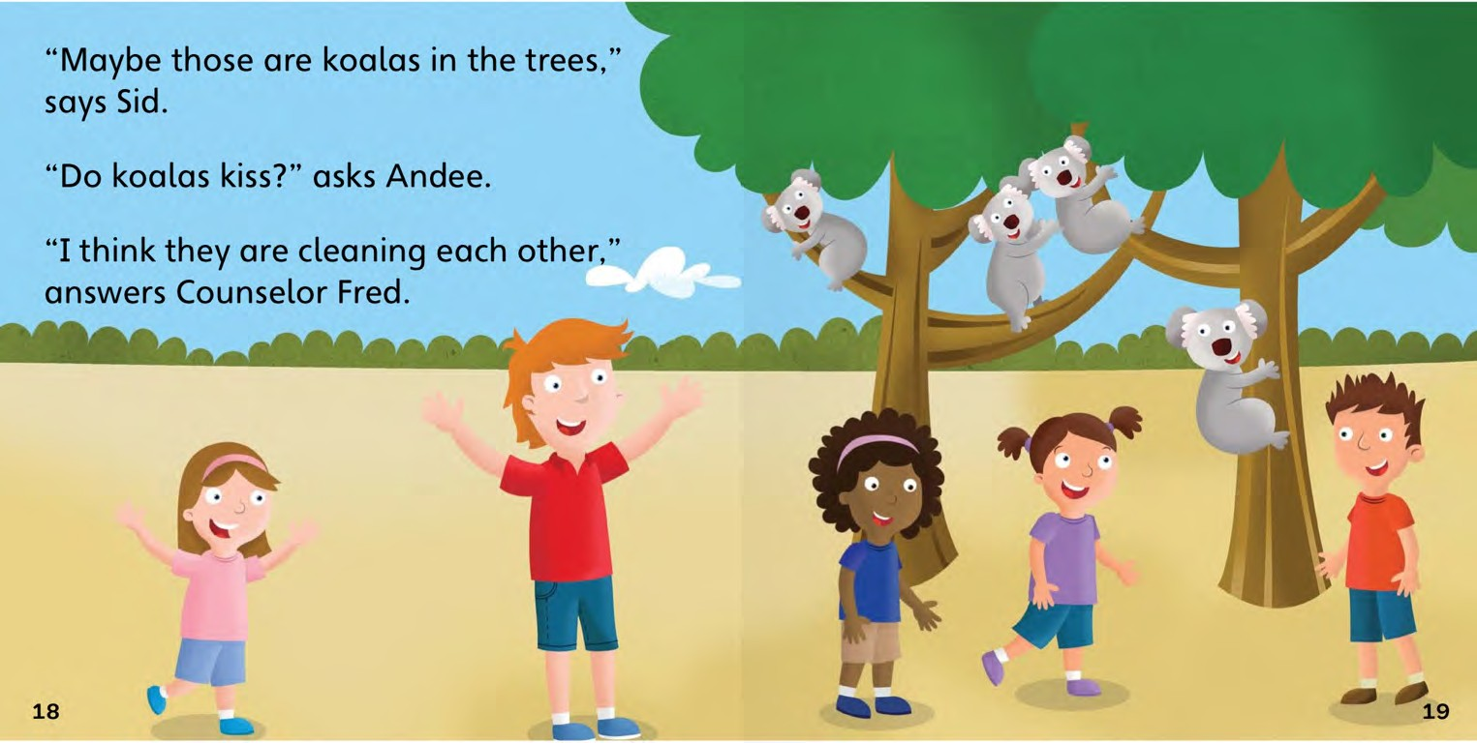
Next the class saw koalas! They were up, up, in trees eating leaves.
I wonder what we will see
next!

Slide 18
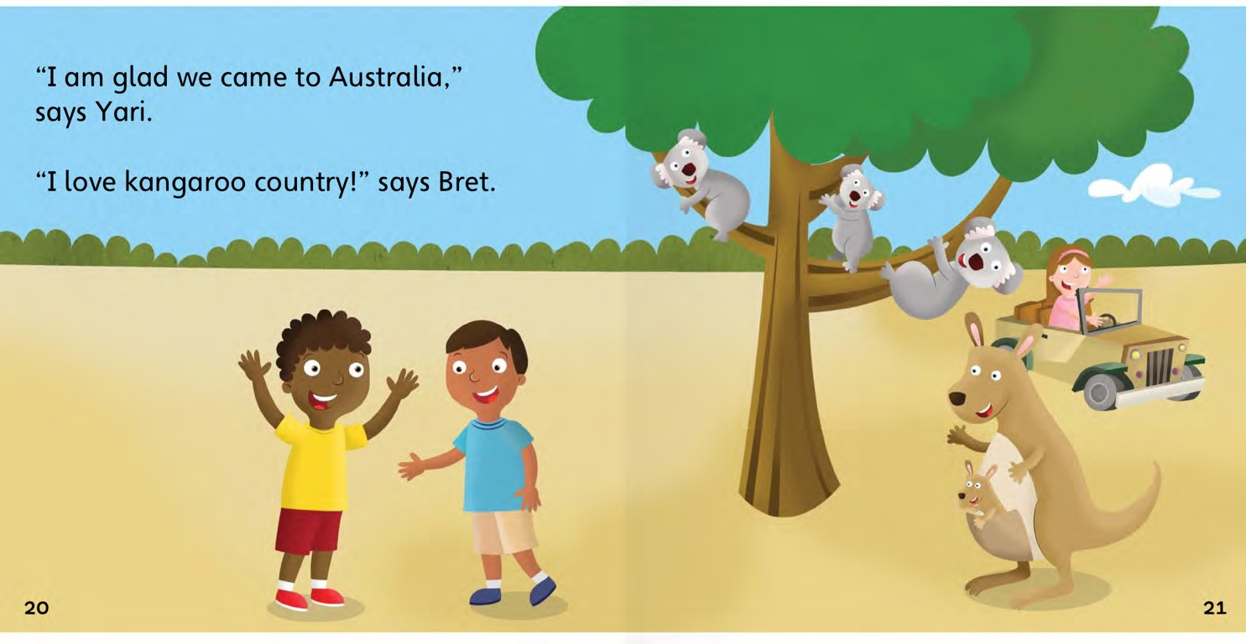
“I am very happy we came to Australia!
This is fun!”

Slide 19
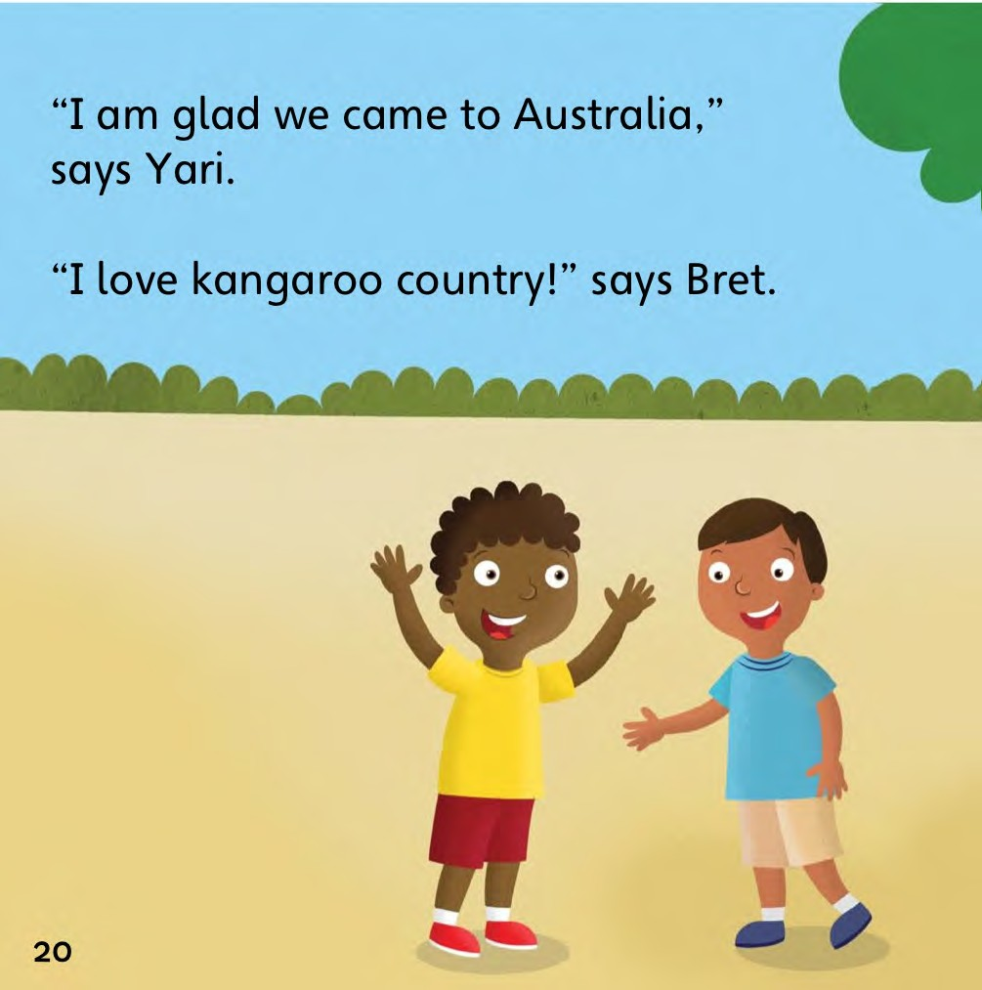
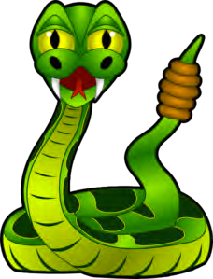
Before the class left they met one more animal.
A rattle snake!

Slide 20
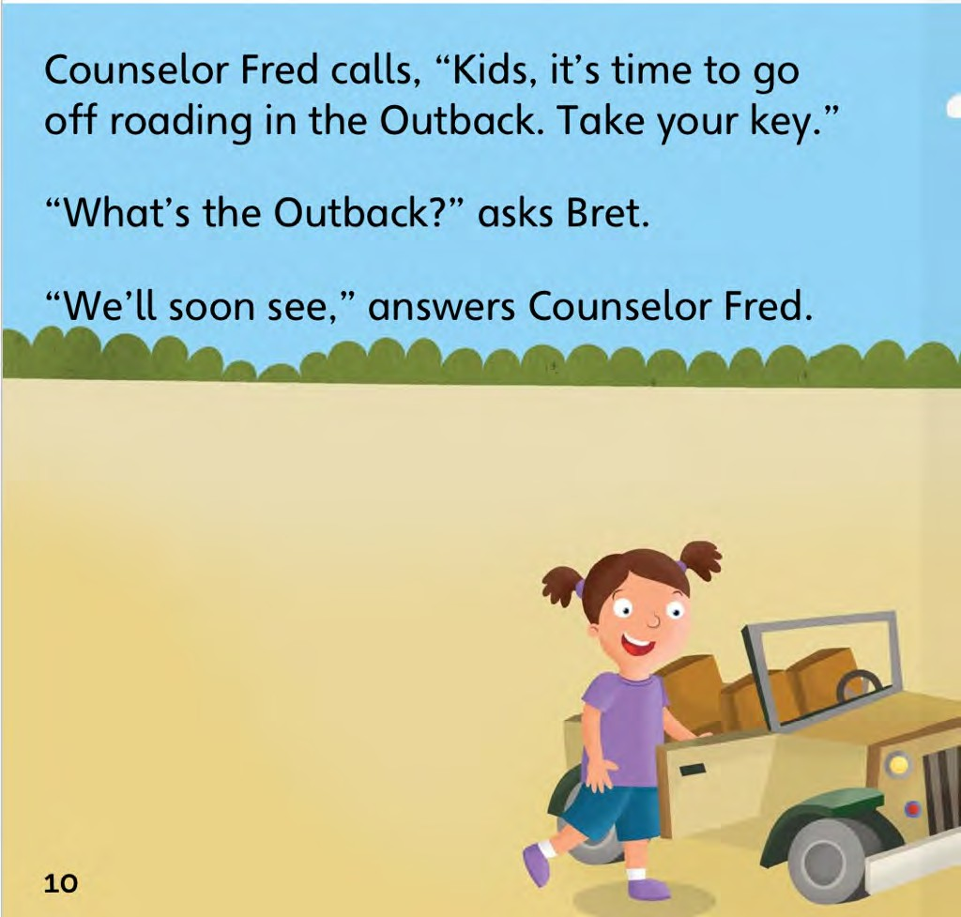
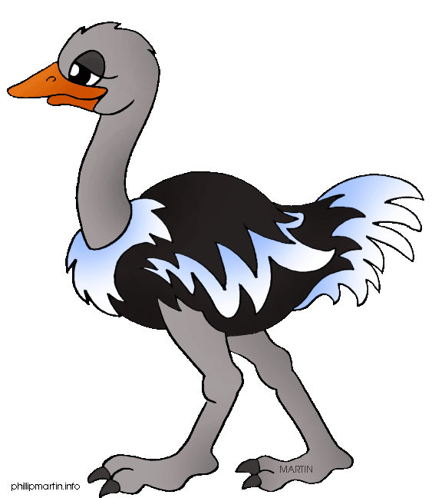
Mr. Fred calls to the class, “It is time to go!”
We had a great day. Now it is time to go home.
Goodbye Australia!

Slide 21
Negation
When we add the word ‘not’ to a sentence.

Slide 22
Negation
When we add the word ‘not’ to a sentence.
I like birds.
I do not like birds.

Slide 23
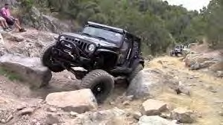
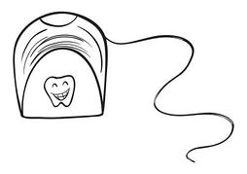
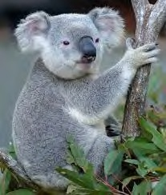
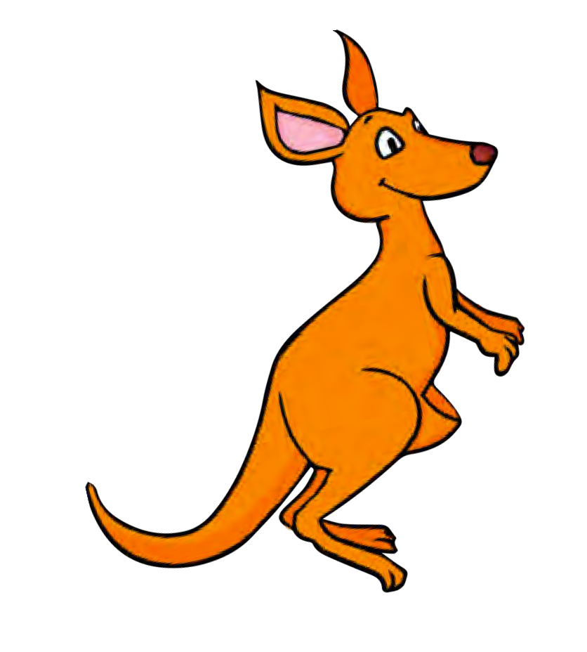
New words I learned today
Outback | Floss
Koala | Kangaroo

Slide 24
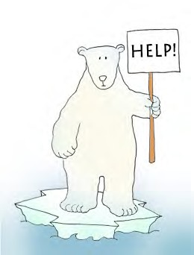

Final Thoughts
Do you have any questions?
Do you understand the handout?

Slide 25

Before next class ...
Listen and read along with the ‘Kangaroo Country’ book Read book to yourself and to your family/friends Complete the worksheet
Practice writing new vocabulary words

