Slide 1
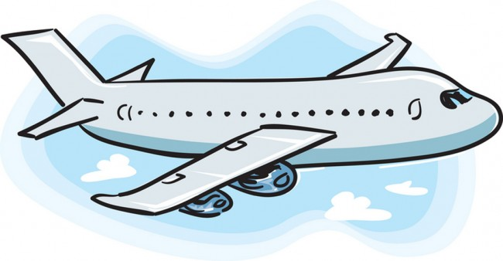
Adventures!
Adventures

Slide 2
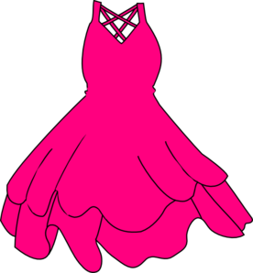
What did I learn last class?
Sounds of the letters ‘SS’
Negation
New Australia Words
Notes:
You can read these goals to them or have them read the goals if they can.
Underlining sentences and asking students to read one sentence at a time works well.

Slide 3
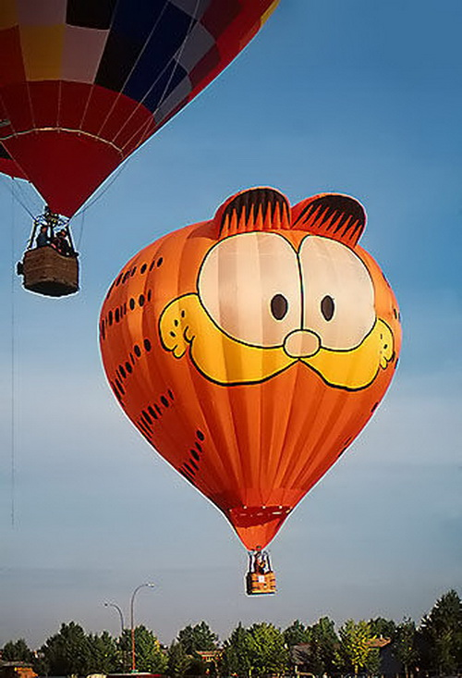
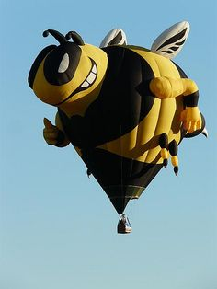
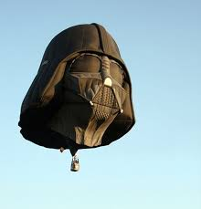
Notes:
‘What’s going on?” <- each lesson in this unit will have a section called Whats going on in the beginning to stimulate conversation and break the ice before class begins! Make your pen colour white and draw all of the key words on the board that the students come up with when they are describing or talking about the picture. Some words like ‘car’ ‘paint’ might come up! Have fun with it!

Slide 4
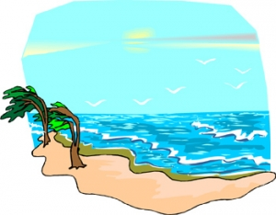
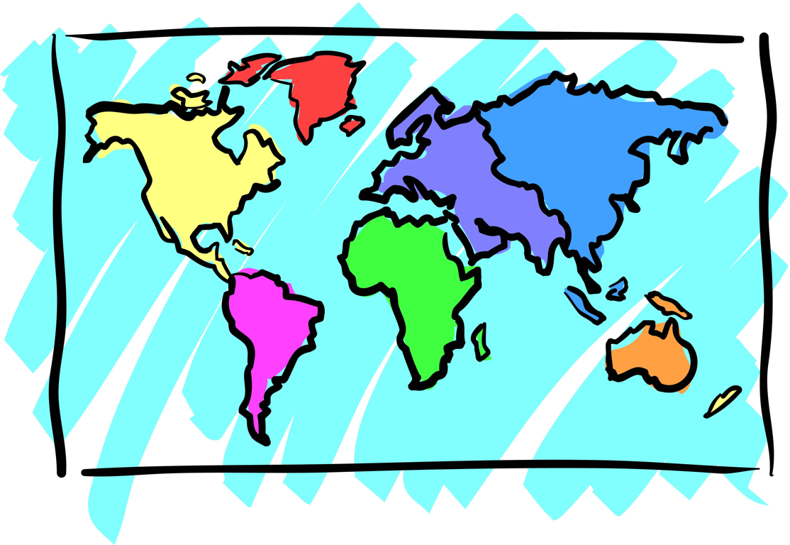
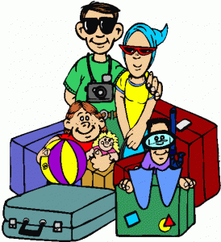
Adventures
Notes:
Define the word adventure for them and/or ask them if they have ever been on an adventure and with whom.
Ask, “What do you see on an adventure” or “What do you take with you on an adventure?”
Take this opportunity to write new words on the screen. Backpacking, Eiffel Tower, family vacation are all words that may be new to them.
If you need more space to write words and define them, you can flip over to a blank Whiteboard screen
If they are lower level English speakers, ask them to circle their favourite image with their mouse.
You can hold up your mouse to the camera and then draw a circle on the page so they can see it and they will copy.

Slide 5
What will I learn today?
The sound of the letters ‘LL’
Writing short sentences describing myself
Making connections between ourselves and the world
Notes:
You can read these goals to them or have them read the goals if they can.
Underlining sentences and asking students to read one sentence at a time works well.

Slide 6
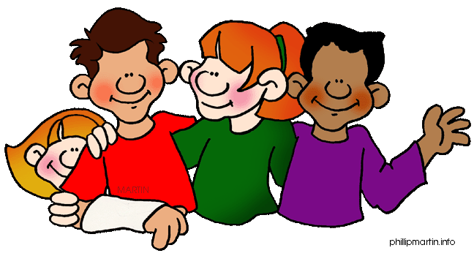
Let’s learn about each other!

Slide 7
My favourite colour is __________.

Slide 8
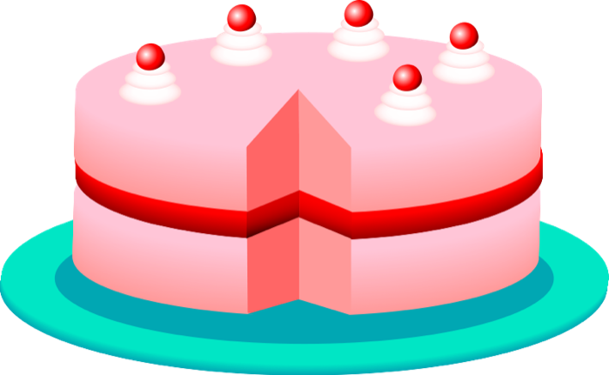
My favourite food is ___________.

Slide 9
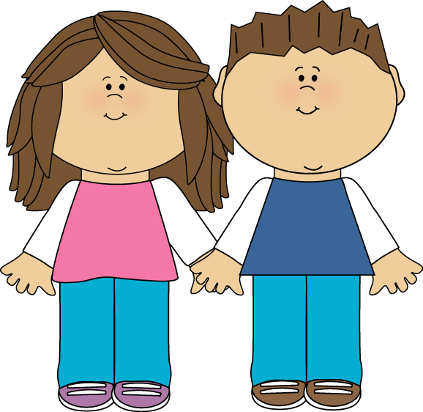
I have_____ brothers and
_____ sisters.

Slide 10
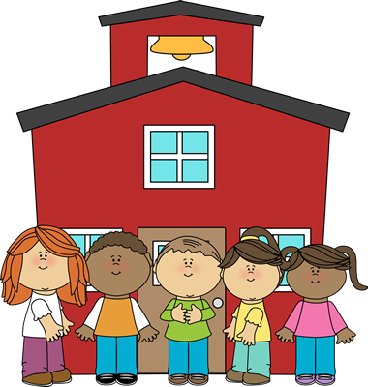
My favourite part about school is _______________
_______________________.

Slide 11
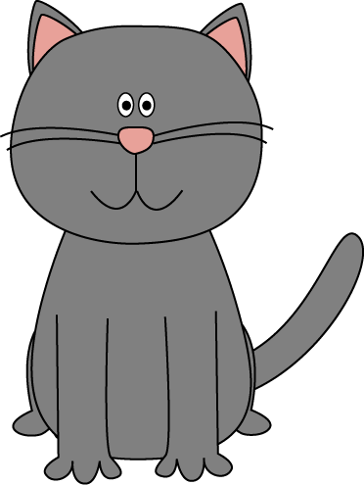
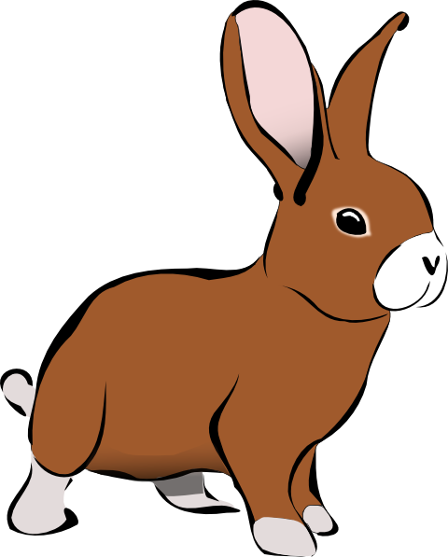
I have _____ pets.
The animal I have is a
_________.

Slide 12
What movie do you like?

Slide 13
Do you have school tomorrow?

Slide 14
What I just learned
Writing short sentences about ourselves.
Notes:
Have the students read the goal that they just completed.
Explain what they learned if needed.
Congratulate them.

Slide 15
What is that sound?
Listen closely and see if you know what the sound is!
Notes:
Find the movie clip “wave” and play it for the students. It is a blank image so that the students can only hear the lion roaring and not see it. Have the students guess before showing them the next slide.

Slide 16
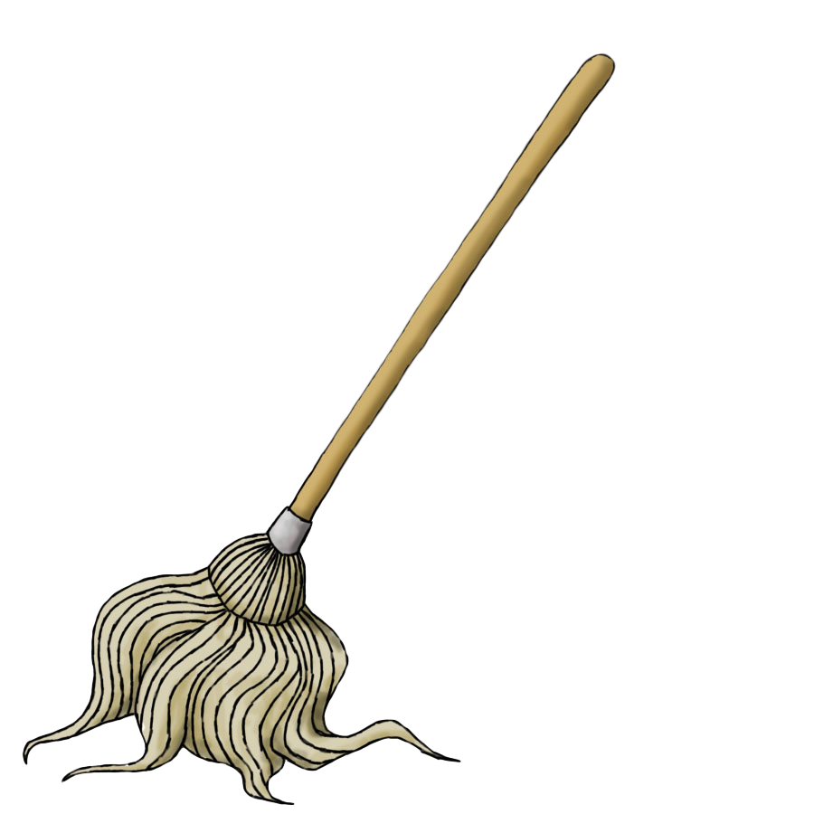
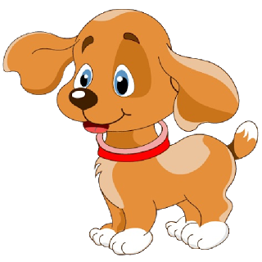
Circle the correct sound

Slide 17
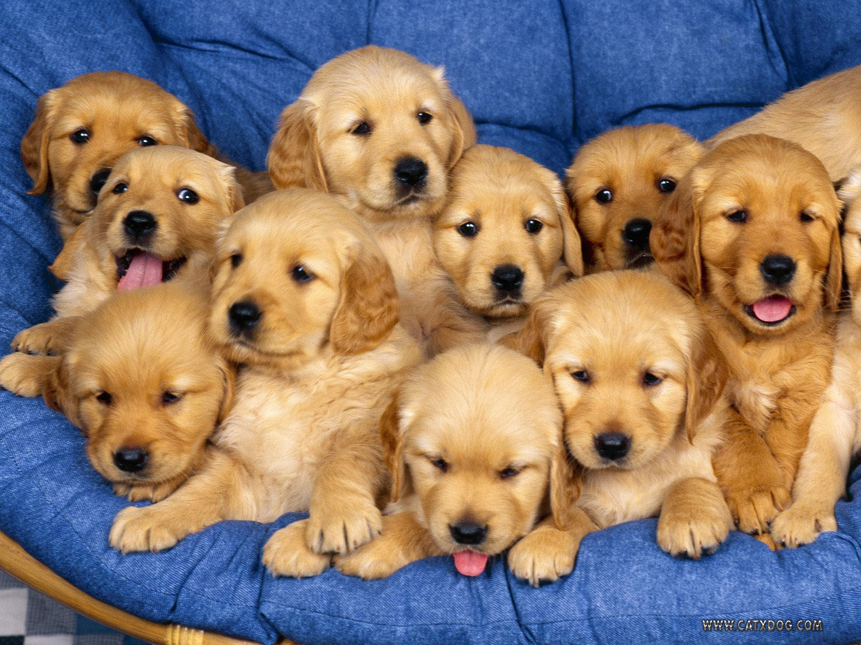
You’re right!
It is puppies barking!
Dogs bark to talk to each other just like cats meow and humans talk!

Slide 18
Odd Word Out Game!
Find the word that does not rhyme !
Notes:
http://www.englishmedialab.com/pronunciation/odd%20sound%20out.htm

Slide 19
Odd Word Out Game!
What is something new we learned during the game ?
Notes:
http://www.englishmedialab.com/pronunciation/odd%20sound%20out.htm

Slide 20
Let’s take a trip together!
Where are we going today?
Notes:
Let the students know that each lesson they will be going on a trip with you! After showing this slide, play the ‘Where are we going today?” video clip for the students. Talk about airplanes and if they would be scared or excited to go on an airplane.

Slide 21
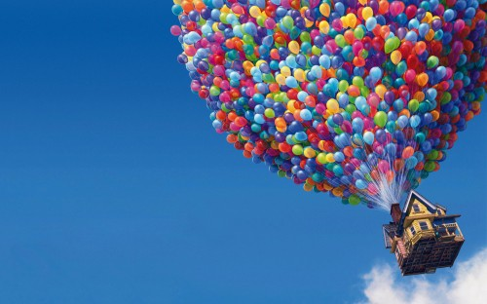
Let’s take a trip together!
Where are we going today?
Notes:
Let the students know that each lesson they will be going on a trip with you! After showing this slide, play the ‘Where are we going today?” video clip for the students. Talk about airplanes and if they would be scared or excited to go on an airplane.

Slide 22
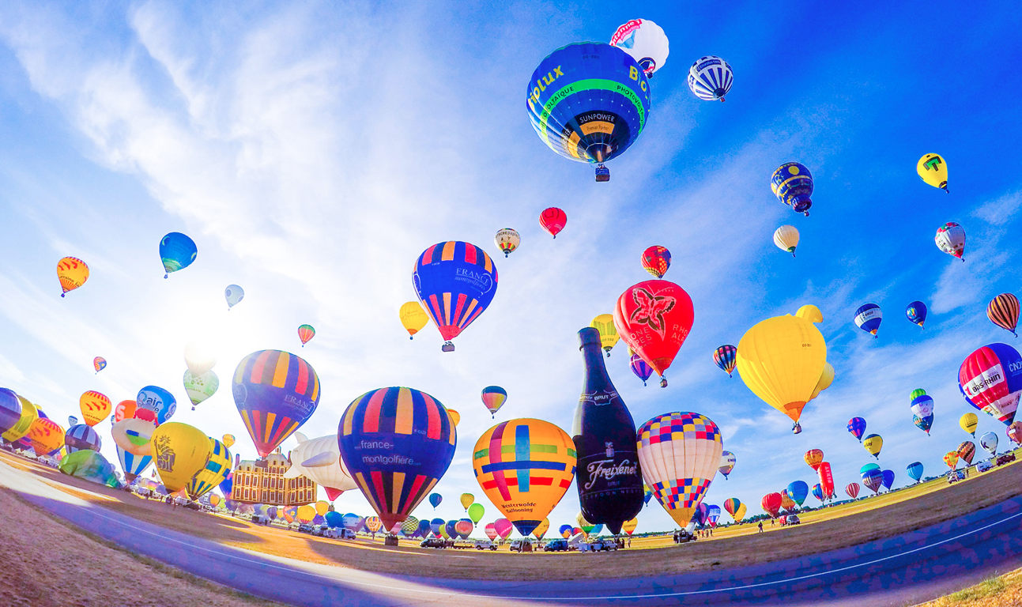
We are going to a
hot air balloon festival in France!

Slide 23
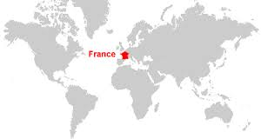
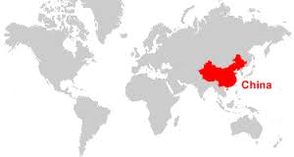
We are going to

Slide 24
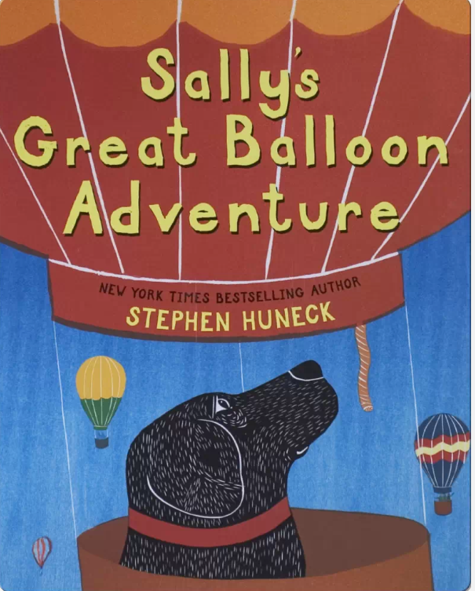

Slide 25
Sally the dog is going on a trip!
She is going to the balloon festival.
Sally knows what a balloon is but....

Slide 26
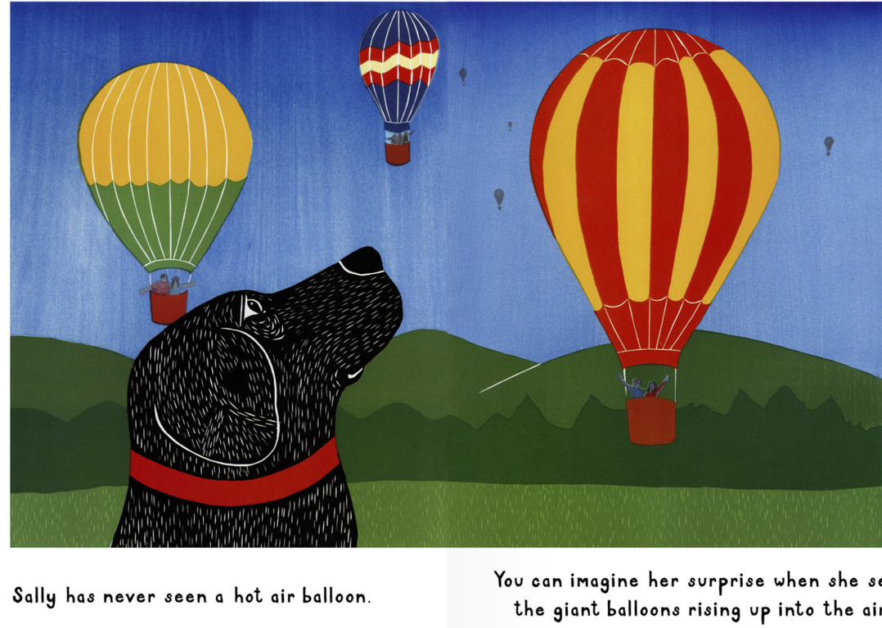
Sally has never seen a hot air balloon!

Slide 27
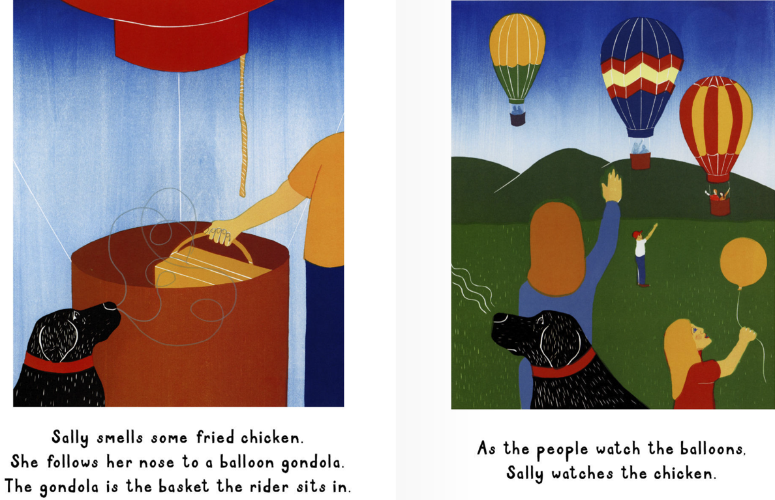
Sally smells chicken. She follows her nose to a balloon.
People watch the balloons. Sally watches the chicken.

Slide 28
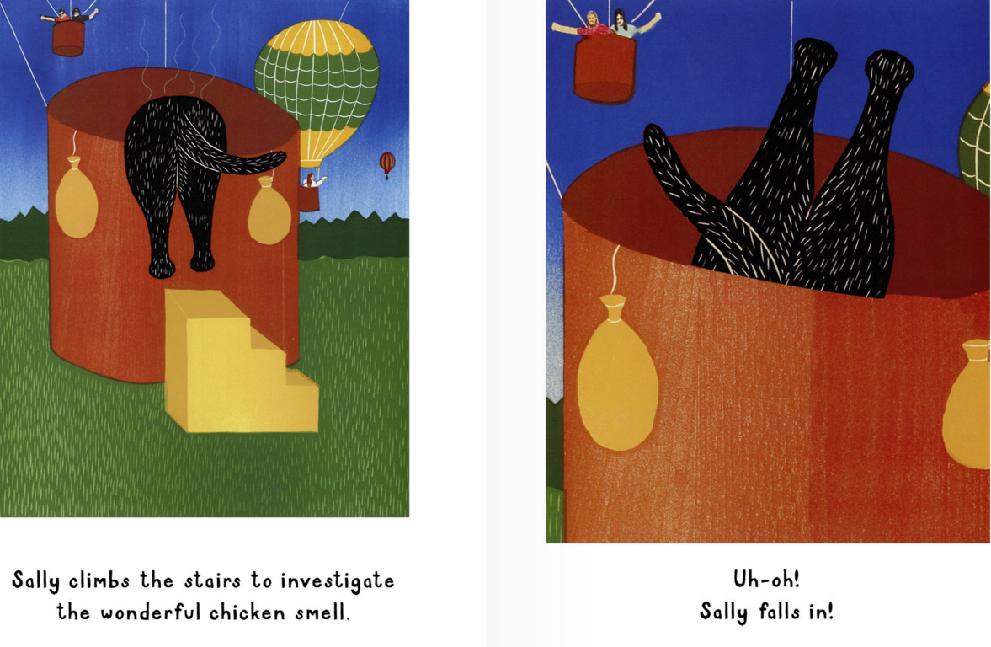
Sally follows her nose to the chicken!
Oh no! Sally falls in!

Slide 29
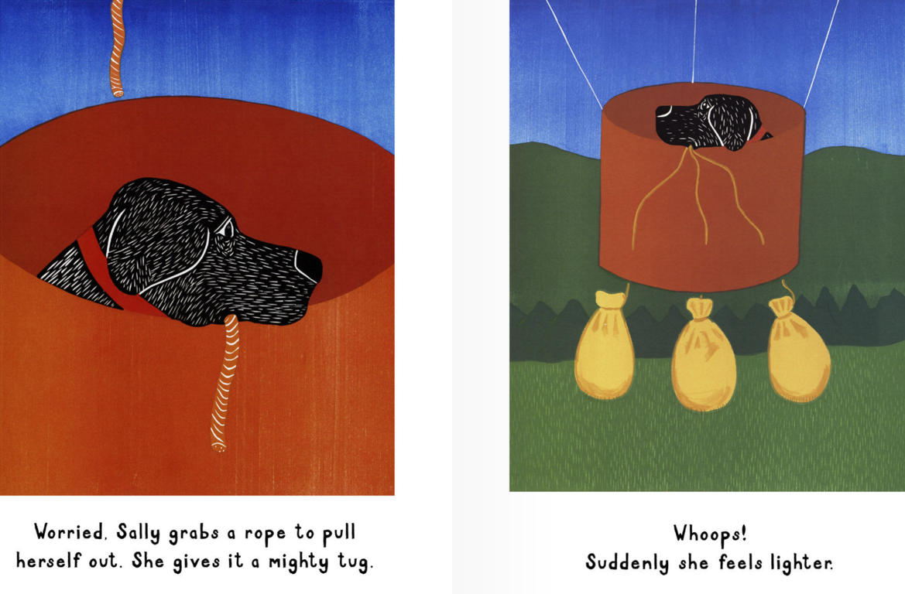
Sally grabs a rope to get out.
The rope makes the balloon fly off the ground!

Slide 30
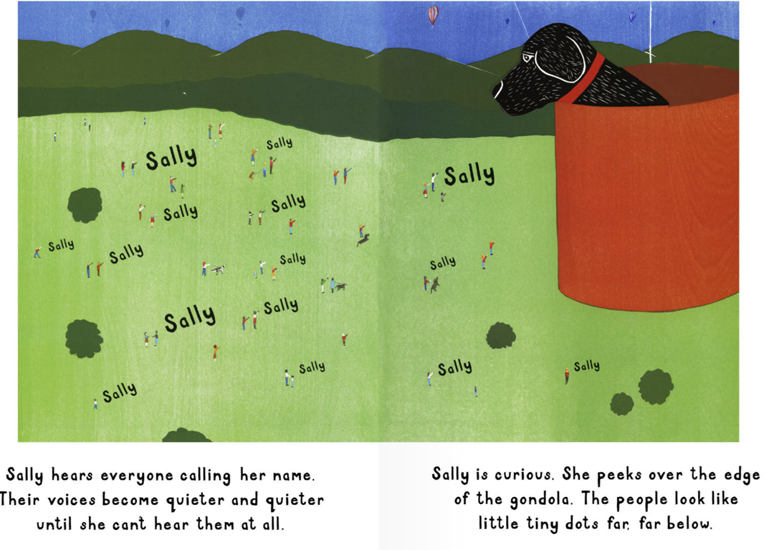
Sally hears her name being called. She is not afraid when she looks down.

Slide 31
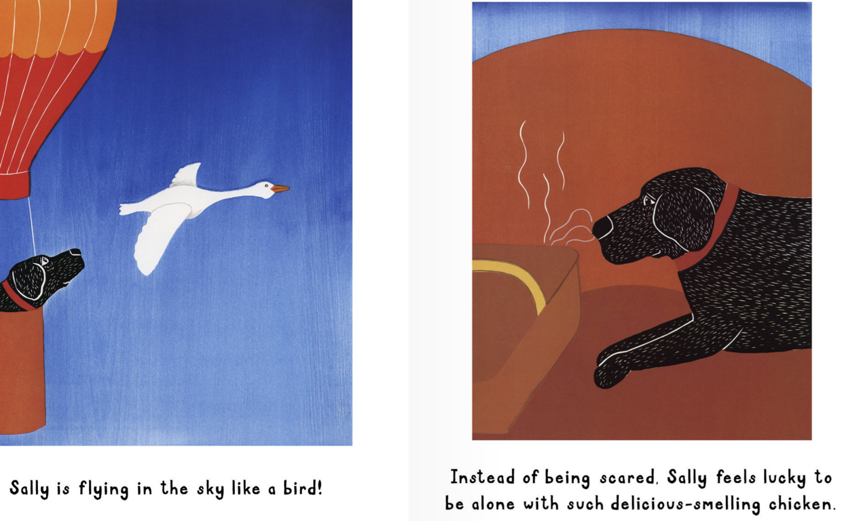
Sally is flying like a bird! She is happy to be with the chicken that smells so good!

Slide 32
Everyone is trying to get Sally down from the balloon!
They think she is stuck in the air!

Slide 33
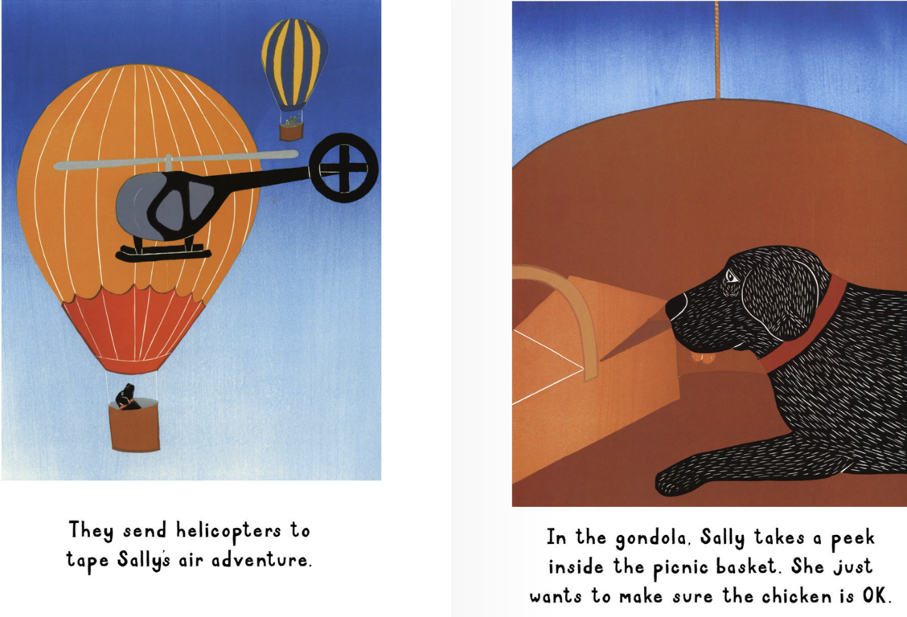
A helicopter goes to see if Sally is okay.
Sally is not scared.

Slide 34
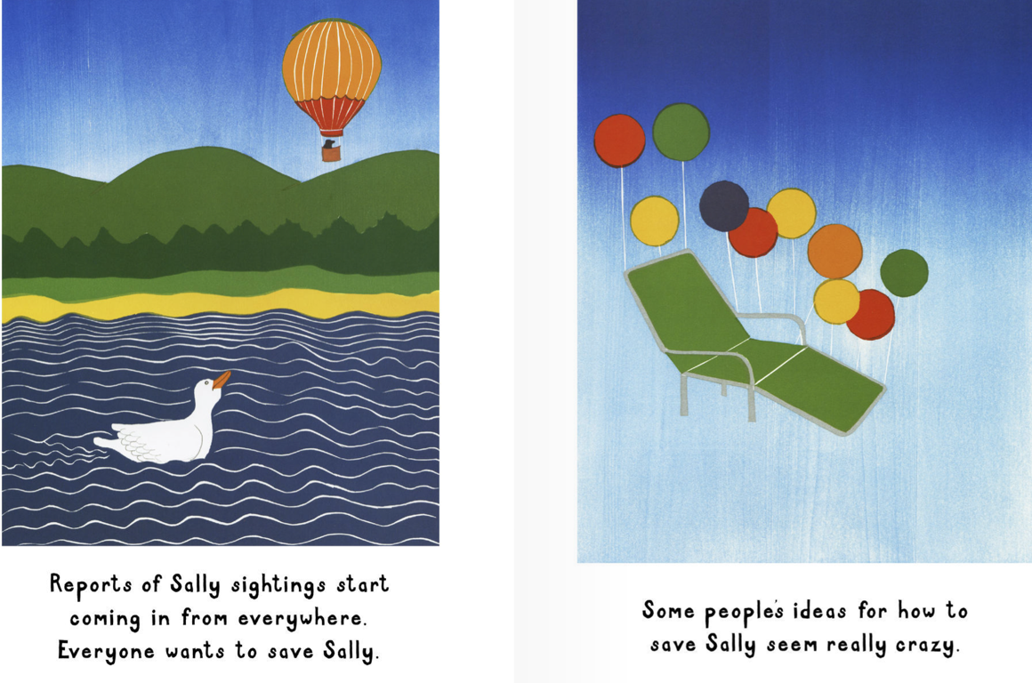
Everyone thinks of different ways to get Sally down!

Slide 35
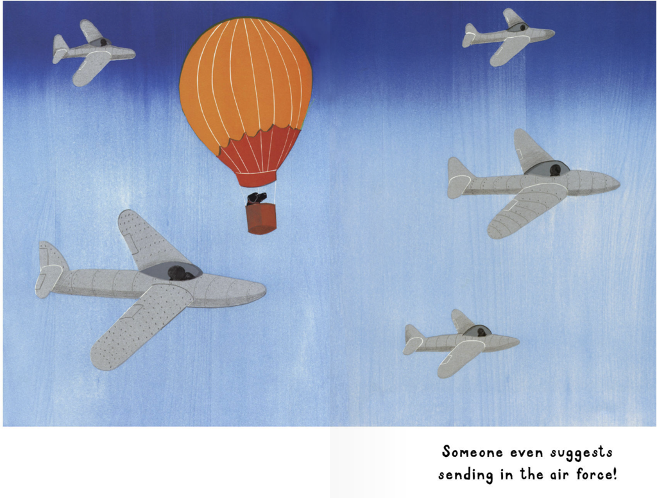
Even airplanes are sent to help Sally.

Slide 36
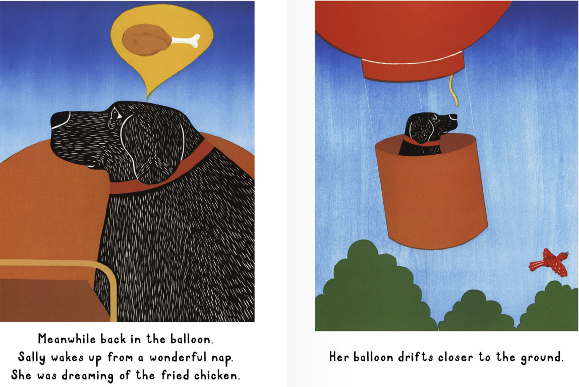
Sally thinks about the chicken as she gets closer to the ground.

Slide 37
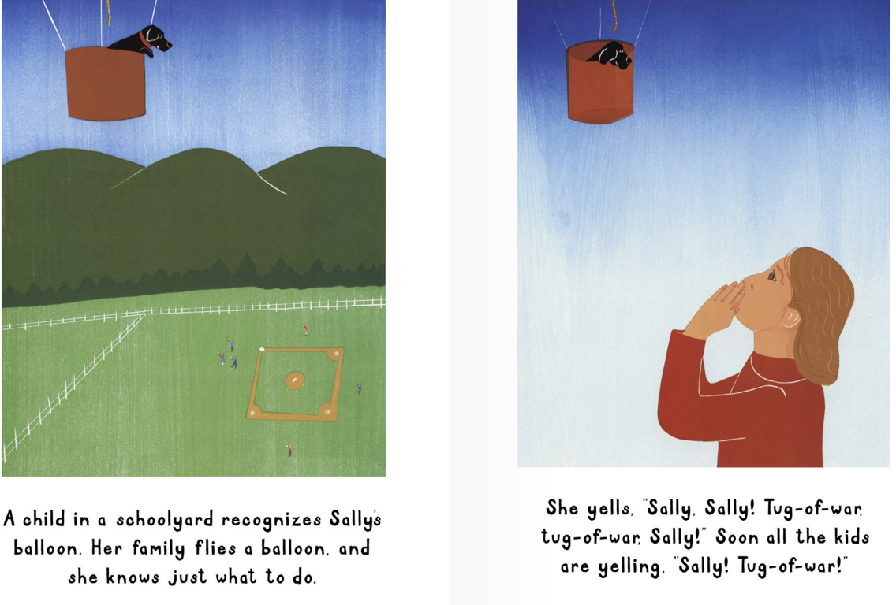
Children on the ground yell her name,
“SALLY! SALLY! Come play!”

Slide 38
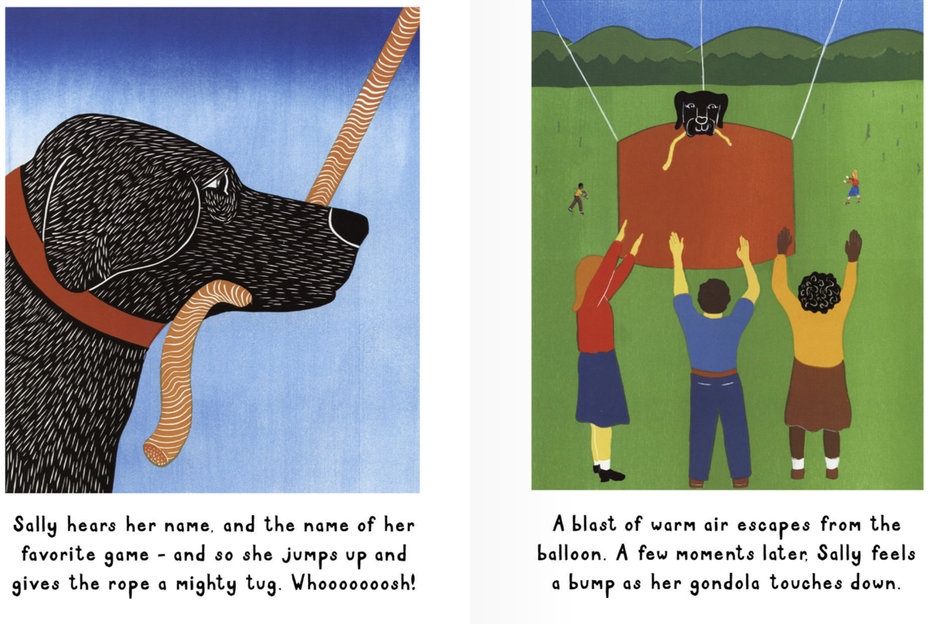
Sally loves to play. She finds a rope and
plays with the kids.

Slide 39
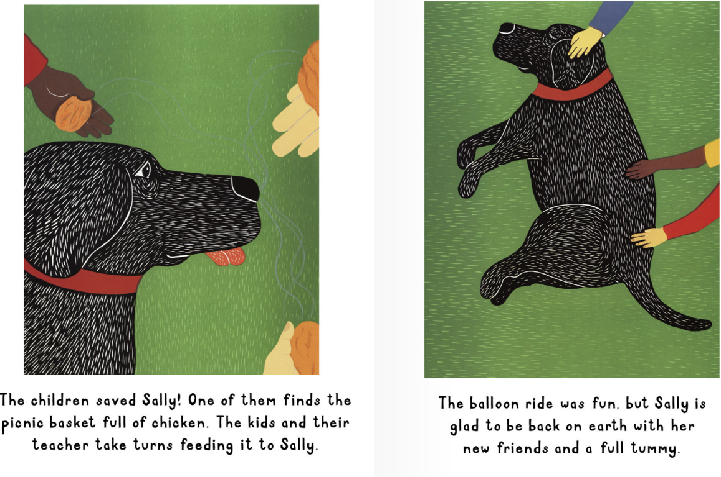
Sally is happy to be back.
She is tired from her adventure!

Slide 40
How do people try to get
Sally down from the Air Balloon?

Slide 41
What I just learned
Sounds of the letters ‘ll’
Summarizing what we have read
Notes:
Have the students read the goal that they just completed.
Explain what they learned if needed.
Congratulate them.

Slide 42
Today’s letters! -> ‘LL’
Notes:
Talk about the word ‘cottage’ which the students are familiar with from before. Write the word on the whiteboard for them so that they know how to spell it. Have them sound the word out as well.

Slide 43
Today’s letters! -> ‘LL’
Sally
Balloon
Notes:
Talk about the word ‘cottage’ which the students are familiar with from before. Write the word on the whiteboard for them so that they know how to spell it. Have them sound the word out as well.

Slide 44
Words with ‘LL’
Fill in the correct ‘LL’ word
_____________
_____________
_____________

Slide 45
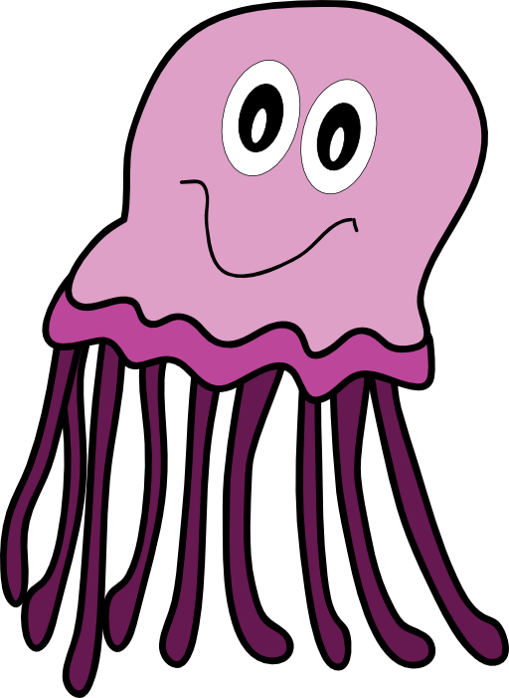
Words with ‘LL’
Fill in the correct ‘LL’ word
_____________
_____________
_____________

Slide 46
Circle the words with ‘LL’

Slide 47
What did I just learn?
The sounds of the letters ‘LL’
Notes:
Have the students read the goal that they just completed.
Explain what they learned if needed.
Congratulate them.
write down the new vocabulary words on the board and have the students write these new words on their worksheets under “Vocabulary”

Slide 48
New words I learned today
France
Jellyfish
Hot air balloon
Umbrella
Notes:
Have the students read the goal that they just completed.
Explain what they learned if needed.
Congratulate them.
write down the new vocabulary words on the board and have the students write these new words on their worksheets under “Vocabulary”. These are the words that the students should be practicing!

Slide 49
What did I learn today?
The sounds of the letters ‘LL’
Notes:
Have the students read the goal that they just completed.
Explain what they learned if needed.
Congratulate them.
write down the new vocabulary words on the board and have the students write these new words on their worksheets under “Vocabulary”

Slide 50
What did I learn today?
Writing short sentences describing myself
Notes:
You can read these goals to them or have them read the goals if they can.
Underlining sentences and asking students to read one sentence at a time works well.

Slide 51
What did I learn today?
Making connections between ourselves and the world
Notes:
You can read these goals to them or have them read the goals if they can.
Underlining sentences and asking students to read one sentence at a time works well.

Slide 52
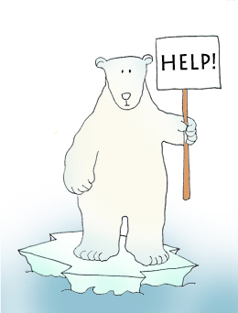
Final Thoughts
Do you have any questions?
Do you understand the handout?
Notes:
Wrap up your lesson and play the extra activities if you have any time. Answer any questions and pull up the worksheet if you want and go over the activities with them to ensure they understand.

Slide 53
Before next class ...
Listen and read along with the ‘Sally’s Balloon Adventure’ book
Read book to yourself and to your family/friends
Complete the worksheet
Practice writing new vocabulary words
Notes:
You can read these goals to them or have them read the goals if they can.
Underlining sentences and asking students to read one sentence at a time works well.

Slide 54
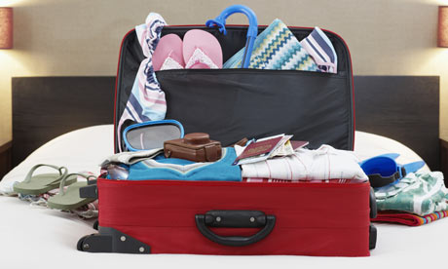
What is in this suitcase?

Slide 55
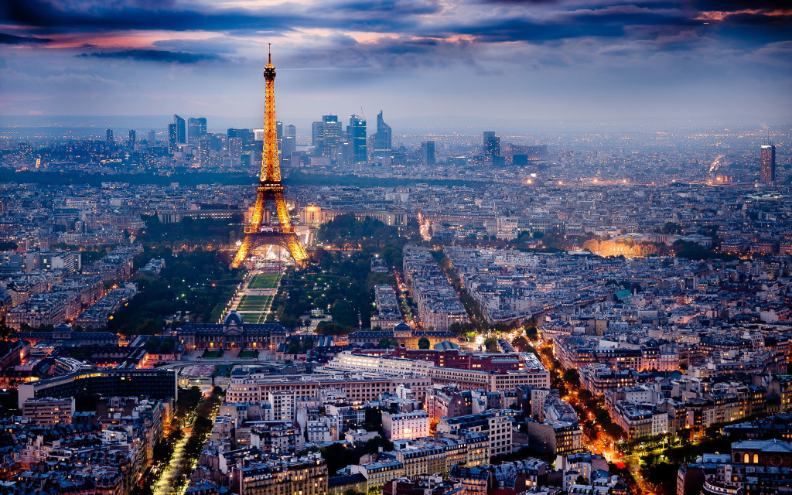
France!

Slide 56
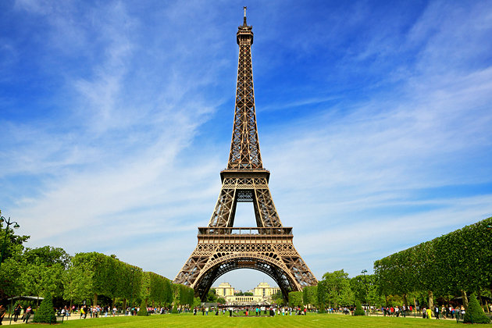
Eiffel Tower!

