Slide 1


Adventures!
Notes:
Unit 2, Lesson 1. Adventures. Let the students know that this unit we will be talking about adventures! See if the students can sound the word out on their own and see if they know what it means. The visual cue should help them (the airplane!)

Slide 2
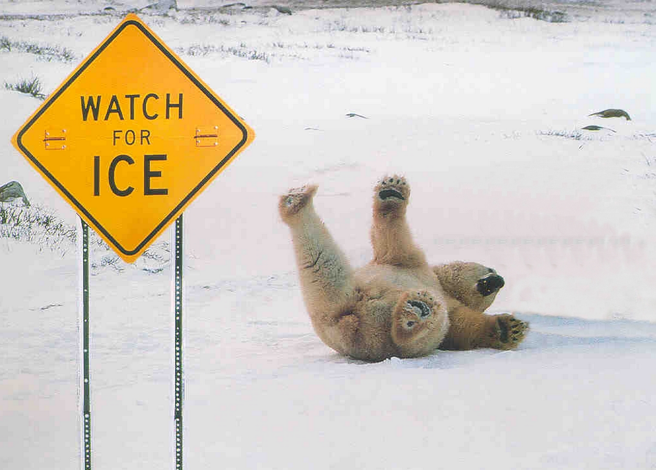

Notes:
What’s going on?” <- each lesson in this unit will have a section called Whats going on in the beginning to stimulate conversation and break the ice before class begins! Make your pen colour white and draw all of the key words on the board that the students come up with when they are describing or talking about the picture.

Slide 3

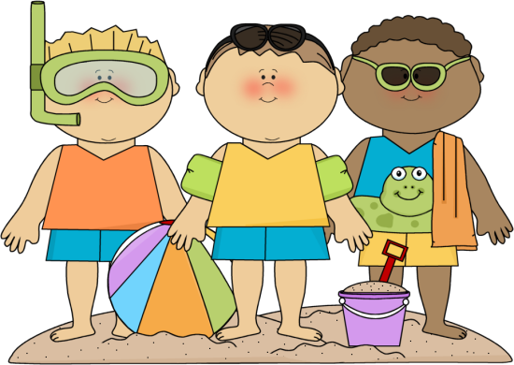
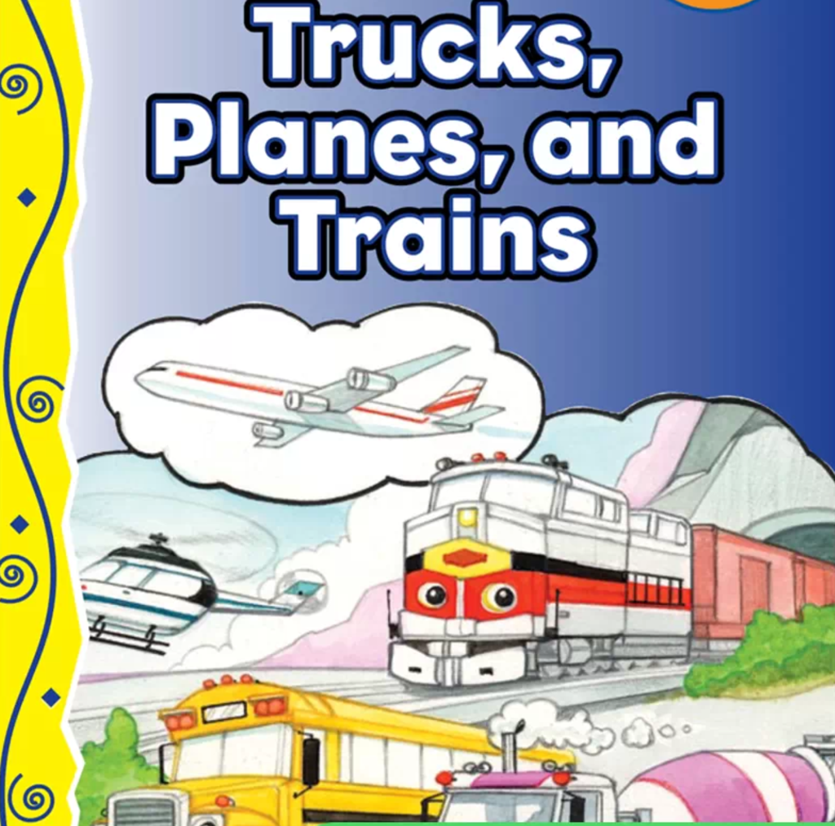
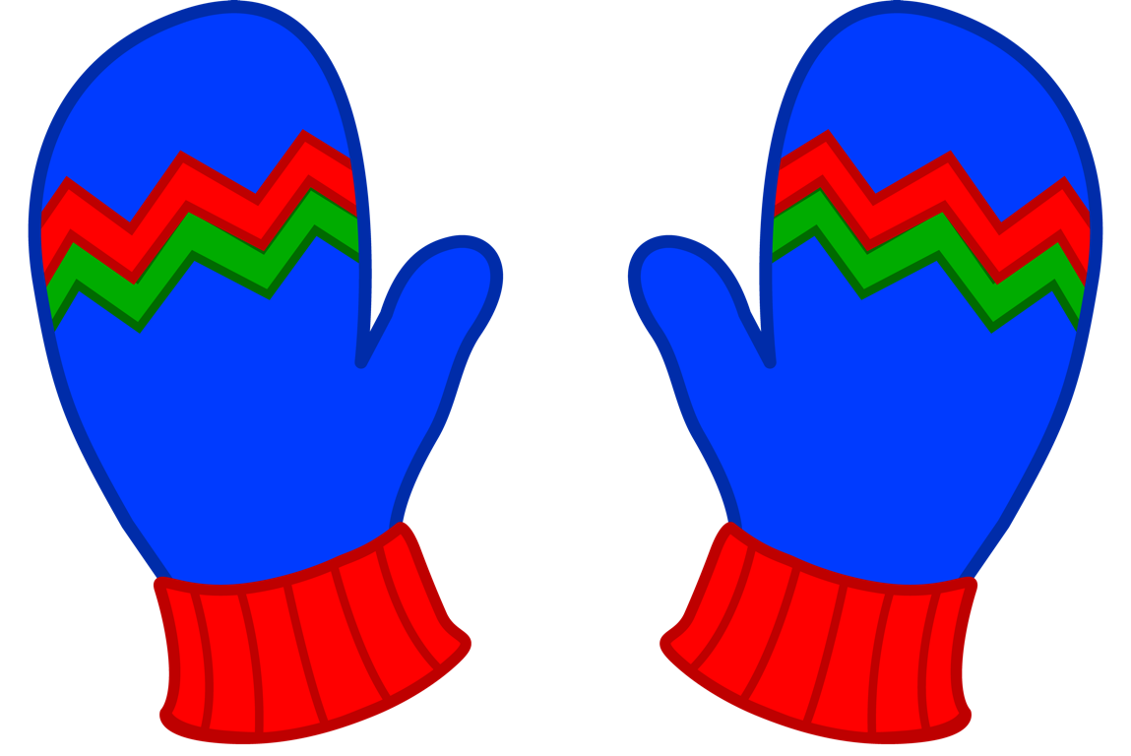

What did I learn last class?
How the letters ‘tt’ sound
Talk to each other using words like ‘please and ‘thank you’
Talk about where we would like to travel
Learn about different ways to travel
Notes:
You can read these goals to them or have them read the goals if they can.
Underlining sentences and asking students to read one sentence at a time works well.

Slide 4
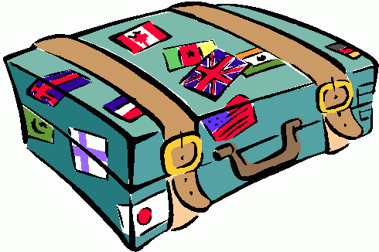


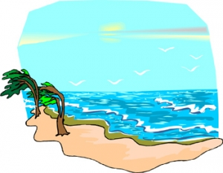
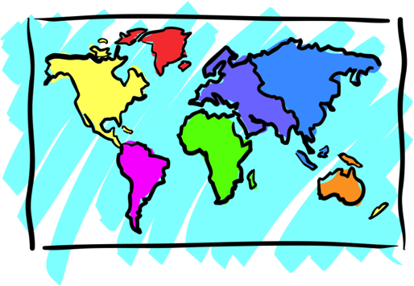

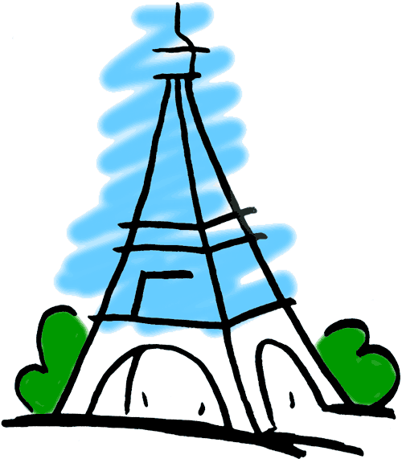
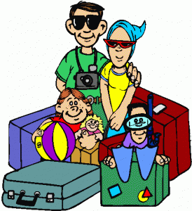
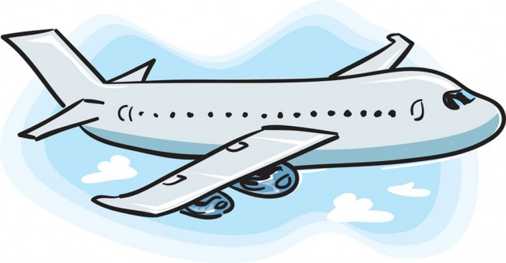
Adventures

Slide 5

What will I learn today?
Fill in the blanks
Use present tense
The sound of the letters ‘pp’
Notes:
Have the students read the goals if they can. I find that underlining sentences and asking students to read one sentence at a time works well.

Slide 6
Today’s Story

Slide 7

Notes:
Have one of the students read the title or you can read it yourself. Have the students point out what they see in the image as well as what kind of animal is in the image. You can even ask the students how they feel right now and see if they are able to answer it.

Slide 8


Slide 9
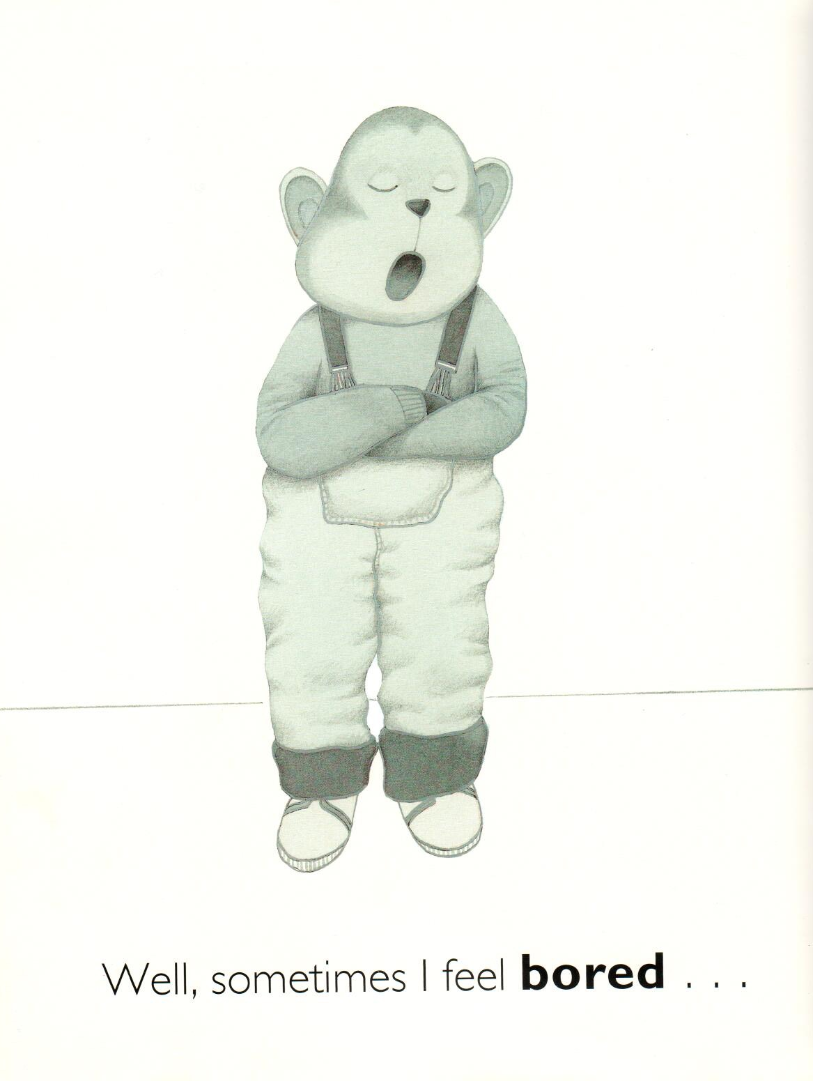
Use a word from the
word wall to complete
the sentence.
Bored
Lonely
Very Happy
____
Notes:
Have the students use the word bank to help them answer the question. Have them circle the answer they think is correct or have them write the answer in! Make sure that the students understand how the bear is feeling. Continue this process with the rest of the story.

Slide 11
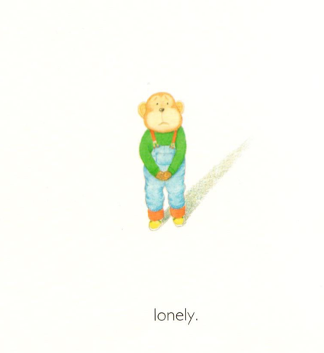
Bored
Lonely
Very Happy
________

Slide 12


Slide 13
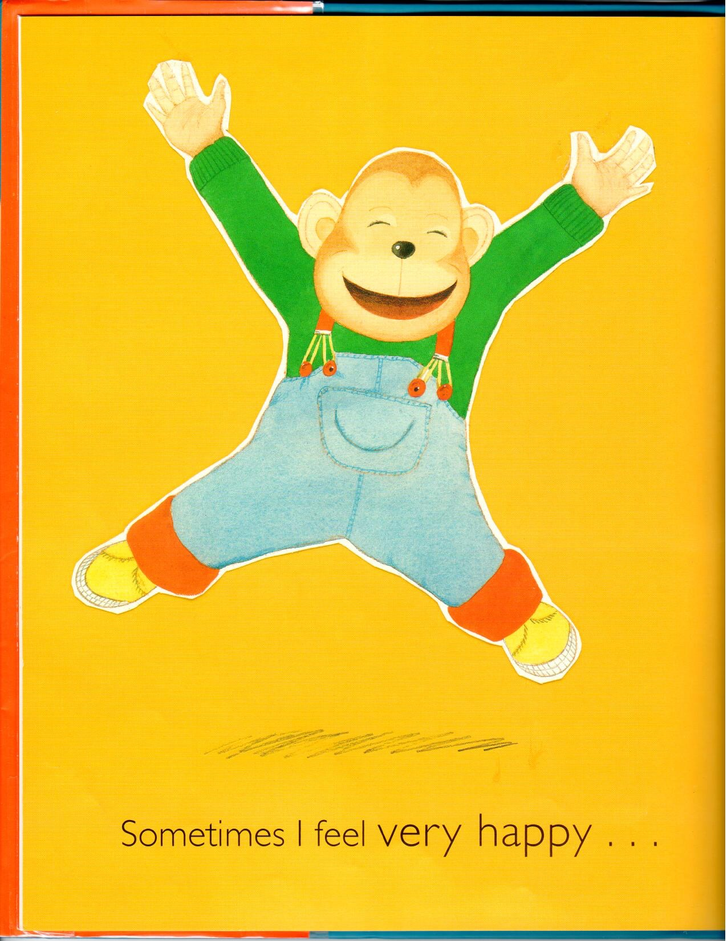
Bored
Lonely
Very Happy
________

Slide 15
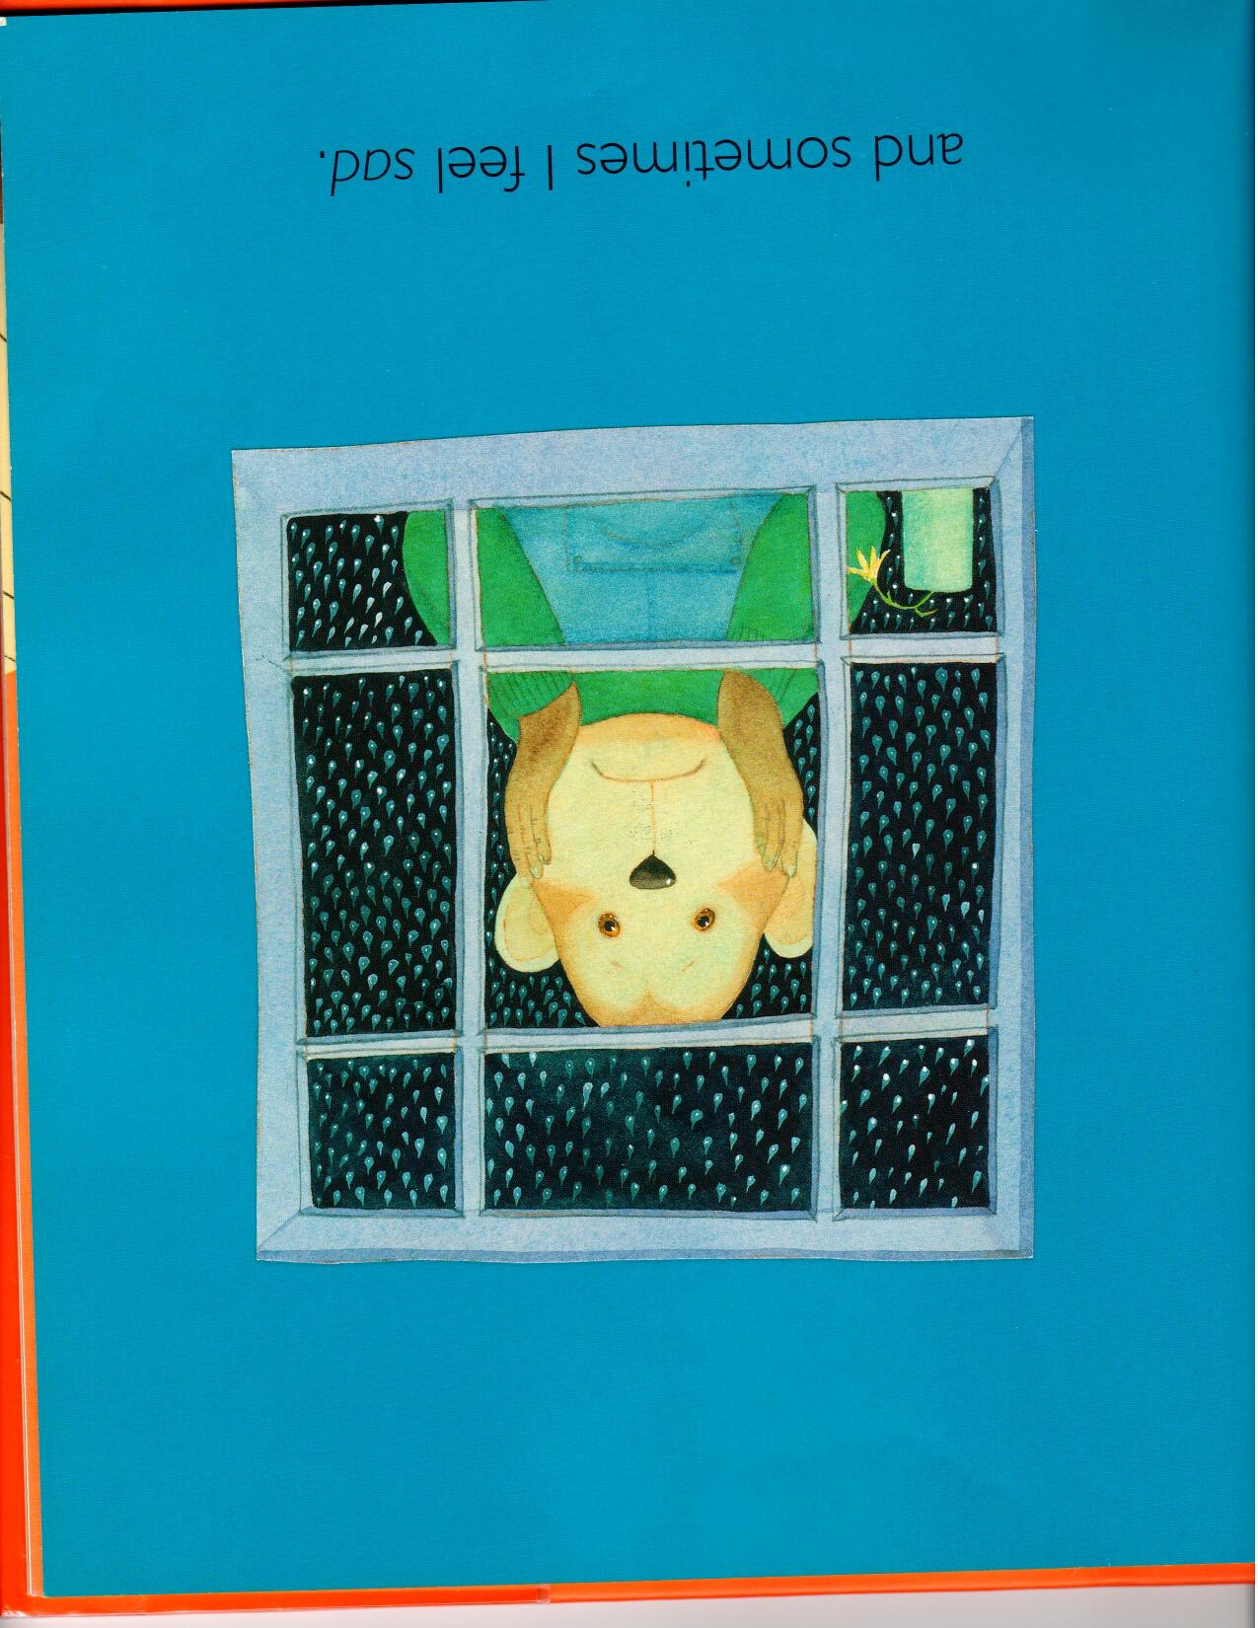
Angry
Sad
Guilty
___

Slide 17
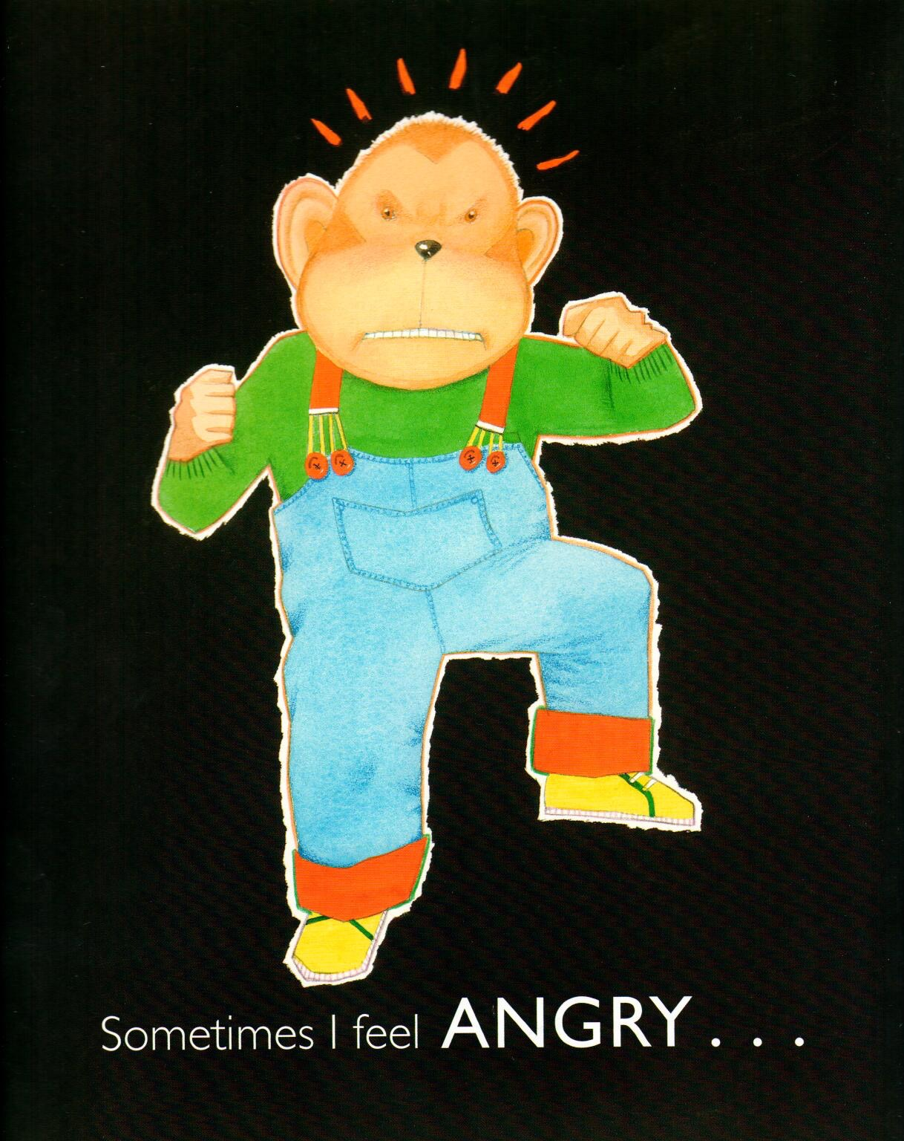
Angry
Sad
Guilty
________

Slide 19
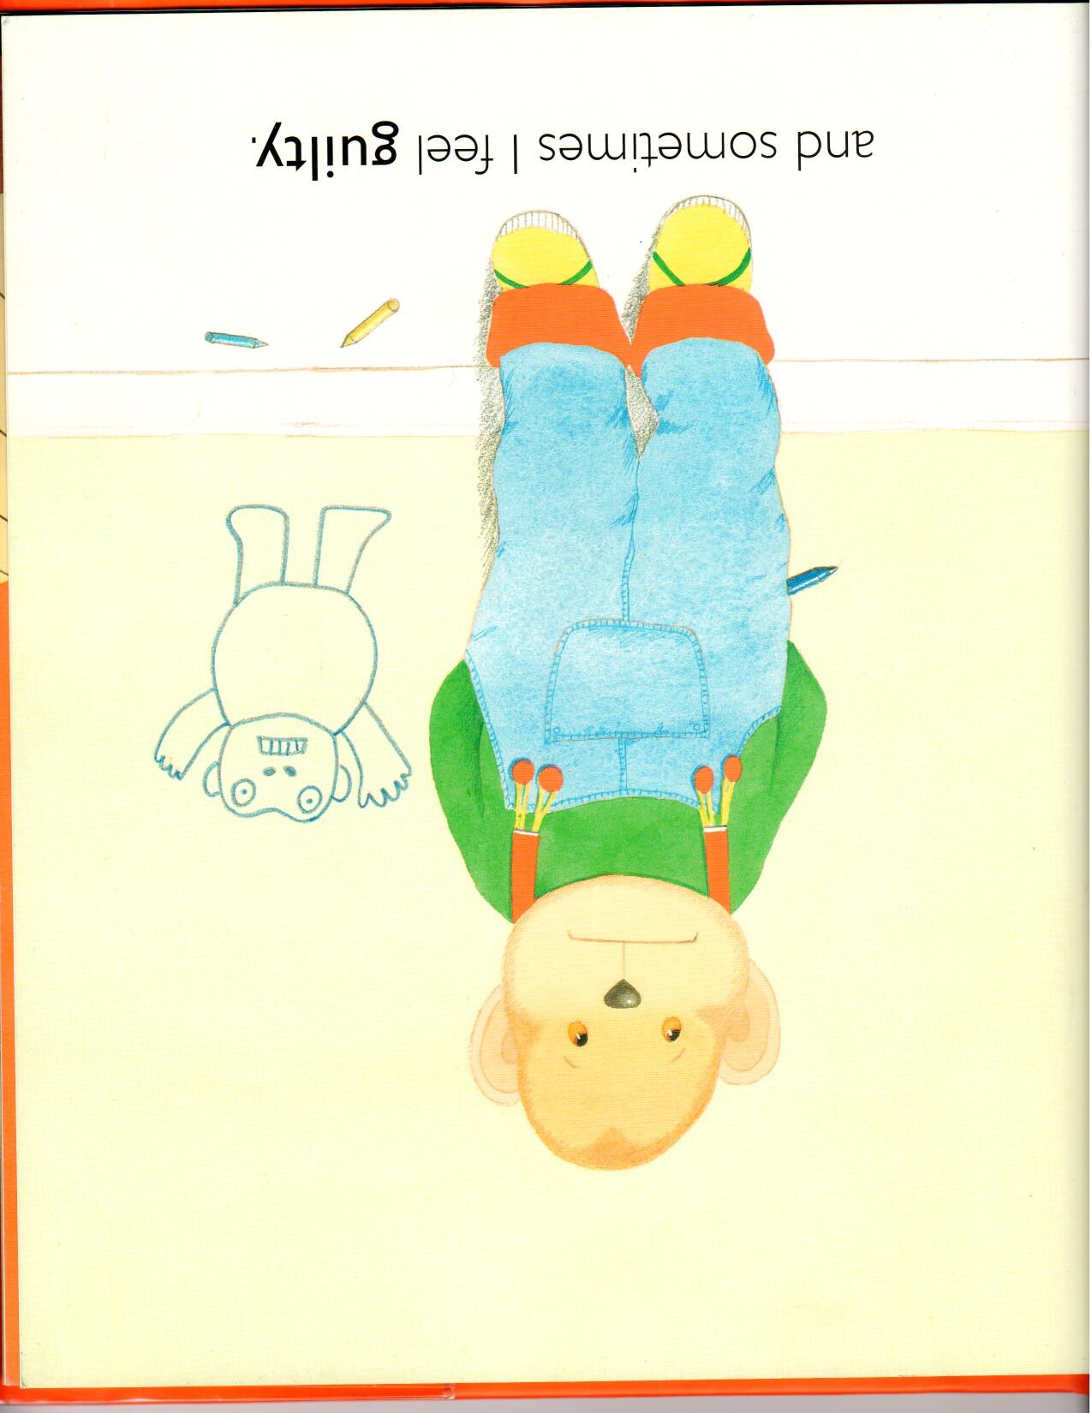
Angry
Sad
Guilty
____

Slide 21

Confident
Curious
Surprised
____

Slide 23
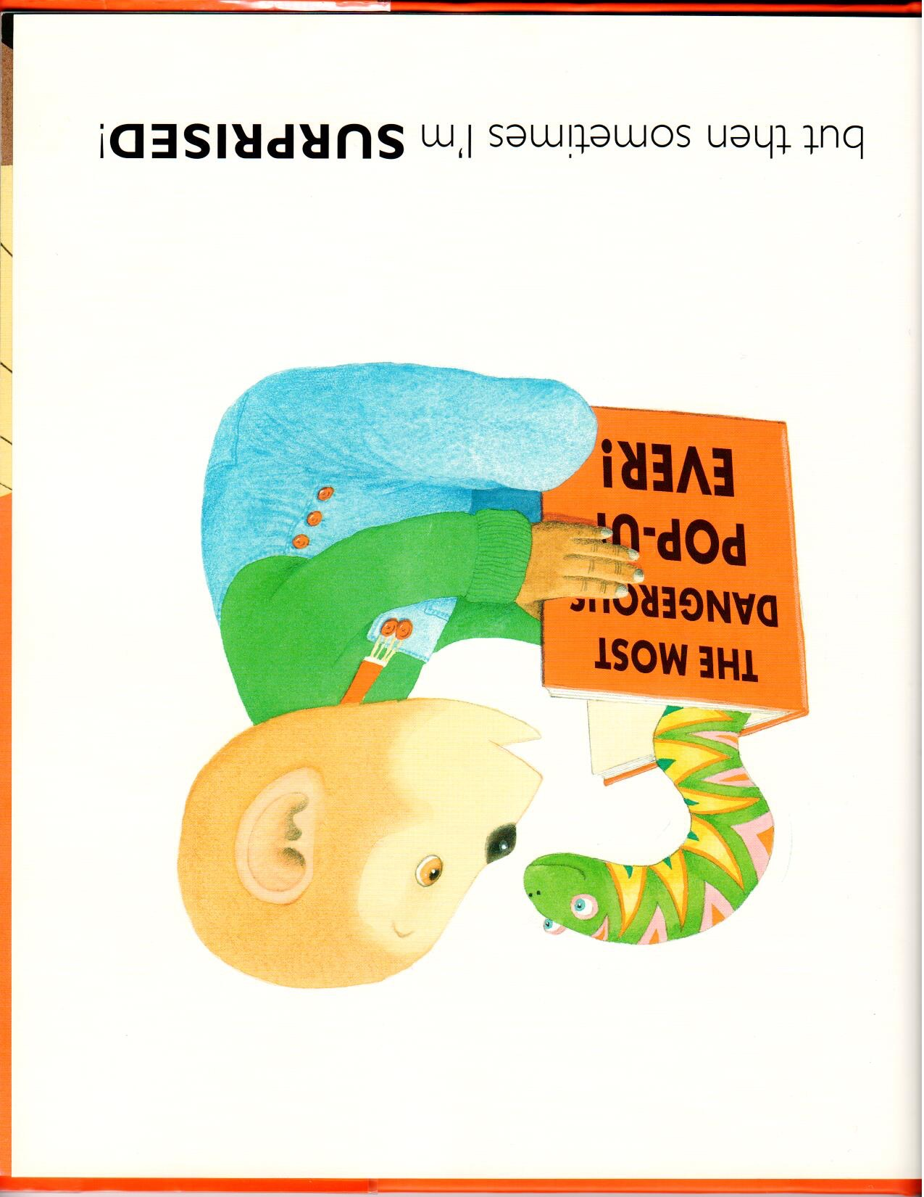
Confident
Curious
Surprised
________

Slide 25

Confident
Curious
Surprised
________

Slide 27

___
Silly
Worried
Shy

Slide 29
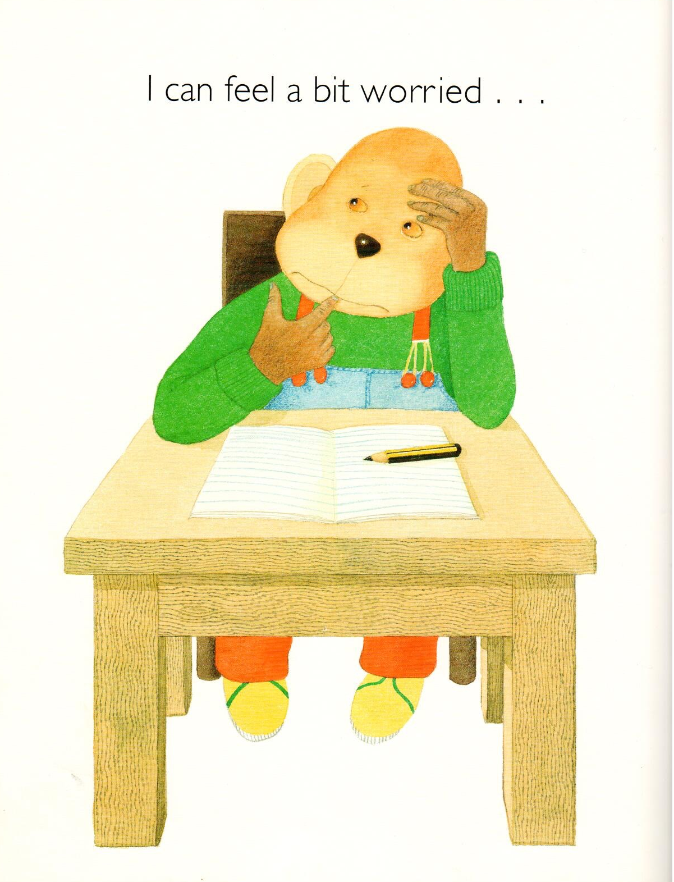
______
Silly
Worried
Shy

Slide 31
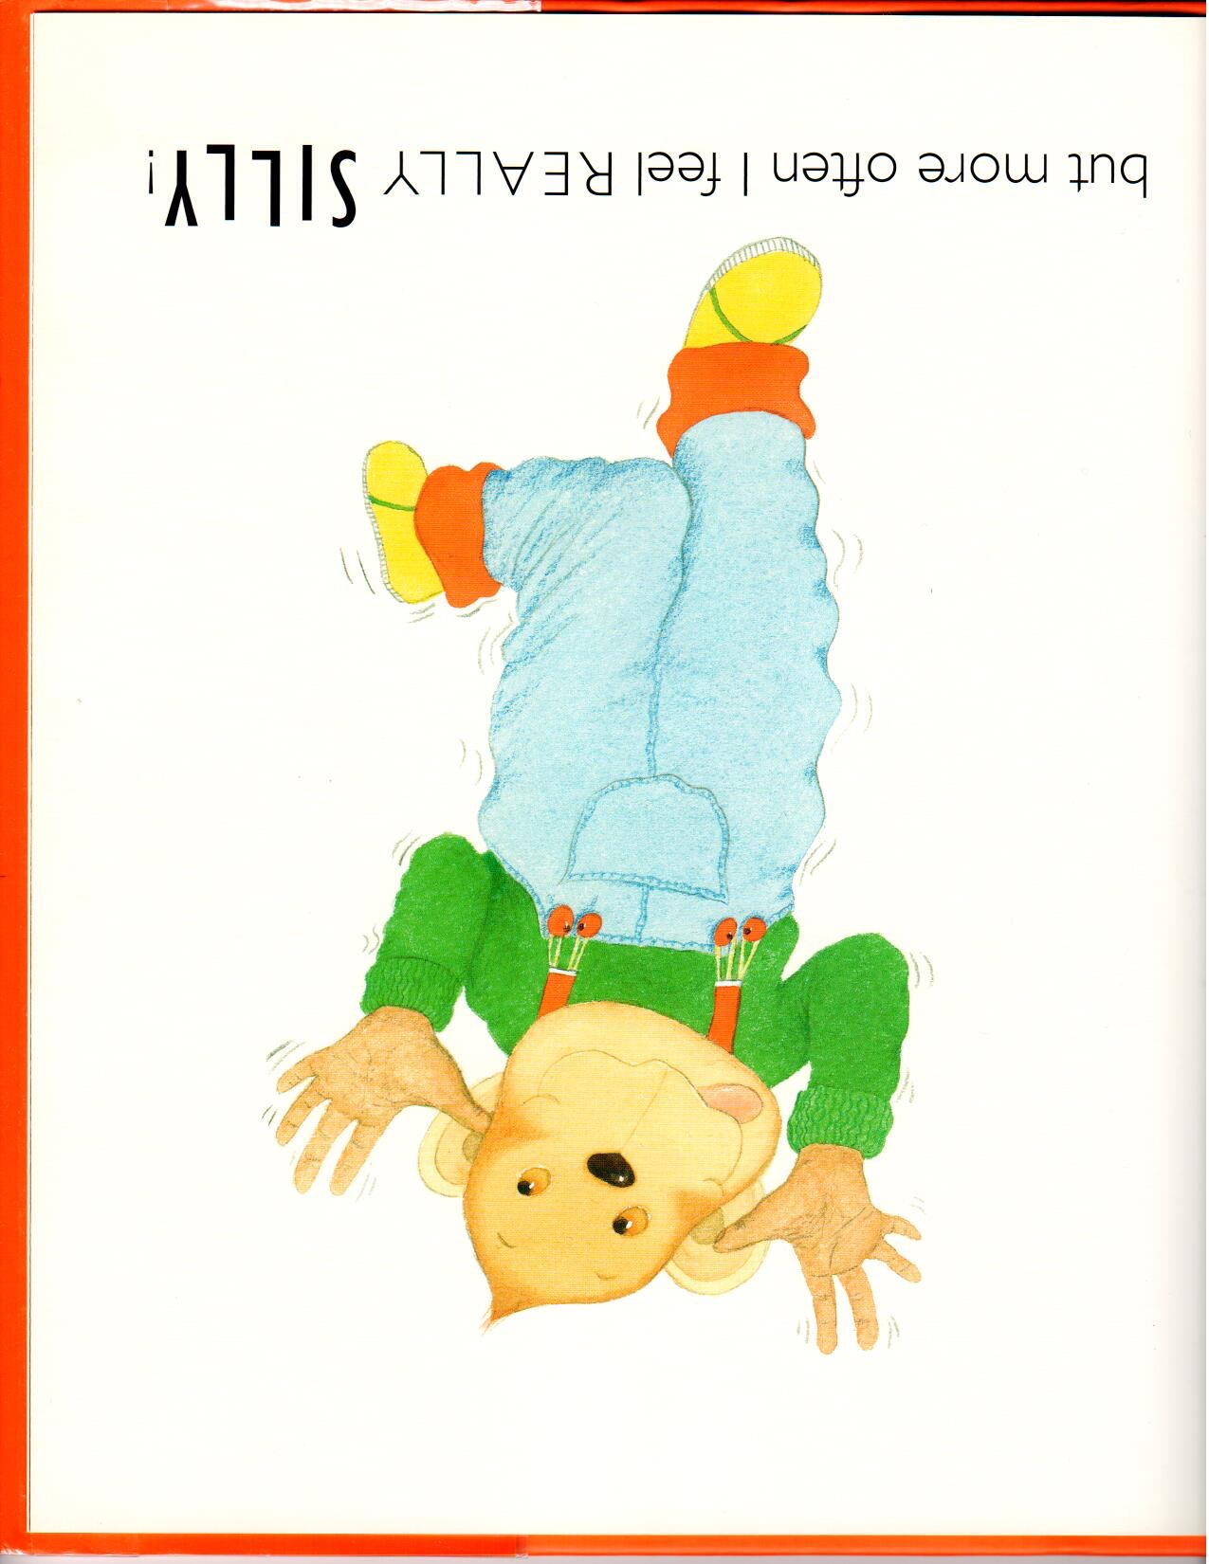
Silly
Worried
Shy
___

Slide 33
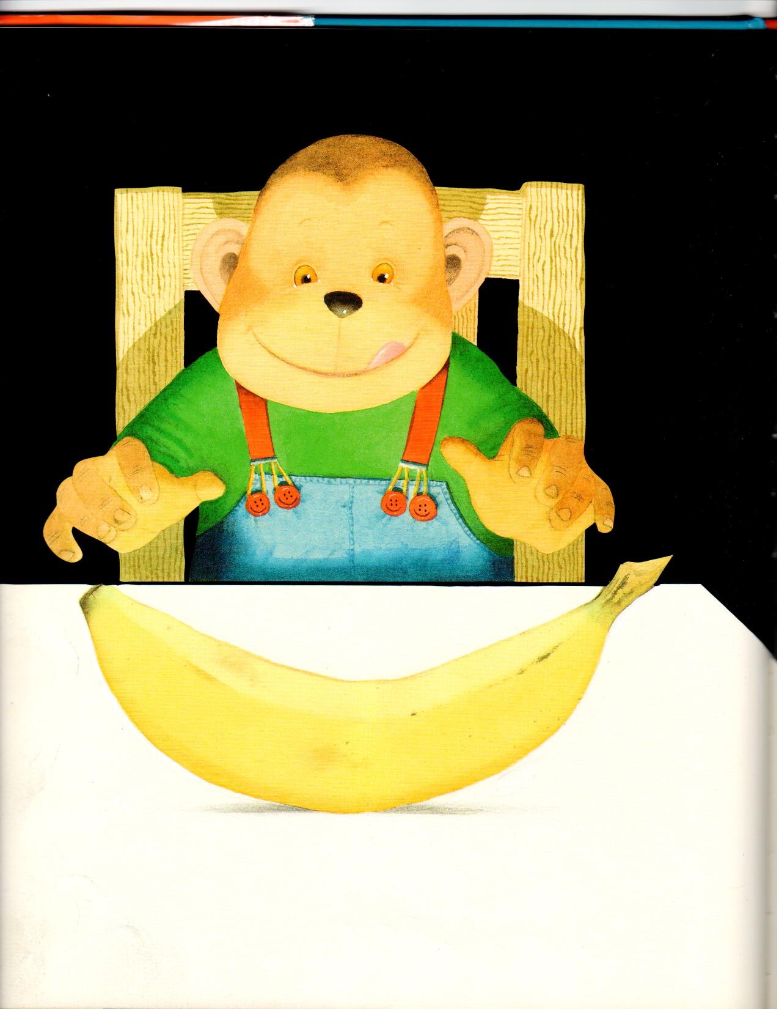
Full
Hungry
Sleepy
___

Slide 34
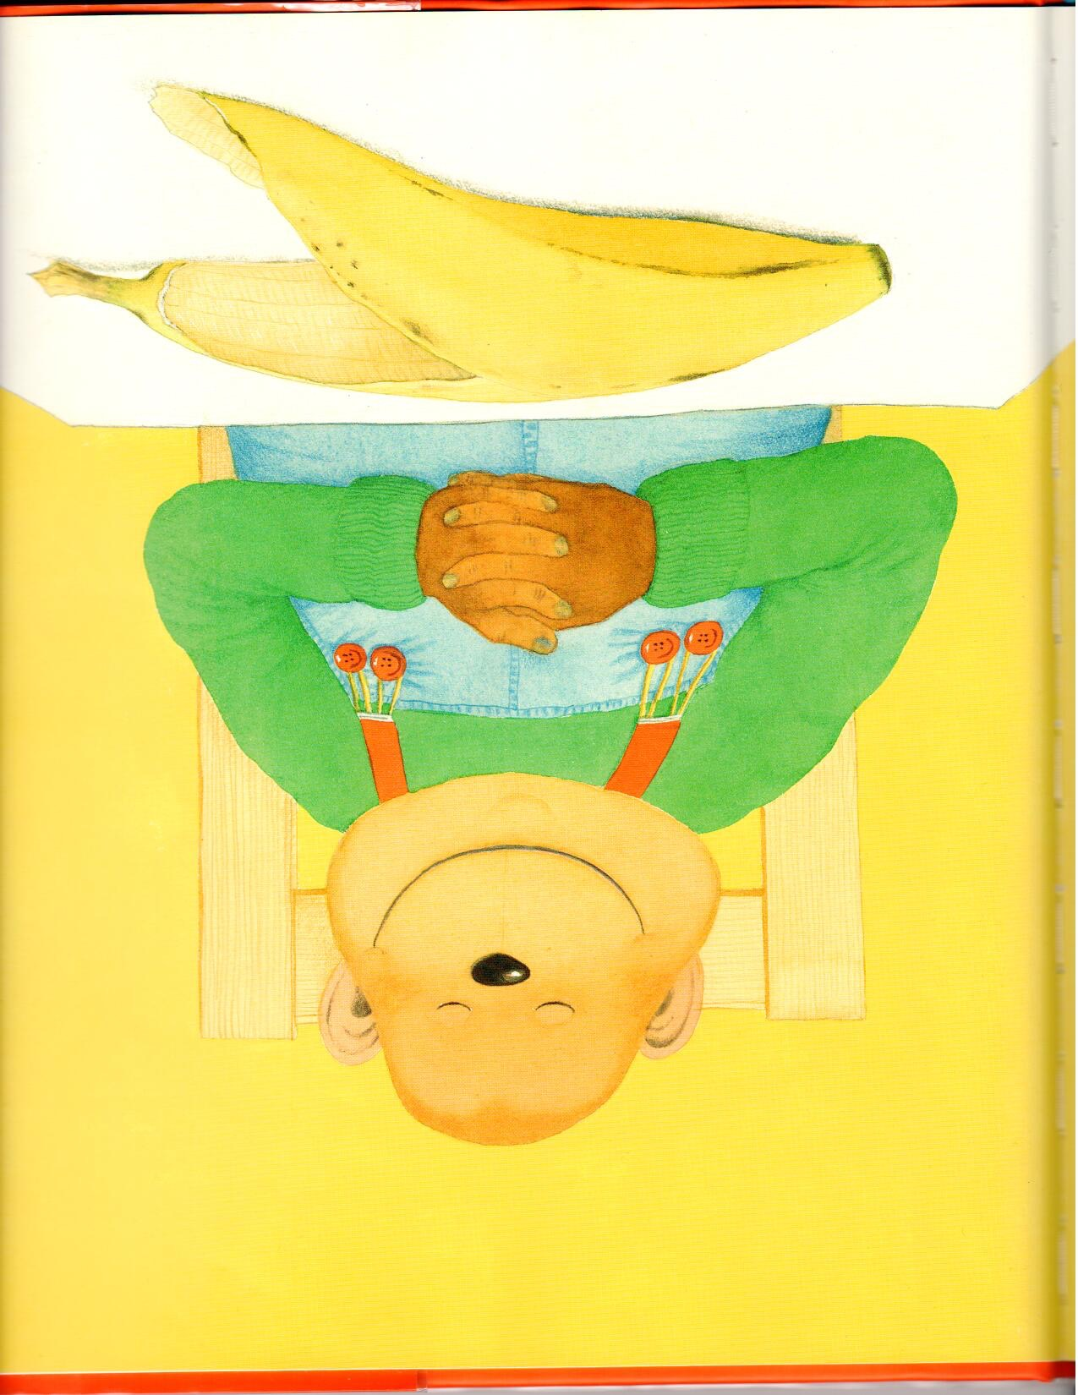
Full
Hungry
Sleepy
___

Slide 35
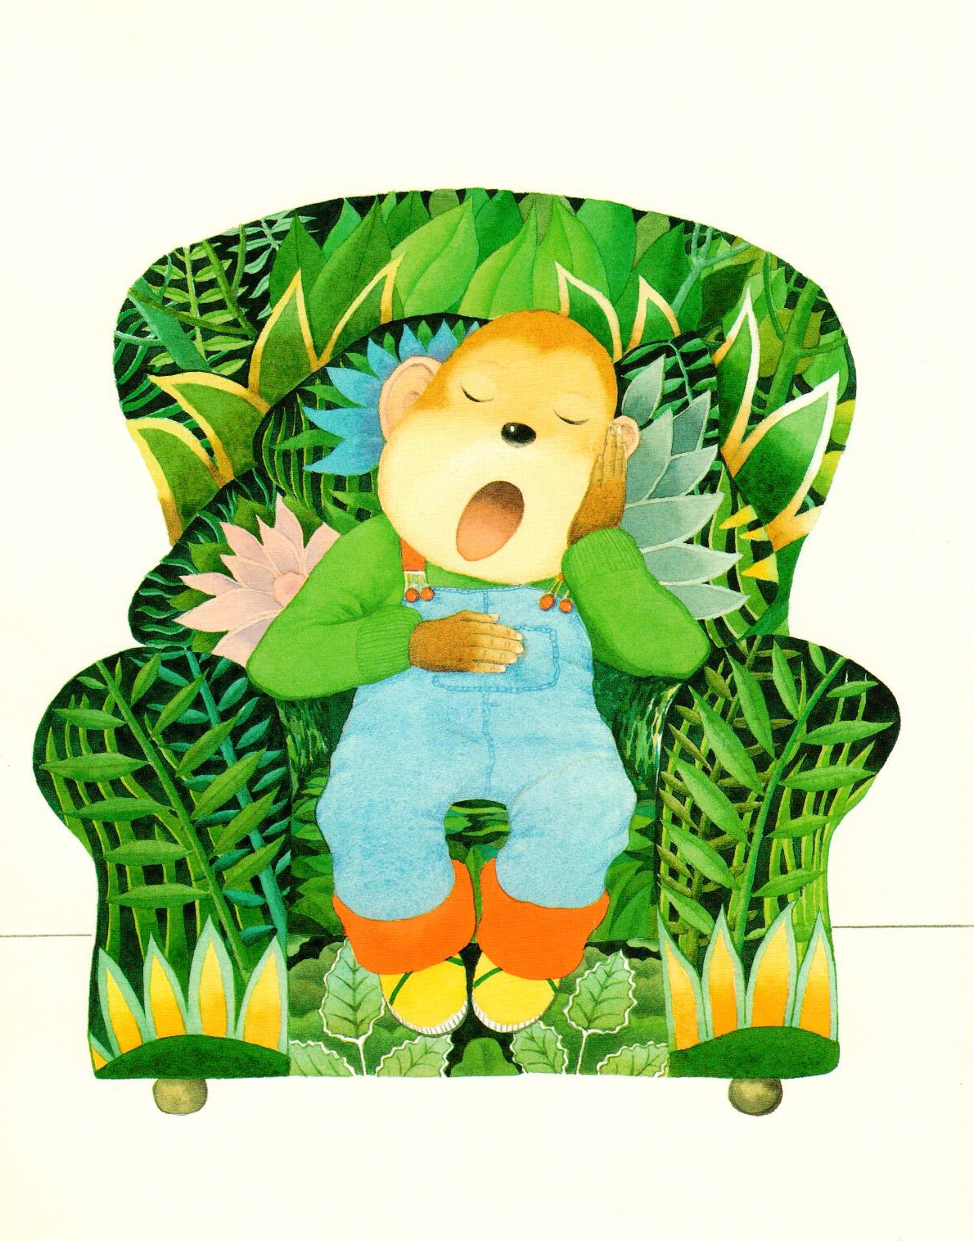
Full
Hungry
Sleepy
___

Slide 36
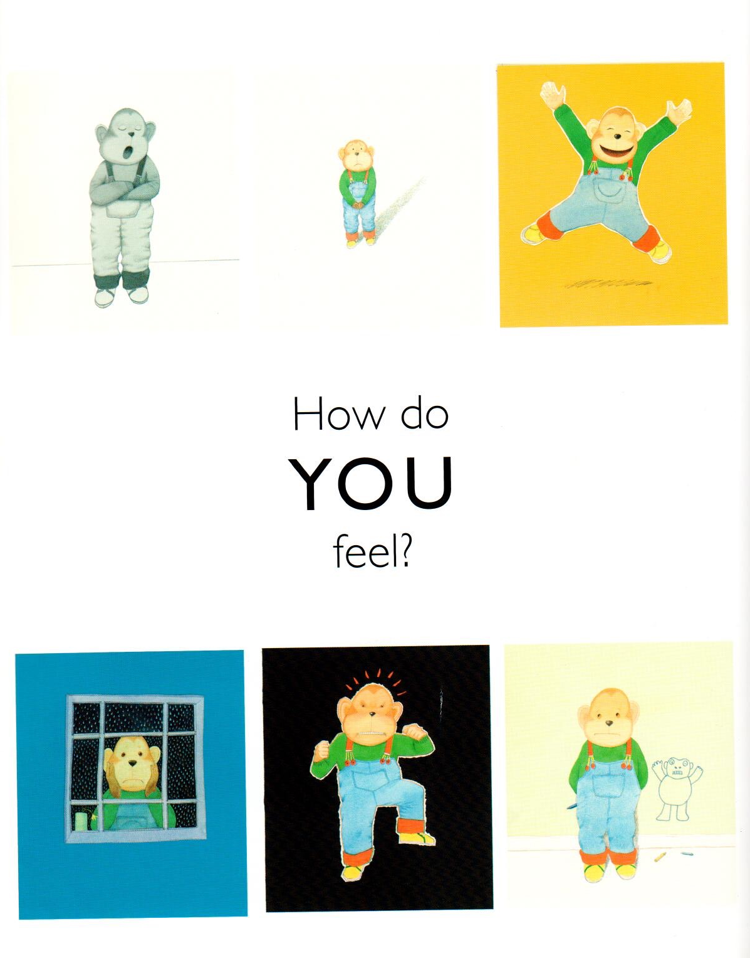
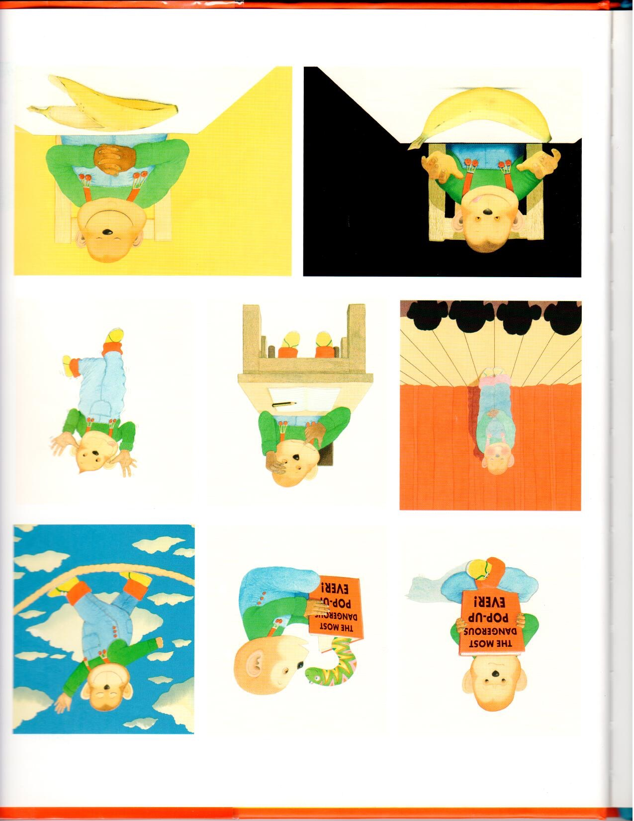
Notes:
Have the students circle how they feel and see if they remember the key words from the story. You can even do a recap of the story here.

Slide 37
How do you feel?
Today I feel __________________________________
Because_____________________________________.
Happy
Sad
Silly
Notes:
Let the students know that this is on their worksheets. Have them take out their worksheets and complete this section with you. You can redo this section for each student, asking them how they feel. You may also chose to model this section first, demonstrating how YOU feel.

Slide 38


What did I just learn?
Fill in the blanks.
Notes:
Have the students read the goals if they can. I find that underlining sentences and asking students to read one sentence at a time works well.

Slide 39

Where are we going today?
Notes:
Play the ‘where are we going today?’ video. They can guess where they will be going.
Have the students talk about the picture, there are books and children all holding hands. The students are learning about places all over the world!

Slide 40
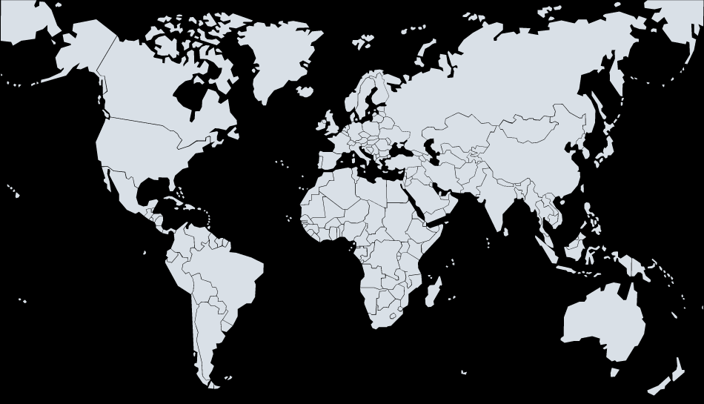



We are going to Costa Rica!
Notes:
We are going to Costa Rica! Have the students talk about how far away Costa Rica is from China, they can also talk about the size difference in the countries. You can also ask the students to tell you what colours the flags are. Ask them if they know anything about Costa Rica!

Slide 41

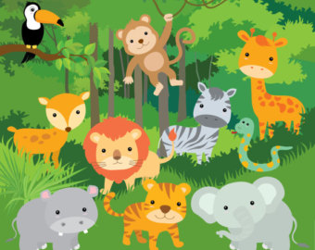
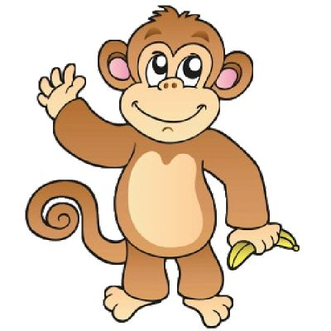
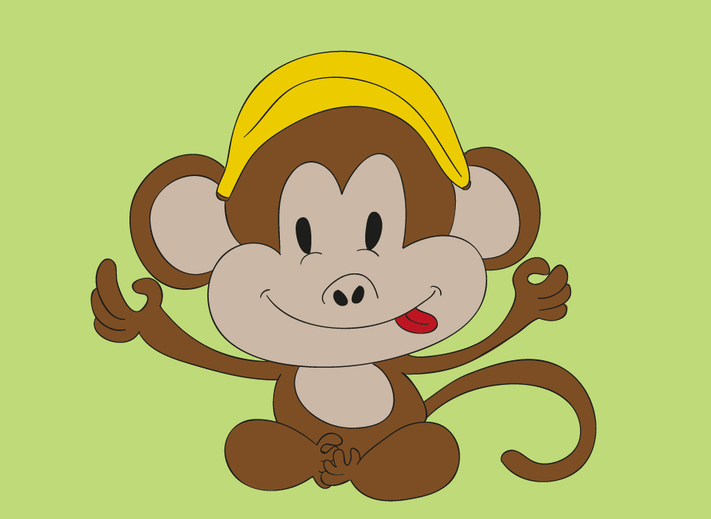
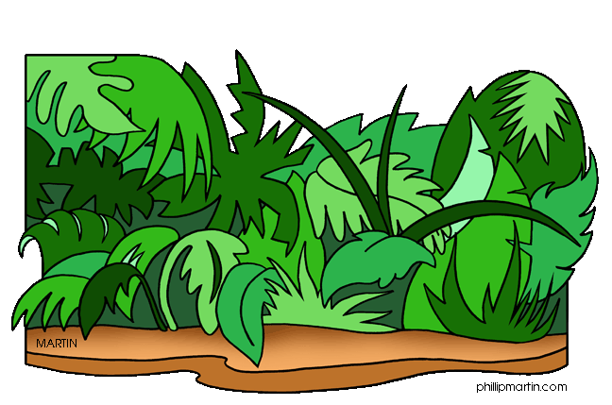
Jungle of Costa Rica!
Notes:
We are going to the jungle in Costa Rica! Have the students point out what they see in this image. Have them circle key words and write them down on the board as well. Have them circle things like specific animals and have them tell you about the forest and about how green the environment is!

Slide 42
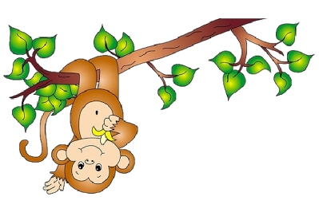
Monkey and Banana
Monkeys like ______________ .
Notes:
Play the ‘NoBananas’ video for the students. After playing the video ask the students questions such as ‘was the monkey happy or sad at the end? Ask them probing questions that will demonstrate their understanding in the video such as , how did the monkey get the banana?

Slide 43
Monkey and Banana
At the end of the video the monkey was happy / sad.
Did the monkey get a banana in the end? Yes / No
Notes:
Play the ‘NoBananas’ video for the students. After playing the video ask the students questions such as ‘was the monkey happy or sad at the end?

Slide 44
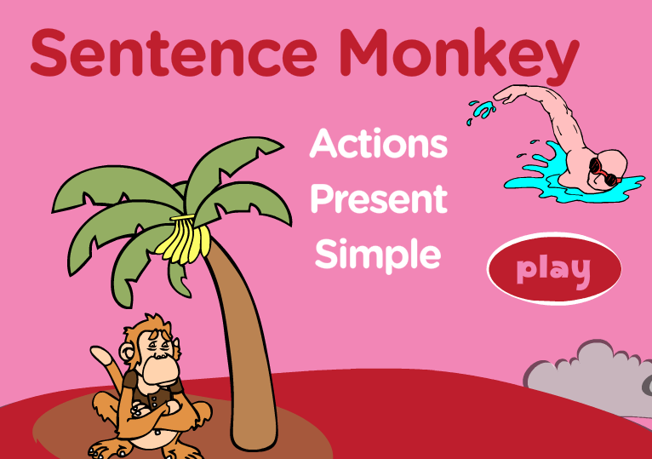
Present Tense Game!
Notes:
Share your screen with the students and have them play this interactive game with you using pictoral induction in order to complete sentences in the present tense. Be sure to try the game out yourself before the lesson!
http://www.eslgamesplus.com/present-simple-tense-action-verbs-interactive-monkey-game/

Slide 45
New words we learned!
Notes:
Together with the students, write down any new words that may have come up in the game as well as any questions that the students had difficulty answering.

Slide 46
What did I just learn?
Review
Present Tense
Notes:
Have the students read the goals if they can. I find that underlining sentences and asking students to read one sentence at a time works well.

Slide 47

Today’s letters! -> ‘PP’
Notes:
Todays letters are pp, see if they know any words that have the letters’ pp’ in it. Write these words down on the whiteboard. Have the students sound out the letters.

Slide 48



What’s that word?
Match the picture with the correct ‘PP’ word
Pineapple
Flippers
Apple
Notes:
Have the students write down on the line what the correct word from the box. A new word might be pinapple as well as flippers.

Slide 49
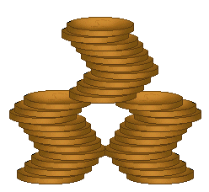
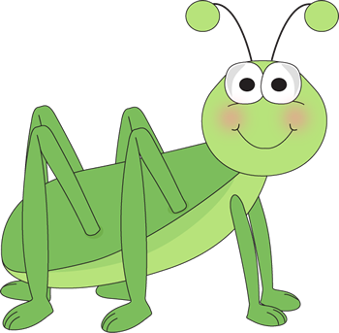

What’s that word?
Match the picture with the correct ‘PP’ word
Clippers
Grasshopper
Copper
Notes:
Have the students write down on the line what the correct word from the box. A new word might be pinapple as well as flippers.

Slide 50

What did I just learn?
The ‘PP’ sound
Notes:
Have the students read the goals if they can. I find that underlining sentences and asking students to read one sentence at a time works well.

Slide 51

What is that sound?
Listen closely and see if you know what the sound is!
Notes:
Find the movie clip “Flippers” and play it for the students. It is a blank image so that the students can only hear the water splashing and not see it. Have the students guess before showing them the next slide.

Slide 52

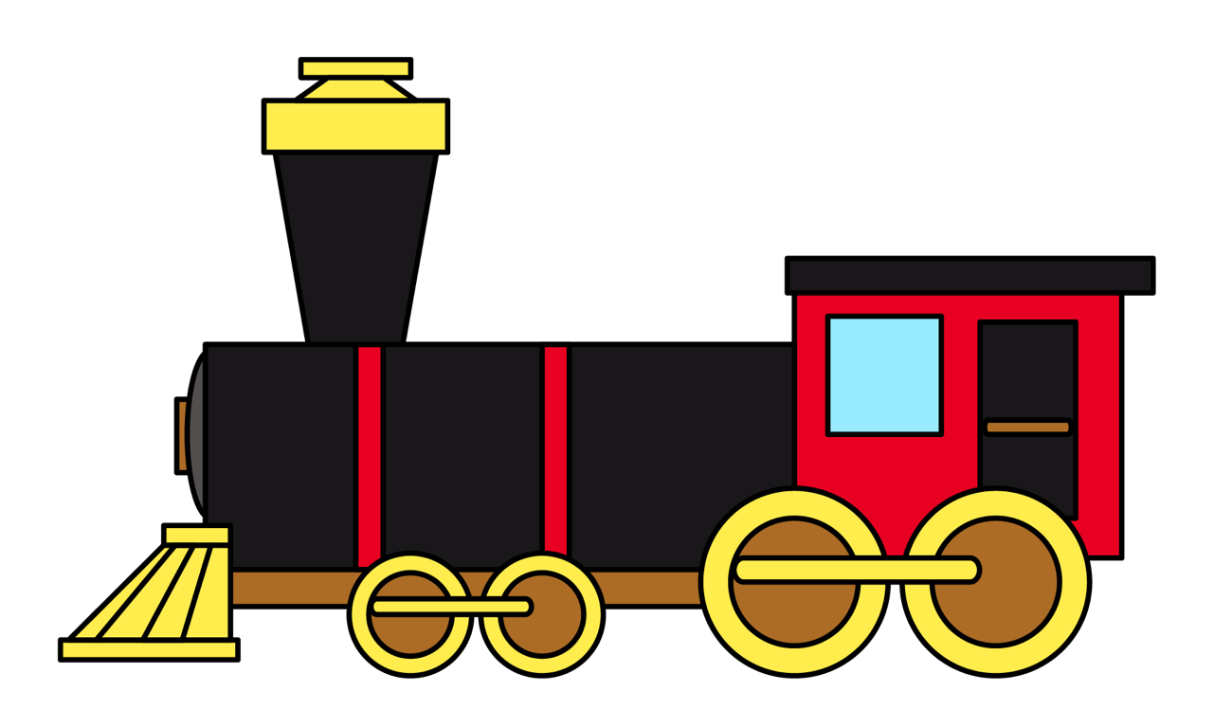
What is that sound?
Listen closely and see if you know what the sound is!
Notes:
Find the movie clip “RaceCarSound” and play it for the students. It is a blank image so that the students can only hear the racecar and not see it. Have the students guess before showing them the next slide.

Slide 53
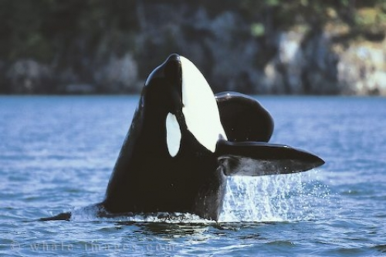
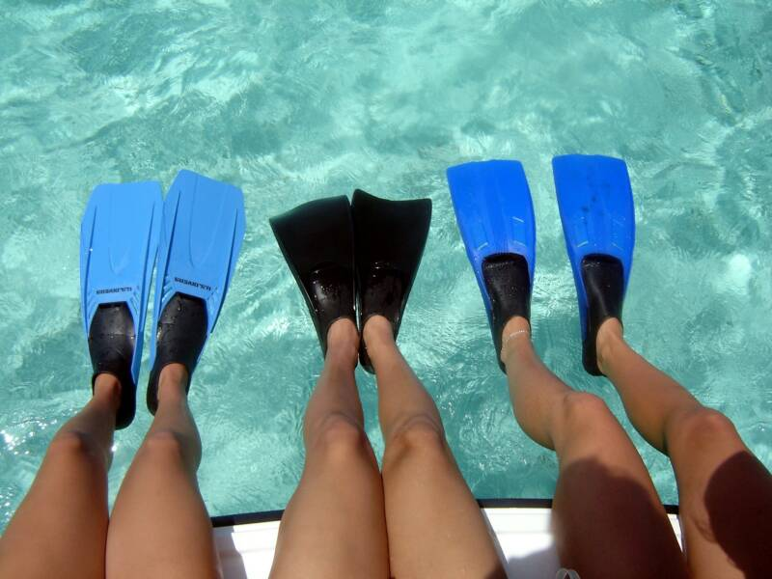
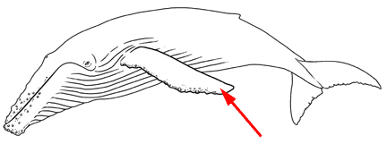
You’re right!
They are flippers! We use flippers to help us swim faster!
Water animals also have flippers!
Notes:
Have them circle the what they thought the sound was. Talk about the other two images in the picture (train and owl).

Slide 54
What did I learn today?
Fill in the blanks
Notes:
Have the students read the goals if they can. I find that underlining sentences and asking students to read one sentence at a time works well.

Slide 55
What did I learn today?
Use the present tense
I feel ___________________ because _____________________
_______________________________________________________.
Notes:
Have the students read the goals if they can. I find that underlining sentences and asking students to read one sentence at a time works well.

Slide 56
What did I learn today?
The ‘pp’ sound
Notes:
Have the students read the goals if they can. I find that underlining sentences and asking students to read one sentence at a time works well.

Slide 57
New words I learned today
pineapple
Jungle
Copper
Clippers
Notes:
Have the students read the goal that they just completed.
Explain what they learned if needed.
Congratulate them.
write down the new vocabulary words on the board and have the students write these new words on their worksheets under “Vocabulary”. These are the words that the students should be practicing!

Slide 58
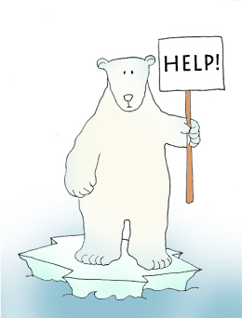

Final Thoughts
Do you have any questions?
Do you understand the handout?
Notes:
Wrap up your lesson and play the extra activities if you have any time. Answer any questions and pull up the worksheet if you want and go over the activities with them to ensure they understand.

Slide 59

Before the next class
Listen and read along with the ‘How do you feel’ book
Read book to yourself and to your family/friends
Complete the worksheet
Practice writing new vocabulary words
Notes:
You can read these goals to them or have them read the goals if they can.
Underlining sentences and asking students to read one sentence at a time works well.

Slide 60
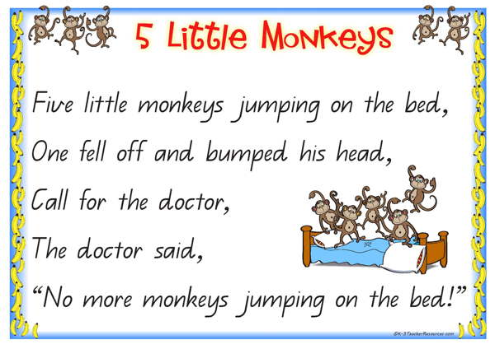
5 Little Monkeys
Notes:
Talk about different types of helicopters and their uses. You can include your own slides with different types of planes and boats!
Above helicopter picture needs to be replaced due to 123RF (completed)

