Slide 1








Adventures!

Slide 2




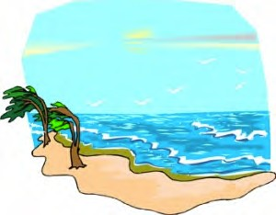
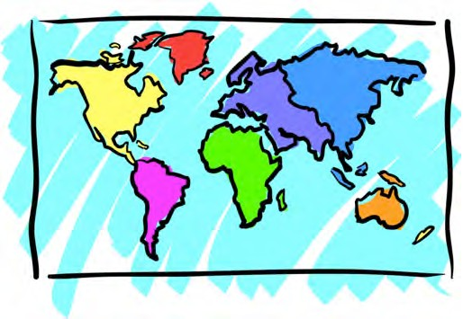


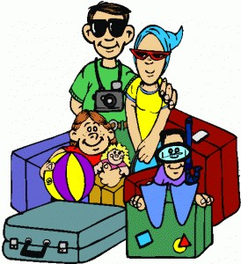

Adventures

Slide 3






What will I learn today?
Sound of the letters ‘gg’ and ‘ff’ Answering questions
Using Questions Marks: ??

Slide 4



Slide 5
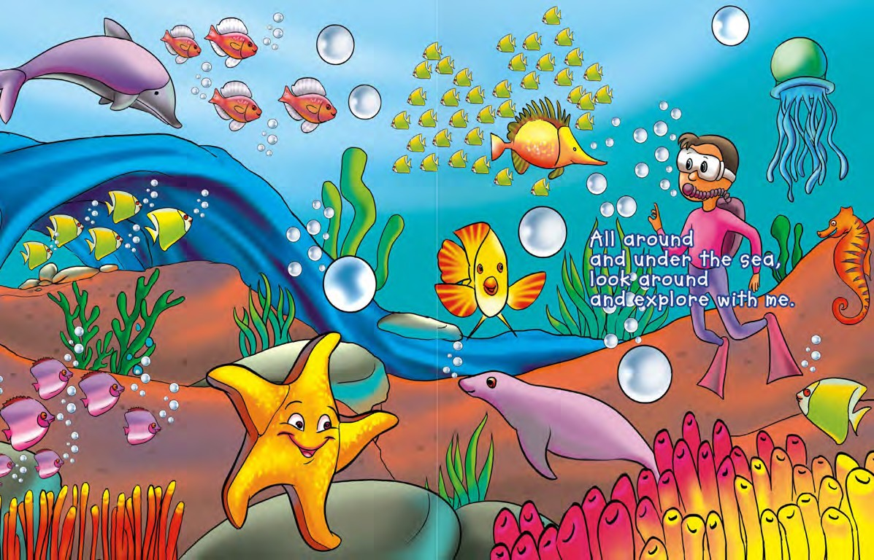
All around and under the sea. Look around and explore with me!
What do you see ?

Slide 6

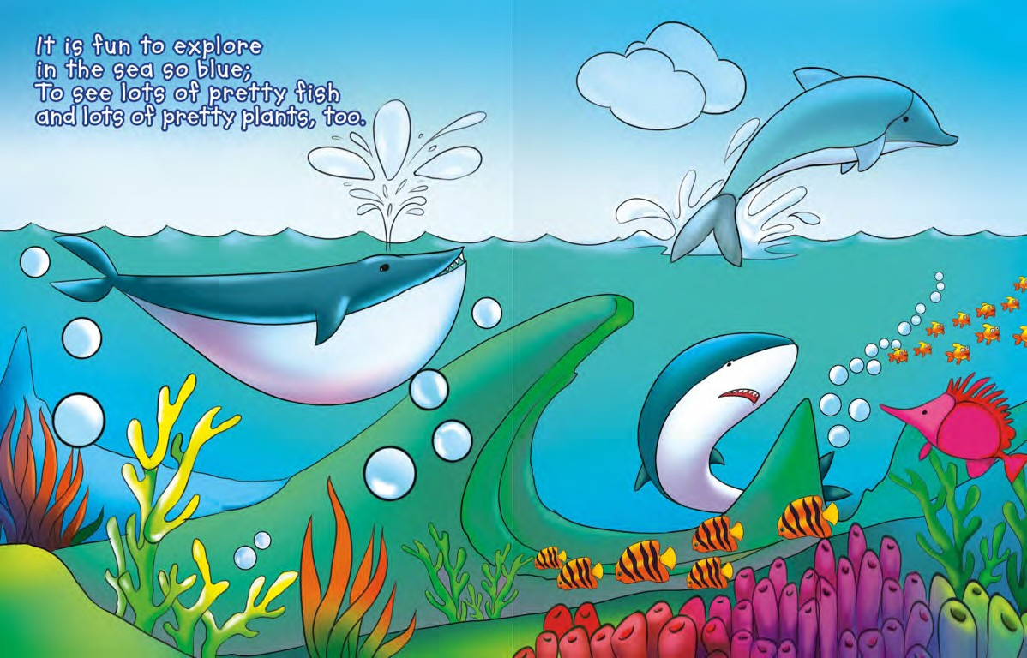
It is fun to explore in the water so blue. There are lots of nice fish and plants too!

Slide 7
It is fun to explore in the water so blue. There are lots of nice fish and plants too!
Can you show me the plants and fish ?

Slide 8
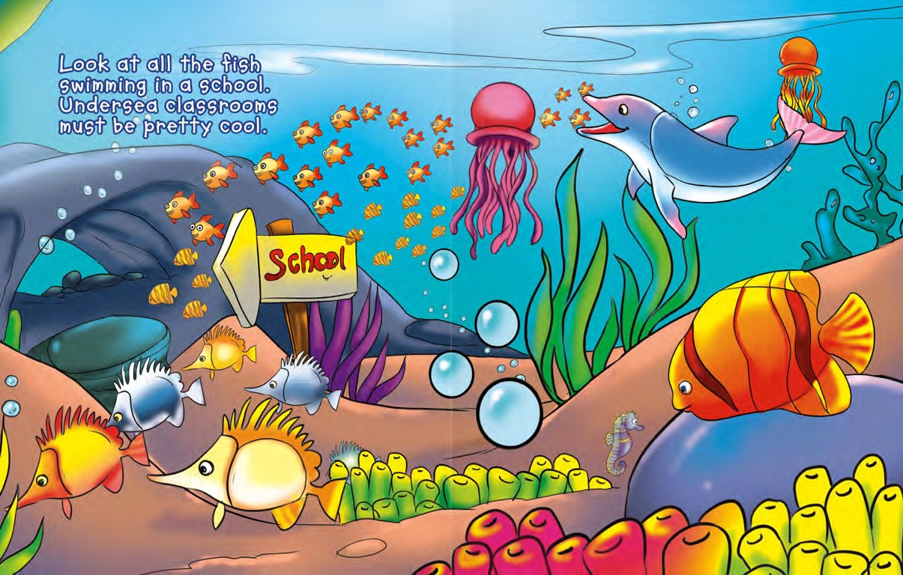
Look at all the fish swimming in a school. Swimming underwater is very cool!

Slide 9
Look at all the fish swimming in a school. Swimming underwater is very cool!
When a lot of fish swim together it is called a SCHOOL OF FISH!

Slide 10
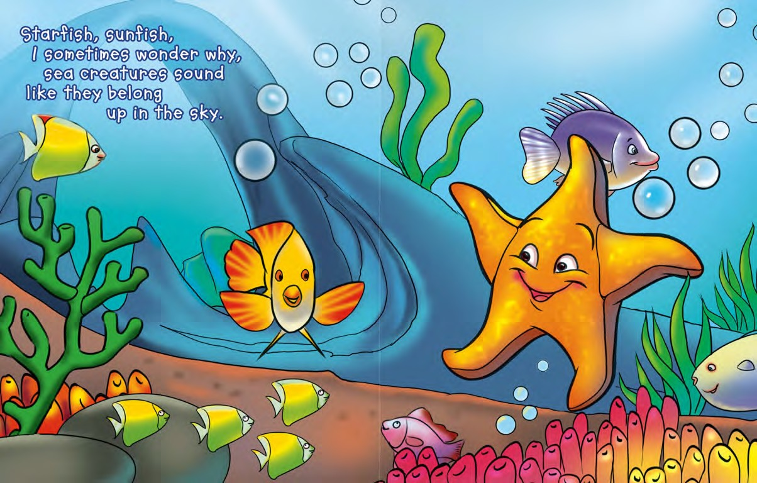
Starfish, sunfish.
I wonder why some fish sound like they
should be in the sky!

Slide 11
Starfish, sunfish.
I wonder why some fish sound like they
should be in the sky!
Why do starfish and sunfish belong in the sky ?

Slide 12
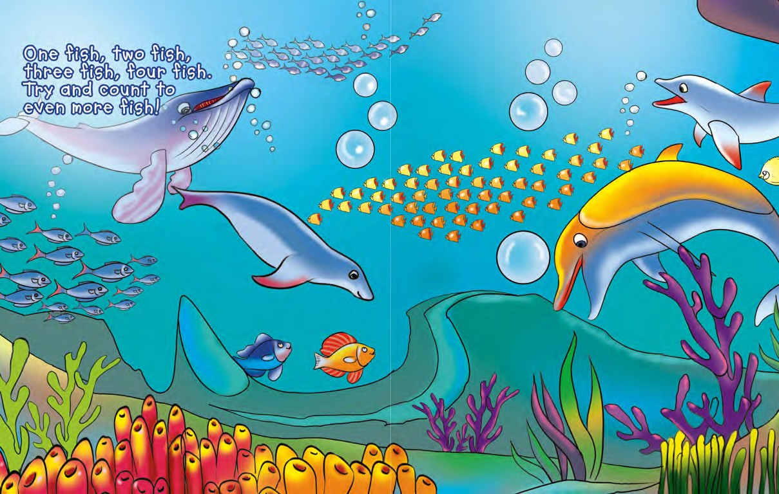
One fish.Two fish.
Three fish. Four fish.

Slide 13
One fish.Two fish.
Three fish. Four fish.
How many blue fish can you count?

Slide 14
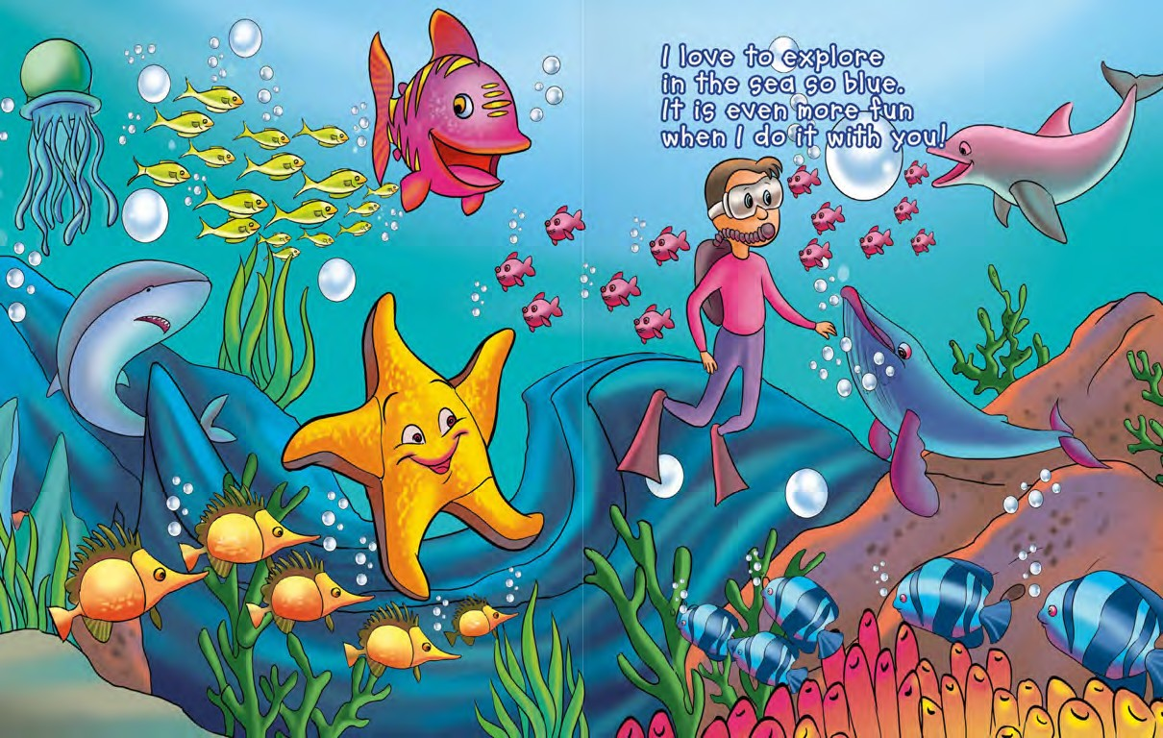
I love to explore the sea so blue! It is even more fun with you!

Slide 15
I love to explore the sea so blue! It is even more fun with you!
What is your favourite fish?

Slide 16

What did I just learn?
Questions & Question Marks Answering Questions

Slide 17


Today’s Letters!

Slide 18


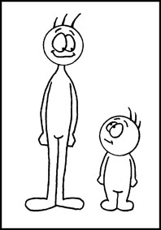
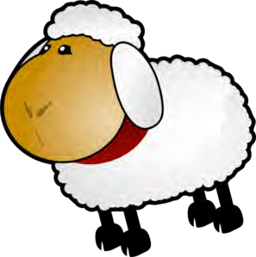


Today’s letters! -> ‘GG’ ‘FF’

Slide 19


Final Thoughts
Do you have any questions?
Do you understand the handout?

