Slide 1








Adventures!

Slide 2
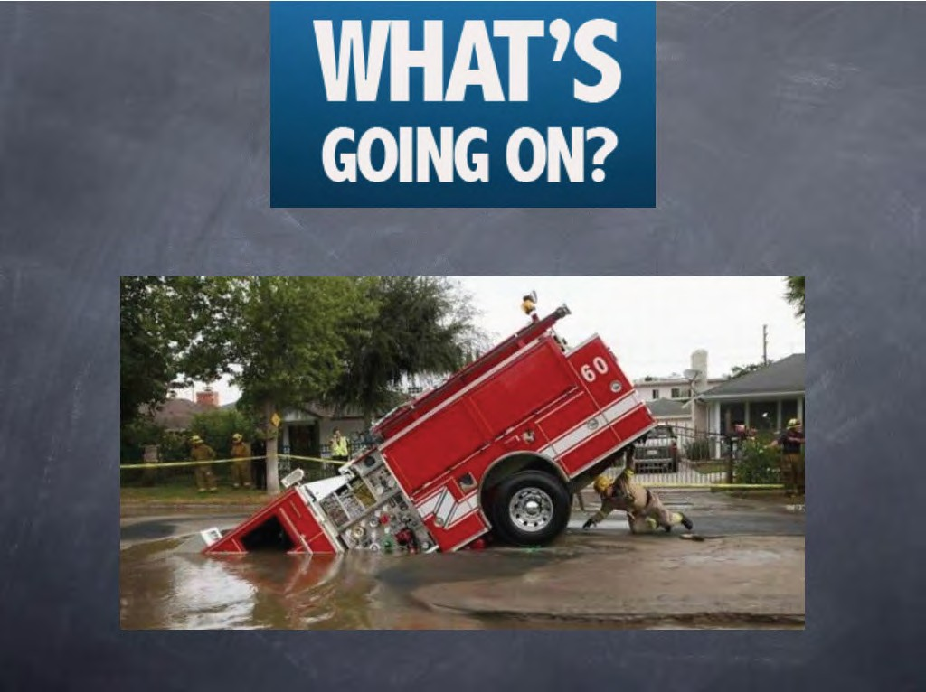

Slide 3


What did I learn last class?
The sound of the letters ‘RR’
Transition words (And, But, Then, Because)

Slide 4

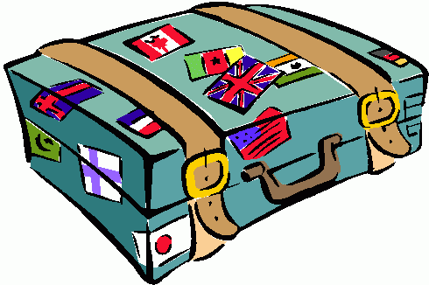


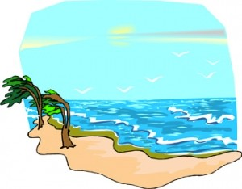
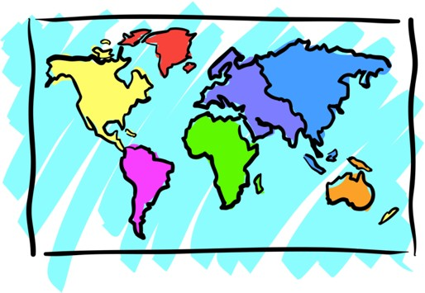

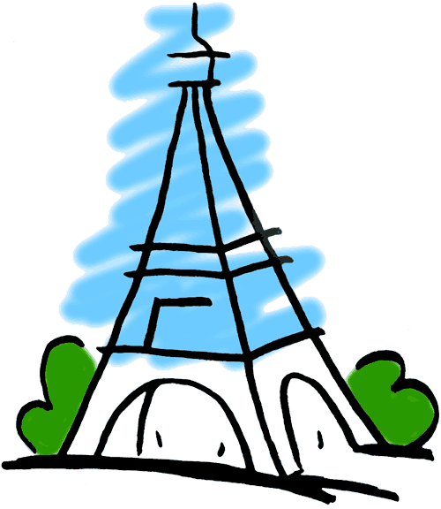
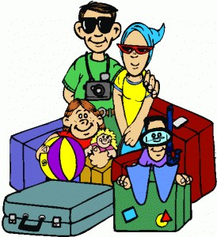

Adventures

Slide 5

What will I learn today?
The sound of the letters ‘BB’ Writing short sentences

Slide 6



What is that sound?
Listen closely and see if you know what the sound is!

Slide 7

Where are we going today?

Slide 8
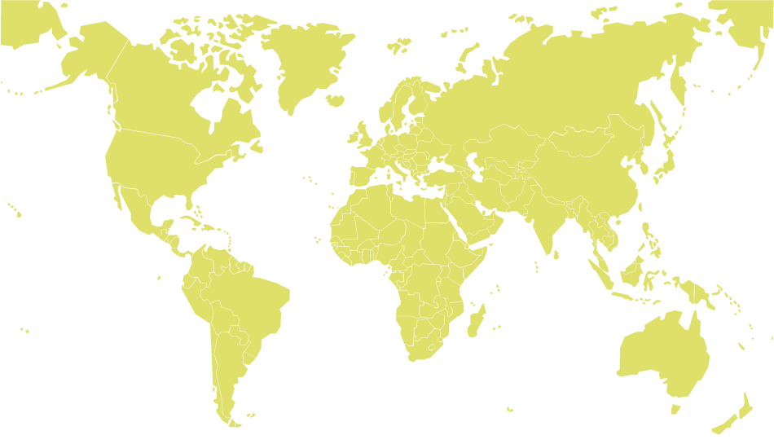




We are going to Hawaii!

Slide 9


Slide 10
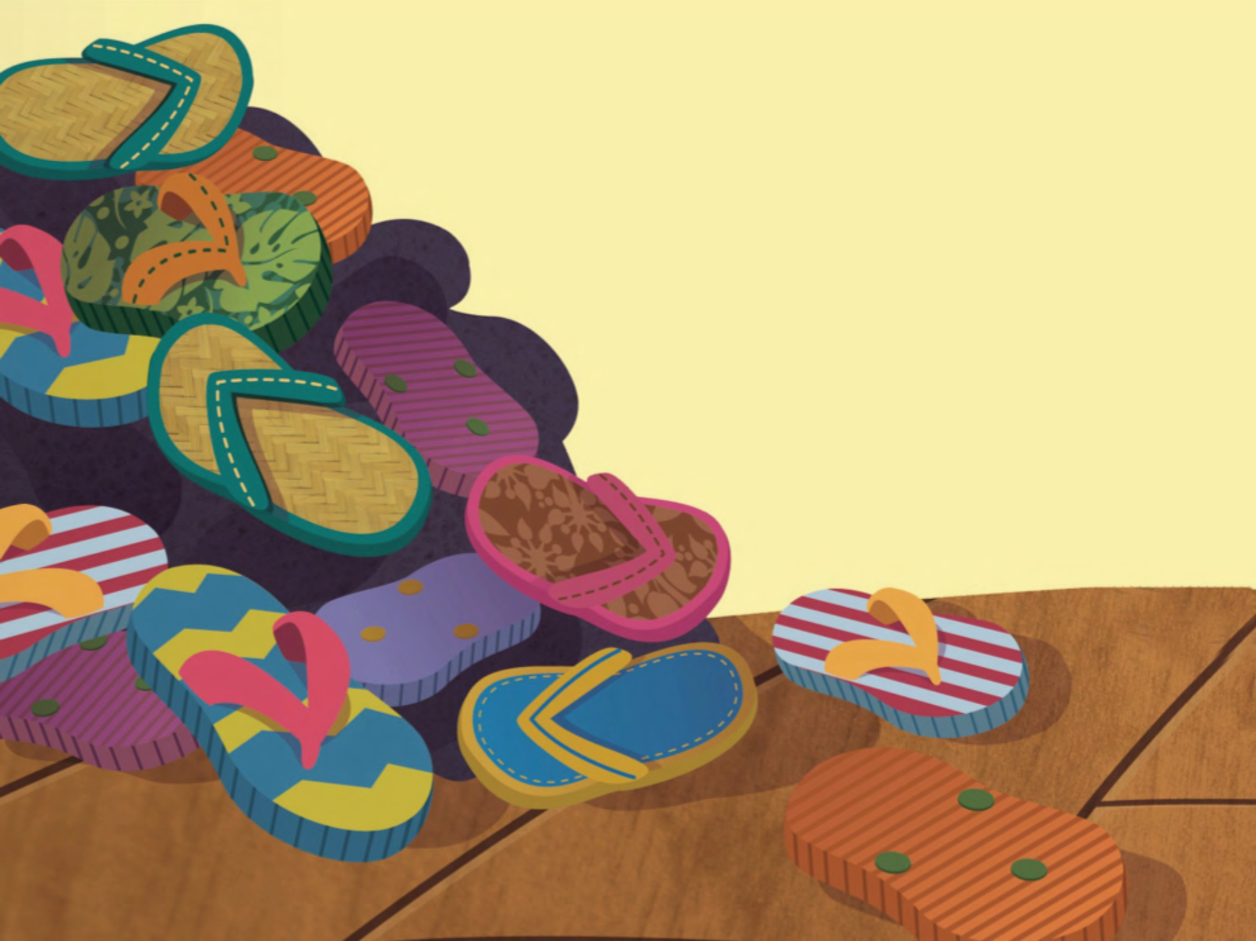

Slide 11
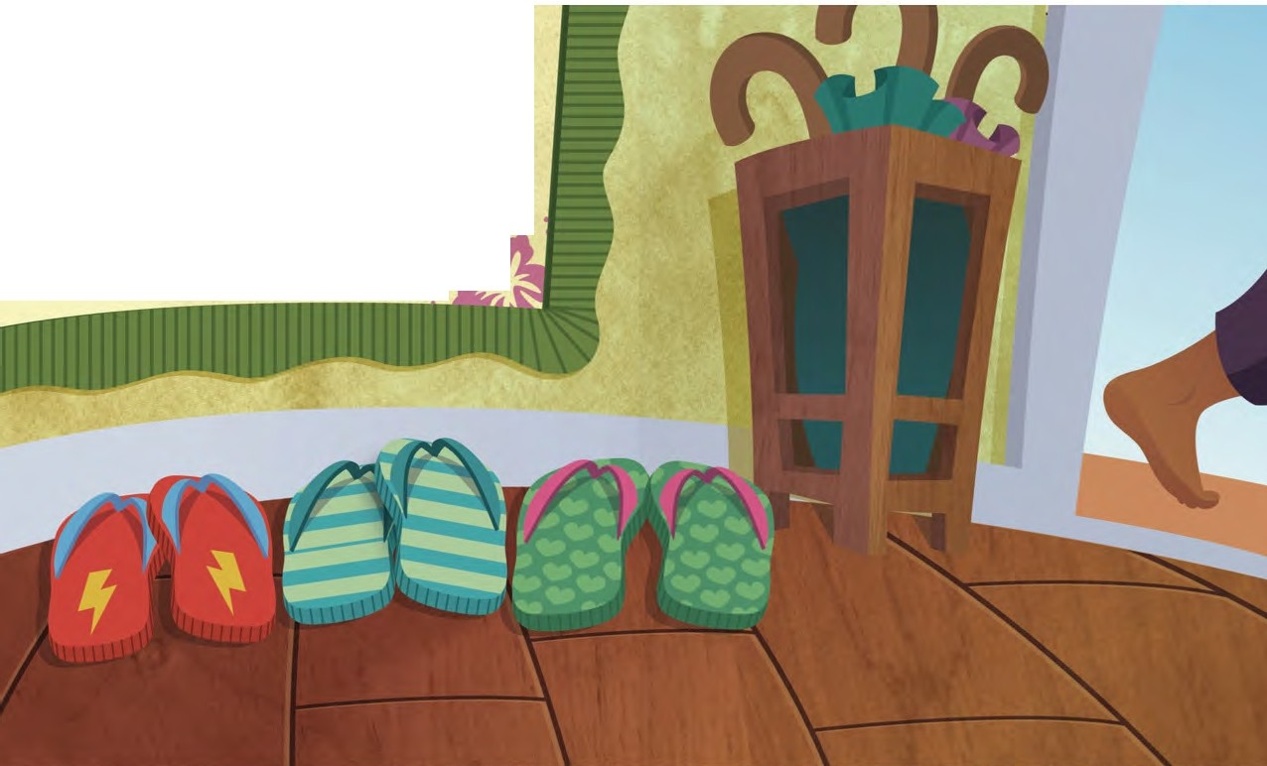
Slippers red.
Slippers CJreen.
Slippers SQUEEZED iNbetween•
.
· .
.
*-•)
• •

Slide 12
Mmis atched
slippers.
Slippers FAIT
and slippers slow.
Ones that
glow.

Slide 13
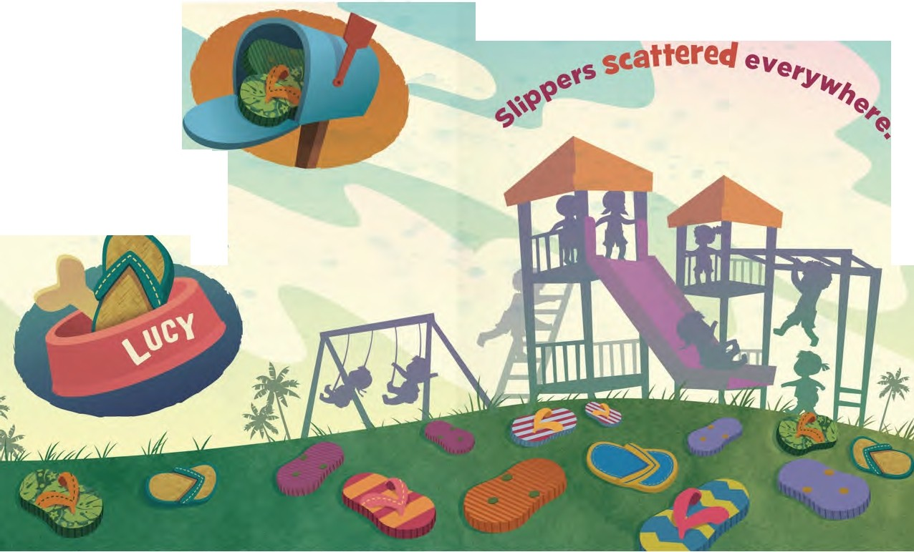

Slippers
hiding
,.e
and,,
A
(0
•

Slide 14
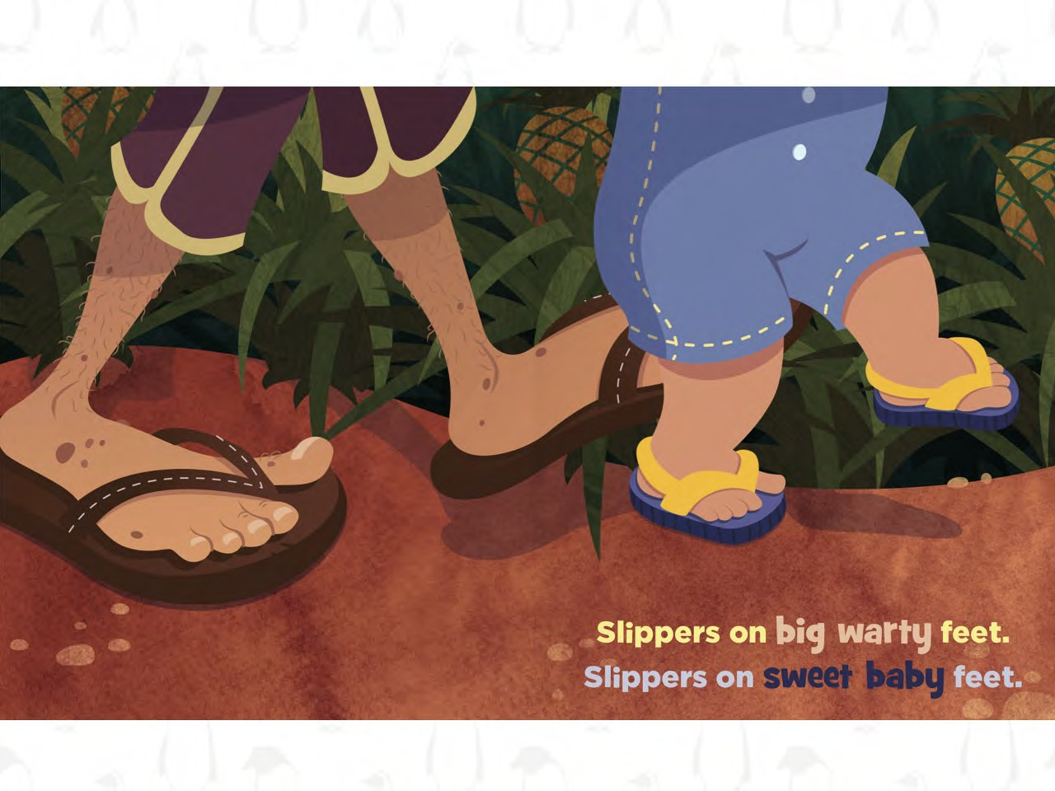

Slide 15
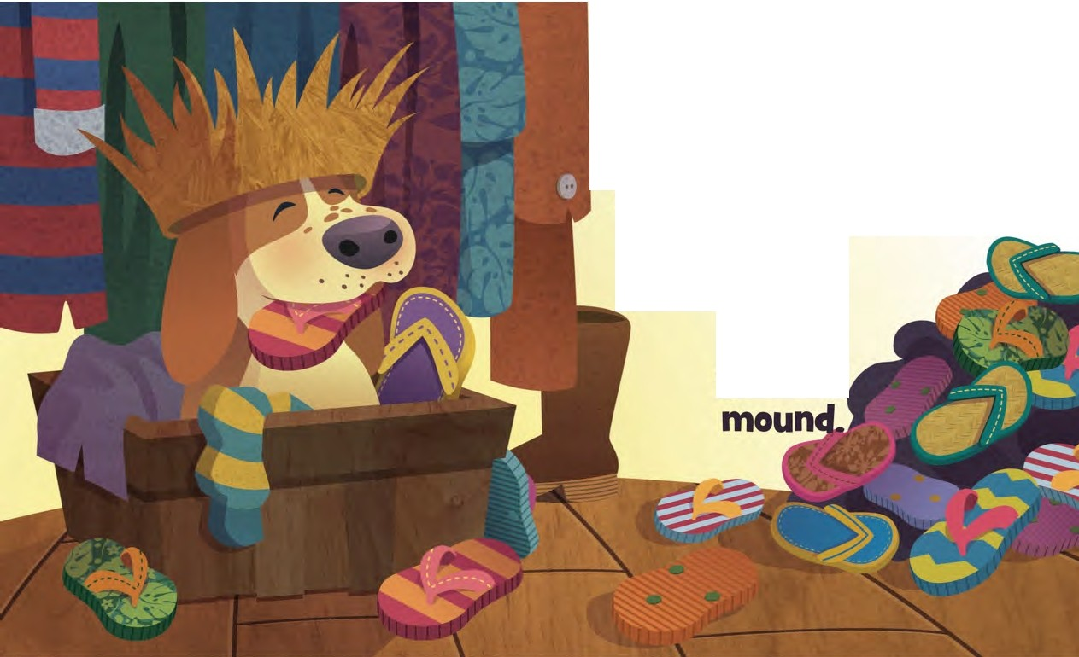
lost and found.
Slippers love the
Some in a box.
.. Some on the 9round.
Some atop a
9rowinCJ

Slide 16
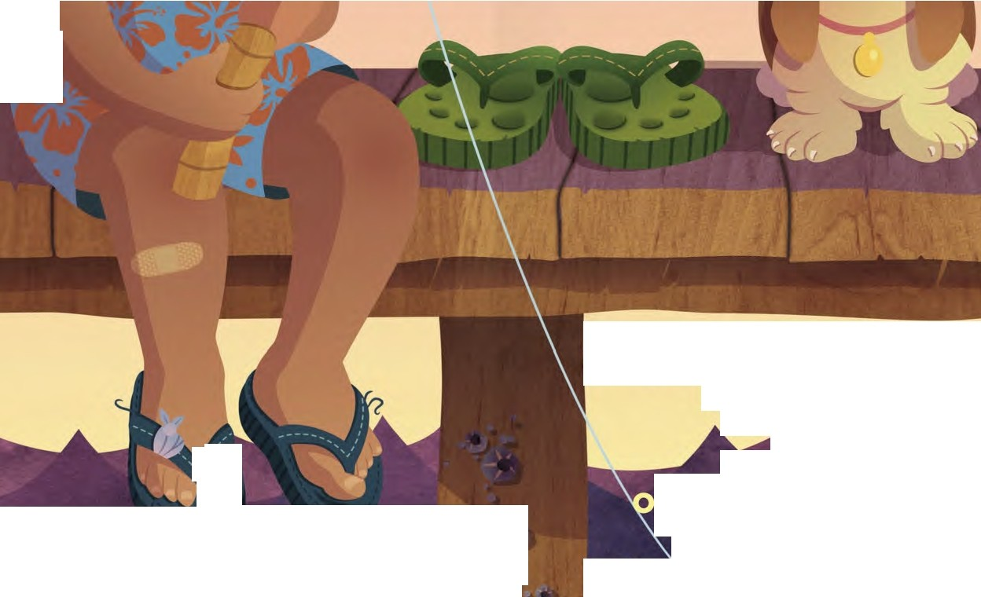
·. ..
!
•
t
•
·.
> '
,,
.
';,
\
~ -
They have five toe-shaped little nests.
,' ,
,
' ,,I
I
. ..
ne for your,.biCJ .t oe . ·.
. .
., : I ,4'1•
.)
I'-·.
p in klJ. too.
:,
rs that fit only you.
Worn-out
slippers are the best,!,-
.1"'•
Slip
•

Slide 17
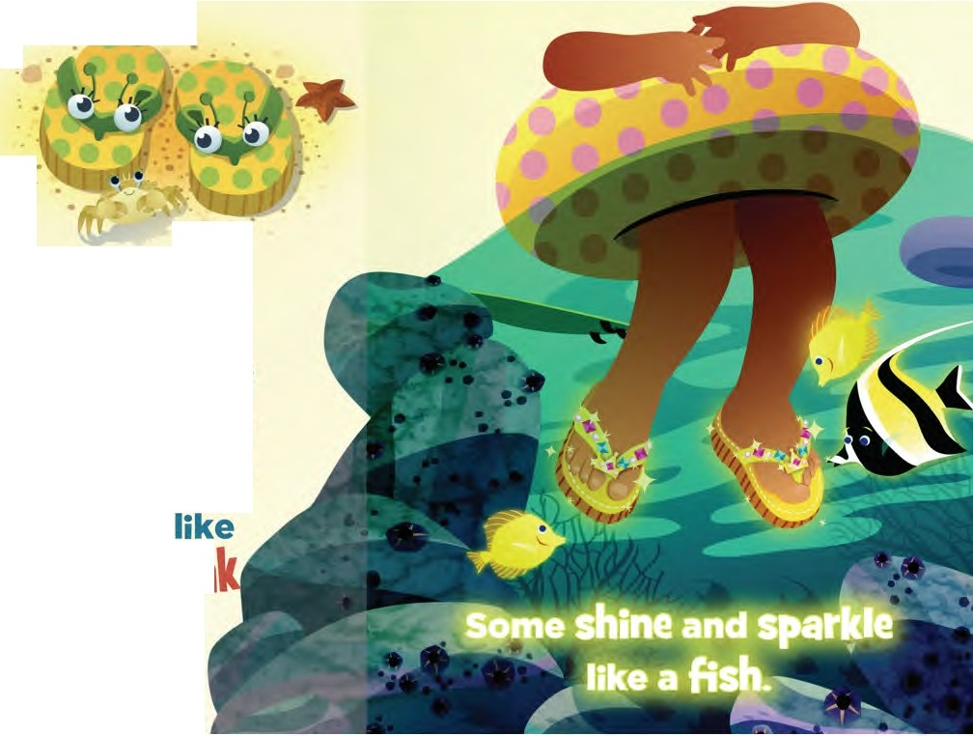
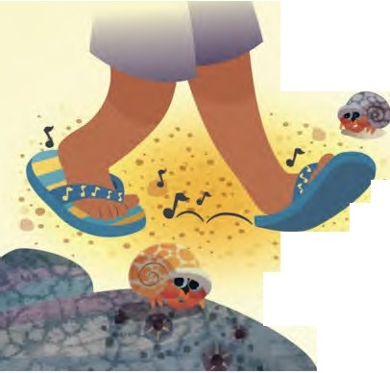
Slippers come
,•n any s•,ze.
•
•
Some have . giant CJ CJI·IJ _.
eyes.
•
Some make noise
. ... squea
8
or
f tJi1J,/

Slide 18
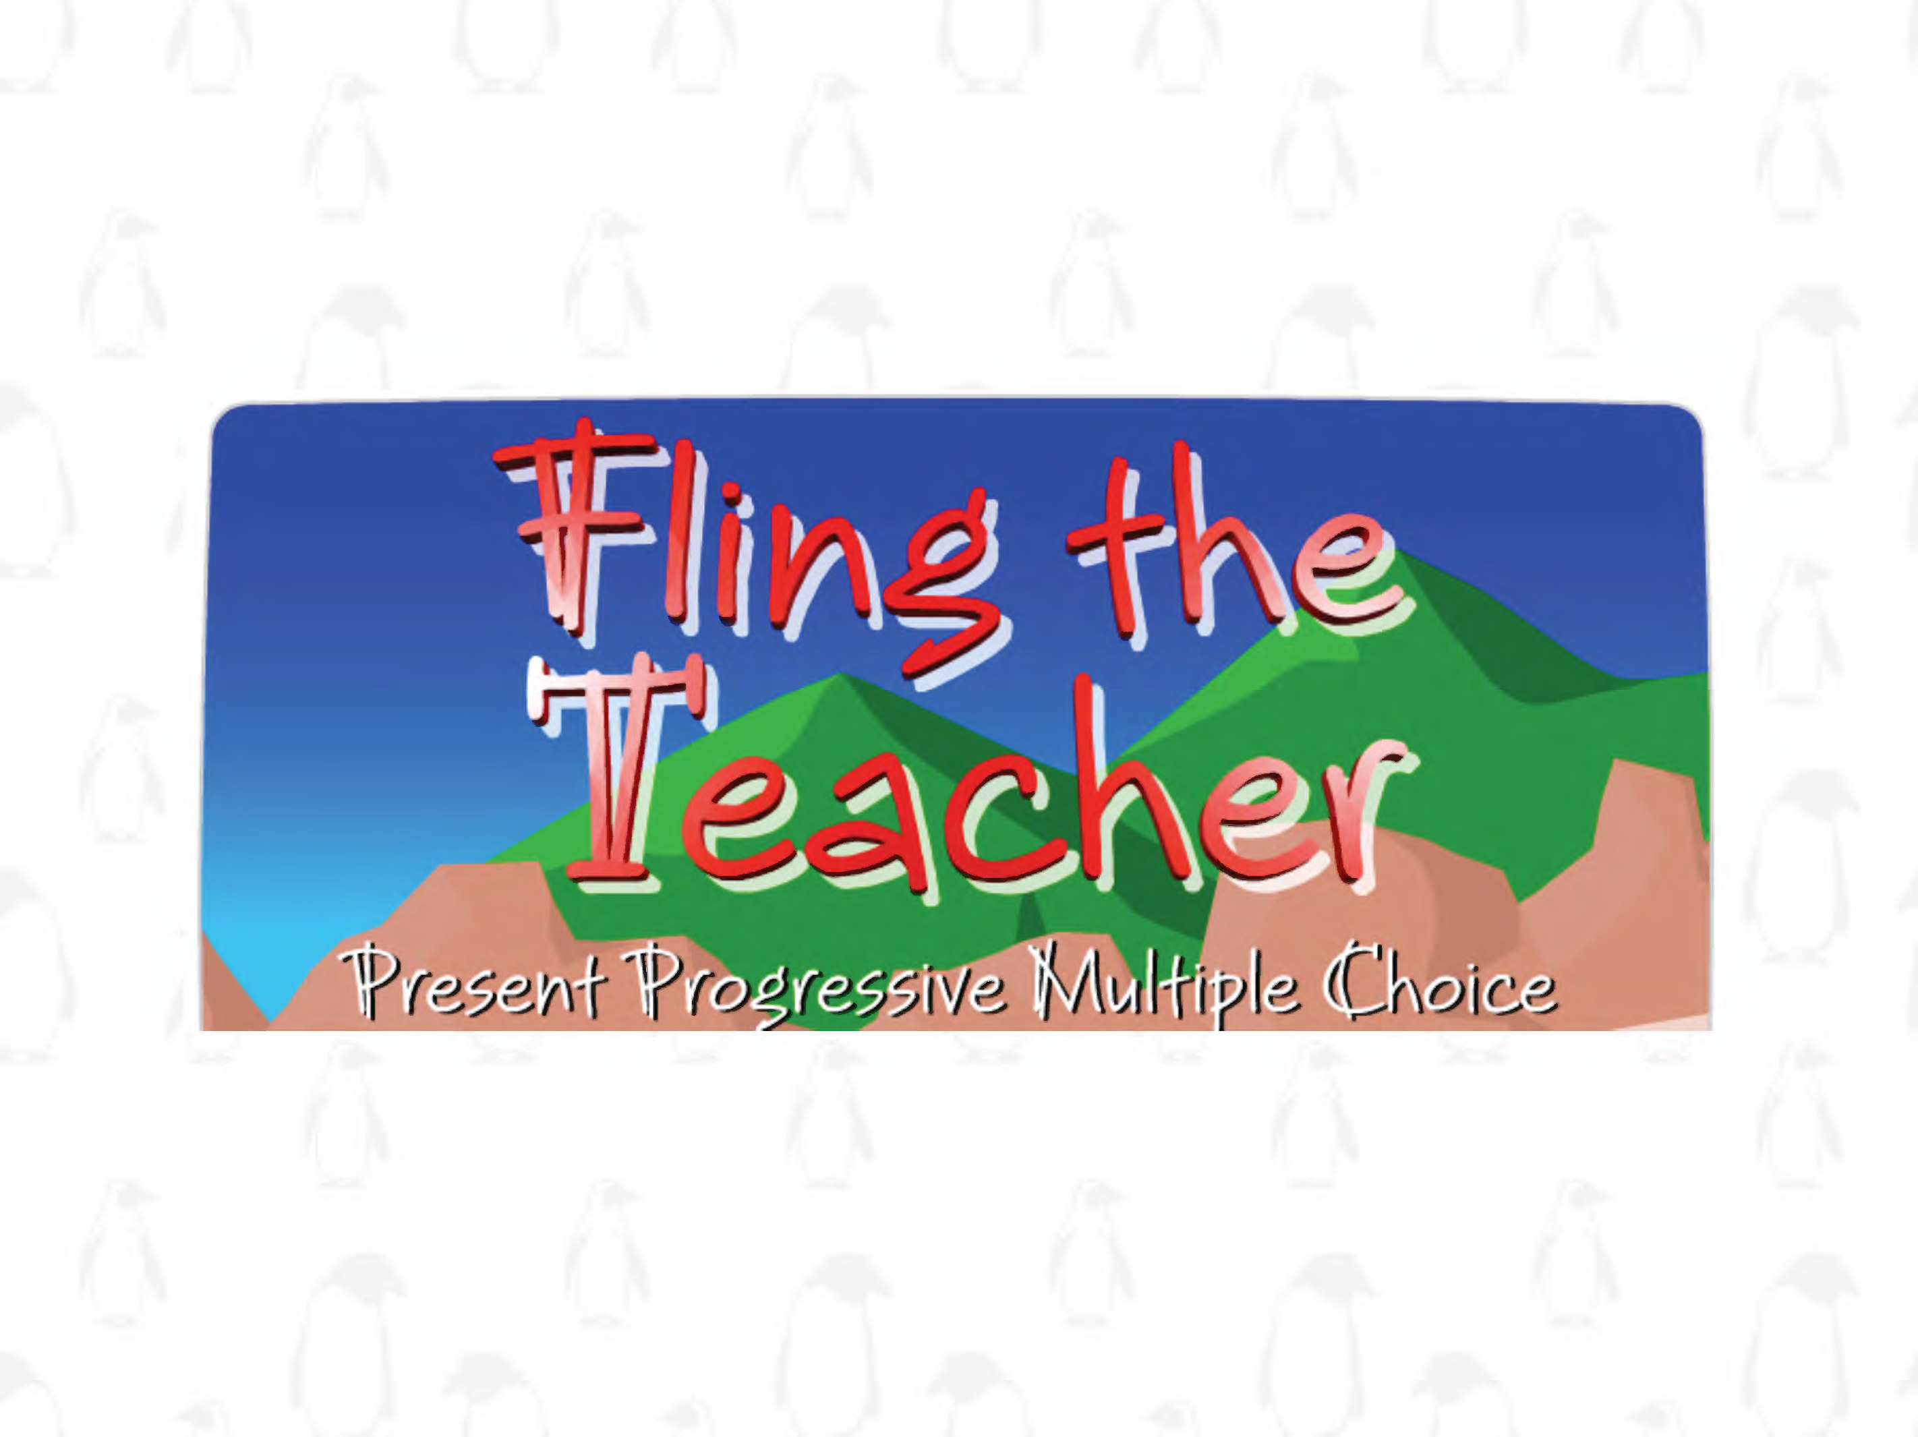
Fling the Teacher Game

Slide 19


Bubble Poem

Slide 20
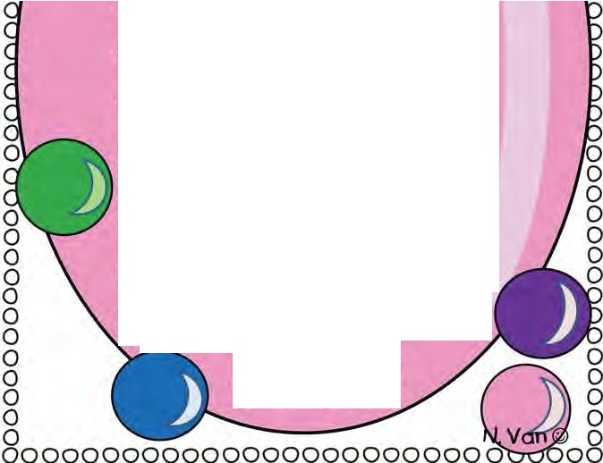
000000000000000000000000000000
0 0
0
_
--------
0
0
0
0
0 -.
0
0 )\ --
8 . L_l., 1 odayis the dayl
§ fhisisthe one!
g 1 odayis the day g g We'\\ \earnand havefunl g f oday we wi\\ growl
f oday we'\\ be kindl
f odayisimportanti
Don't \eaveit behindf let'sgiveit our a\\l let'snever stopl We'dbetter getbusy Before we a\\ ...
POPIII
0
0
0
0
8
§

Slide 21

Today’s letters! -> ‘BB’

Slide 22

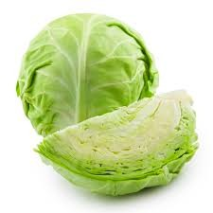

Today’s letters! -> ‘BB’

Slide 23

What did I just learn?
The sounds of the letters ‘BB’

Slide 24
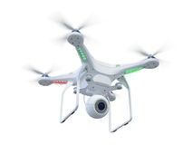
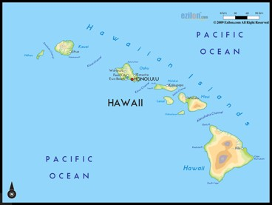
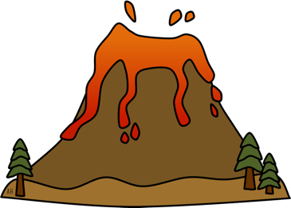
What did I learn today?
drone | cabbage
Hawaii | volcano

Slide 25

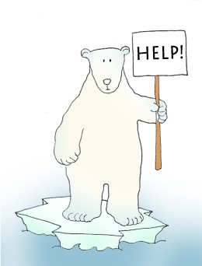

Final Thoughts
Do you have any questions?
Do you understand the handout?

Slide 26

Before the next class
Listen and read along with the ‘’Slippers in Hawaii’ book Read book to yourself and to your family/friends Complete the worksheet
Practice writing new vocabulary words

