Slide 1
Let’s Learn About Pets!

Slide 3
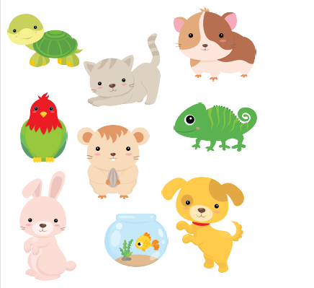

Slide 9
1. Let’s think about
phonics!
CK

Slide 10
Duck
Chick Brick Knock Luck Sock Stick Back

Slide 11
Chick Knock Sock Back
Duck Brick Luck Stick

Slide 12
2. Let’s tell a story!

Slide 13
Things to think about:
Meet our characters!

Slide 14
Let’s watch what happens!

Slide 15
Let’s write our story together!

Slide 16
What happens next?
Take out your workbook and write three sentences about these dogs.
Draw a picture.

Slide 17
Descriptive Adjectives
Let’s look at grammar!

Slide 18
Adjectives
Colour
Opinion
Size
Sound
Age

Slide 19
Adjectives
Colour
Opinion
Size
Age

Slide 20
Find something in your house and use 5 different adjectives to describe it!
Adjectives
Colour
Shape
Opinion
Size
Age

Slide 22
Let’s review

Slide 23
Let’s review

Slide 24
Let’s review

Slide 25
Let’s review

Slide 26
Homework.
Choose a pet animal that you would like to have. Write 4 sentences describing what it looks like. Use adjectives.
My pet is a bunny. She has big ears and a white tail. She has blue eyes and a pink nose. She is very quiet and very soft. She is fast and happy.

