Slide 1



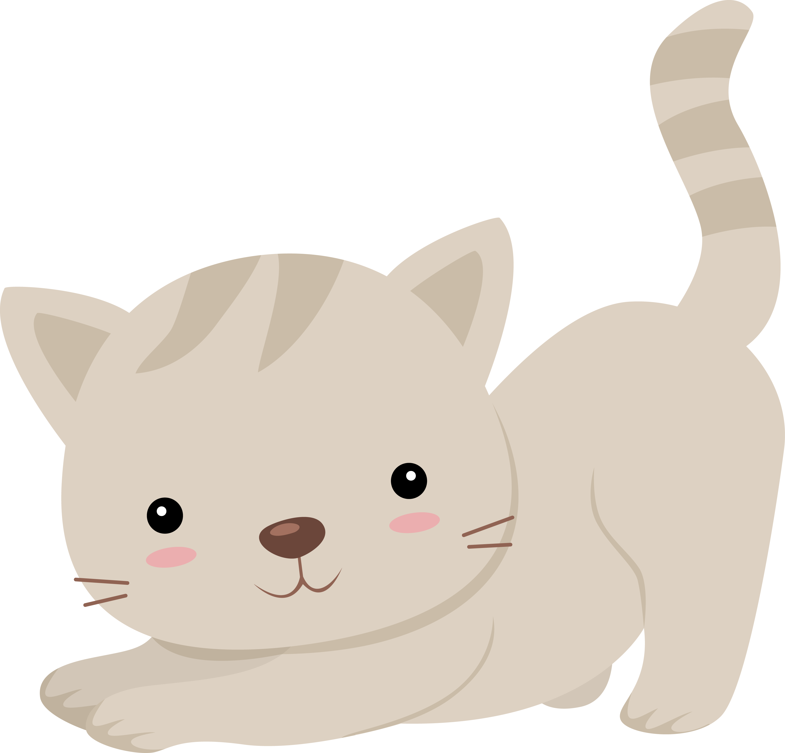

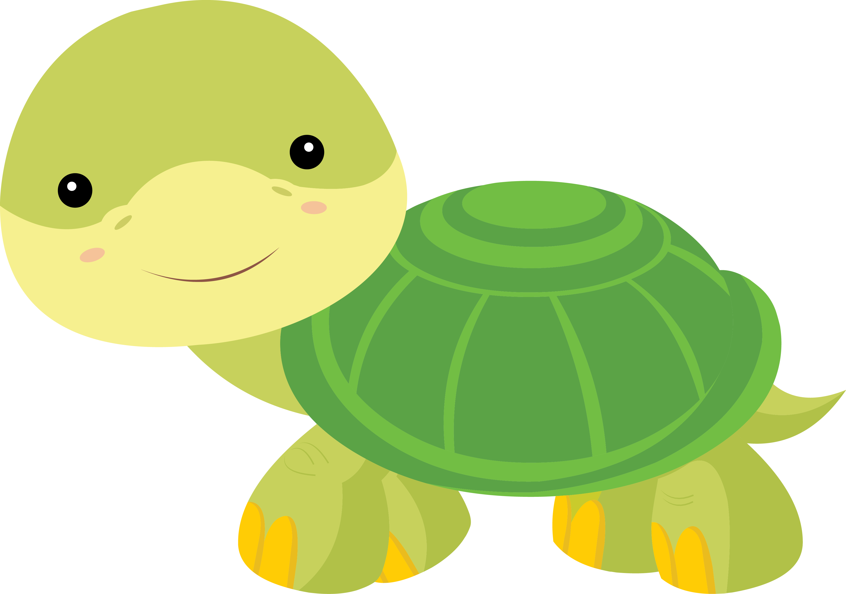

Lesson 10
Let’s Learn About Pets!

Slide 2




What will we do today?

Slide 3




Let’s talk about opposites!

Slide 4
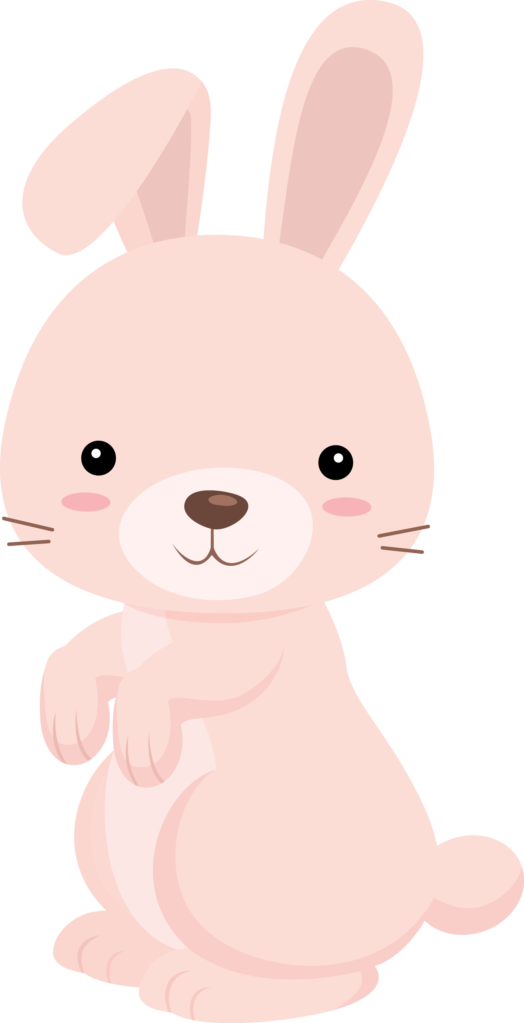
The rabbit runs quickly.
The turtle walks slowly.

Slide 5

The bird squawks loudly.
The cat purrs quietly.

Slide 6
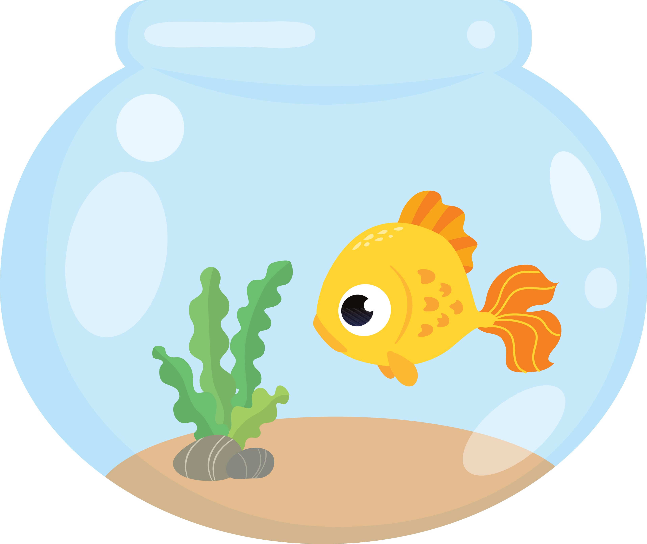
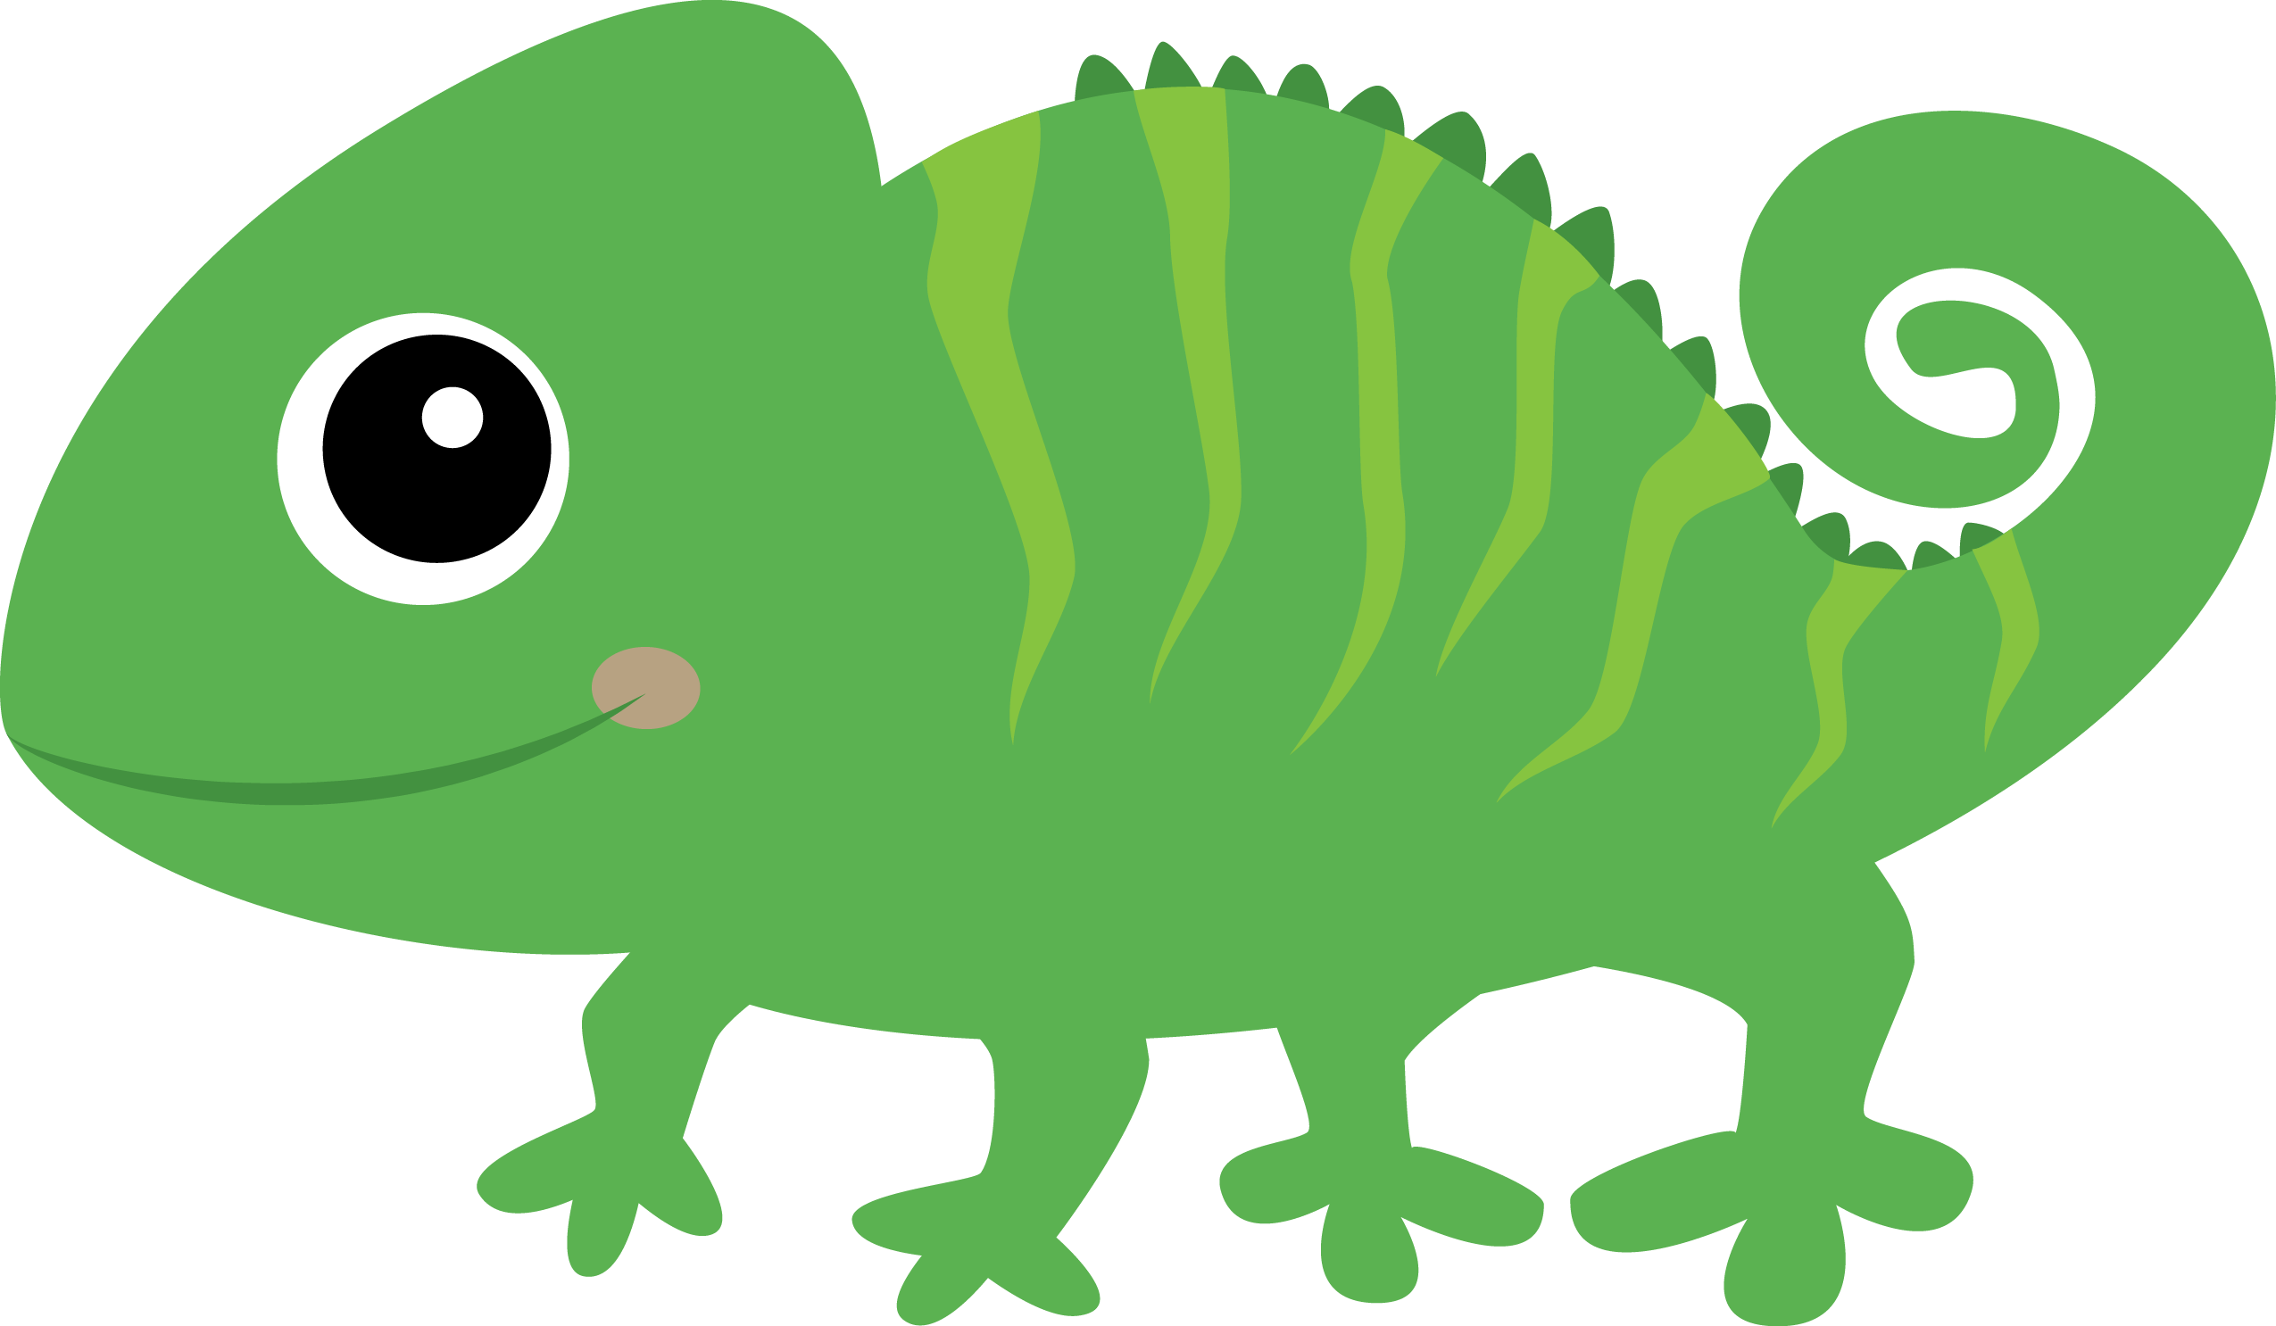
The fish is on the left.
The lizard is on the right.

Slide 7
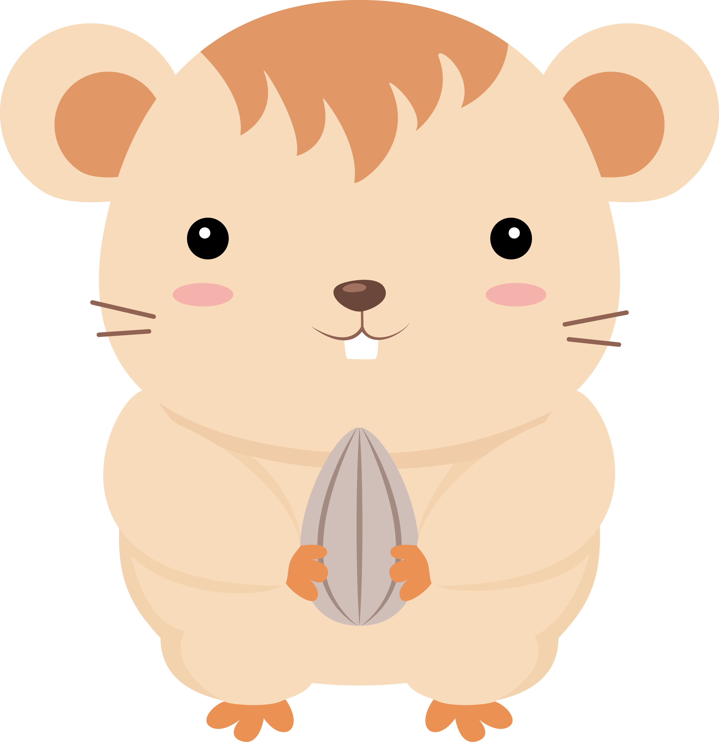
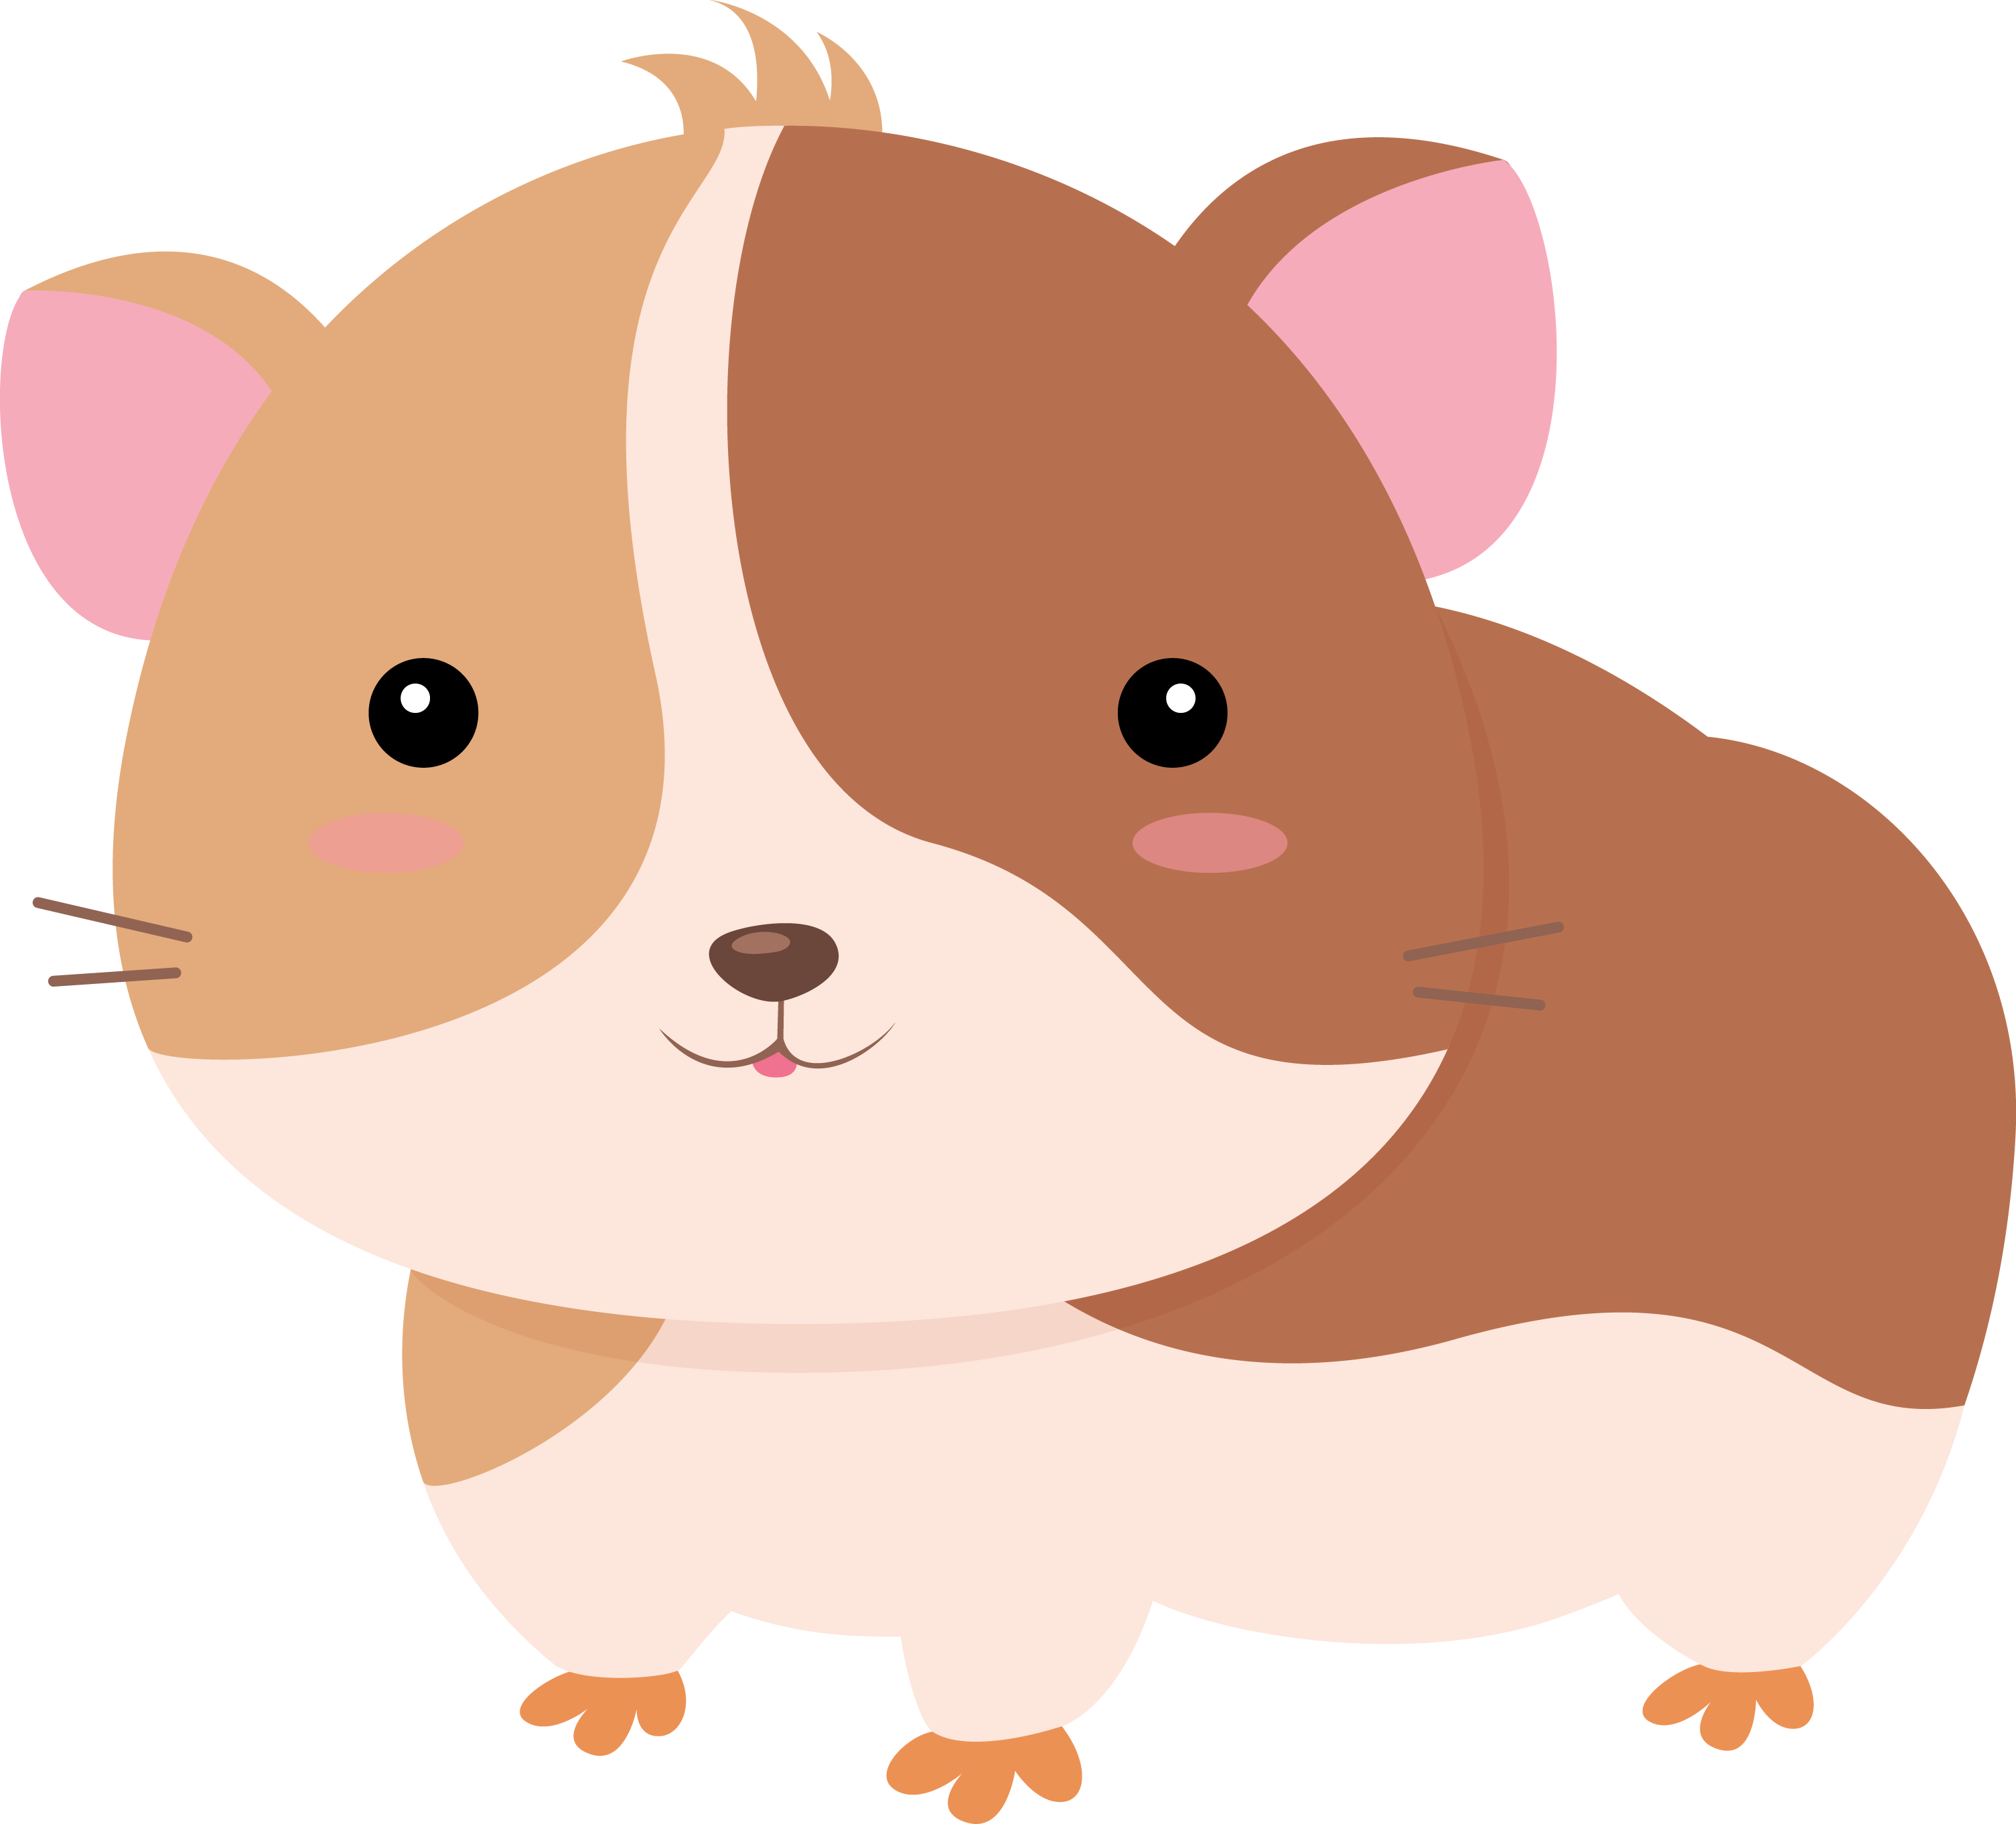


Slide 8


1. Let’s think about
phonics!
WH

Slide 9
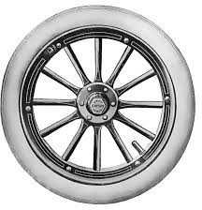






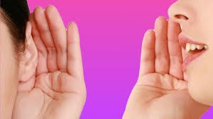
w h
e

Slide 10
w h
p r

Slide 11

w h
l

Slide 12
w h
k r

Slide 13
w h n

Slide 14
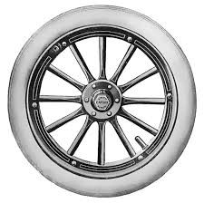

Slide 15

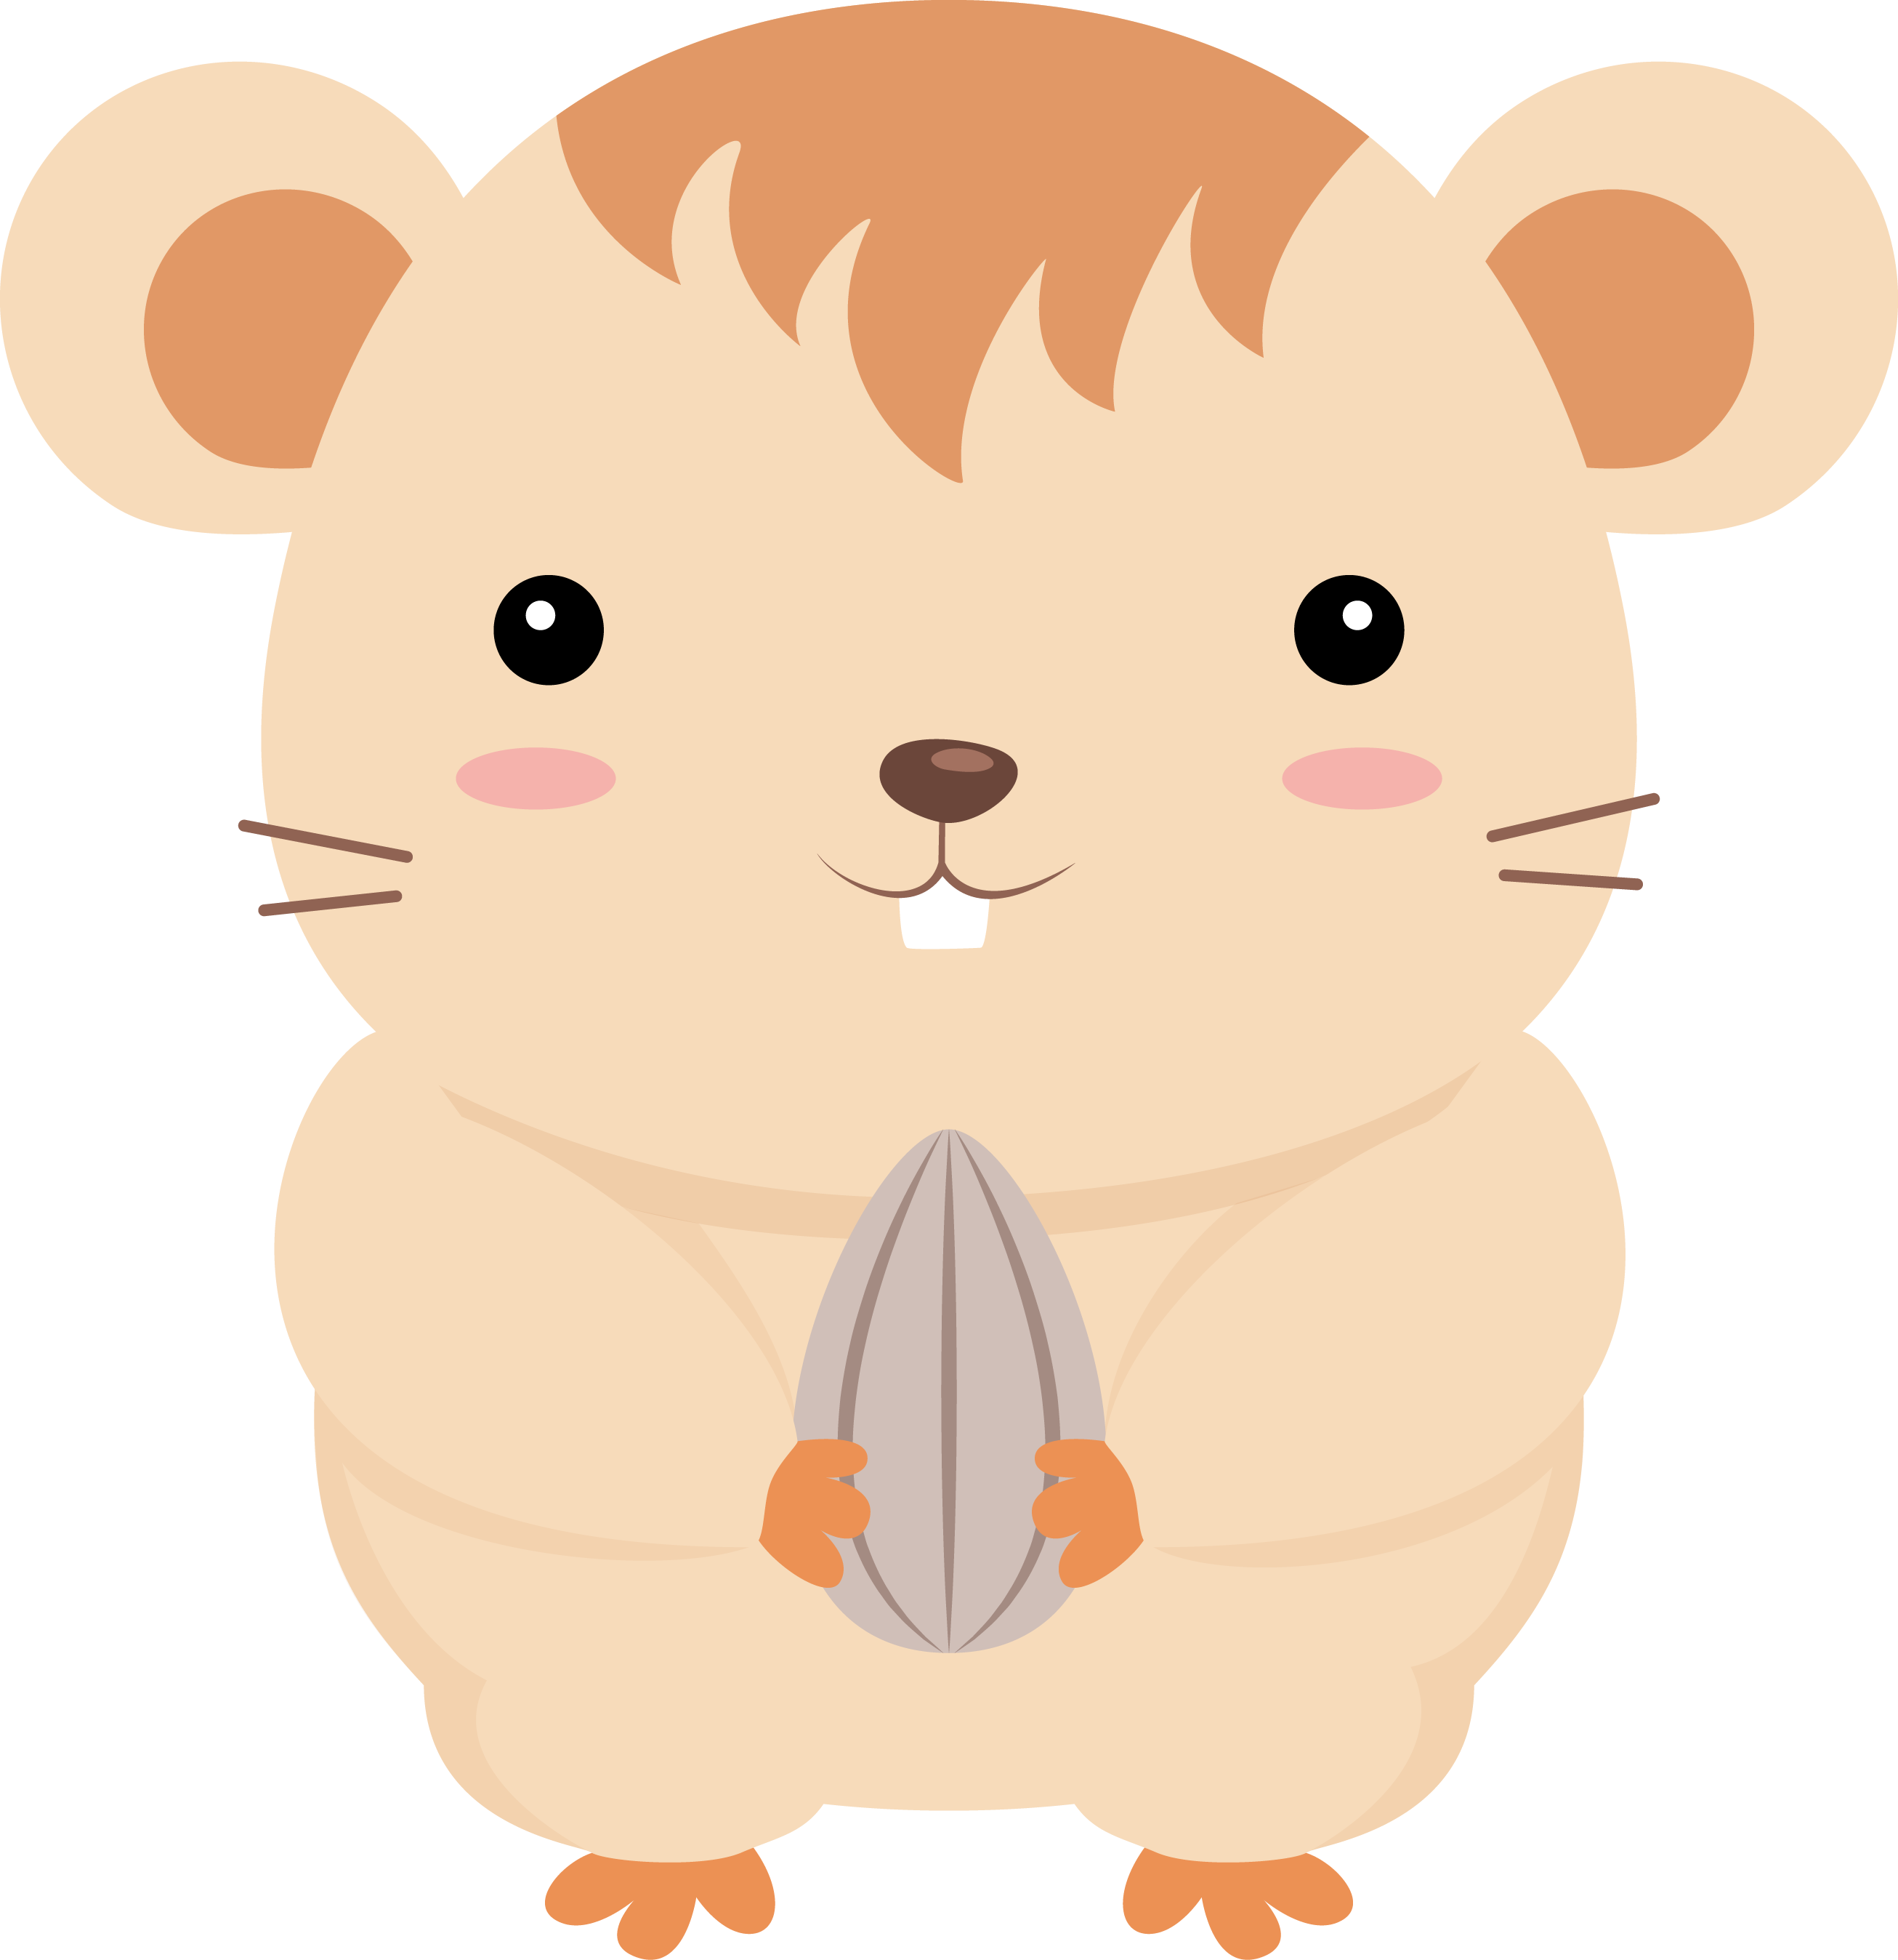
2. Can & Can’t

Slide 16


Can & Can’t
Tell us about ability
Birds can not swim. Fish can’t fly.
Dogs can run as fast as cats. Rabbits can jump very high.

Slide 17
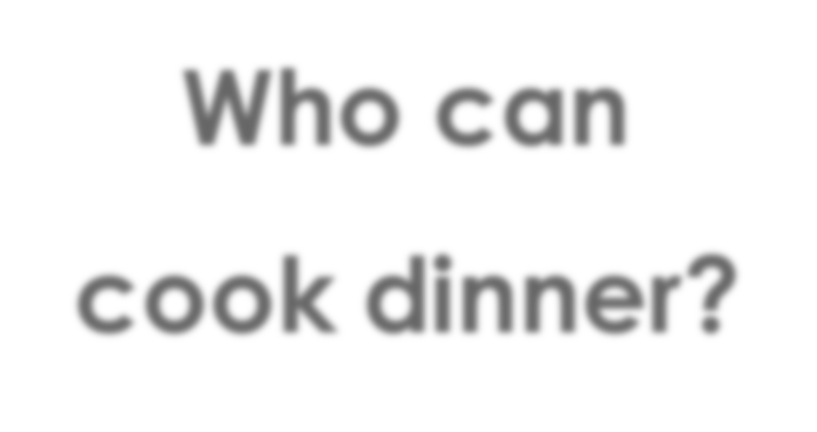

Who can cook dinner?
I
can cook
dinner.

Slide 18
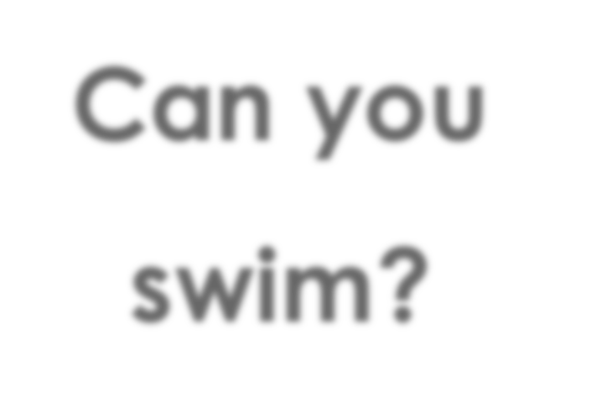

Can you swim?
I
can’t
swim.

Slide 19
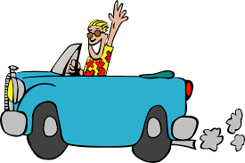

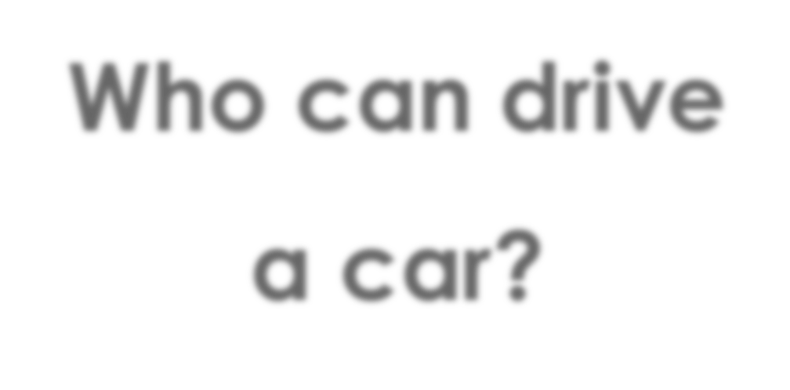
Who can drive a car?
I
can drive
a car.

Slide 20
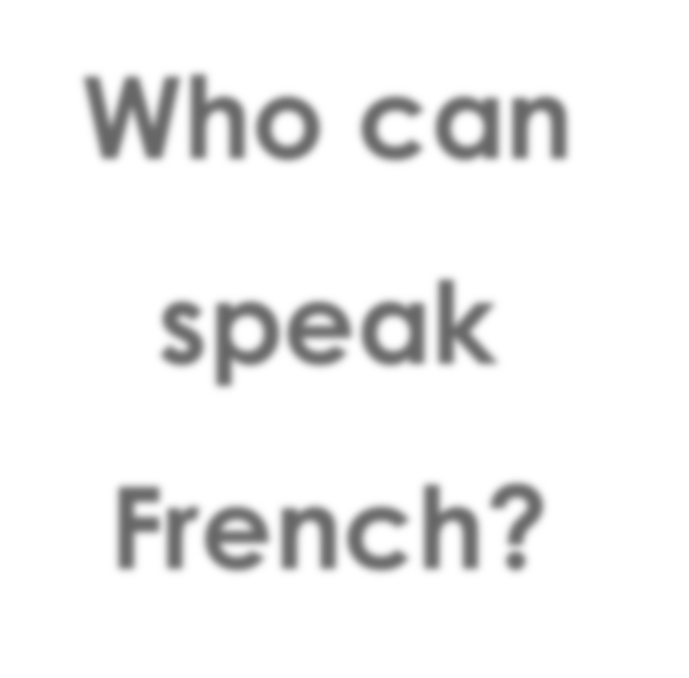
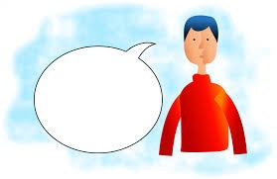
Who can speak French?
I
can speak
French.

Slide 21
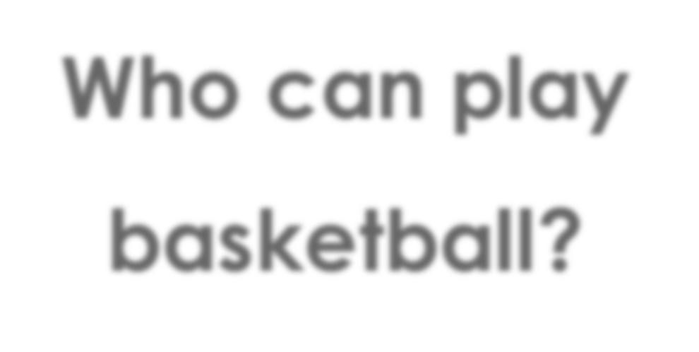
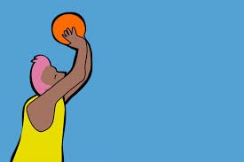
Who can play basketball?
I
can’t play
basketball.

Slide 22

3. Opposites

Slide 23


Let’s read a story!

Slide 24
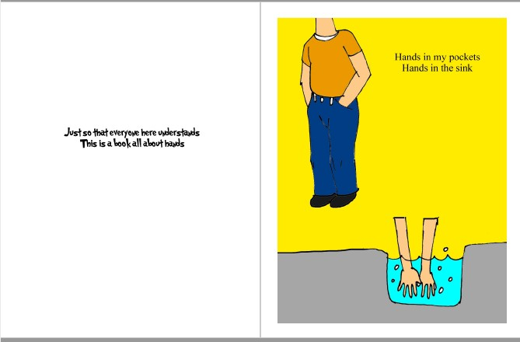

Slide 25
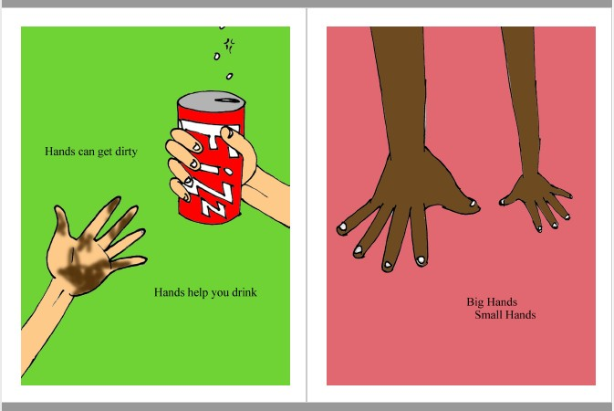

Slide 26
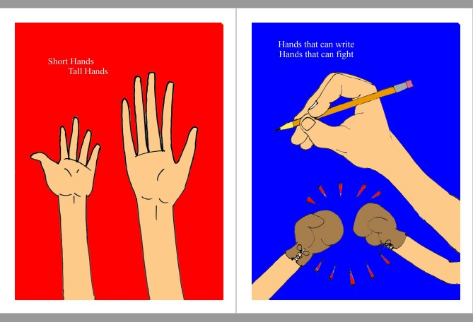

Slide 27
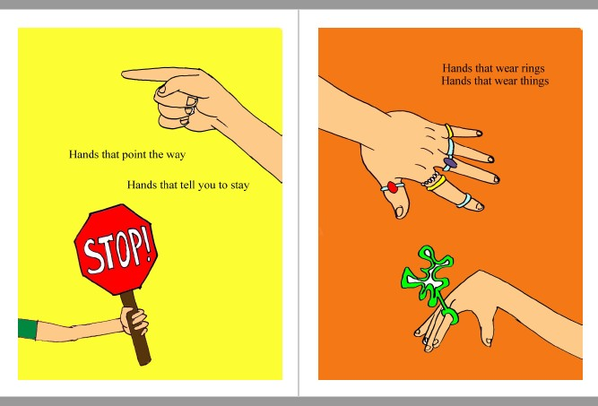

Slide 28
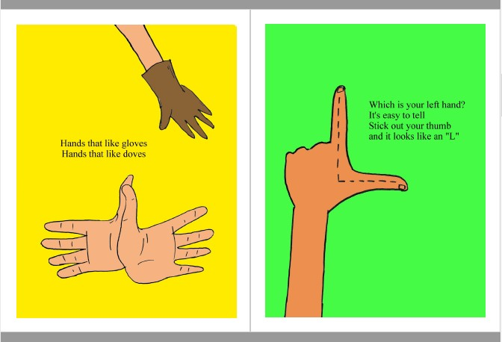

Slide 29


Slide 30
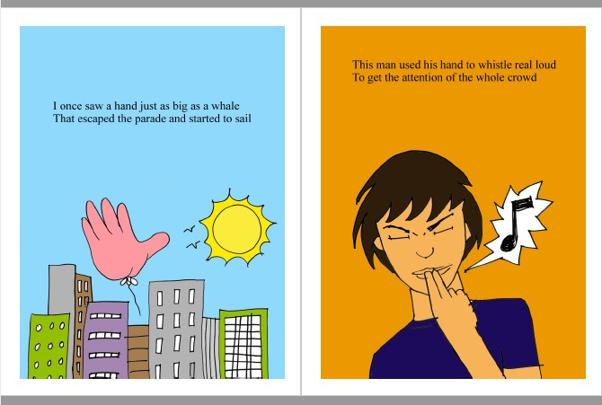

Slide 31
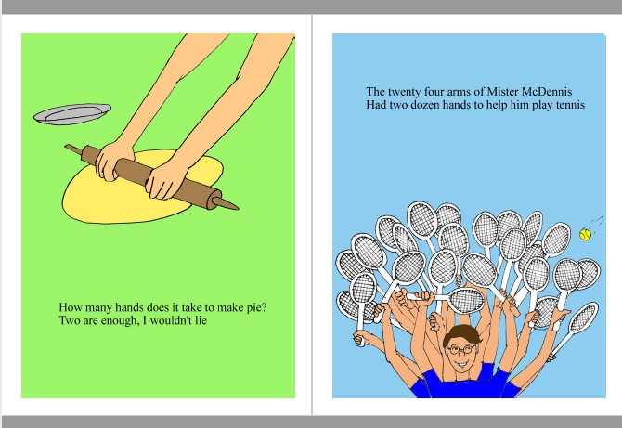

Slide 32
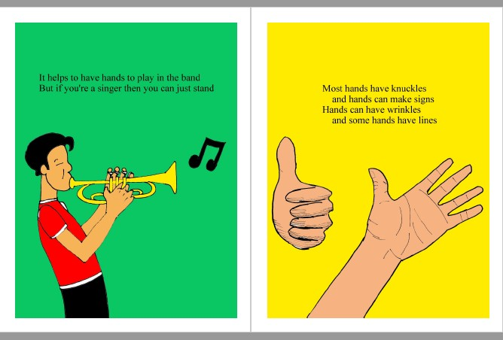

Slide 33
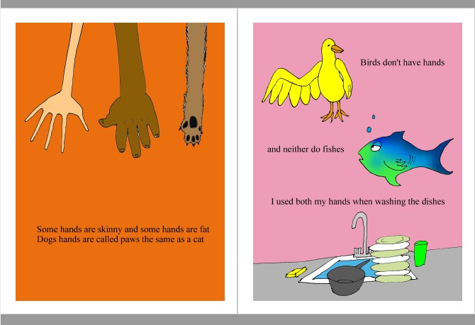

Slide 34
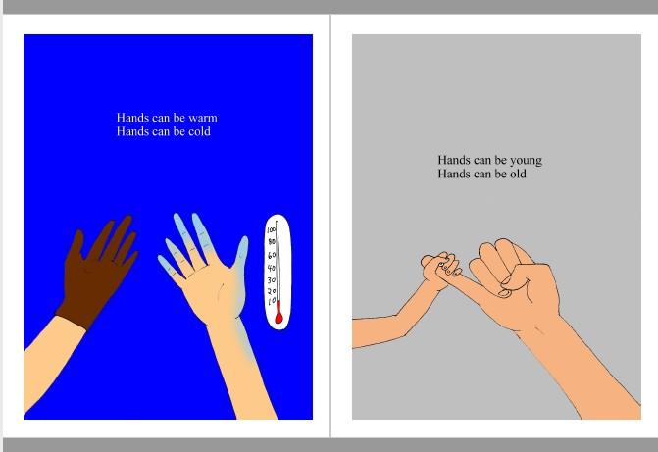

Slide 35
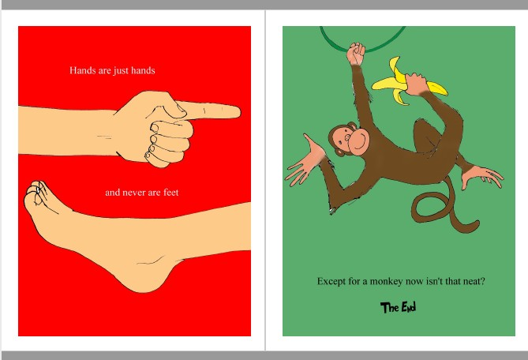

Slide 37



What did I learn today?

Slide 38

Let’s review

Slide 39
Let’s review

Slide 40

Let’s review

Slide 41

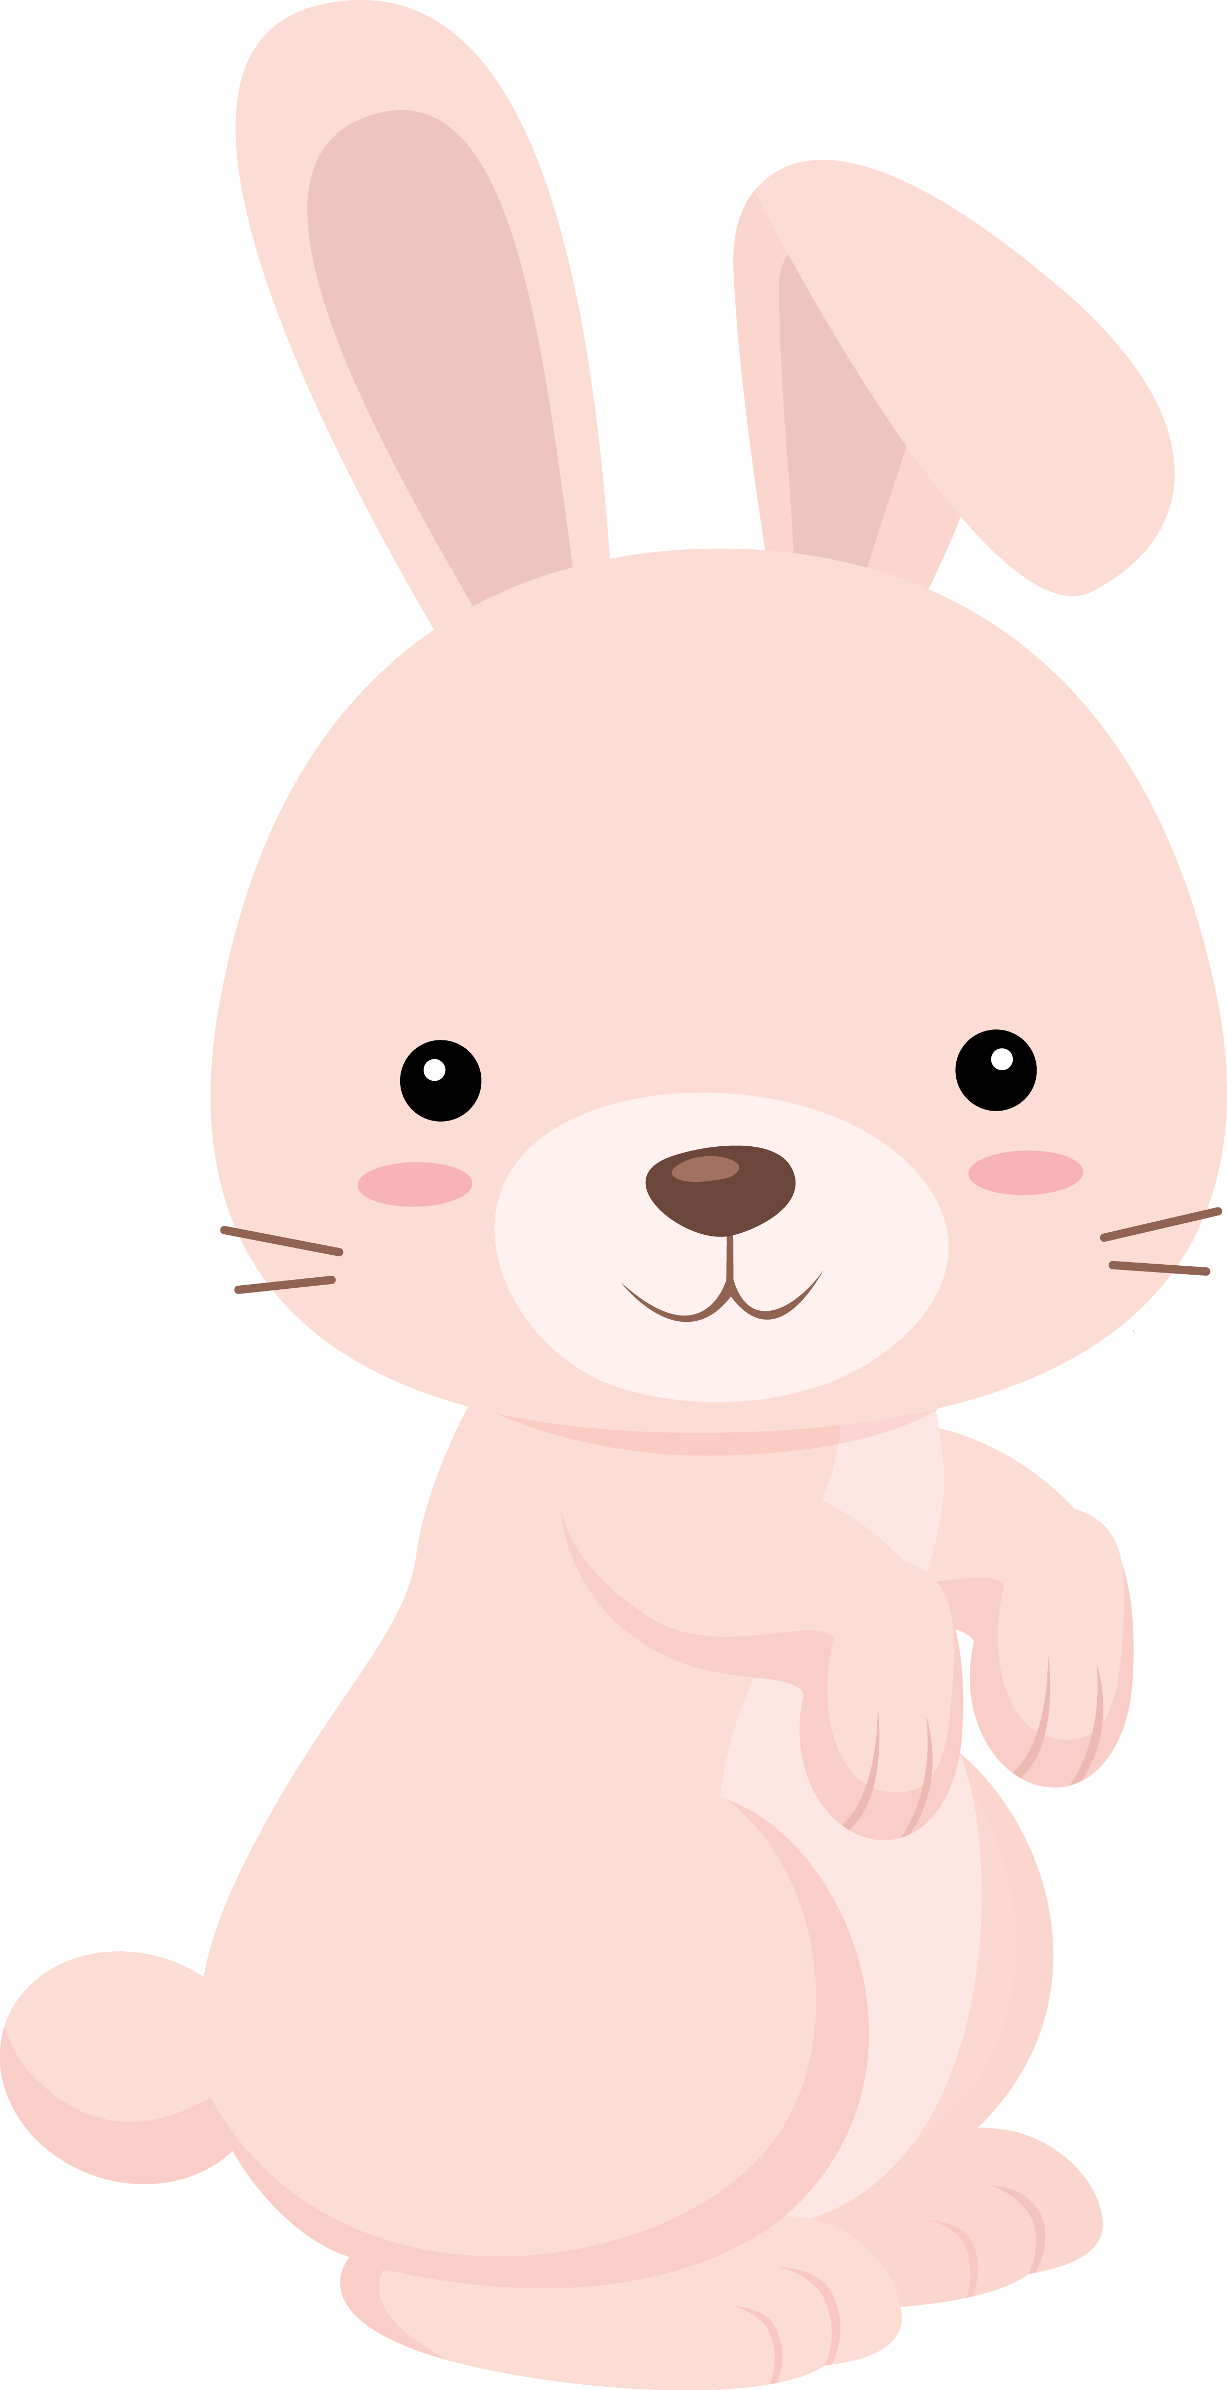
Homework.
Can and Can’t
Write about 3 things you can do. Write about 3 things you can’t do.

