Slide 1





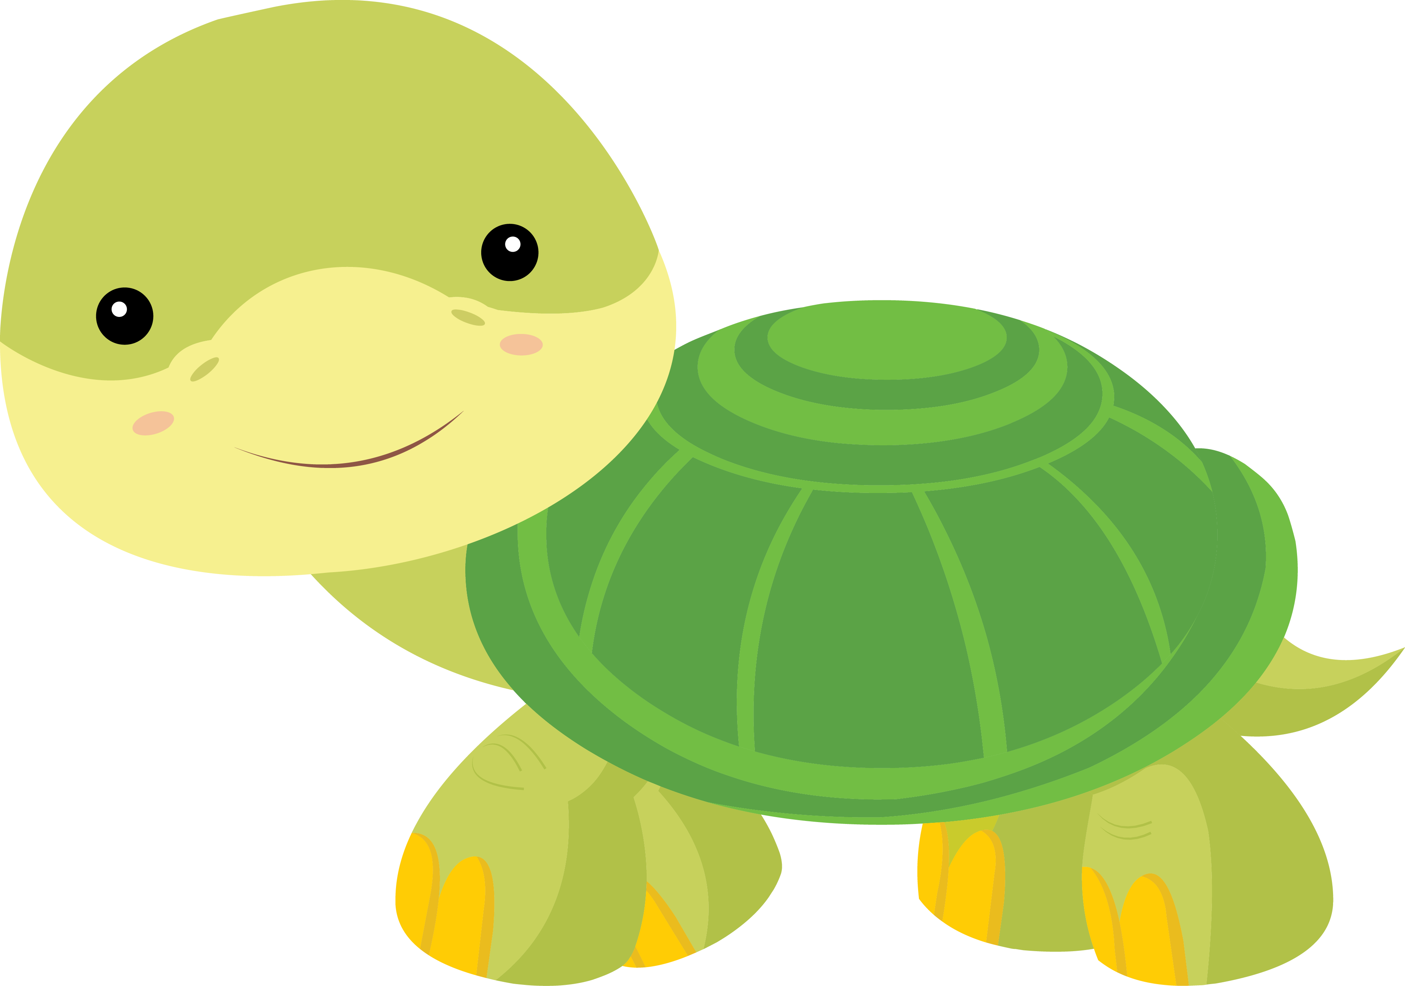

Lesson 11
Let’s Learn About Pets!

Slide 2






What will we do today?

Slide 3




Let’s talk about pictures!

Slide 4

Draw a picture on your worksheet in 3 minutes.

Slide 5
Tell us about your picture!

Slide 6
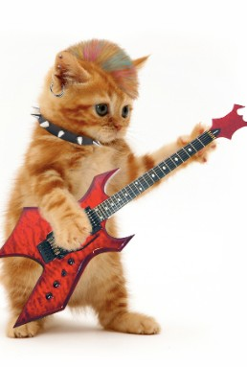

Tell me about this picture.

Slide 7
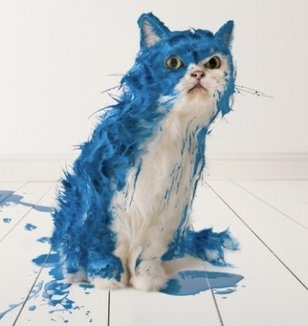
Tell me about this picture.

Slide 8
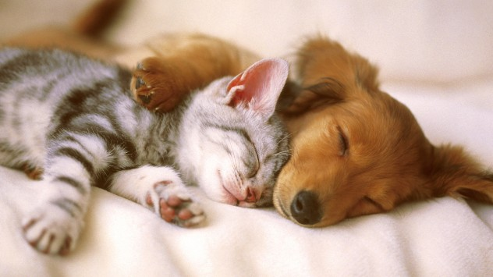
Tell me about this picture.

Slide 9


1. There is / there are

Slide 10

There is & There are
Singular | Plural
There is one cat in the | There are three birds in the
house. | tree.
There is a dog playing with | There are some lizards on
the cat. | the patio.

Slide 11
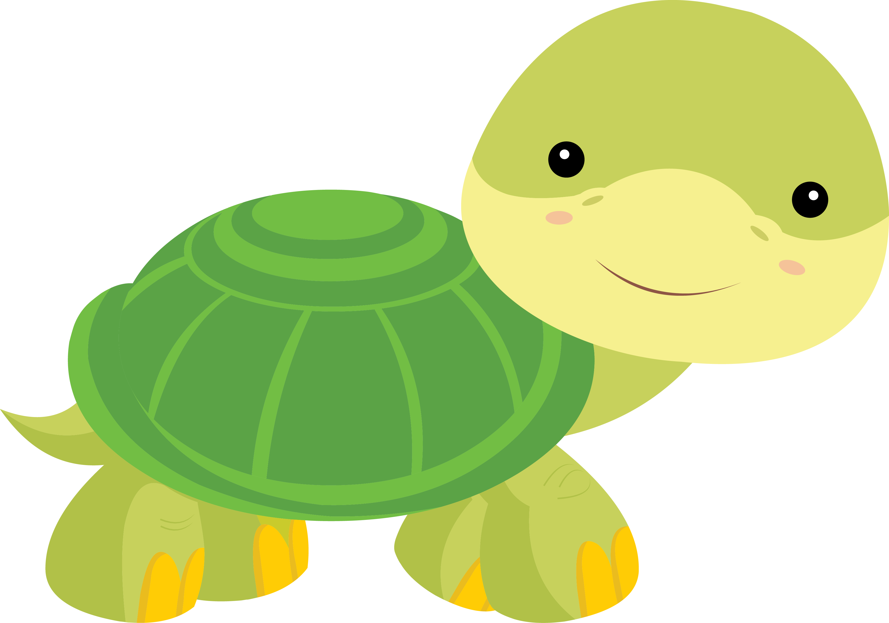


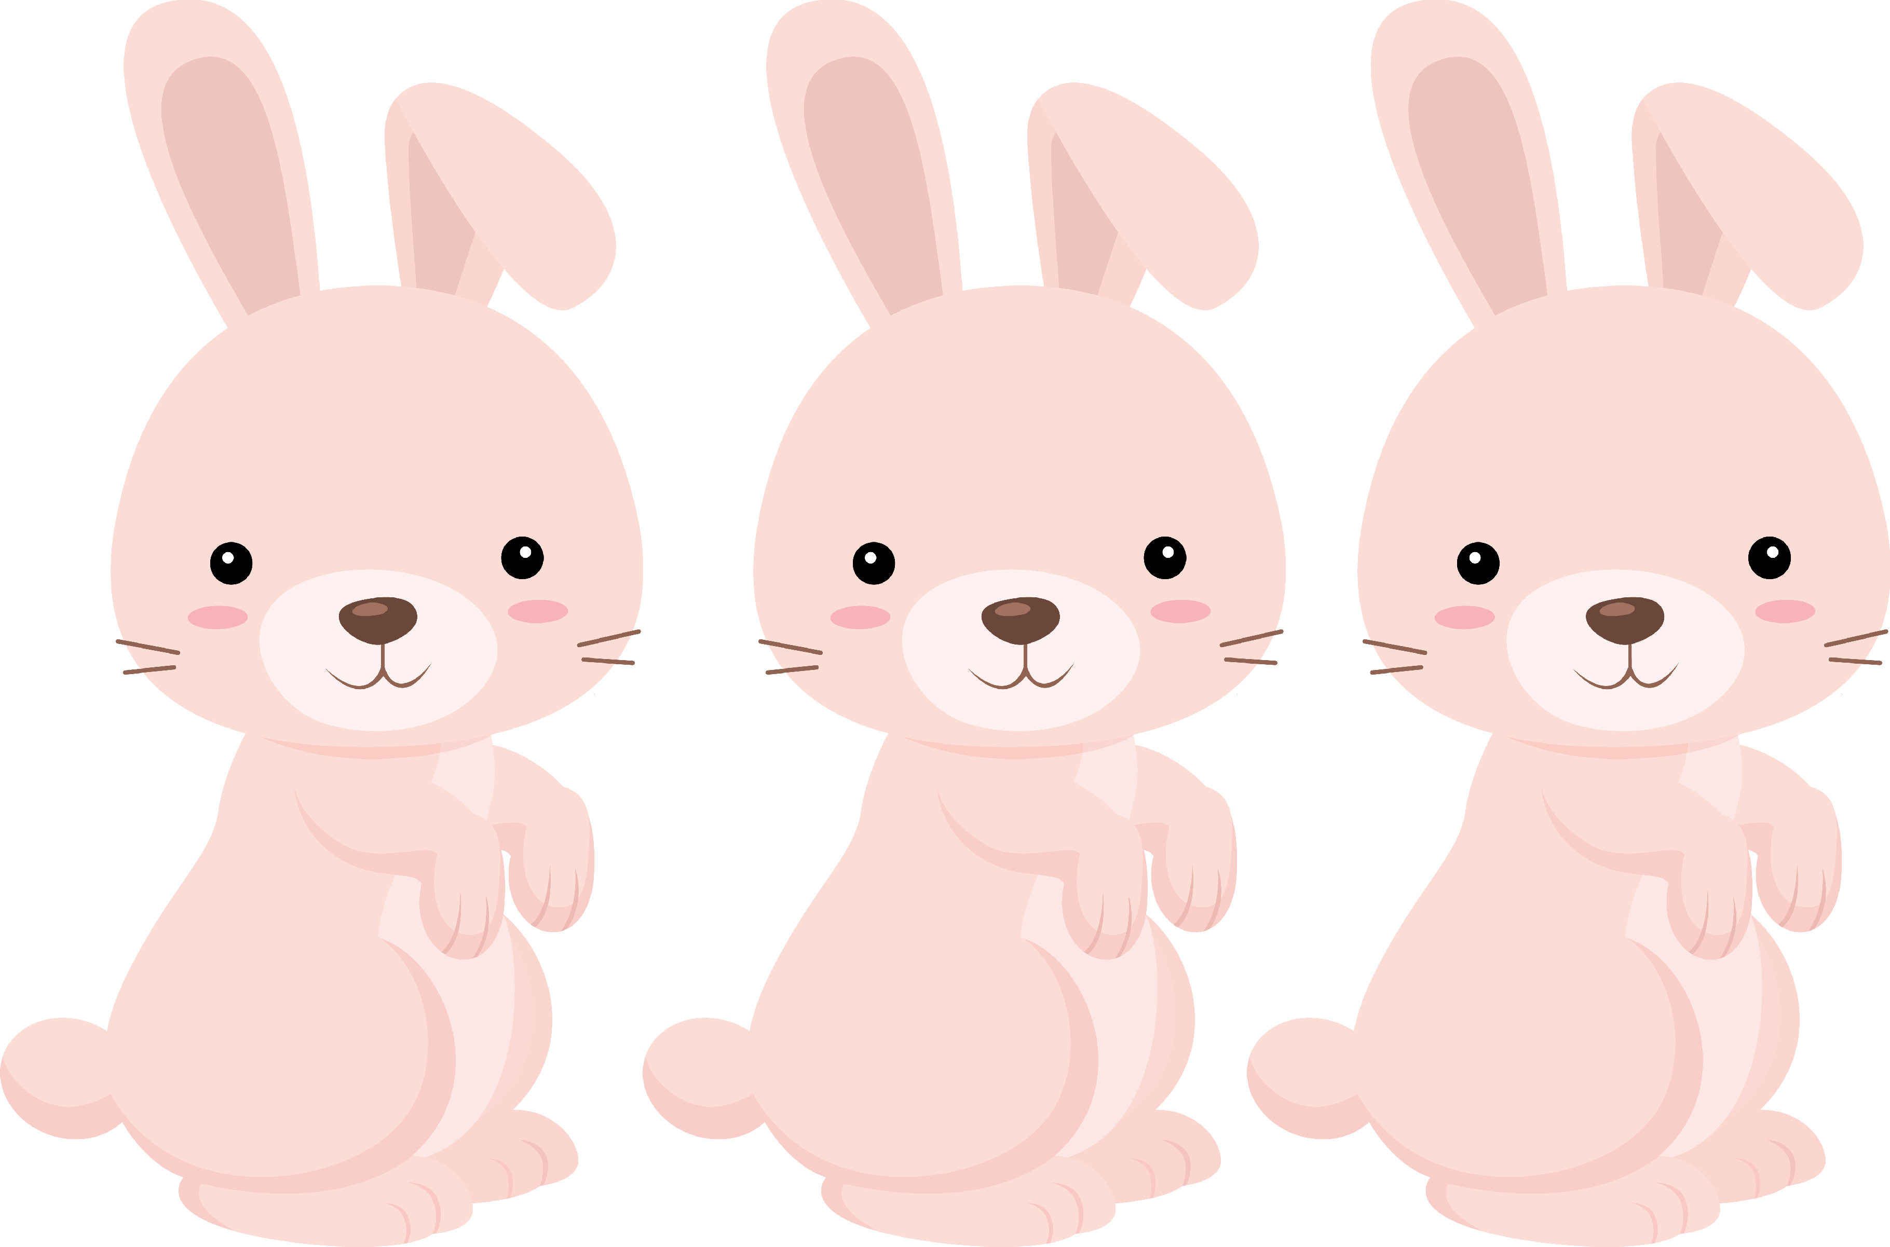
There are | one | rabbits
There is | a | dog
There are | two | turtles
There is | some | cats
There are | four | bird

Slide 12
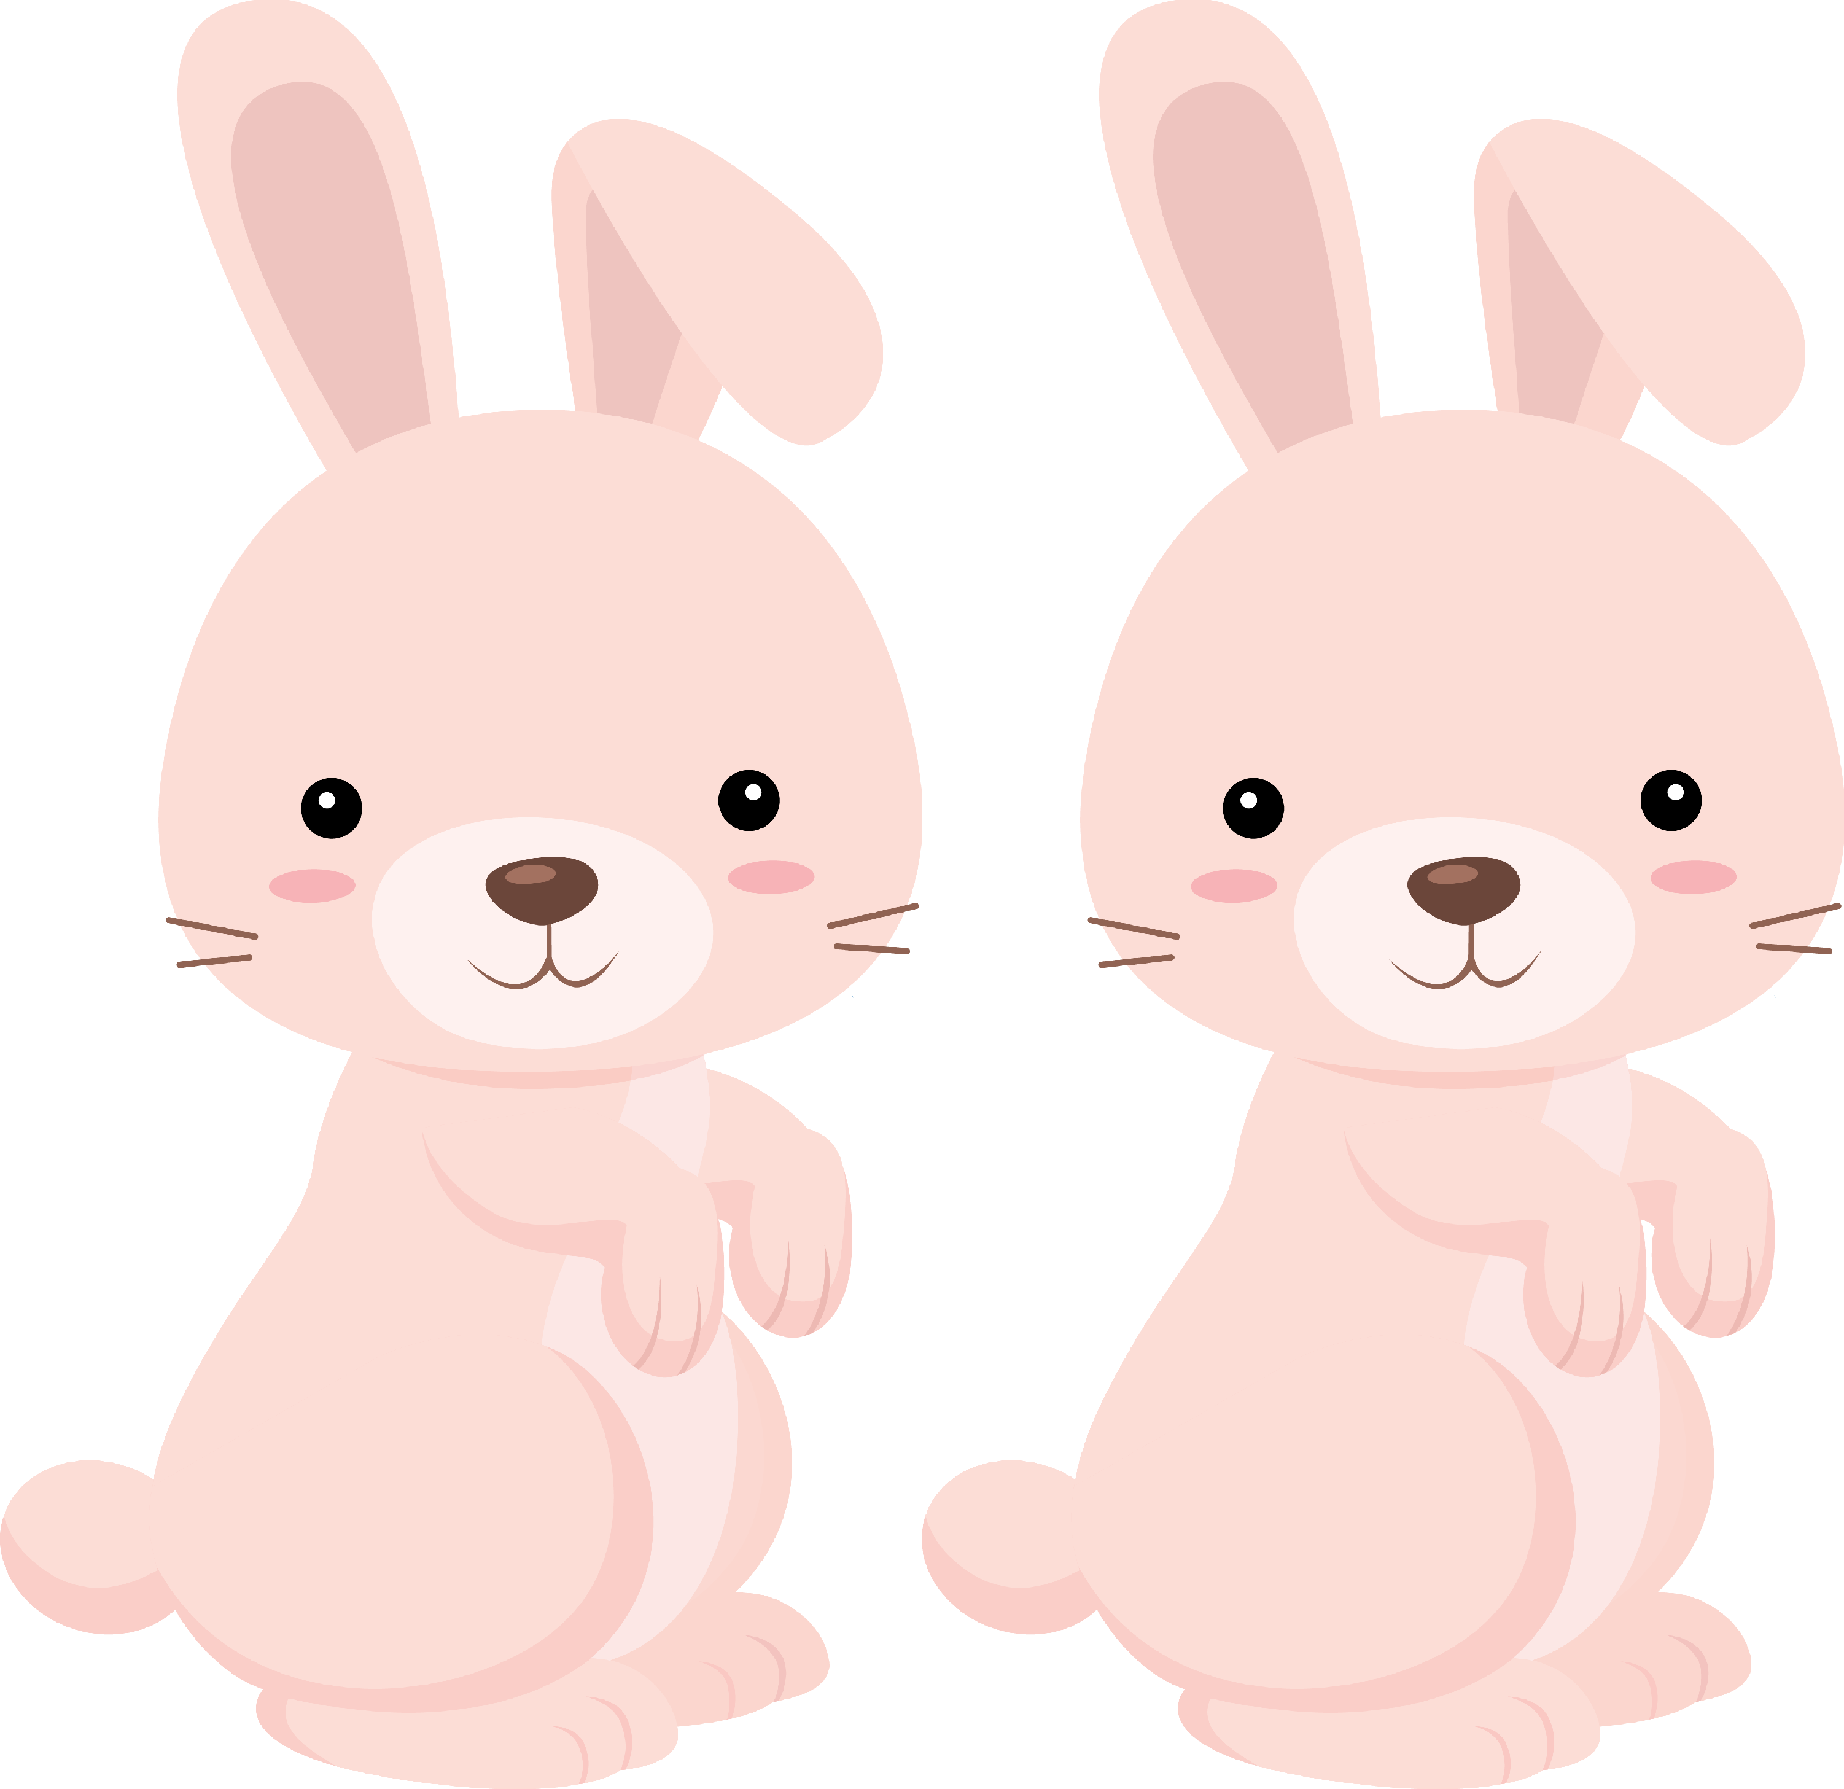
There |  | rabbits
There |  | dog
There |  | turtle
There |  | cats
There |  | birds

Slide 13


3. Simple Sentences

Slide 14

Alphabet madness
Choose a letter
Write a sentence using words that start with that letter
Get one point for each word you used
Example Letter – M
Marisa makes mint milkshakes on Monday. (6 points)

Slide 15
Alphabet madness
LETTER

Slide 16

Vocabulary Word Race
Teacher writes two words on the slide
Students must write a sentence using the two words
Get one point each word in the sentence.
Example
Words: cat + pizza
My cat doesn’t eat pizza. (5 points)

Slide 17
Vocabulary Word Race
WORDS

Slide 18




What did I learn today?

Slide 19



Let’s review

Slide 20

Let’s review

Slide 21

Let’s review

Slide 22

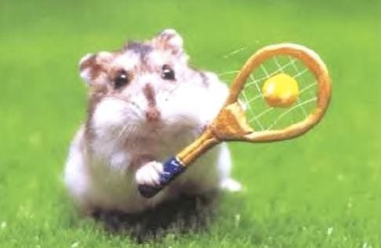
Homework.
Simple sentences
Write 3 sentences about this picture.

