Slide 1
Lesson 3
Let’s Learn About Pets!

Slide 2
Let’s review last week’s homework:
Choose a picture from your worksheet and write three sentences using ordinals.

Slide 3
What new words will I learn today?

Slide 4
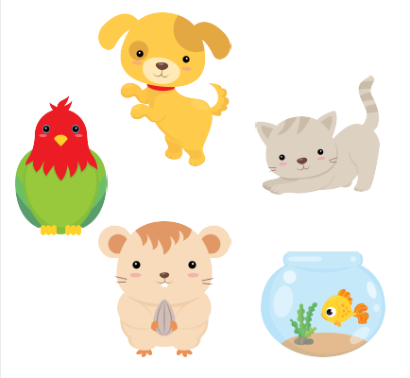

Slide 6
squawk | meow | squeak | woof | bark | purr

Slide 7
What will I be learning today?

Slide 8
1. Let’s think about
phonics!
SH

Slide 9
ship sheep shoes shark shell shower shop shamrock shirt

Slide 10
Let’s play tic tac toe!

Slide 11
Let’s play tic tac toe!

Slide 12
Let’s play tic tac toe!
This animal sounds like baa baa baa | Take this instead of a bath | This is something you can wear
If you find one, you’ll have good luck | Take this if you want to travel on the sea | This animal lives in the sea and has huge teeth
You can find these on the beach | Go here if you need to buy something | Wear these on your feet

Slide 13
2. Let’s talk about alphabetical order

Slide 14
Alphabetical order
bird | cat | dog

Slide 15
Alphabetical order
guinea pig
fish
hamster

Slide 16
Alphabetical order
woof
meow
squawk

Slide 17
Alphabetical order
sheep
shirt
shamrock

Slide 18
Alphabetical order
shop
shower
shoes

Slide 19
Let’s watch a movie together and use prediction!

Slide 20
Would you like to have a pet? Why or why not?
Before the movie:
What kind of pet would you like to have?

Slide 21
Let’s watch the movie!
**Pause the film at 2:40**

Slide 22
How does the boy feel about the present? Why?
After the Pause:
What do you think will happen at the end of the movie?

Slide 23
Let’s finish the movie!

Slide 24
 Were your predictions correct?
After the movie:
 Do you like the ending? Why or why not?

Slide 25
What did I learn today?

Slide 26
Let’s review

Slide 27
Let’s review

Slide 28
Let’s review

Slide 29
Let’s review

Slide 30
Homework.
Using prediction: What do you think the boy and the dog will do tomorrow? Write four sentences.

