Slide 1
Lesson 4
Let’s Learn About Pets!

Slide 2
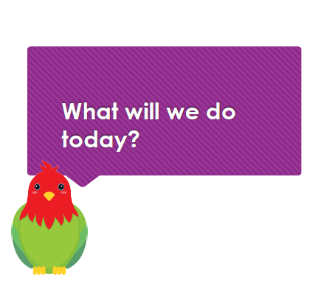

Slide 3
Let’s try tongue twisters!
Sam's shop stocks short spotted socks.

Slide 4
Let’s try tongue twisters!
Jack the duck found an icky sticky chick that quacked quickly.

Slide 5
Let’s try tongue twisters!
Sixty six sick chicks are stuck in the stock room full of sixty six sticks.

Slide 6
Let’s review adjectives

Slide 7
Review: Adjectives
Adjectives
Colour
Opinion
Size
Sound
Age

Slide 8
Adjective Alphabet Challenge!

Slide 9
Adjectives and you!

Slide 10
Let’s review ordinals

Slide 11
Warm-up!
1st
third
one
3rd
second
four
6th
fifth
seven
4th
tenth
two
2nd
eighth
three
7th
ninth
nine
9th
fourth
ten
8th
first
eight
10th
seventh
six
5th
sixth
five

Slide 12
Let’s play a game!

Slide 13
Let’s play a game!
Who is the tallest?
Who is the oldest?
Whose birth month comes first?
Whose hair is longest?
Who has the biggest shoe size?

Slide 14
Let’s review alphabetical order

Slide 15
F
N
V

Slide 16
Put these animals in order!

Slide 17
Let’s write a story together

Slide 18
What are these animals’ names?
How did they become friends?
What do they like to do together?
Will they always be friends?

Slide 19
Let’s Write our story!

Slide 20
Draw a picture of our story.

