Slide 1





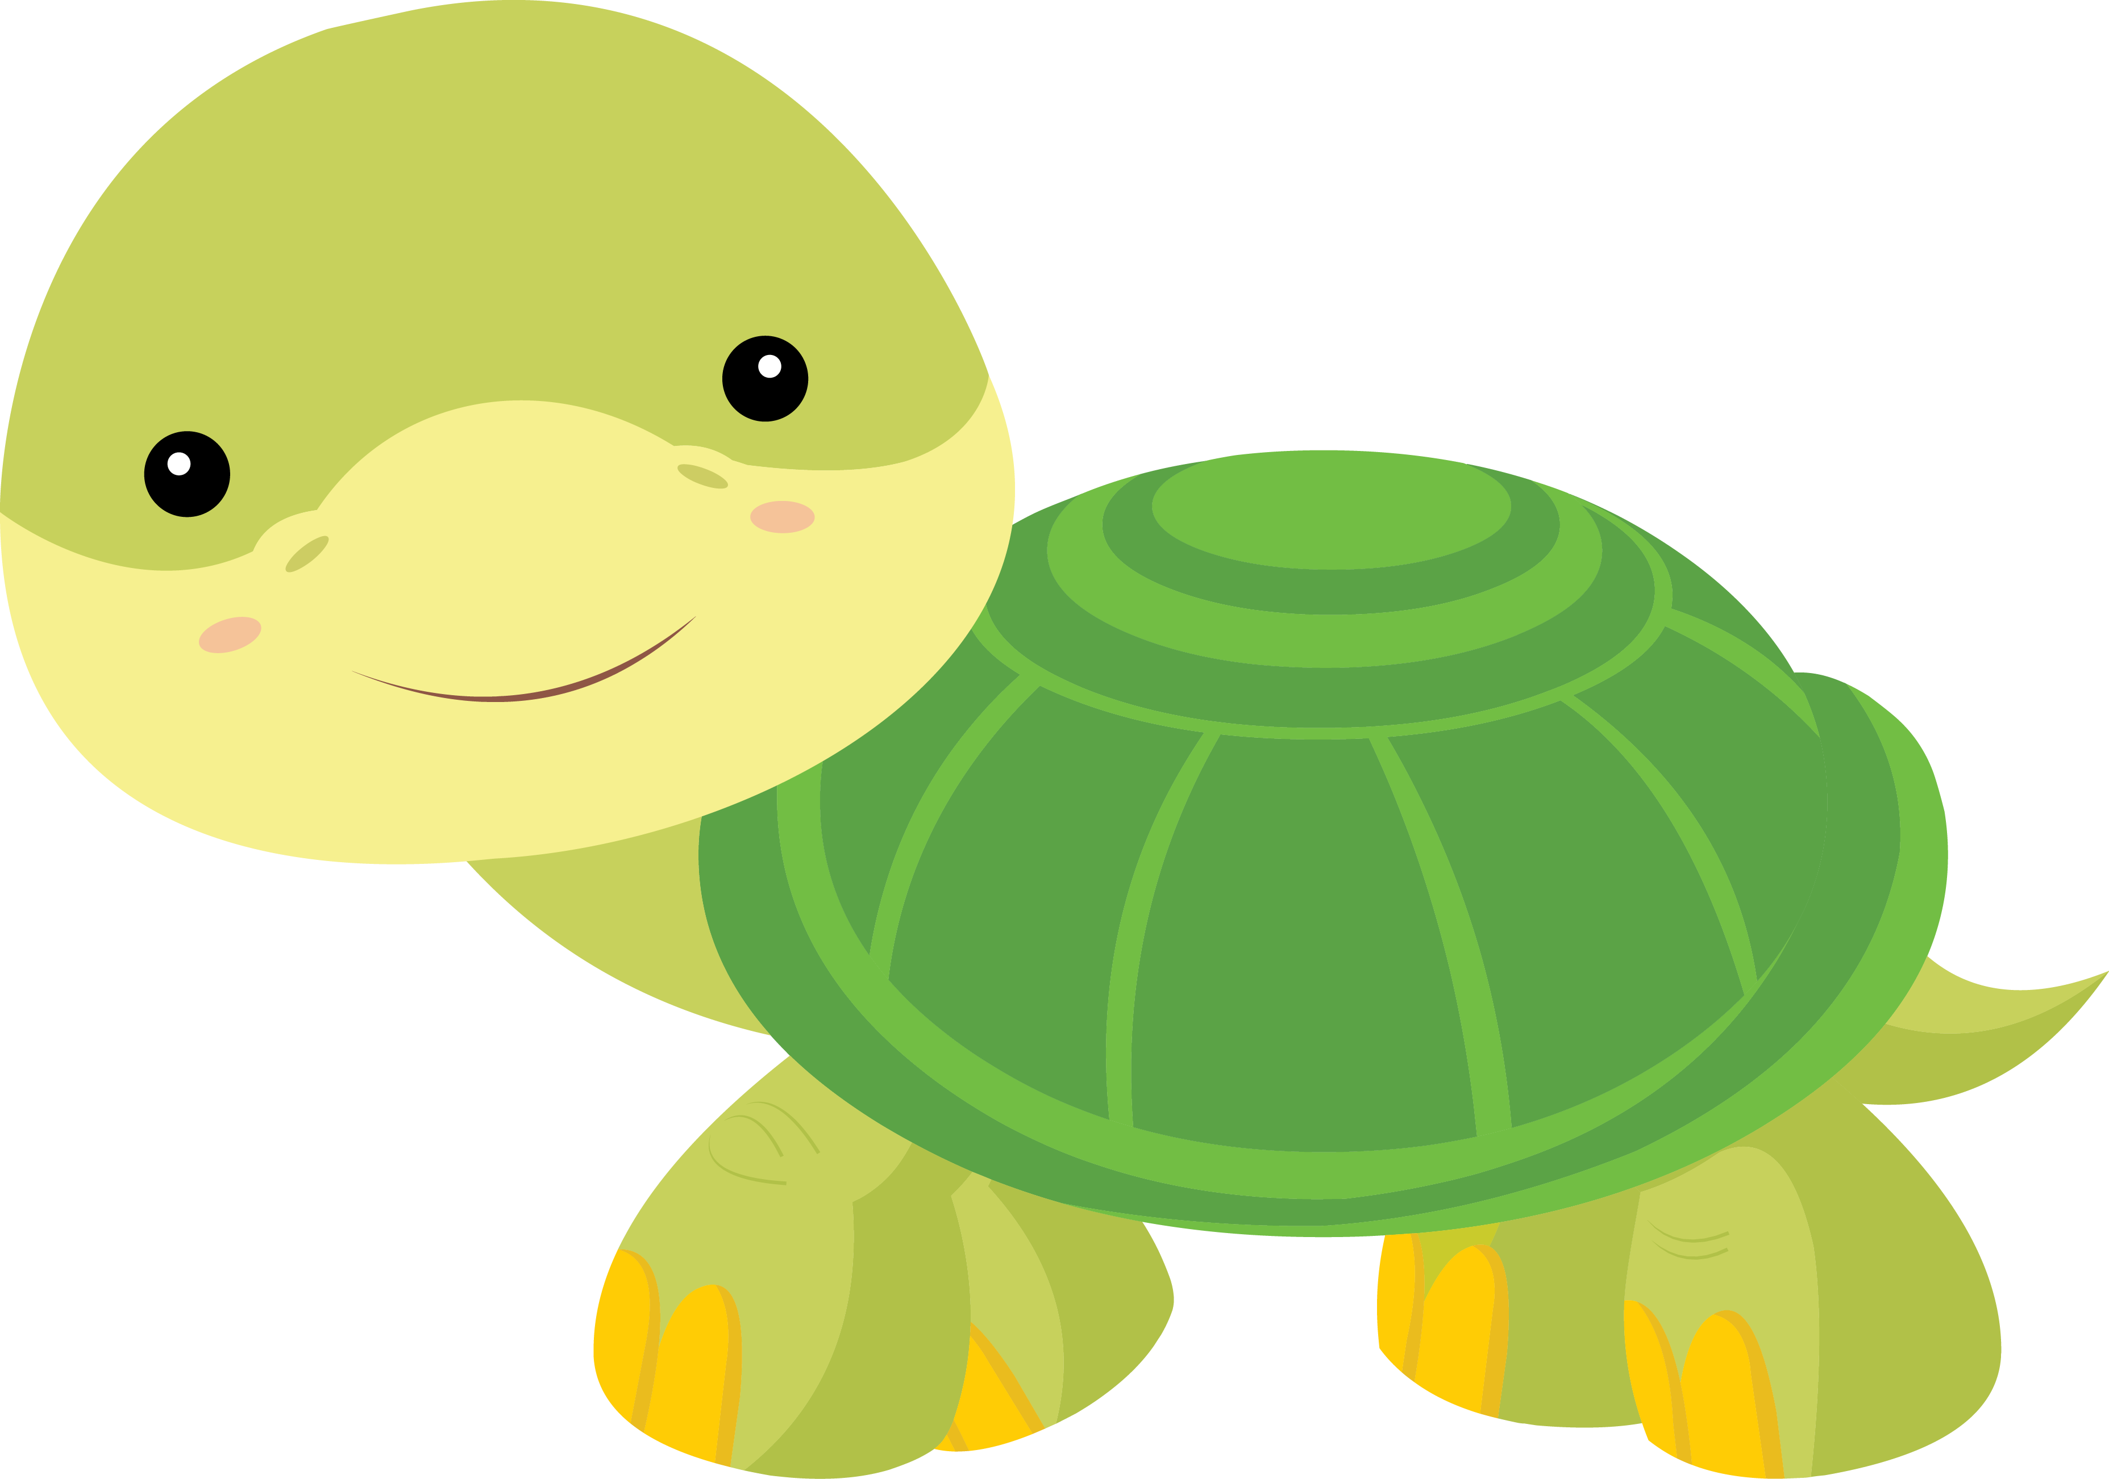

Lesson 5
Let’s Learn About Pets!

Slide 2


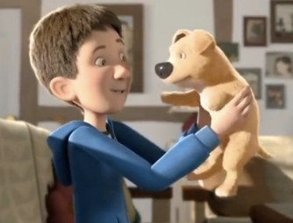
Let’s review last week’s homework.
Using prediction: What do you think the boy and the dog will do tomorrow? Write four sentences.

Slide 3


What new words will I learn today?

Slide 4

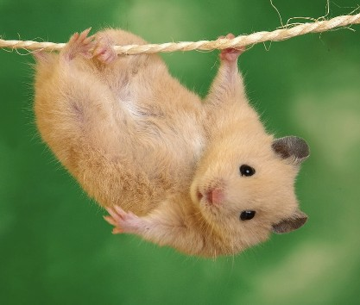
This is Jellybean. She is a golden hamster with small ears and dark eyes. She is very strong and loves
hanging on thin rope. Jellybean lives in a green, beautiful jungle.
7 adjectives!
Find

Slide 5
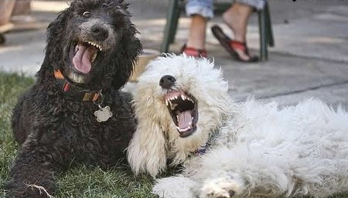
Coffee is the black dog and Olaf is the white dog. They are loud dogs who tell funny jokes. Yesterday, they went to the small park and sat on the soft grass. They spent the afternoon laughing and having a great time.
7 adjectives!
Find

Slide 6


Let’s play a word game!
I N T E R E S T I N G

Slide 7






What will I be learning today?

Slide 8



1. Let’s think about
phonics!
FL

Slide 9







flower
flag flute floor flame fly flood

Slide 10

Let’s play a game!
R E F O W L
Y F L
L A G F

Slide 11

Let’s play a game!
T E L F U
F M L A E
O O R F L
D O F O L

Slide 12
Let’s play a game!

Slide 13
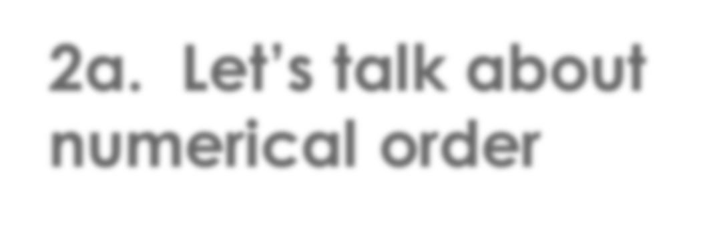
2a. Let’s talk about numerical order

Slide 14
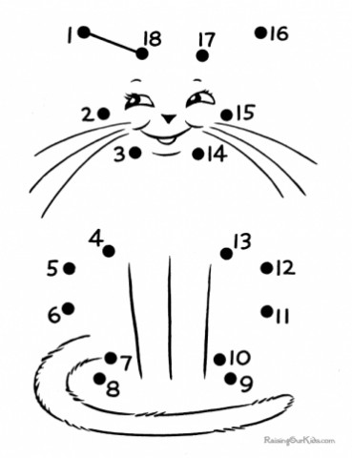


Warm-up!

Slide 15


Let’s play a game!
2 = fizz
5 = buzz
8 = beep

Slide 16


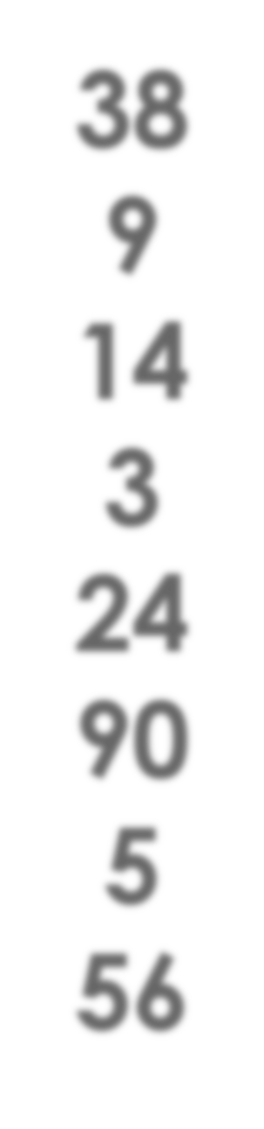
Put the numbers in order from lowest to highest:
38
9
14
3
24
90
5
56

Slide 17


Put the numbers in order from highest to lowest:
60
2
37
15
10
0
40
55

Slide 18
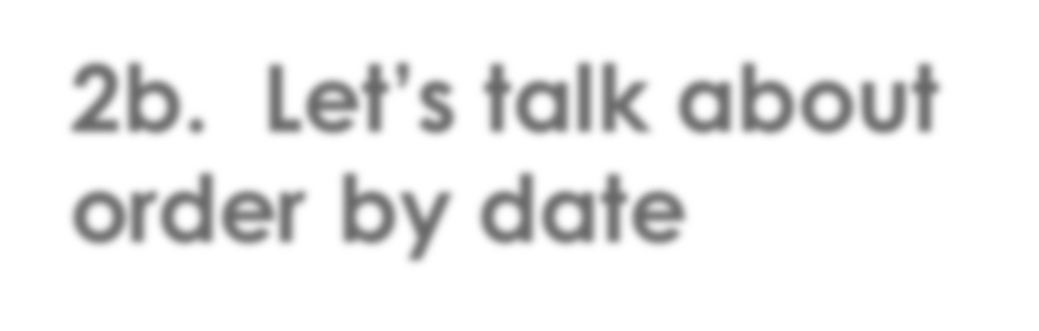
2b. Let’s talk about order by date

Slide 19




Order by Date
March
January
October

Slide 20
Order by Date
November
February
May

Slide 21
Order by Date
Tuesday
Saturday
Friday

Slide 22
Order by Date
April 15
April 5
April 25

Slide 23
Order by Date
2016
2004
2010

Slide 24


Let’s practice following directions

Slide 25
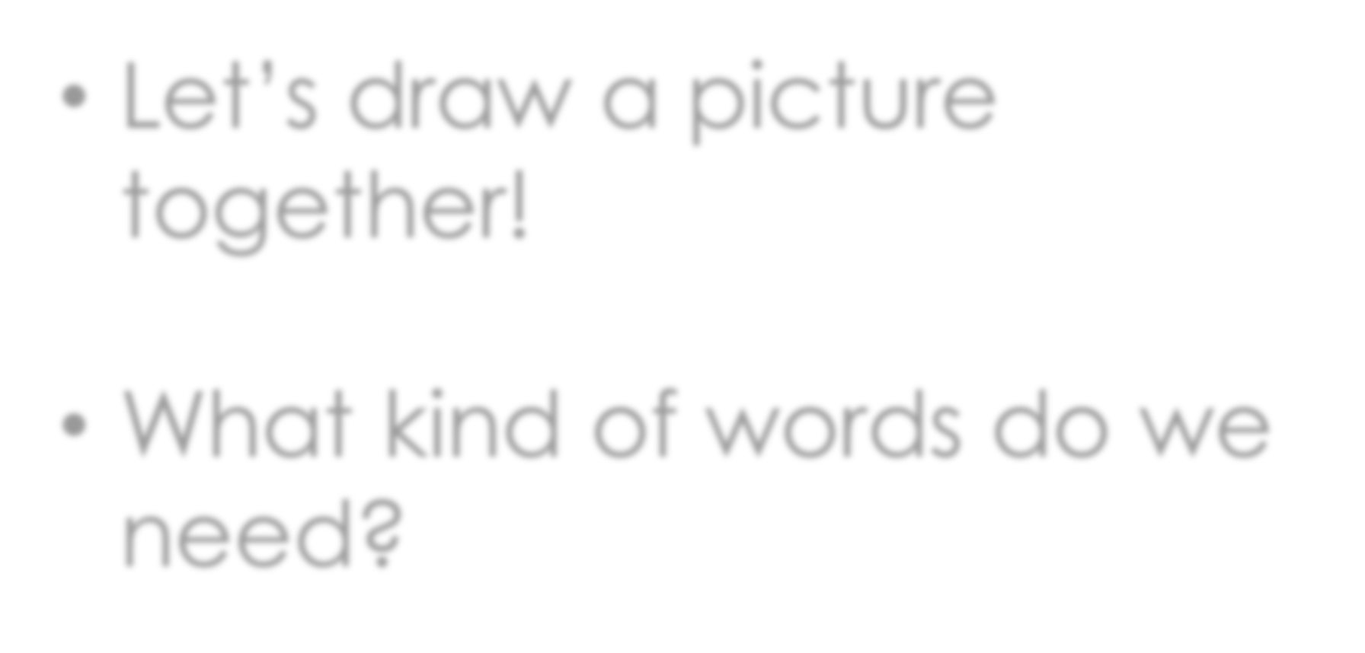
Let’s draw a picture together!
What kind of words do we need?

Slide 26
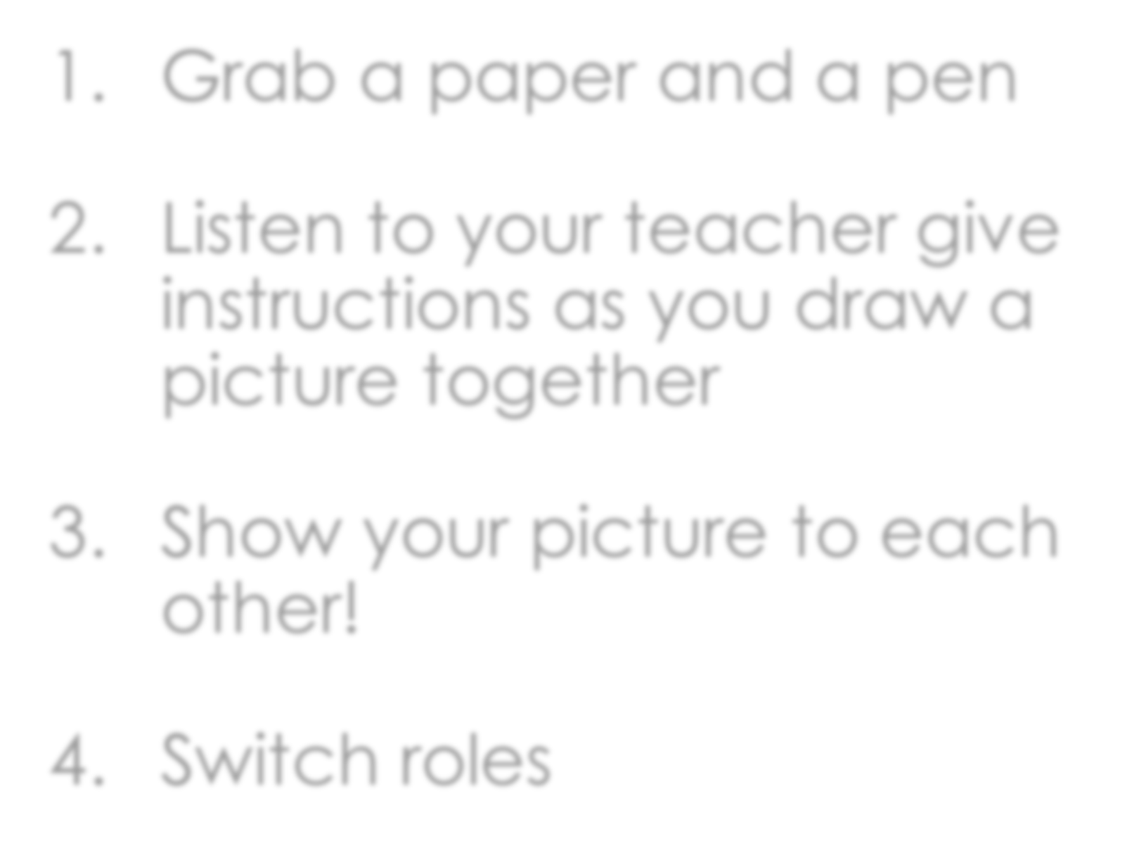
Grab a paper and a pen
Listen to your teacher give instructions as you draw a picture together
Show your picture to each other!
Switch roles

Slide 27





What did I learn today?

Slide 28



Let’s review

Slide 29

Let’s review

Slide 30

Let’s review

Slide 31


Let’s review

Slide 32

Homework
Giving Directions:
Tell me about how you get ready for school. Write five sentences describing it.

