Slide 1
Lesson 8
Let’s Learn About Pets!

Slide 2
Homework:
Think about a book you would like to write. Draw the cover. Make sure to include a title, author and illustration!

Slide 3
What will we do today?

Slide 4
Let’s try tongue twisters!
I flipped the flapjacks into the flames.

Slide 5
Let’s try tongue twisters!
Charlie chooses cheese and cherries.

Slide 6
Let’s review numerical order

Slide 7
0
7

Slide 8
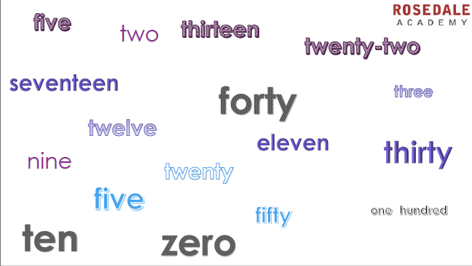

Slide 9
What day am I thinking?
= dentist
= visit grandma
= school party

Slide 10
Let’s review days of the week

Slide 11
Days of the Week

Slide 12
What are the short forms for days of the week?

Slide 13
My Perfect Week
Sunday | Monday | Tuesday | Wednesday | Thursday | Friday | Saturday

Slide 14
Let’s review elements of a story

Slide 15
Elements of a Story
Author?
Title?
Illustration?

Slide 16
Let’s rea
d this story together!

Slide 31
Let’s finish the story together

Slide 32
What other animals live in the garden?
Draw a picture and write the numbers!

Slide 33
What did I learn today?

