Slide 1





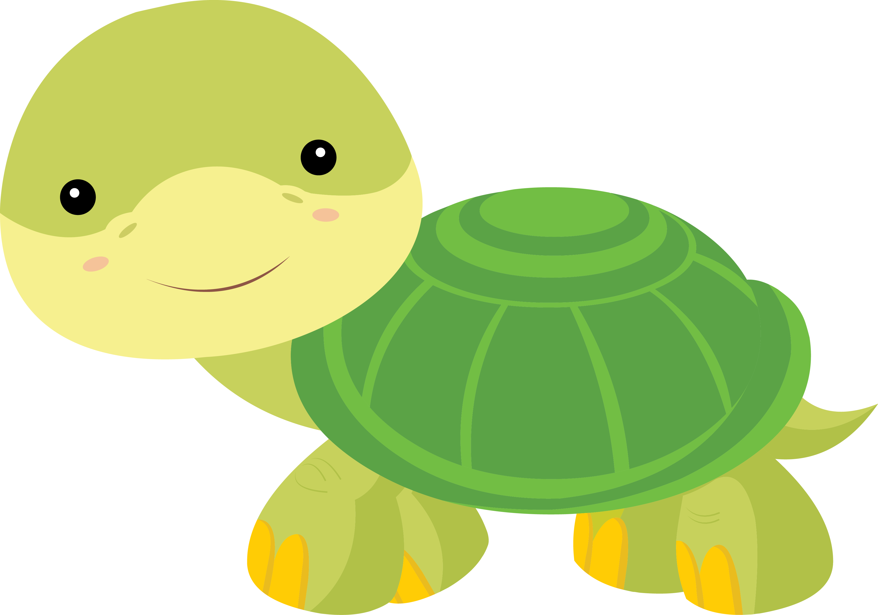

Lesson 9
Let’s Learn About Pets!

Slide 2







What will we do today?

Slide 3
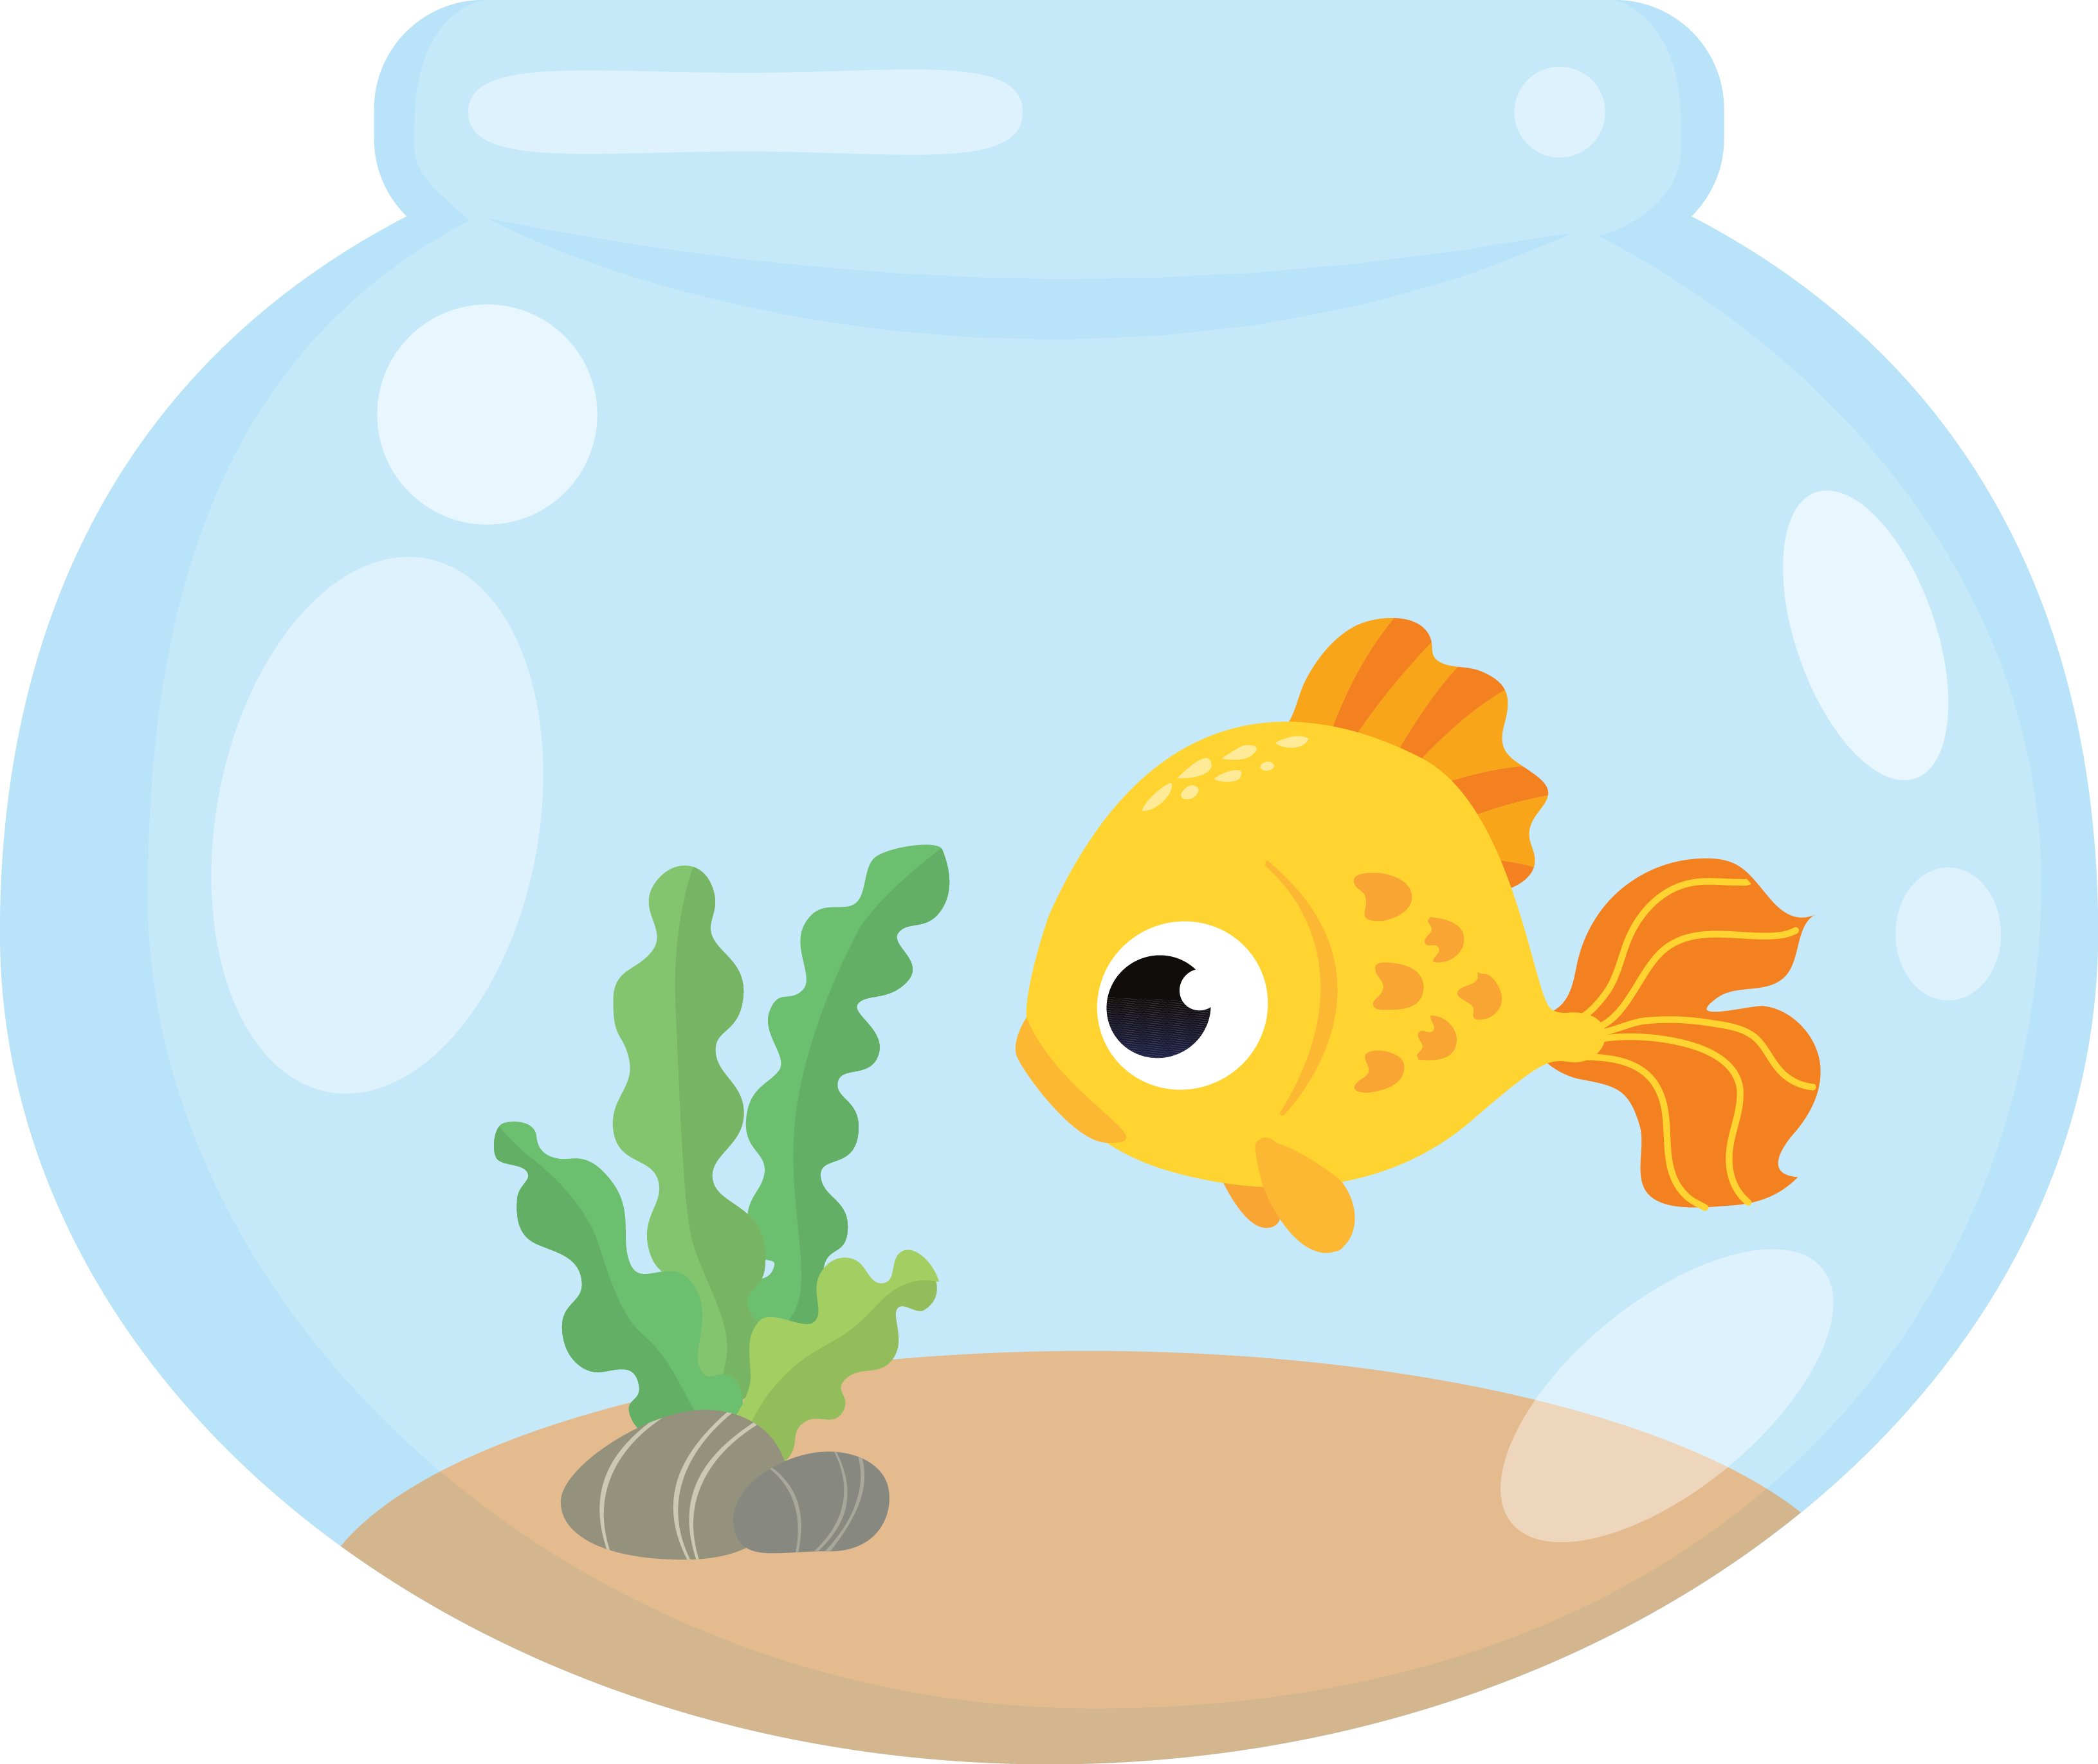
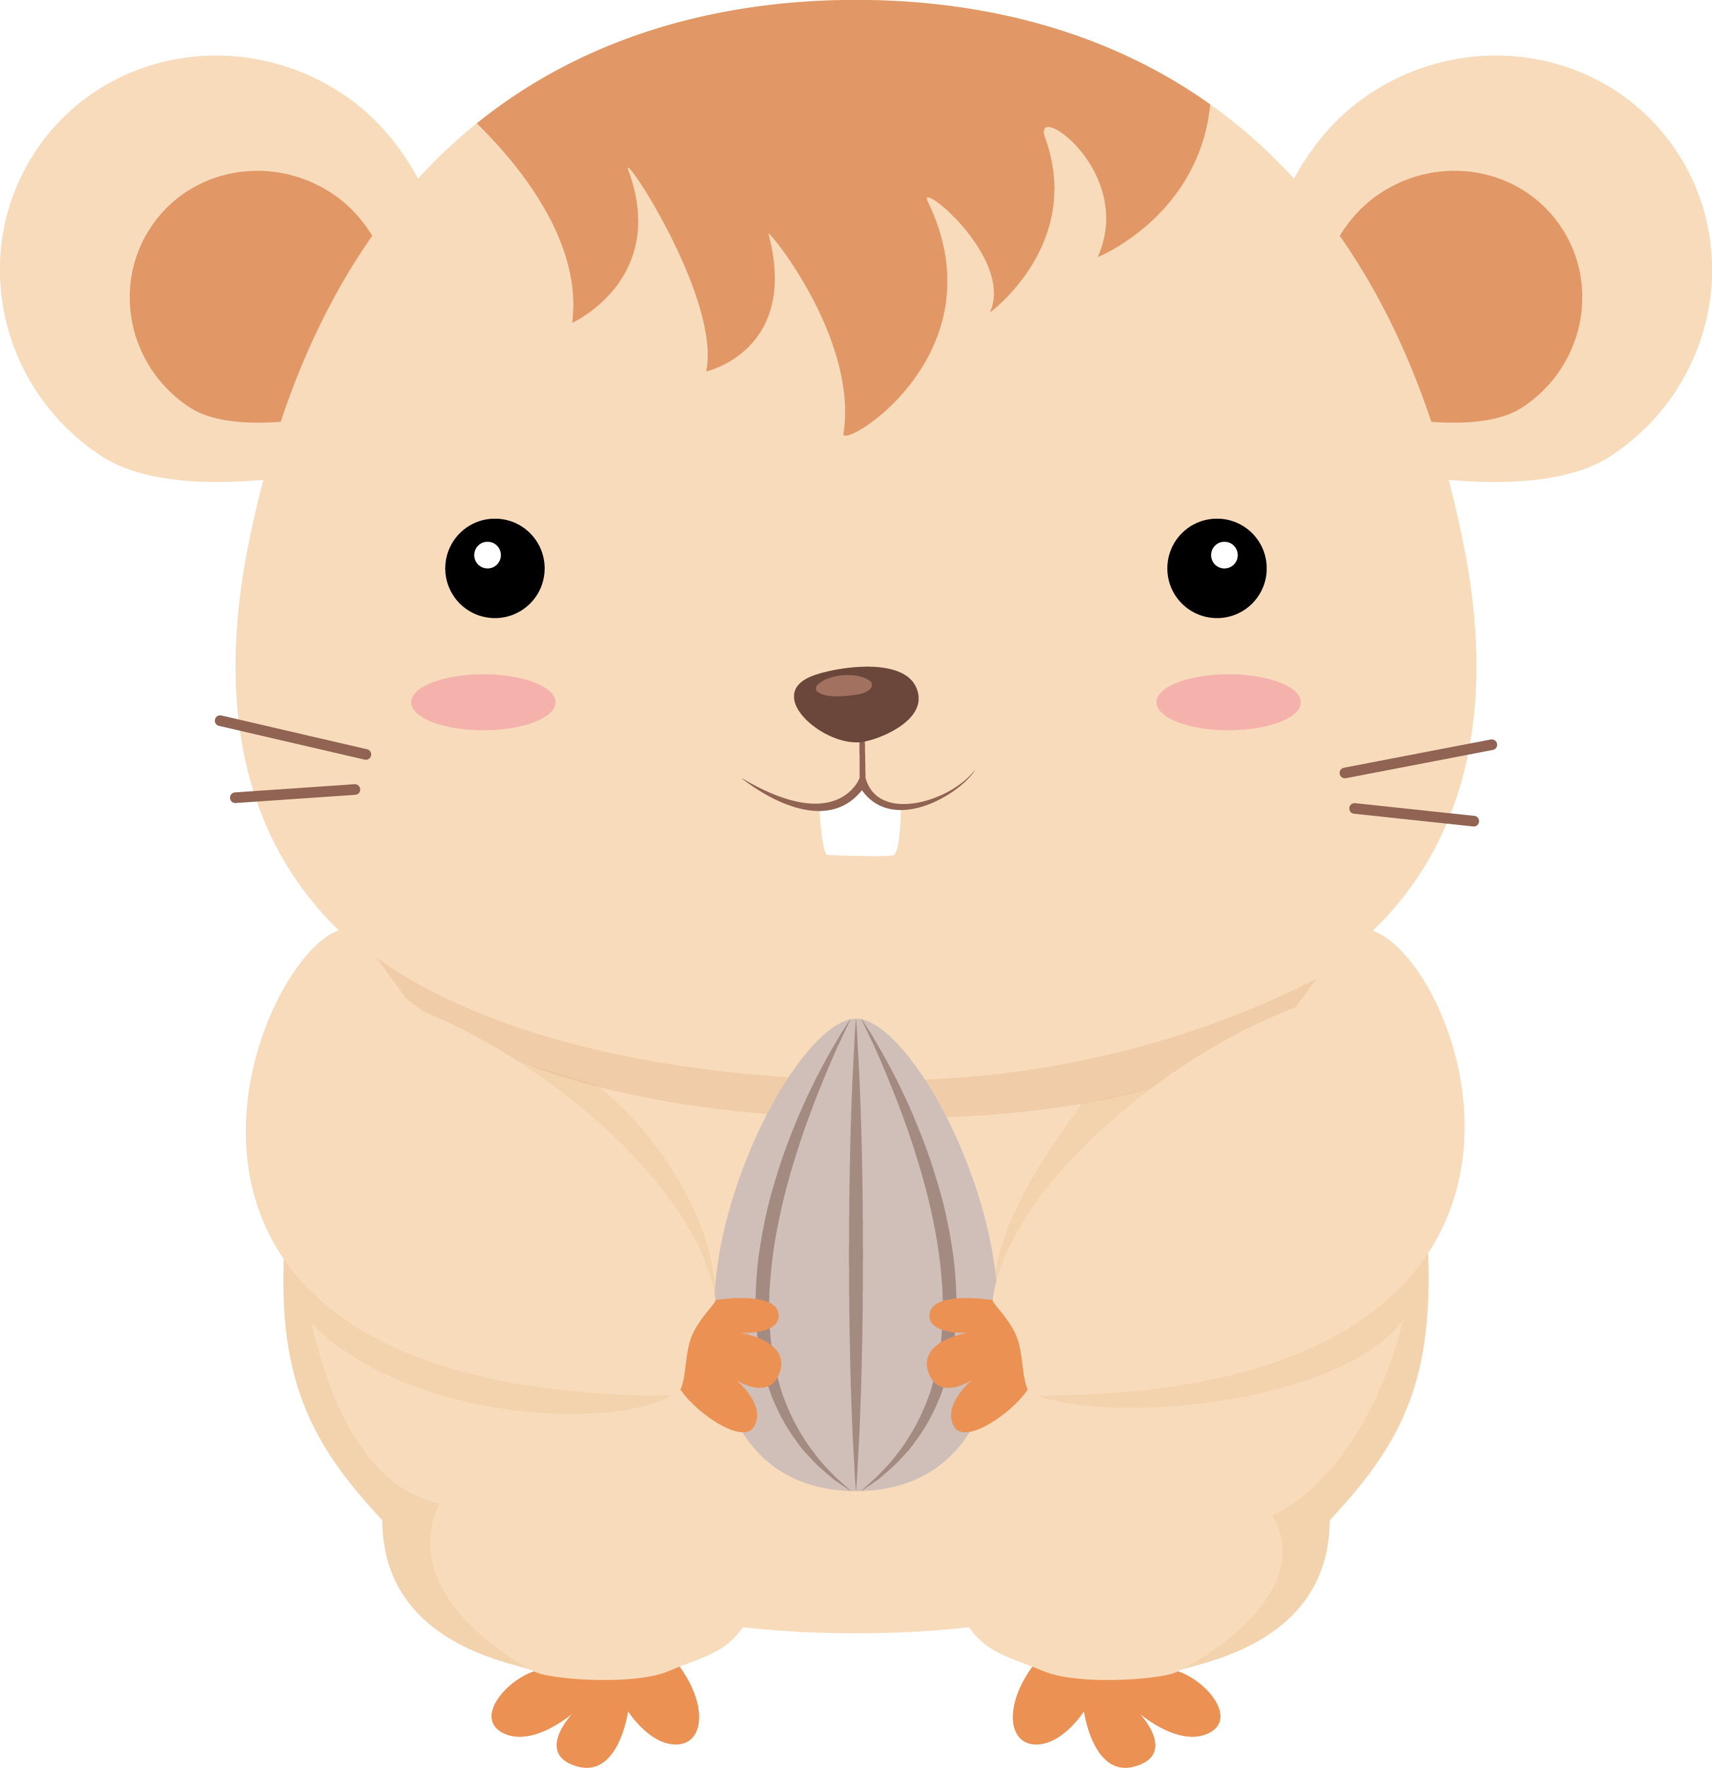


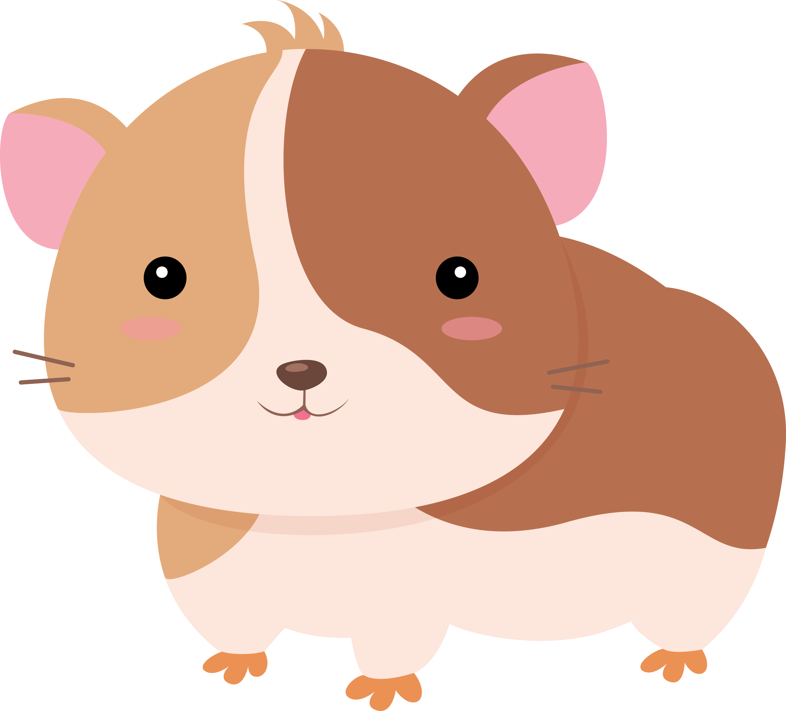





Slide 4



Slide 5



Slide 6


Slide 7


Slide 8


Slide 9


Slide 10


Slide 11



1. Let’s think about
phonics!
TH

Slide 12



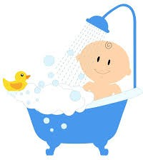




e __ __ t h
t h __ __ b
t __ __ t h
t h __ __ d e r
t h __ __ k
__ __ u t h
__ __ t h
t h __ e __

Slide 14

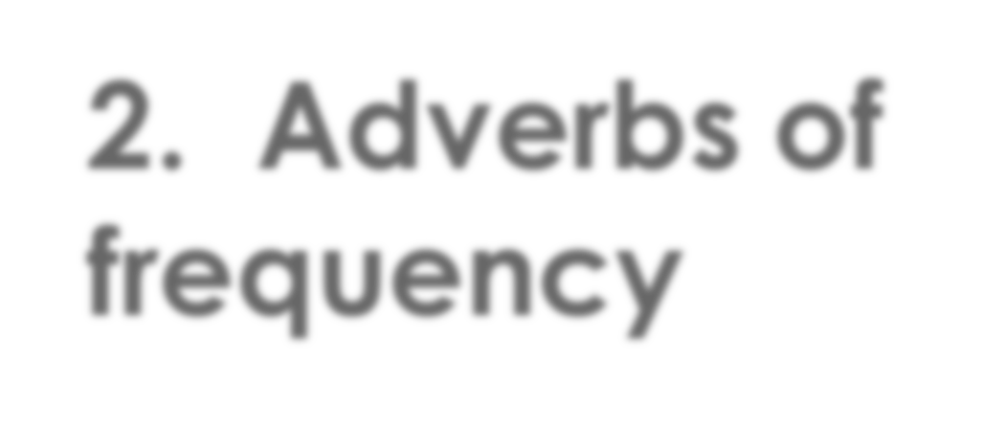
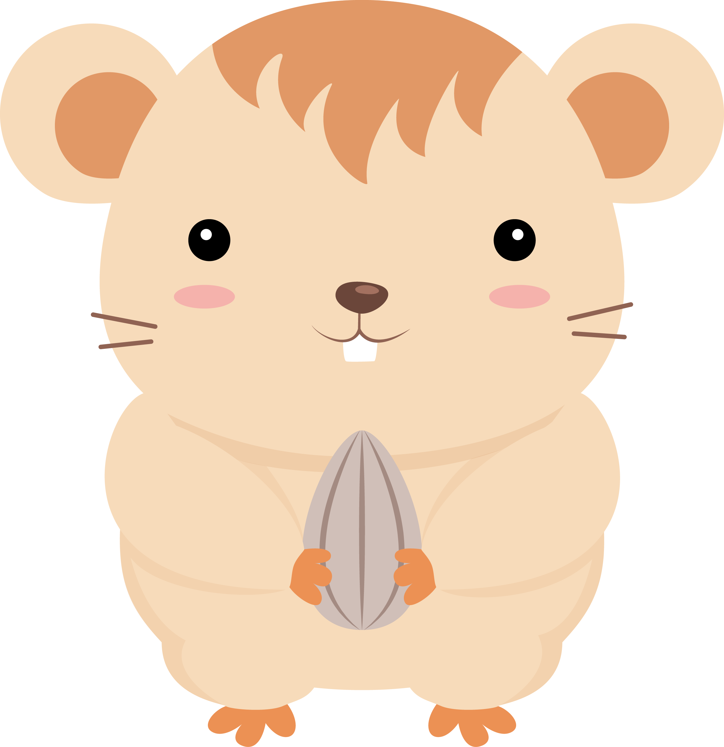
2. Adverbs of frequency

Slide 15

Adverbs of Frequency
 Tell us how often something happens
never | rarely | sometimes | usually | always
I always walk to school.
I never eat bananas.
She forgets her homework rarely. He plays video games sometimes.

Slide 16



always barks The dog at night.

Slide 17
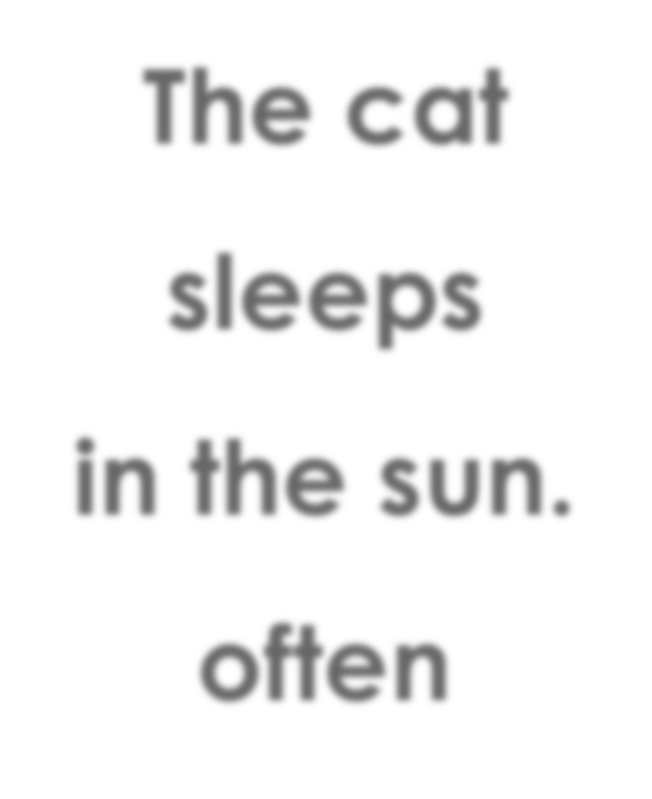
The cat sleeps
in the sun. often

Slide 18

in the water. never
The bird goes

Slide 19
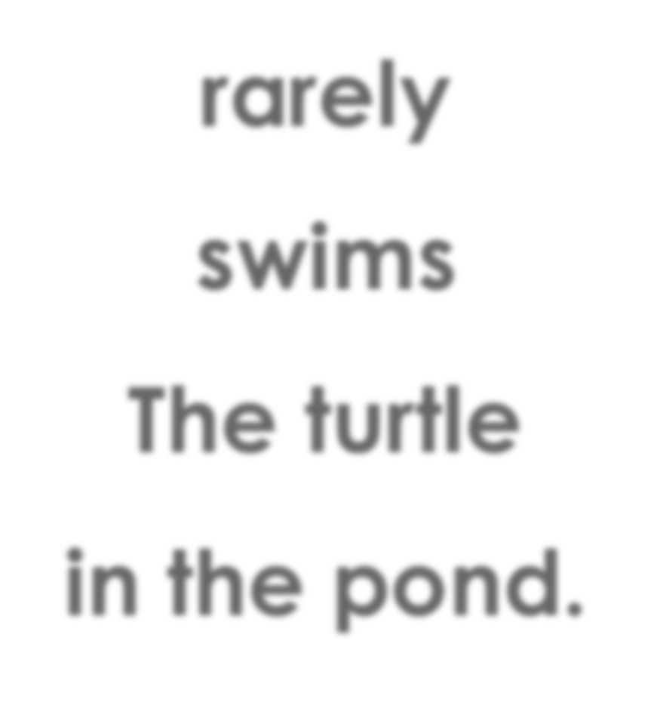
rarely swims The turtle
in the pond.

Slide 20
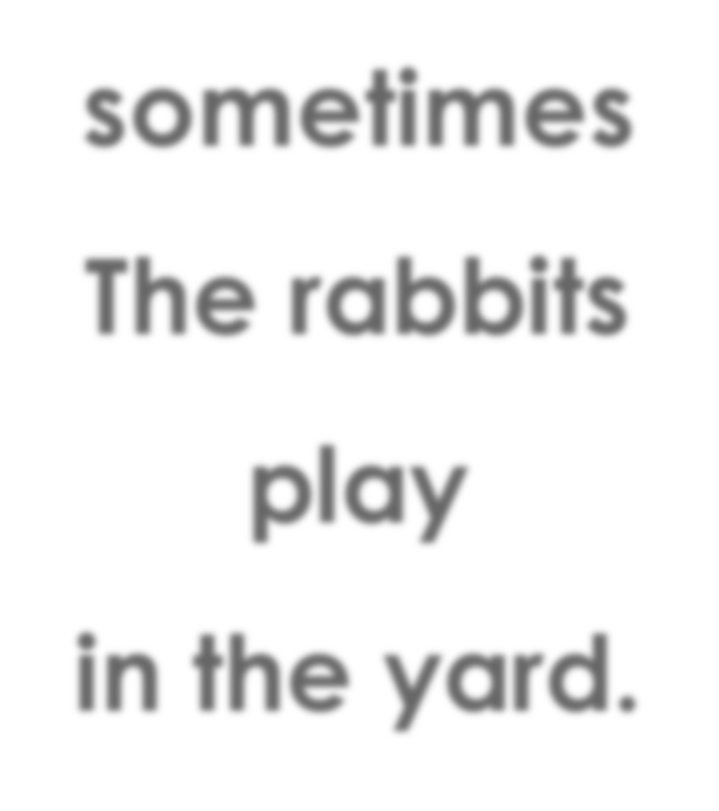
sometimes The rabbits play
in the yard.

Slide 21


How often do you take a holiday?

Slide 22

How often do you play hockey?

Slide 23

How often do you play video games?

Slide 24

How often do you watch scary movies?

Slide 25

How often do you eat seafood?

Slide 26
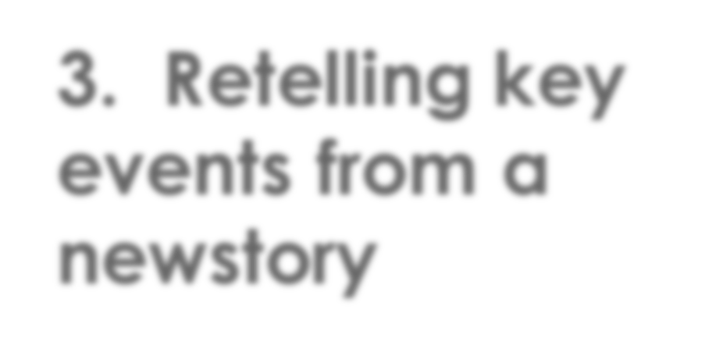
3. Retelling key events from a newstory

Slide 27


Breaking News English
An unwanted puppy has a new home. Someone left the 7- week-old puppy at a baseball stadium in the USA. The team put a message on its website but did not find the dog's owner. The team's president adopted the puppy. He called her Daisy. She is now the team's 'bat dog'. She will take baseball bats to players.
Pg 1 of 2

Slide 28
Breaking News English
Mr Orton said Daisy was also hungry and needed a drink.
The vet said she "was in pretty good health". Daisy may be too small to pick up a bat. She will be at the ballpark every
day and greet visitors. She will be very popular. Mr Orton said: "It was just meant to be that we'd have a team dog as
part of our staff."
Pg 2 of 2

Slide 29
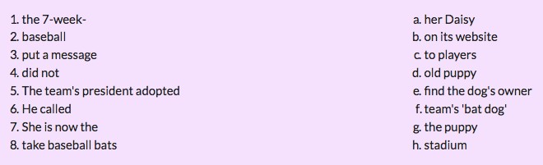
Breaking News English

Slide 30
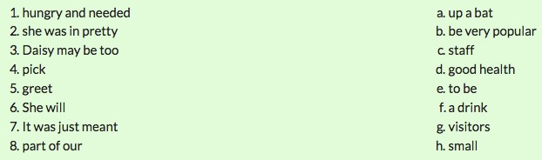
Breaking News English

Slide 31
Breaking News English
Draw a picture of the story.

Slide 32
Breaking News English
What is the main idea of the story?
Do you think it’s a good idea?
Would you like to have a pet? Why?

Slide 33






What did I learn today?

Slide 34


Let’s review

Slide 35


Let’s review

Slide 36



Let’s review

