Slide 1
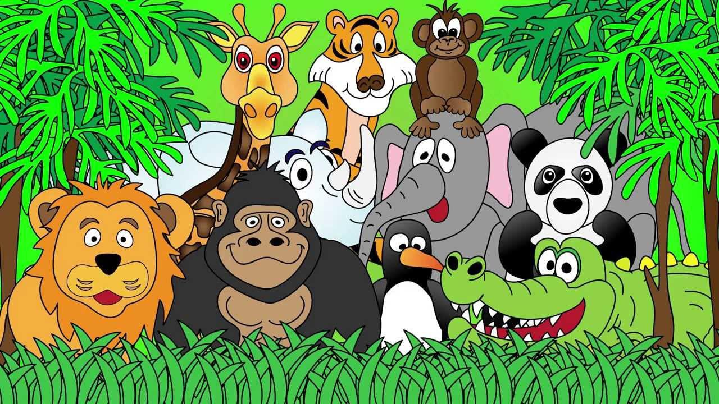
Welcome to the Animal Kingdom! This is Lesson 1!

Slide 2
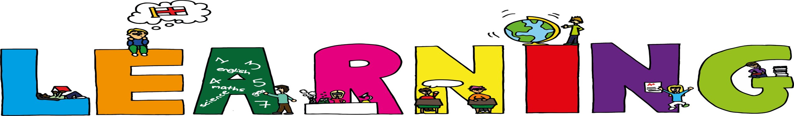
Today we are learning to:
Read an interesting story
Create pictures to tell the story
Use adjectives and adverbs
Review ck sounds

Slide 3
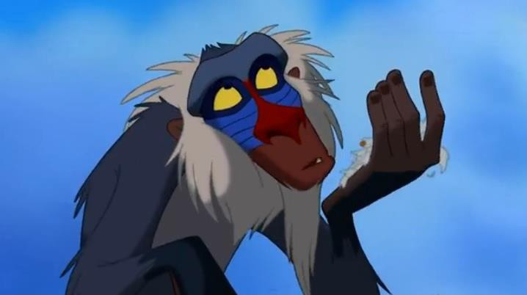




Slide 4
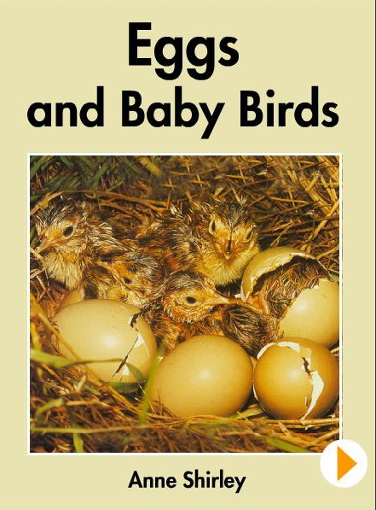

Slide 5
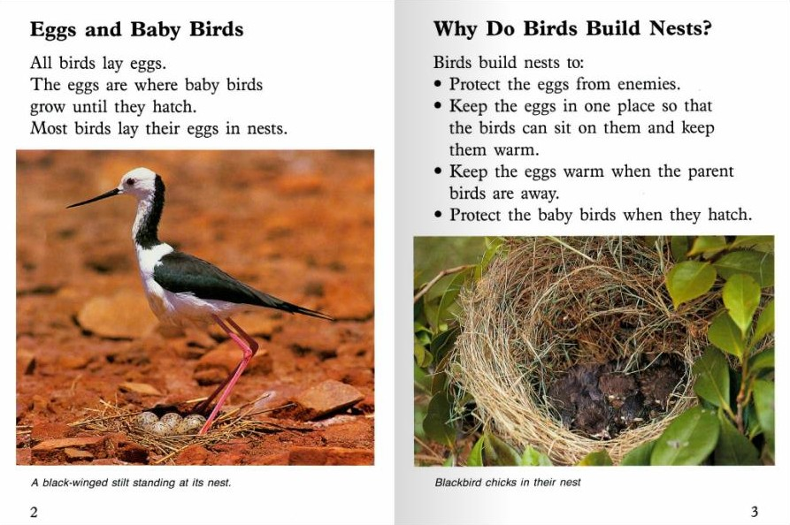

Slide 6
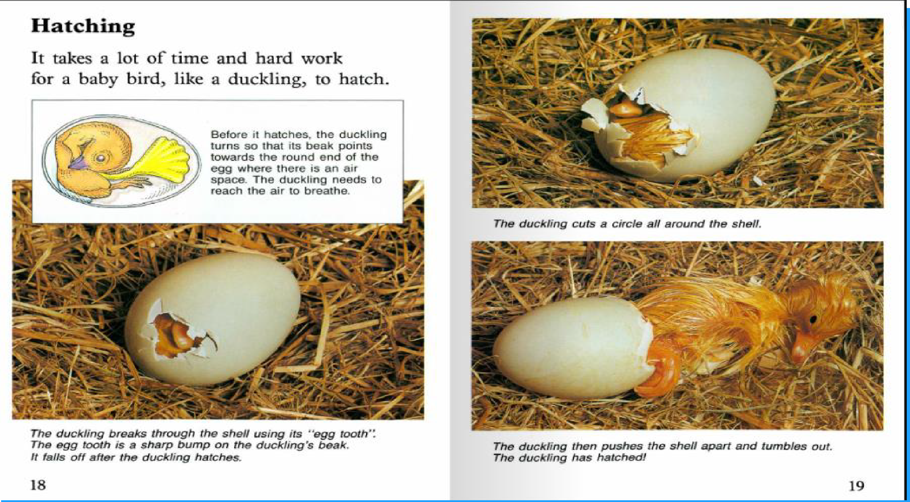

Slide 7
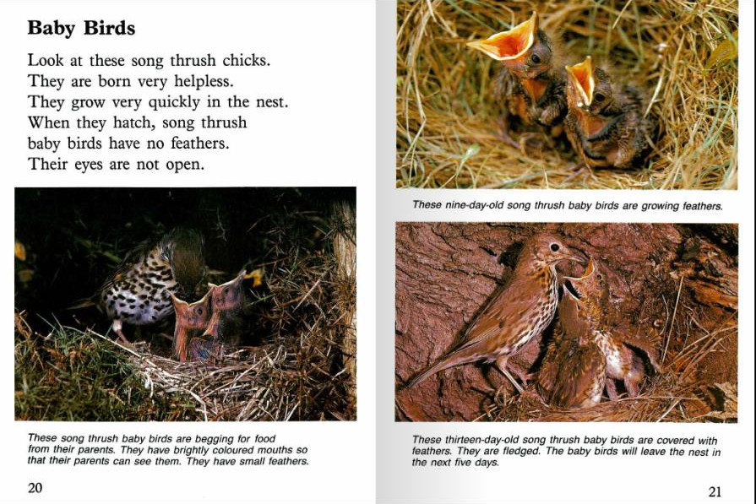

Slide 8
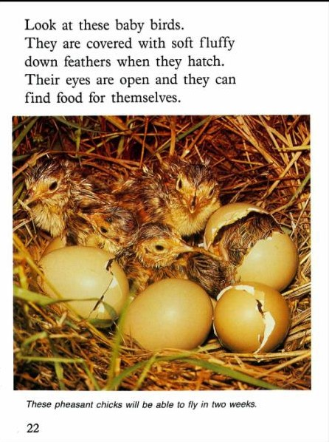

Slide 9
Look at these baby birds.
They are covered with soft fluffy feathers
when they hatch.
Their eyes are open and they can find food for themselves.

Slide 10
Some birds build their nests on the
ground.
This nest was built by a malleefowl.
It is a huge mound of soil, leaves and
small sticks.

Slide 11
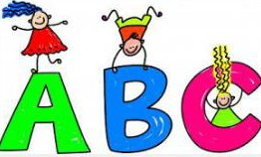
LEARNING
OUR WORDS!

Slide 12

What words can you think
of that have the ‘ck‘ sound?
Lets make a list!

Slide 13
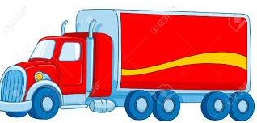
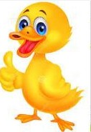
__
__
ck

Slide 14
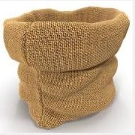

ck
__
__

Slide 15
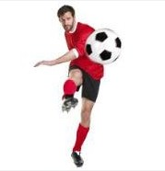
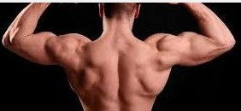
__
ck
__

Slide 16
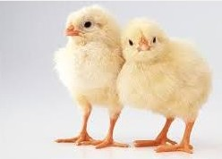
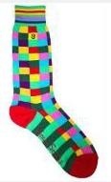
__
ck

Slide 17
Homework
Using the reading about birds and nests
to create pictures.
Creating sentences using the new ‘ck’
words

