Slide 1
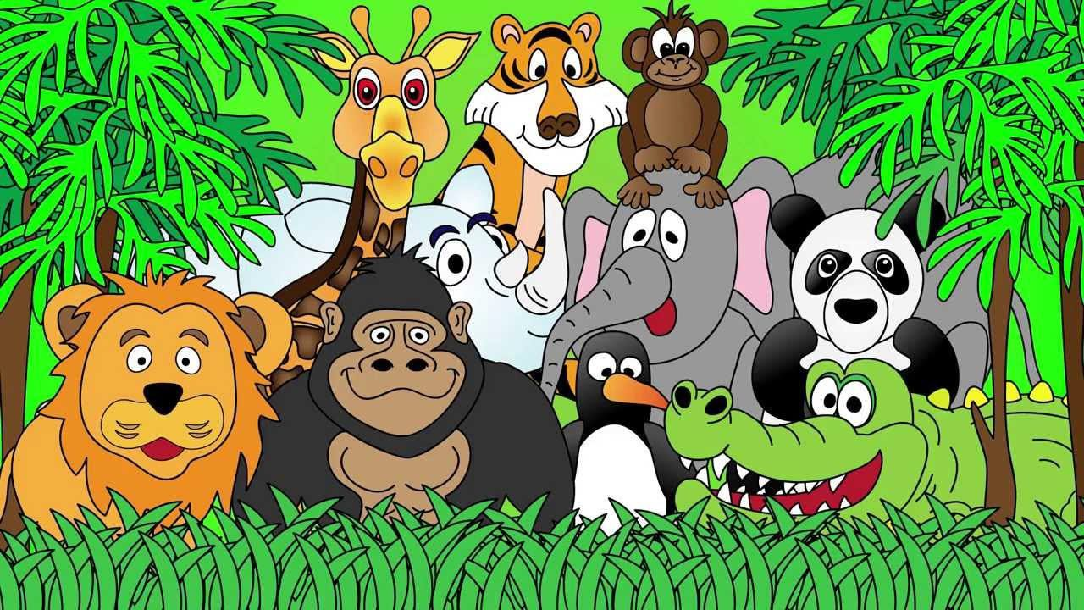
Welcome to the Animal Kingdom! This is Lesson 10!

Slide 2
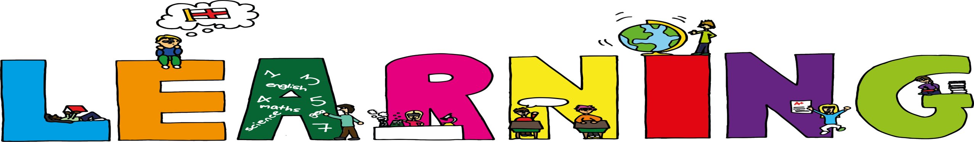
Students will:
Explore the questions (who, what, where, when,
why and how)
Create yes and no answered questions.
Learn how to use did not, didn’t, do not and don’t
Use rising intonation in oral conversations and
reading

Slide 3

Asking Yes and No Questions
Asking a question which has a yes or no answer is a ‘closed’ question.
This is because you do not need more information.
These questions start with ‘did’ or ‘do.’

Slide 4
Did and Do Questions
Lets write some examples and ask our classmates.
Did you take a shower?
Do you like chocolate?
Did you eat a piece of cake?
Do you want to go to the park?

Slide 5
Students will:
Explore the questions (who, what, where, when,
why and how)
Create yes and no answered questions. ✓
Learn how to use did not, didn’t, do not and don’t
Use rising intonation in oral conversations and
reading

Slide 6
Using Did not, Didn’t, Do not and Don’t
Did not or Do not is used in formal sentences and Didn’t or
Don’t is used more informally.
Formal Sentence: I did not want to go to his home today.
Informal Sentence: I didn’t like the cake.
Did not and didn’t can be used instead of one another.
Do not and don’t can be used instead of one another.

Slide 7
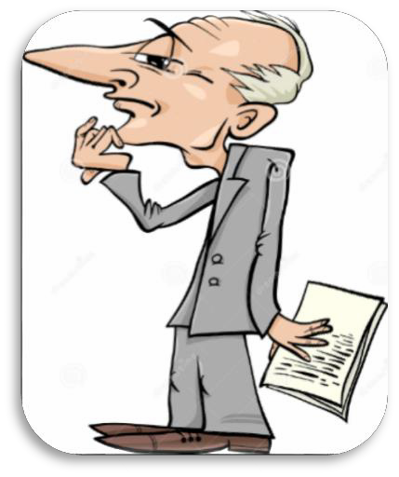
Present Tense: Do not and Don’t
Examples:
I don’t like peaches.
Don’t pick up that bug!
Past Tense: Did not and Didn’t
Examples:
Charlie did not want to go shopping.
I didn’t like the chicken salad.

Slide 8
Sam told the teacher that he like the lesson.
I need to eat before class.
Charlie want to go to Grandma house.
jump in the classroom!
I want to sleep at night.
The monkey want to eat a banana.
Did not
Didn’t Do not Don’t

Slide 9
Students will:
Explore the five questions (where, who, why, which,
what and how)
Create yes and no answered questions. ✓
Learn how to use did not, didn’t, do not and don’t ✓
Use rising intonation in oral conversations and reading

Slide 10
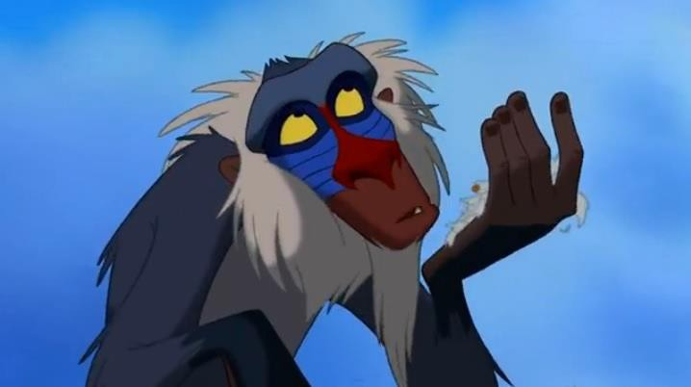
Lets read a story

Slide 11

LEARNING OUR WORDS!

Slide 12
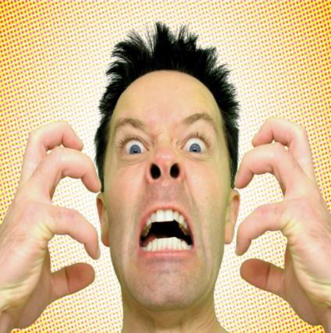
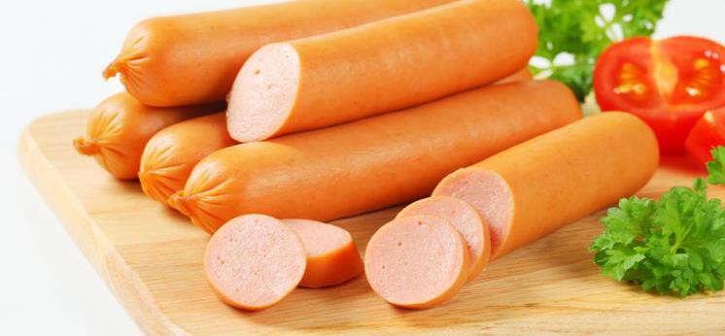
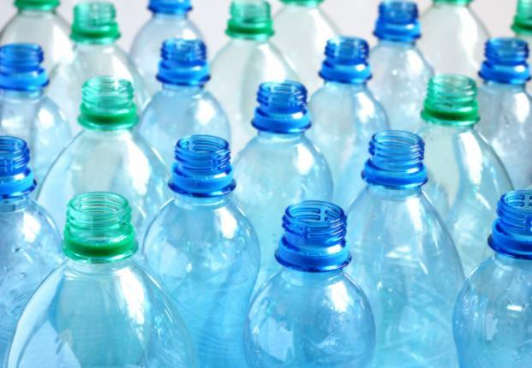
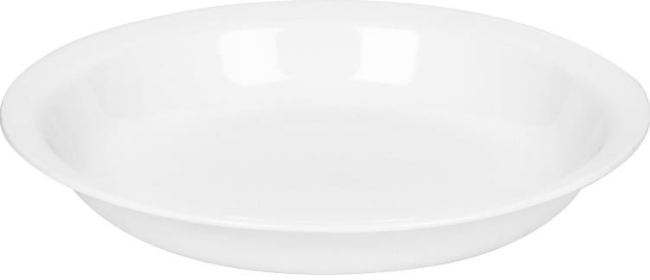
Reading Vocabulary
Frankfurters
Annoyed Plastic Dish

Slide 13
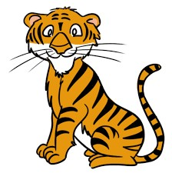

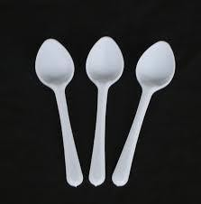
Write a definition for the words.
tiger
balloons
spoons

Slide 14
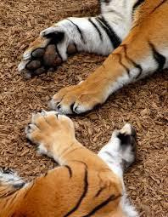
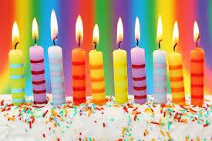
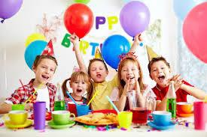
Draw a picture and write a definition of
the words.
paws
candles
party

Slide 15
Choose three to five words from the reading vocabulary and create a short interesting sentence.

Slide 16
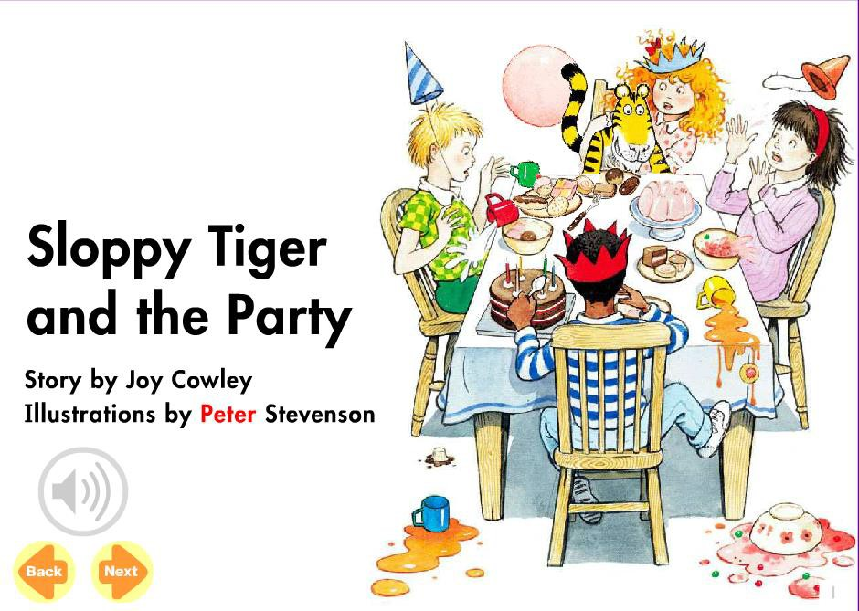

Slide 17
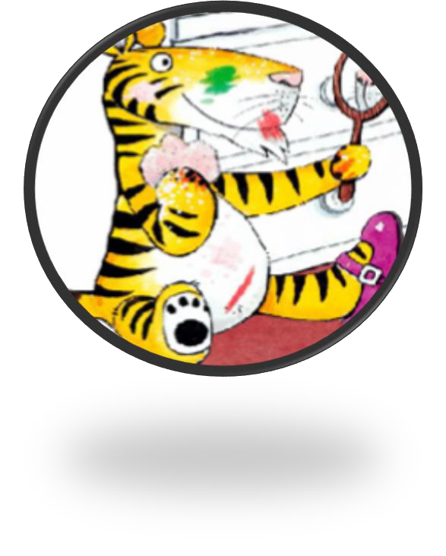
Pre-Reading Activities
Look at the illustration on the front cover of the book.
What do you think happens in the story? Who is this story about?
Where is the story taking place?
Why are they sitting around a table? When does the story take place?
How can you know the story before reading the book?

Slide 18
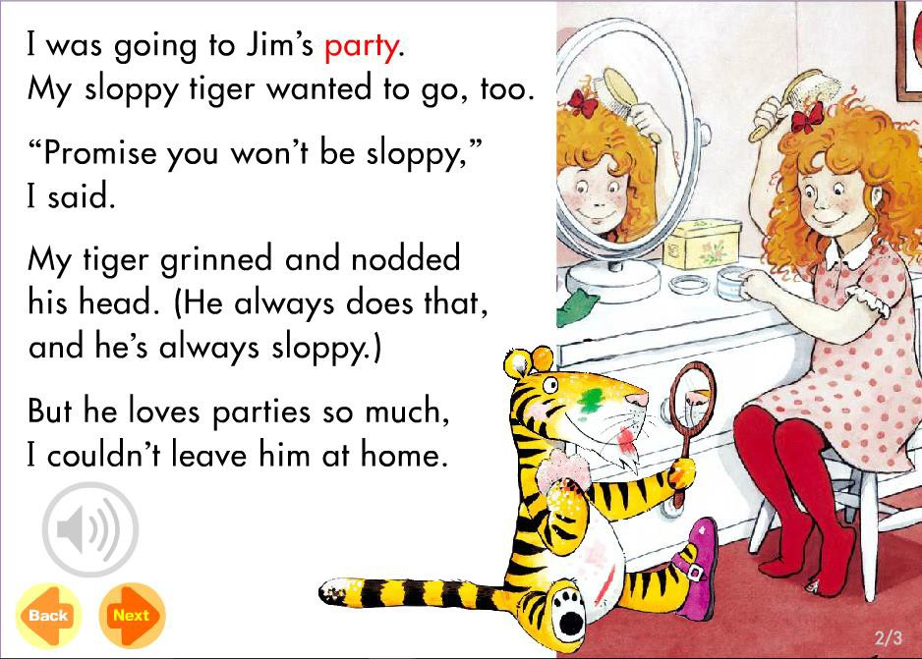

Slide 19
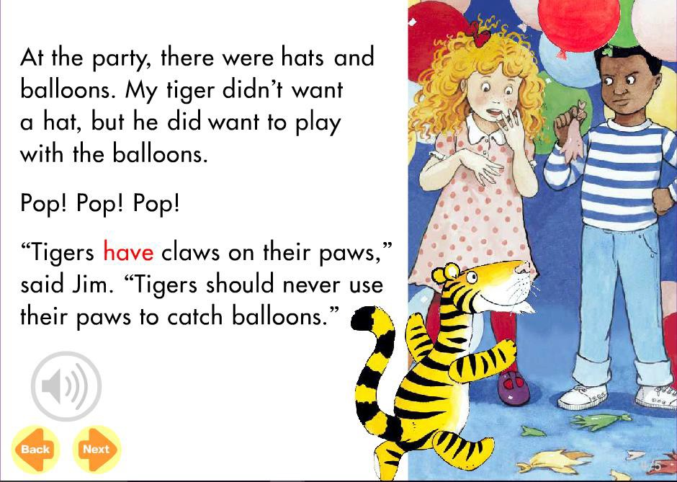

Slide 20
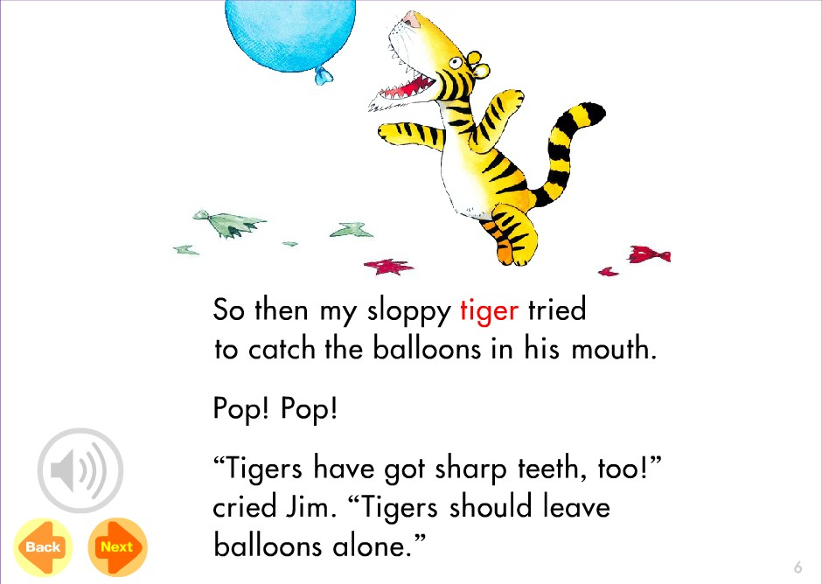

Slide 21
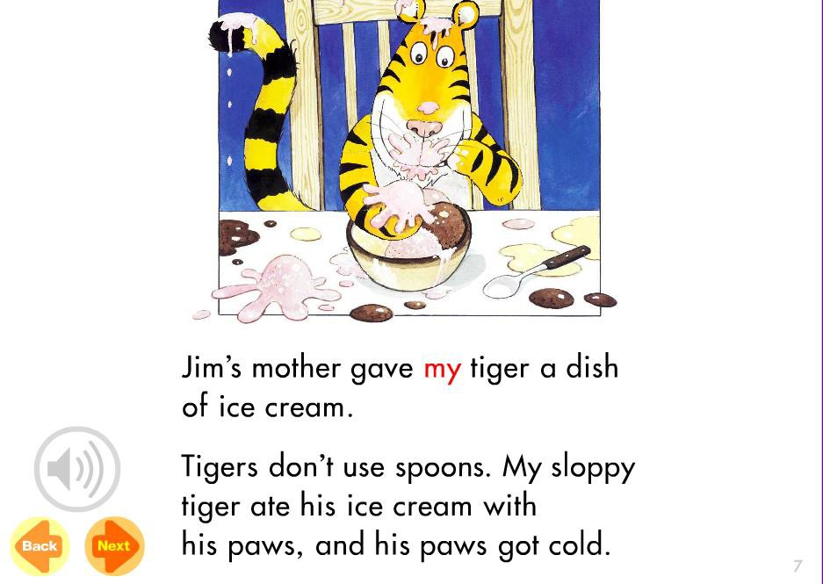

Slide 22
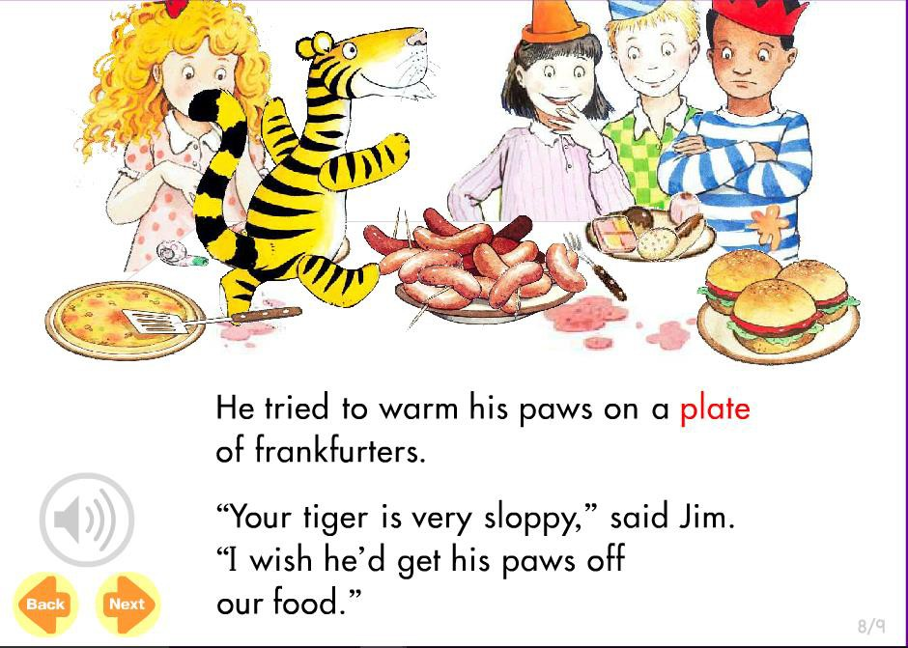

Slide 23
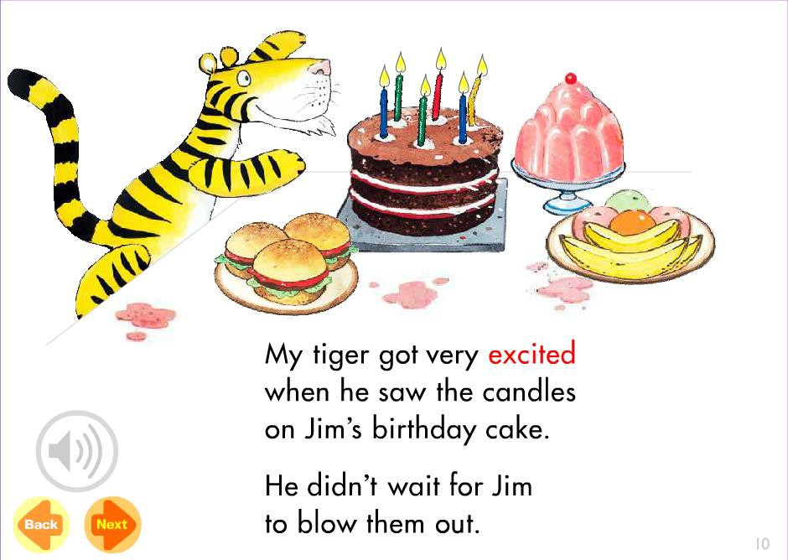

Slide 24
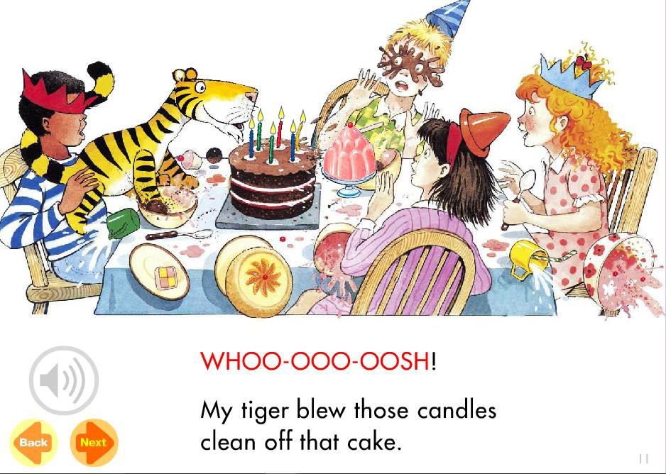

Slide 25
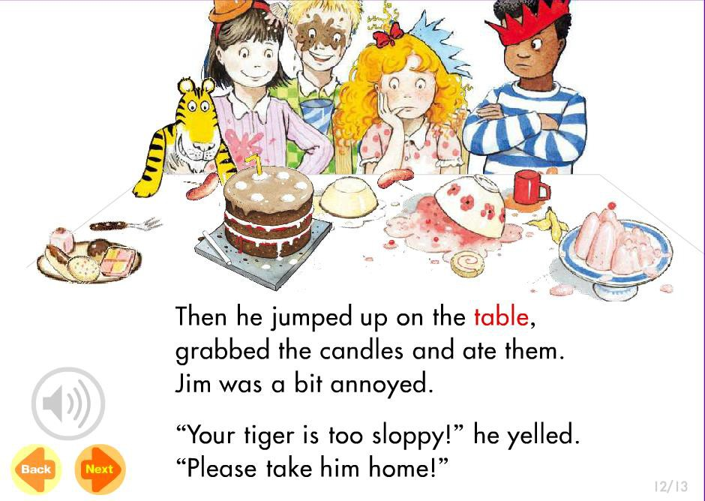

Slide 26
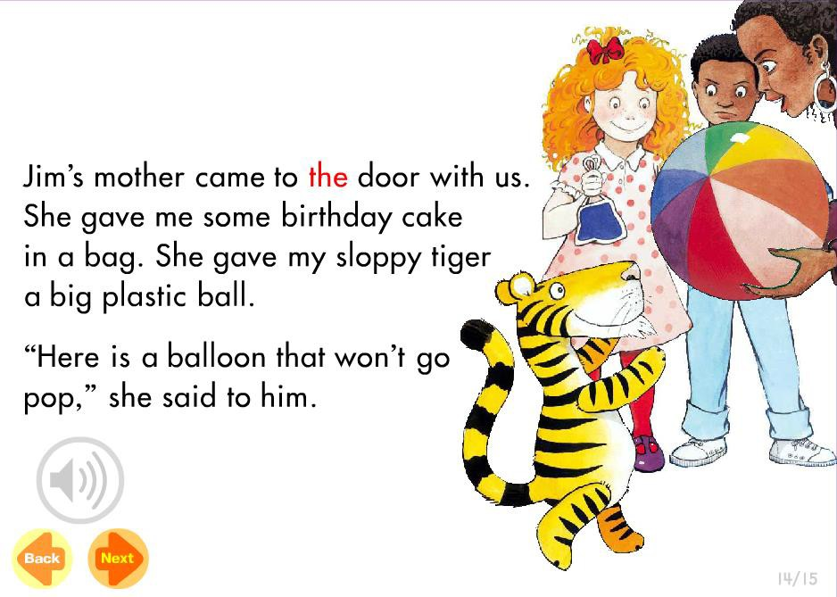

Slide 27
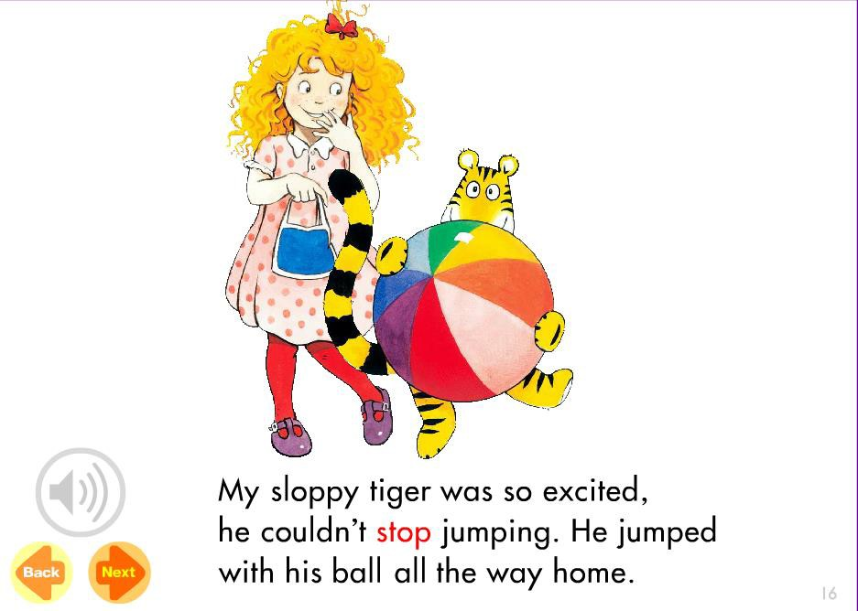

Slide 28
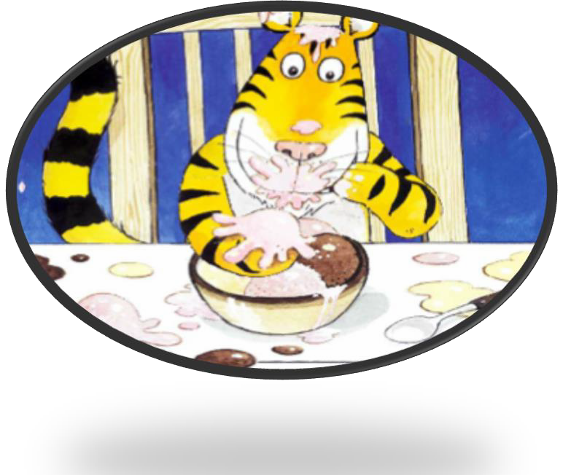
Now that you have read the story ‘Sloppy
Tiger and the Party,’ write down four
questions using the 5W’s and H.
Who, What, Where, When, Why and How

Slide 29

Post-Reading Comprehension Questions using the 5W and H
Whose party are they attending?
What did the tiger promise his friend? Why did the balloons pop?
How did the tiger eat his ice cream?
What did the tiger want to play with at the party?

Slide 30

Post-Reading Comprehension Questions using the 5W and H
What did the tiger do to Jim’s birthday cake?
Why were they asked to leave the party? What did Jim’s mother give the tiger at the
end of the party?
Where was the party?

Slide 31
Students will:
Explore the questions (who, what, where, when,
why and how) ✓
Create yes and no answered questions. ✓
Learn how to use did not, didn’t, do not and don’t
✓
Use rising intonation in oral conversations and reading

Slide 32
Rising Intonation in Speech
Intonation is how we say things, rather than what we say.
For example:
It’s raining. (No intonation – statement)
It’s raining. (Rising intonation – Surprise or question) It’s raining. (Low intonation – Sadness)

Slide 33
Students will:
Explore the questions (who, what, where, when,
why and how) ✓
Create yes and no answered questions. ✓
Learn how to use did not, didn’t, do not and don’t
✓
Use rising intonation in oral conversations and reading ✓

Slide 34
Homework
Write a list of questions with the 5W and H.
Write sentences and questions using did not, didn’t, do not and didn’t.
Create interesting sentences using the reading
vocabulary.

Slide 35

Final Thoughts
Do you have any questions?

