Slide 1
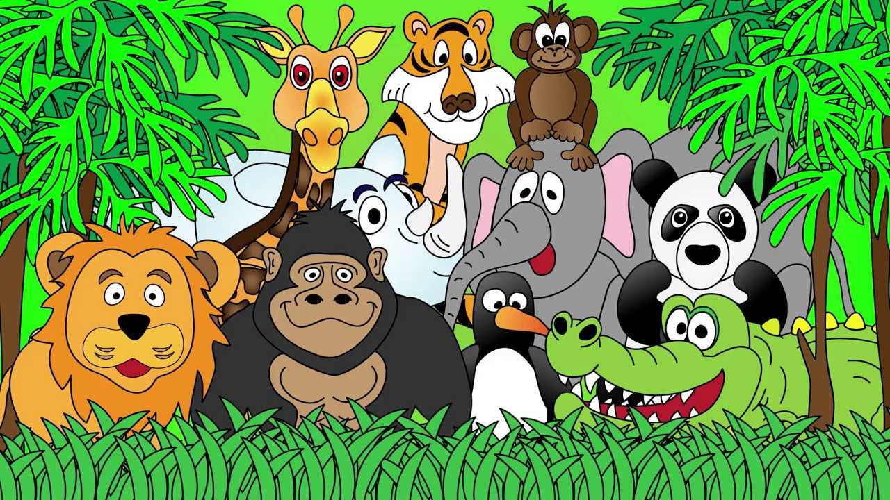
Welcome to the Animal Kingdom! This is Lesson 10!
Notes:
Welcome the students to the unit.
Ask the students how there week has been and discuss some of the fun things they did at school or for fun to establish a rapport with your students.
Ask the students if they have been to the Zoo before? What animals did they see? What animals can they see in this picture.

Slide 2
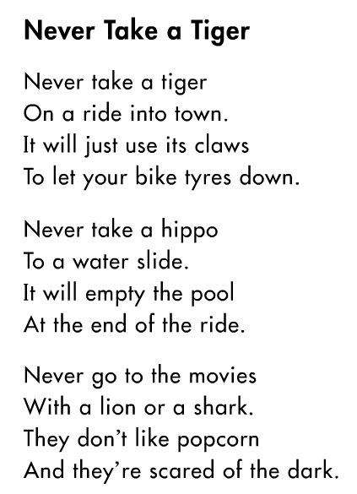
Read through the poem.
Create an additional stanza of the poem using the following starter:
Never take a cow…..

Slide 3

Students will:
Explore the questions (who, what, where, when, why and how)
Create yes and no answered questions.
Learn how to use did not, didn’t, do not and don’t
Use rising intonation in oral conversations and reading
Notes:
m45yDiscuss the goals for todays lesson. Emphasize to the students that there writing and pictures must be descriptive.

Slide 4
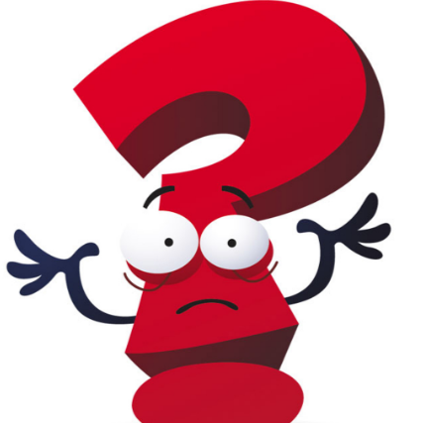
Asking Yes and No Questions
Asking a question which has a yes or no answer is a ‘closed’ question. This is because you do not need more information.
These questions start with ‘did’ or ‘do.’

Slide 5
Did and Do Questions
Did you take a shower?
Do you like chocolate?
Did you eat a piece of cake?
Do you want to go to the park?
Lets write some examples and ask our classmates.

Slide 6
Students will:
Explore the questions (who, what, where, when, why and how)
Create yes and no answered questions. ✓
Learn how to use did not, didn’t, do not and don’t
Use rising intonation in oral conversations and reading
Notes:
m45yDiscuss the goals for todays lesson. Emphasize to the students that there writing and pictures must be descriptive.

Slide 7
Using Did not, Didn’t, Do not and Don’t
Did not or Do not is used in formal sentences and Didn’t or Don’t is used more informally.
Formal Sentence: I did not want to go to his home today.
Informal Sentence: I didn’t like the cake.
Did not and didn’t can be used instead of one another.
Do not and don’t can be used instead of one another.

Slide 8
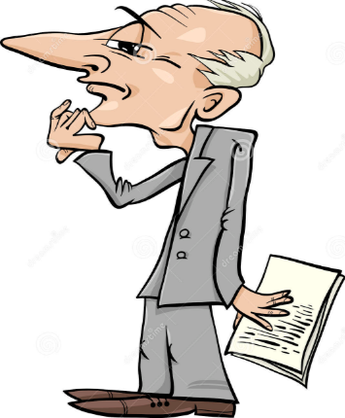
Present Tense: Do not and Don’t
Examples:
I don’t like peaches.
Don’t pick up that bug!
Past Tense: Did not and Didn’t
Examples:
Charlie did not want to go shopping.
I didn’t like the chicken salad.

Slide 9
Sam told the teacher that he ________________ like the lesson.
I __________________ need to eat before class.
Charlie ___________________ want to go to Grandma house.
___________ jump in the classroom!
I _______________ want to sleep at night.
The monkey ___________ want to eat a banana.
Did not
Didn’t
Do not
Don’t

Slide 10
Students will:
Explore the five questions (where, who, why, which, what and how)
Create yes and no answered questions. ✓
Learn how to use did not, didn’t, do not and don’t ✓
Use rising intonation in oral conversations and reading
Notes:
m45yDiscuss the goals for todays lesson. Emphasize to the students that there writing and pictures must be descriptive.

Slide 11
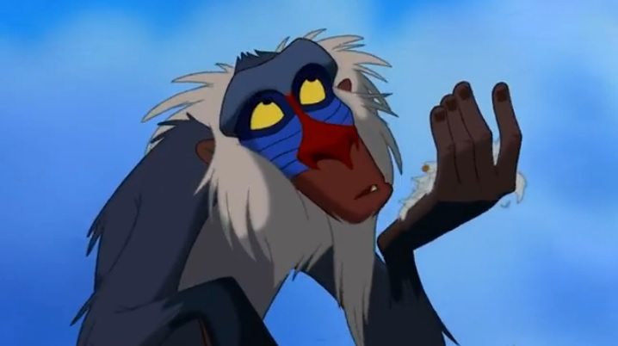
Lets read a story

Slide 12
LEARNING OUR WORDS!

Slide 13
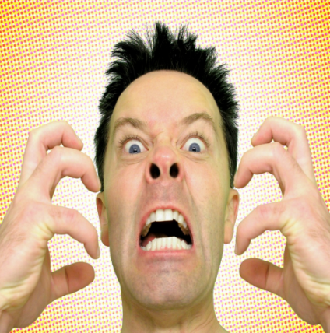
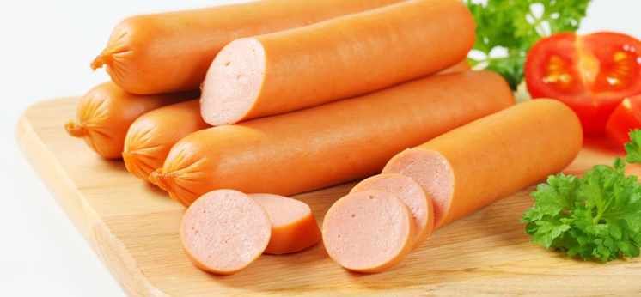
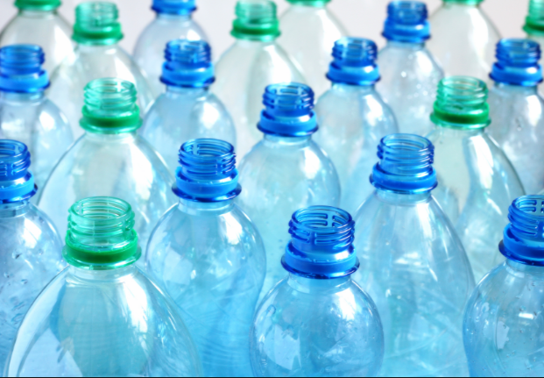
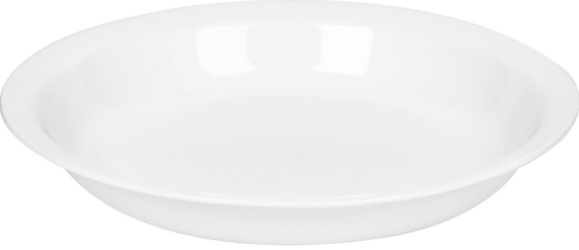
Reading Vocabulary
Frankfurters
Annoyed
Plastic
Dish

Slide 14
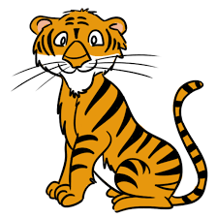

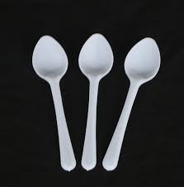
Write a definition for the words.
tiger
balloons
spoons

Slide 15
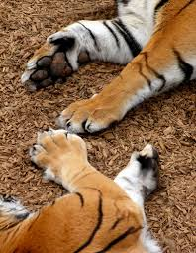
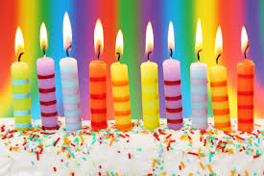
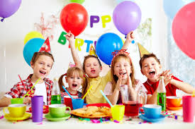
Draw a picture and write a definition of the words.
paws
candles
party

Slide 16
Choose three to five words from the reading vocabulary and create a short interesting sentence.

Slide 17
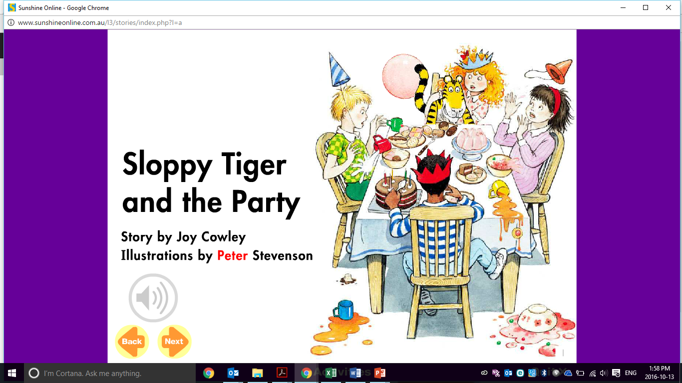

Slide 18
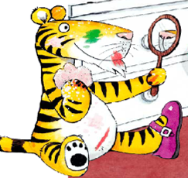
Pre-Reading Activities
Look at the illustration on the front cover of the book.
What do you think happens in the story?
Who is this story about?
Where is the story taking place?
Why are they sitting around a table?
When does the story take place?
How can you know the story before reading the book?

Slide 19
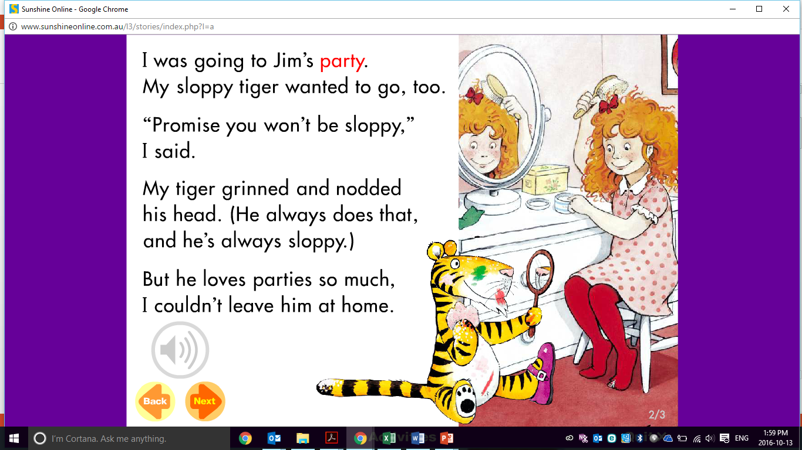

Slide 20
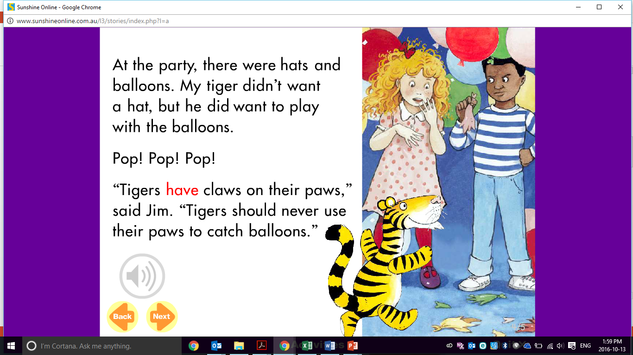

Slide 21
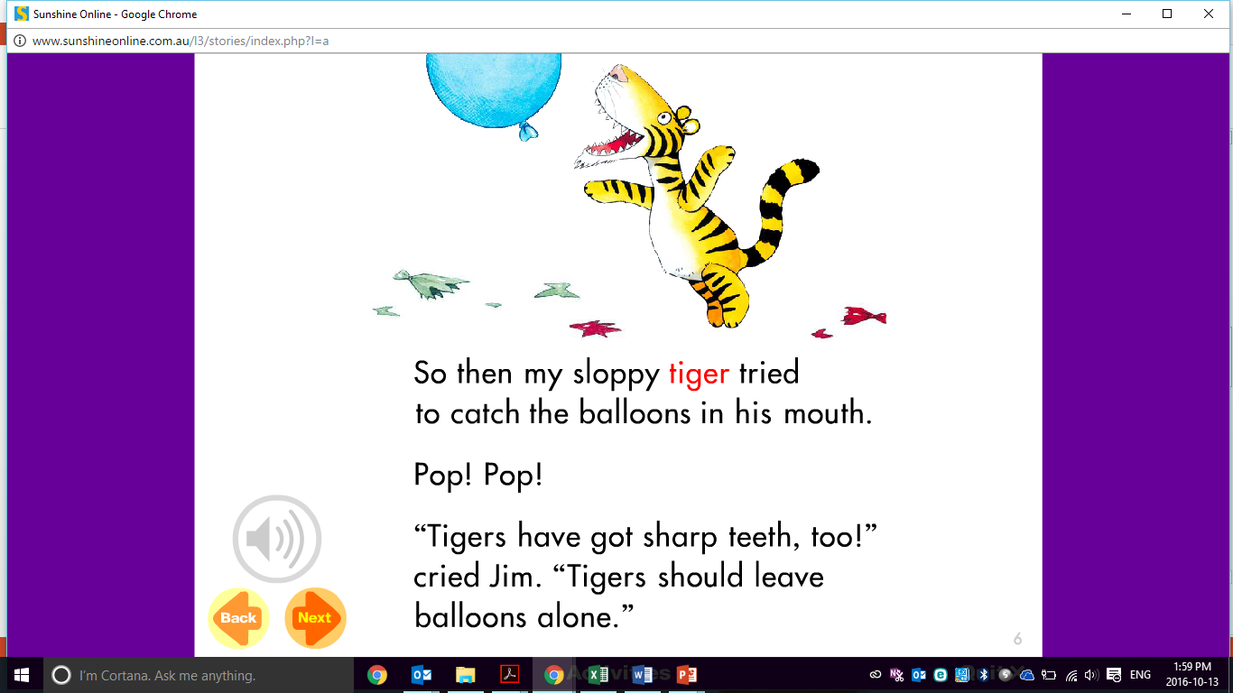

Slide 22
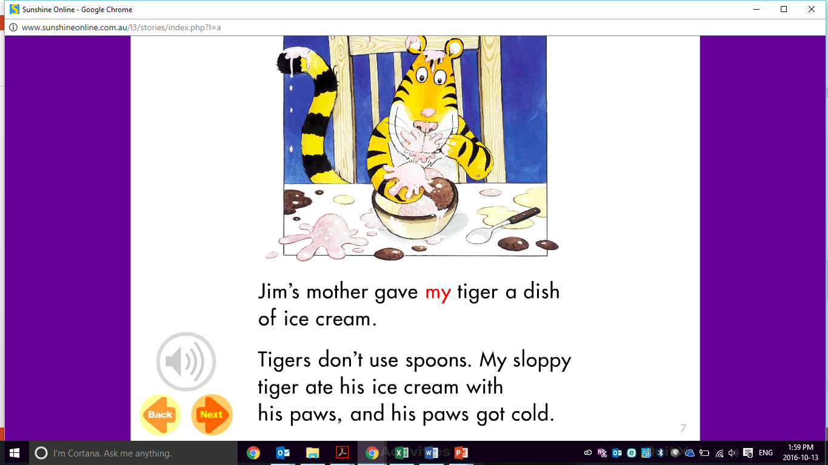

Slide 23
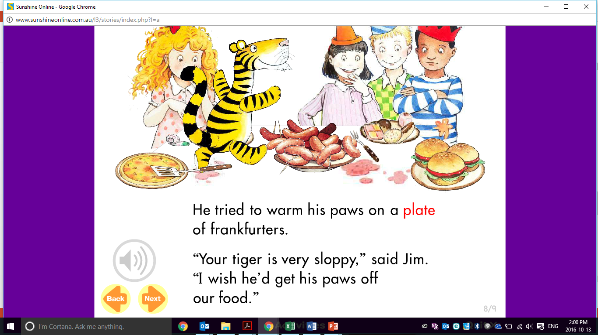

Slide 24
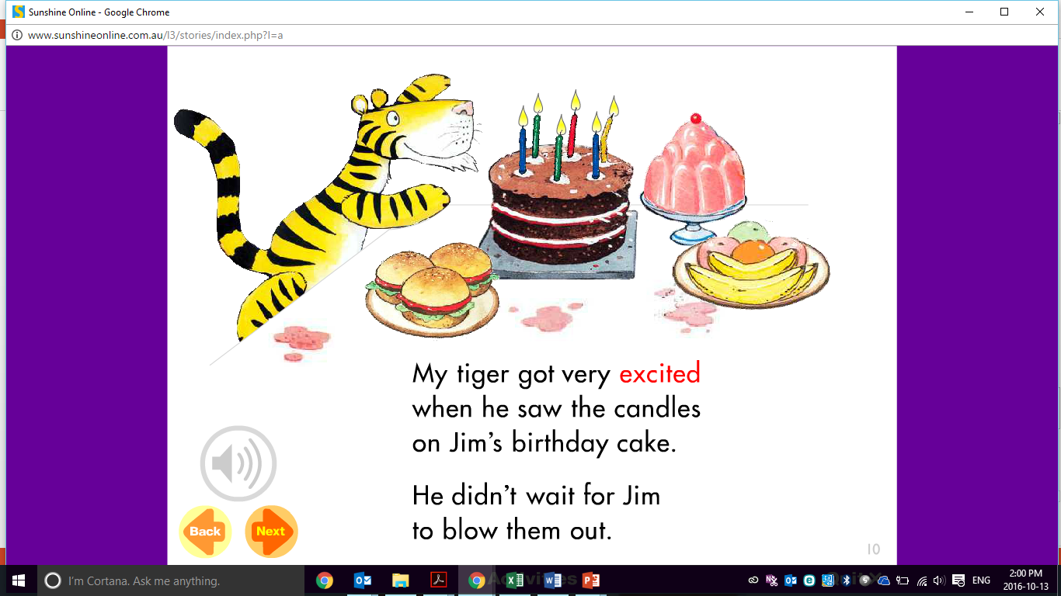

Slide 25
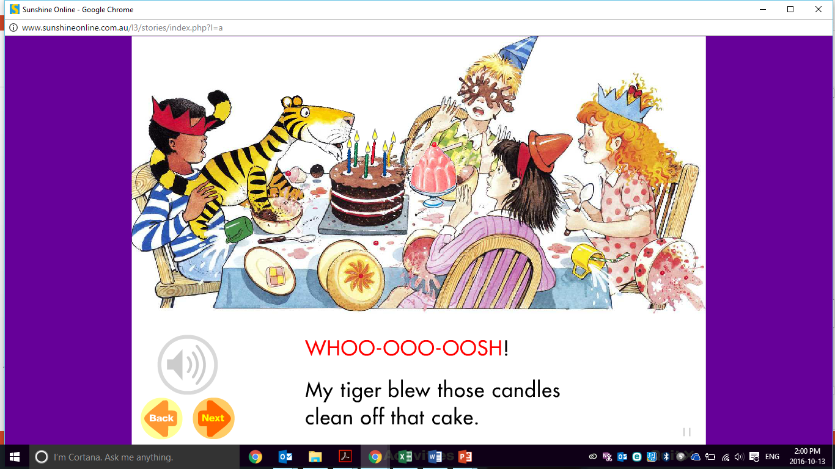

Slide 26
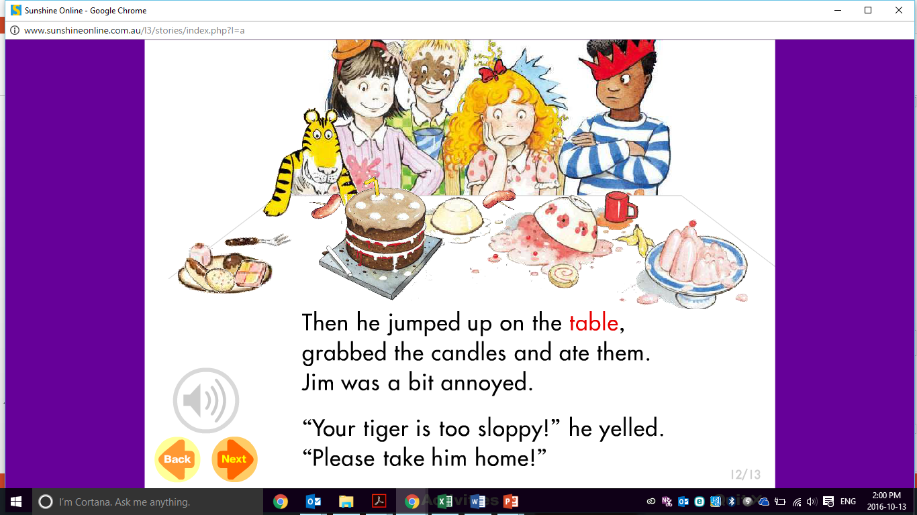

Slide 27
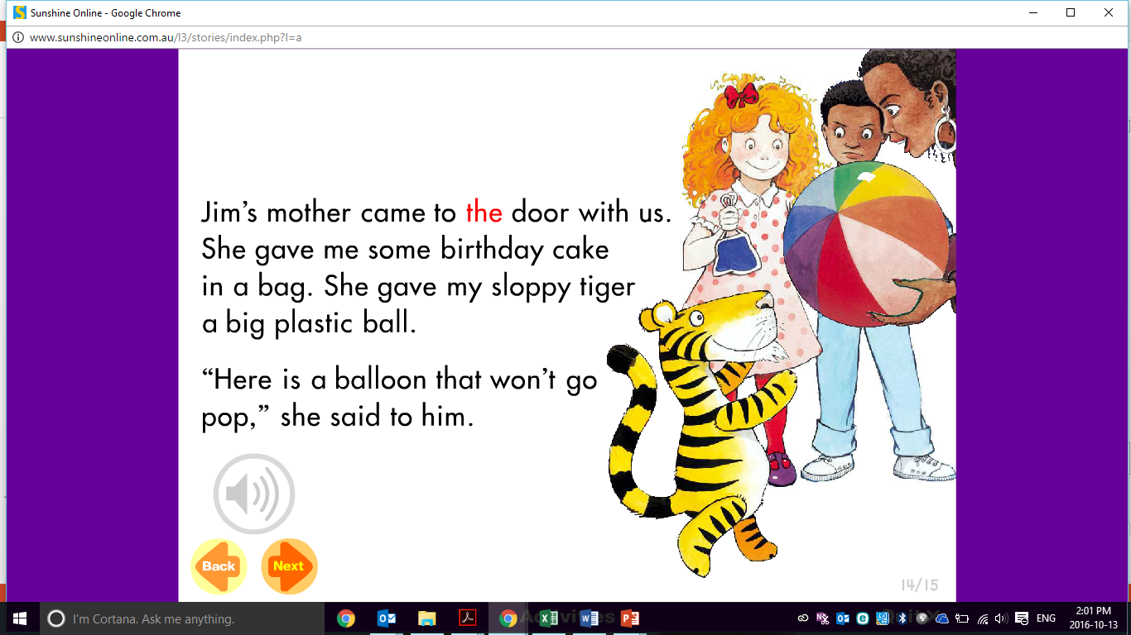

Slide 28
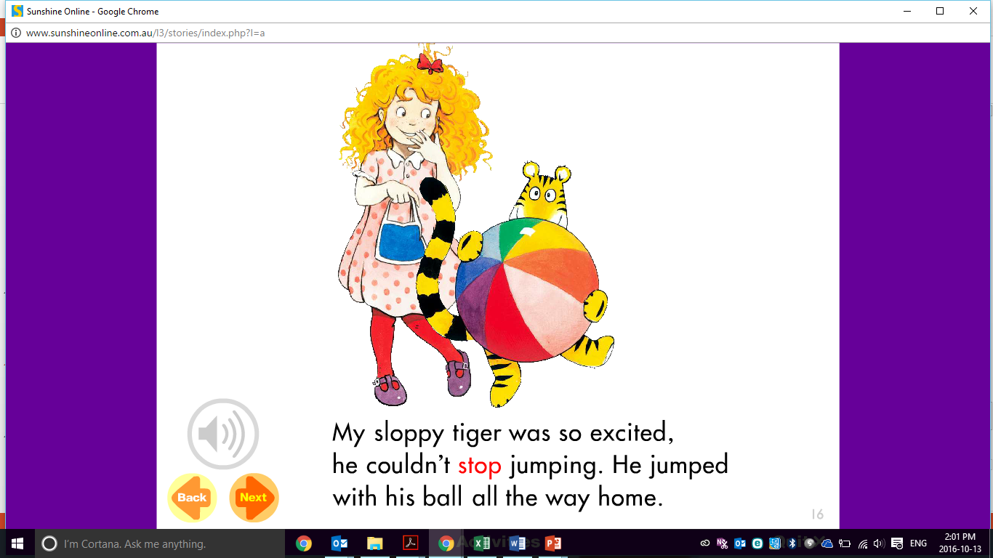

Slide 29
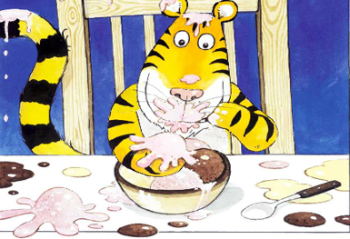
Now that you have read the story ‘Sloppy Tiger and the Party,’ write down four questions using the 5W’s and H.
Who, What, Where, When, Why and How

Slide 30

Post-Reading Comprehension Questions using the 5W and H
Whose party are they attending?
What did the tiger promise his friend?
Why did the balloons pop?
How did the tiger eat his ice cream?
What did the tiger want to play with at the party?

Slide 31
Post-Reading Comprehension Questions using the 5W and H
What did the tiger do to Jim’s birthday cake?
Why were they asked to leave the party?
What did Jim’s mother give the tiger at the
end of the party?
Where was the party?

Slide 32
Students will:
Explore the questions (who, what, where, when, why and how) ✓
Create yes and no answered questions. ✓
Learn how to use did not, didn’t, do not and don’t ✓
Use rising intonation in oral conversations and reading
Notes:
m45yDiscuss the goals for todays lesson. Emphasize to the students that there writing and pictures must be descriptive.

Slide 33
Rising Intonation in Speech
Intonation is how we say things, rather than what we say.
For example:
It’s raining. (No intonation – statement)
It’s raining. (Rising intonation – Surprise or question)
It’s raining. (Low intonation – Sadness)

Slide 34
Practicing intonation
Say these phrases with rising intonation
It’s cold.
Stop there.
Where?
It fell.

Slide 35
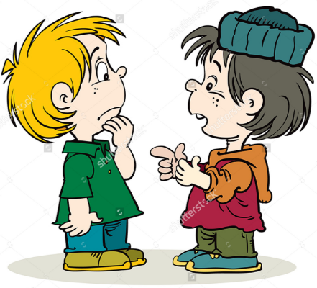
Practicing intonation
Have a conversation with your teacher or classmates about their week.
Ask questions and listen to the answers.
Where can you hear rising intonation?

Slide 36
Students will:
Explore the questions (who, what, where, when, why and how) ✓
Create yes and no answered questions. ✓
Learn how to use did not, didn’t, do not and don’t ✓
Use rising intonation in oral conversations and reading ✓
Notes:
m45yDiscuss the goals for todays lesson. Emphasize to the students that there writing and pictures must be descriptive.

Slide 37
Homework
Write a list of questions with the 5W and H.
Write sentences and questions using did not, didn’t, do not and didn’t.
Create interesting sentences using the reading vocabulary.

Slide 38
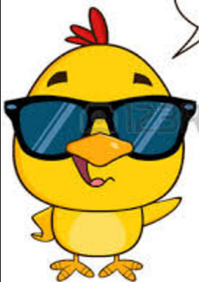
Final Thoughts
Do you have any questions?

