Slide 1
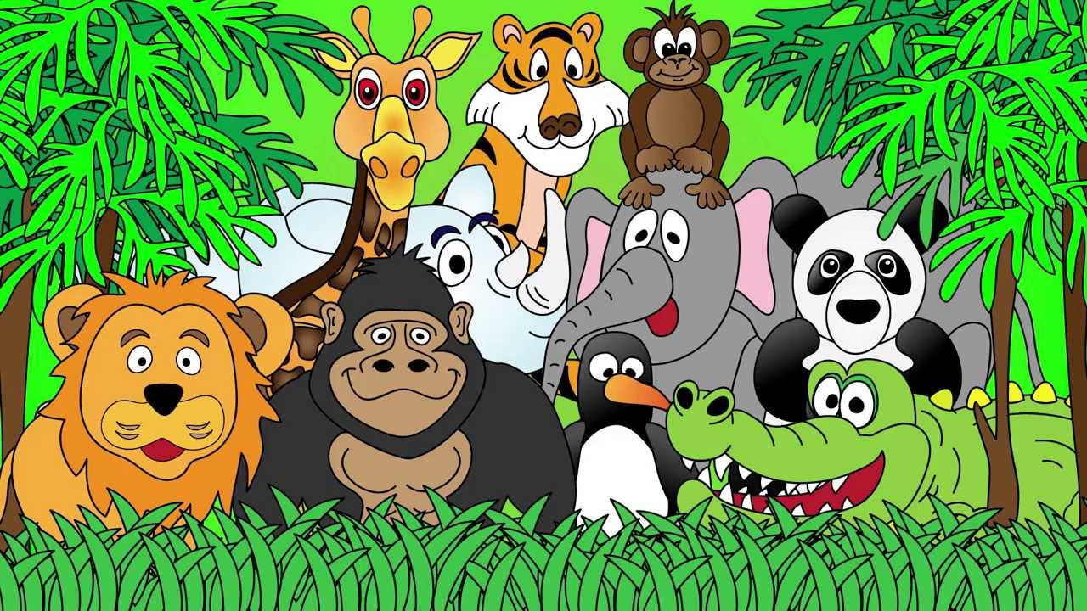
Welcome to the Animal Kingdom! This is Lesson 11!
Notes:
Welcome the students to the unit.
Ask the students how there week has been and discuss some of the fun things they did at school or for fun to establish a rapport with your students.
Ask the students if they have been to the Zoo before? What animals did they see? What animals can they see in this picture.

Slide 2
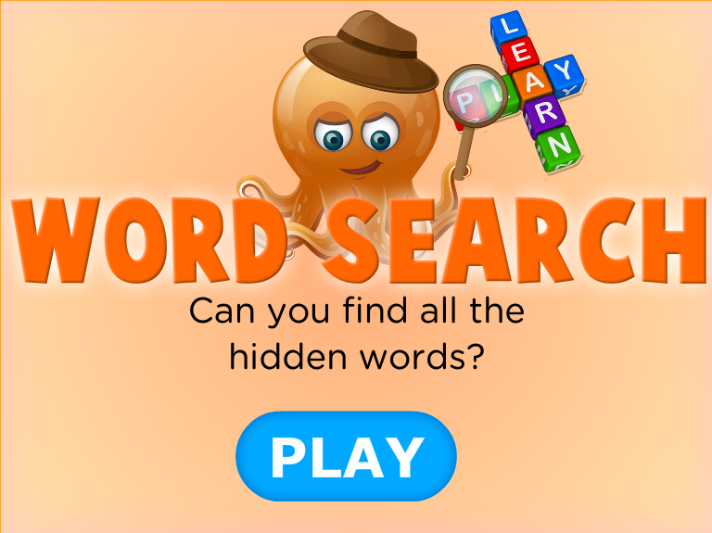
Notes:
http://www.eslgamesplus.com/animals-on-the-farm-interactive-word-search/

Slide 3

Students will:
Sing a song and develop thinking questions
Write questions about a topic they are interested in
Read a story and discuss the events and characters
Learn new vocabulary
Notes:
m45yDiscuss the goals for todays lesson. Emphasize to the students that there writing and pictures must be descriptive.

Slide 4
Listen to the Question Words Song!
WHO
WHAT
WHERE
WHEN
WHY
HOW
Activity:
Think of six questions, one for each question word to ask your friends.
Activity:
List the six question words to start your sentences.
What does each word mean?

Slide 5
Writing and Talking Activity
Write a simple conversation between two friends planning a party for a friend’s birthday.
Think about six questions, one for each question word that describes the party you are planning.

Slide 6
Students will:
Sing a song and develop thinking questions ✓
Write questions about a topic they are interested in
Read a story and discuss the events and characters
Learn new vocabulary
Notes:
m45yDiscuss the goals for todays lesson. Emphasize to the students that there writing and pictures must be descriptive.

Slide 7
Choose a topic you are interested in.
ZOO ANIMALS
Food
FRIENDS
FARM ANIMALS
SCHOOL

Slide 8
WHICH TOPIC DID YOU CHOOSE?
Write a set of questions about this topic.
How many questions can you think of?
WHO
WHAT
WHERE
WHEN
WHY
HOW

Slide 9
Students will:
Sing a song and develop thinking questions ✓
Write questions about a topic they are interested in ✓
Read a story and discuss the events and characters
Learn new vocabulary
Notes:
m45yDiscuss the goals for todays lesson. Emphasize to the students that there writing and pictures must be descriptive.

Slide 10
LEARNING OUR WORDS!

Slide 11
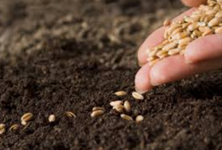
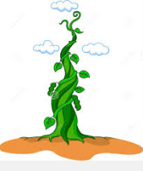
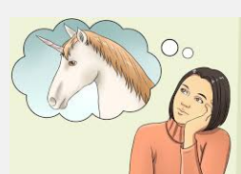
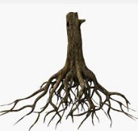
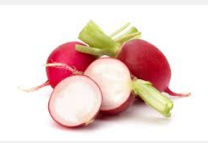
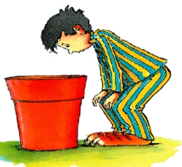
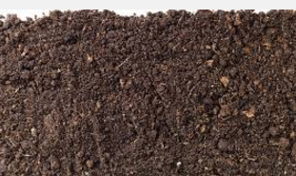
soil
day-dreamed
pyjamas
radish
seed
beanstalk
roots

Slide 12
Students will:
Sing a song and develop thinking questions ✓
Write questions about a topic they are interested in ✓
Read a story and discuss the events and characters
Learn new vocabulary ✓
Notes:
m45yDiscuss the goals for todays lesson. Emphasize to the students that there writing and pictures must be descriptive.

Slide 13
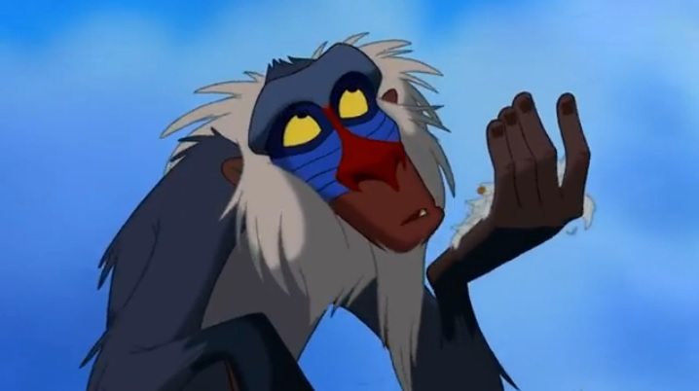
Lets read a story

Slide 14
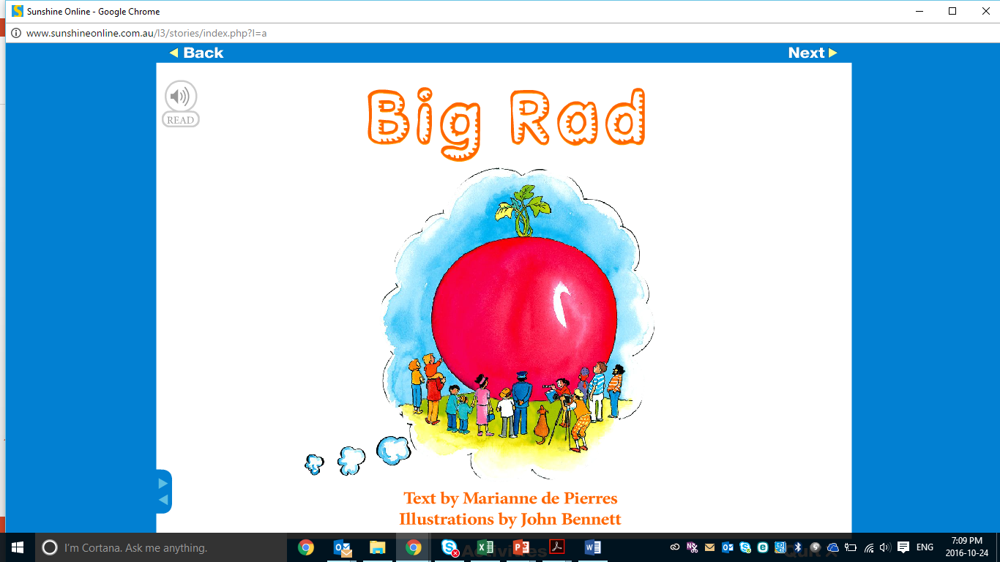

Slide 15
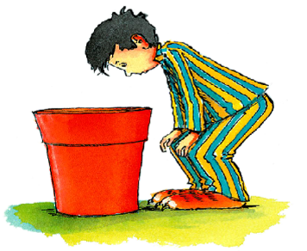
Pre-reading Questions
What is a radish?
Why do you think many people are standing around the radish?
Describe the radish on the book cover.
What do you think the story is about?

Slide 16
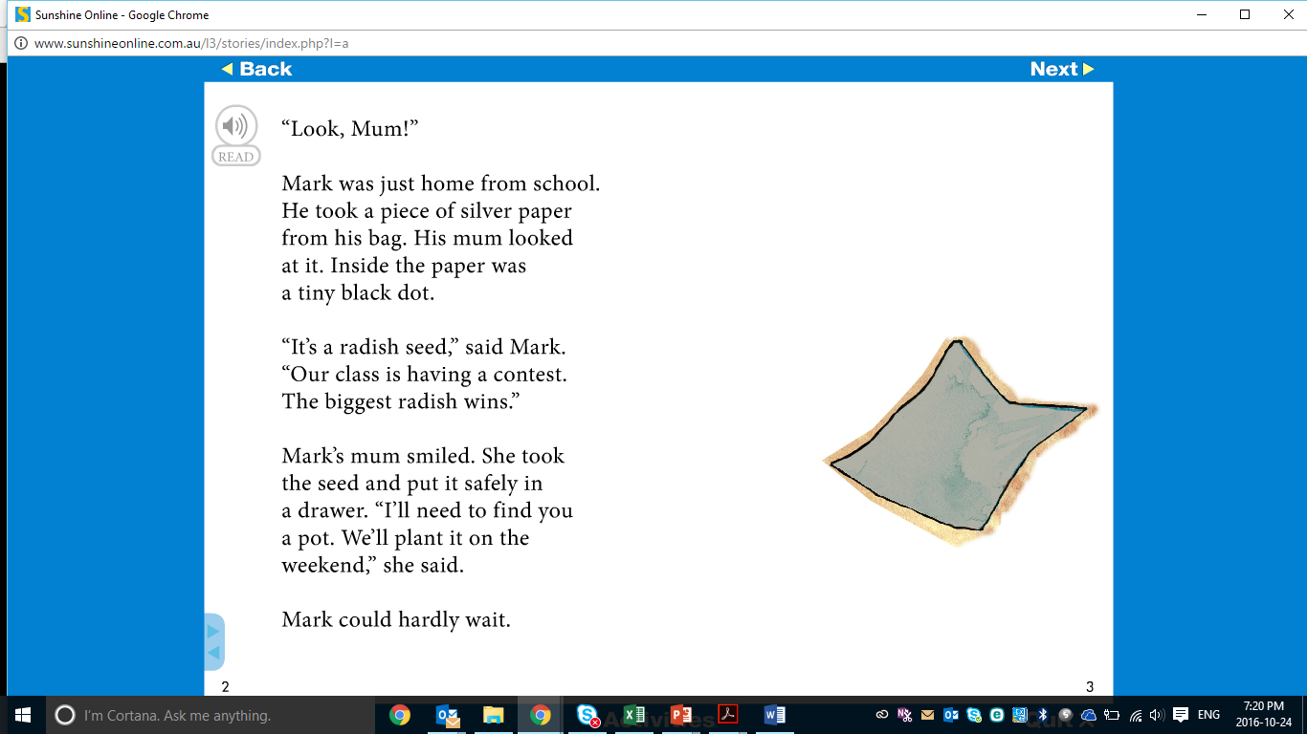

Slide 17
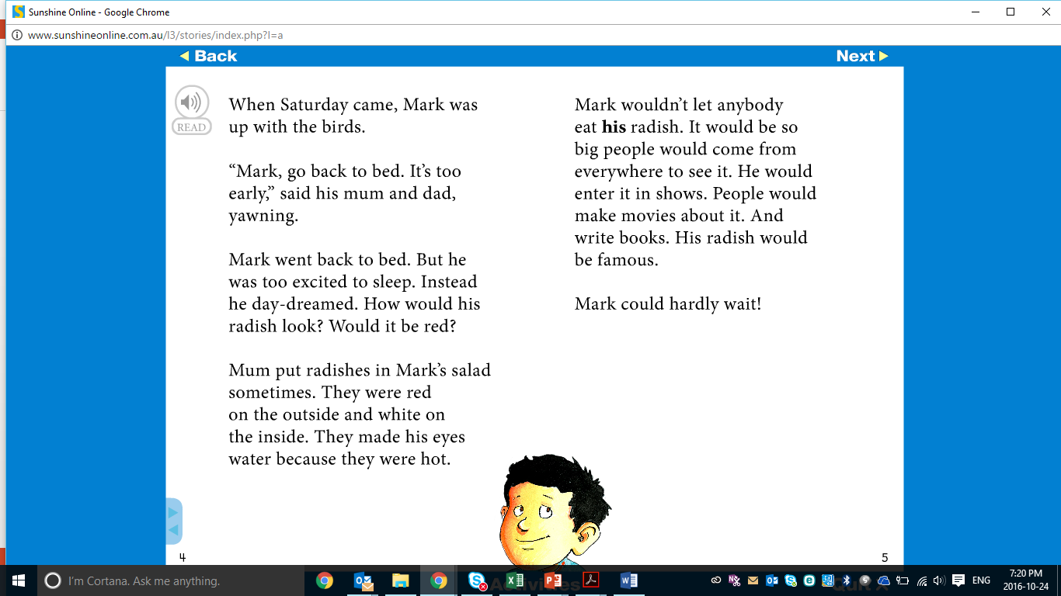

Slide 18
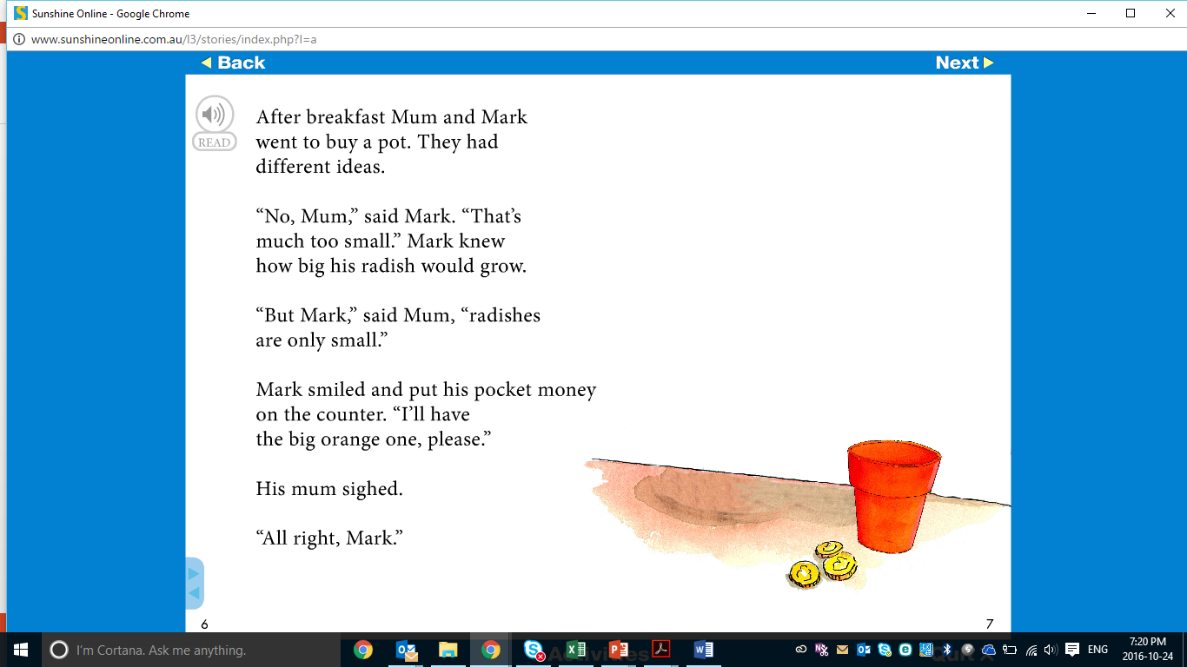

Slide 19
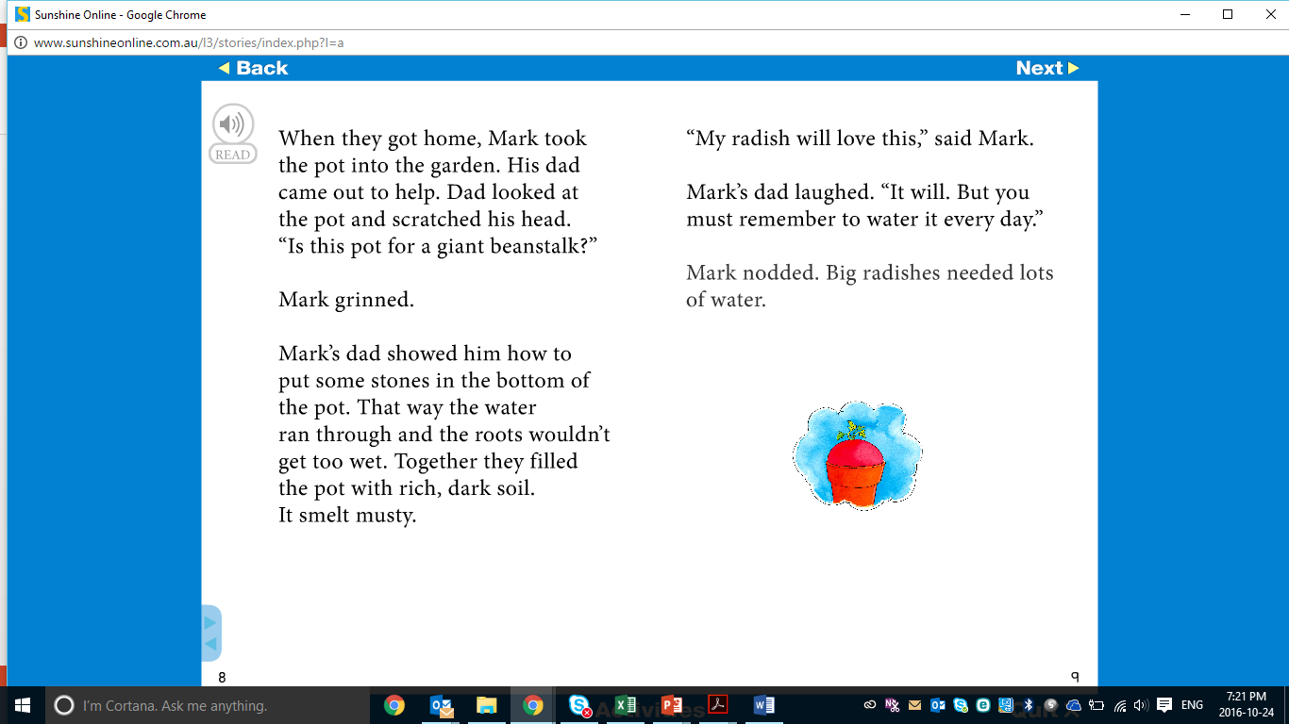

Slide 20
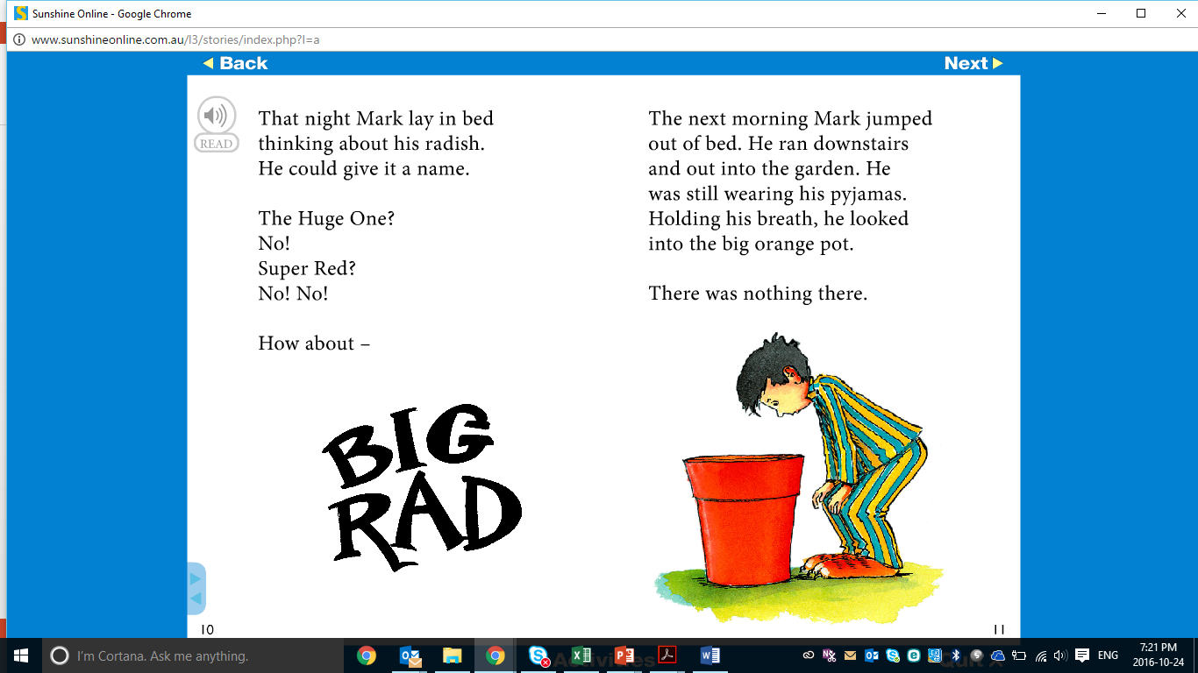

Slide 21
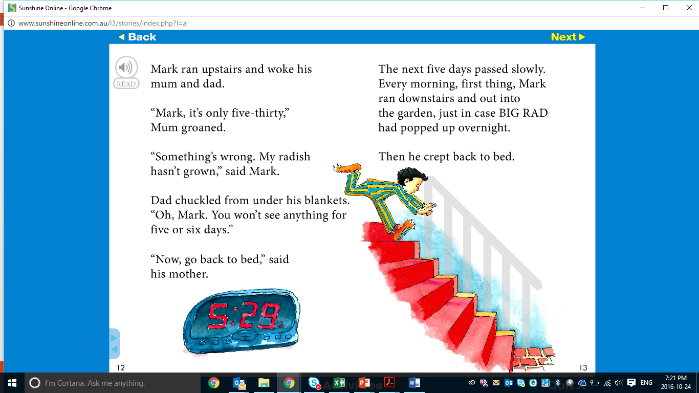

Slide 22
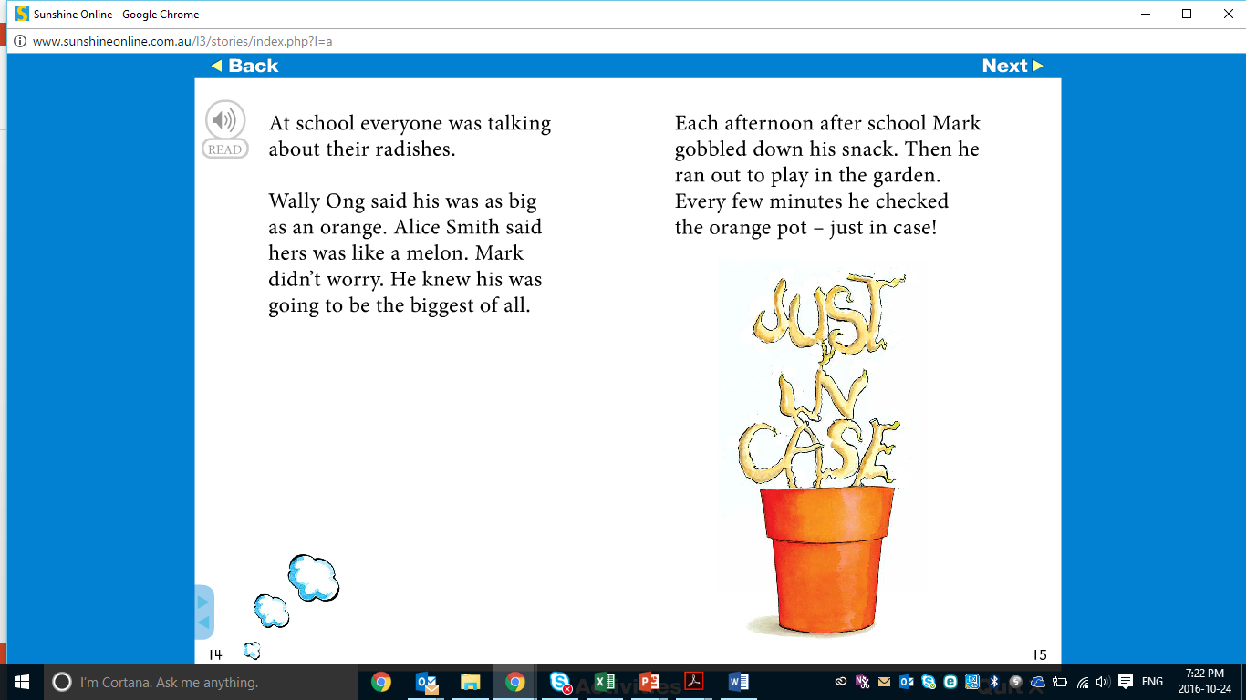

Slide 23
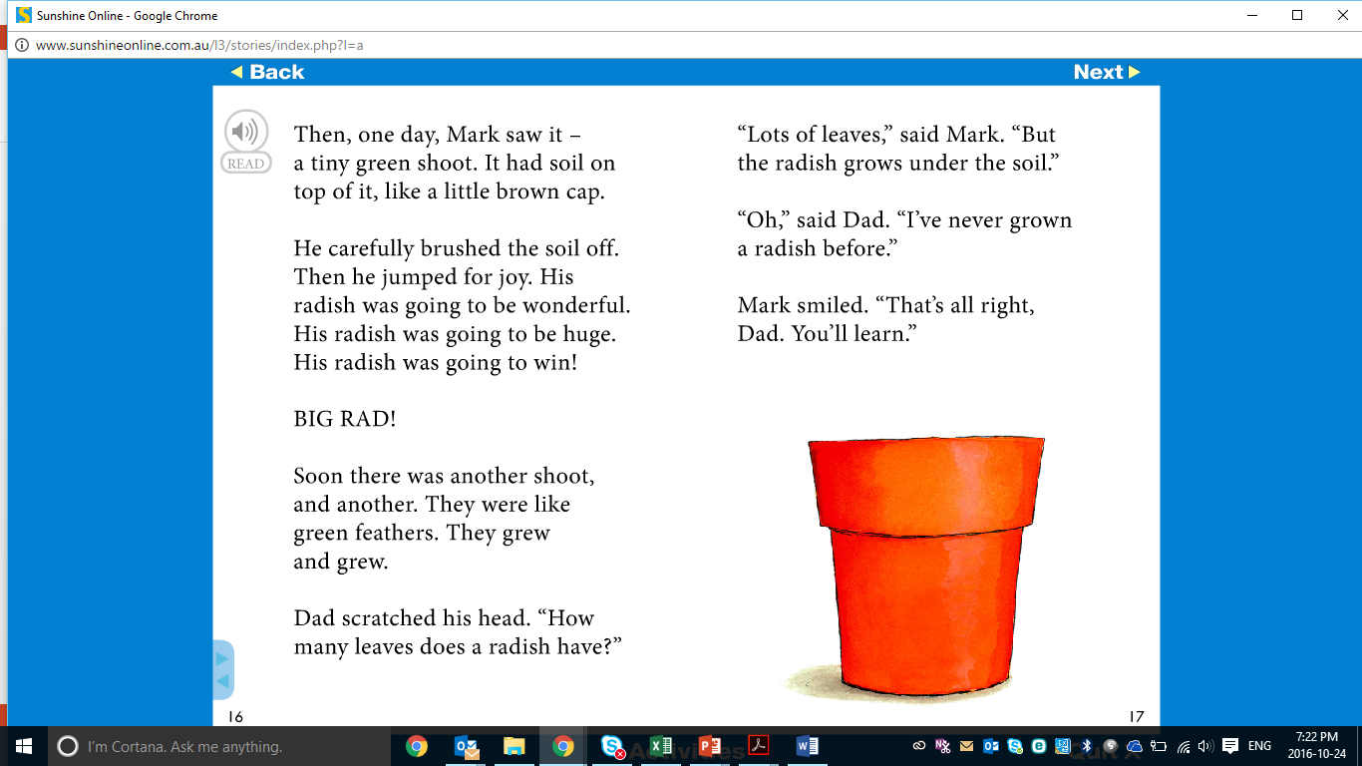

Slide 24
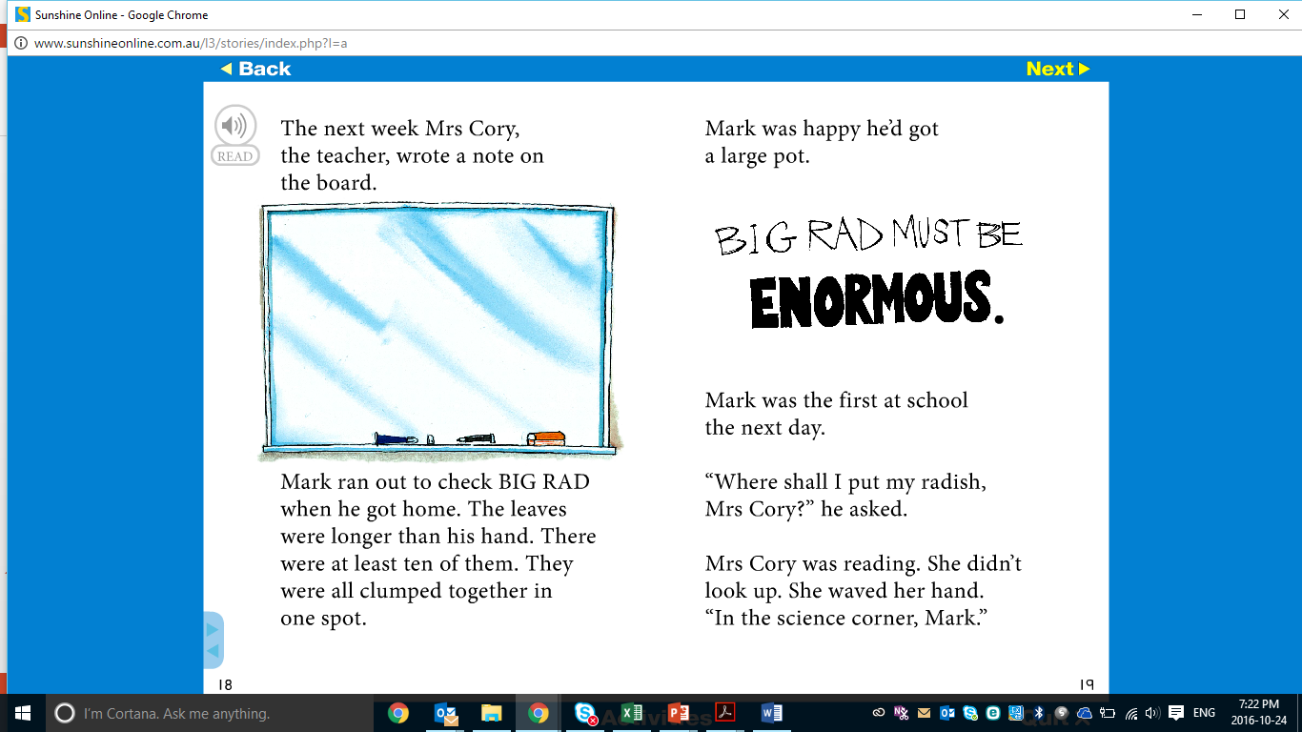

Slide 25
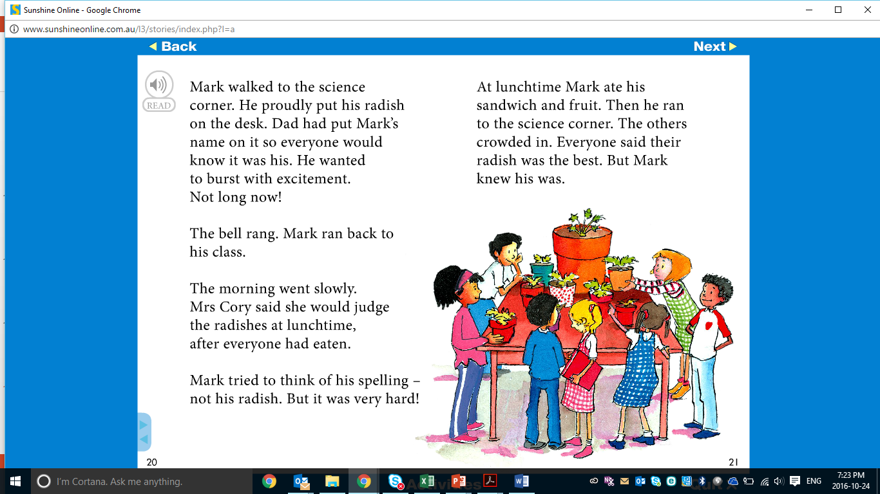

Slide 26
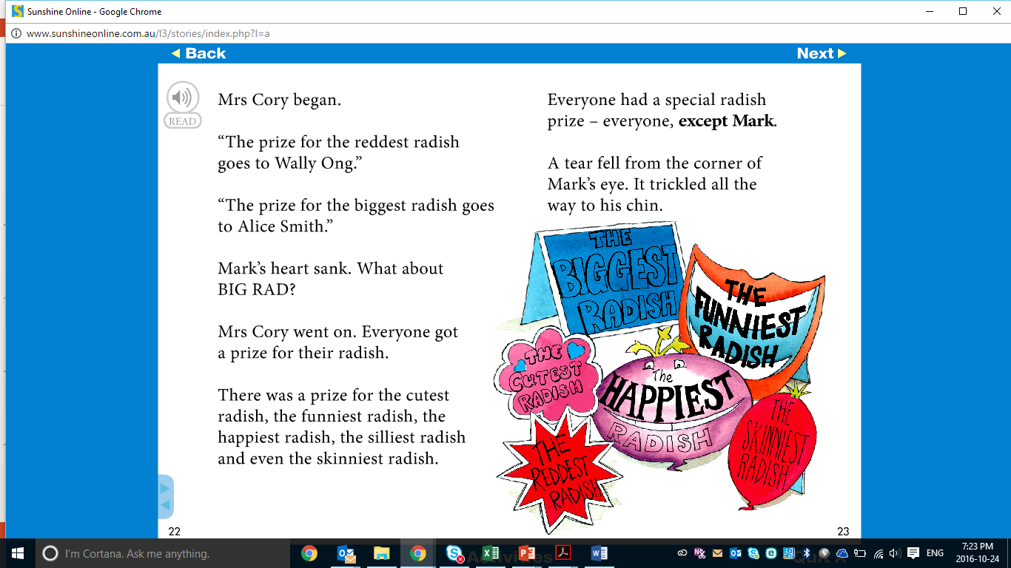

Slide 27
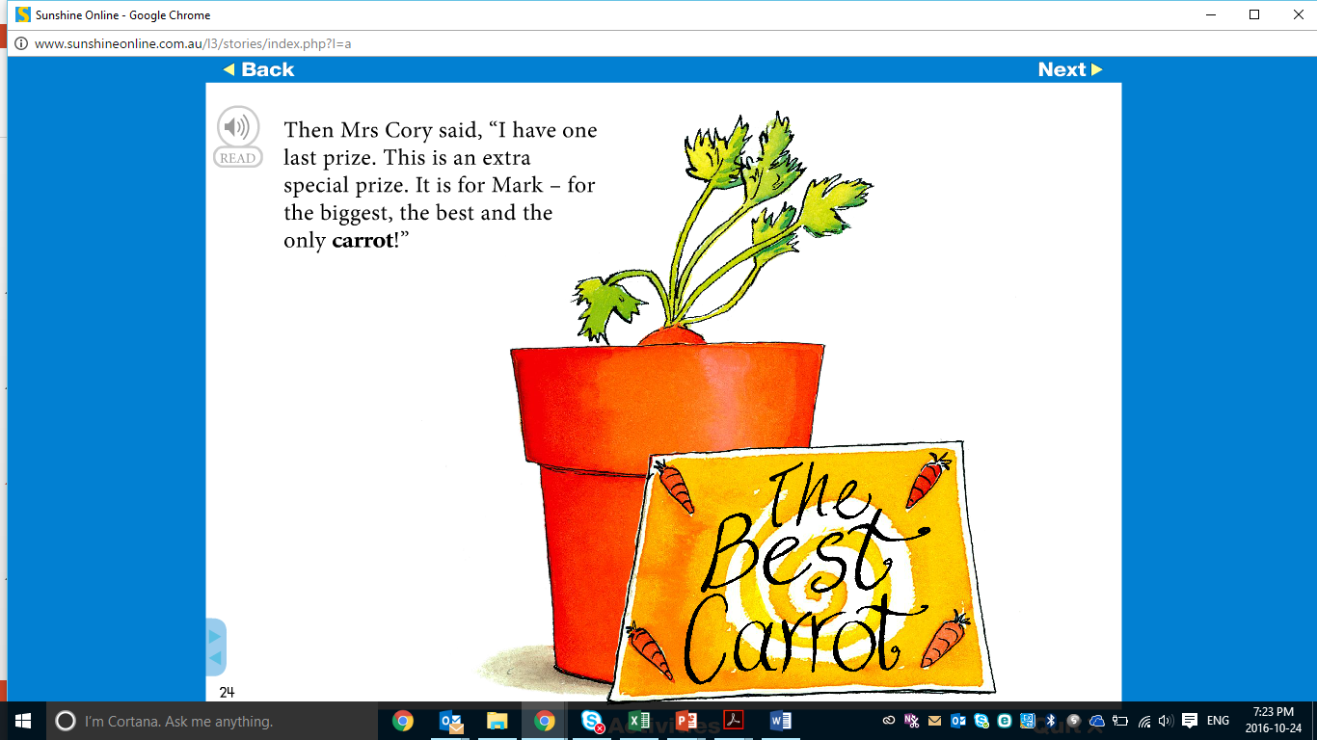

Slide 28
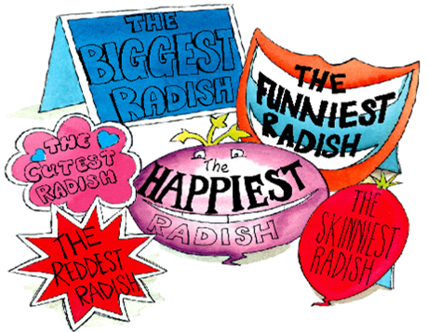
Post-reading Questions
What does a radish taste like?
What was put into the pot before planting the seed?
Why did Mark get up really early every morning?
Where do radishes grow?
Why didn’t Mark get a prize for his radish?

Slide 29
Reading Activity
What synonyms for large can you find in the story?
Draw an image of Mark’s carrot and describe the carrot you have drawn.

Slide 30
Students will:
Sing a song and develop thinking questions ✓
Write questions about a topic they are interested in ✓
Read a story and discuss the events and characters ✓
Learn new vocabulary ✓
Notes:
m45yDiscuss the goals for todays lesson. Emphasize to the students that there writing and pictures must be descriptive.

Slide 31
Vocabulary Activity

Slide 32

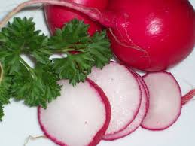
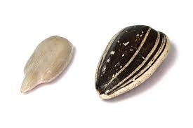
Write a definition for each of the words.
pyjamas
radish
seed

Slide 33
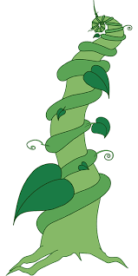
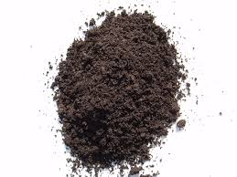
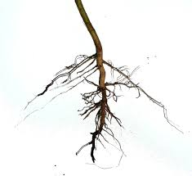
Write a definition for each of the words.
beanstalk
soil
roots

Slide 34
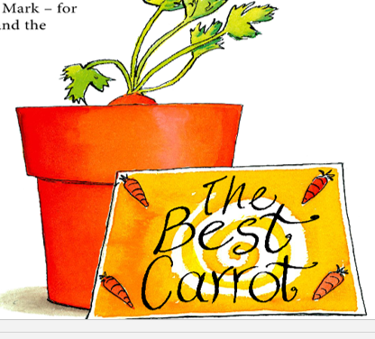
Create a silly story using the reading vocabulary.

Slide 35
Homework
Ask your mom or dad about themselves using the six question words. Record the questions and answers.
Using the seven new vocabulary words, create a short paragraph about the story and
illustrate your favourite scene.

Slide 36
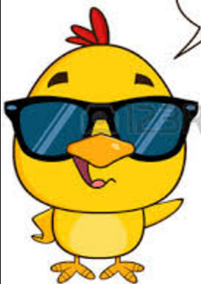
Final Thoughts
Do you have any questions?

