Slide 1
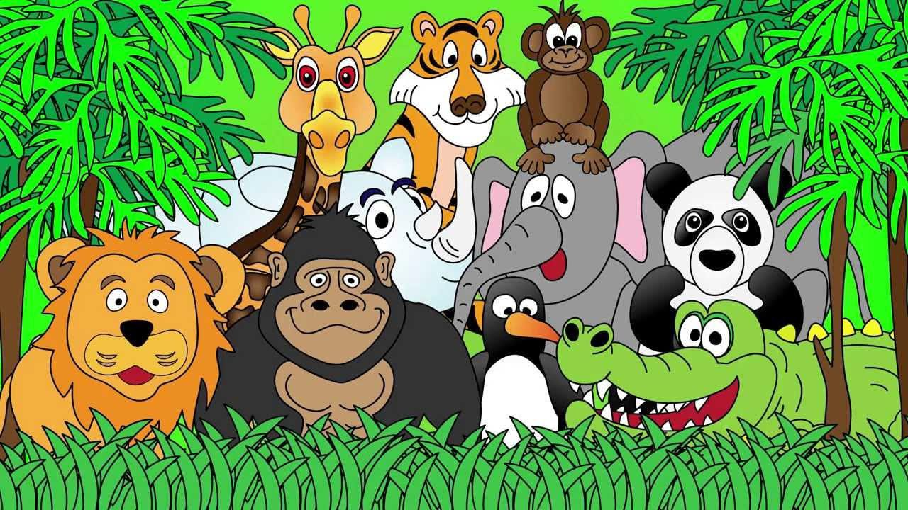
Welcome to the Animal Kingdom! This is Lesson 12!

Slide 2
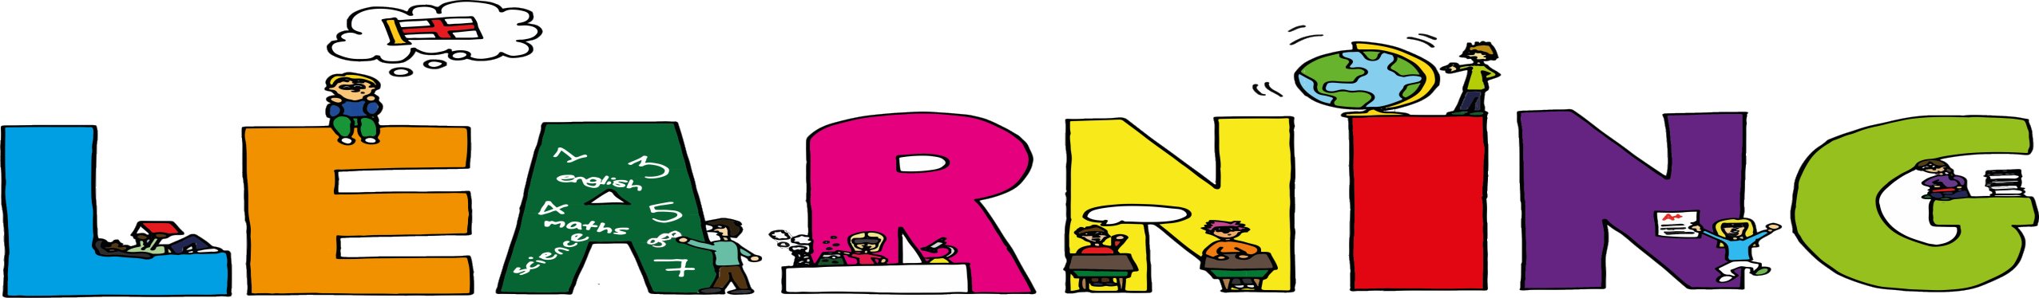
Students will review:
Synonyms
Question words—5W and H
Questions about a topic of interest

Slide 3
Small
Happy
Large

Slide 4
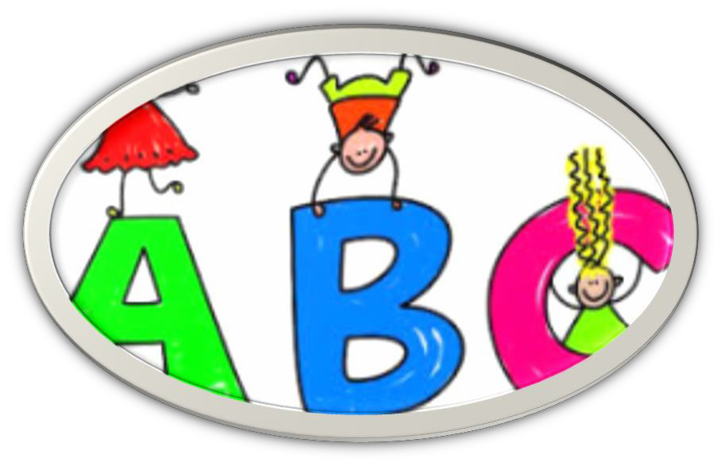
LEARNING OUR READING WORDS!

Slide 5
Match the word to the meaning.
Word | Meaning
amphibian | Used to taste and eat food
lungs | small
tadpoles | An part of the body used to breath
tongue | Baby frog
predator | cold-blooded animal
goliath | Animal that preys on other animals
dwarf | large

Slide 6
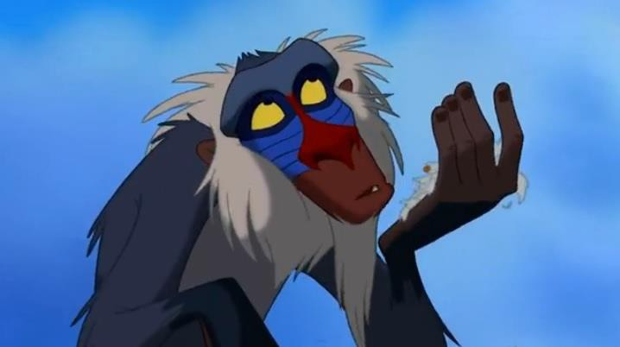
Let's read a non-fiction text

Slide 7
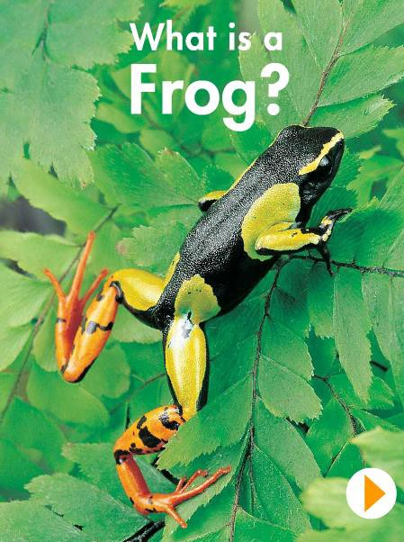
Describe
this

Slide 8
5W and H Questions
Think about 5W and H questions about the book about frogs. What do you want to know about frogs?
WHO
WHAT
WHERE
WHEN
WHY
HOW

Slide 9
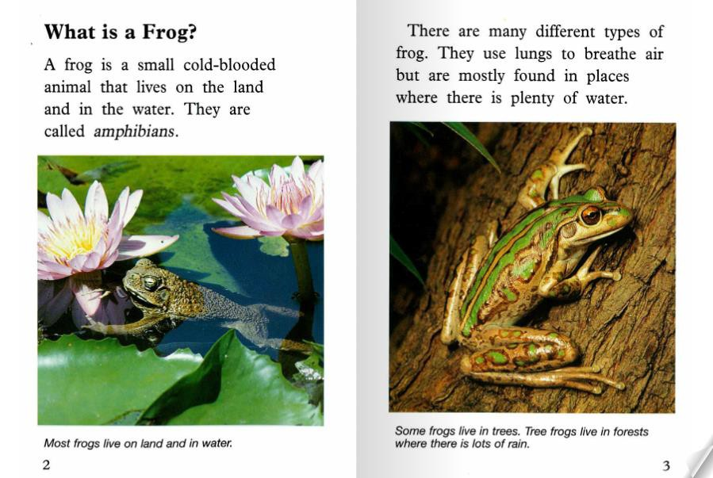

Slide 10
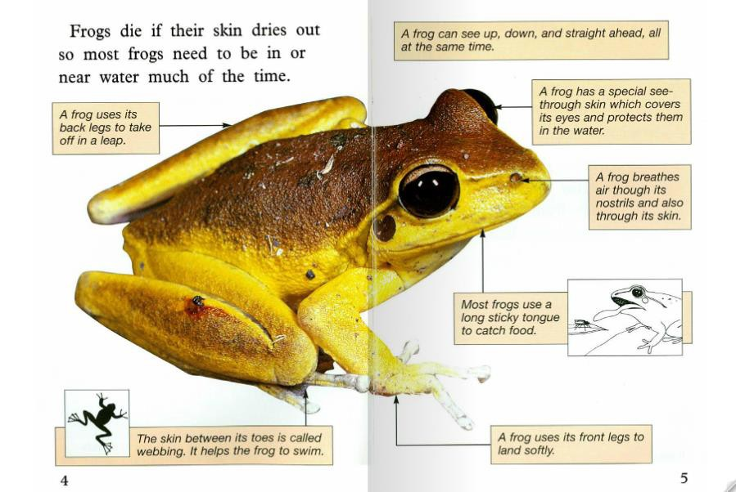

Slide 11
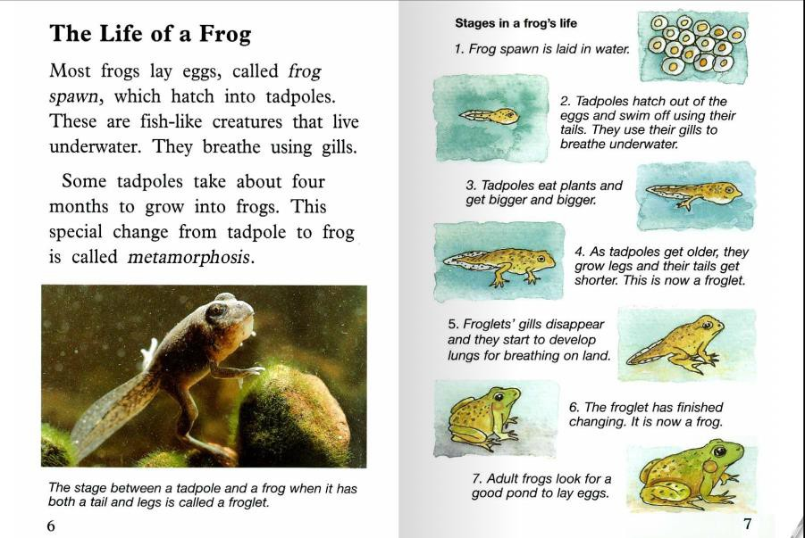

Slide 12
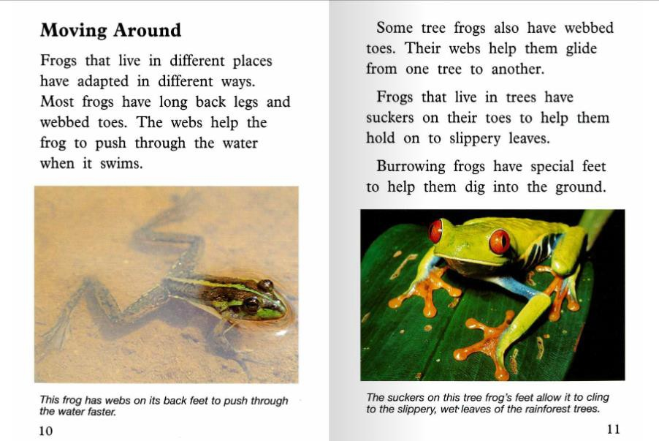

Slide 13
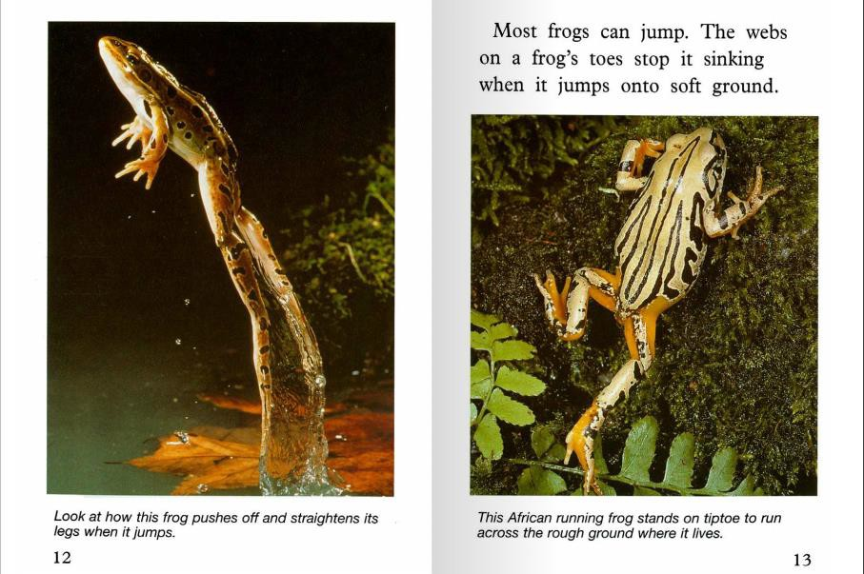

Slide 14
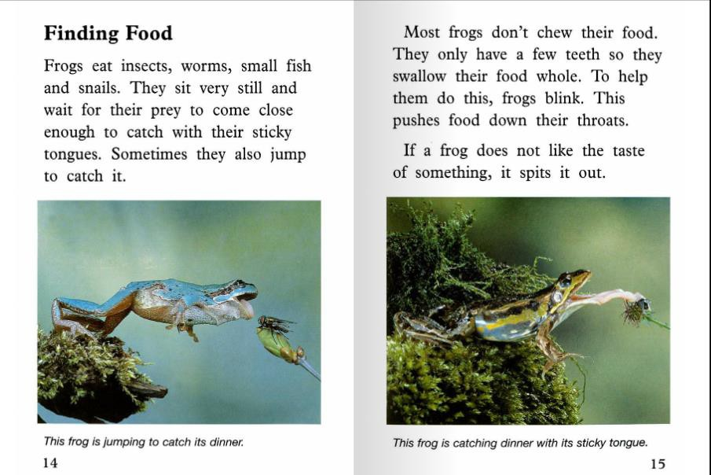

Slide 15
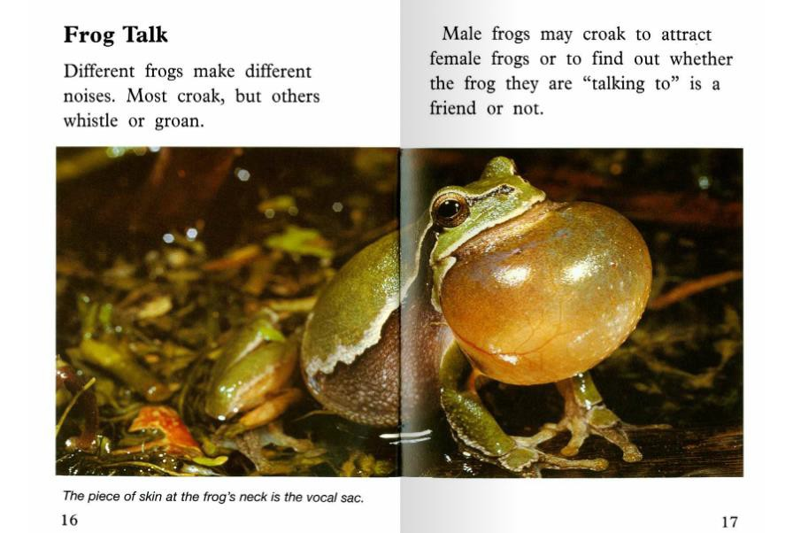

Slide 16
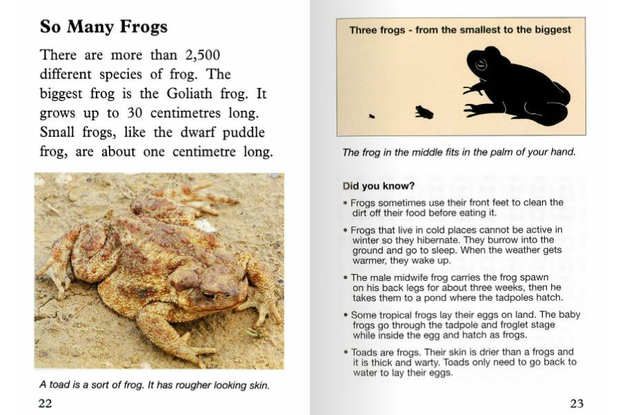

Slide 17
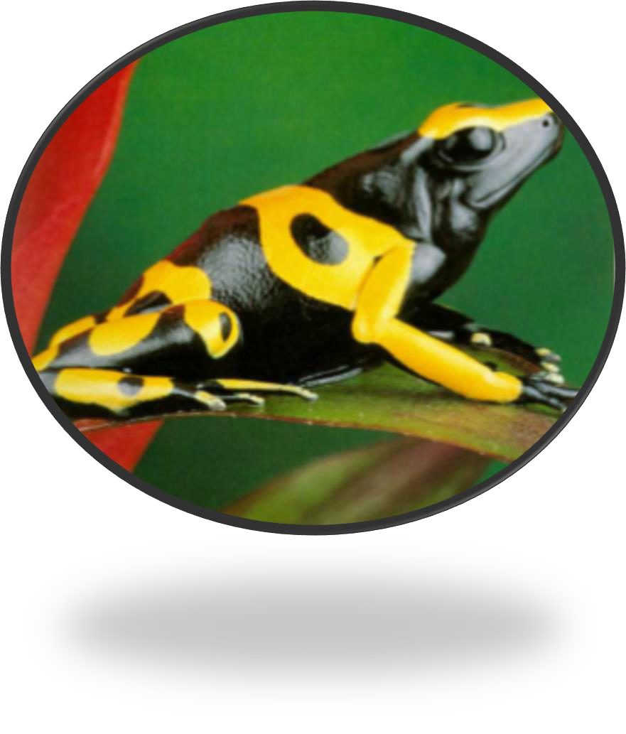
Comprehension Questions
How do frogs breathe?
Where do frogs live?
What do frogs eat?
What are baby frogs called?
How does a frog sound?

Slide 18

Vocabulary
Activity

Slide 19
Draw a picture and write a definition of
the words.
lungs
tadpole
tongue

Slide 20
Students will review:
Synonyms ✓
Question words—5W and H ✓
Questions about a topic of interest ✓

Slide 21
Homework
The first task is to draw a picture of a frog from your reading. Write a description about the frog. How many adjectives can you use in your description.
The second task is to find three friends and ask them
four questions about themselves.

Slide 22
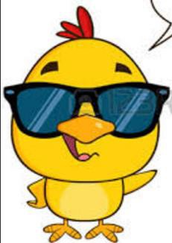
Final Thoughts
Do you have any questions?

