Slide 1
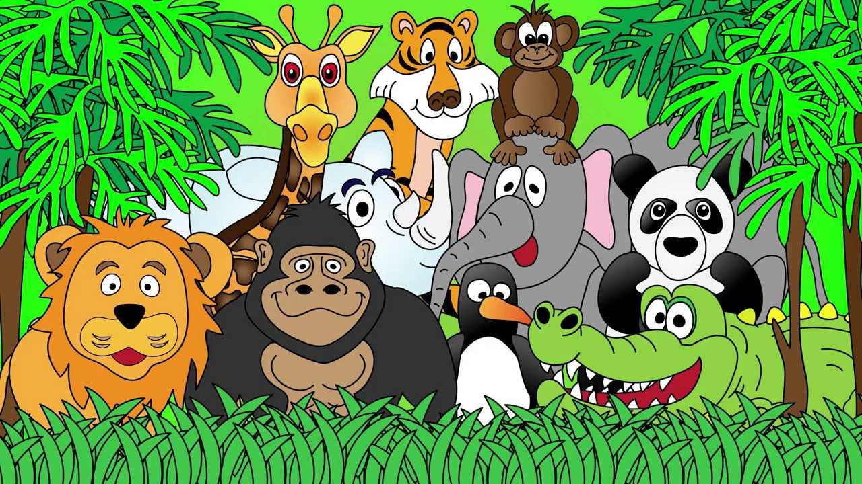
Welcome to the Animal Kingdom! This is Lesson 12!
Notes:
Welcome the students to the unit.
Ask the students how there week has been and discuss some of the fun things they did at school or for fun to establish a rapport with your students.
Ask the students if they have been to the Zoo before? What animals did they see? What animals can they see in this picture.

Slide 2
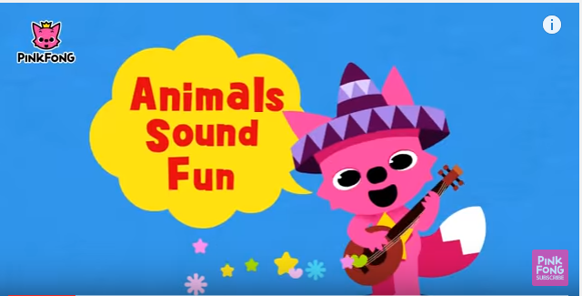
Watch the video and sing along

Slide 3

Students will review:
Synonyms
Question words—5W and H
Questions about a topic of interest
Notes:
m45yDiscuss the goals for todays lesson. Emphasize to the students that there writing and pictures must be descriptive.

Slide 4
Choose a topic you are interested in.
Food
Parents
Teacher
Books
World

Slide 5
Write questions about your topic of interest.

Slide 6
Students will review:
Synonyms
Question words—5W and H
Questions about a topic of interest ✓
Notes:
m45yDiscuss the goals for todays lesson. Emphasize to the students that there writing and pictures must be descriptive.

Slide 7
Happy
Large
Small

Slide 8
Replace the word happy with synonyms.
My happy friend Sally went into her happy house and played with her happy friend.
She was feeling very happy about her day and loved to make others also feel happy.
Her happy dog played with her happy friend.

Slide 9
Students will review:
Synonyms ✓
Question words—5W and H
Questions about a topic of interest ✓
Notes:
m45yDiscuss the goals for todays lesson. Emphasize to the students that there writing and pictures must be descriptive.

Slide 10
LEARNING OUR READING WORDS!

Slide 11
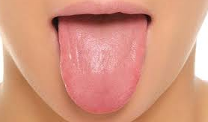
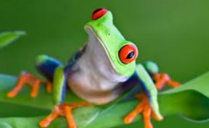
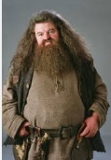
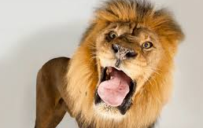
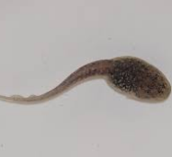
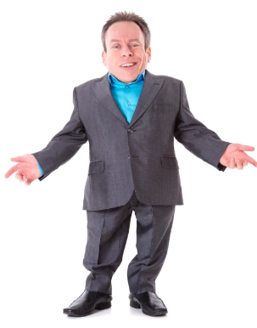
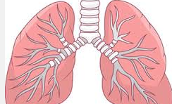
amphibian
lungs
tadpole
tongue
predator
goliath
dwarf

Slide 12
Match the word to the meaning.
Word | Meaning
amphibian | Used to taste and eat food
lungs | Small
tadpole | A part of the body used to breath
tongue | Baby frog
predator | Cold-blooded animal
goliath | Animal that prey on other animals
dwarf | Large

Slide 13
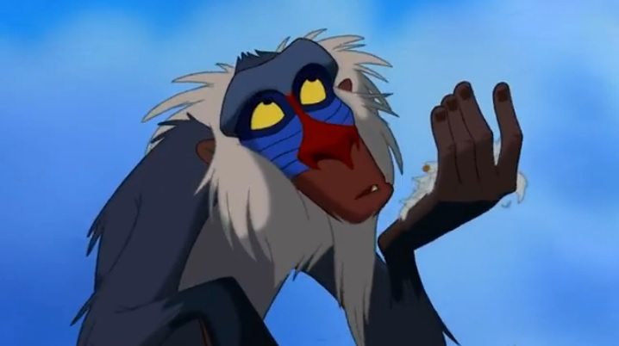
Lets read a non-fiction text

Slide 14
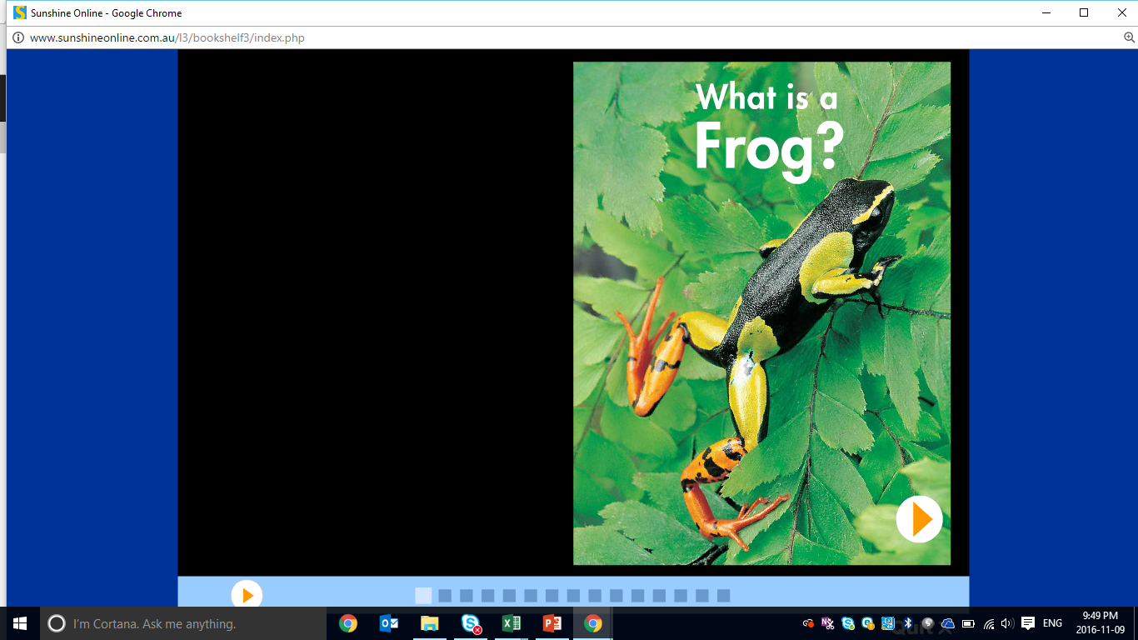
Describe this animal.

Slide 15
Pre-reading Questions
Name three interesting facts about frogs.
1.
2.
3.

Slide 16
5W and H Questions
What do you want to know about frogs?
Think about 5W and H questions about frogs.
WHO
WHAT
WHERE
WHEN
WHY
HOW

Slide 17
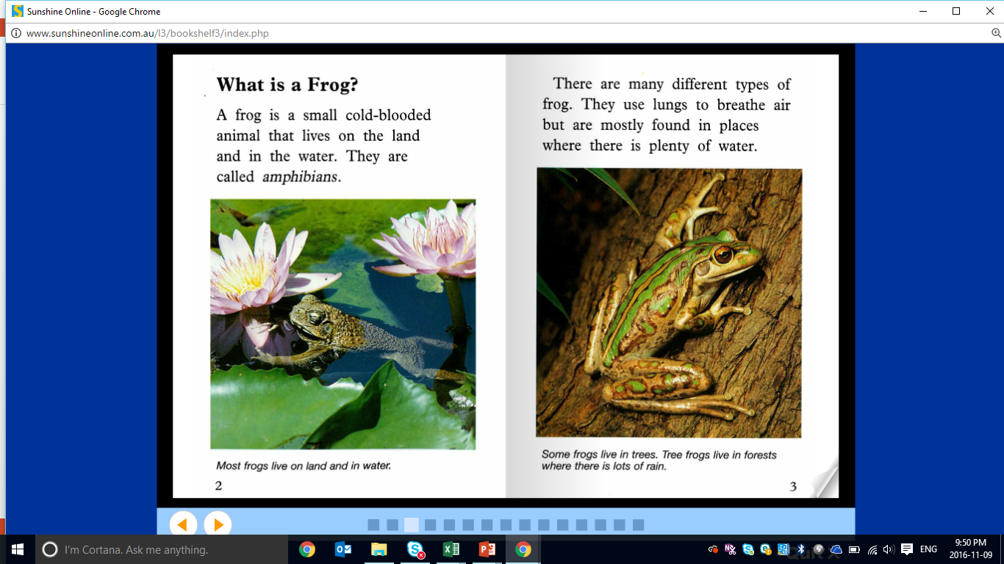

Slide 18
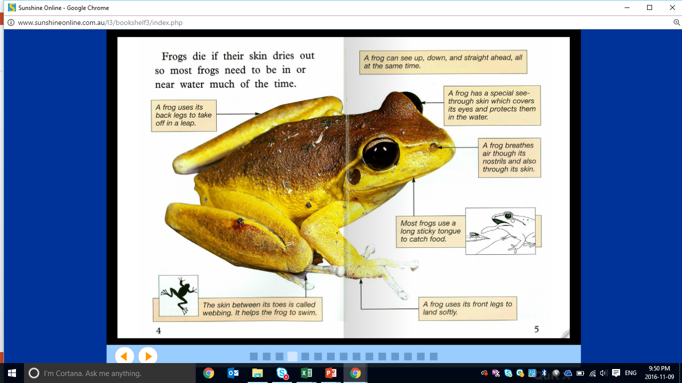

Slide 19
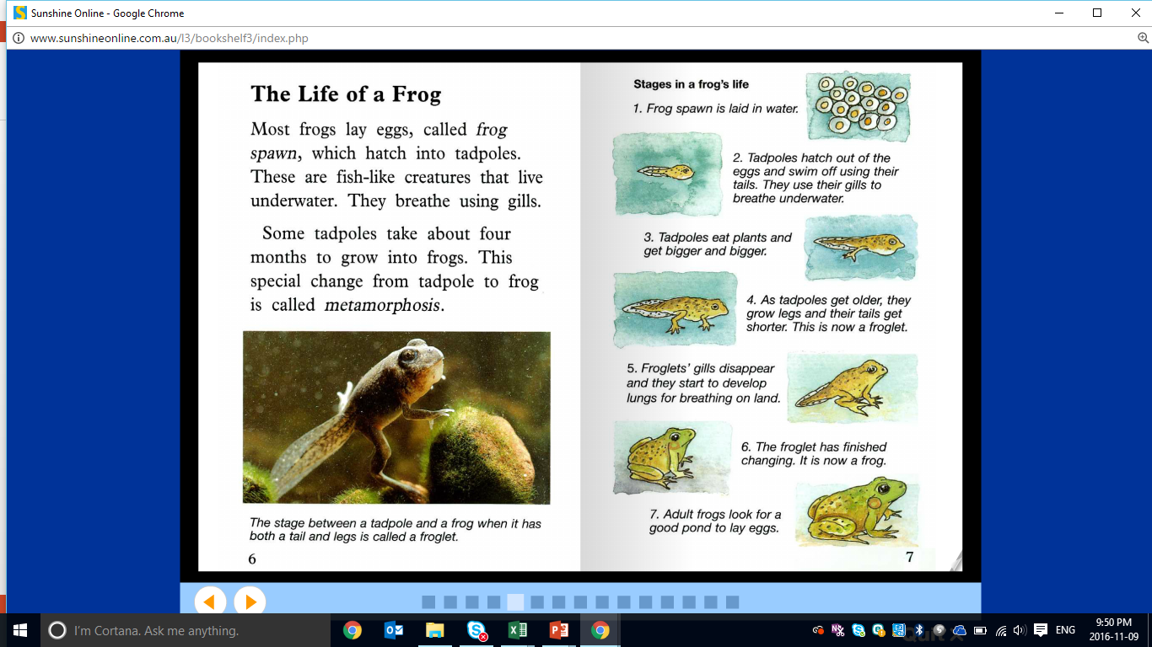

Slide 20
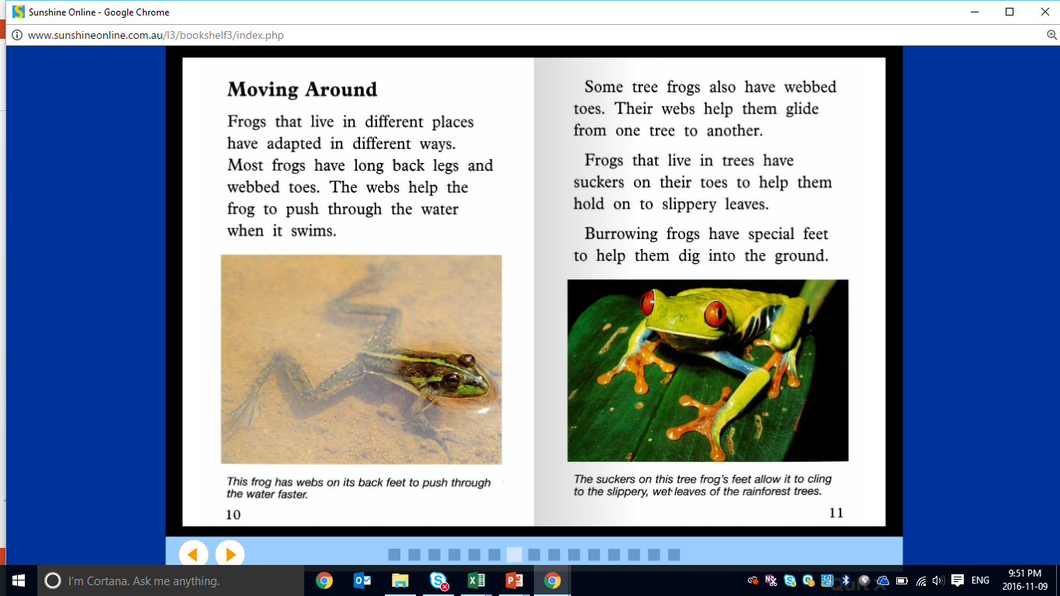

Slide 21
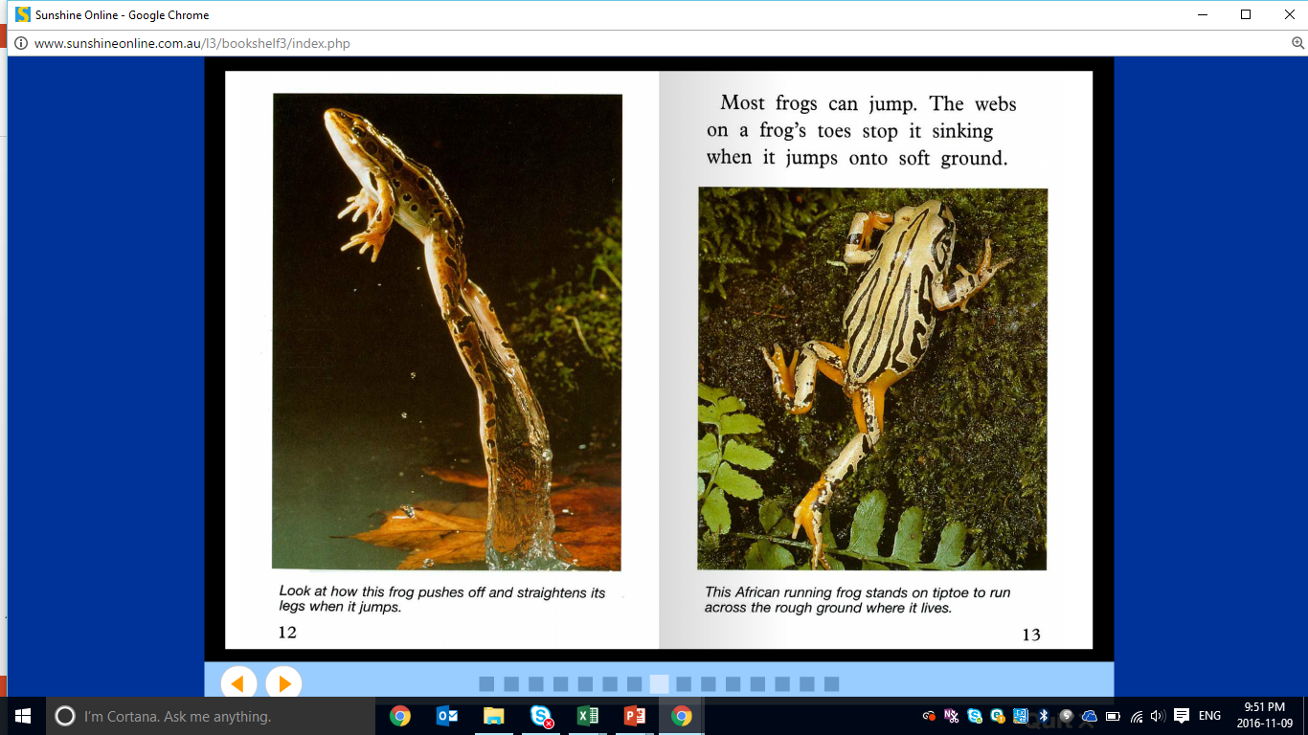

Slide 22
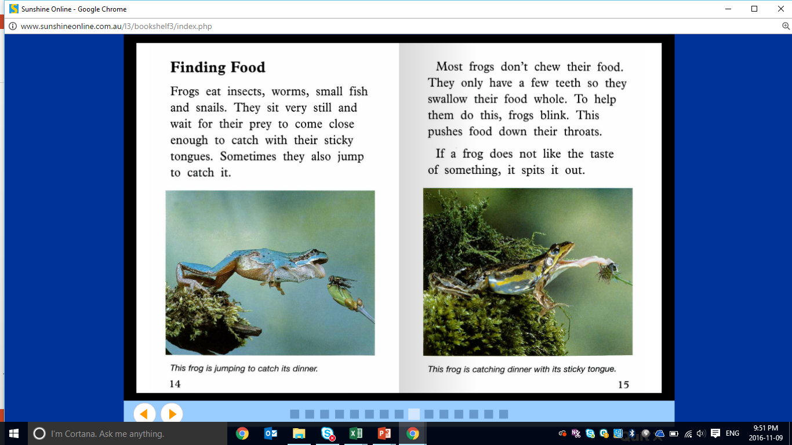

Slide 23
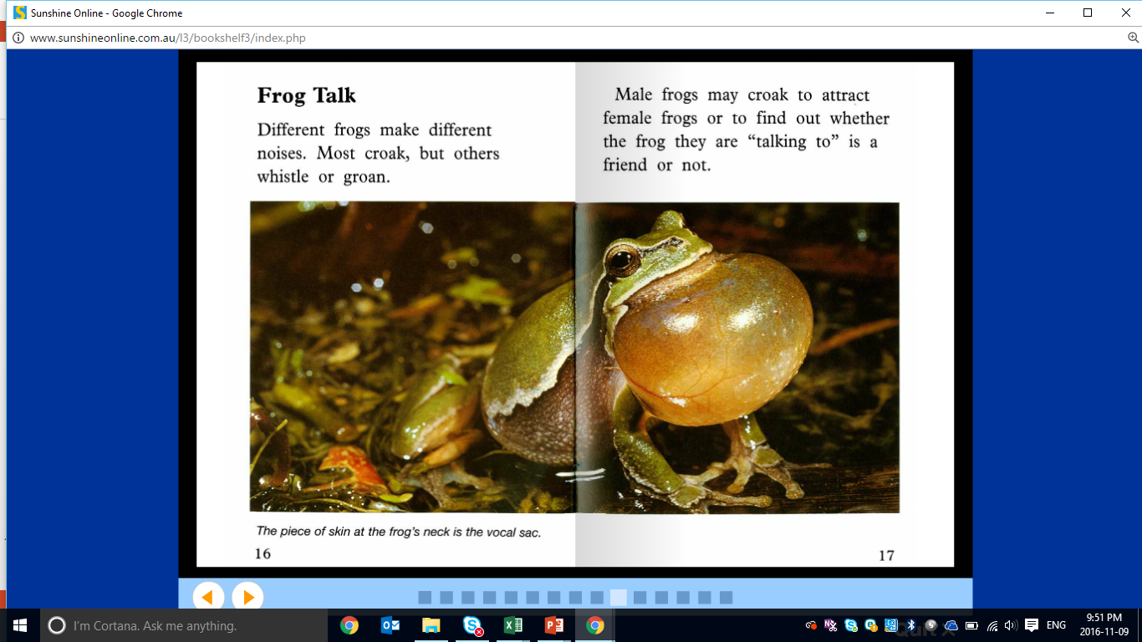

Slide 24
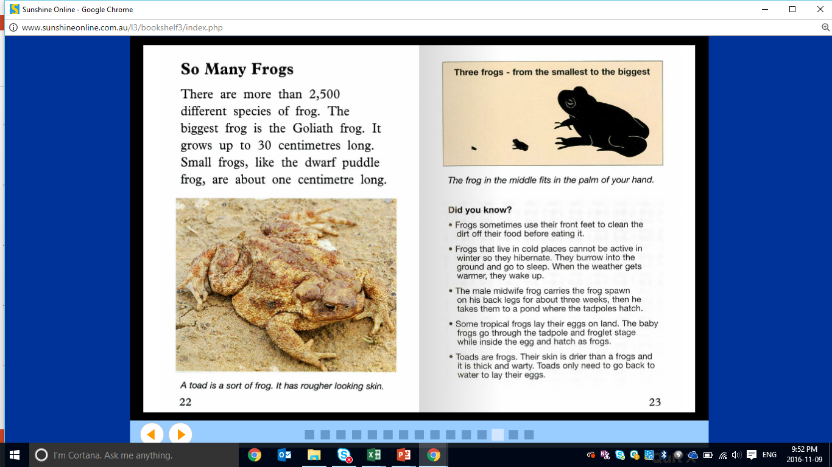

Slide 25
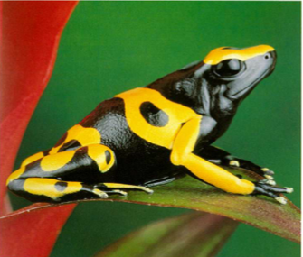
Comprehension Questions
How do frogs breath?
Where do frogs live?
What do frogs eat?
What are baby frogs called?
How does a frog sound?

Slide 26
Reading Activity
What are three interesting things about frogs that you discovered in the non-fiction text?

Slide 27
Reading Activity
Draw your favourite frog from the reading and write a three sentence description.

Slide 28
Students will review:
Synonyms ✓
Question words—5W and H ✓
Questions about a topic of interest ✓
Notes:
m45yDiscuss the goals for todays lesson. Emphasize to the students that there writing and pictures must be descriptive.

Slide 29
Vocabulary Activity

Slide 30
Write a definition for these words.
lungs
tadpole
tongue

Slide 31
Create a short story about a frog who leaves his pond to discover a
new city.

Slide 32
Students will review:
Synonyms ✓
Question words—5W and H ✓
Questions about a topic of interest ✓
Notes:
m45yDiscuss the goals for todays lesson. Emphasize to the students that there writing and pictures must be descriptive.

Slide 33
Homework
The first task is to draw a picture of a frog from your reading. Write a description about the frog. How many adjectives can you use in your description?
The second task is to find three friends and ask them four questions about themselves.

Slide 34
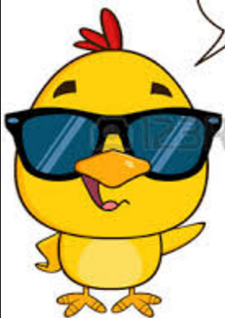
Final Thoughts
Do you have any questions?

