Slide 1
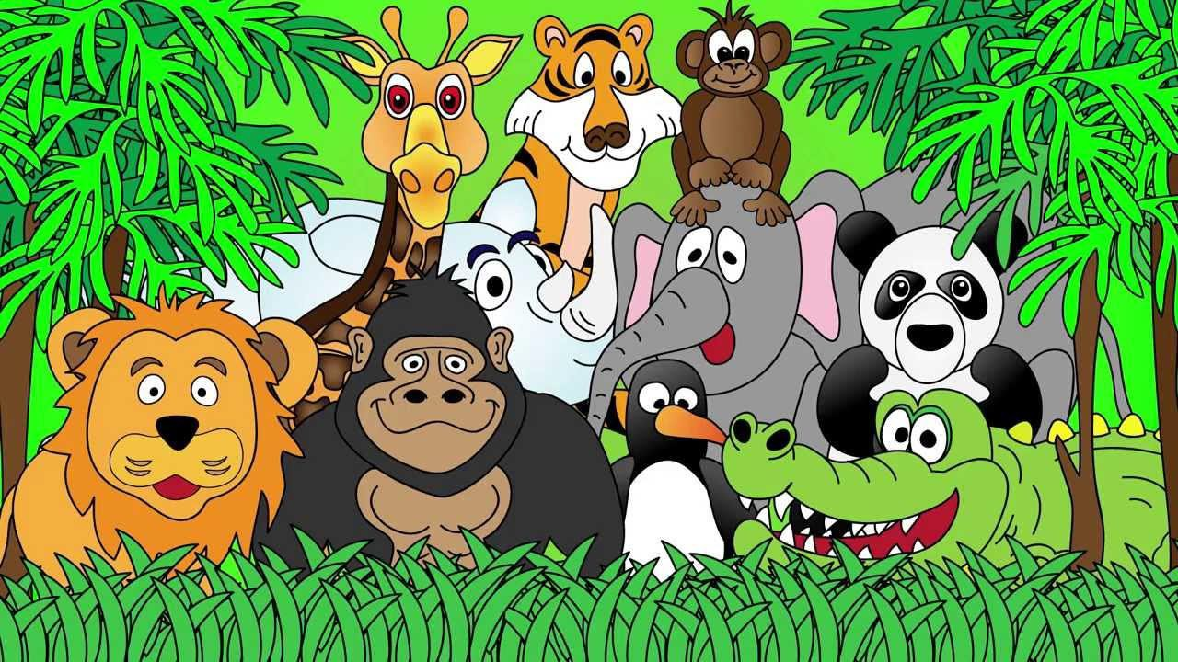
Welcome to the Animal Kingdom! This is Lesson 2!

Slide 2
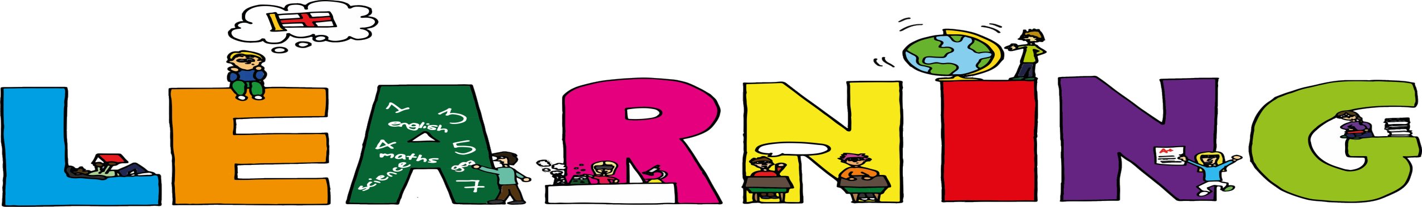
Today we are learning to:
Read an interesting story
Use simple past tense
Review ‘ks’ sounds

Slide 3
Simple Past Tense
Past tense is used when something has happened in the ‘before’ or in the ‘past.’
Present tense: I walk to the park. Past tense: I walked to the park.

Slide 4
Present tense: Past tense:
Present tense:
Past tense:
Present tense:
Past tense:
walk walked
jump
jumped
skip
skipped

Slide 5
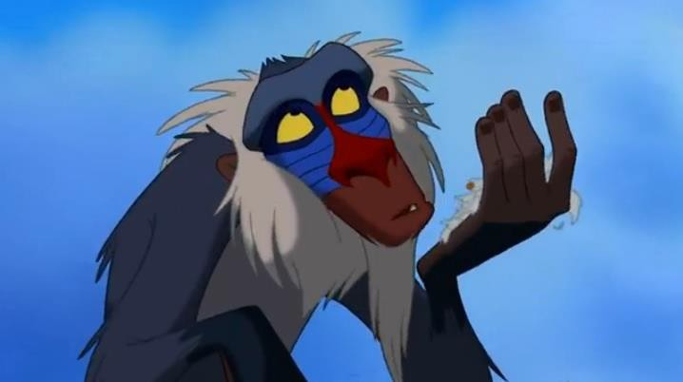




Slide 6
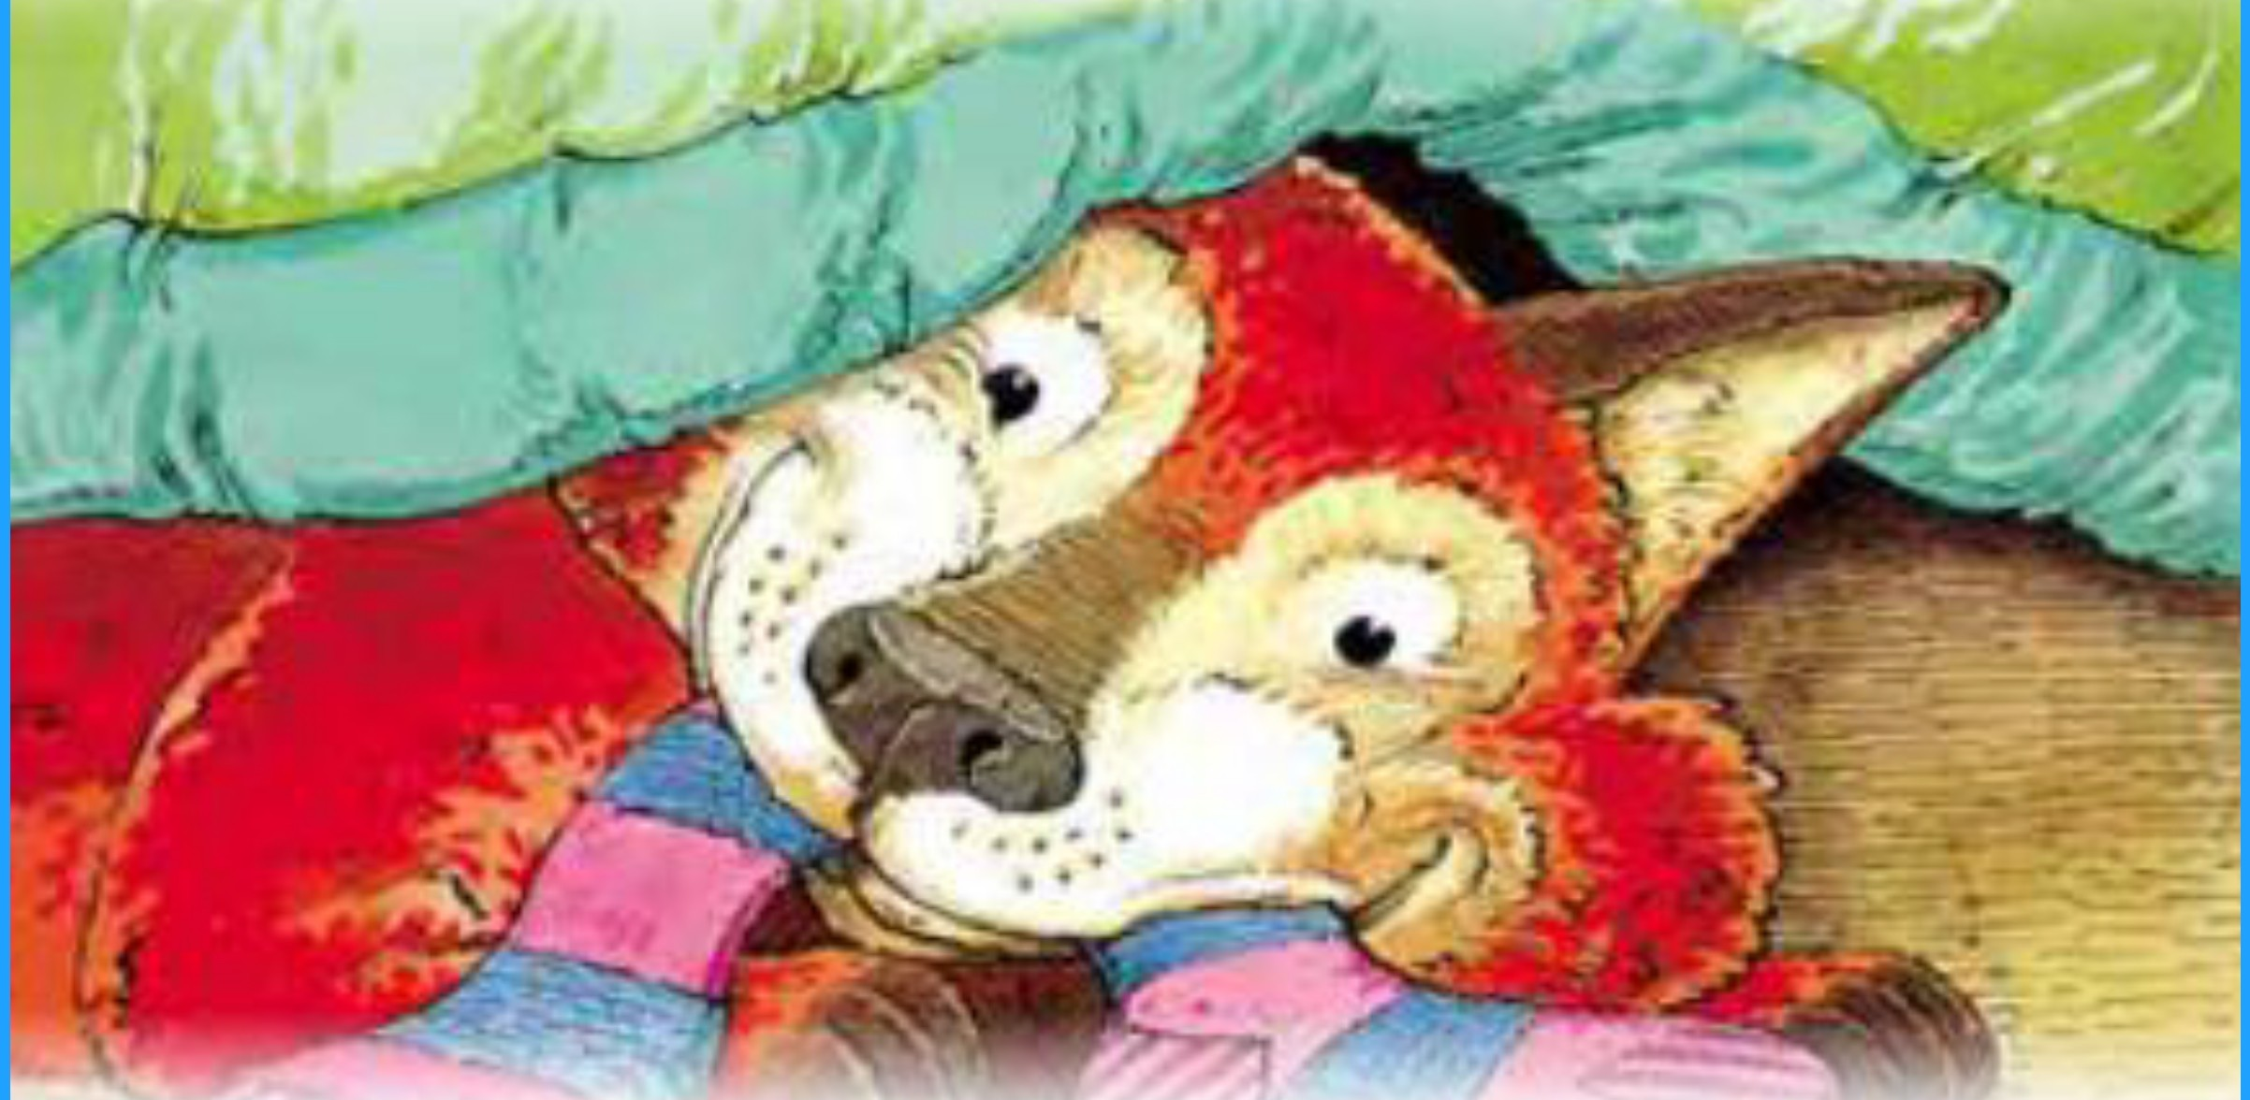

T e So Fox
S ory by
Jae son
II s o s y ck P ic

Slide 7
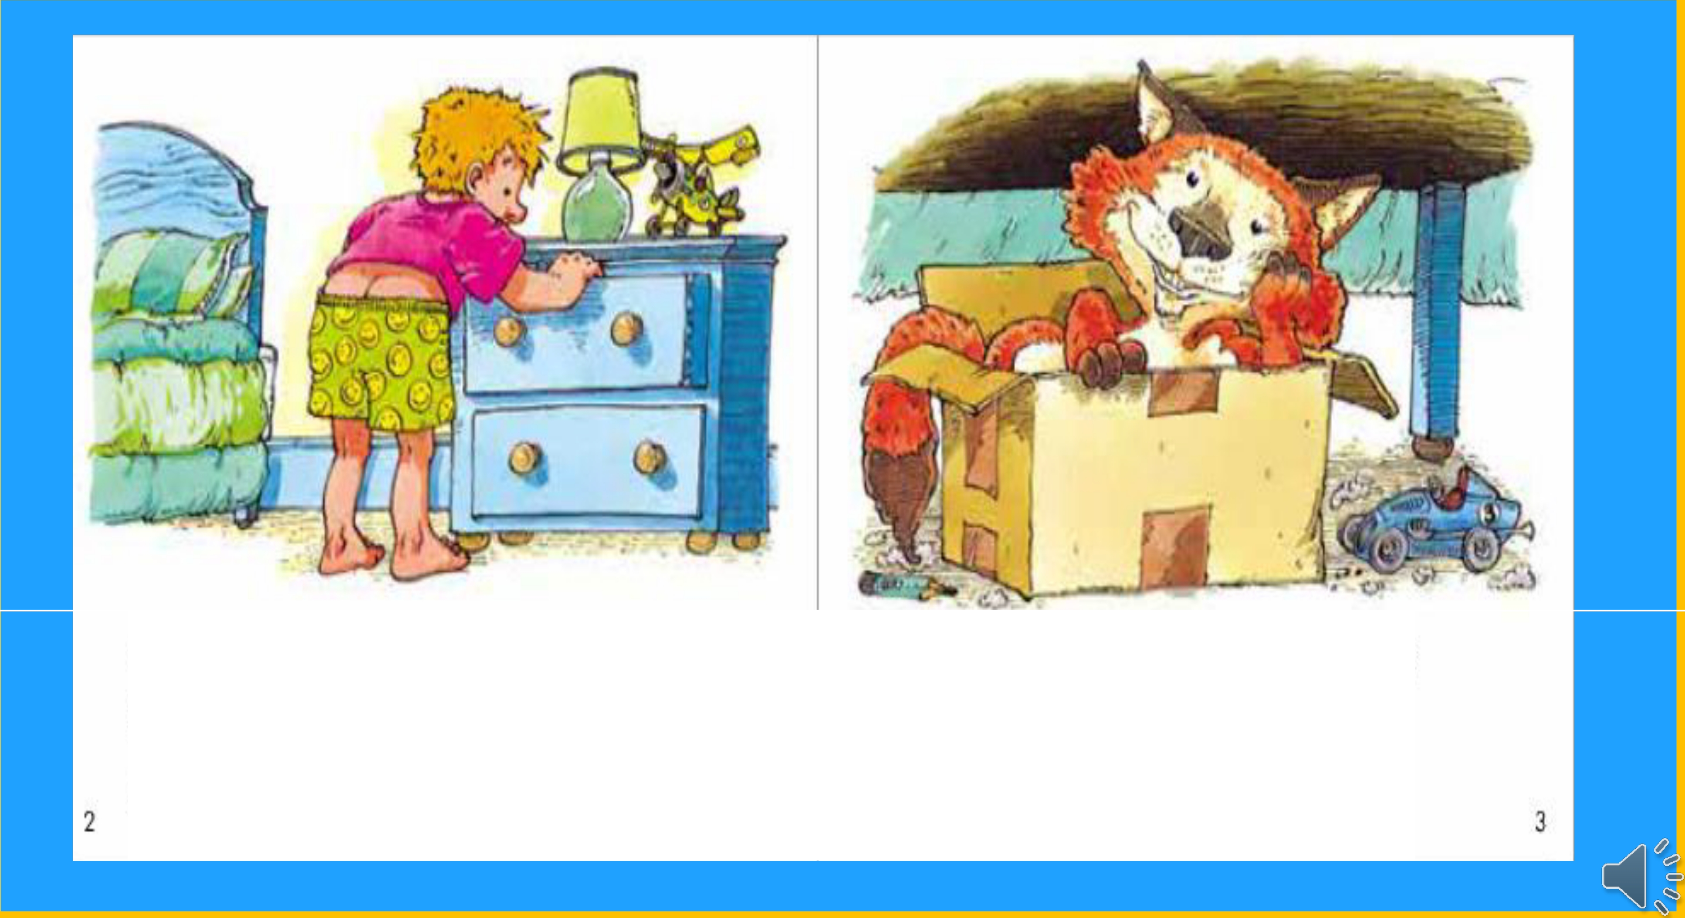
When I look for a clean pair of socks, they¹ ve always been taken
by a cunning old fox.
I'm the sox fox, the sox fox and I live under his bed in a big cardboard boxl

Slide 8
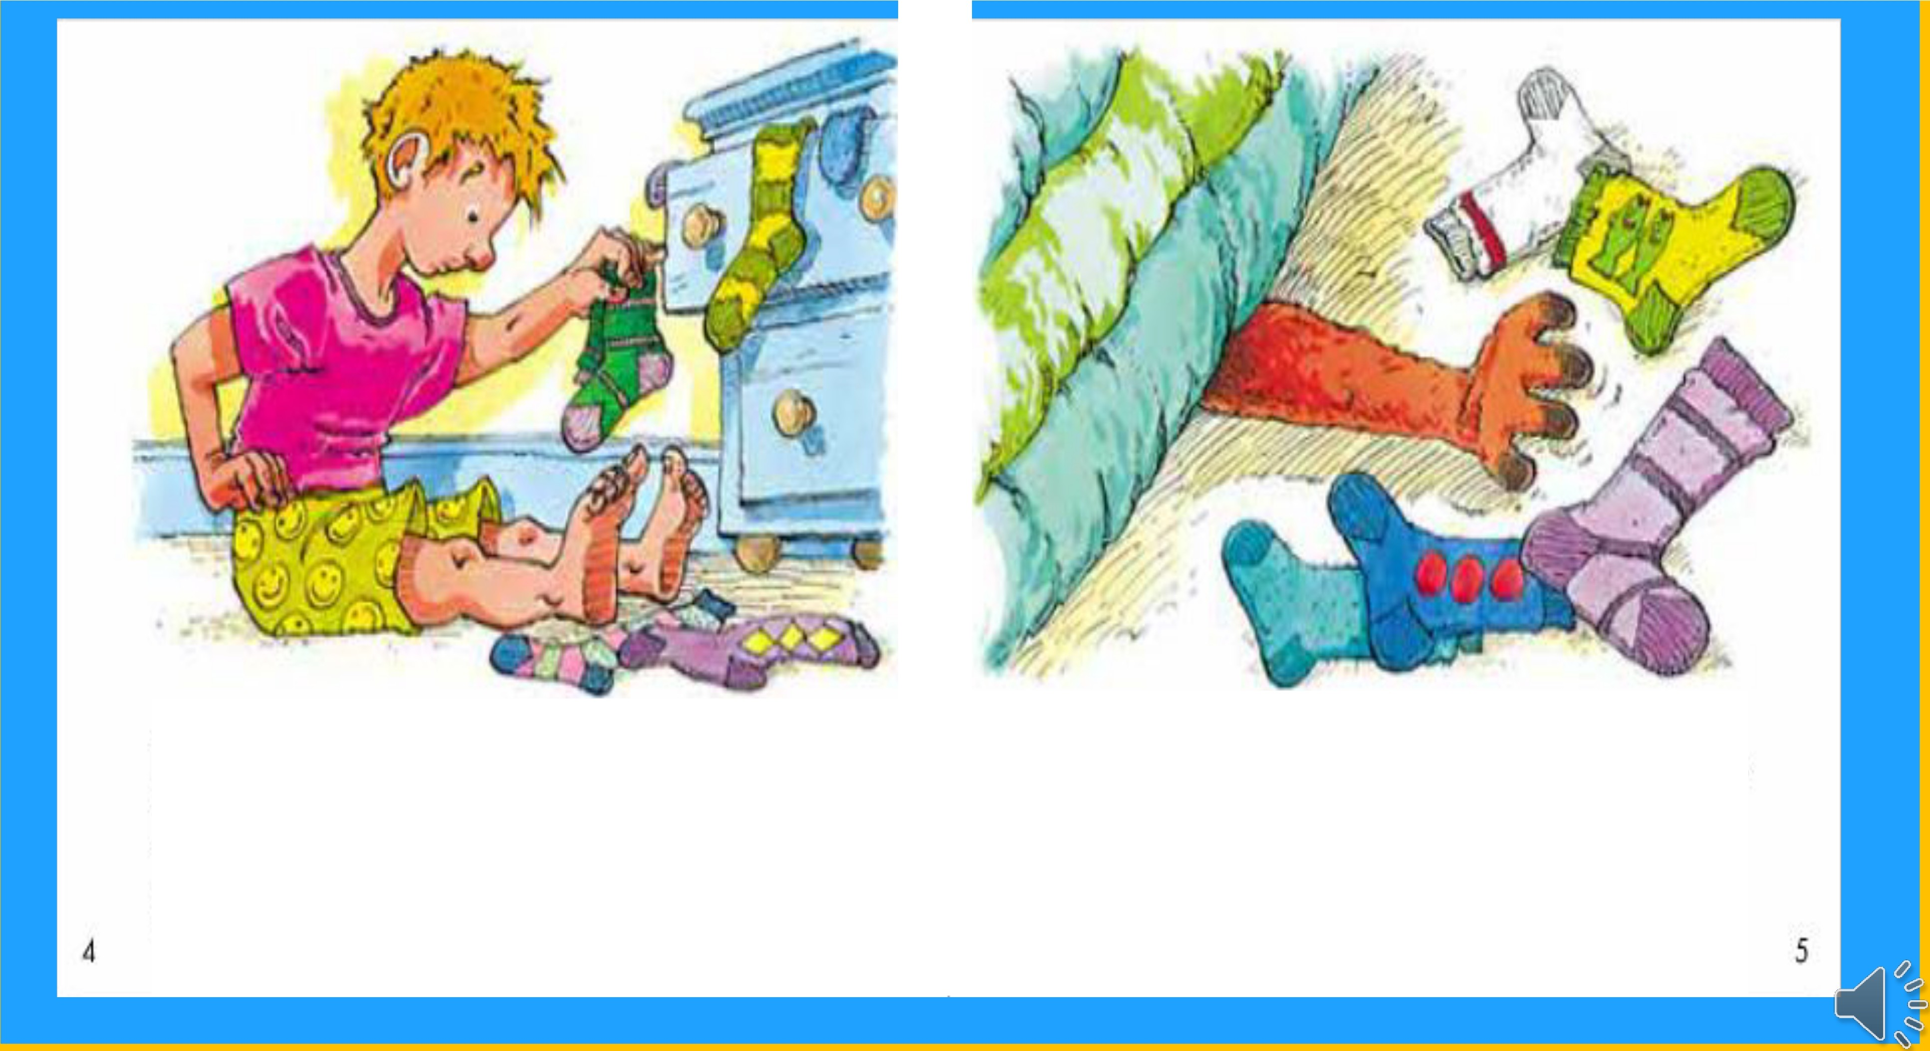
The sox fox lives in my bedroom - I'm sure - and when he feels hungry, he robs my sock drawer.
He leaves his socks all over the floor,
so back I come to eat some morel

Slide 9
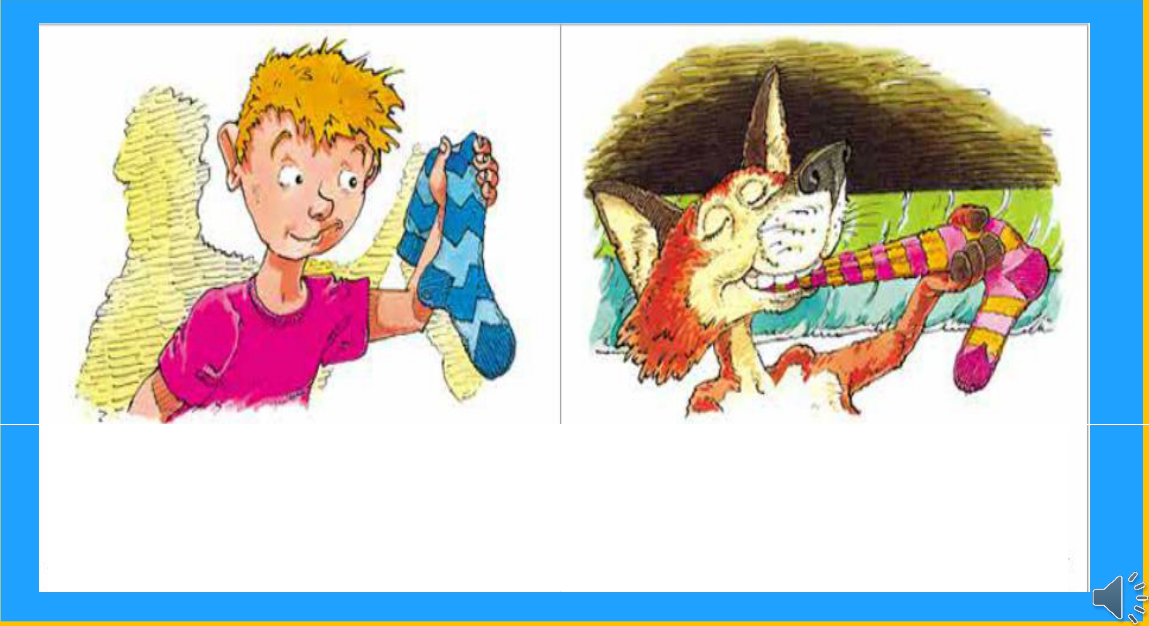
The sox fox eats just one of a pair,
which leaves only one sock for me to wear.
My favourite socks are stretchy
and light. I gobble them up
in one chewy bite.
6
7

Slide 10
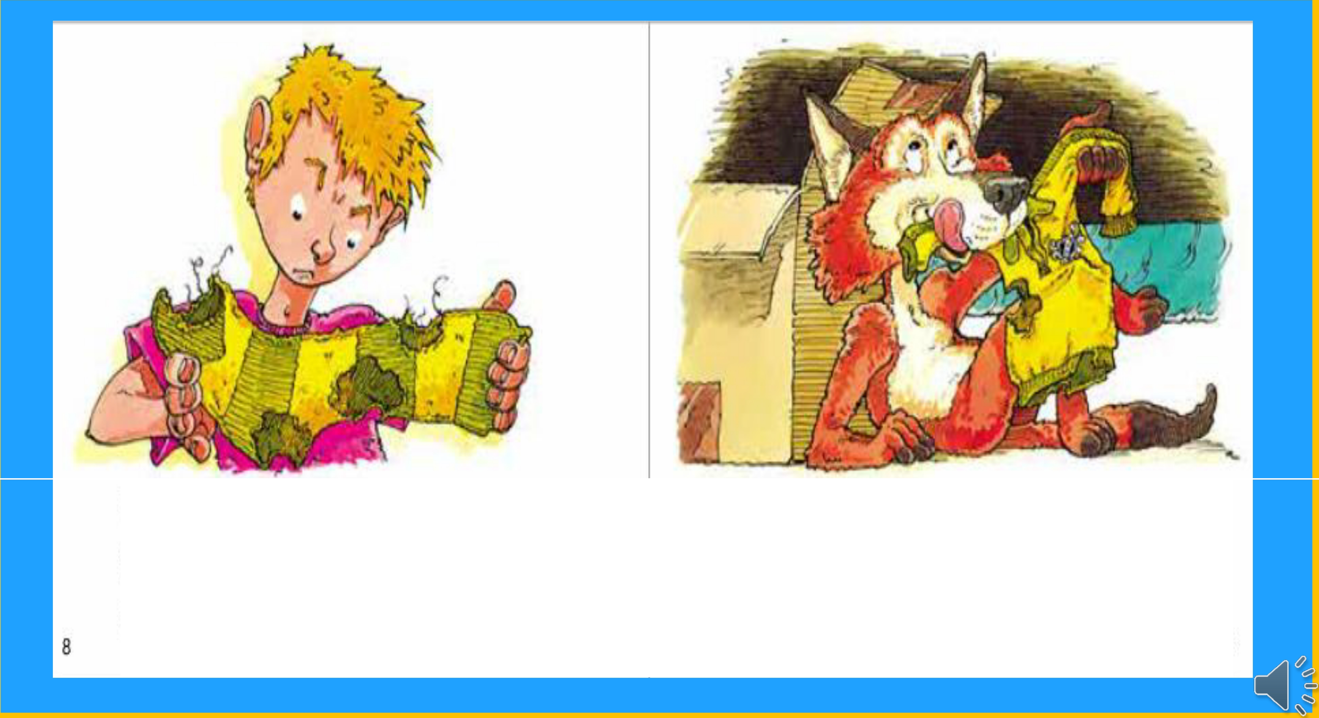
The sox fox gobbles up socks from the toe to the heel. What a yucky, disgusting kind of a meall
I like socks that taste of sweat and of dirt. They go really well with pieces of shirt.
9

Slide 11
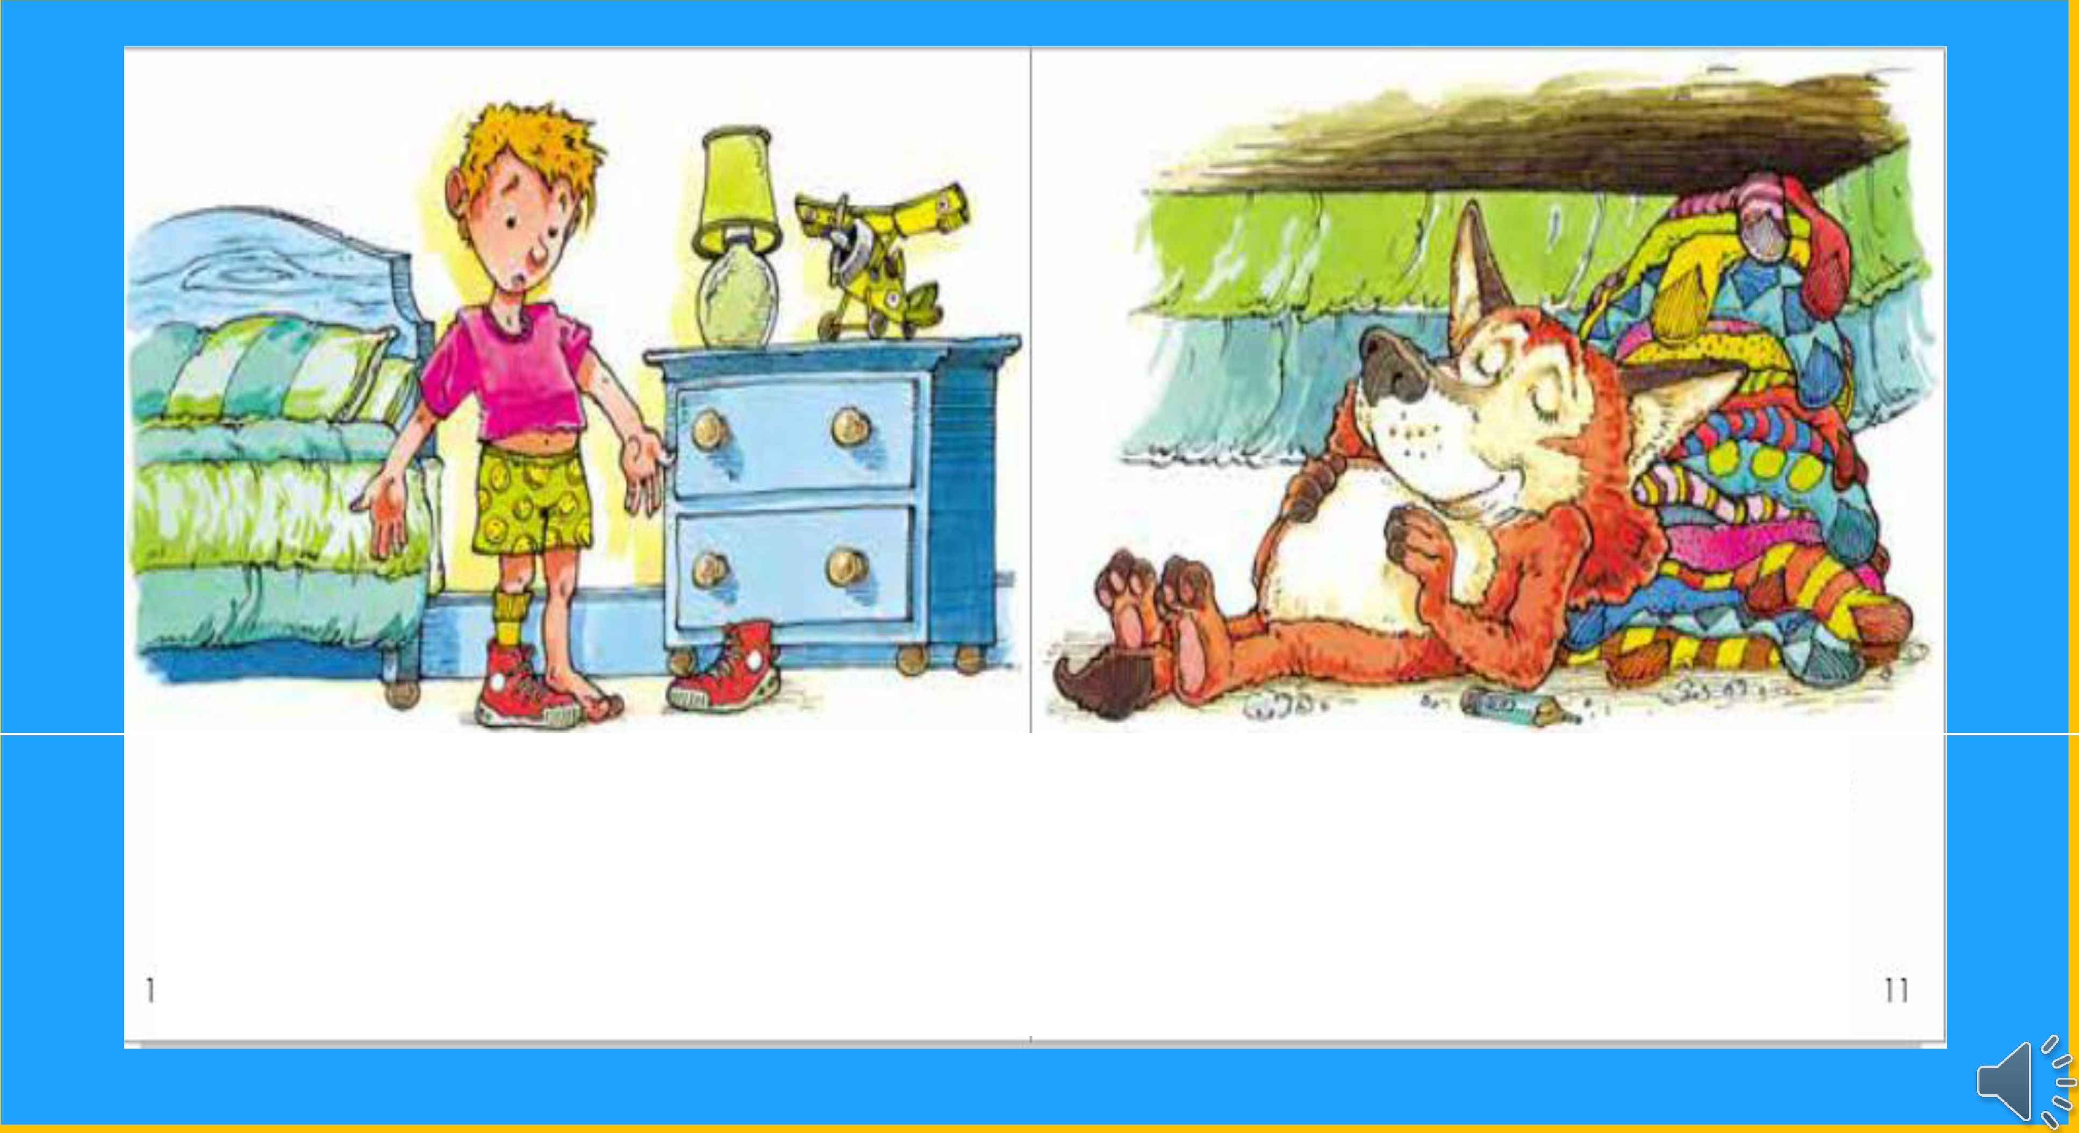
Mum says I lose my socks but it just
isn't true. How could a sock fall off when it's in my shoe?
He leaves socks lying around just for me. He's really very kind you see!
0

Slide 12
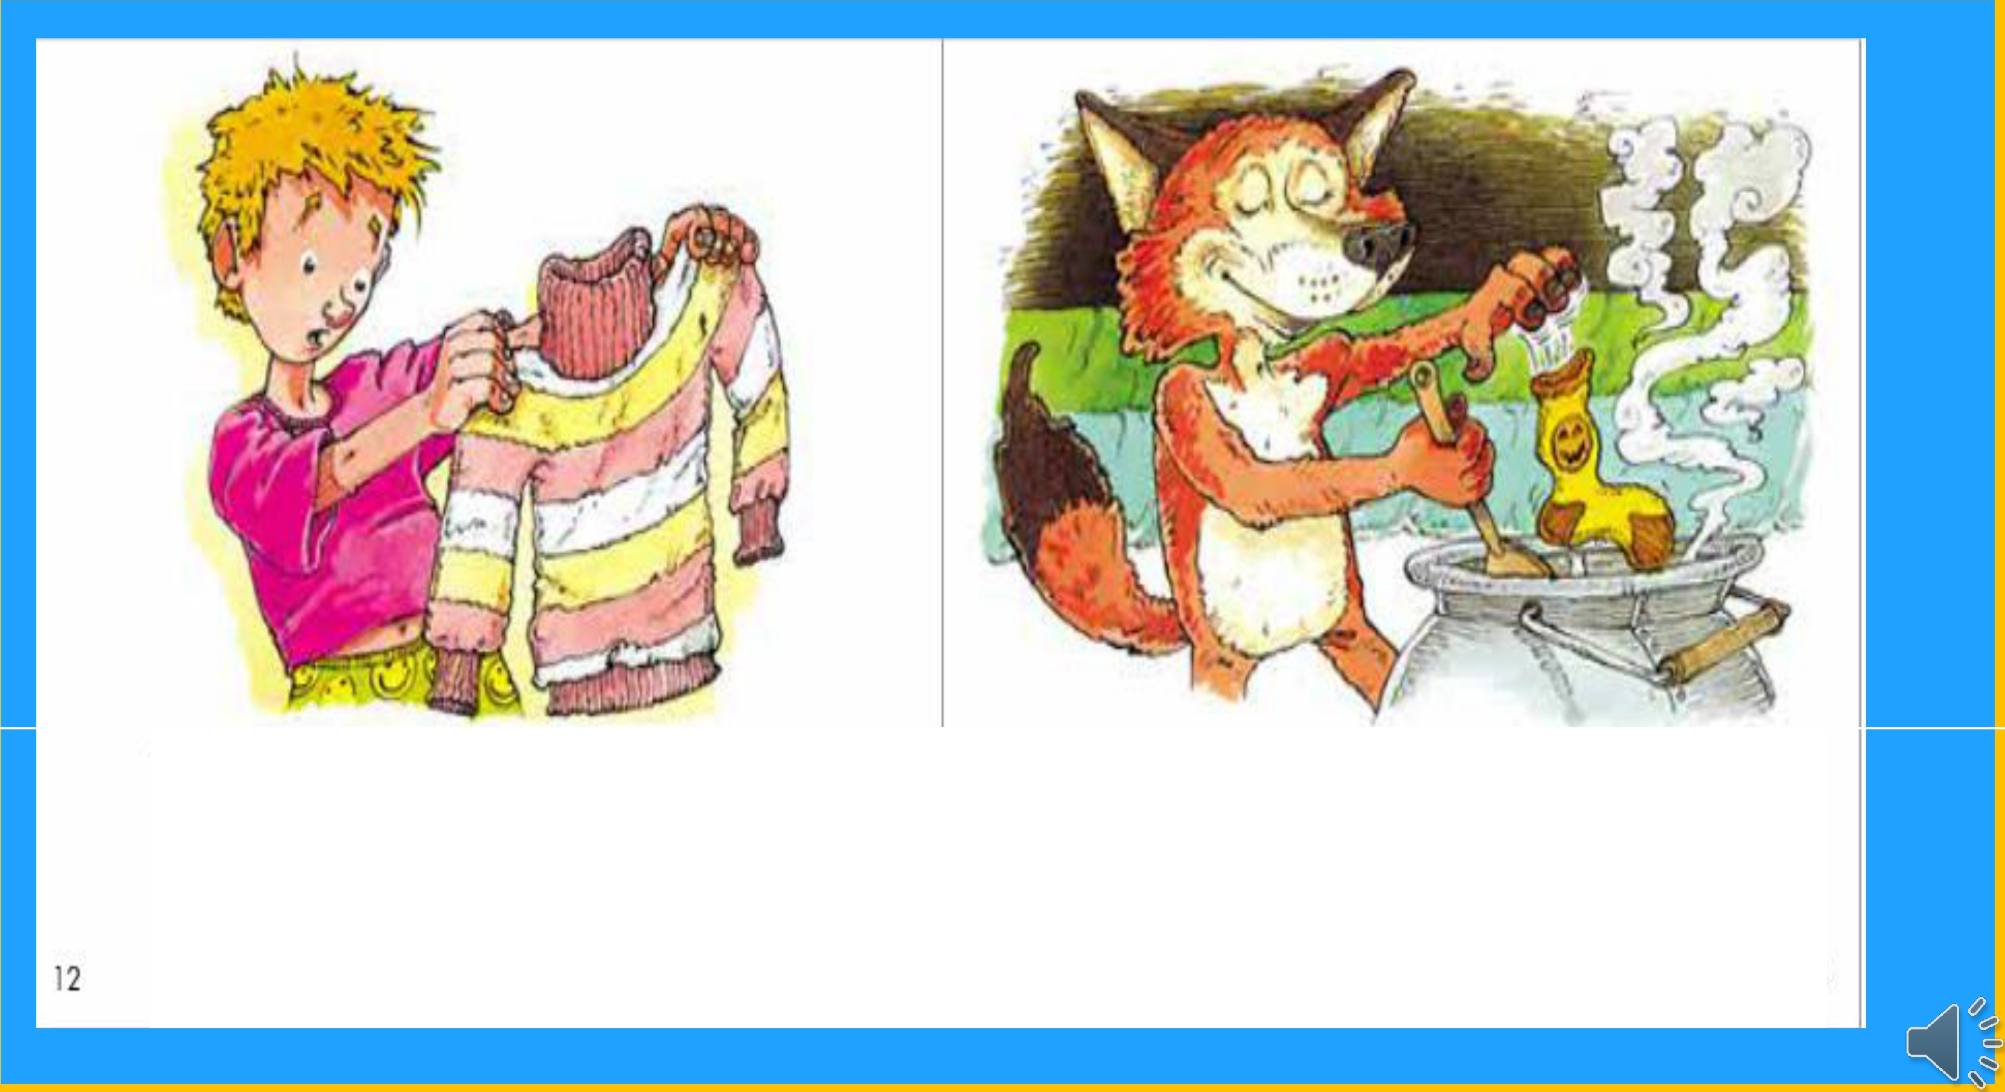
Why can't he eat the clothes
that ore boring, instead of takrng
my socks while I'm snoring?
Boots and shoes are too tough to chew. Socks are the best - they're great in a stew.
3

Slide 13
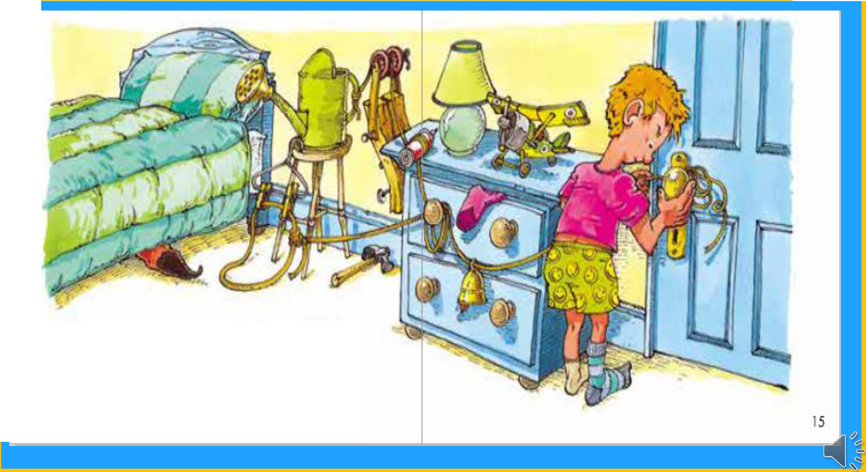
I'll set a trap to catch that old fox, so I don't have to walk around in odd socks.

Slide 14
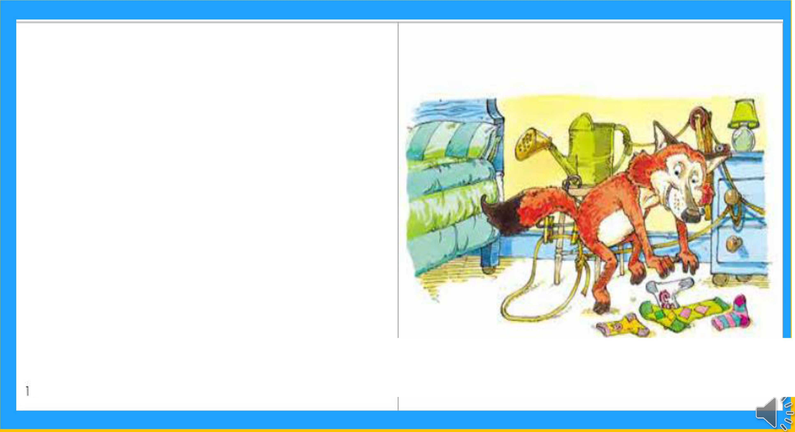
I love gobbling up his smelly old socks.
He won't catch me
I'm the cunning sox foxl
6

Slide 15

LEARNING
OUR WORDS!

Slide 16

What words can you think
of that have the ‘ks’sound?
Lets make a list!
Remember, that ‘ks’ and ‘x’
both make the same sound.

Slide 17
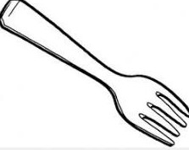

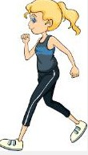
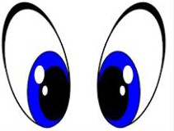

looks
forks walks cooks books

Slide 18
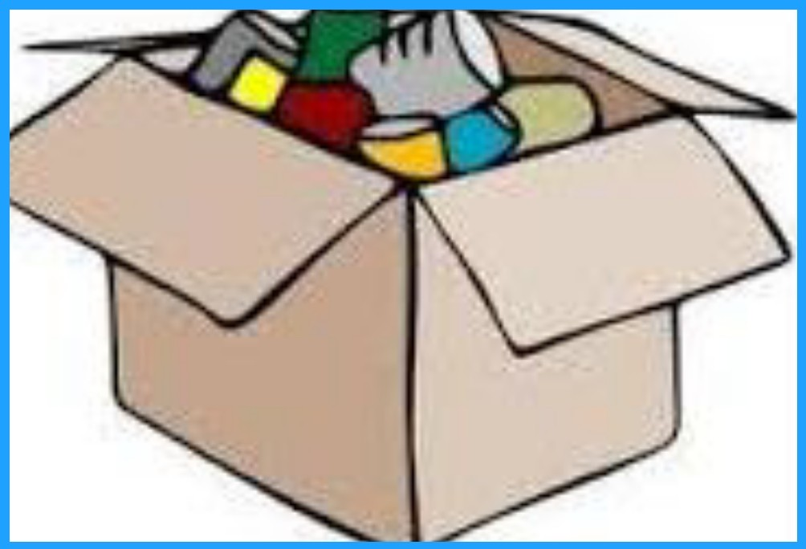
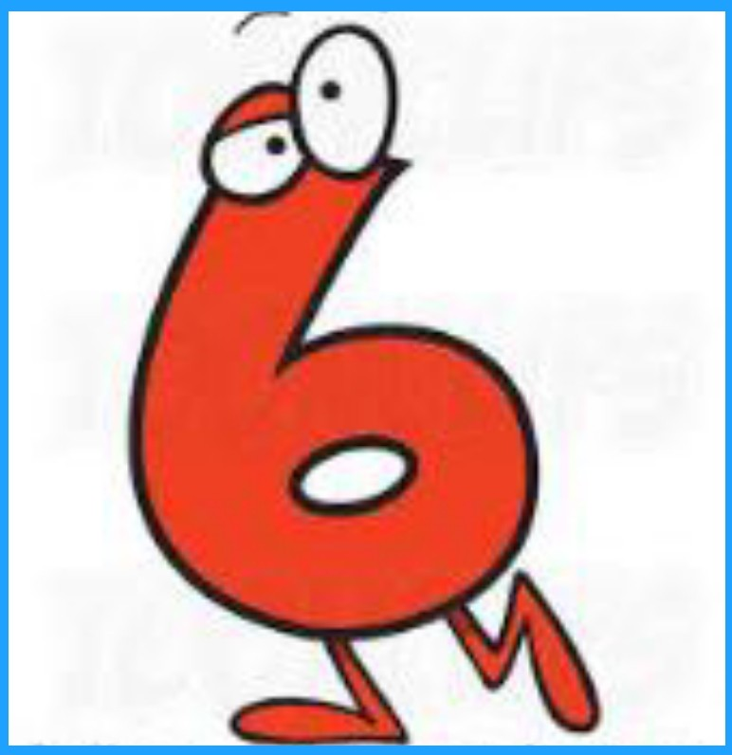
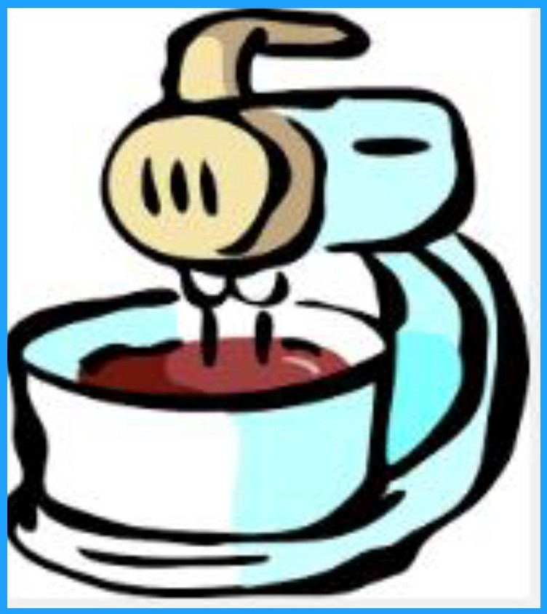

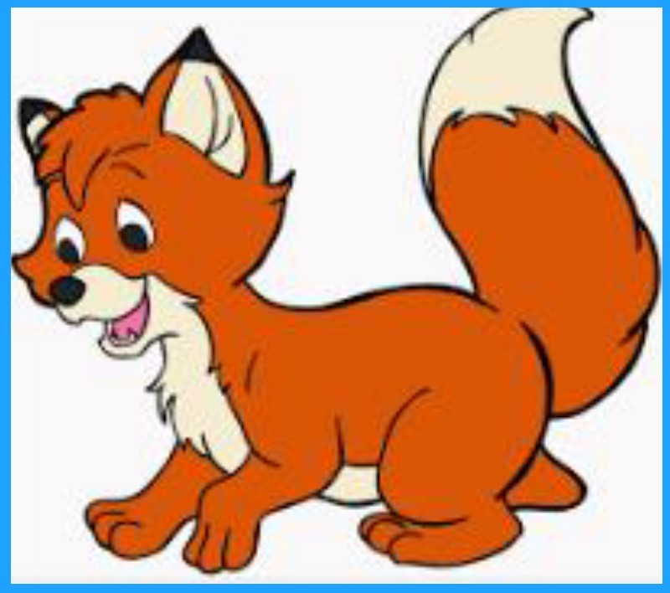
fox
box six mix ax

Slide 19
Homework
Using the reading about birds and nests
to create pictures.
Creating sentences using the new ‘ck’
words

