Slide 1
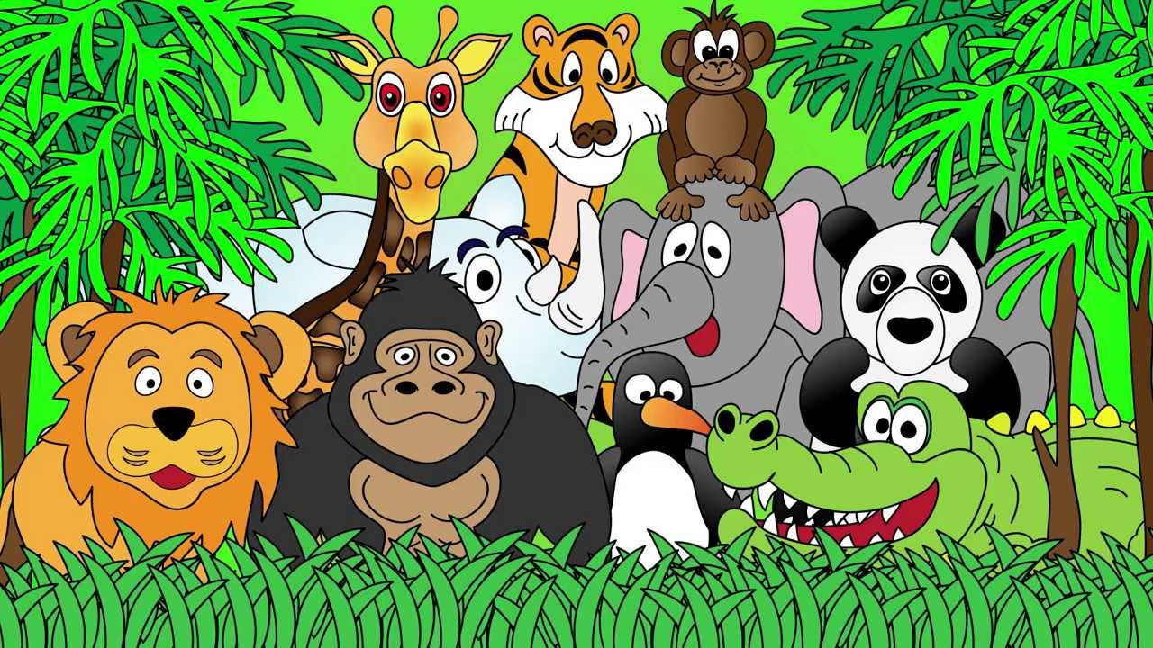
Welcome to the Animal Kingdom! This is Lesson 2!
Notes:
Welcome the students to the unit.
Ask the students how there week has been and discuss some of the fun things they did at school or for fun to establish a rapport with your students.
Ask the students if they have been to the Zoo before? What animals did they see? What animals can they see in this picture.

Slide 2
Describe this picture

Slide 3

Today we are learning to:
Read an interesting story
Use simple past tense
Review ‘ks’ sounds
Notes:
Discuss the goals for todays lesson. Emphasize to the students that there writing and pictures must be descriptive.

Slide 4
Simple Past Tense
Past tense is used when something has happened in the ‘before’ or in the ‘past.’
Present tense: I walk to the park.
Past tense: I walked to the park.

Slide 5
Present tense: walk
Past tense: walked
Present tense: jump
Past tense: jumped
Present tense: skip
Past tense: skipped

Slide 6
walk moved
skipped jump
skip
watched
closed move cooked
look walked
watch jumped
cook
looked open opened close

Slide 7
Using ‘past tense’ in sentences.
I cook a pizza.
_____________________________________________
I close the door.
_____________________________________________

Slide 8
Using ‘past tense’ in sentences.
I dance to the shopping mall.
_____________________________________________
I move the table.
_____________________________________________

Slide 9
Talking Practice
Talk to your teacher or another classmate about what you did yesterday using past tense.
For example: Yesterday, I cooked noodles at home.

Slide 10
Today we are learning to:
Read an interesting story
Use simple past tense
Review ‘ks’ sounds
Notes:
Discuss the goals for todays lesson.

Slide 11
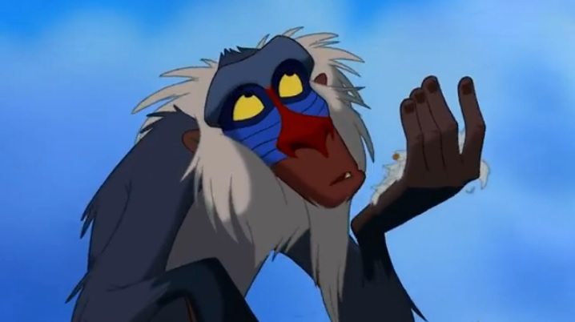
Lets read a story

Slide 12


Slide 21
Questions about ‘The Sox Fox.’
Why did the fox take the socks?
________________________________________________________________________________
Which socks are the fox’s favourite?
________________________________________________________________________________

Slide 22
Questions about ‘The Sox Fox.’
What does the boy want the fox to eat?
________________________________________________________________________________
Why does the boy dislike the fox?
________________________________________________________________________________

Slide 23
Grammar activity about the sox fox.’
List some adjectives in the story.
________________________________________________________________________________
List some rhyming words in the story.
________________________________________________________________________________

Slide 24
Today we are learning to:
Read an interesting story
Use simple past tense
Review ‘ks’ sounds
Notes:
Discuss the goals for todays lesson.

Slide 25
LEARNING OUR WORDS!

Slide 26
What words can you think of that have the ‘ks’sound?
Lets make a list!
Remember, that ‘ks’ and ‘x’ both make the same sound.

Slide 27
looks
forks
walks
cooks
books

Slide 28
fox
box
six
mix
ax

Slide 29
Write a funny/interesting sentence using two or more ‘ks’ words.
Draw a picture about your sentence.
Notes:
Activity is on the students worksheet.

Slide 30
Today we are learning to:
Read an interesting story
Create pictures to tell the story
Use adjectives and adverbs
Review ck sounds
Notes:
Discuss the goals for todays lesson. Emphasize to the students that there writing and pictures must be descriptive.

Slide 31
Homework
Using the reading about birds and nests to create pictures.
Creating sentences using the new ‘ks’ words

Slide 32
Describe the fox from the story. Use adjectives.

Slide 33
Write a recount about your last weekend. Use past tense to describe your activities.

Slide 34
New Reading Vocabulary
cunning
socks
cardboard
hungry
drawer
stretchy
light
disgusting
sweat
dirt
pieces
snoring
chew
stew
gobbling
Notes:
Discuss the words and their meaning.
Show images from the text where possible.

