Slide 1
Welcome to the Animal Kingdom! This is Lesson 3!

Slide 2
Today we are learning to:
Read an interesting story
Use simple contractions
Review ‘er’ sounds

Slide 3
Using simple contractions
To create a short form you drop the vowel sound and add an apostrophe.
I am
You are Did not Should not
I’m
You’re Don’t
Shouldn’t

Slide 4
Simple contractions
I | I am | I’m
You | You are | You’re
We | We are | We’re
They | They are | They’re

Slide 5
He | He is | He’s
She | She is | She’s
It | It is | It’s
There | There is | There’s
That | That is | That’s

Slide 6
Do not | Don’t
Does not | Doesn’t
Did not | Didn’t
Is not | Isn’t
Was not | Wasn’t

Slide 7
Has not | Hasn’t
Will not | Won’t
Can not | Can’t
Should not | Shouldn’t
Could not | Couldn’t

Slide 8
Play the Game

Slide 10
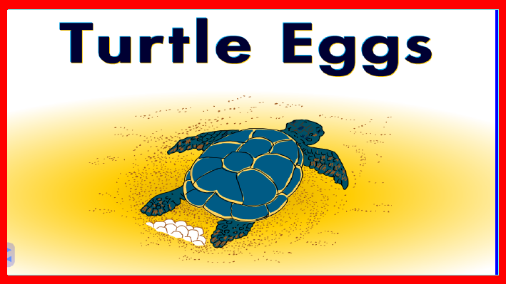

Slide 11
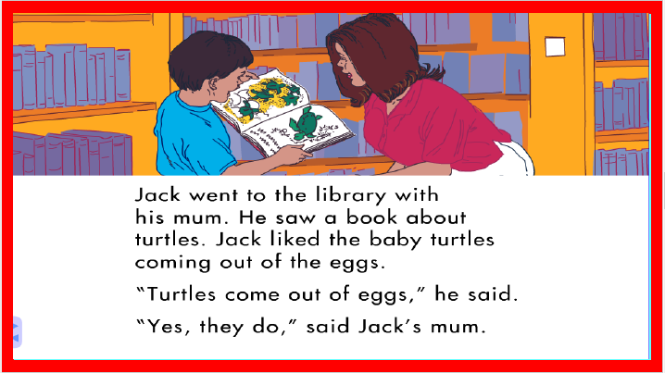

Slide 12
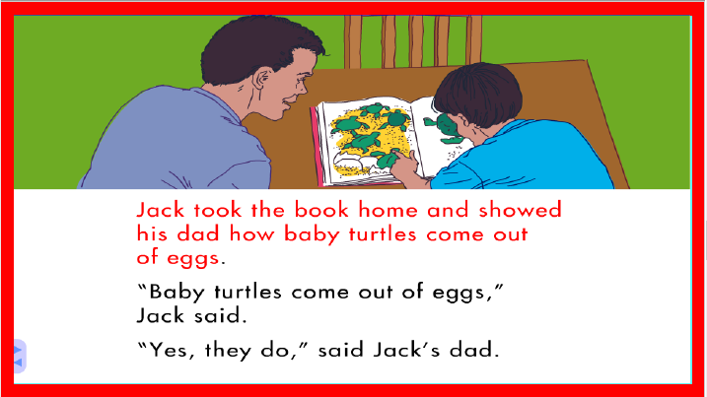

Slide 15
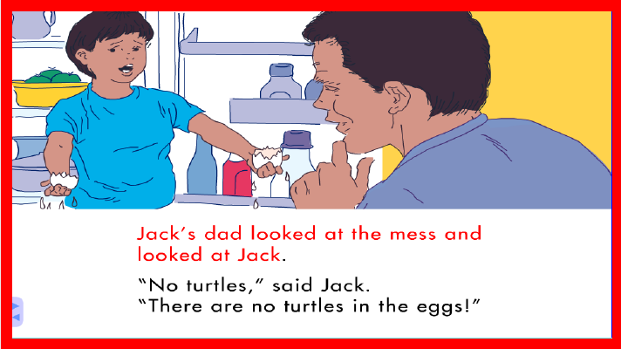

Slide 16
LEARNING
OUR WORDS!

Slide 17
What words can you think
of that have the ‘er’ sound?
Lets make a list!

Slide 18
Ruler
River
Mermaid Tower water

Slide 19
Ginger
Germ Person Mother Flower

Slide 20
Homework
Practicing simple contractions in
descriptive writing.
Sentence writing with ‘er’ words.
Drawing a descriptive picture.

