Slide 1
Welcome to the Animal Kingdom! This is Lesson 4!

Slide 2
Today is a review lesson:
Sounds – ck, ks and sh
Pictorial Representation
Months January to December
Simple contractions
New Learning for today – Time in 5min lots

Slide 3
Practising the months of the year
Say the months from January – December?
Questions:
What is the 2nd month?
What is the 9th month?
Which month were you born in?

Slide 4
Telling the Time
When telling the time each number represents 5 min on the clock.
Draw 1:00AM
Draw 1:05AM
How much did the long hand move?

Slide 10
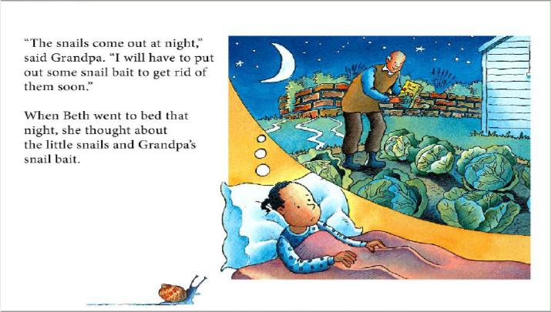

Slide 12
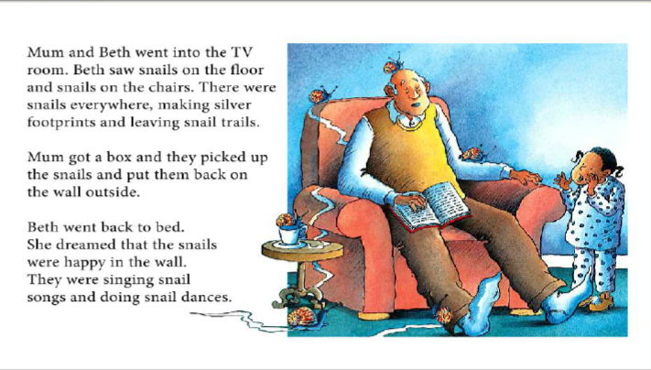

Slide 15
Thinking Questions
What do the snails leave on the path?
Where does Beth put the snails she found on the path? Why doesn’t Grandpa like the snails?
Draw the snails in the wall.

Slide 16
Simple contractions
Has not | Hasn’t
Will not | Won’t
Can not | Can’t
Should not | Shouldn’t
Could not | Couldn’t
I | I am | I’m
You | You are | You’re
We | We are | We’re
They | They are | They’re

Slide 17
LEARNING
OUR WORDS!

Slide 18
What words can you think of that have the
‘sh’, ‘ck,’ and ‘ks’ sound?
Lets make a list!

