Slide 1
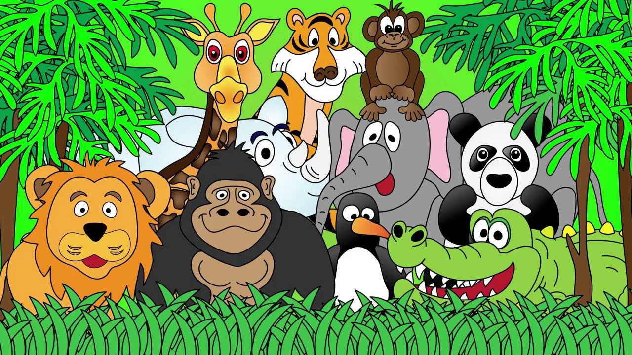
Welcome to the Animal Kingdom! This is Lesson 4!
Notes:
Welcome the students to the unit.
Ask the students how there week has been and discuss some of the fun things they did at school or for fun to establish a rapport with your students.
Ask the students if they have been to the Zoo before? What animals did they see? What animals can they see in this picture.

Slide 2
Describe this picture

Slide 3

Today is a review lesson:
Sounds – ck, ks and sh
Pictorial Representation
Months January to December
Simple contractions
New Learning for today – Time in 5min lots
Notes:
Discuss the goals for todays lesson. Emphasize to the students that there writing and pictures must be descriptive.

Slide 4
Practising the months of the year
Say the months from January – December?
Questions:
What is the 2nd month?
2. What is the 9th month?
3. Which month were you born in?

Slide 6
Today is a review lesson:
Sounds – ck, ks and sh
Pictorial Representation
Months January to December
New Learning for today – Time in 5min lots
Notes:
Discuss the goals for todays lesson. Emphasize to the students that there writing and pictures must be descriptive.

Slide 7
Telling the Time
When telling the time each number represents 5 min on the clock.
Draw 1:00AM
Draw 1:05AM
How much did the long hand move?

Slide 11
Play the game:
BANG ON TIME
http://resources.oswego.org/games/BangOnTime/clockwordres.html

Slide 12
Today is a review lesson:
Sounds – ck, ks and sh
Pictorial Representation
Months January to December
New Learning for today – Time in 5min lots
Notes:
Discuss the goals for todays lesson. Emphasize to the students that there writing and pictures must be descriptive.

Slide 13
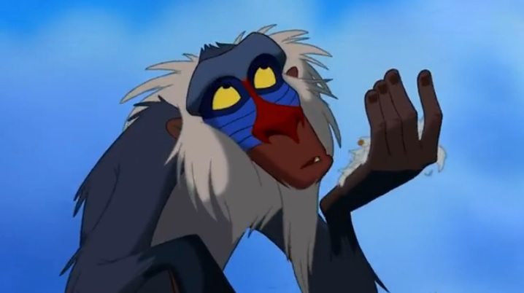
Lets read a story

Slide 23
Thinking Questions
What do the snails leave on the path?
Where does Beth put the snails she found on the path?
Why doesn’t Grandpa like the snails?
Draw the snails in the wall.

Slide 24
Today is a review lesson:
Sounds – ck, ks and sh
Simple contractions
Pictorial Representation
Months January to December
New Learning for today – Time in 5min lots
Notes:
Discuss the goals for todays lesson. Emphasize to the students that there writing and pictures must be descriptive.

Slide 25
Simple contractions
Has not | Hasn’t
Will not | Won’t
Can not | Can’t
Should not | Shouldn’t
Could not | Couldn’t
I | I am | I’m
You | You are | You’re
We | We are | We’re
They | They are | They’re

Slide 26
Write simple short sentences using the contractions below:
________________________________________________________________________________________________________________________________________________________________________________________________________________________________________________

Slide 27
Write simple short sentences using the contractions below:
____________________________________________________________________________________________________________________________________________________________________________________
He | He is | He’s
She | She is | She’s
It | It is | It’s
There | There is | There’s
That | That is | That’s

Slide 28
Today is a review lesson:
Sounds – ck, ks and sh
Simple contractions
Pictorial Representation
Months January to December
New Learning for today – Time in 5min lots
Notes:
Discuss the goals for todays lesson. Emphasize to the students that there writing and pictures must be descriptive.

Slide 29
LEARNING OUR WORDS!

Slide 30
What words can you think of that have the ‘sh’, ‘ck,’ and ‘ks’ sound?
Lets make a list!

Slide 31
Write a funny/interesting sentence using two or more ‘sh, ck, ks’ words.
Draw a picture about your sentence.
Notes:
Activity is on the students worksheet.

Slide 32
Today is a review lesson:
Sounds – ck, ks and sh
Simple contractions
Pictorial Representation
Months January to December
New Learning for today – Time in 5min lots
Notes:
Discuss the goals for todays lesson. Emphasize to the students that there writing and pictures must be descriptive.

Slide 33
Extension Activities for Tutoring Sessions

Slide 34
Thinking about ‘Silver Footprints.’
Tell me the story in your own words.
Where does Beth put the snails at night?
What happens to all the snails?

Slide 35
Writing sentences using simple contractions.
Write about your weekend.
_________________________________________________________________________________________________________

Slide 36
New Reading Vocabulary
Silver
Footprint
Foot
Feet
trail
Cabbages
Wall
Garden
snail
Notes:
Discuss the words and their meaning.
Show images from the text where possible.

