Slide 1
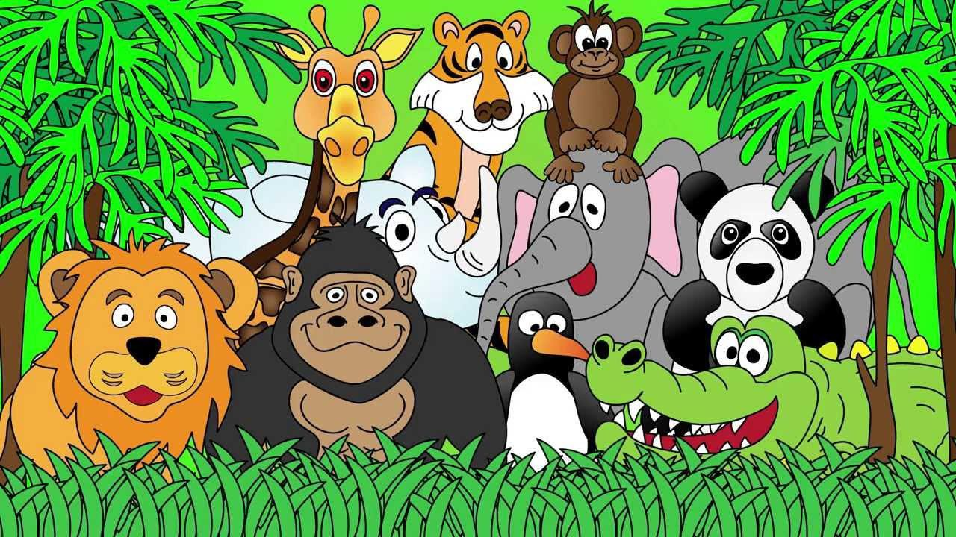
Welcome to the Animal Kingdom! This is Lesson 5!

Slide 2

We are learning about:
Sound (er)
Numbers from one – fifty
Time (an hour, day, month, year and decade)

Slide 3
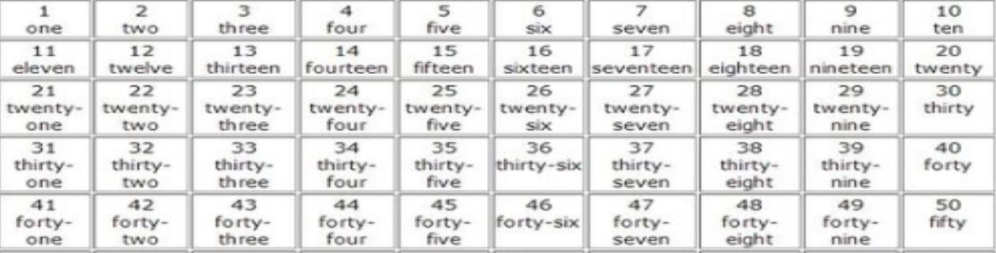

Slide 4
TIMI
One hour - 60 minutes
One day - 24 hours
One month - 30 days One year - 12 months One decade - 10 years

Slide 5
One hour | 30 days
One day | 60 minutes
One month | 10 years
One year | 24 hours
One decade | 12 months

Slide 6
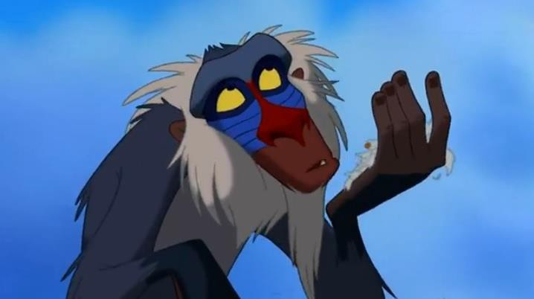




Slide 7


Slide 8
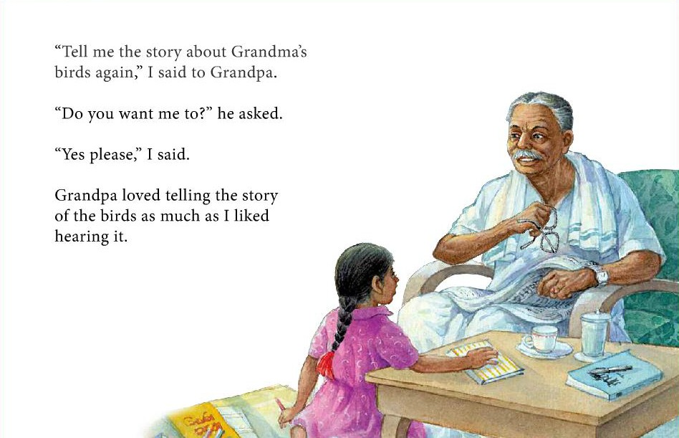

Slide 9
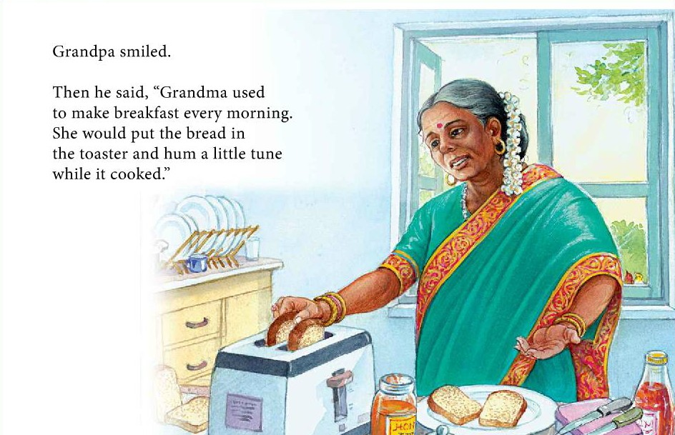

Slide 10
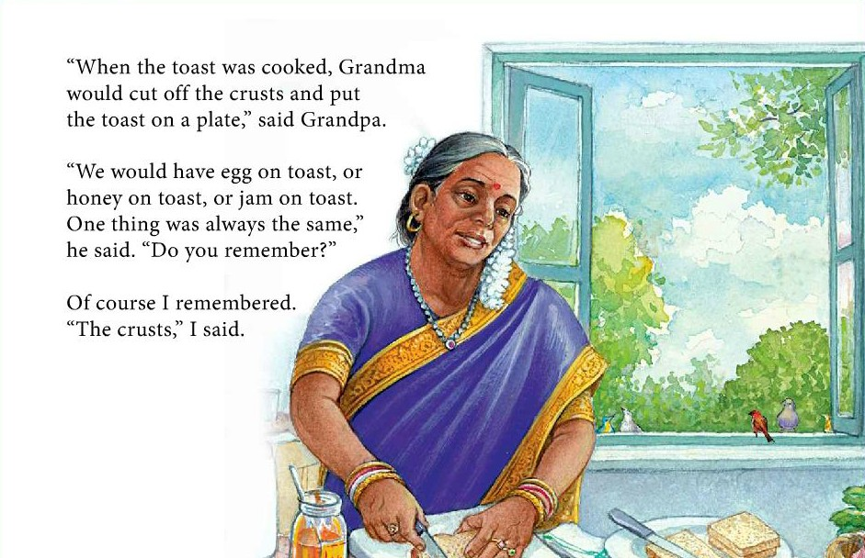

Slide 11
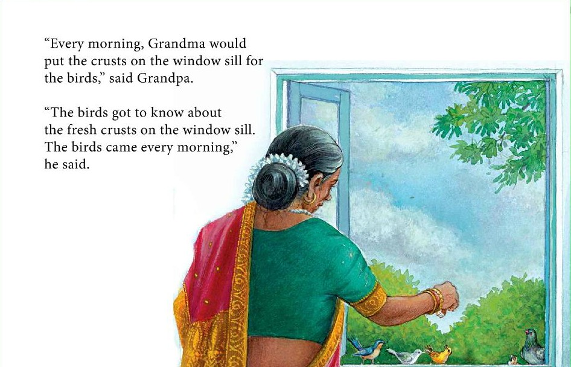

Slide 12
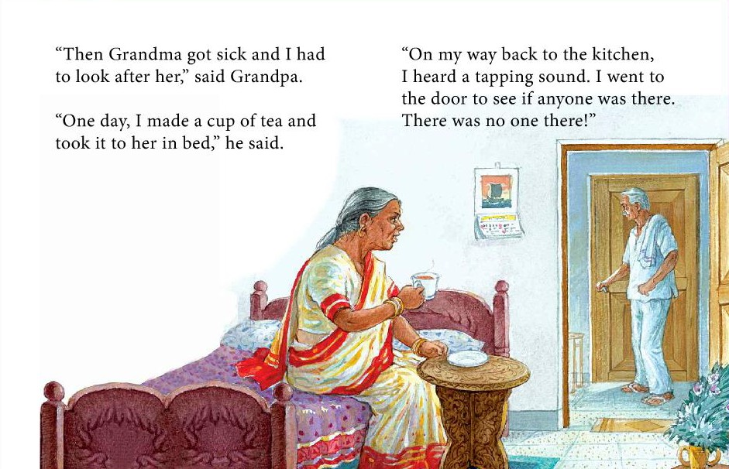

Slide 13
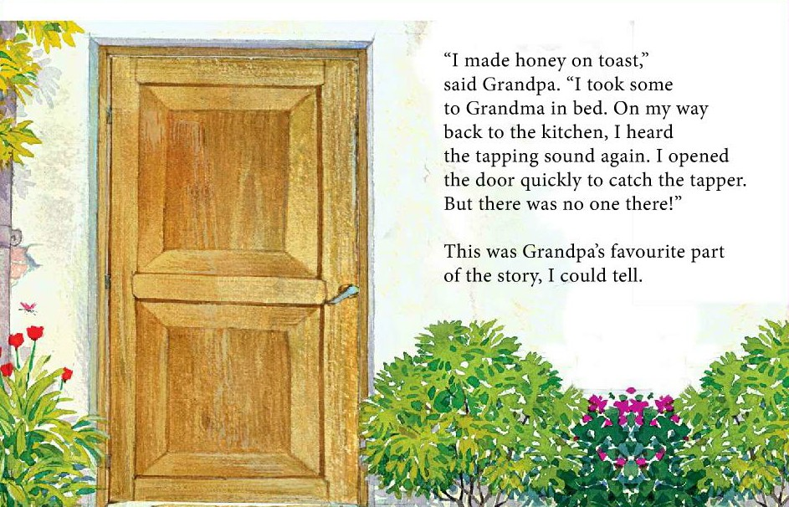

Slide 14
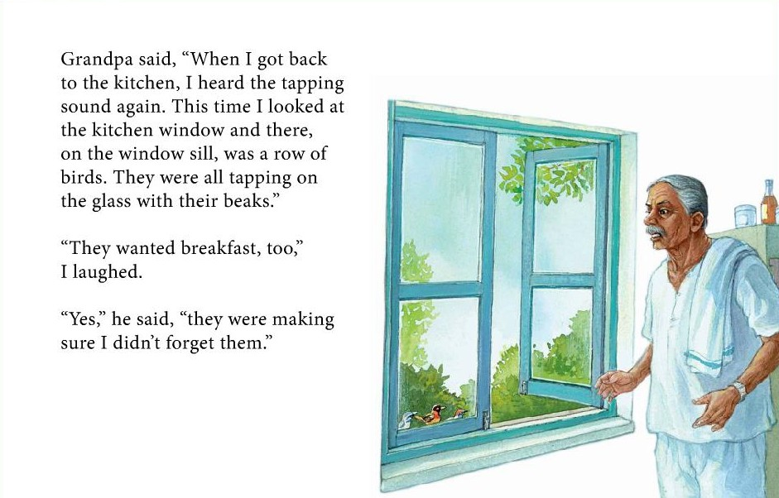

Slide 15

LEARNING
OUR WORDS!

Slide 16








Teacher
Older
Computer
Writer
Silver
Cauliflower
Farmer
Flower

Slide 17
Homework Activities
Drawing a visual from the story and writing a
few sentences.
Using new vocabulary words to create simple
sentences.

