Slide 1
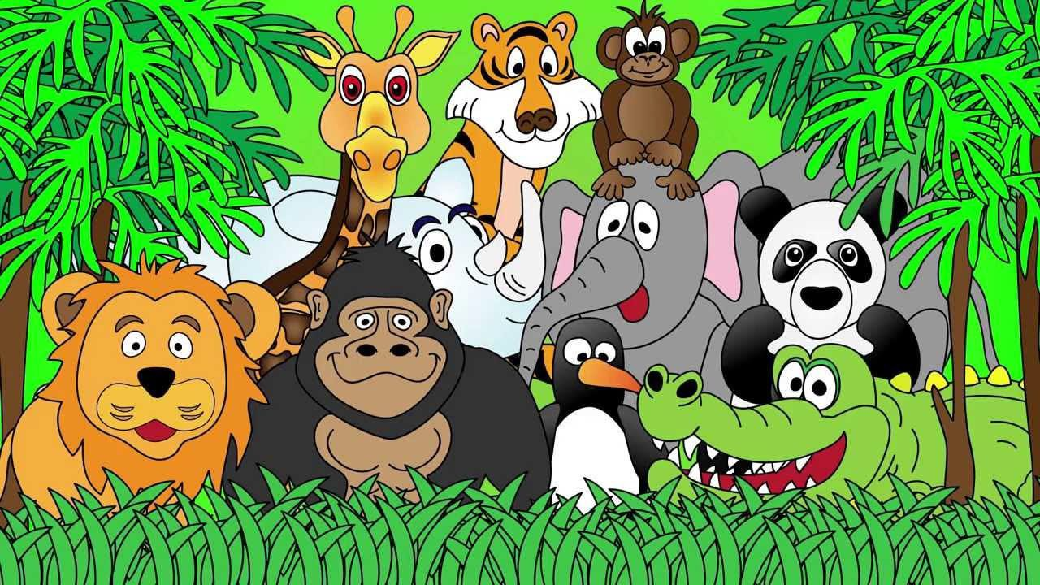
Welcome to the Animal Kingdom! This is Lesson 6!

Slide 2
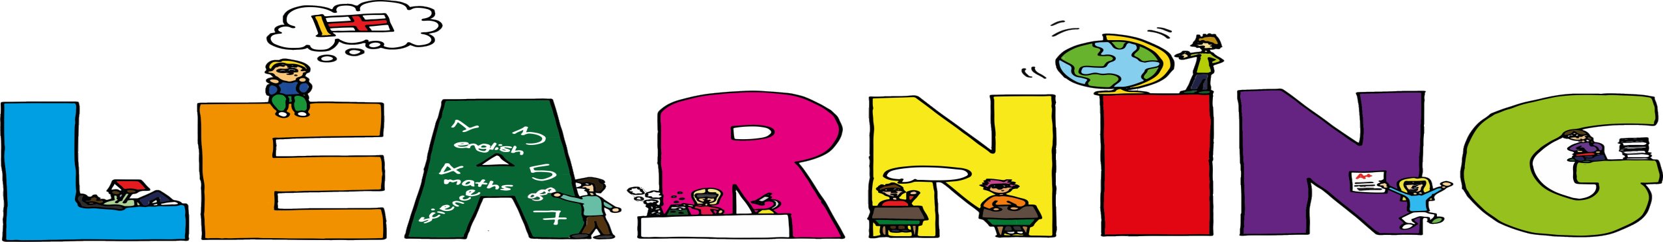
Students will:
Learn to use the sound (ch)
Learn how to brainstorm ideas about a topic.
Learn how write sentences using before and
after.

Slide 3
Brainstorming Activity
When you brainstorm, you think about all of the ideas about topic.
Lets do some practice.
Lets think about the topic: Animals

Slide 4
Animals

Slide 5
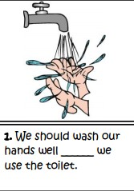
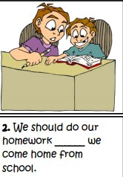
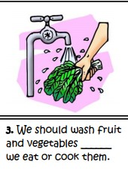
Use the words before and after in these sentences.

Slide 6
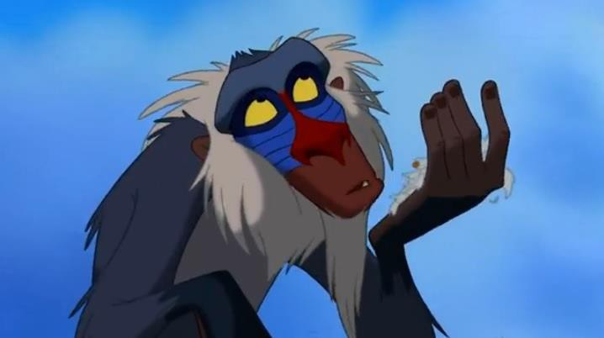




Slide 7


Slide 8
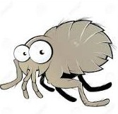
Pre-Reading Activities
What do they think this story is about?
What does Super Duper mean?

Slide 9
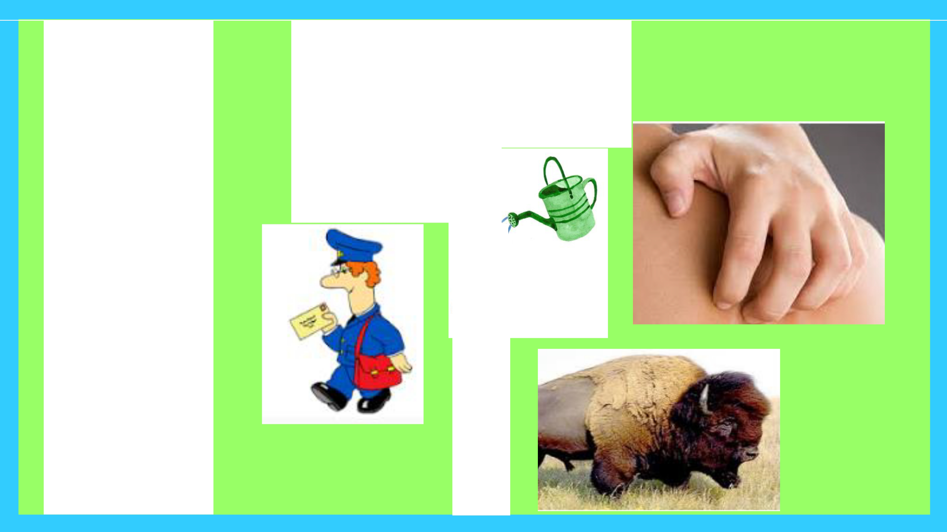
New Vocabulary
scratched
II I,,
I. / =·
I
,',II _{,11} 1 1
sprinkled
I/ I I 1
_{I I} I I c
I I
I '
I
postman
gigantic

Slide 10
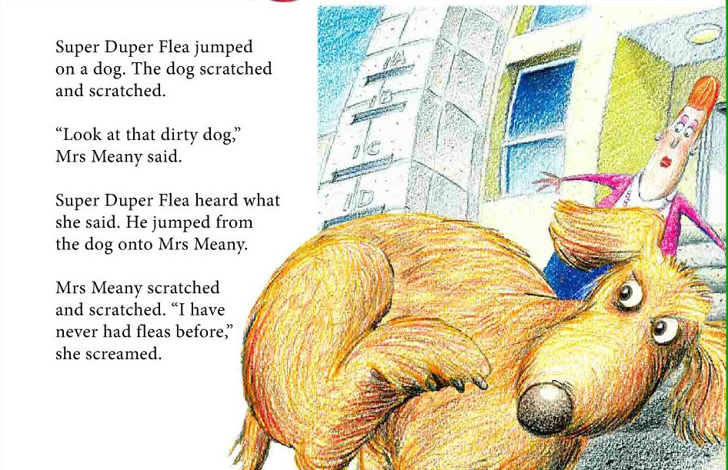

Slide 11
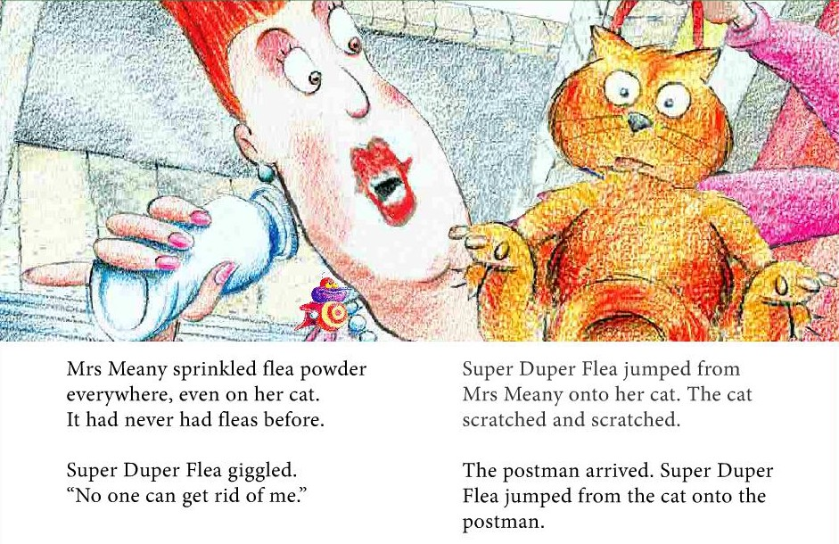

Slide 12
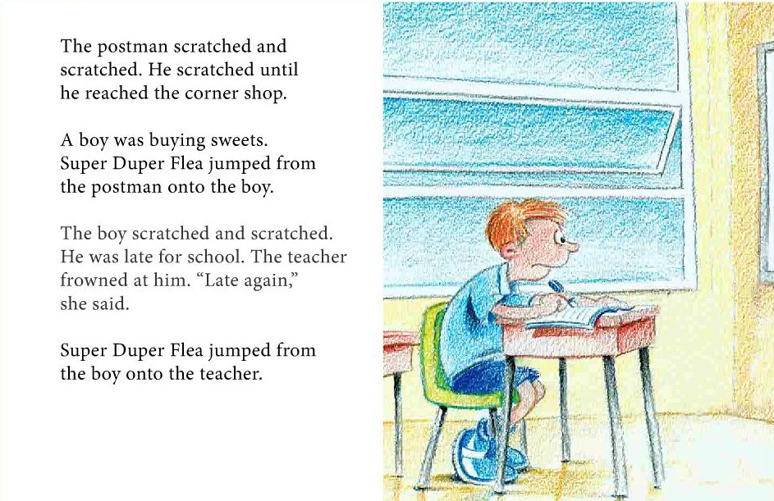

Slide 13
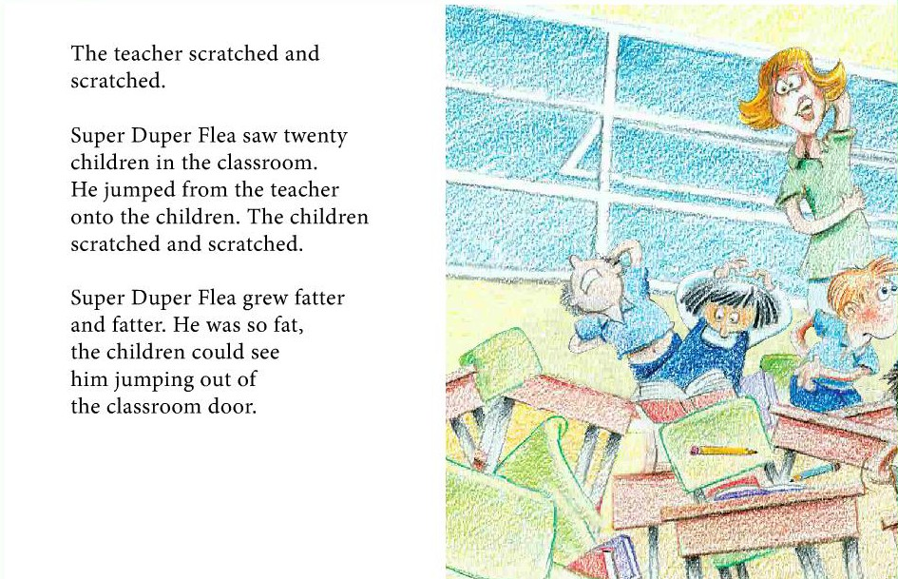

Slide 14
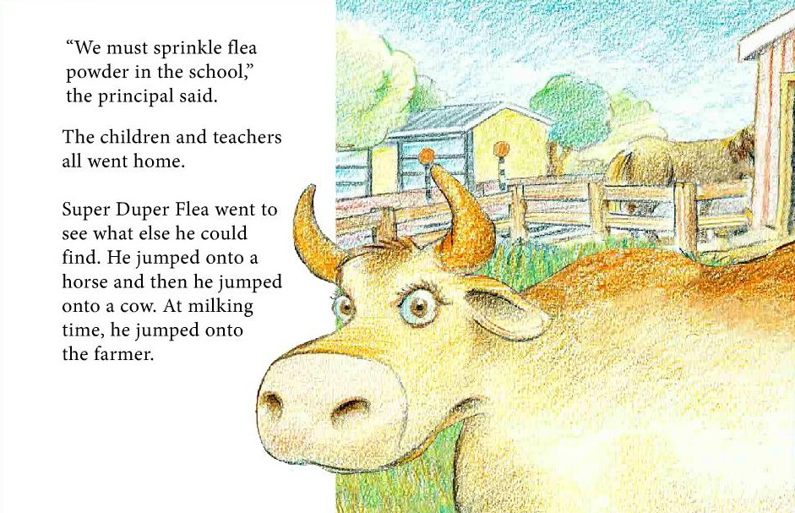

Slide 15
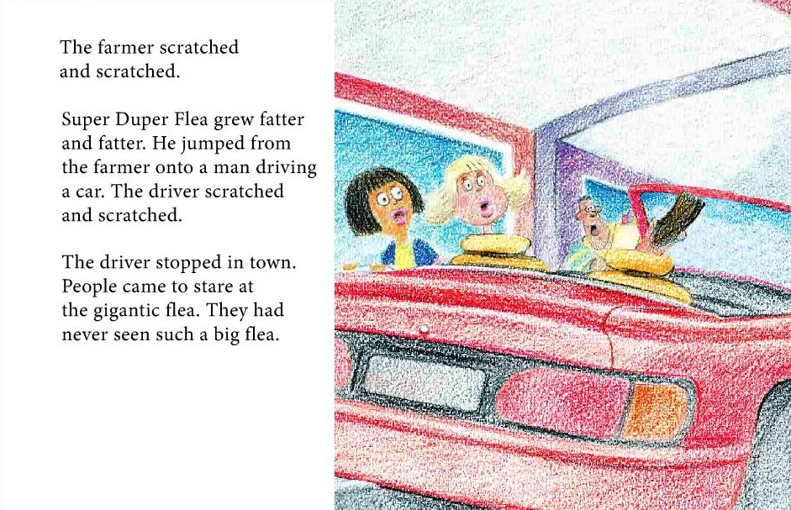

Slide 16
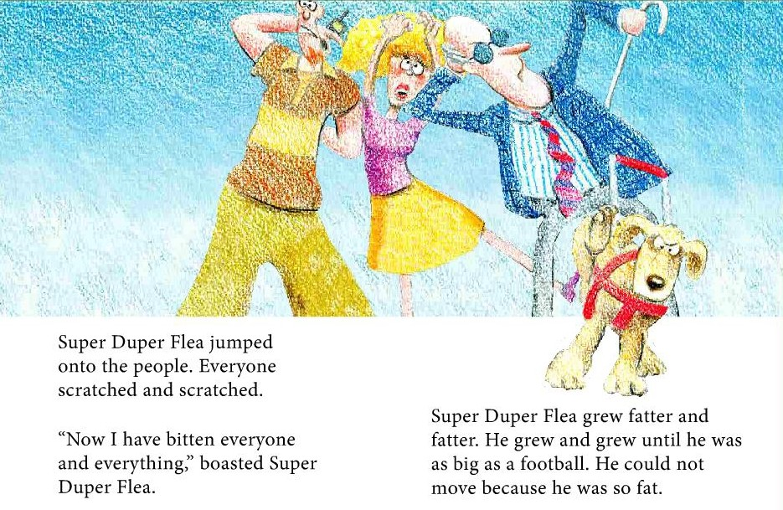

Slide 17
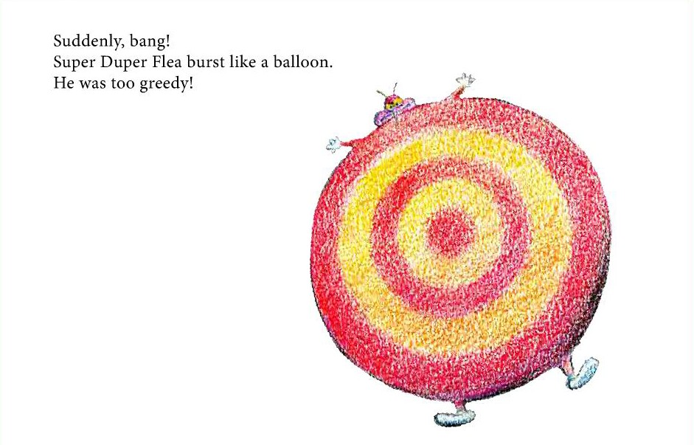

Slide 18
Post- Reading Activities
Circle all the words with the ‘ch’ sound
Underline the adjectives in red.
Underline the verbs in green.

Slide 19

LEARNING
OUR WORDS!

Slide 20
Draw a picture and write a definition of the ‘ch’
words.
cherry
chicken
China

Slide 21
Draw a picture and write a definition of the ‘ch’
words.
cheetah
church
chopsticks

Slide 22
Draw a picture and write a definition of the ‘ch’
words.
children
chin
chocolate

Slide 23
Homework
Think about the main character in the story. How do the pictures and words describe him? Draw a picture and write two sentences describing the Super Duper Flea.
Write two sentences using your new vocabulary words either from the story or the ‘ch’ words. Make the sentences funny and interesting. Encourage students to use before and after in their writing.

