Slide 1
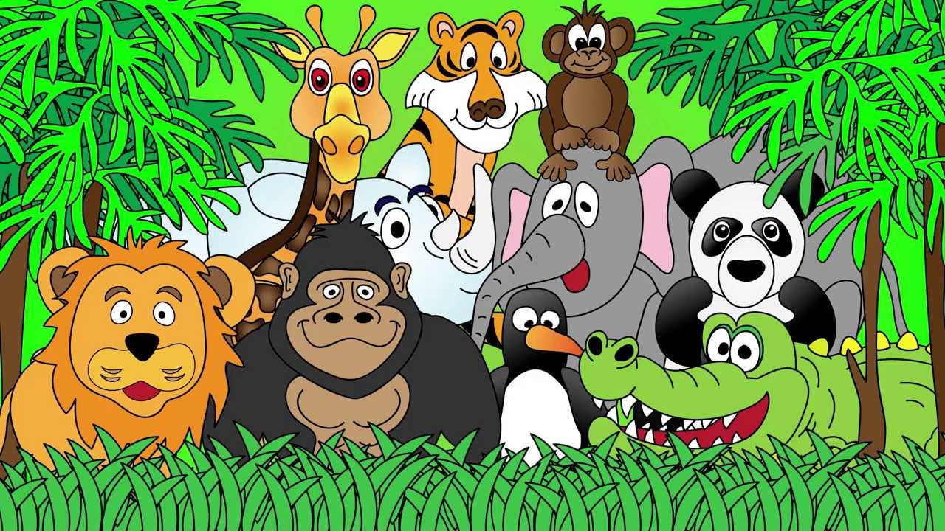
Welcome to the Animal Kingdom! This is Lesson 6!
Notes:
Welcome the students to the unit.
Ask the students how there week has been and discuss some of the fun things they did at school or for fun to establish a rapport with your students.
Ask the students if they have been to the Zoo before? What animals did they see? What animals can they see in this picture.

Slide 2
Talking Activity
Ask students to talk about 3 of their favourite moments from the past week.
For example:
I ate an amazing sandwich for lunch.
I danced at my friend’s birthday party

Slide 3
Play the Game: Wheel of Fortune
This game helps you practice animals, colours, clothes and numbers.
http://www.eslgamesplus.com/animals-colors-colours-clothes-numbers-english-vocabulary-game/
Notes:
http://www.eslgamesplus.com/animals-colors-colours-clothes-numbers-english-vocabulary-game/

Slide 4

Students will:
Learn to use the sound (ch)
Learn how to brainstorm ideas about a topic.
Learn how write sentences using before and after.
Notes:
Discuss the goals for todays lesson. Emphasize to the students that there writing and pictures must be descriptive.

Slide 5
Brainstorming Activity
When you brainstorm, you think about all of the ideas about topic.
Lets do some practice.
Lets think about the topic: Animals

Slide 6
Animals

Slide 7
What did you write down about the topic of food?
Lets put the ideas into categories.
Animals that live on the ground. | Animals that live in the water. | Animals that can fly.

Slide 8
Lets think about a topic you are interested in!
Brainstorm

Slide 9
Students will:
Learn to use the sound (ch)
Learn how to brainstorm ideas about a topic. ✓
Learn how write sentences using before and after.
Notes:
Discuss the goals for todays lesson. Emphasize to the students that there writing and pictures must be descriptive.

Slide 10
Use the words before and after in these sentences.

Slide 11
Use the words before and after in these sentences.

Slide 12
Use the words before and after in these sentences.

Slide 13
Before
Talk to the class about three things you do before school and after school.
After

Slide 14
Students will:
Learn to use the sound (ch)
Learn how to brainstorm ideas about a topic. ✓
Learn how write sentences using before and after. ✓
Notes:
Discuss the goals for todays lesson. Emphasize to the students that there writing and pictures must be descriptive.

Slide 15
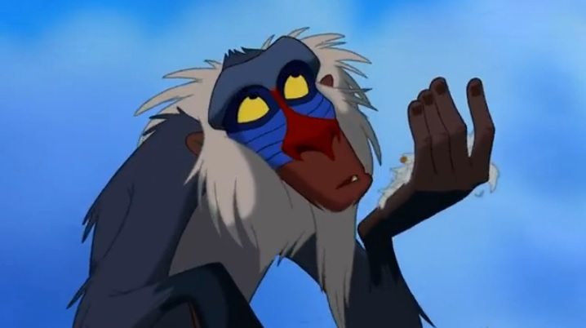
Lets read a story

Slide 17
Pre-Reading Activities
What do they think this story is about?
What does Super Duper mean?

Slide 18
New Vocabulary
scratched
sprinkled
postman
gigantic

Slide 27
Post- Reading Activities
Circle all the words with the ‘ch’ sound
Underline the adjectives in red.
Underline the verbs in green.

Slide 28
What happened in the story.

Slide 29
Put into order the people and animals that Super Duper Flea bit?
Everyone
Mrs Meany
Horse and Cow
Farmer
Dog
Students in the class.
Boy
Teacher
Man Driving a Car

Slide 30
LEARNING OUR WORDS!

Slide 31
Ready, Set, Go!
Have a competition with your classmate or on your own list as many ‘ch’ words in 1 min.

Slide 32
Draw a picture and write a definition of the ‘ch’ words.
cherry
chicken
China

Slide 33
Draw a picture and write a definition of the ‘ch’ words.
cheetah
church
chopsticks

Slide 34
Draw a picture and write a definition of the ‘ch’ words.
children
chin
chocolate

Slide 35
Students will:
Learn to use the sound (ch) ✓
Learn how to brainstorm ideas about a topic. ✓
Learn how write sentences using before and after. ✓
Notes:
Discuss the goals for todays lesson. Emphasize to the students that there writing and pictures must be descriptive.

Slide 36
Homework
Think about the main character in the story. How do the pictures and words describe him? Draw a picture and write two sentences describing the Super Duper Flea.
Write two sentences using your new vocabulary words either from the story or the ‘ch’ words. Make the sentences funny and interesting. Encourage students to use before and after in their writing.

