Slide 1
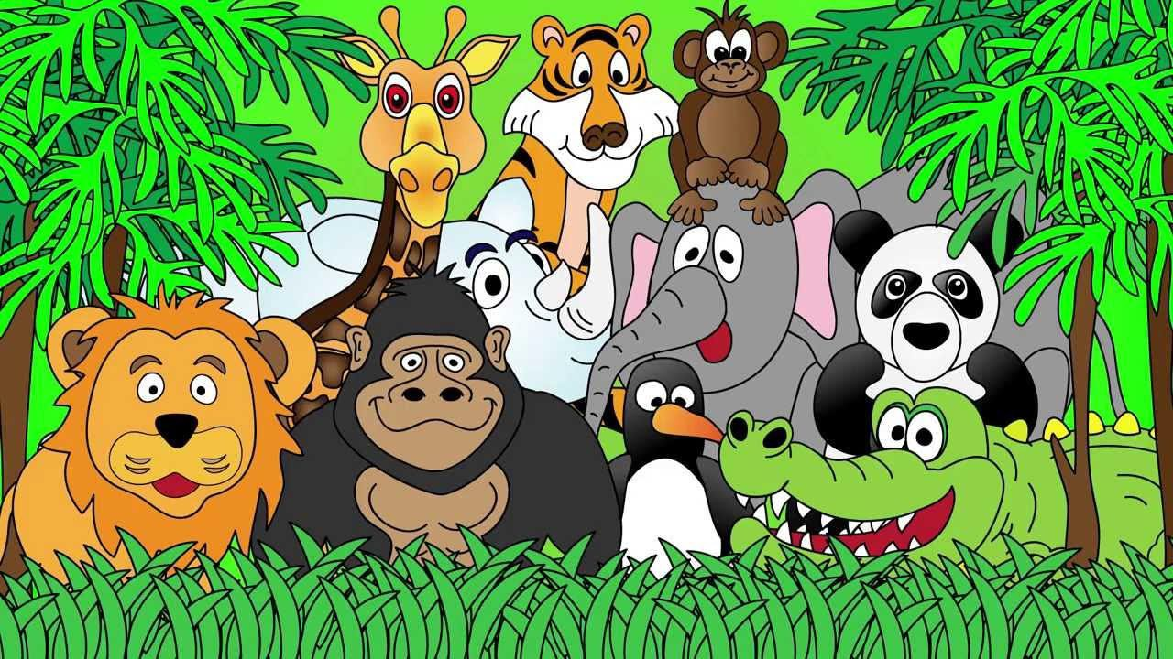
Welcome to the Animal Kingdom! This is Lesson 7!

Slide 2
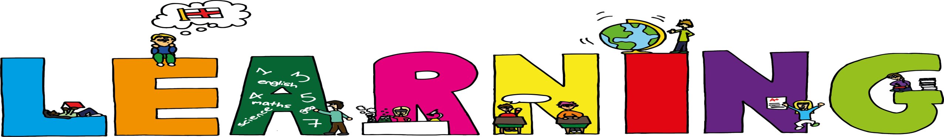
Students will:
Learn about the sounds ‘fl’
Identify titles, headlines, captions and
illustrations
Use prepositions to describe the location
of an object.

Slide 3
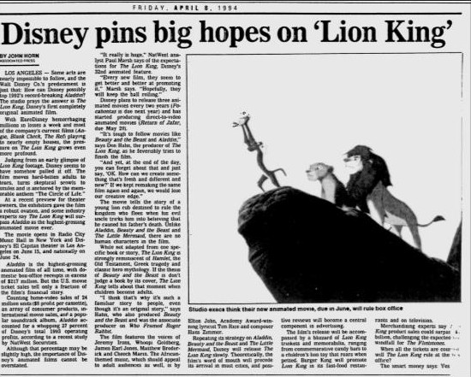
Title
Headlines Captions Illustrations

Slide 4
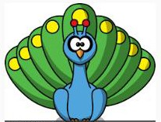




Prepositions
Example: Where is the pig? The pig is beside the peacock.
Right
Behind
Where is the elephant?
Where is the cow?
In front
Where is the owl?
Beside
Left

Slide 5
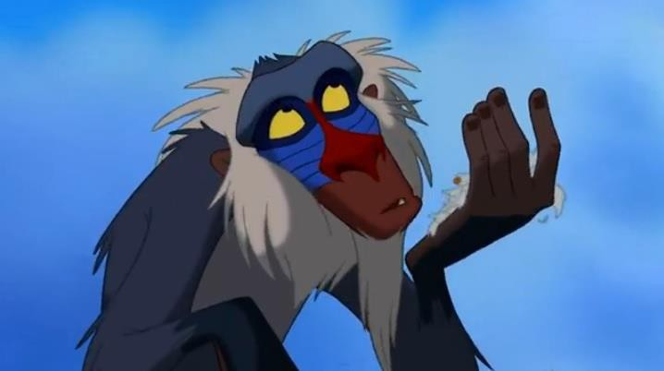
Lets read
a story

Slide 6

Identify:
Title
Illustration
Caption

Slide 7
Pre-Reading Activities
What do you think this story is about from the title
and the illustration?

Slide 8
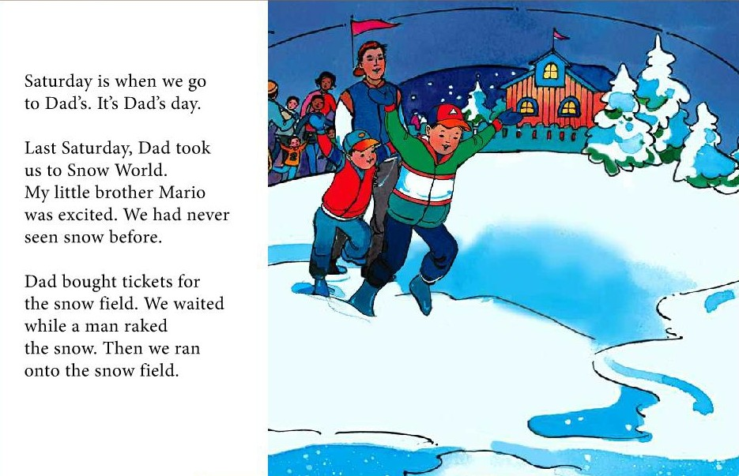

Slide 9
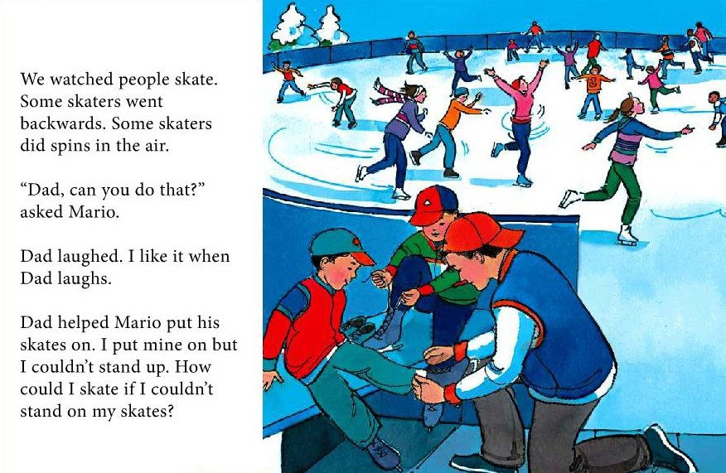

Slide 10
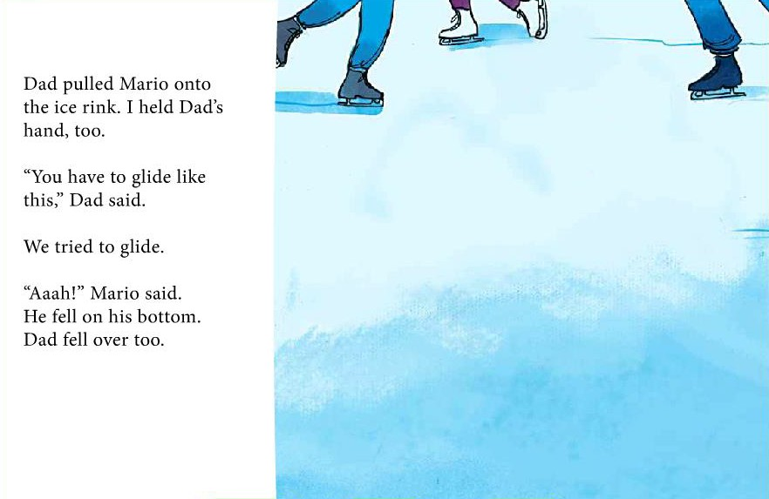

Slide 11
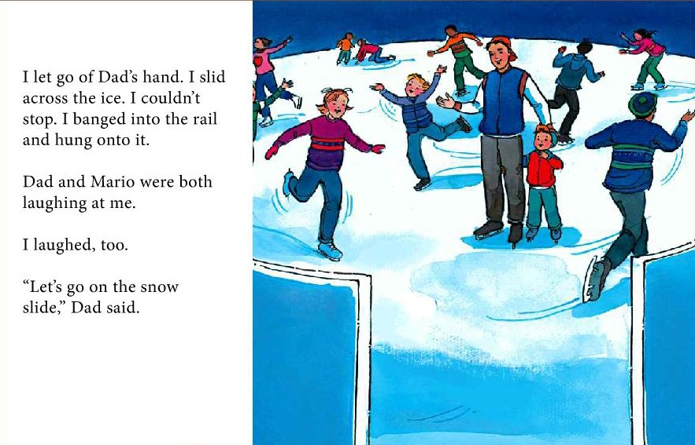

Slide 12
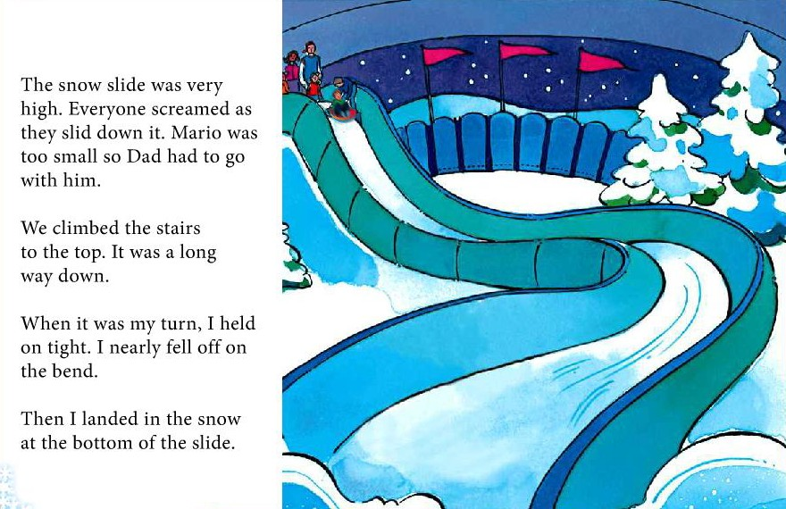

Slide 13
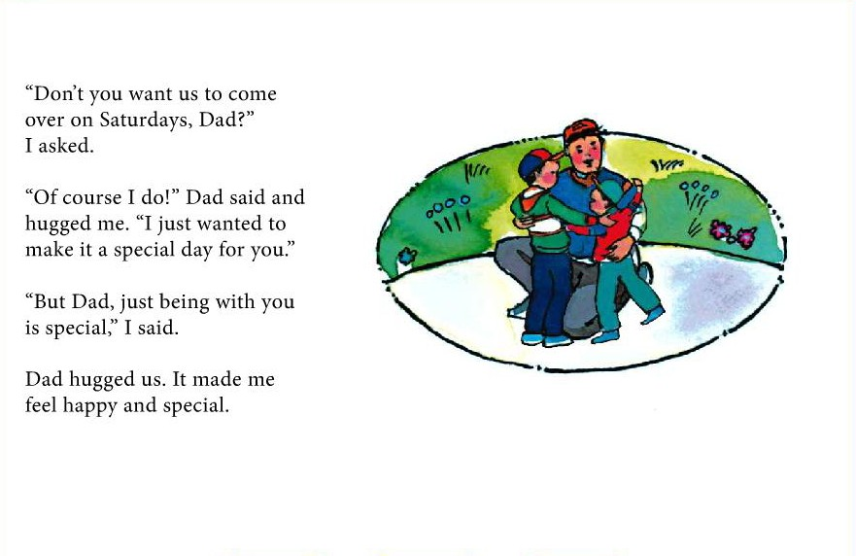

Slide 14

LEARNING OUR WORDS!

Slide 15
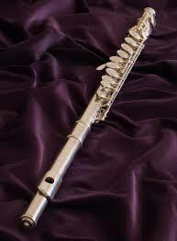

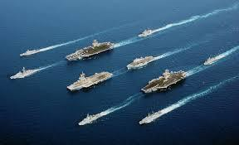
Write a definition of the ‘fl’ words.
flag
flute
fleet

Slide 16
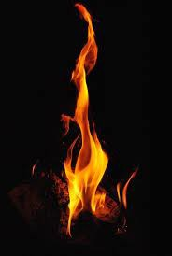
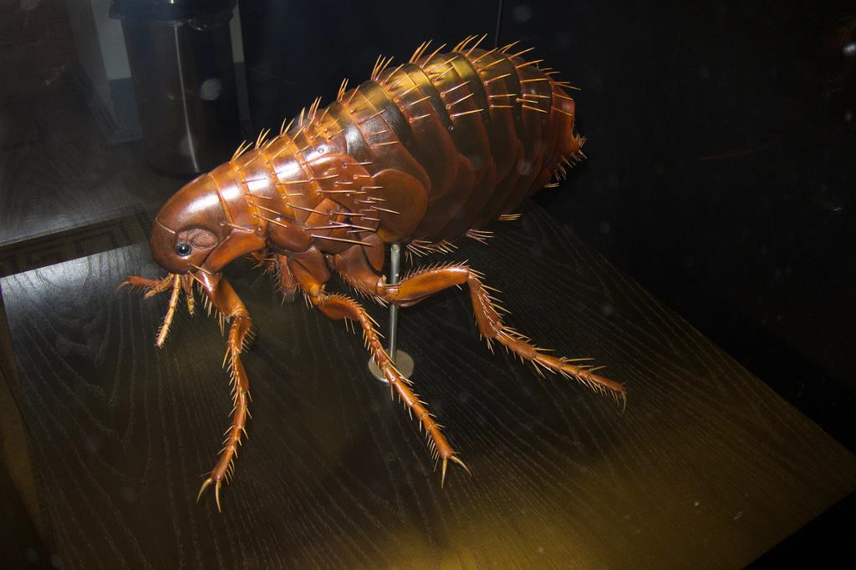
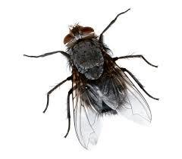
Write a definition of the ‘fl’ words.
flea
fly
flames

Slide 17
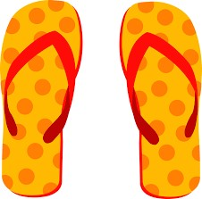
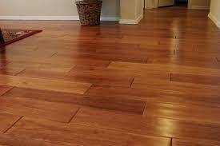
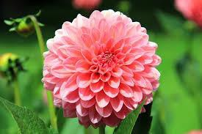
Write a definition of the ‘fl’ words.
floor
flip flops
flower

Slide 18
Students will:
Learn about the sounds ‘fl’ ✓
Identify titles, headlines, captions and illustrations ✓
Use prepositions to describe the location of an
object.✓

Slide 19
Homework
Think about your bedroom.
Draw your bedroom and where all the furniture
is located.
Write some sentences about the things beside your bed, under and above the bed and on the left and right side.

Slide 20
Final Thoughts
Do you have any questions?

