Slide 1
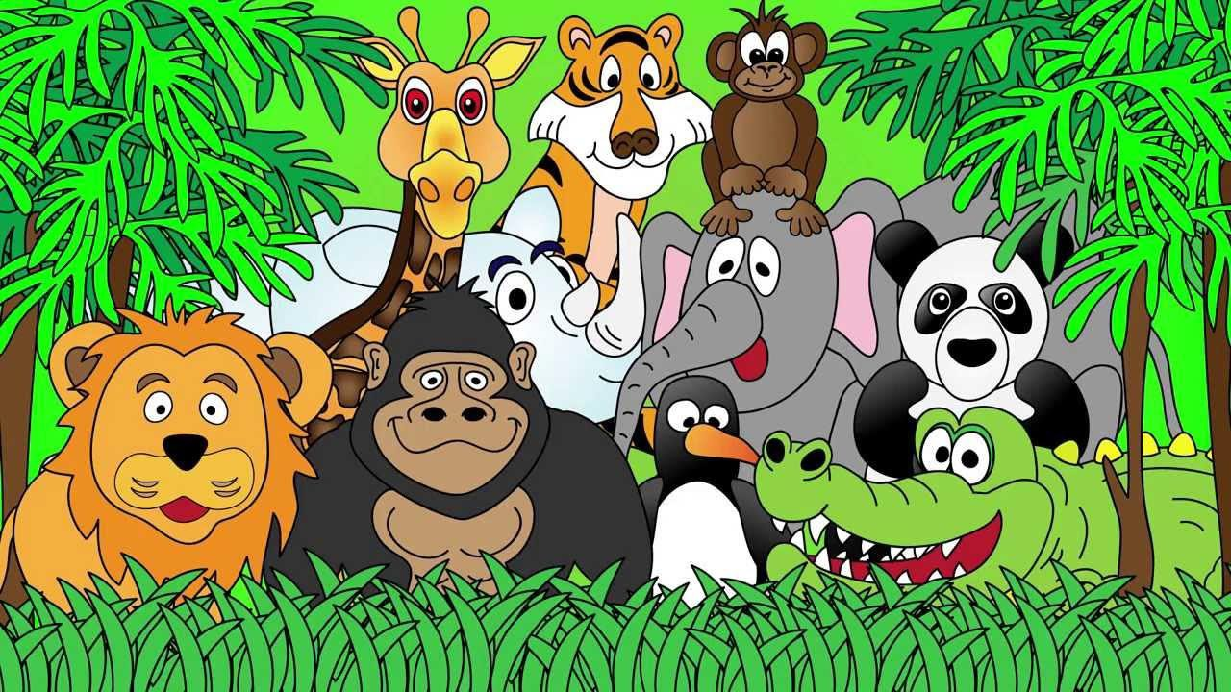
Welcome to the Animal Kingdom! This is Lesson 7!

Slide 2
ESL Animals Memory Game
Let’s practice animal names.

Slide 3
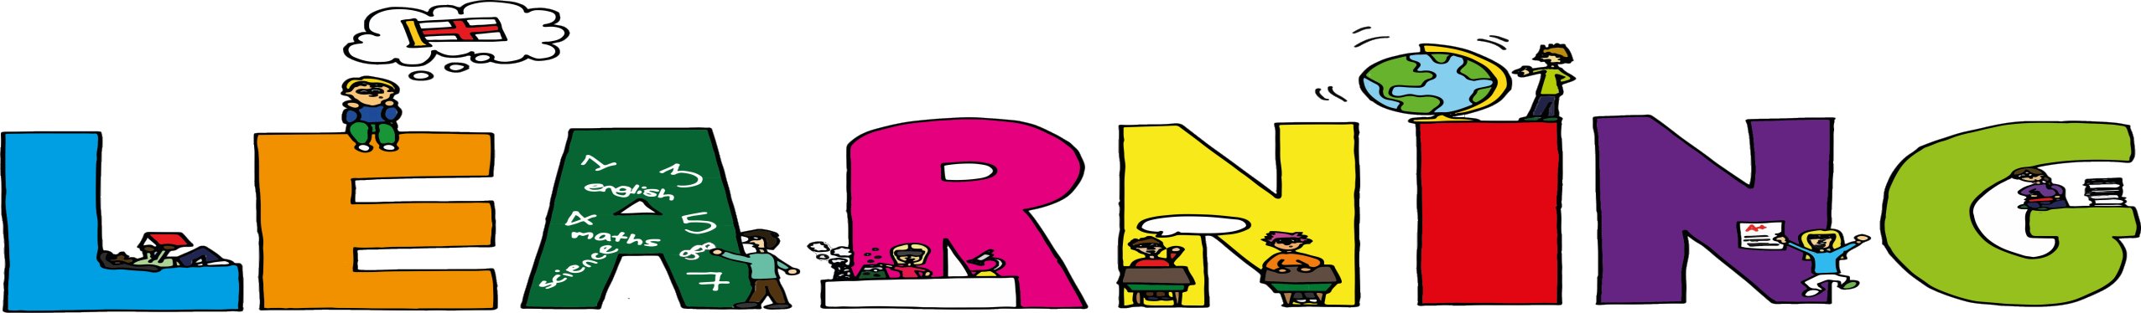
Students will:
Learn about the sounds ‘fl’
Identify titles, headlines, captions and
illustrations
Use prepositions to describe the location
of an object.

Slide 4
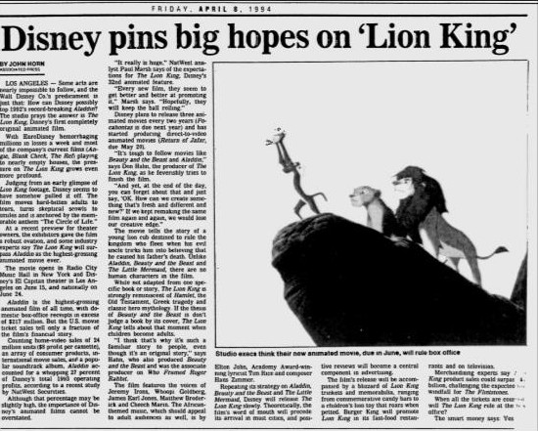
Title
Headlines Captions Illustrations

Slide 5
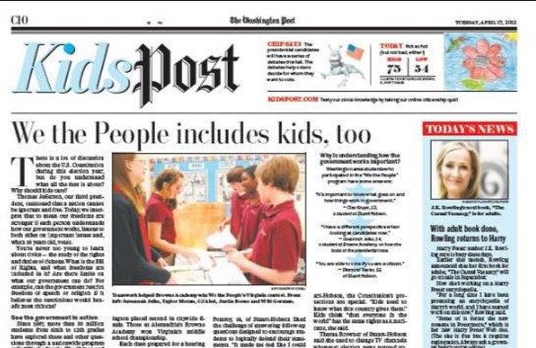
Can you identify these?
Title
Caption
Headline
Illustration

Slide 6
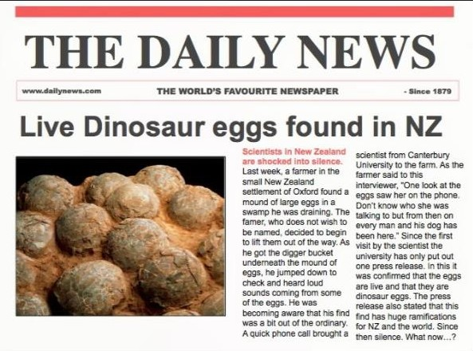
Can you identify
these?
Title
Caption
Headline
Illustration

Slide 7
Create a headline/title for a newspaper that is interesting and catchy.
Imagine that a dragon flew into your school and
ate the Principal.

Slide 8
Students will:
Learn about the sounds ‘fl’
Identify titles, headlines, captions and
illustrations ✓
Use prepositions to describe the location
of an object.

Slide 9
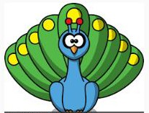




Prepositions
Example: Where is the pig? The pig is beside the peacock.
Right
Behind
Where is the elephant?
Where is the cow?
In front
Where is the owl?
Beside
Left

Slide 10



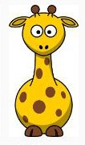

Talk about the location
of the following animals:
Monkey
Sheep
Giraffe
Hippo
Billy Goat

Slide 11
Draw a picture using the following
instructions:
Draw a blue square in the middle of the page
Draw a yellow square on the left hand side of the blue square
Draw a red square on the right hand side of the blue
square
Draw a pink circle above the blue square
Draw two green rectangles below the blue square on each corner of the blue square.

Slide 13
Students will:
Learn about the sounds ‘fl’
Identify titles, headlines, captions and
illustrations ✓
Use prepositions to describe the location of an
object.✓

Slide 14
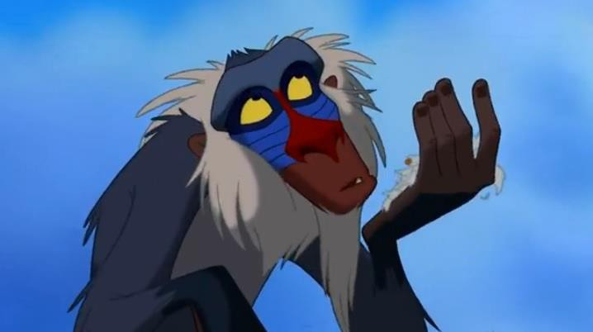
Lets read
a story

Slide 15

Identify:
Title
Illustration
Caption

Slide 16
Pre-Reading Activities
What do you think this story is about from the title
and the illustration?

Slide 17
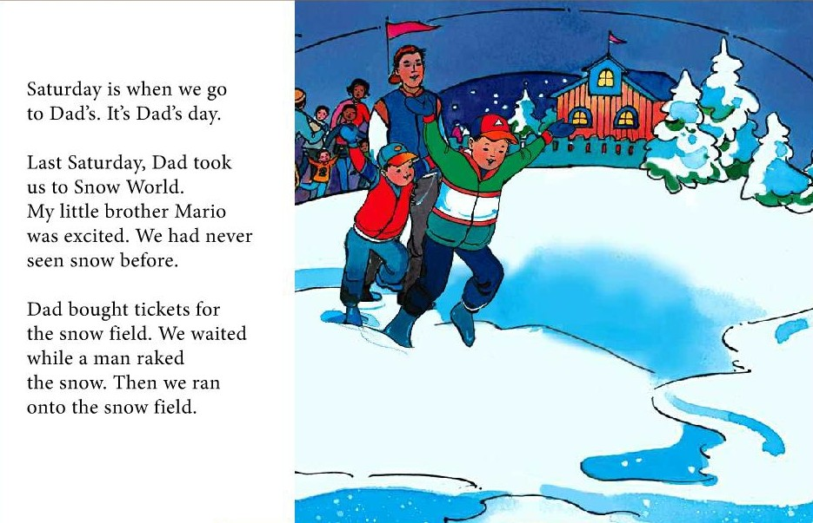

Slide 18
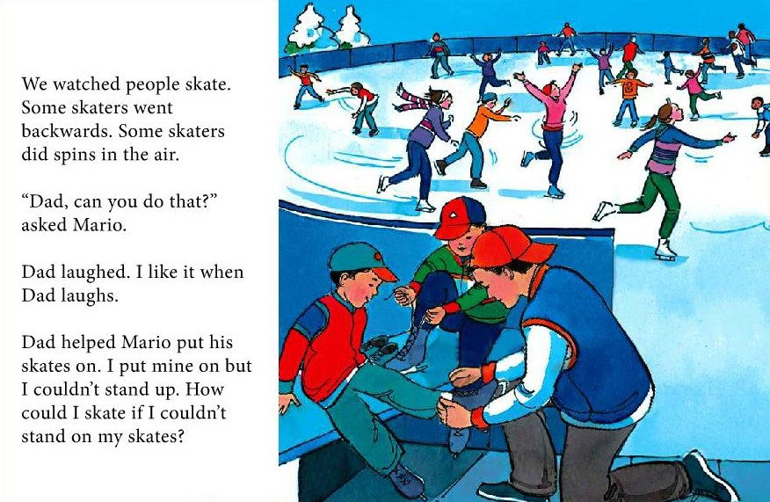

Slide 19
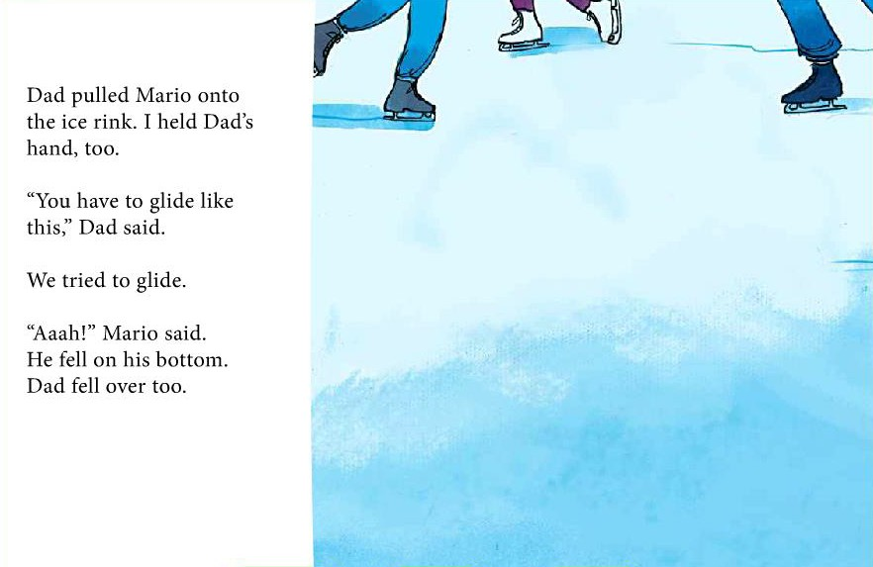

Slide 20
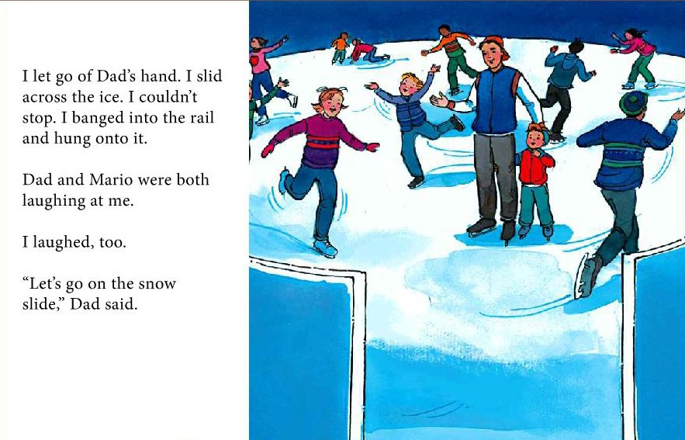

Slide 21
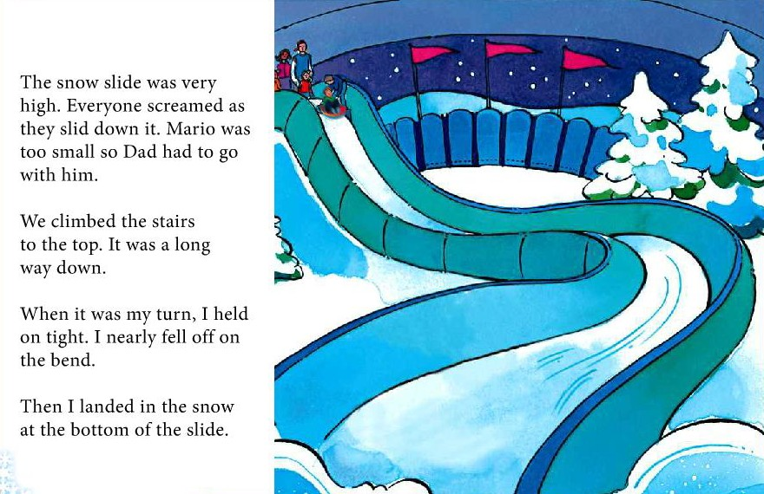

Slide 22
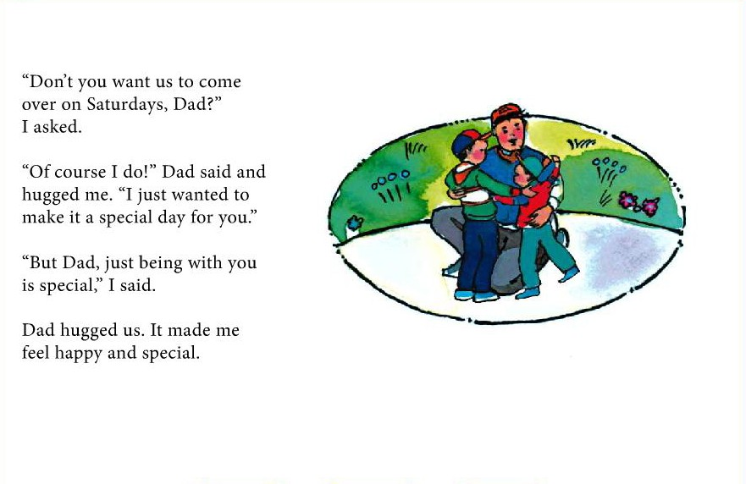

Slide 23
Reading Activity
Think about a day where you had fun with your family.
Write a description about that day:
What did you do?
How did you feel?
Who came with you?

Slide 24

LEARNING OUR WORDS!

Slide 25
Ready, Set, Go!
Have a competition with your classmate(s) or on your own to list as many ‘fl’ words in 1 minute as you can.

Slide 26
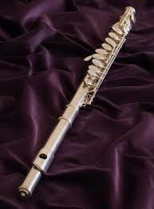

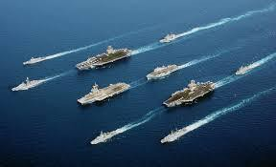
Write a definition of the ‘fl’ words.
flag
flute
fleet

Slide 27
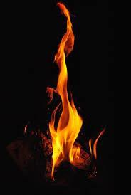
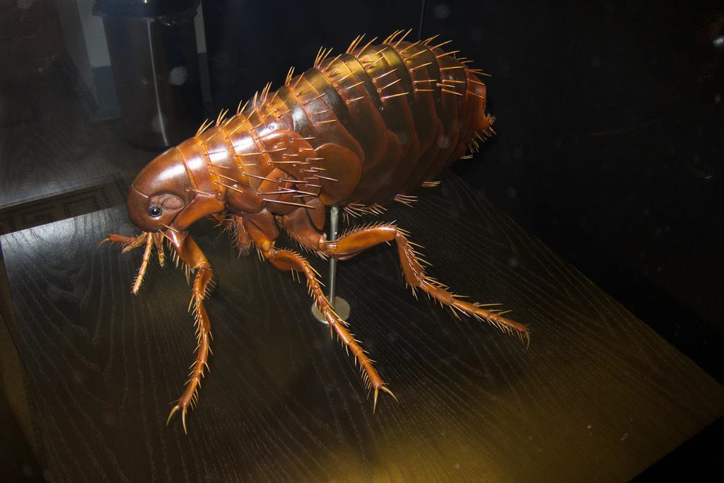
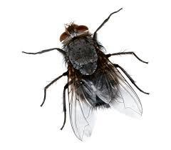
Write a definition of the ‘fl’ words.
flea
fly
flames

Slide 28
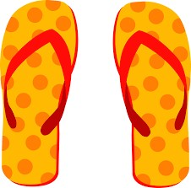
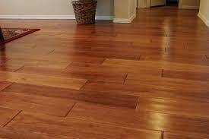
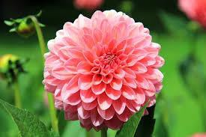
Write a definition of the ‘fl’ words.
floor
flip flops
flower

Slide 29
Short Story
Write a short story using the fl words as a class.
The teacher will begin the story by writing one sentence. You will continue the story by adding another sentence.
Be sure to use lots of adjectives and verbs.

Slide 30
Students will:
Learn about the sounds ‘fl’ ✓
Identify titles, headlines, captions and illustrations ✓
Use prepositions to describe the location of an
object.✓

Slide 31
Homework
Think about your bedroom.
Draw your bedroom and where all the furniture
is located.
Write some sentences about the things beside your bed, under and above the bed and on the left and right side.

Slide 32
Final Thoughts
Do you have any questions?

