Slide 1
Welcome to the Animal Kingdom! This is Lesson 8!

Slide 2
•
•

Slide 3
Party Chicken
I’m a party chicken, party chicken,
Cluck! Cluck! Cluck!
I can sing like a swan.
I can dance like a duck.
I can boogie like a pigeon
When I wiggle all about.
And I gobble like a turkey
When the food comes out!

Slide 6
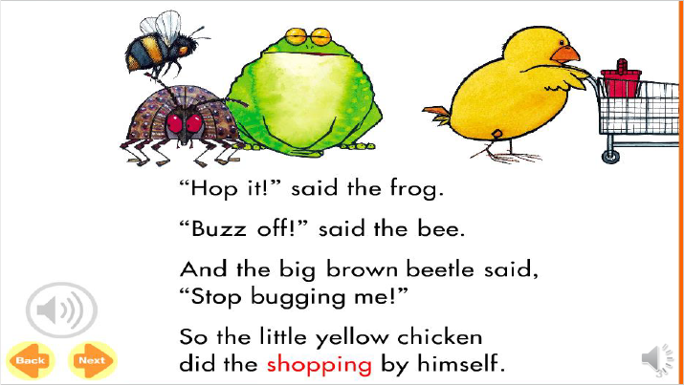

Slide 7
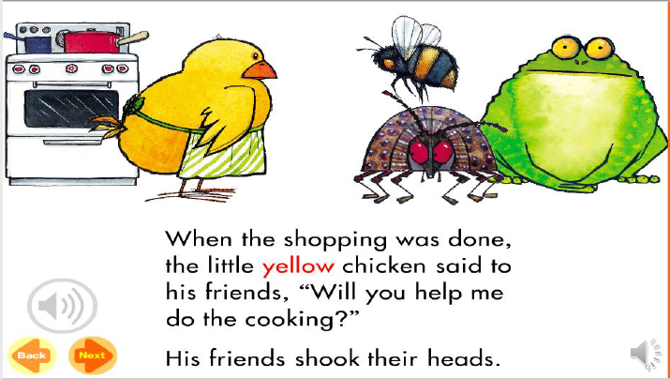

Slide 8
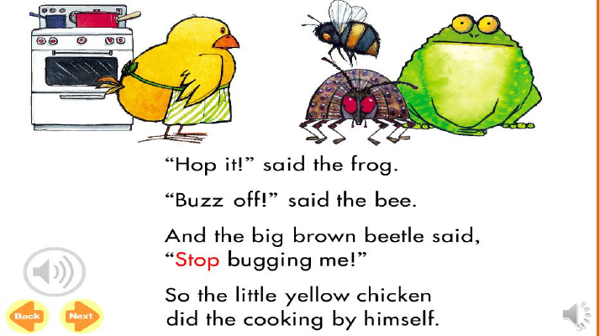

Slide 10
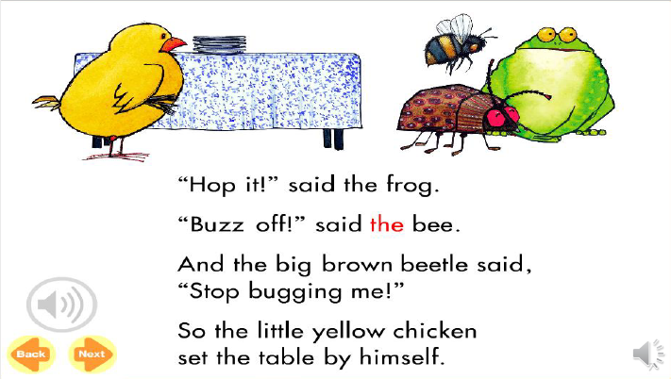

Slide 12
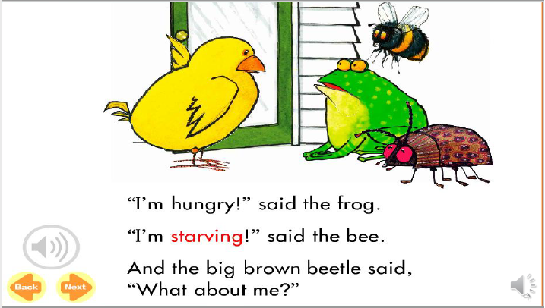

Slide 13
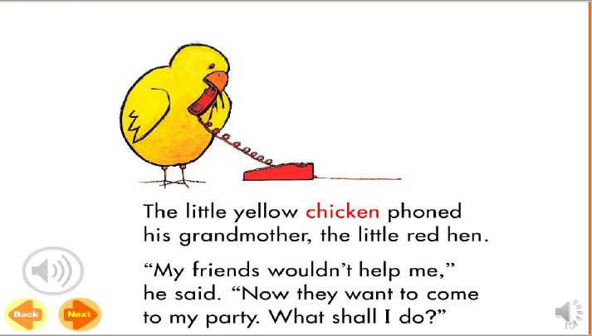

Slide 14
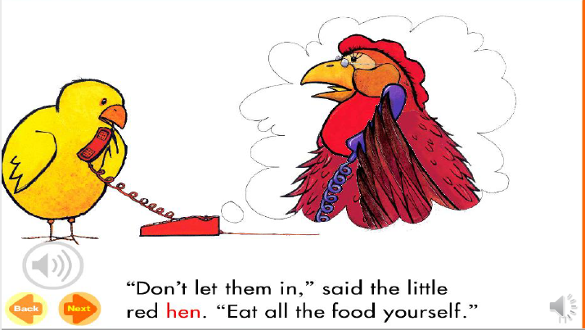

Slide 15
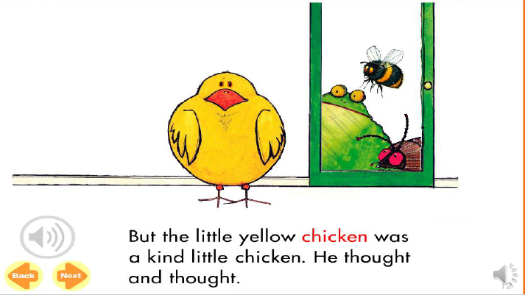

Slide 16
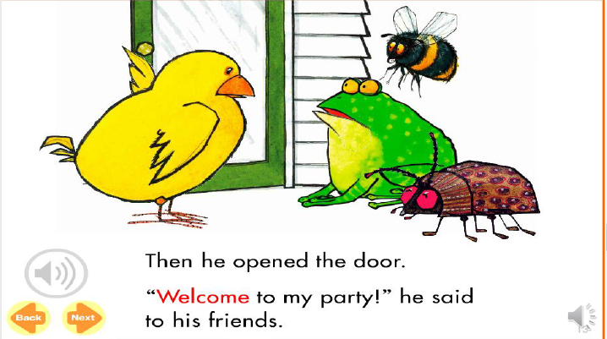

Slide 17
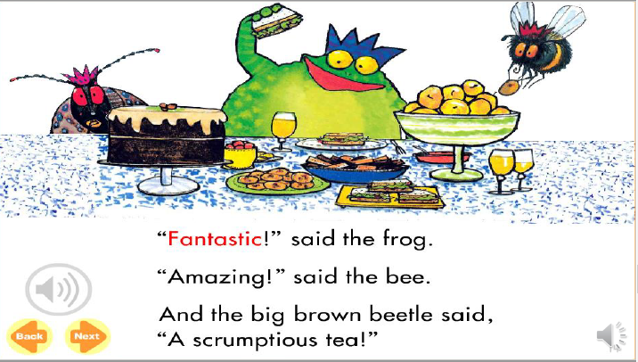

Slide 18
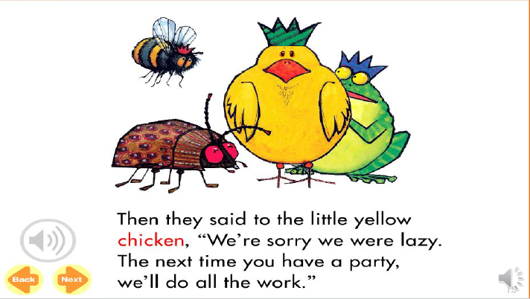

Slide 19
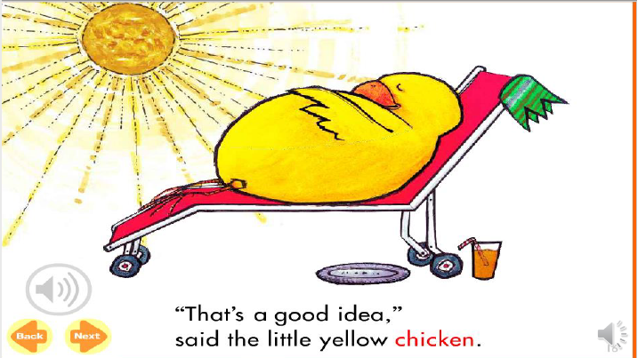

Slide 21
think
thumb
thick

Slide 22
teeth
bath
south

Slide 23
thistle
path
mouth

Slide 24
Homework

Slide 25
Final Thoughts
•

