Slide 1
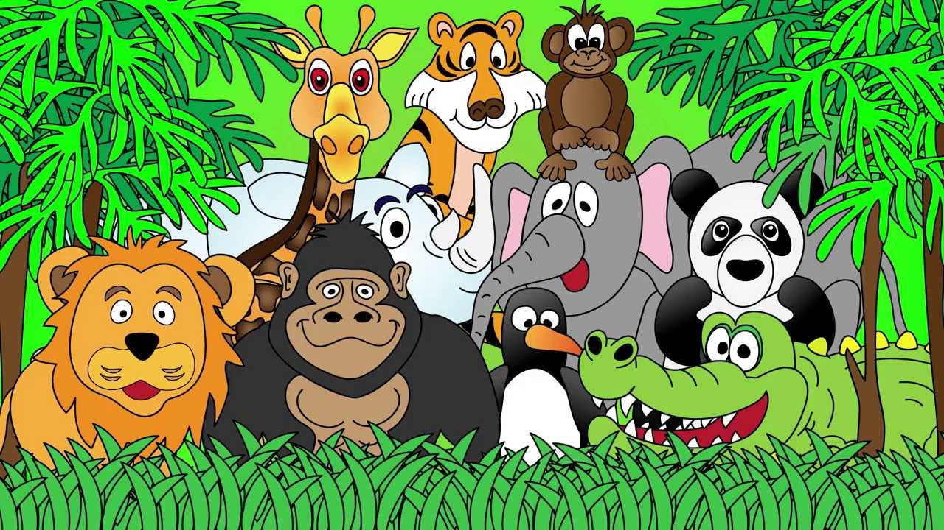
Welcome to the Animal Kingdom!
This is Lesson 8!
Notes:
Welcome the students to the unit.
Ask the students how there week has been and discuss some of the fun things they did at school or for fun to establish a rapport with your students.
Ask the students if they have been to the Zoo before? What animals did they see? What animals can they see in this picture.

Slide 2
Watch the song ‘We Are Chicken’
Talk about the song with the class.
What are the chickens singing about?

Slide 3

Students will:
Learn to use sounds (th) in speech and sentences.
Identify the subject, verb and object in a sentence.
Notes:
m45yDiscuss the goals for todays lesson. Emphasize to the students that there writing and pictures must be descriptive.

Slide 4
Notes:
http://www.eslgamesplus.com/farm-domestic-animals-vocabulary-esl-memory-game/

Slide 5
Party Chicken
Read through the poem ‘Party Chicken.’
Underline the nouns in blue.
Circle the adjectives in red.
Draw a square around the verbs in green.

Slide 6
Students will:
Learn to use sounds (th) in speech and sentences.
Identify the subject, verb and object in a sentence. ✓
Notes:
m45yDiscuss the goals for todays lesson. Emphasize to the students that there writing and pictures must be descriptive.

Slide 7
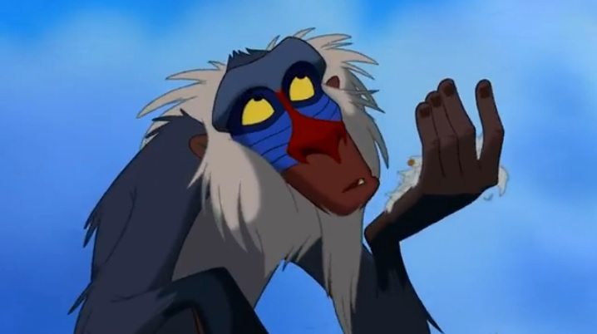
Lets read a story

Slide 8


Slide 9
Pre-Reading Activity:
What do you think this story is about?
Why is the chicken yellow?
What words describe the chicken?

Slide 24
Post-Reading Activity:
How would you describe the little yellow chicken’s friends?
How did the chicken prepare for the party?
Think of four describing words for the little yellow chicken.

Slide 25
Creative Thinking Activity:
In the story, the chicken’s friends are rude and lazy. They don’t help the little yellow chicken plan his party.
Let’s continue the story. What happens after to the little yellow chicken and his friends.
Brainstorm some ideas as a class and choose one to write about.

Slide 26
Ideas for the story

Slide 27
Students will:
Learn to use sounds (th) in speech and sentences.
Identify the subject, verb and object in a sentence. ✓
Notes:
m45yDiscuss the goals for todays lesson. Emphasize to the students that there writing and pictures must be descriptive.

Slide 28
LEARNING OUR WORDS!

Slide 29
Vocabulary Activity
Circle all the ‘th’ words in the Little Yellow Chicken story.
Sentence Structure Activity
Choose four sentences from the reading. Circle the nouns in red, underline the verbs in green and draw a square in yellow around the adjectives.

Slide 30
Ready, Set, Go!
Have a competition with your classmate or on your own to list as many ‘th’ words as you can in 1 min.

Slide 31



Write a definition of the ‘th’ words.
think
thumb
thick

Slide 32
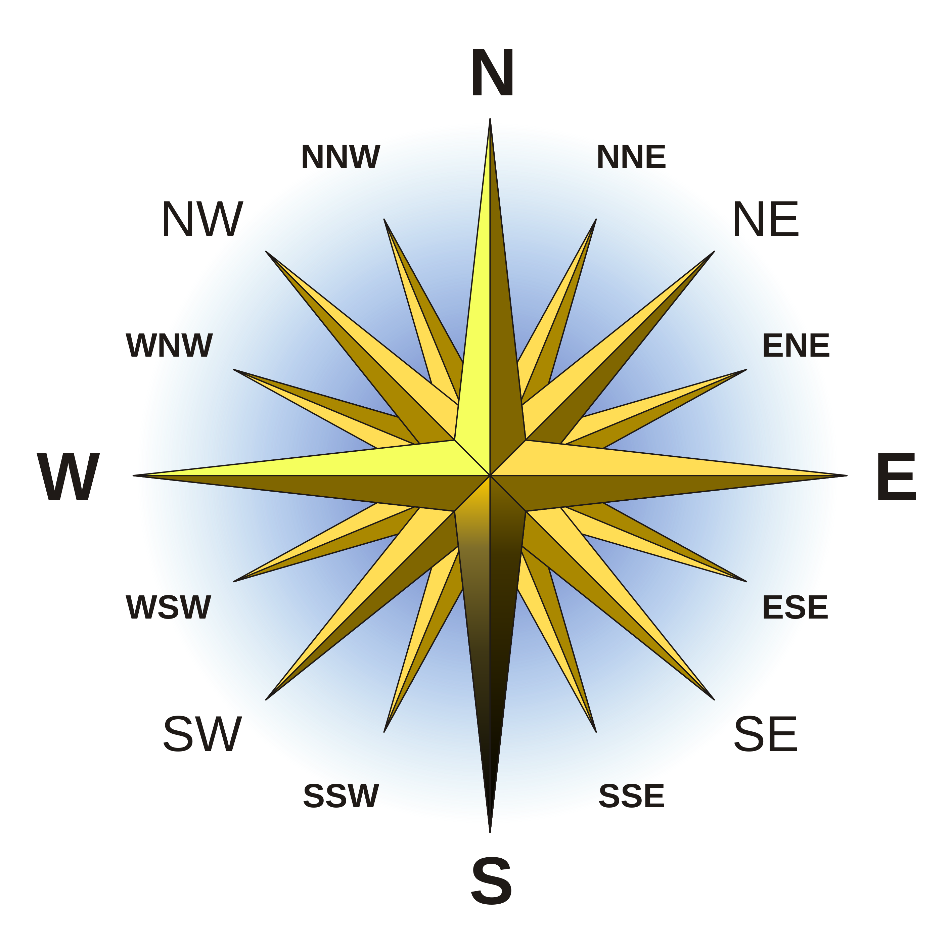
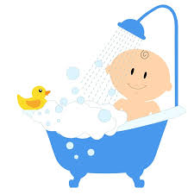
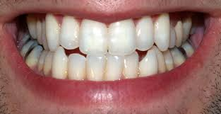
Write a definition of the ‘th’ words.
teeth
bath
south

Slide 33
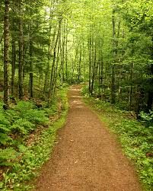
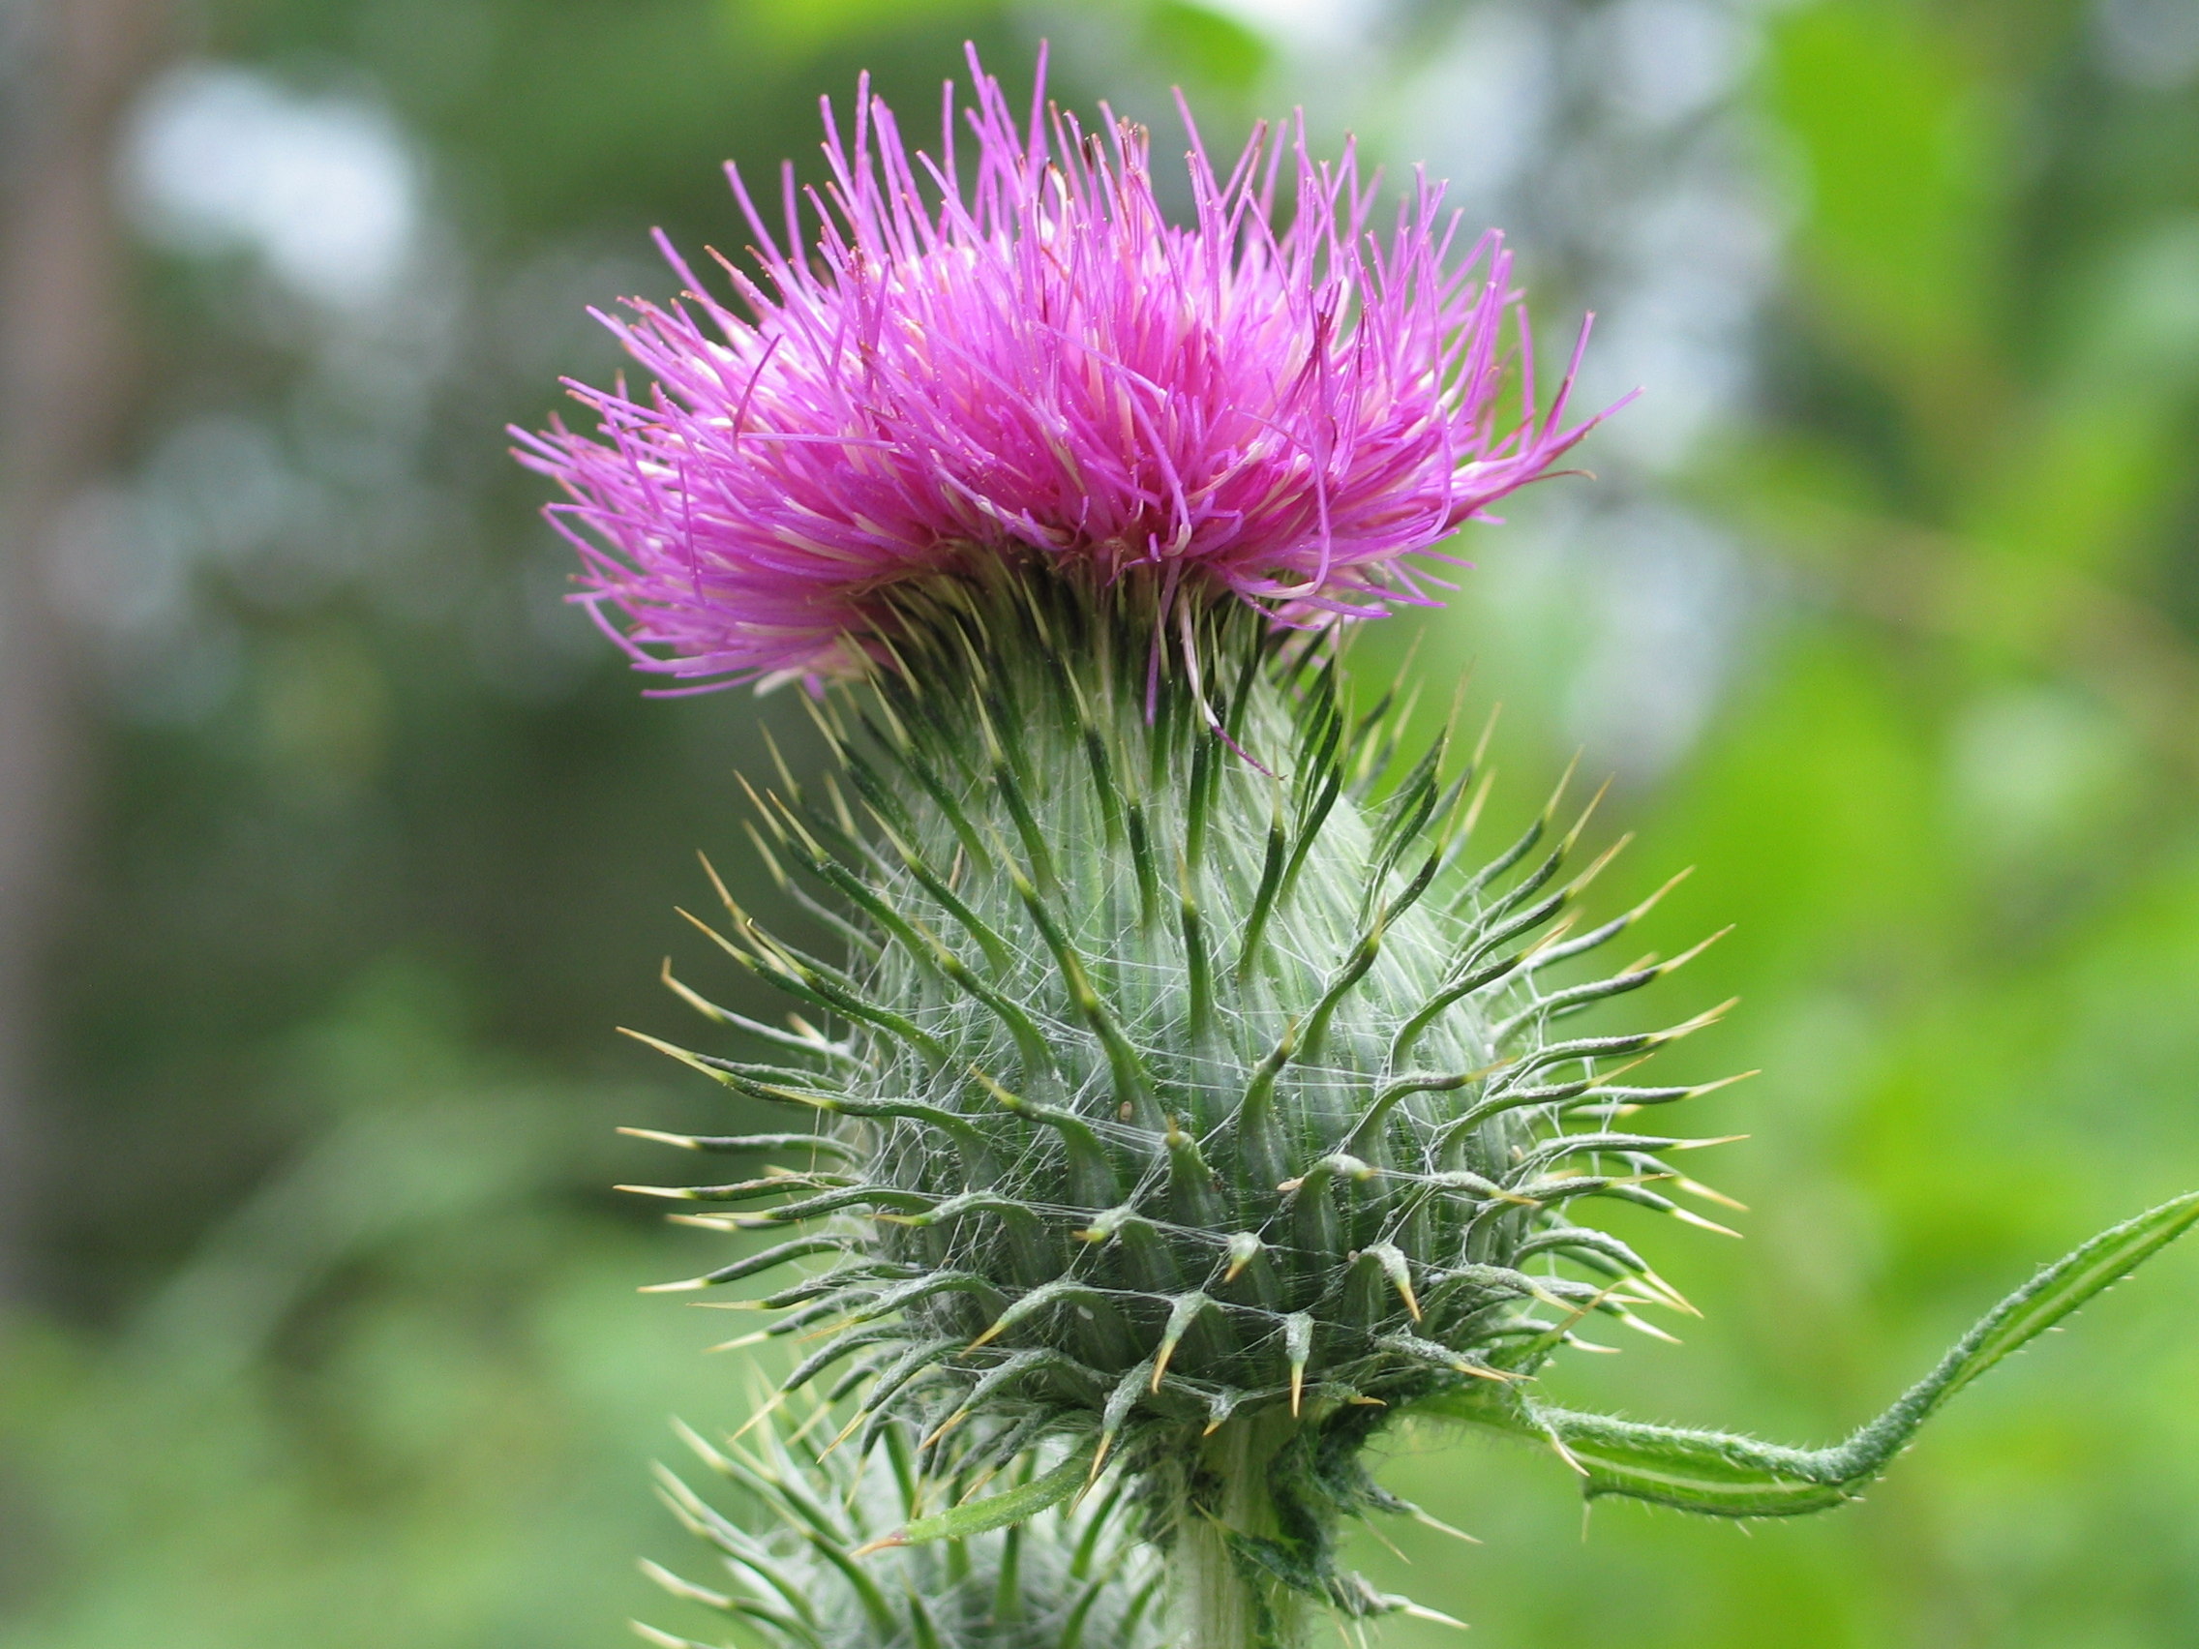
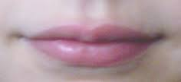
Write a definition of the ‘th’ words.
thistle
path
mouth

Slide 34
Writing Activity
Choose five words from the vocabulary list or from the story.
Write five silly sentences.
Each sentence must have a noun, adjective and verb.

Slide 35
Students will:
Learn to use sounds (th) in speech and sentences. ✓
Identify the subject, verb and object in a sentence. ✓
Notes:
m45yDiscuss the goals for todays lesson. Emphasize to the students that there writing and pictures must be descriptive.

Slide 36
Homework
Write a description about a party you have attended and complete the activities about the description.
Write interesting sentences using ‘th’ words.

Slide 37
Final Thoughts
Do you have any questions?

