Slide 1
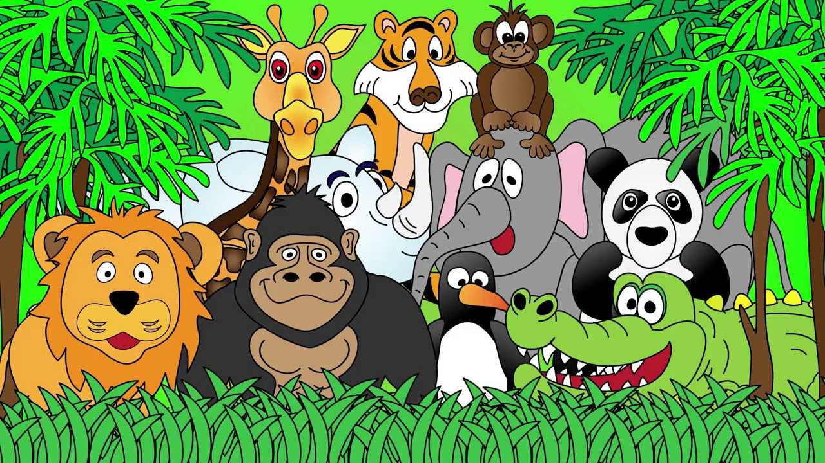
Welcome to the Animal Kingdom! This is Lesson 9!
Notes:
Welcome the students to the unit.
Ask the students how there week has been and discuss some of the fun things they did at school or for fun to establish a rapport with your students.
Ask the students if they have been to the Zoo before? What animals did they see? What animals can they see in this picture.

Slide 2
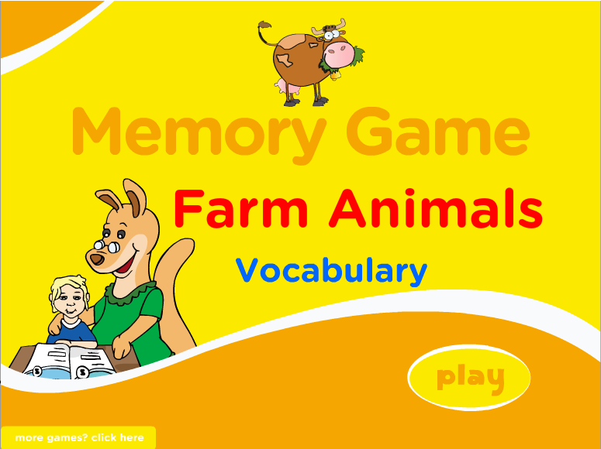
Game Time
Play the Farm Animals Memory Game
http://www.eslgamesplus.com/farm-domestic-animals-vocabulary-esl-memory-game/

Slide 3
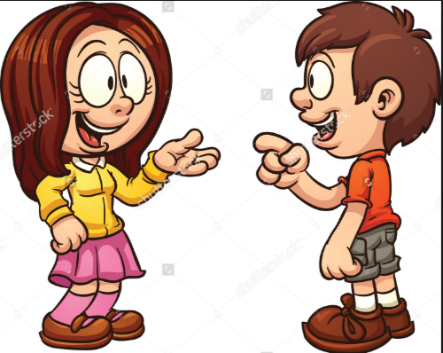
Talk to your classmate or teacher about three things you did this week.

Slide 4

Students will:
Learn to use the sounds (th) in speech and sentences.
Identify simple synonyms
Notes:
m45yDiscuss the goals for todays lesson. Emphasize to the students that there writing and pictures must be descriptive.

Slide 5
Learning Simple Synonyms
A ‘synonym’ is a word that means that same as another.
unhappy
low
Sad
gloomy
down

Slide 6
Happy
Large
Small

Slide 7
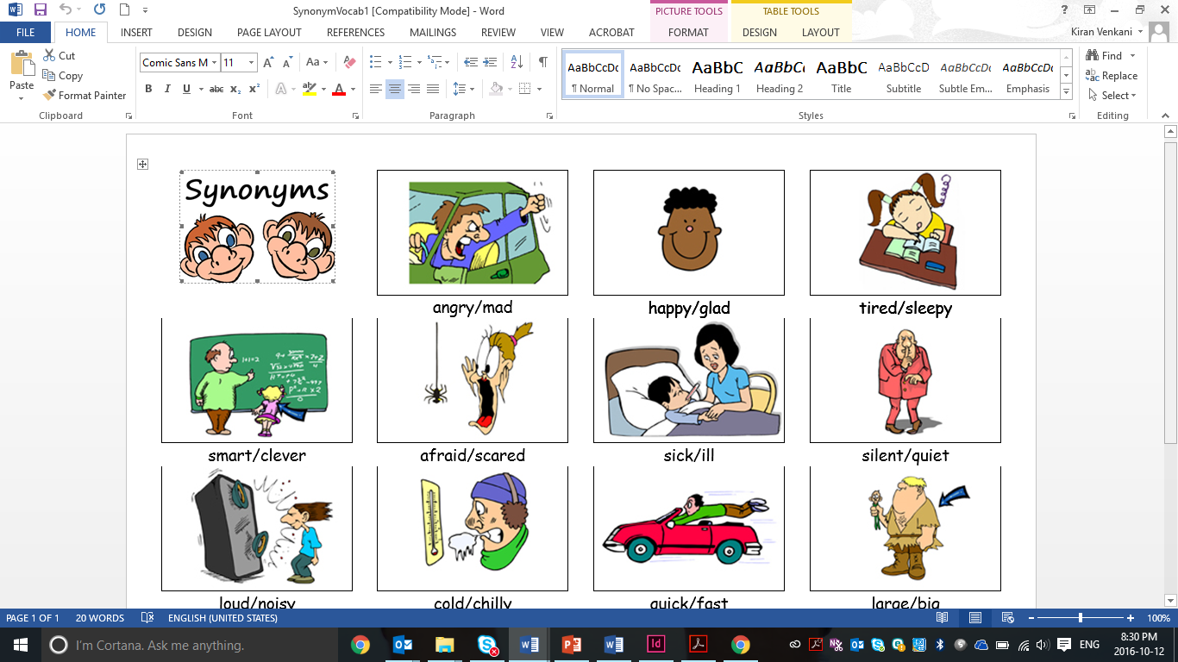
Sandy was angry at school.
_______________________________________________________________
The busy bee was happy because he found a beautiful flower.
_______________________________________________________________
I am tired because I worked really hard.
_______________________________________________________________

Slide 8
Bob is a very smart boy.
_______________________________________________________________
I was very scared to go outside in the dark.
_______________________________________________________________
I feel ill.
_______________________________________________________________
Be silent during the test.
_______________________________________________________________

Slide 9
Students will:
Learn to use sounds (th) in speech and sentences.
Identify simple synonyms ✓
Notes:
m45yDiscuss the goals for todays lesson. Emphasize to the students that there writing and pictures must be descriptive.

Slide 10
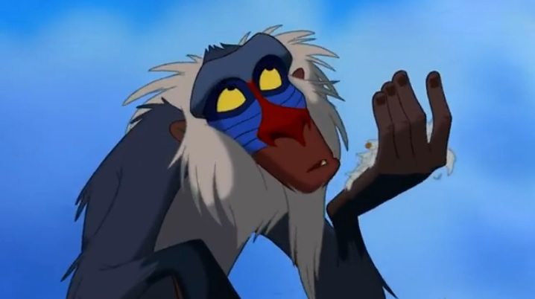
Lets read a story

Slide 11
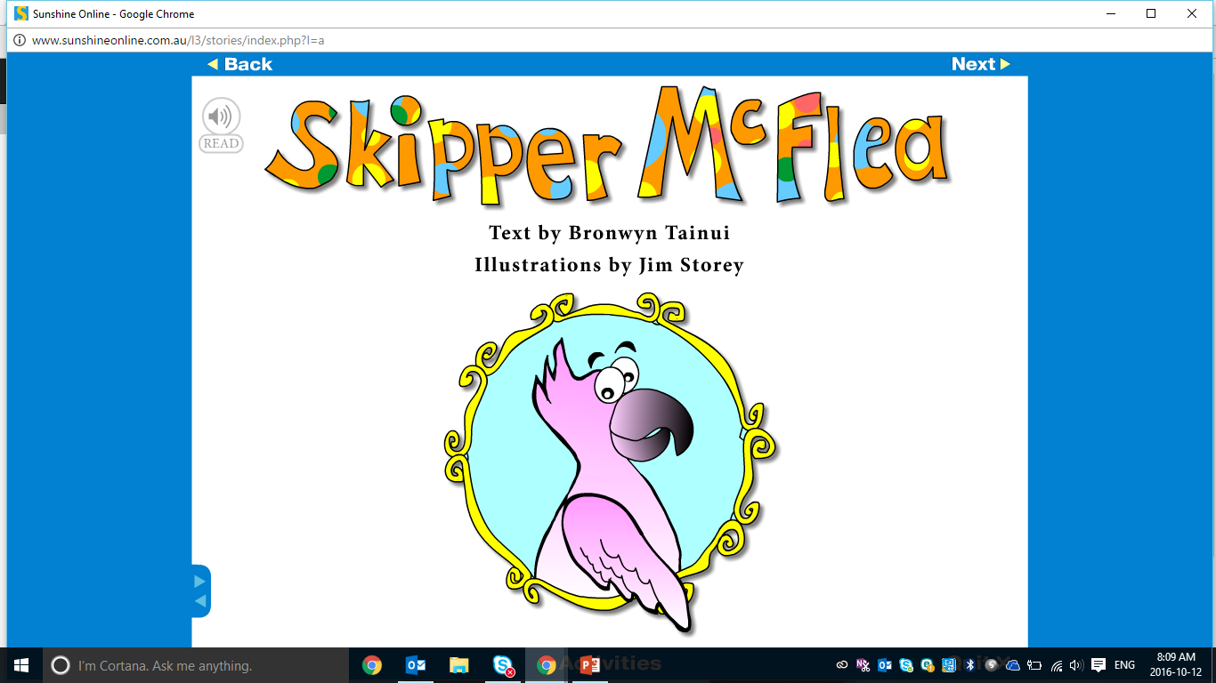

Slide 12
Pre-Reading Activities
What animal is Skipper McFlea?
Describe Skipper McFlea.
Can you guess the events of the story?

Slide 13
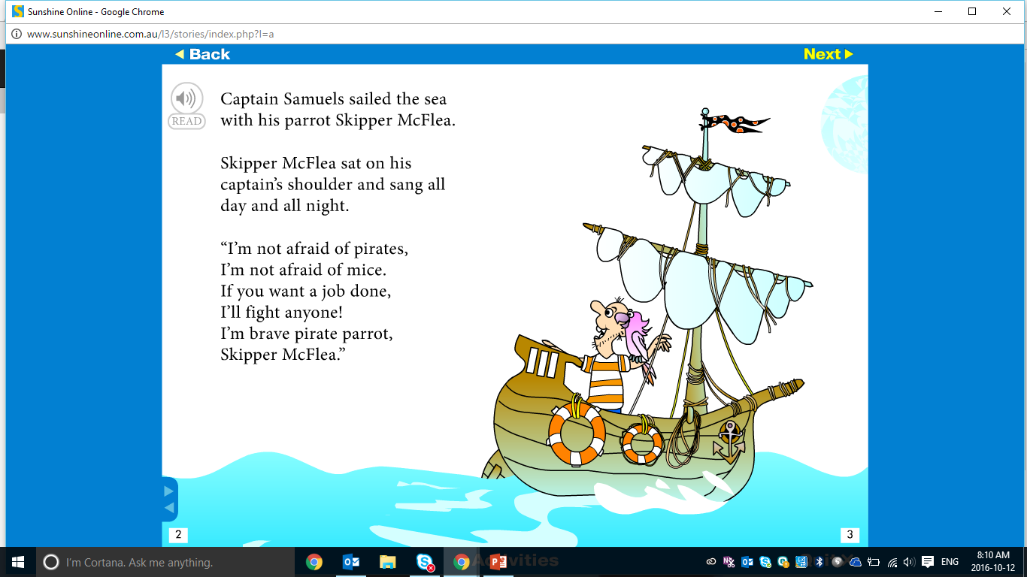

Slide 14
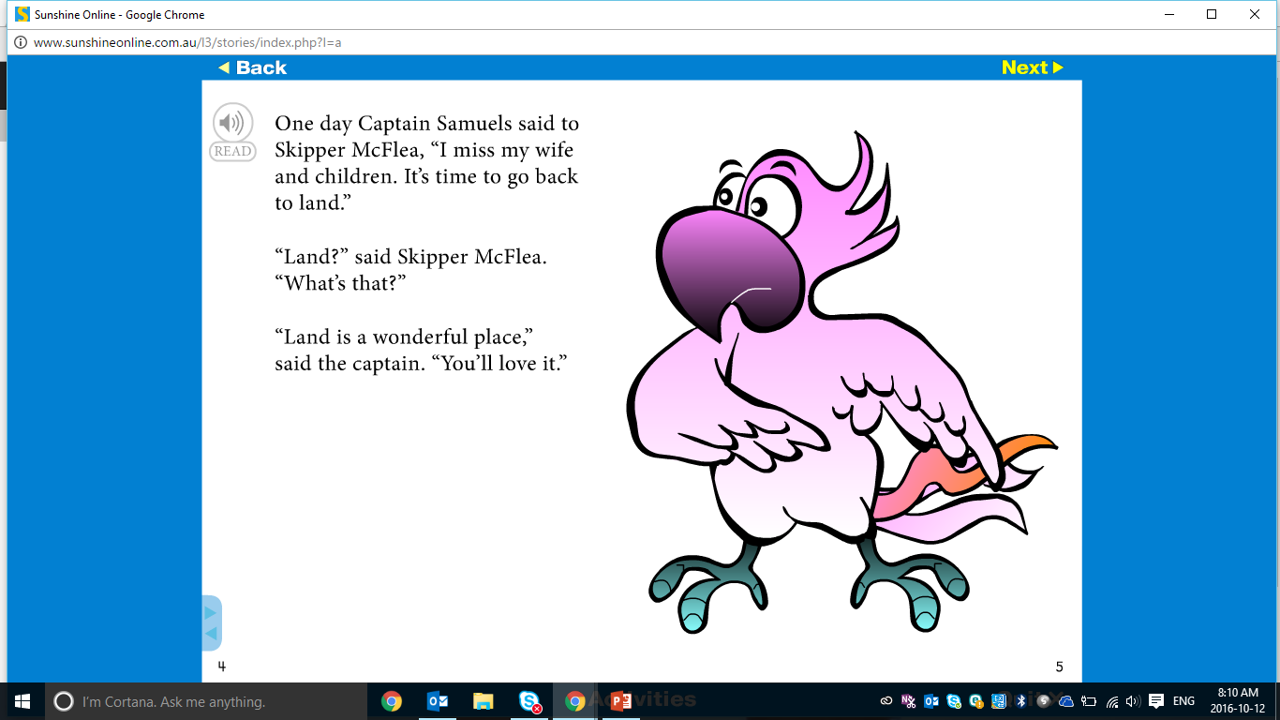

Slide 15
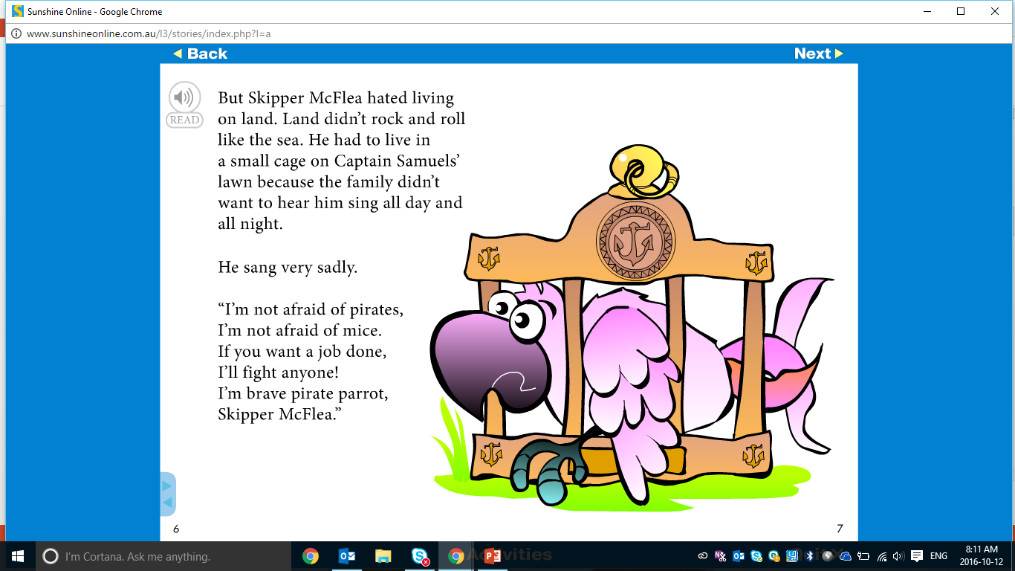

Slide 16
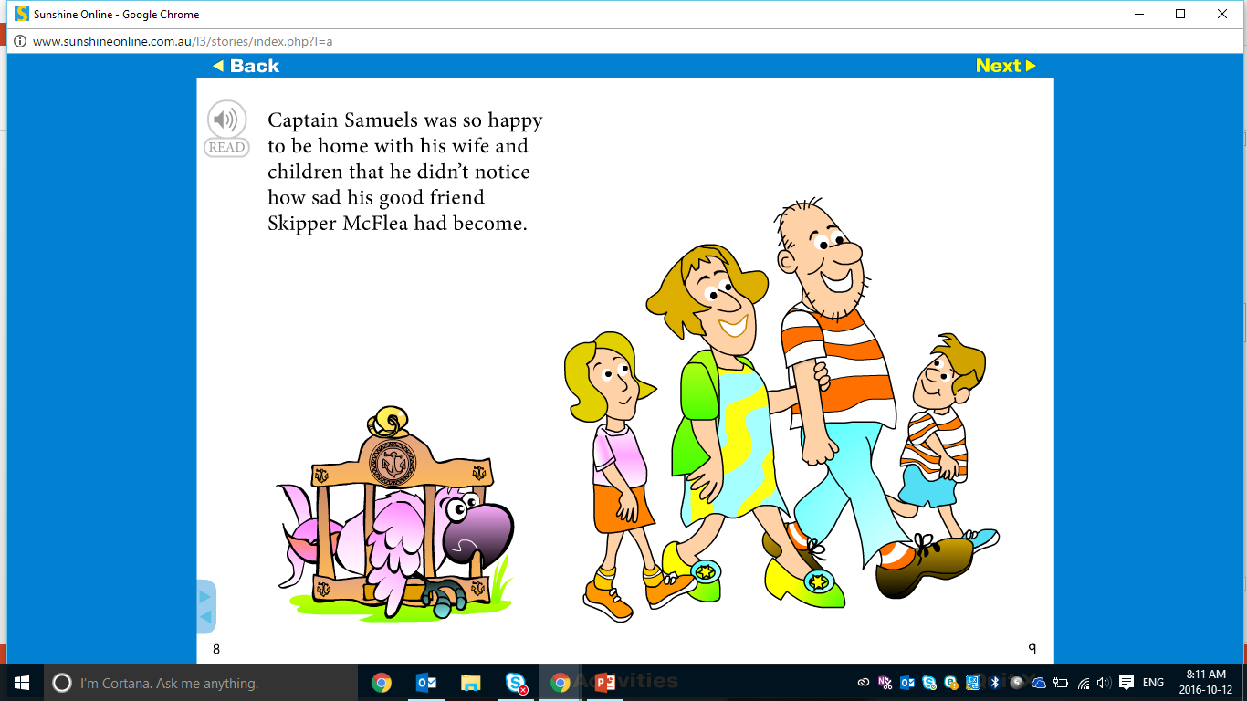

Slide 17
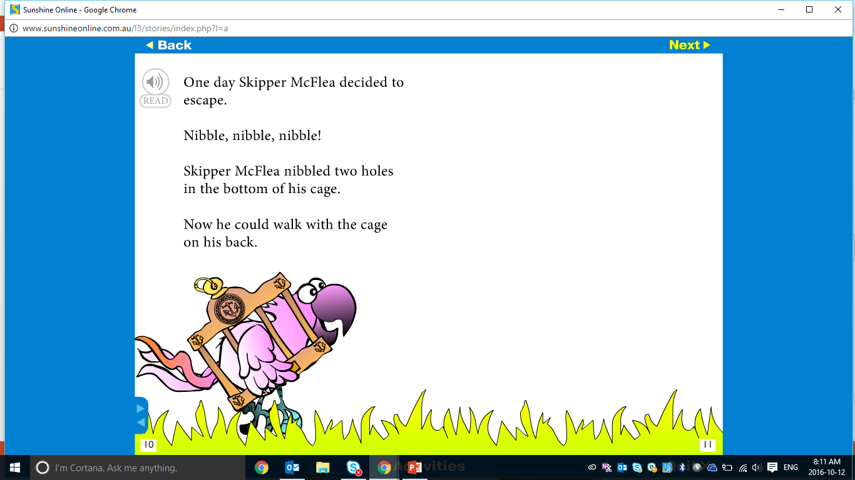

Slide 18
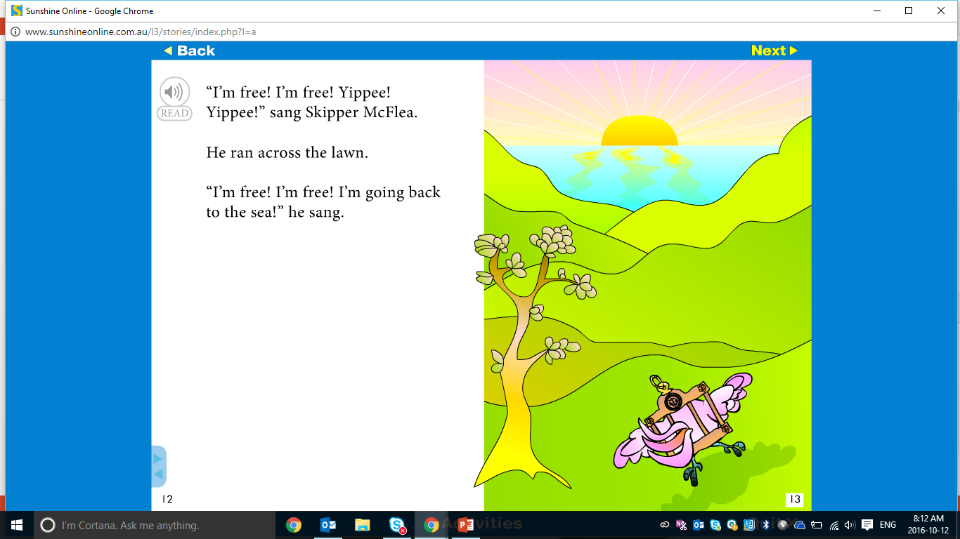

Slide 19
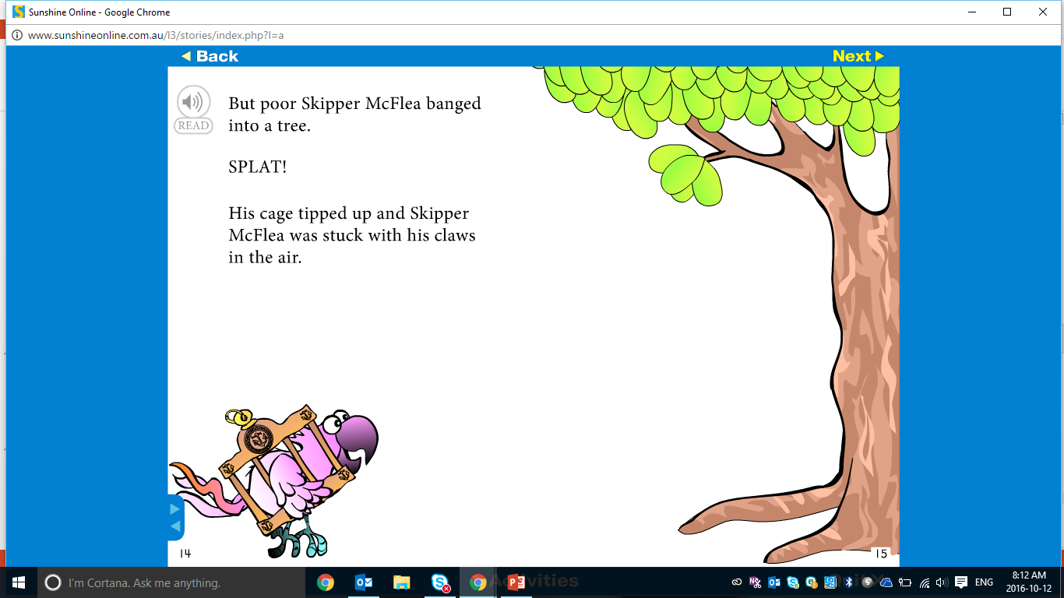

Slide 20
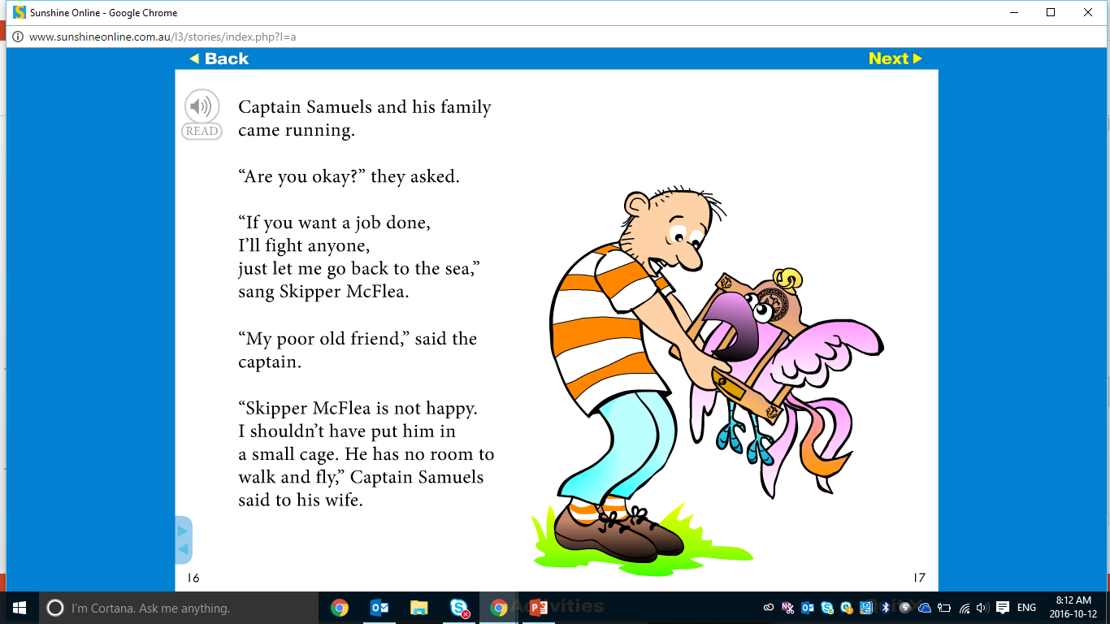

Slide 21
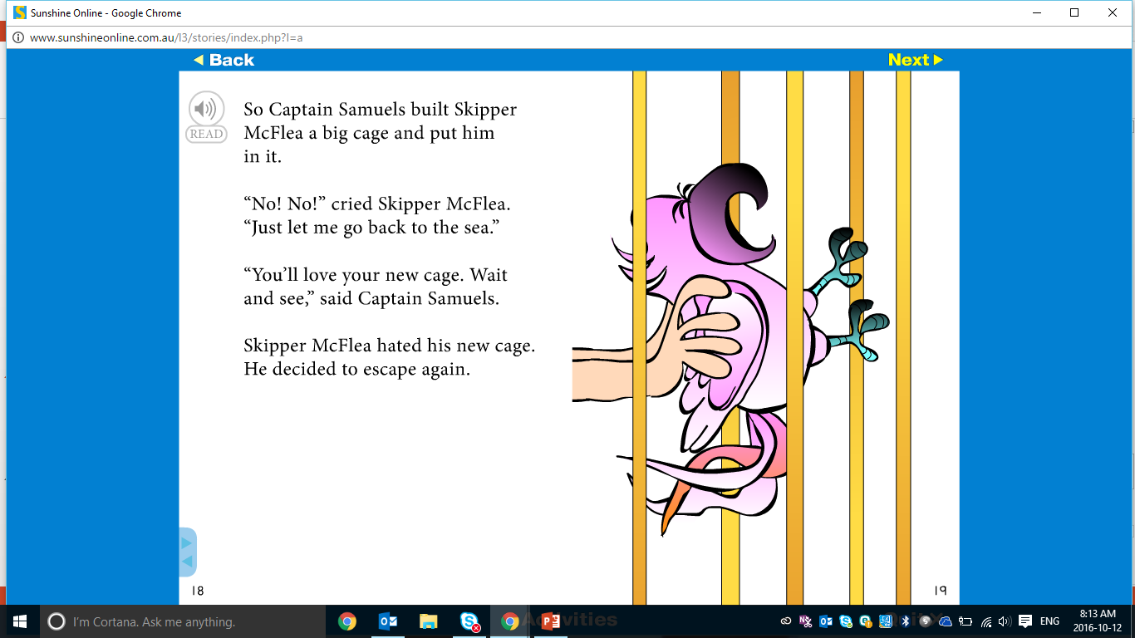

Slide 22
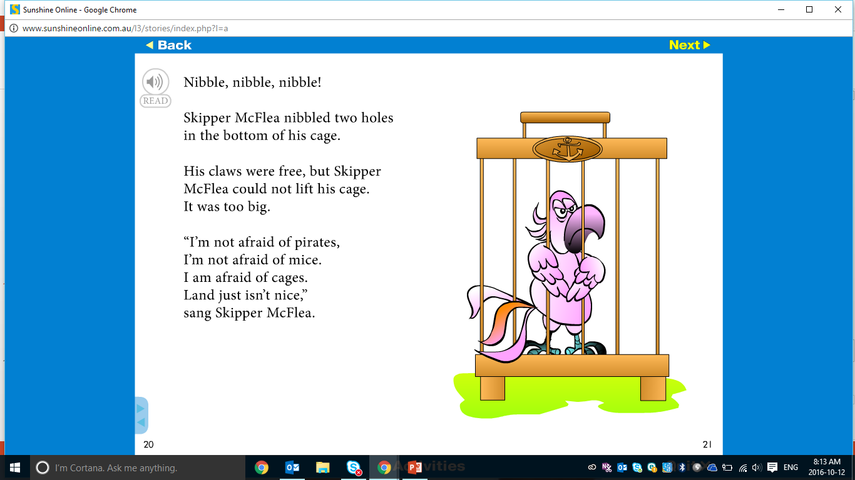

Slide 23
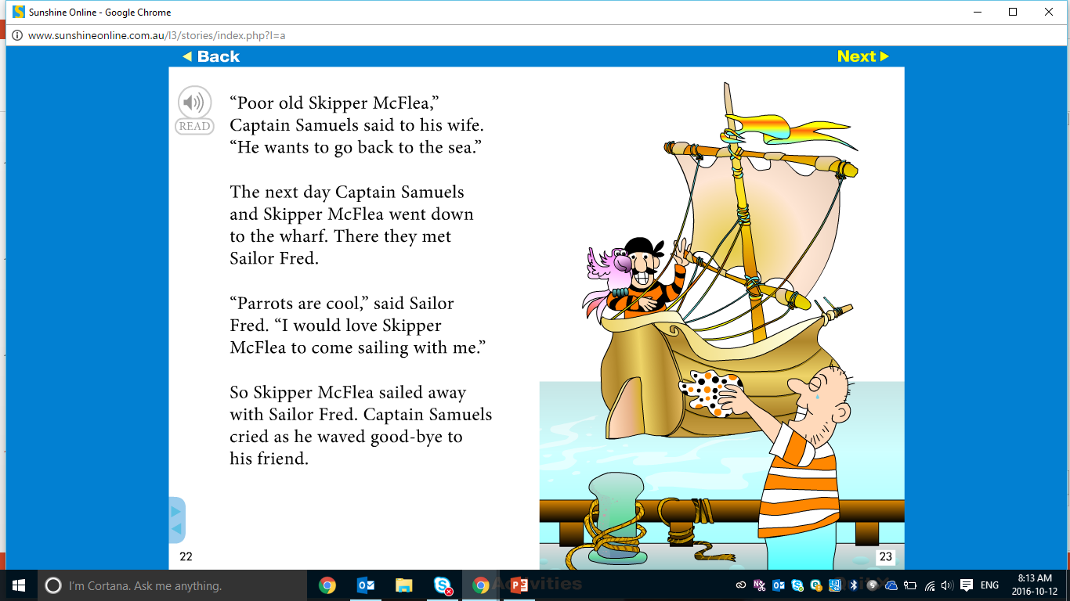

Slide 24
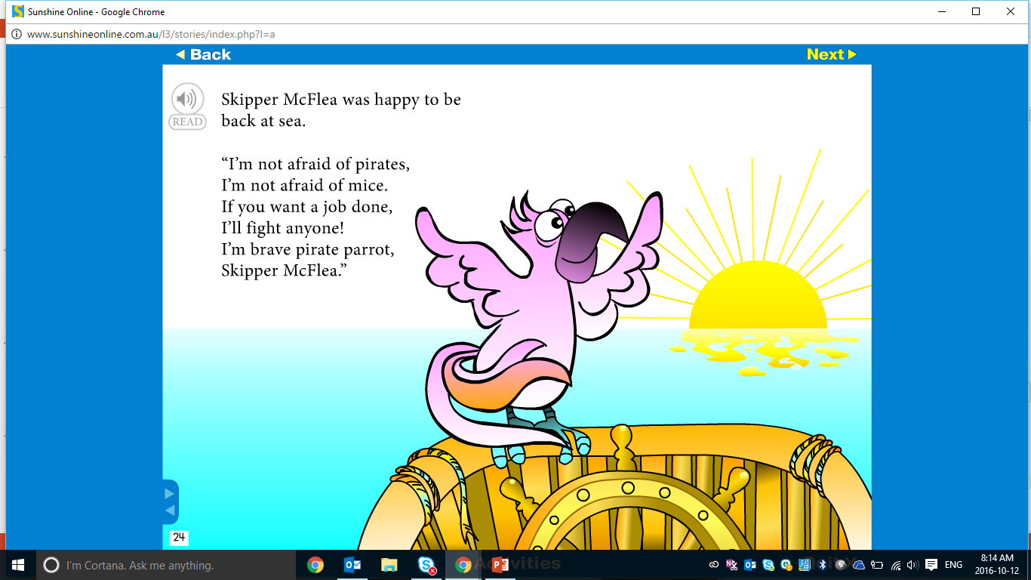

Slide 25
Post-Reading Comprehension Questions
Why did the pirate want to go back to the land?
Why was Skipper McFlea sad on the land?
Where did Skipper McFlea want to go after he escaped?
Why didn’t Skipper McFlea like cages?
How does the story end?

Slide 26
Reading Activity
The story ends as Skipper McFlea joins Sailor Fred on his pirate boat heading out to sea.
As a class, start the story of Skipper McFlea on his next great adventure.
Each student will write one line of the story.
Each sentence must have an Adjective and a Verb

Slide 27
Skipper McFlea and Captain Fred’s Great Adventure!

Slide 28
Students will:
Learn to use sounds (th) in speech and sentences.
Identify simple synonyms ✓
Notes:
m45yDiscuss the goals for todays lesson. Emphasize to the students that there writing and pictures must be descriptive.

Slide 29
LEARNING OUR WORDS!

Slide 30
Ready, Set, Go!
Have a competition with your classmate or on your own to list as many ‘th’ words as you can in 1 min.

Slide 31
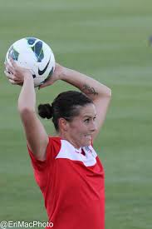
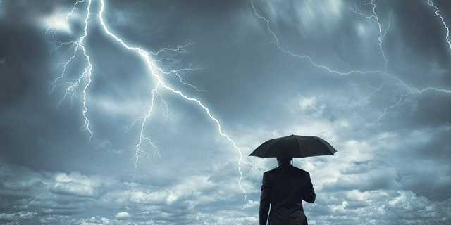
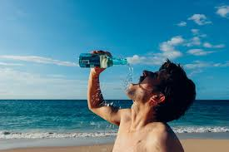
Write a definition for the ‘th’ words.
thunderstorm
throw
thirsty

Slide 32
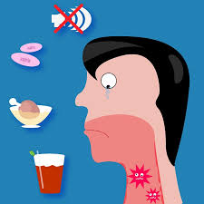

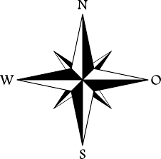
Write a definition for the ‘th’ words.
throat
thought
north

Slide 33
Write a silly story with as many ‘th’ words in each sentence as you can.

Slide 34
Students will:
Learn to use sounds (th) in speech and sentences. ✓
Identify simple synonyms ✓
Notes:
m45yDiscuss the goals for todays lesson. Emphasize to the students that there writing and pictures must be descriptive.

Slide 35
Homework
Continue the story of Skipper McFlea on his next great adventure with Captain Fred.
As a class you began this story.
Complete the story for homework and add an illustration showing Skipper McFlea having fun with Captain Fred.

Slide 36
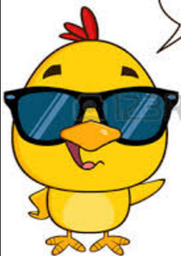
Final Thoughts
Do you have any questions?

