Slide 1

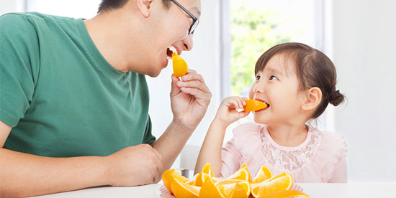
Taking care of our bodies
Unit 5: Lesson 1

Slide 2

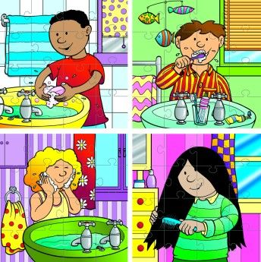


What will we be learning about?
The sound that (ee) makes!
Using the word could in conversation!
Taking care of our bodies

Slide 3

What sound does (ee) make?
Let’s practice saying these words together:
See
Feet
Teeth
Keep
Feel
Sleep
What did you notice? The letters (ee) together say their own name!

Slide 4

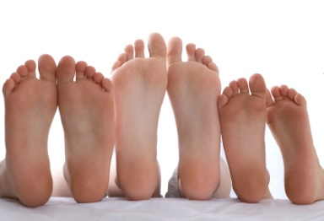

Can you match the pictures to the words?
See
Feet
Teeth
Keep
Feel
Sleep
Can you think of any other (ee) words? Share them with the group!
Notes:
Students can share words that have the double (ee) sound
Other words to share: feed, deep, seem, free, need, seed, tree, bee, speech, queen, three, week, cheek, meet, agree, disagree…ect

Slide 5
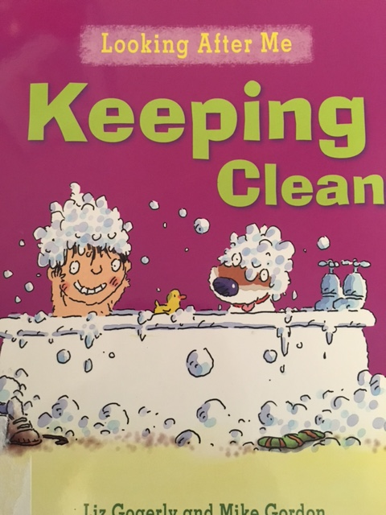
Keeping Clean
We are going to read a book about keeping clean. Try to find as many (ee) words as you can!

Slide 6
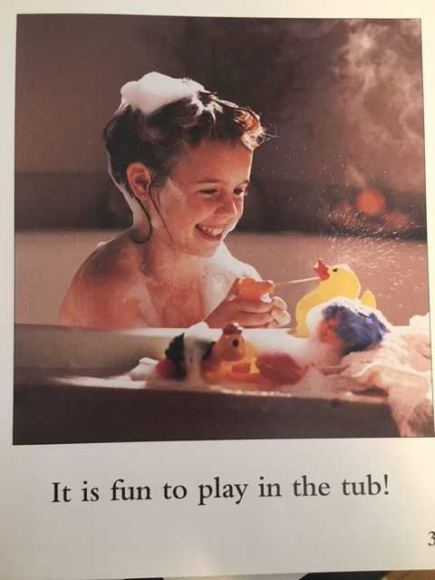

Slide 7
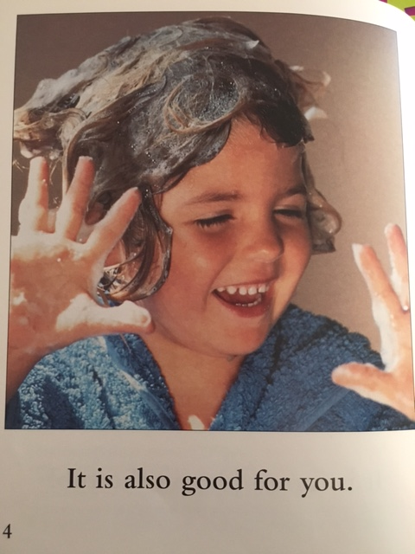
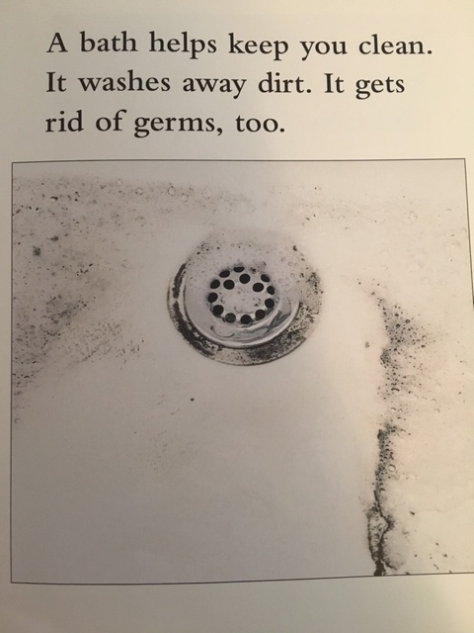

Slide 8
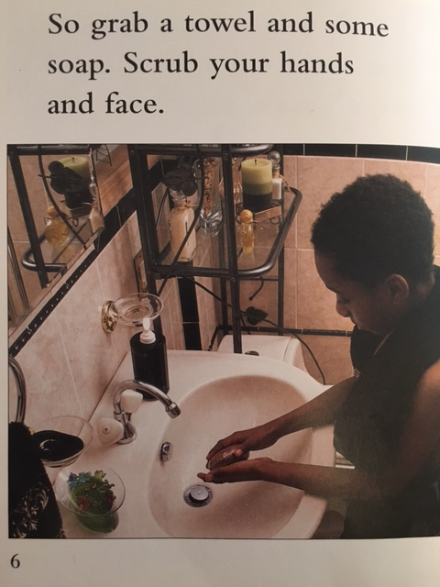
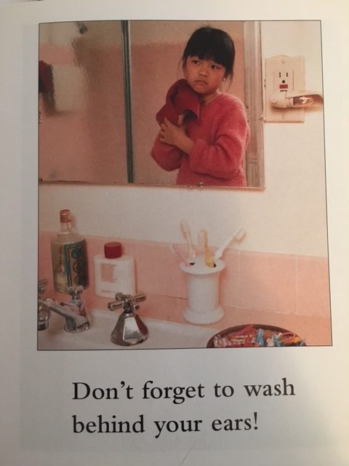

Slide 9
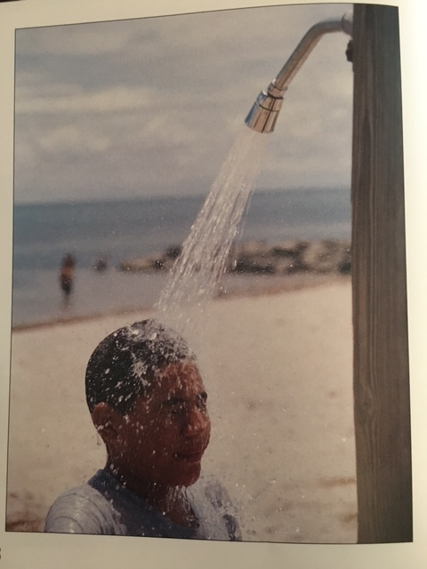
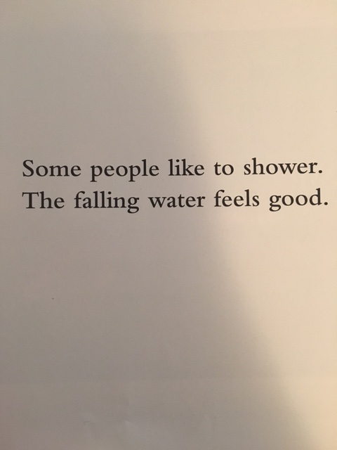

Slide 10
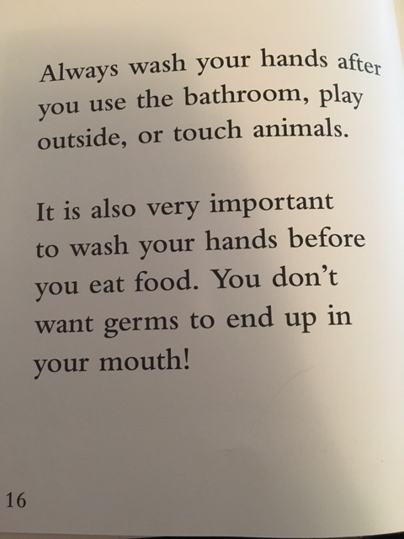
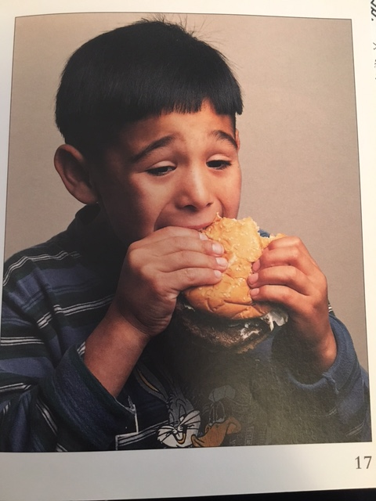

Slide 11
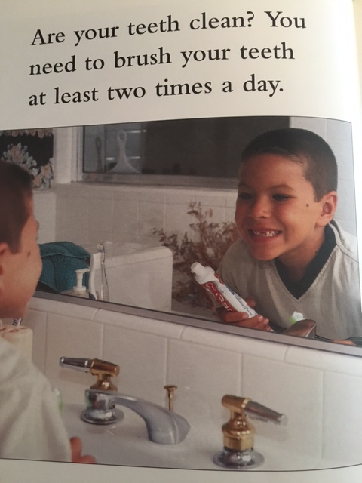
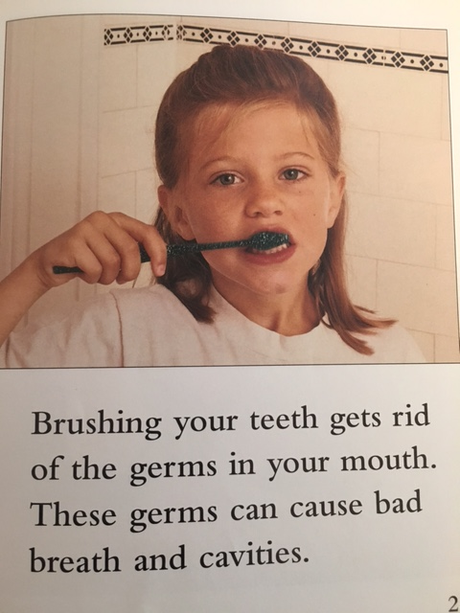

Slide 12
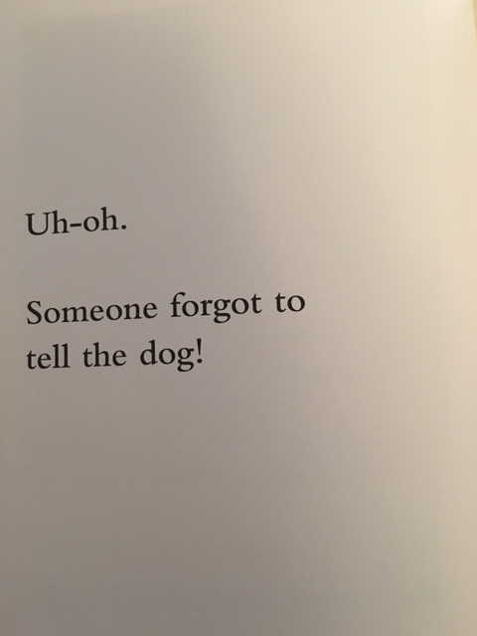
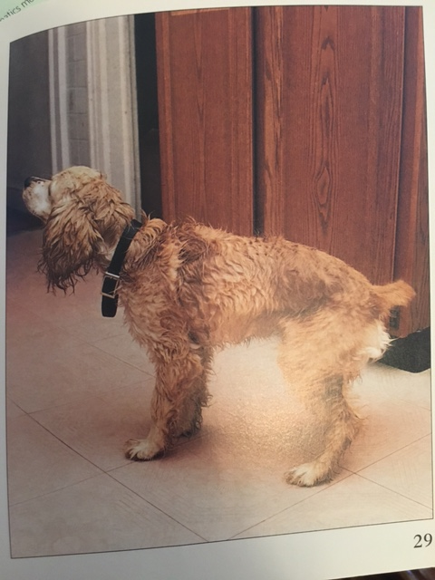

Slide 13
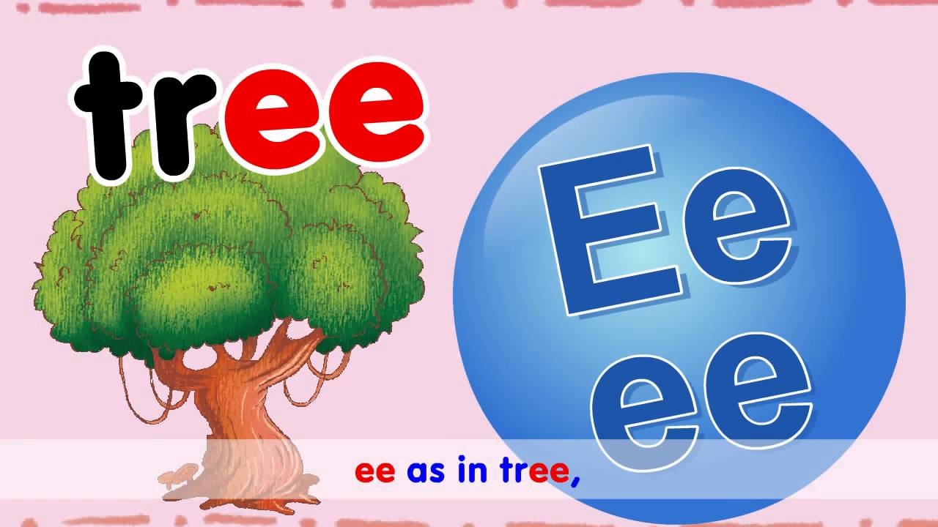

Slide 14

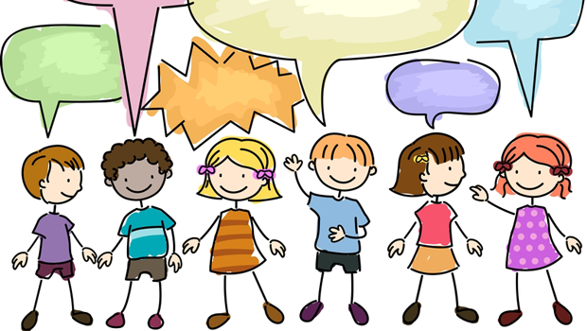
Let’s Practice these tongue twisters together:
1.) I see a peach seed.
2.) A seal is on the beach.
3.) Did you meet the queen?
4.) The green leaf is on the tree.
5.) Keep your feet off the seat!
Notes:
Make this as fun as possible! There should be lots of giggling here! Be sure that students understand the sentences but know that they are silly and playful. Discuss the hard (e) sound and that it comes when one e is followed by either another (e) or an (a)

Slide 15
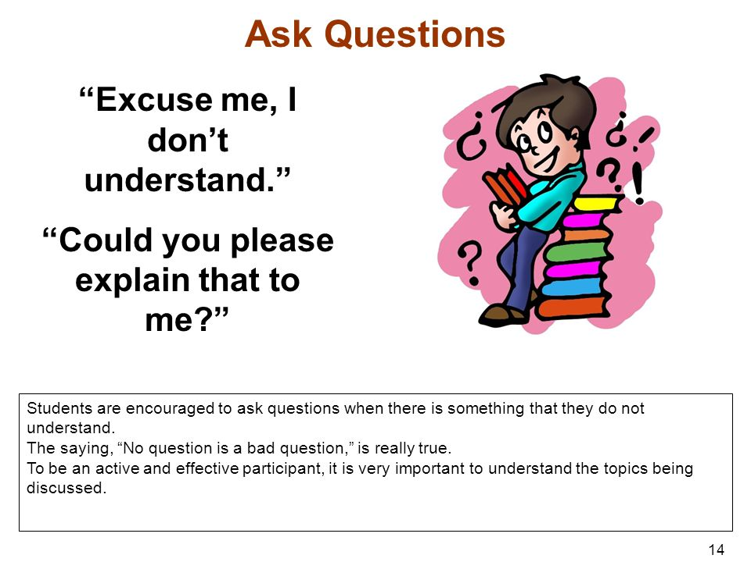
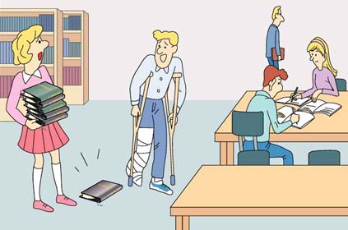
Could you? Would you?
Could is a word that means that something might happen.
Or you might use it when you are asking a question.
Notes:
Ex. Could it rain today?
It could also be something that has already happened (past tense)
Ex. Vanessa could swim by the time she was three.
Have students asks questions about the photo on the right that use could? Ex. Could the man using crutches pick the book up by himself?

Slide 16


Scenario
Response
Ex. It is very cloudy outside
Your turn:
Swim
Read
Dance
Think up your own example
Think up your own example
R: It could rain today
R:
R:
R:
R:
R:
Notes:
https://learnenglishkids.britishcouncil.org/en/grammar-practice/modals-could-and-couldnt

Slide 17
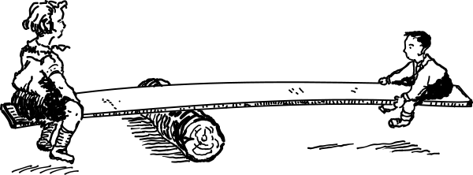
Conversations
Having conversations is like being on a see-saw, you have to take turns, go back and forth and reply to what someone else has said.

Slide 18
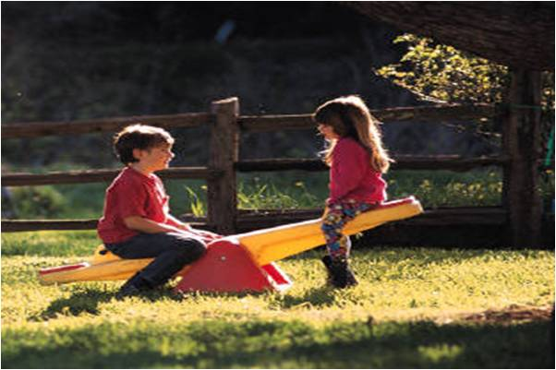
Taking Turns
Conversations go back and forth from one person to the other and can be about many different topics (things!). You can try taking turns in conversations by:
1. Asking Questions
2. Making comments (about what someone has just said)
3. Telling Stories
Notes:
http://thesocialexpress.com/teaching-child-start-conversations-3-brilliant-basics/
Asking questions. When practicing the asking questions step “w” words like who, what, when, where, and why (also, how) are great questions!
On the next slide you will see a picture, let’s take turns asking questions about it!

Slide 19
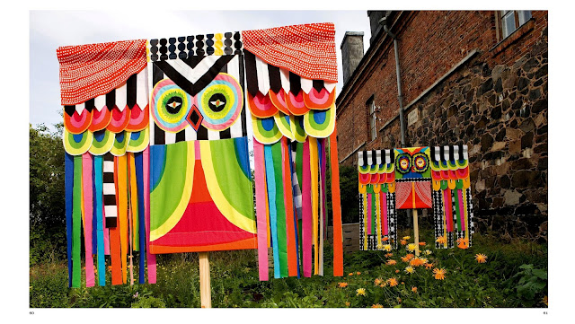

Slide 20

MAKING COMMENTS
Making comments means that you will listen to what the person has said and you will give your opinion about it.
For example if someone says: “It is a very nice day today”
You might comment by saying: “Yes, I hope I can play outside today”

Slide 21

Telling Stories
Telling stories. There are so many things you can tell a story about.
For example: a family trip to the zoo, a movie you really liked or other fun event that happened to you!
Let’s brainstorm some things that you can tell a story about!

Slide 22
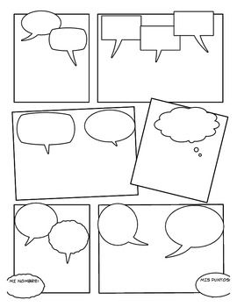

Telling Stories
Use this comic strip planner to tell your own story!

Slide 23
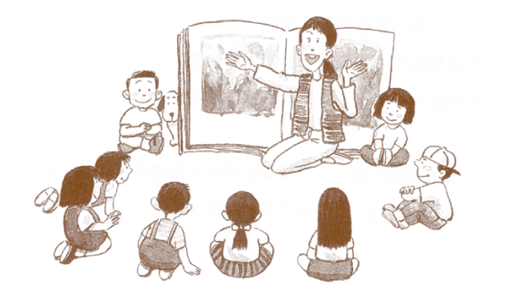
Let’s Review
Today we learned:
The sound of (ee)
Using the word “could”
How we keep our body clean
Taking turns in conversation
This week: create your own comic story. Use 3 (ee) words in your comic!

