Slide 1
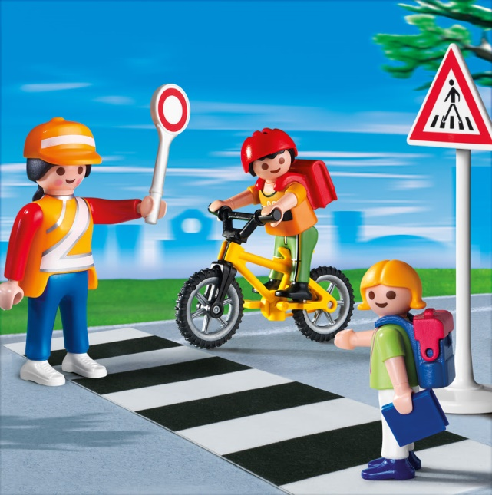
Safety Around Strangers Lesson 10

Slide 2
We will be learning:
Sounds (ay)
More simple synonyms (fast and quick, etc.)
Quantifiers: any, some, much, many, a lot
Review sounds (ew)
Personal note format; common expressions in a thank you note

Slide 3
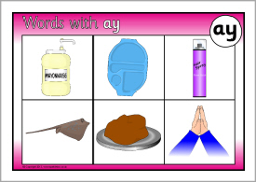
Let’s Pl-ay with “AY”

Slide 5
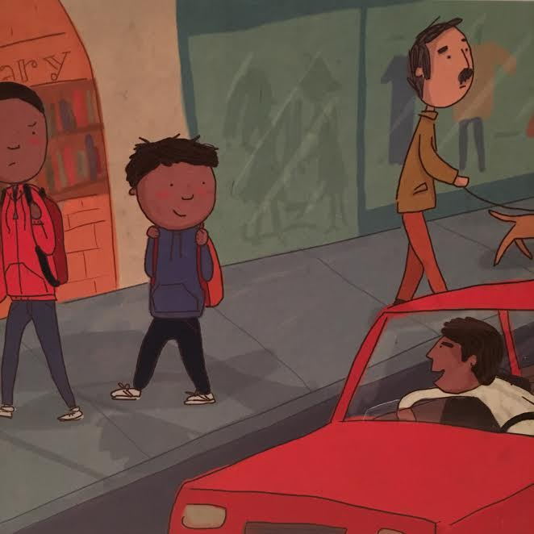
Safety Around Strangers
By: Bridget Heos Illustrated By: Silvia Baroncelli

Slide 6
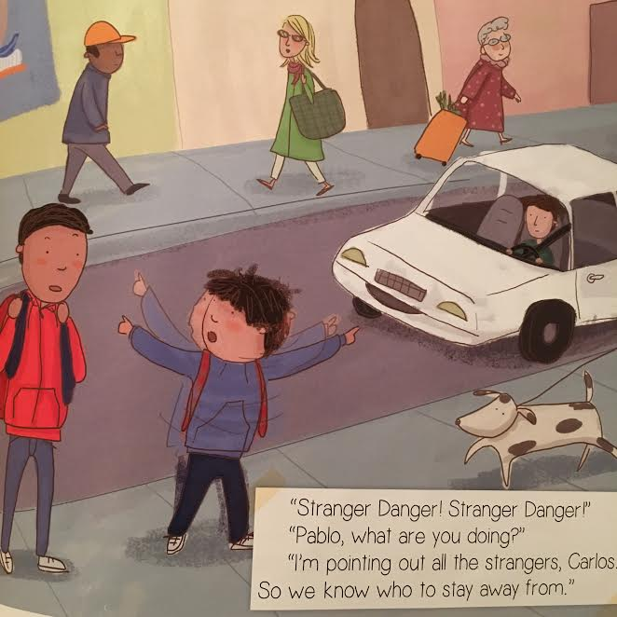

Slide 7
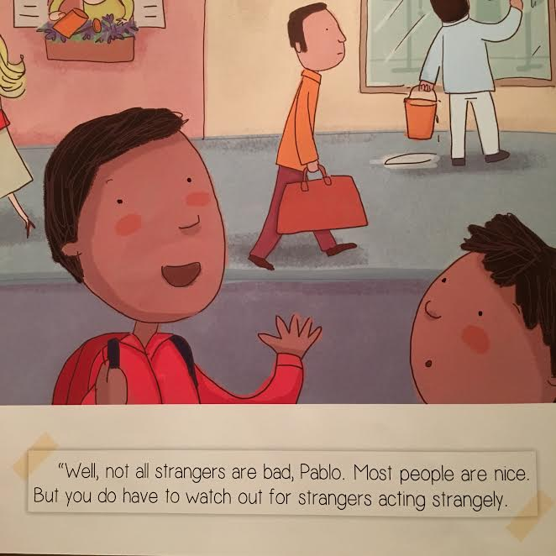

Slide 8
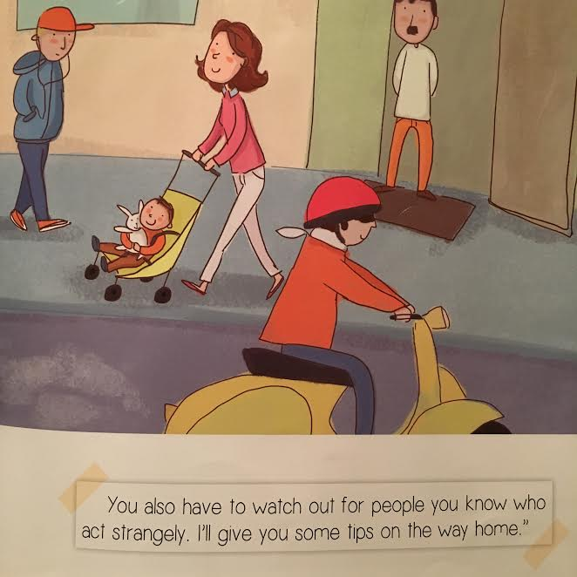

Slide 9
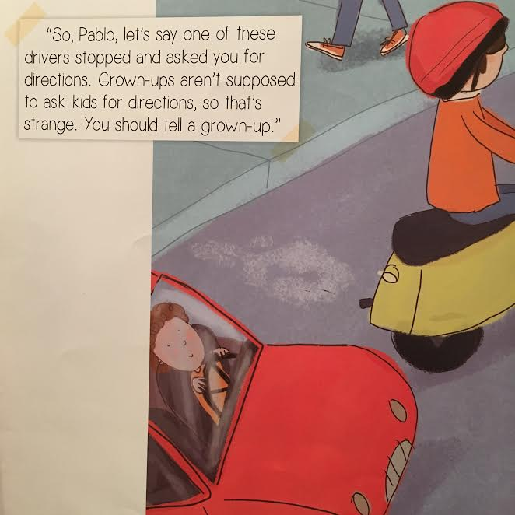

Slide 10
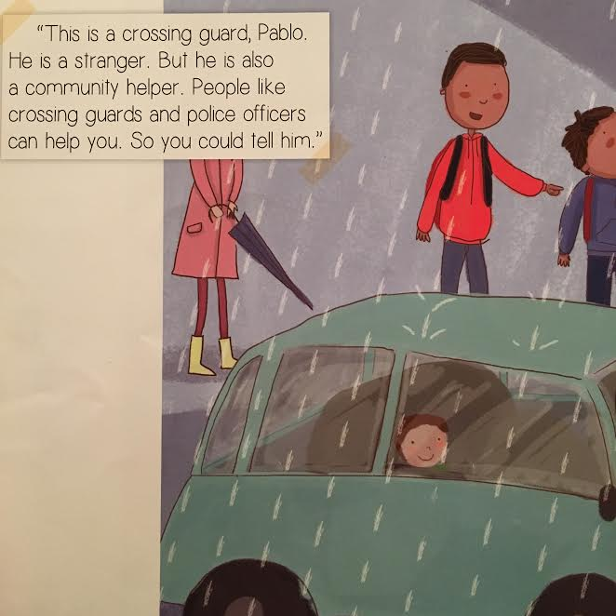

Slide 11
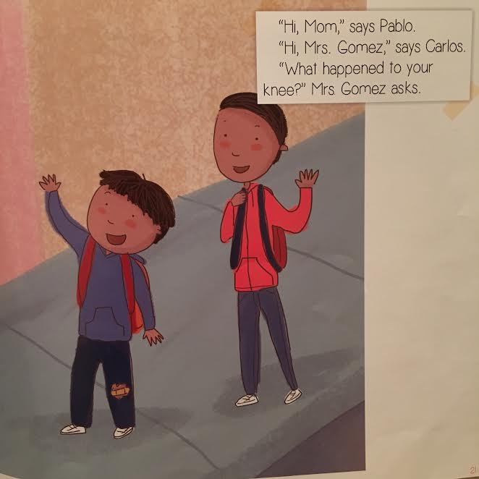

Slide 12
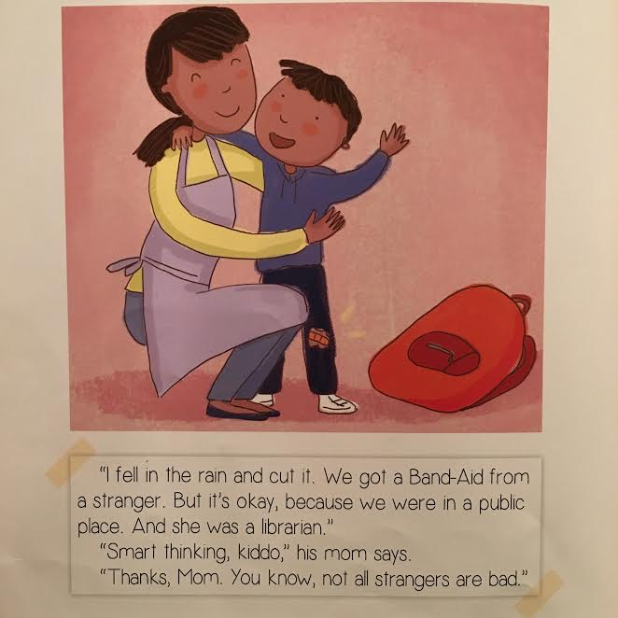

Slide 13
Synonyms

Slide 14
More words that mean the same!!

Slide 15
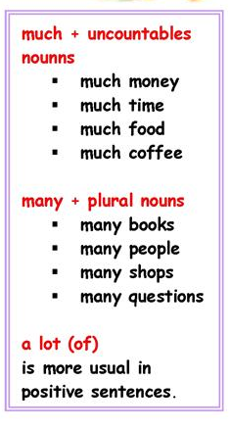
Quantifiers – Much, Many, A Lot
Much or Many?
___________ pens
___________ lemonade
___________ peaches
___________ sugar
___________ children
___________ rice
Positive: I have a lot of crayons.
Negative: I don’t have many crayons.

Slide 16
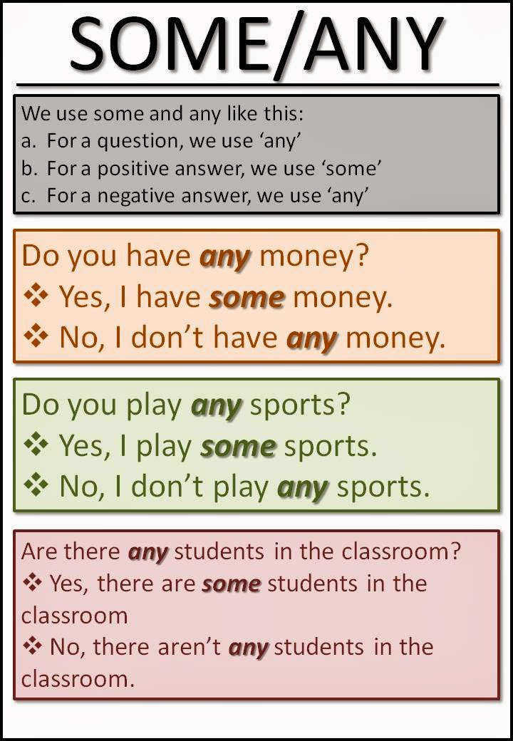
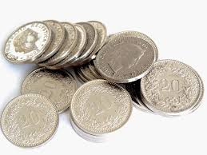
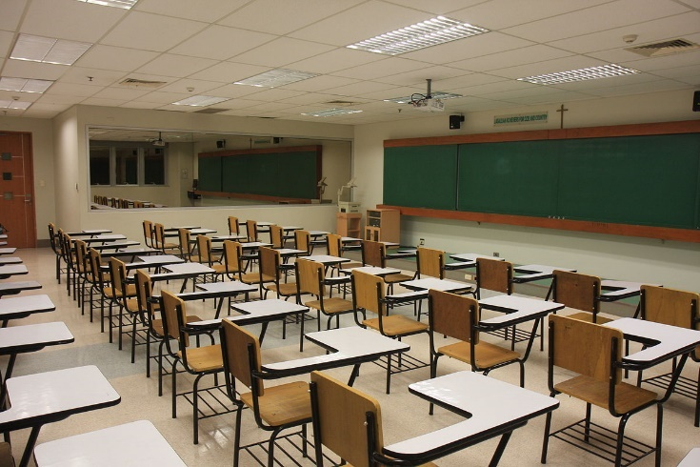

Slide 17
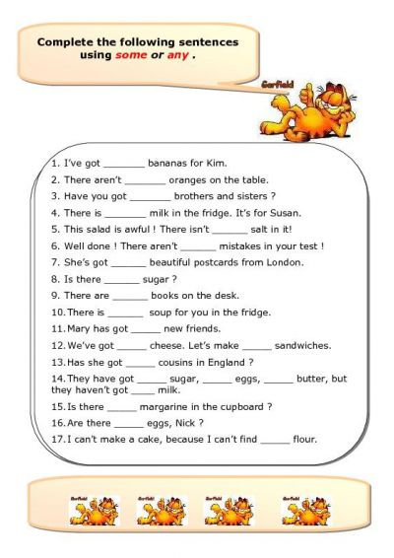

Slide 18
Let’s Revi-ew “EW”
few
new
hew
knew
stew
news
view
mew
review
grew
flew
blew
chew
slew
crew
chewing gum

Slide 21
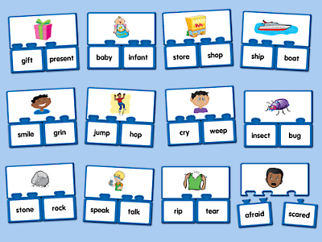
We have learned:
How to write a letter
The “EW” sound
Some/Any, Much/Many/A Lot
Synonyms
The “AY” sound

Slide 22
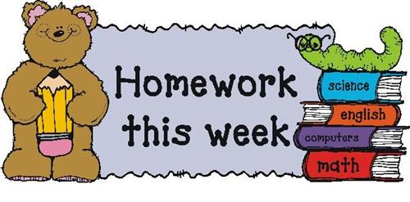
Complete the worksheet about synonyms.
Complete the worksheet about using some or any.

