Slide 1
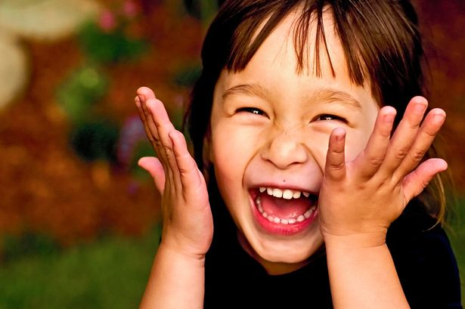
Clean and Healthy Teeth Lesson 11

Slide 2
We will be learning about:
EW words
Rhyming and Repetition
Writing poems
Keeping our teeth clean

Slide 3
Keeping your teeth healthy
What do you do when you brush your teeth?
Notes:
https://www.youtube.com/watch?v=lnHIgRhJctc

Slide 4
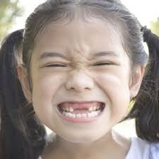
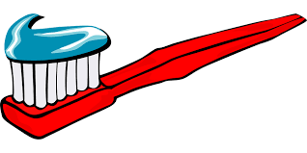
My Tooth
My tooth fell out and left a space
So big my tongue can touch my face,
And every time I smile I show
The place where something used to grow.
I miss my tooth as you can guess
But now I have to brush one less!

Slide 6
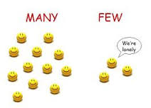
More EW Words
Ew
few
new
sew
news
view
grew
chew
chewing gum

Slide 7
Rhyming words are words that have the same sounds at the end.
Cat and Bat

Slide 9
It’s time to RHYME

Slide 11
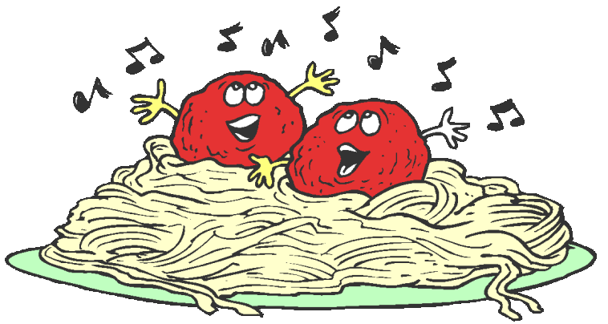

Slide 14
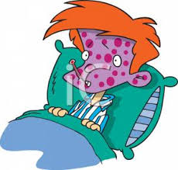
I
I have the measles and the mumps,
A gash, a rash, and purple bumps.
By
Shel Silverstein

Slide 15
Let’s Learn about
SYLLABLES
Watch the video

Slide 17
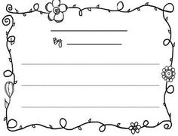
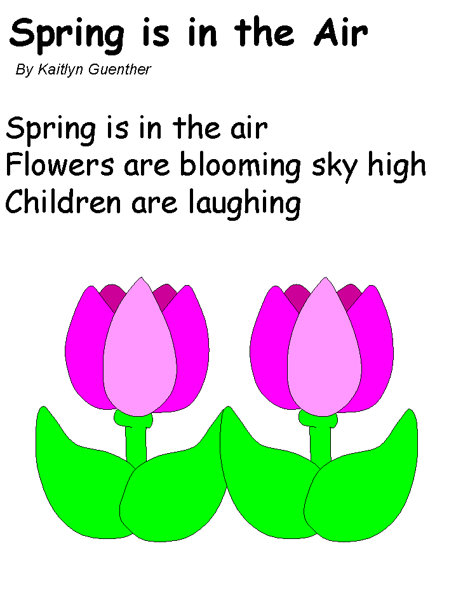
Let’s Try it!

Slide 18
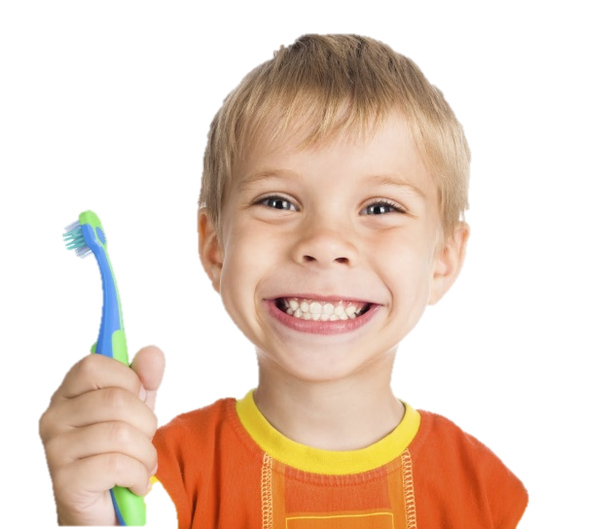
Taking care of our teeth
Poetry!
“EW” words
Rhyming Words
What did we learn today?

Slide 19
Complete both the EW words and the Rhyming words worksheet for homework.
Any questions?

