Slide 1
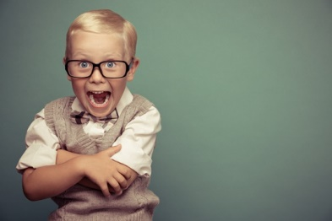
Let’s Review Lessons
9-11

Slide 3
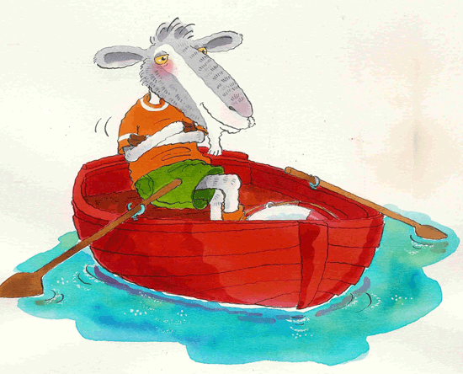
Could you? Would you? With a goat? Could you? Would you? On a boat?

Slide 4
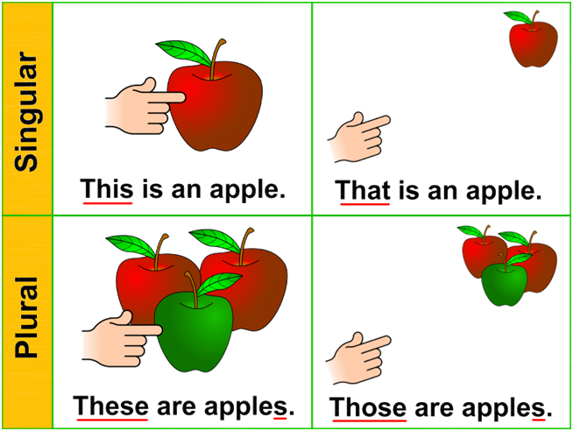
Let’s practice asking for specific objects!

Slide 5
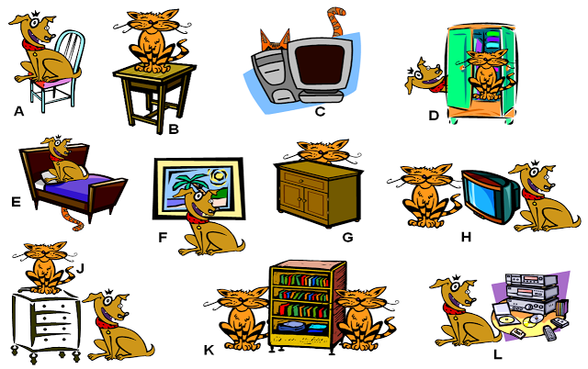

Slide 6
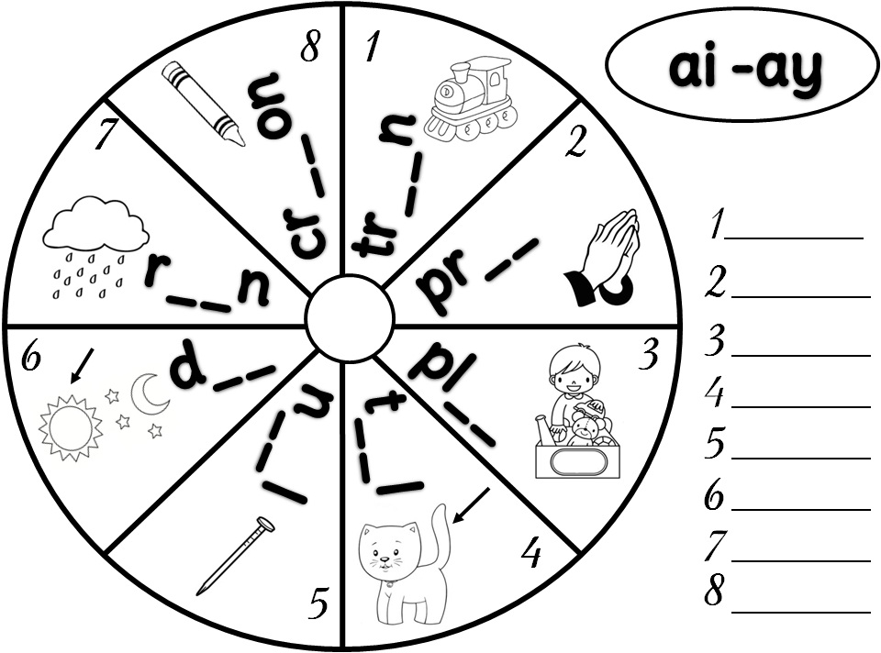

Slide 7
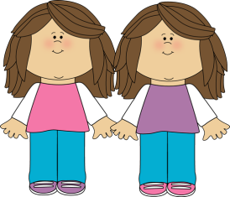
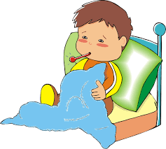
Practicing words that mean the same:
Start
Sick
Alike

Slide 8
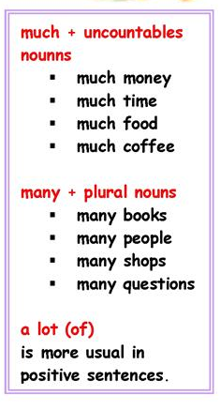
Quantifiers – Much, Many, A Lot
Much or Many?
___________ pens
___________ lemonade
___________ peaches
___________ sugar
___________ children
___________ rice
Positive: I have a lot of crayons.
Negative: I don’t have many crayons.

Slide 9
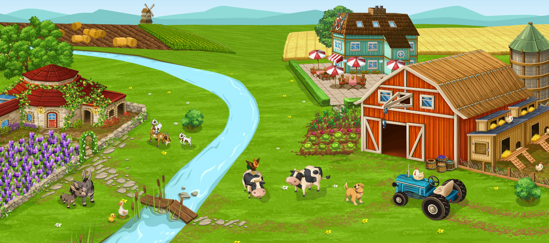

Slide 11
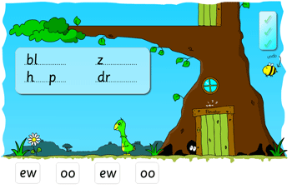

Slide 12
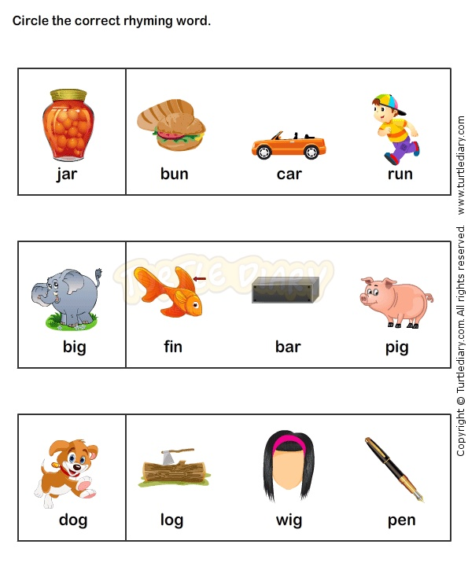
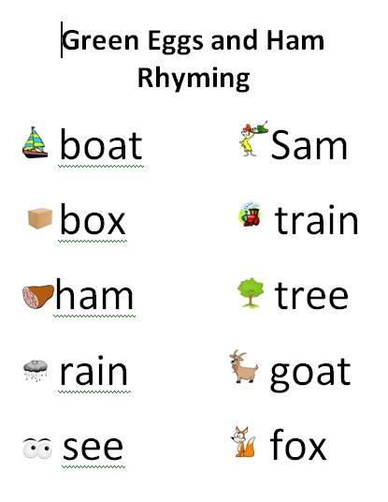

Slide 13
Let’s try writing a poem:

Slide 14
Let’s Review
The “OA” Sound
Asking for specific objects
(This/That/These/Those)
Letter writing
Prepositions
Synonyms

