Slide 1
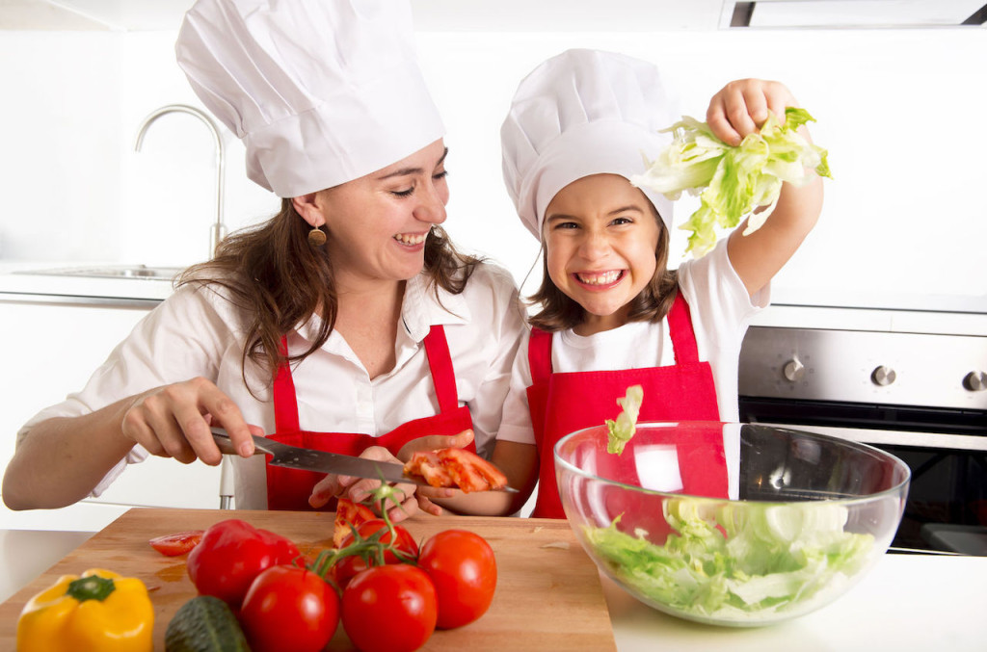
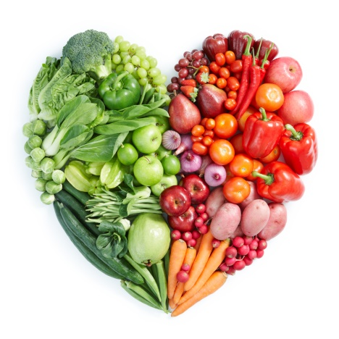
EATING WELL FROM A-Z
Unit 5, Lesson 3

Slide 2
What are we Learning Today?
Alphabetical Order
Gestures and Mime to clarify meaning
Order by expiry date
The importance of eating well

Slide 3
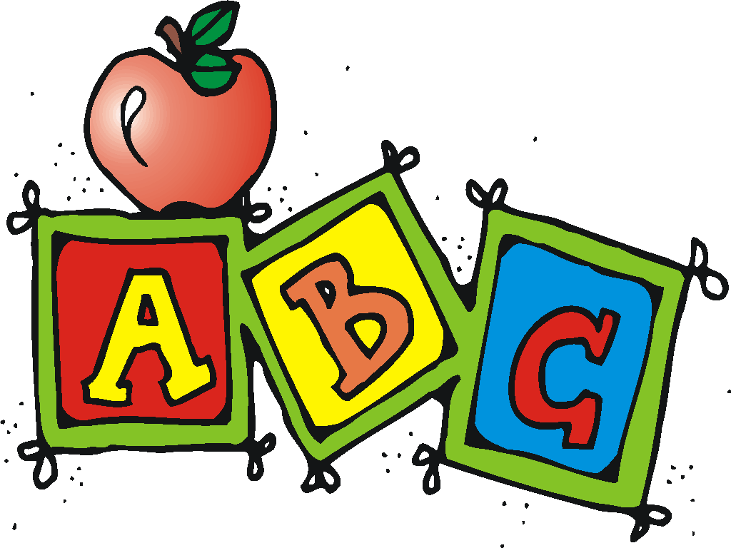
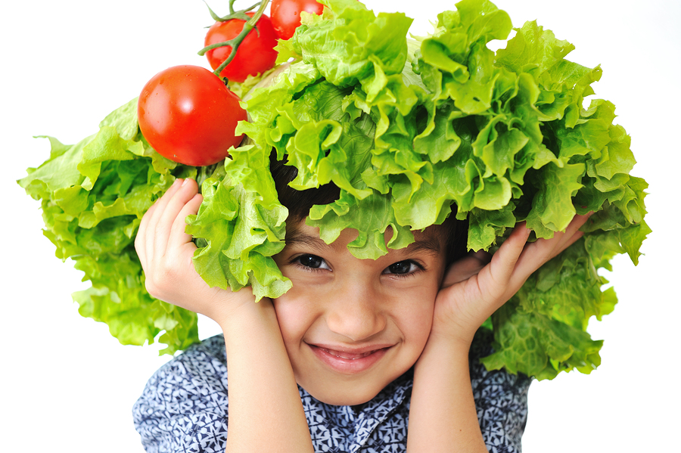
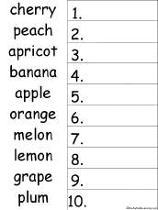
Alphabetical order
Alphabetical order means sorting words in a list by the order of the alphabet.
Sometimes people call it “A-B-C” order

Slide 4
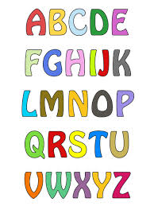
Let’s put these foods into alphabetical order
Notes:
https://www.youtube.com/watch?v=oCDYoEm5Ls8

Slide 5
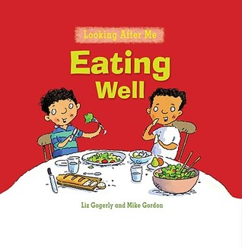
A story about the importance of eating healthy and good foods that will help you grow big and strong!

Slide 6
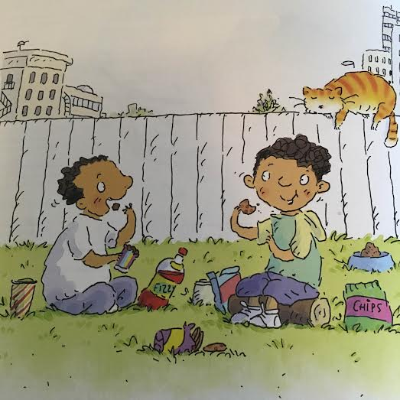
I love staying over at my friend Ethan’s house. We eat the best snacks ever!

Slide 7
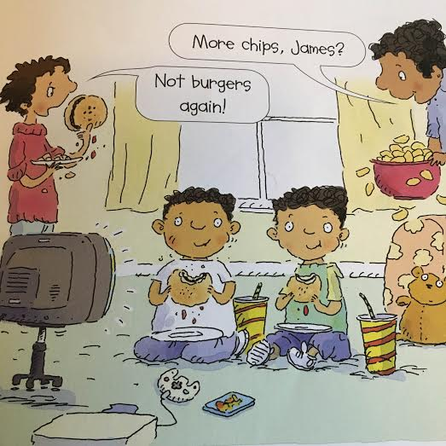
At lunchtime, Ethan’s family eats the greatest food in the world and best of all, we are allowed to eat in front of the television!

Slide 8
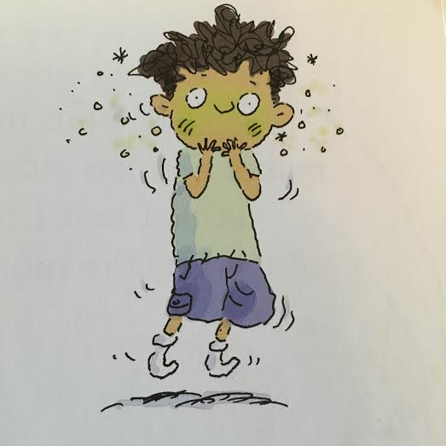
Later we had a midnight snack. But, it wasn’t all fun and games. My stomach started to feel very sick, we ate too much!

Slide 9
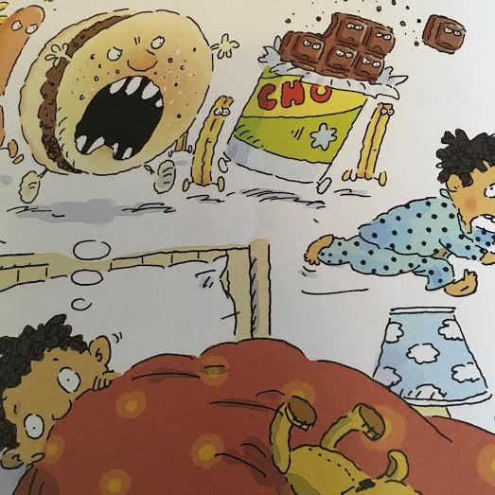
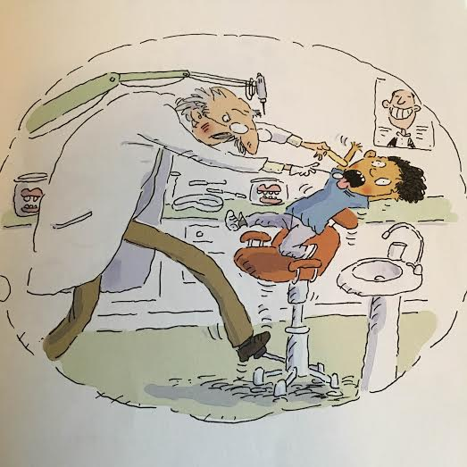
Dad said, “Too much junk food makes you feel sick.”. He tucked me in and I fell asleep. But, then the nightmares began…

Slide 10
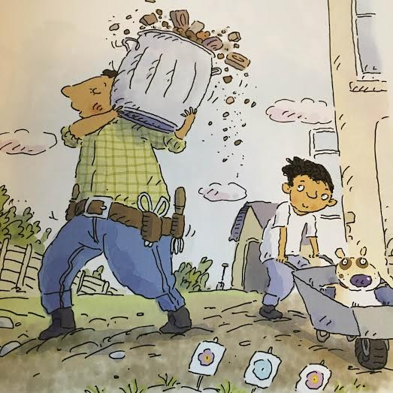
When I grow up, I don’t want to be unhealthy. I want to be strong, just like my Dad!

Slide 11
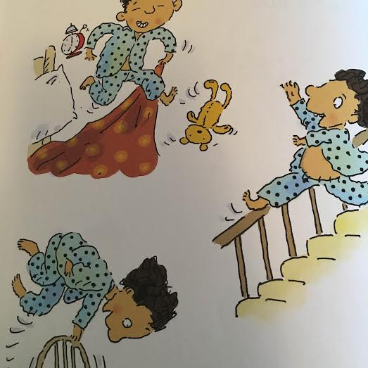
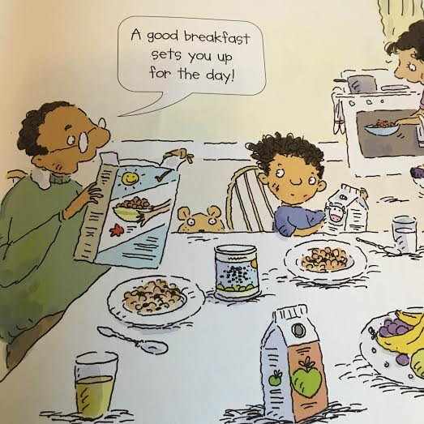
I want to feel good and have a lot of energy. Dad says that one of the secrets of staying fit and healthy is eating well.

Slide 12
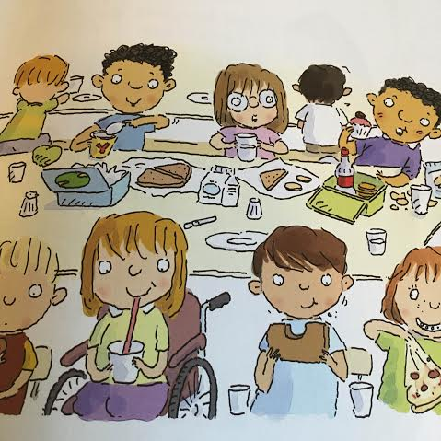
At school the next day, I ate my sandwich and yogurt and drank some ice-cold water for lunch. I told all my friends about how important it is to eat well.

Slide 13
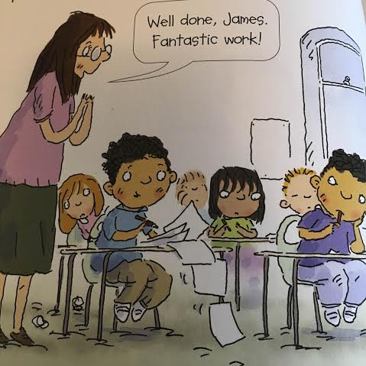
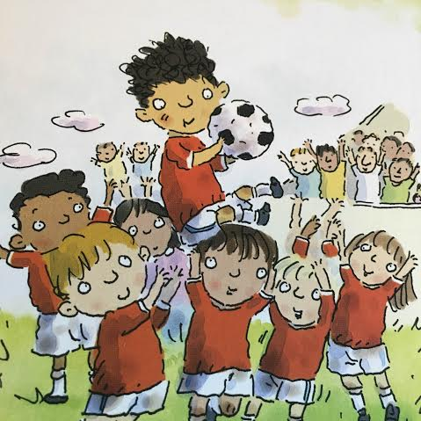
Because I ate such a healthy lunch, I whizzed through my school work. But best of all, I scored TWO goals in our soccer match!

Slide 14
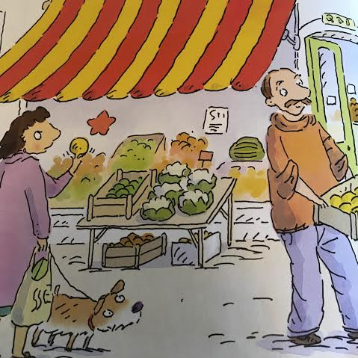
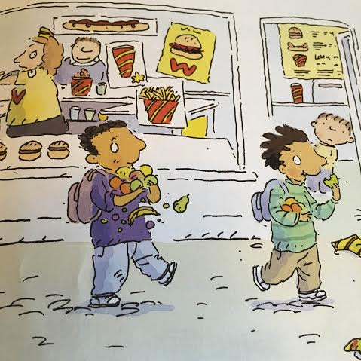
I felt great and I wanted Ethan to feel great too so, I shared the secret of eating well with him. Everyone needs plenty of fresh fruit and vegetables, at least five a day.

Slide 15
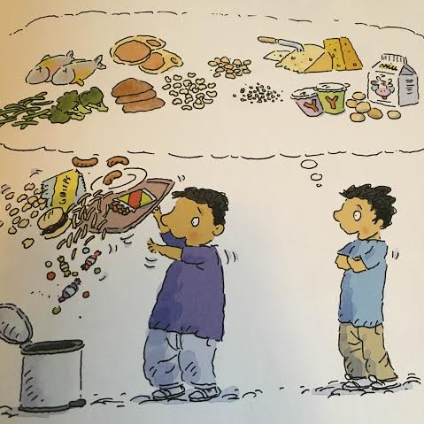
To eat well eat fresh fish, lean meat, chicken, beans, nuts and seeds.
Cheese, yogurt and milk are good for your bones and teeth.

Slide 16
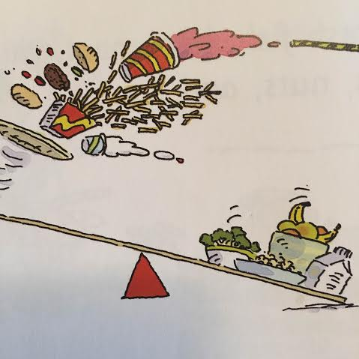
If you eat a balanced diet, you’ll be fit, healthy and strong!

Slide 17
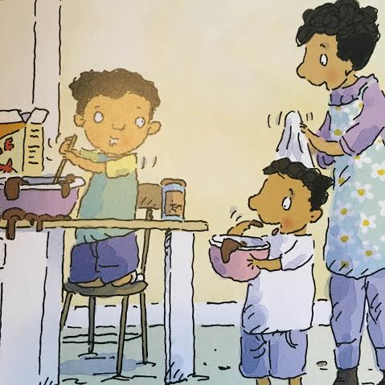
But sometimes, a special treat is ok too!

Slide 18
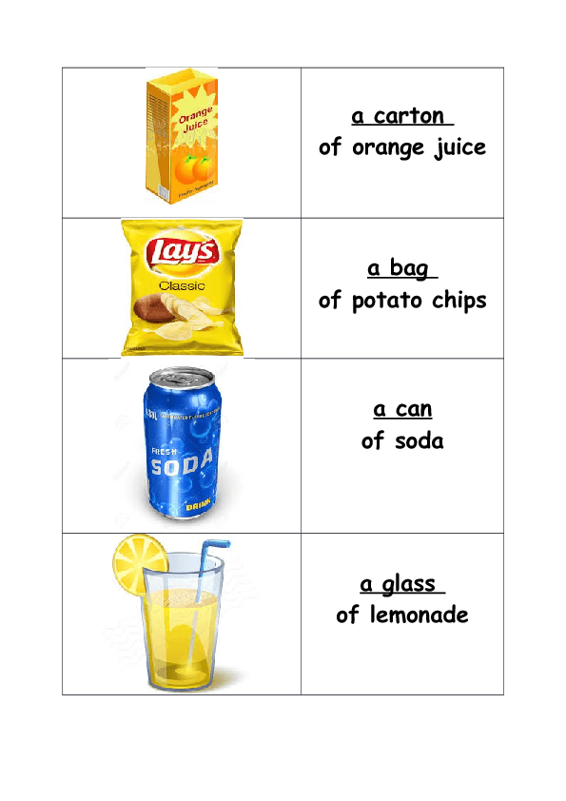
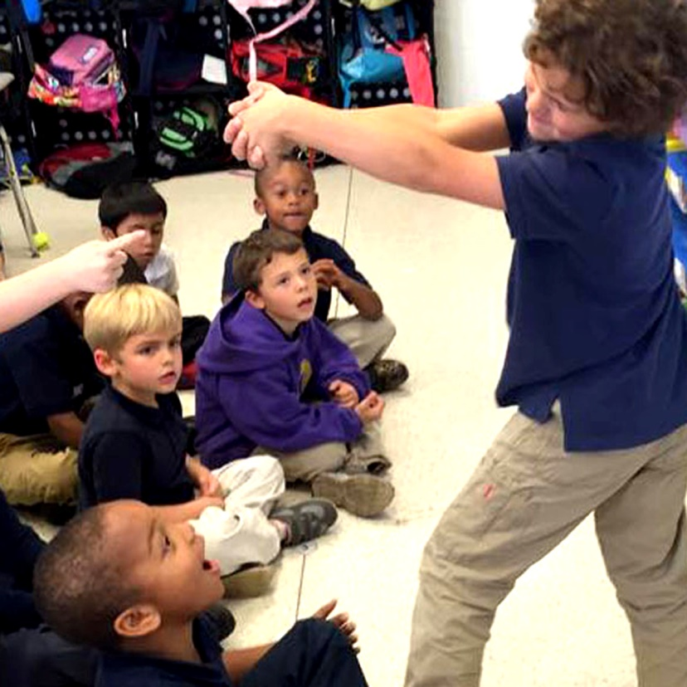
Special Treats
Here are some special foods that we eat as treats. Let’s practice acting out the words without speaking and see if our friends can guess which one we are saying.

Slide 19
Miming-Charades
Sometimes when we are having trouble finding the right word it will be easier to use gestures (e.g. pointing) to help others understand what we mean. Let’s play charades!

Slide 20
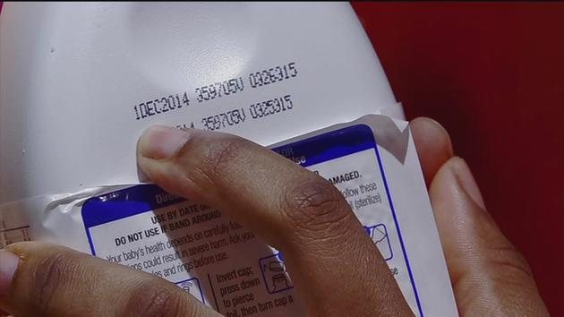
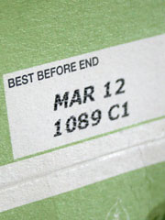
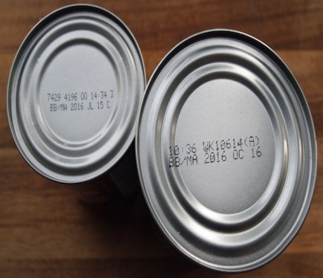
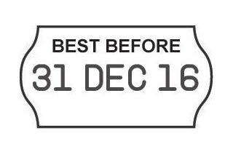
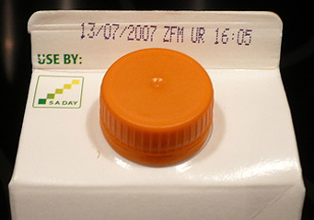
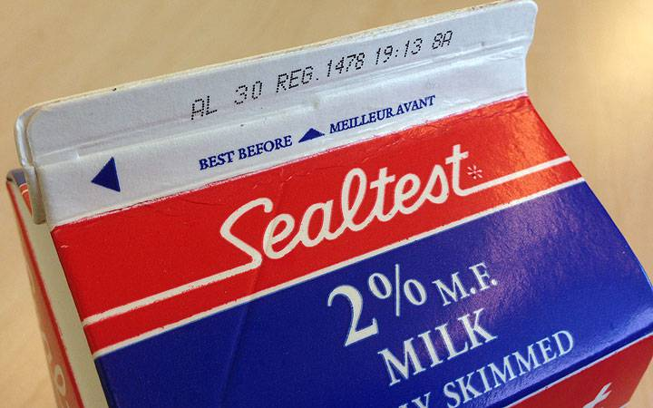
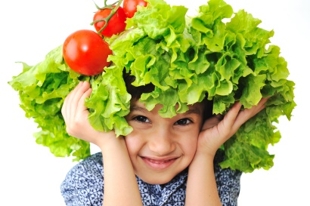
Expiry Dates
Eating well also means that we need our food to be as fresh as possible. We use an EXPIRY DATE to know if our food is still good to eat.
First we look for the MONTH and then we look for the YEAR
Notes:
Have students grab 3 things in their homes with an expiration date and have them identify when it will no longer be fresh enough to eat.

Slide 21
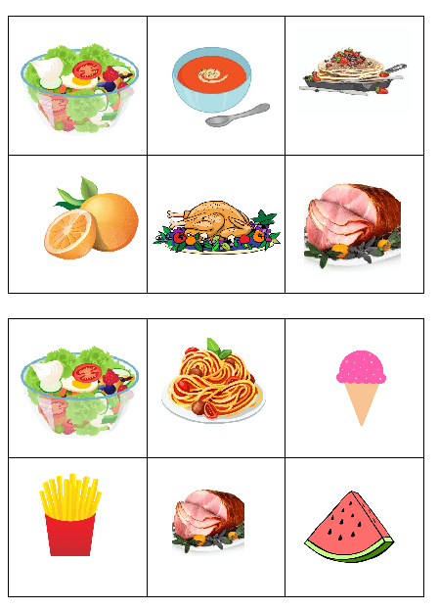
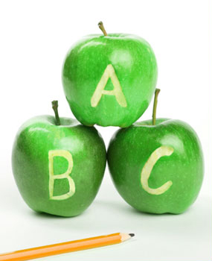
Let’s Review
Practice by labelling these foods and then put them in ABC order:
Today we learned about:
Alphabetical Order

Slide 22
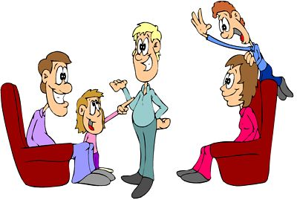
Let’s Review
Practice acting out your favourite part of the story with your family.
We also learned about:
Gestures and mime to clarify meaning.

Slide 23
Let’s Review
Next time you go grocery shopping pay attention to the expiration dates of the products your Mom and Dad are buying.
Finally we learned about:
Expiration dates and Best Before

Slide 24
HOMEWORK

