Slide 1
Lesson 4: Let’s Review
We have learned so much! Let’s review our 1st, 2nd and 3rd lessons!

Slide 2
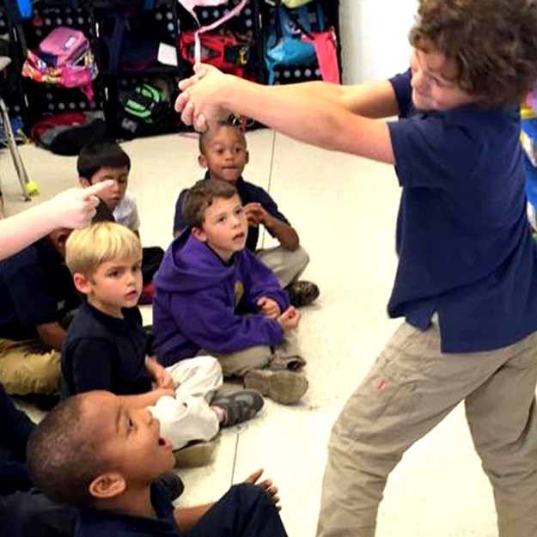
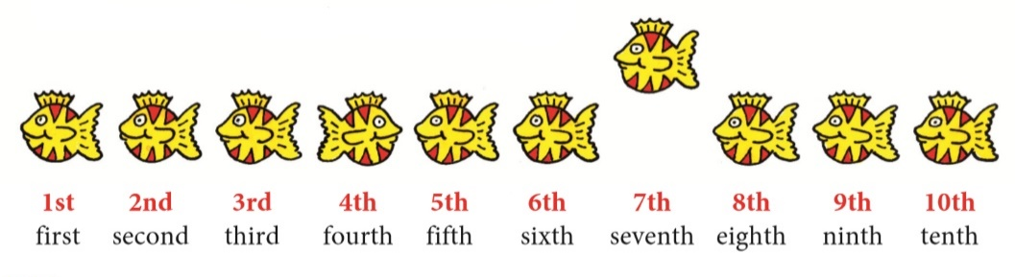
Let’s Review what we have learned so far
Sounds and Words
Gestures and Mimes
Alphabetical Order
Ordinals

Slide 4
Circle the pictures with the sound ‘ee’

Slide 5
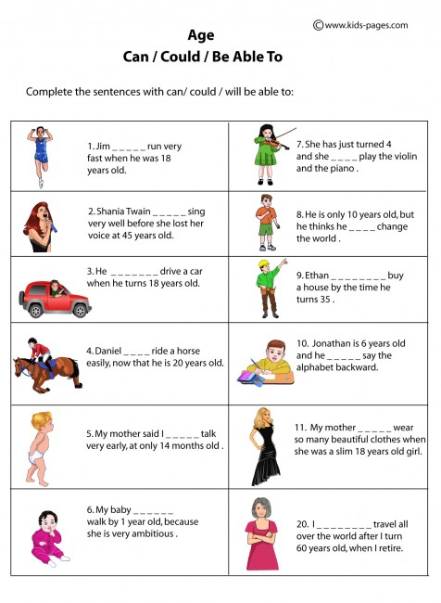

Slide 6
Conversations
Conversations go back and forth like a teeter-totter.
You can:
1.) Ask questions
2.) Make comments
3.) Share stories
Questions:
What is your favourite book and why?
Do you have a pet? If not would you want one?

Slide 8
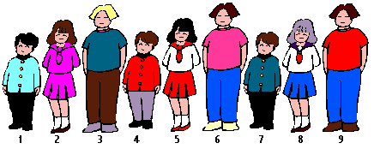
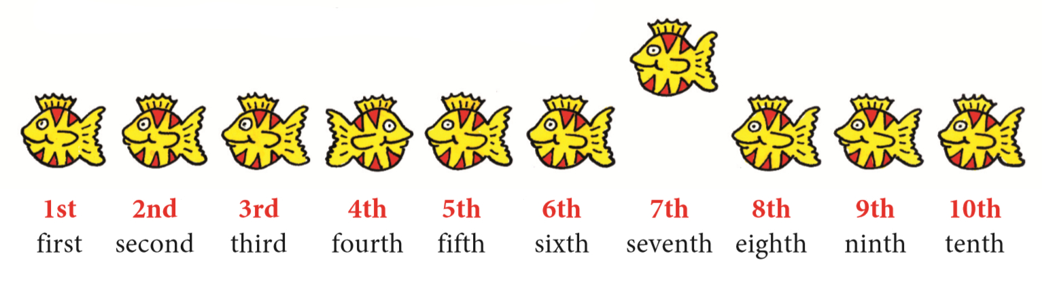
ORDINAL NUMBERS

Slide 10
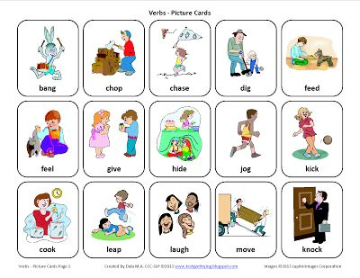
Let’s act it out!

Slide 11
REVIEW LESSON
Conversations
&
Gestures
“EE” & “EA”
Could
Ordinal
Numbers

Slide 12
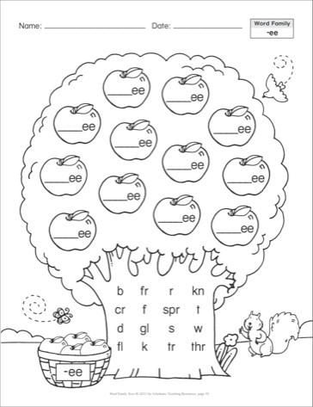
HOMEWORK

