Slide 1
Lesson 4: Let’s Review
We have learned so much! Let’s review our 1st, 2nd and 3rd lessons!

Slide 2
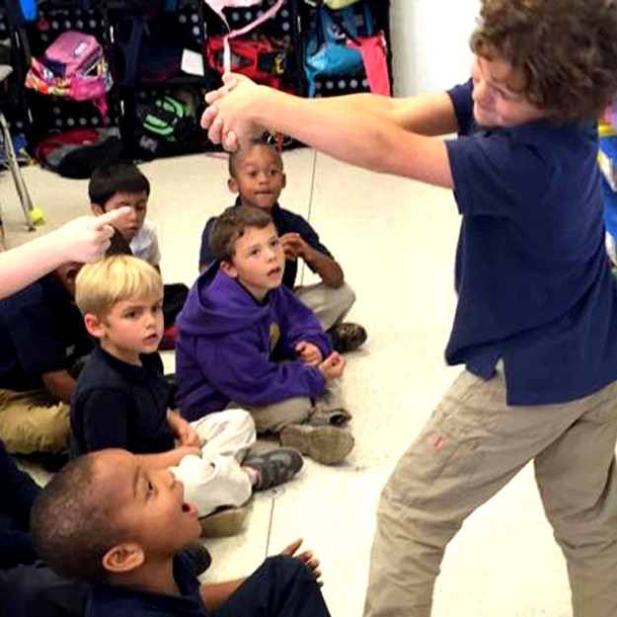
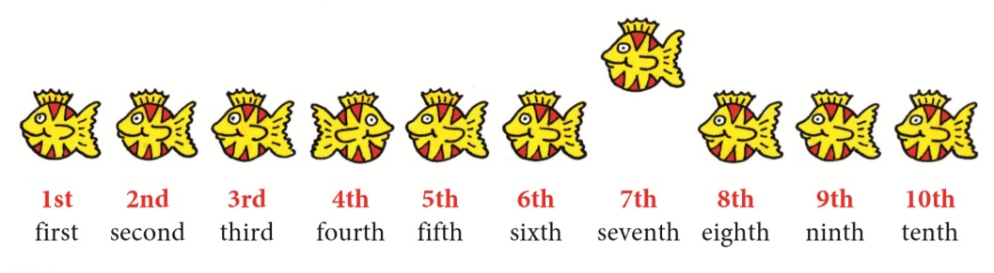
Let’s Review what we have learned so far
Sounds and Words
Gestures and Mimes
Alphabetical Order
Ordinals

Slide 4
Circle the pictures with the sound ‘ee’

Slide 5
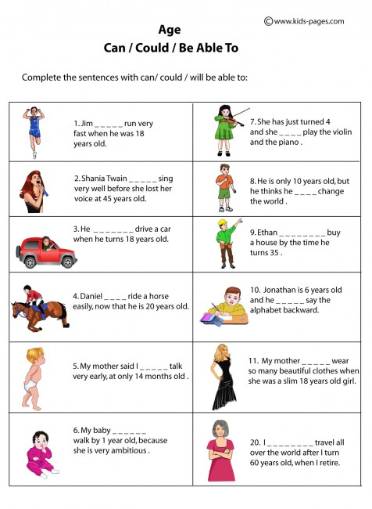

Slide 6
Conversations
Conversations go back and forth like a teeter-totter.
You can:
1.) Ask questions
2.) Make comments
3.) Share stories
Questions:
What is your favourite book and why?
Do you have a pet? If not would you want one?

Slide 7
Notes:
https://www.youtube.com/watch?v=XITq0yrqlYA

Slide 8
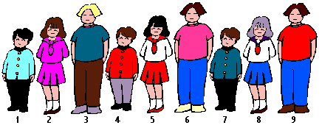
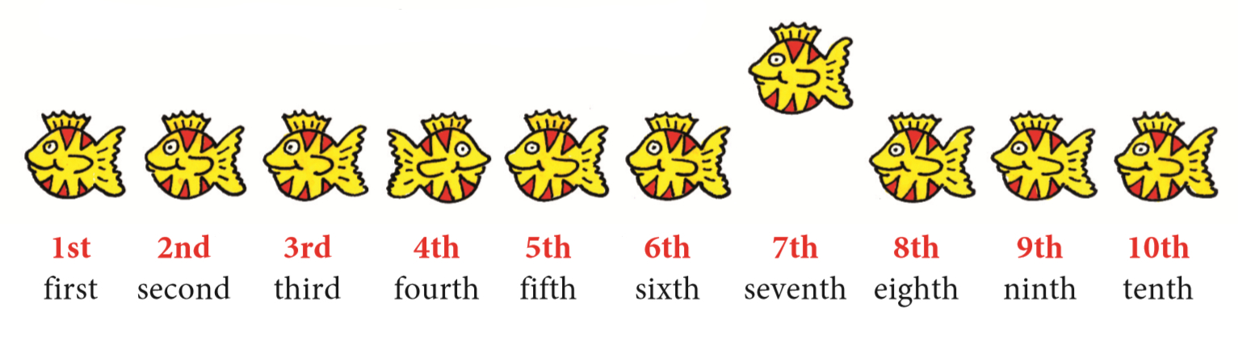
ORDINAL NUMBERS
Notes:
Have students gather 5 objects in their home and ask each other which object is in 1st, 2nd, 3rd etc…see if they can extend the ordinal numbers up to 20! Have students describe each of the people in the line asking them questions that connect to ordinal numbers.

Slide 10
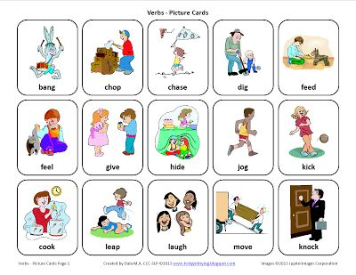
Let’s act it out!

Slide 11
REVIEW LESSON
Conversations
&
Gestures
“EE” & “EA”
Could
Ordinal
Numbers

Slide 12
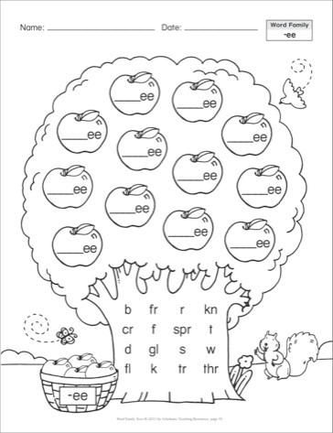
HOMEWORK

