Slide 1
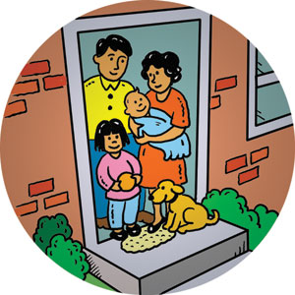


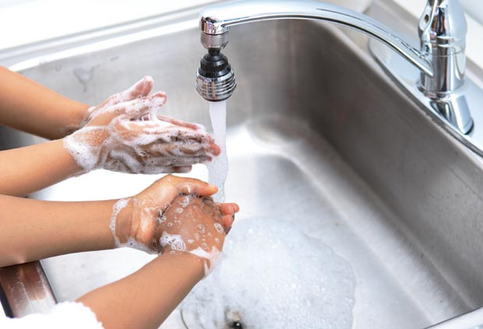

Lesson 5: Safety in the Home

Slide 2



Lesson Overview
We are learning to:
Science Connection:
Make and find the “OU and OW” sounds
Create ordered and unordered lists
Make to do lists
Personal safety in the home

Slide 3

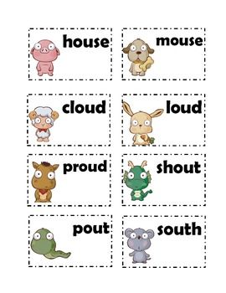
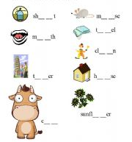
Notes:
https://www.youtube.com/watch?v=KMuAjxj6bSk&list=PLJdn7TmCPXdWktdMVrc-ZnBXXlucQwiZy

Slide 4

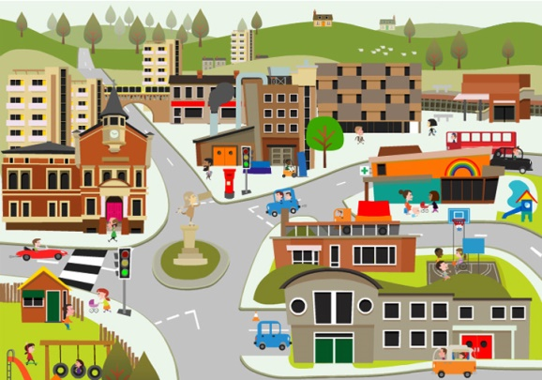
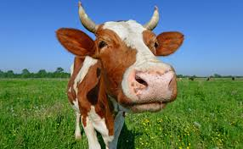
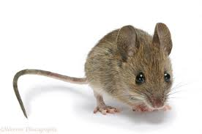
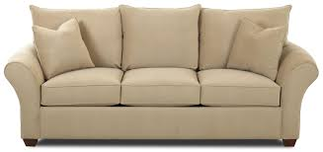

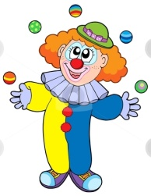

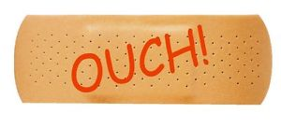
“OW” WORDS
“OU” WORDS
Notes:
Word sort

Slide 5

Notes:
It is important to stress the connection between physical safety and healthy living. Having students understand how to avoid the “ouches” and be careful around the house is a large part of personal health and safety.

Slide 6

Home is where you live with your family. It’s a very special place.

Slide 7

Home is where you play your favourite games. It’s comfortable and safe. Or is it? Have you ever slipped on the stairs and gone bump, bump, bump to the bottom?

Slide 8
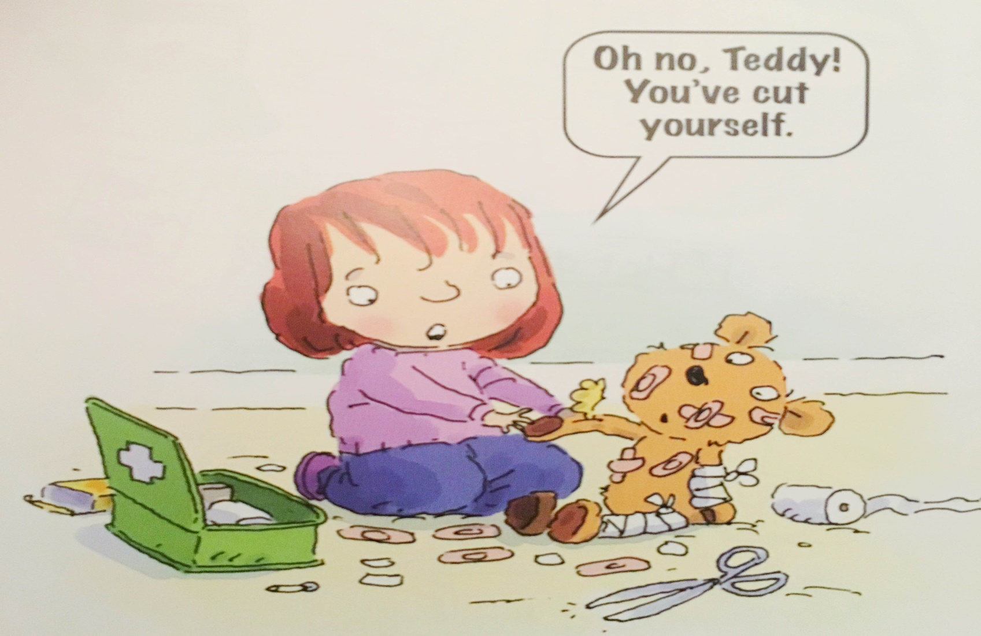
Some things around the house can be sharp. Some sharp items are useful for cutting things. But what could happen if you played with them?

Slide 9
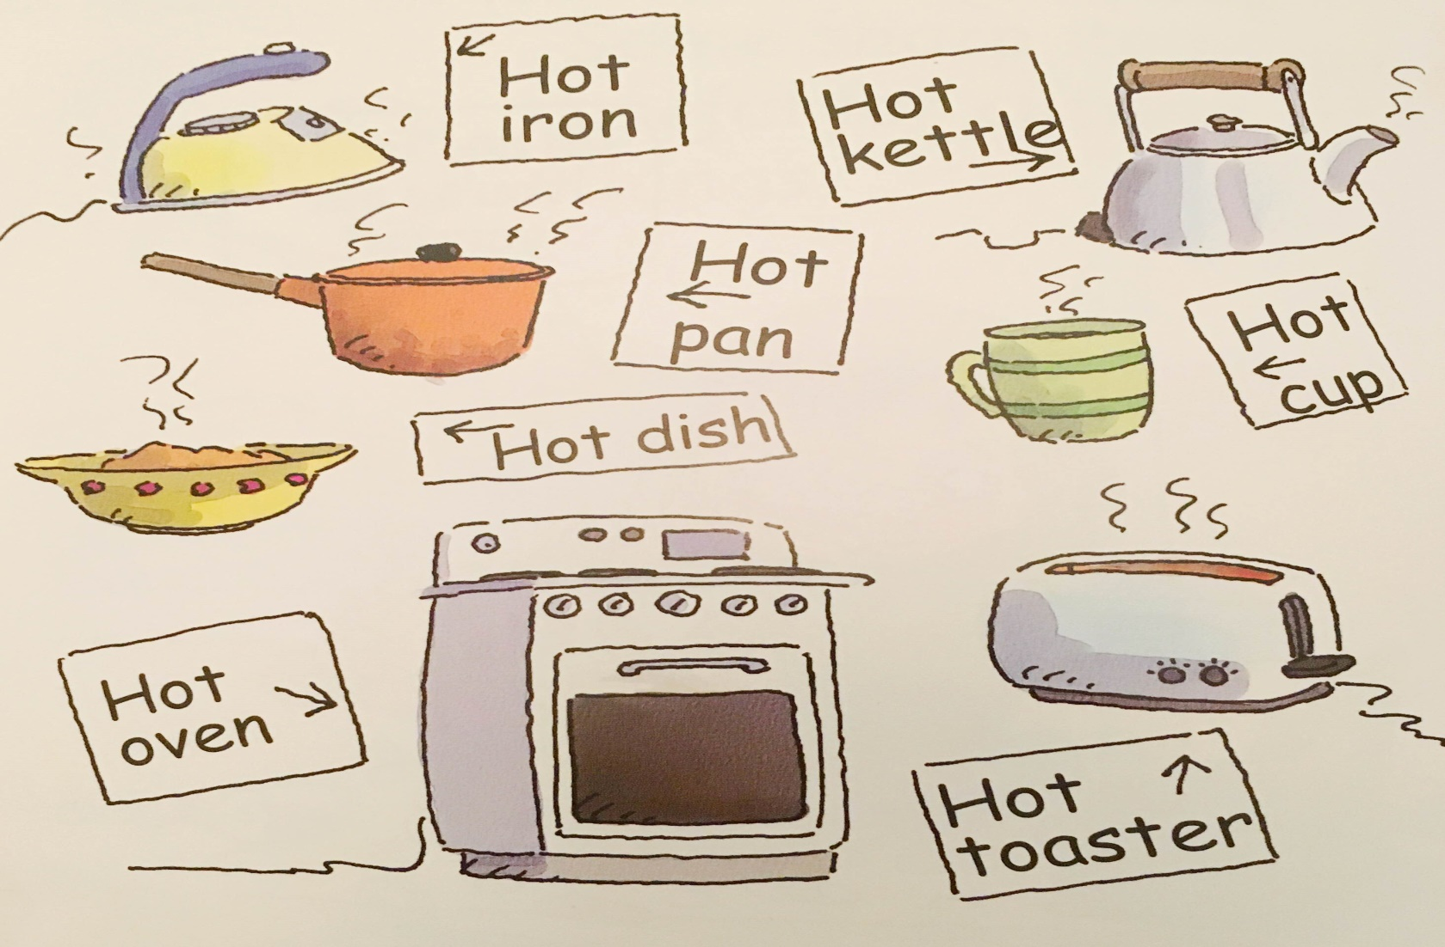
Many things in the house are hot. Always be careful when you’re near hot things because they could burn you.

Slide 10
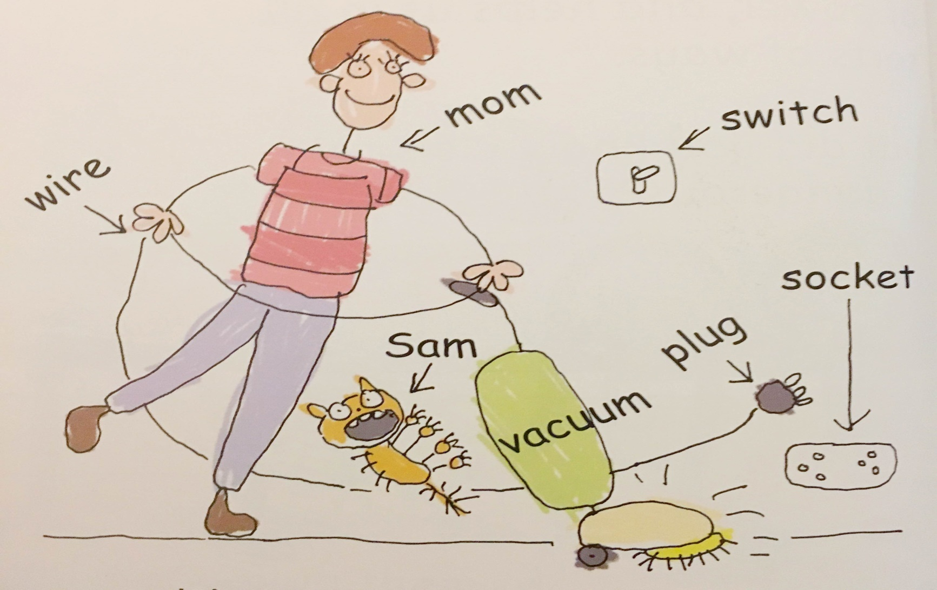
Many things in the house have plugs and wires. When you plug them in and switch them on, they begin to work. Electricity can be dangerous so you must be very careful when you are using things that use it.

Slide 11
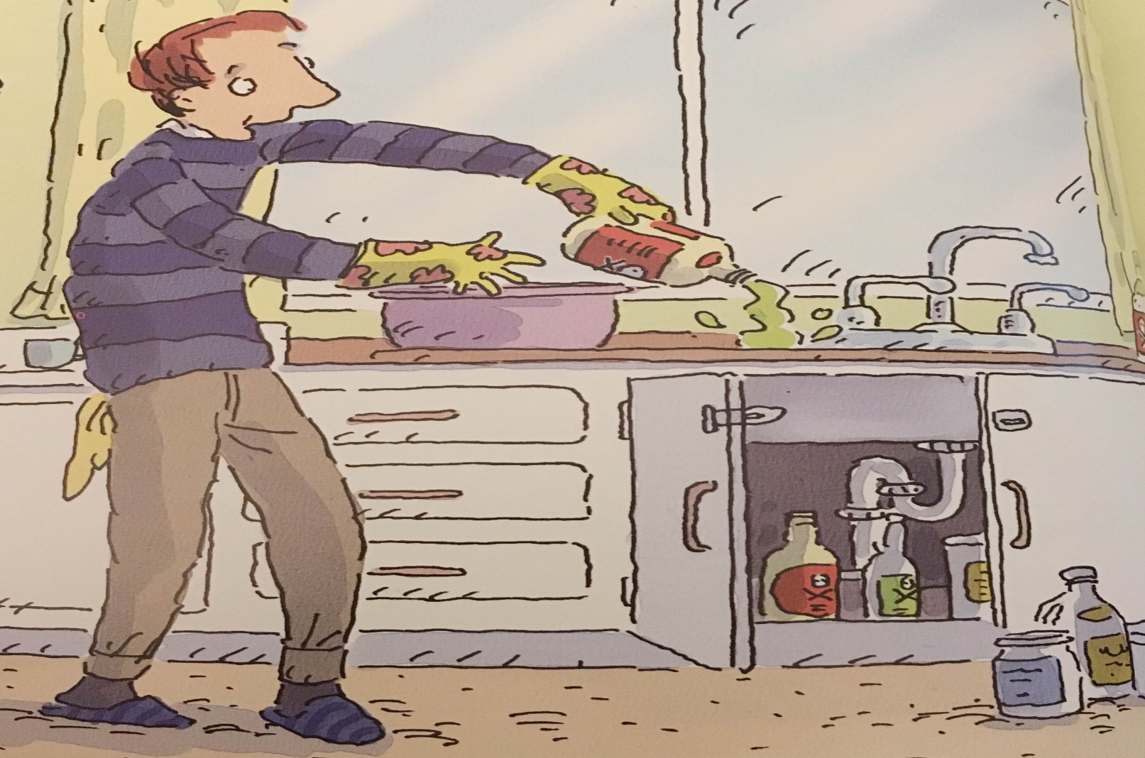
How do you keep your house clean? Most of us use polish, sprays and other cleaning products. It’s a good idea to wear gloves when you use these household items.

Slide 12
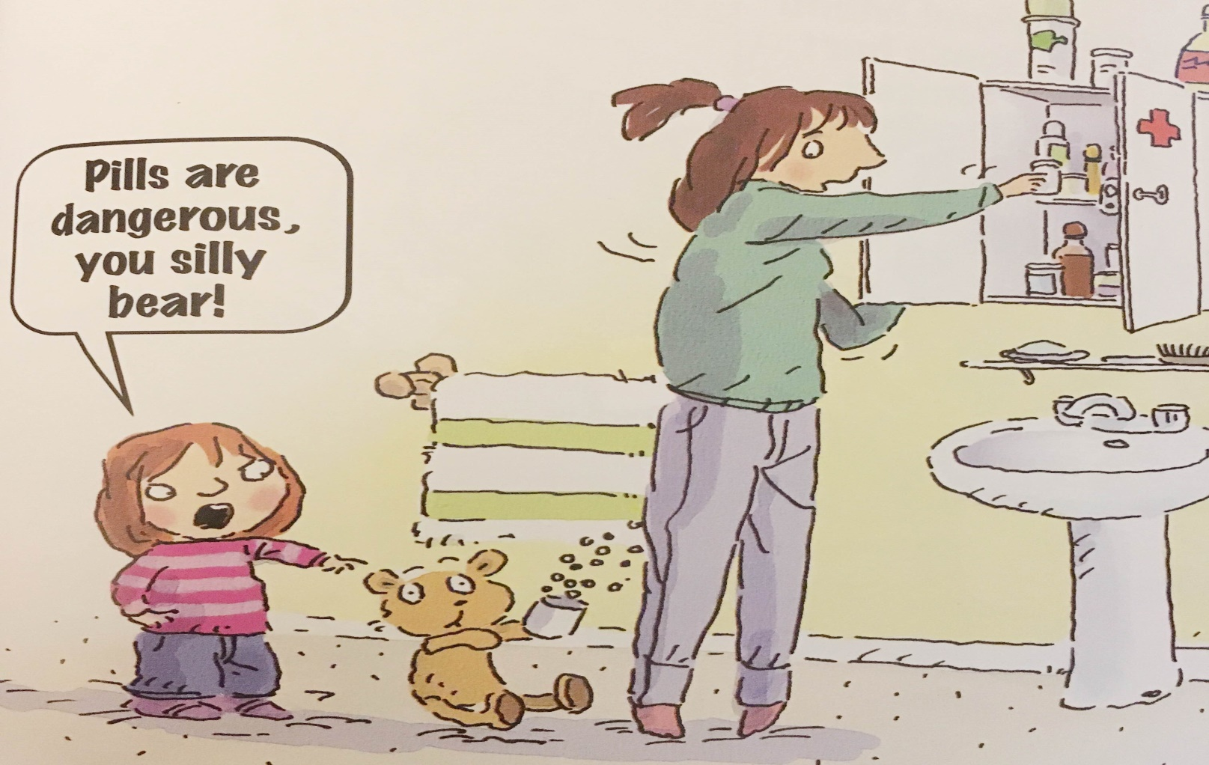
A little medicine can help you when you are sick. But too much could make you very ill. Medicine should be locked away and you should only use it with the supervision of an adult.

Slide 13
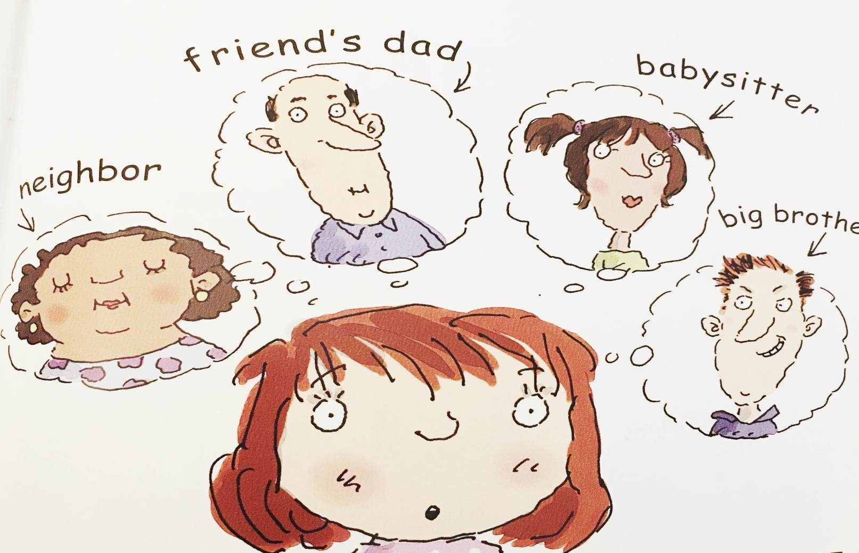
It is important to be careful and to ask an adult when you are not sure how something works or what it is. If Mom or Dad is are not around, who do you think could help?

Slide 14
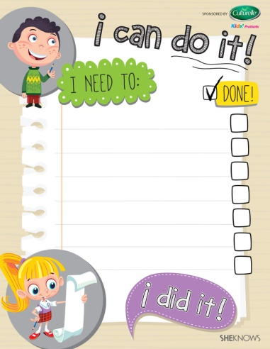
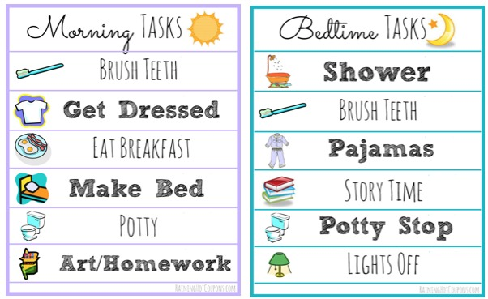
LISTS
Lists are ways that you can organize things:
They might organize “thoughts”, like before you write a story or paragraph.
They might organize “groups” and “categories”
They might event have to organize things that you have “to do”.

Slide 15
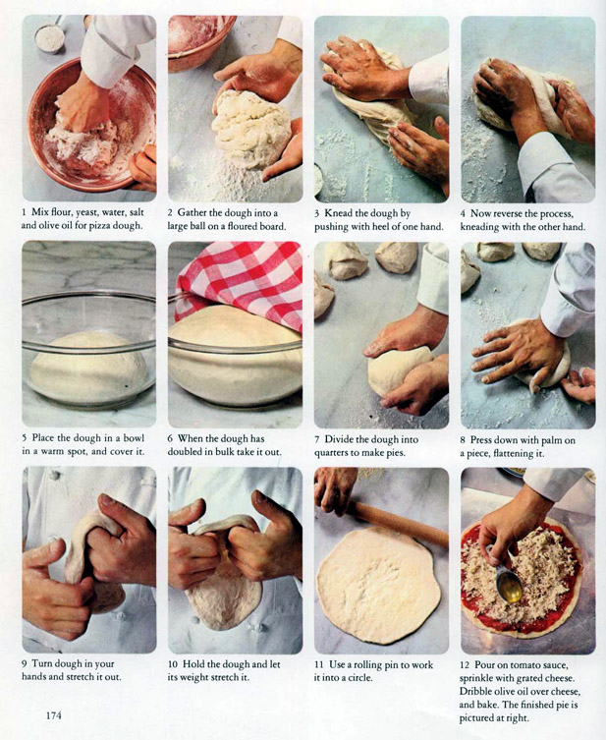
ORDERED LISTS
An ordered list is a list that you need to complete in a specific way. They are numbered.
Instructions are ordered lists because you need to complete them step-by-step!
So are recipes! Yummy!

Slide 16
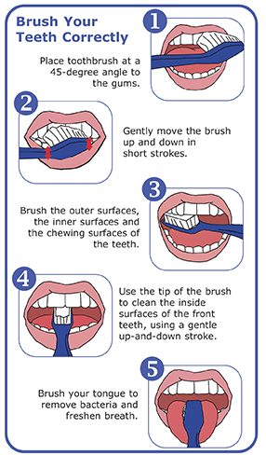
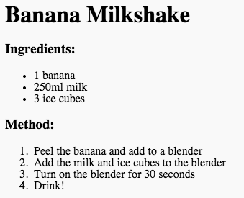
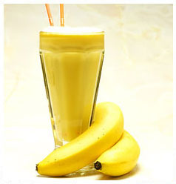
Make your own list
CREATE YOUR
FAVOURITE RECIPE:
HOW TO BRUSH YOUR TEETH:
Notes:
Have students create their own simple, numbered recipes or have them write the procedure for a simple, common household chore ☺

Slide 17
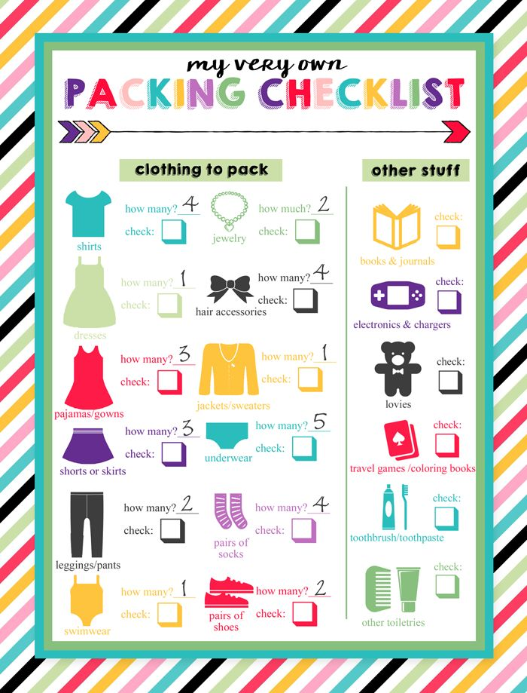
UNORDERED LISTS
An unordered list can help you remember all the things that you need
BUT
you don’t have to remember them in a particular order
Notes:
Have students brainstorm (popcorn out answers of things that they would put into an unordered list. They can discuss how useful an unordered list can be in brainstorming for writing, when you need to remember to do pack many things or do the groceries.

Slide 18
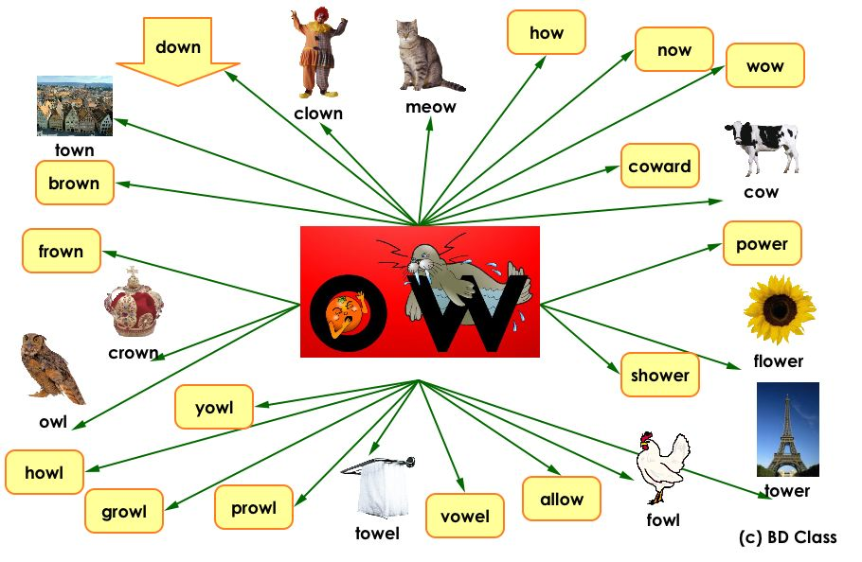
Make Your Own Mind-Map

Slide 19
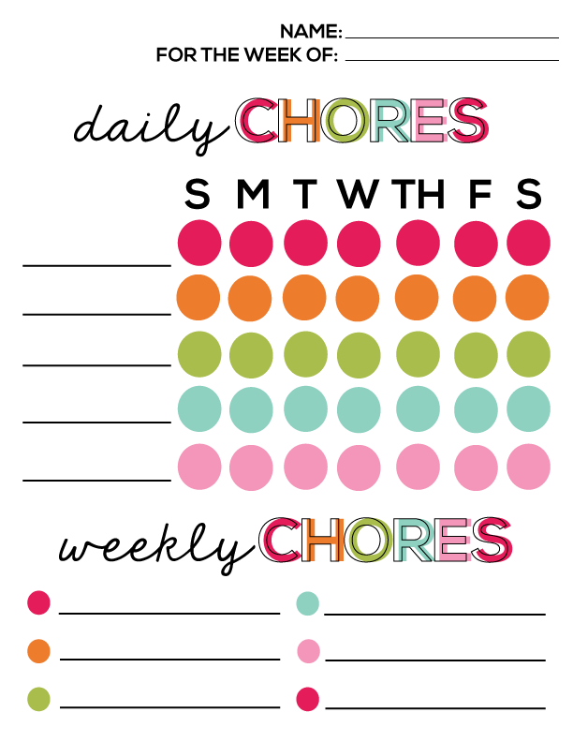
TO DO LISTS
Writing a “to do” list can help you to stay organized.
“To do” lists can be written in an agenda or even on your technology!
When would writing a “to do” list help you?

Slide 20

Your weekend or summer vacation “to do” list
Notes:
https://www.youtube.com/watch?v=DKs-bNQz0Ts

Slide 21

Let’s Review what we learned by making a list:
__________________________
__________________________
__________________________
__________________________
__________________________

Slide 22
Homework

