Slide 1
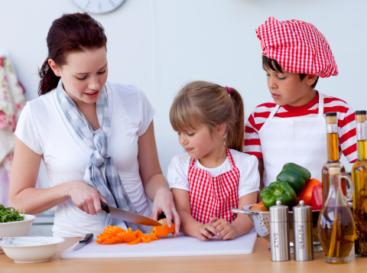

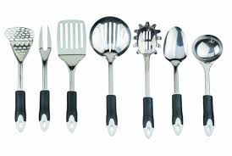
Learning to Cook
Lesson 6

Slide 2
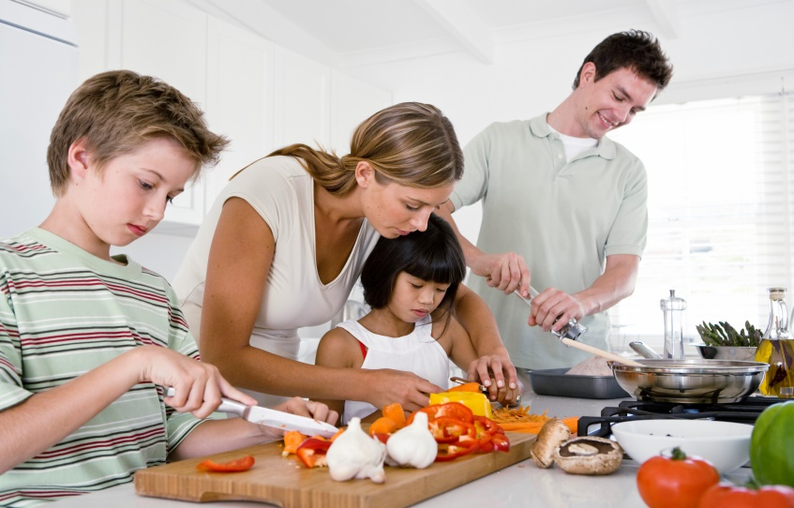

WE WILL BE LEARNING TO:
Recognize sounds (oo - cook, spoon)
Use repetition in song
Categorizing words by theme
Use prepositions: inside, outside
COOK

Slide 3
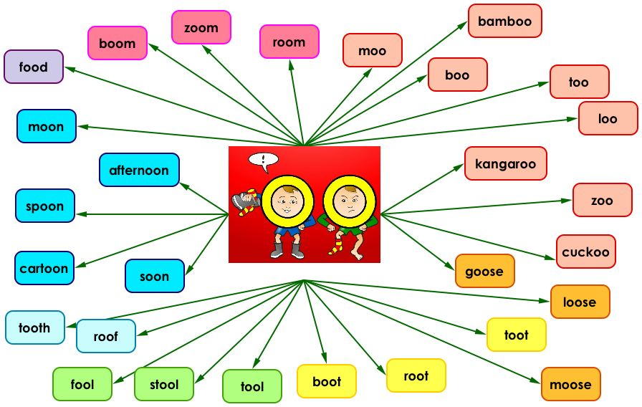
“OO” FAMILY WORDS
Notes:
https://www.youtube.com/watch?v=0-DUDBKrLY4

Slide 4
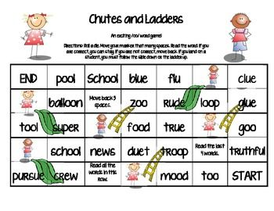
Exploring the “OO” sound

Slide 5
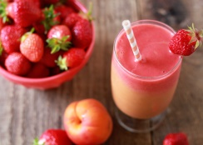
LET’S TRY COOKING
We have learned a lot about our bodies and how to keep them healthy. Let’s try making our very own healthy recipe!

Slide 6
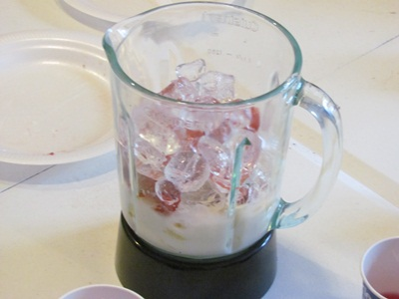
The first step in cooking is to gather all your materials. You will need a blender, washed and chopped strawberries (10), ice cubes (6), 1 cup of milk, cutting board and a knife.

Slide 7
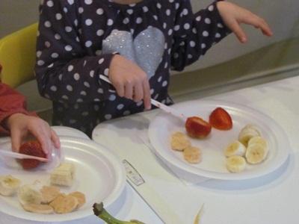
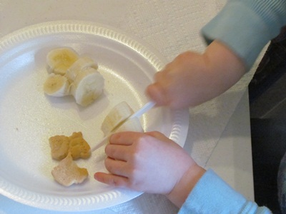
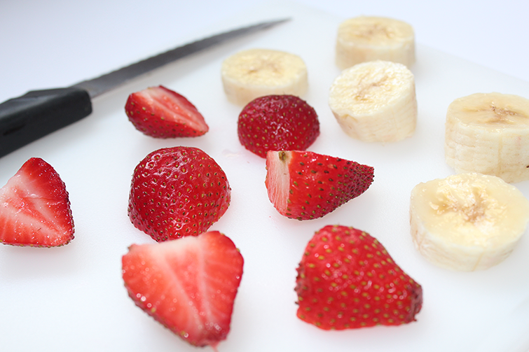
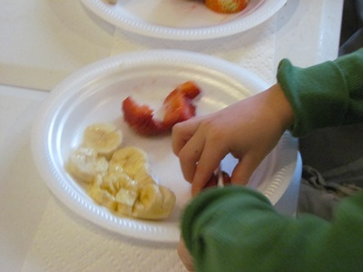
Once you have washed your hands, get a cutting board and begin slicing the strawberries and bananas.

Slide 8
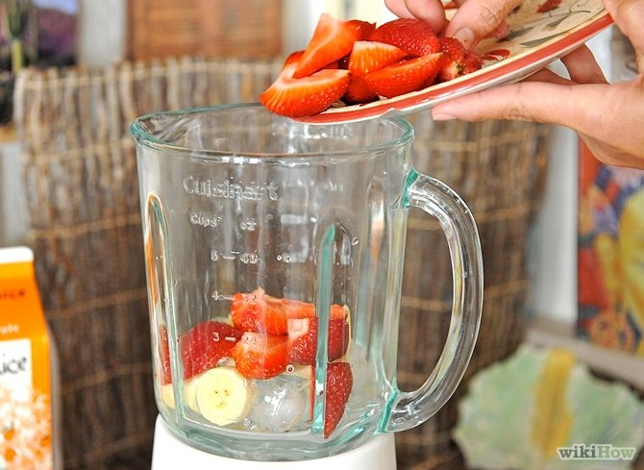
Place all the ingredients into the blender (carefully because a blender has blades inside).

Slide 9
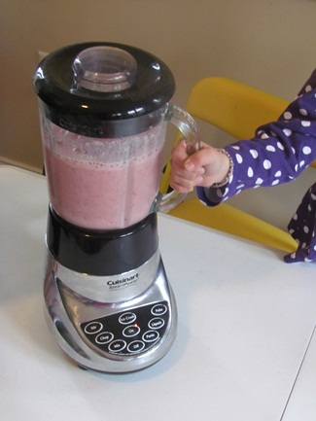
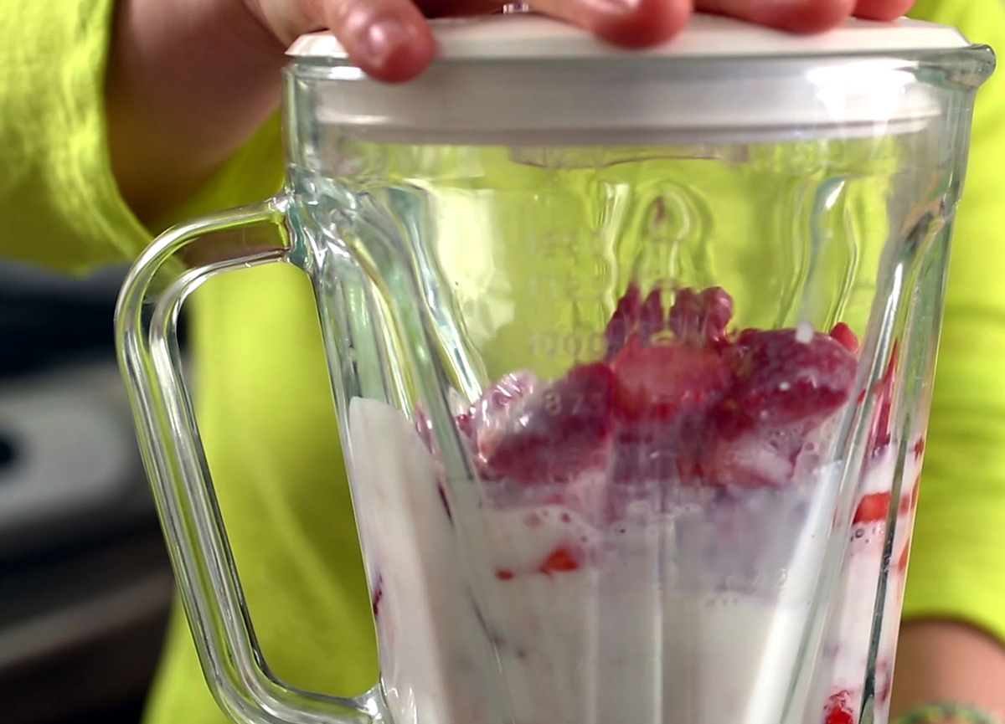
Once all the ingredients are in the blender press the “blend” button and watch the magic happen!

Slide 10
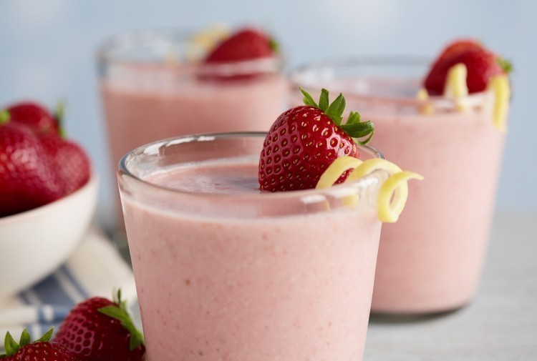
Pour the smoothie into your favourite glass, garnish with a strawberry and enjoy your hard work.

Slide 11
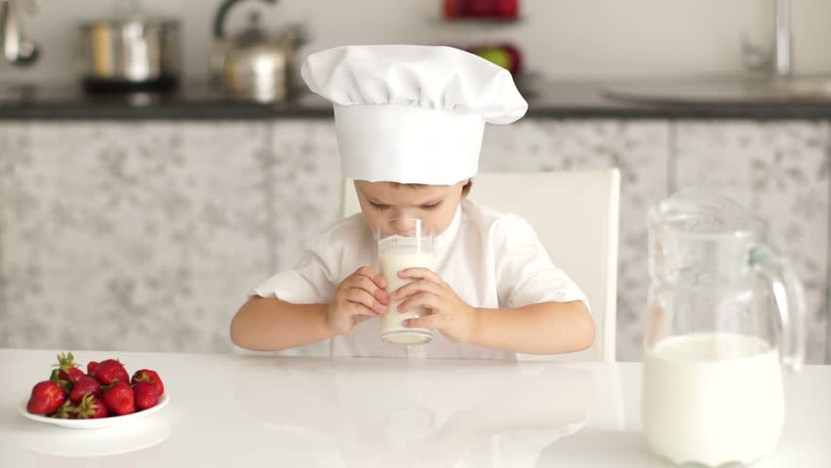
Delicious work chef!

Slide 12


Repetition
Let’s Sing Along!
Notes:
https://www.youtube.com/watch?v=KM4Ey9K9S_g

Slide 13
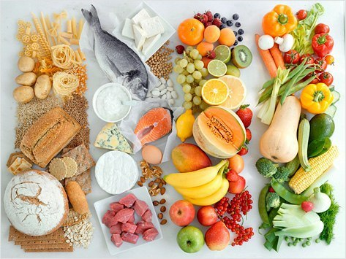
MAKING GROUPS BY THEME
Notes:
Themes help to organize information into groups that are the same. Ask students if they can guess the theme of each of these groupings

Slide 14
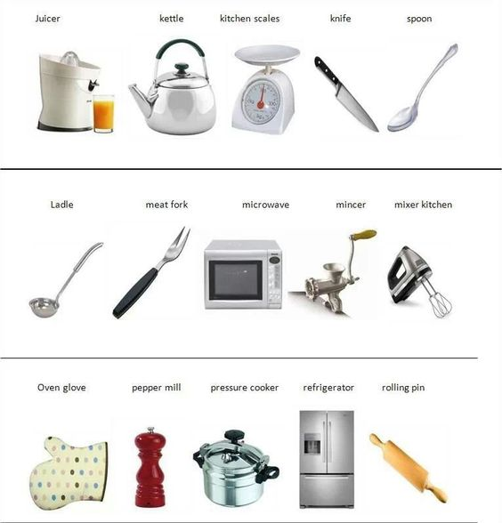
SORTING BY THEME
Sort: to separate items by like features.
Theme: a group of similar objects
You can sort by:
Theme
Size
Colour
_________________
_________________
_________________
_________________

Slide 15
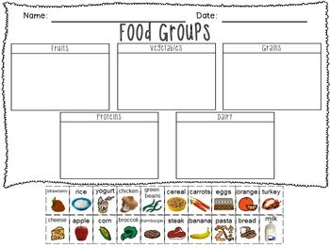
LET’S PRACTICE SORTING
Fruits
Vegetables
Grains
Proteins
Dairy

Slide 16
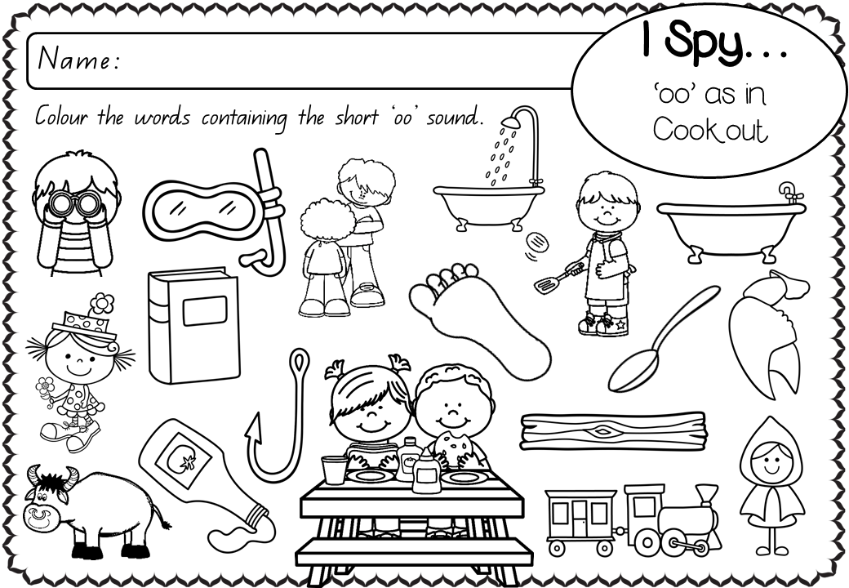
KEEP PRACTICING
Circle

Slide 17
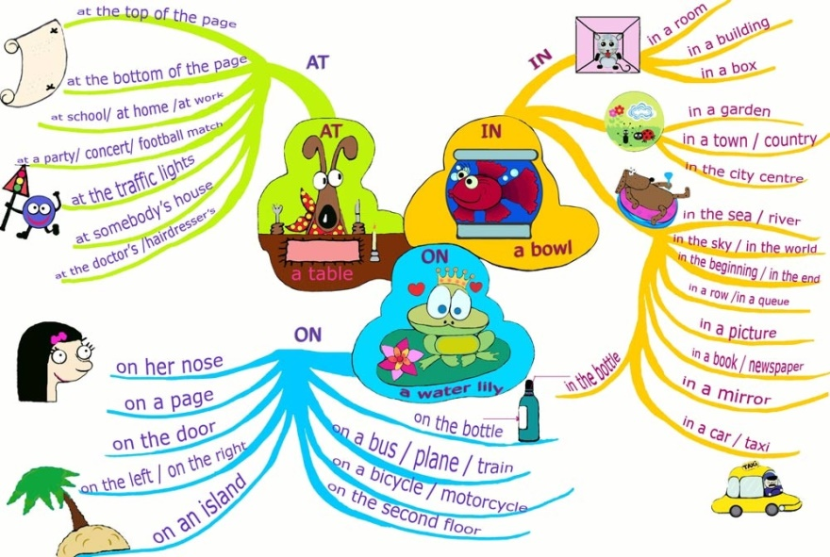

Slide 18
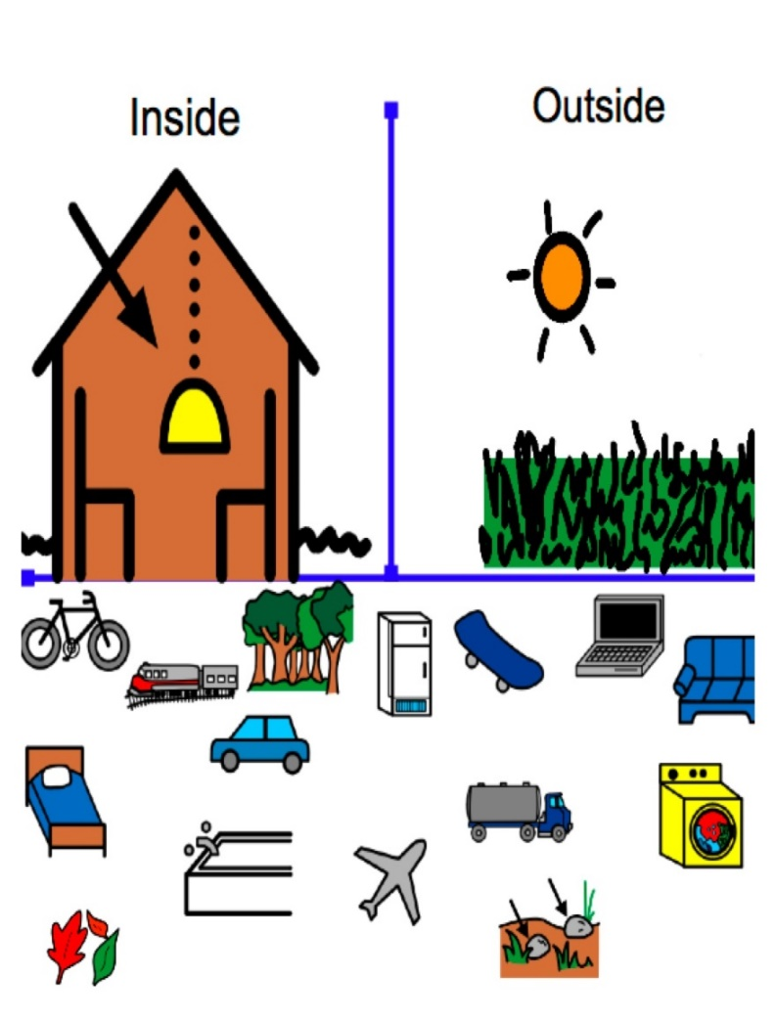
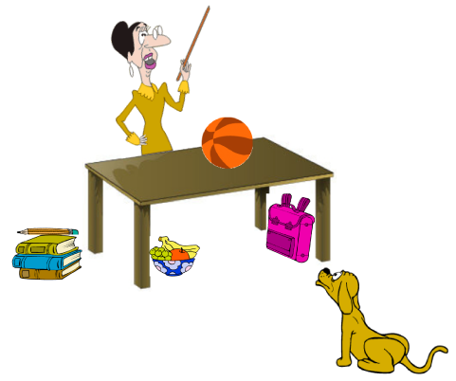
PREPOSITIONS
Notes:
Practise describing these pictures

Slide 19

LET’S REVIEW WHAT WE’VE LEARNED
Cooking
&
“OO” Sounds
Prepositions
&
Sorting
Repetition

Slide 20
Homework

